Slide 1
Janice White
Safeguarding:
the answer to all our woes?
23rd June 2016

Slide 2
Context and overview of the session
- the local authority’s responsibilities to children
- the local authority’s responsibilities to adults
- never the twain shall meet?

Slide 3
Local authority responsibility to children?
- the general duty of every Local Authority is to safeguard and promote the welfare of children within their area who are in need and in so far as is consistent with that duty to promote the upbringing of such children by their families providing a range and level of services appropriate to those children’s needs

Slide 4
The duty to investigate – s47
- A local authority has a duty to investigate when it has reasonable cause to suspect that a child in its area is suffering, or is likely to suffer, significant harm
- Why? To decide whether to take any action to safeguard or protect the child’s welfare.

Slide 5
Range of protective orders available
Emergency Protection Order
Care order
Supervision order
Child assessment order

Slide 6
Range of support options available
S17 ‘child in need’ support
S20 provision of accommodation
Duties towards looked after children
‘After care’ services for care leavers
Secure accommodation

Slide 7
Local authority responsibility to adults?
Care Act 2014: S1(1) The general duty of a LA, in exercising a function under this Part in the case of an individual, is to promote that individual’s well-being
How is ‘wellbeing’ defined?
What does ‘promoting wellbeing’ mean’?
What are the guiding principles?

Slide 8
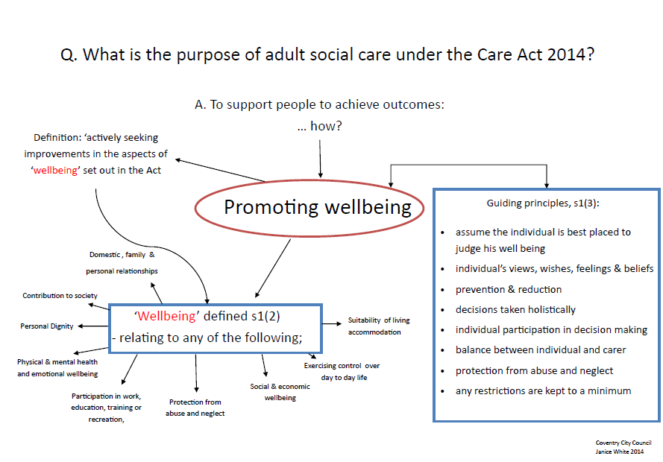

Slide 9
S2 – Preventing needs for care & support
LA MUST provide or arrange for the provision of services, facilities or resources or take other steps which it considers will
· contribute to preventing or delaying need for care & /or support
· reduce need for care & / or support
For ALL adults and carers / prospective carers in its area

Slide 10
Assessment – the trigger
LA MUST carry out an assessment if it appears to the LA that the adult may have needs for care and support and must assess
whether the adult does have needs for care and support, and if so,
what those needs are
To include - the impact on the adult’s well being
- the outcomes the adult wants to achieve
- whether, and if so, how far, care and support can help to achieve those

Slide 11
Eligibility
If satisfied that there are needs for care and / or support, must determine if it meets the eligibility criteria set out in regulations
Must provide a written record and if ineligible, advice and information on prevention and reduction
National eligibility criteria – set out in regulations

Slide 12
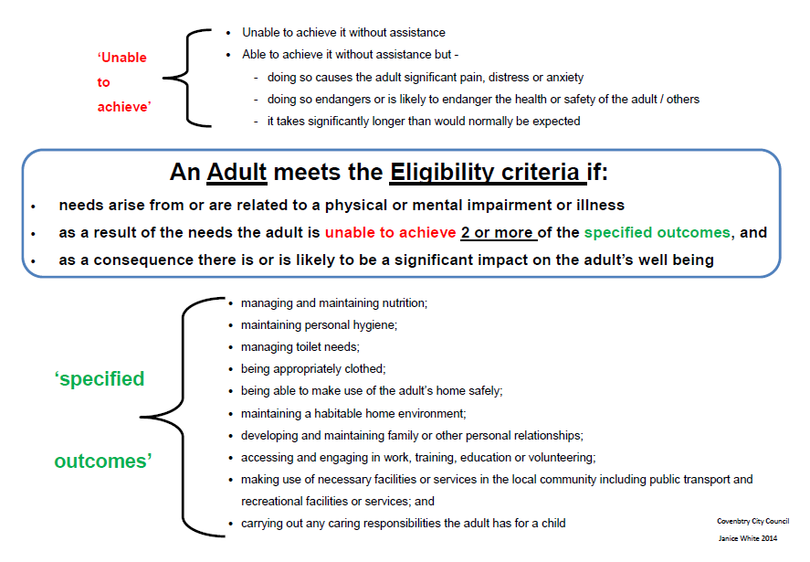

Slide 13
Safeguarding: the duty to investigate?
LA is required to ‘make enquiries’ if it has reasonable cause to suspect an adult in its area
has needs for care and support
is experiencing / is at risk of abuse or neglect, and
as a result of those needs is unable to protect himself against the abuse or neglect or the risk of it

Slide 14
Transition
If it appears that a child is likely to have needs for care and support after becoming 18, the LA must, if it is satisfied that it would be of significant benefit to the child to do so, assess
whether the child does have needs for care and support and if so, what those needs are and
whether the child is likely to have needs for care and support after becoming 18 and if so what they are likely to be.

Slide 15
Questions?

