Slide 1
Consultation workshop findings
March 2017

Slide 2
Overview of approach
Below is a summary of the methodology used to complete the consultation:
Method | Responses
Online survey for members of the public and paper based survey | 230 respondents
Two professional workshops Jan/Feb | 12 small groups. At each event participants were divided into smaller, facilitated, groups of between 5-6.
Mamta – parents of BME backgrounds | 16 respondents
Parents focus group | 19 respondents
6 professional workshops with frontline staff | 75 respondents
Focus group with parents from newly arrived communities | 20 attendees

Slide 3
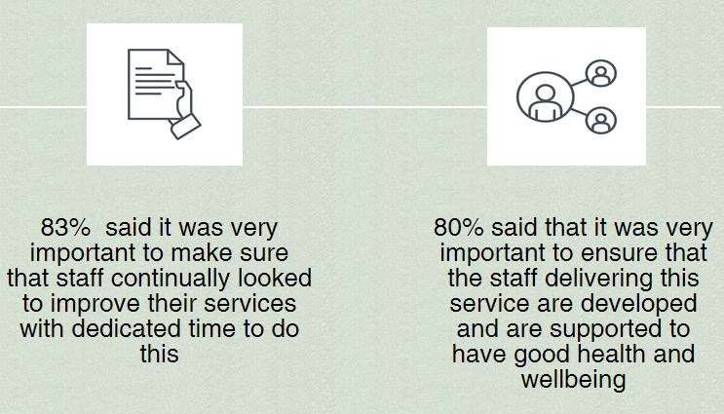
Online survey: Principles/ways of working
Respondents were presented with a number of principles/ ways of working and asked to prioritise them in order of importance. All respondents felt that the following principles/ways of working were very important or important:
83% 145 out of 174
80% 139 out of 173

Slide 4
Online survey: Key areas of focus
Respondents were given a list of key areas we want the service to focus on and asked to prioritise them in order of importance . The areas of focus that received the most positive responses were:
Key areas of focus | Very important %
To ensure all staff were able to spot the signs of children who were at risk of being abused or neglected | 88% 147 out of 168
Making sure that where possible families are supported by a small number of professionals that they can get to know well and who can support them through important transitions | 85% 142 out of 168

Slide 5
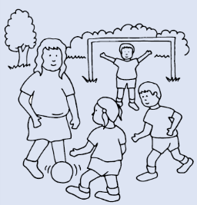
Online survey: Key areas of focus
Respondents were given a list of key areas we want the service to focus on and asked to prioritise them in order of importance . The areas of focus that received the most positive responses were:
Key areas of focus | Very important %
To ensure all staff are able to spot the early warning signs of children who need or would benefit from support with their health and wellbeing | 84% 141 out of168
Multi-skilled staff that can support on a variety of issues including lifestyles | 83% 138 out of 167

Slide 6
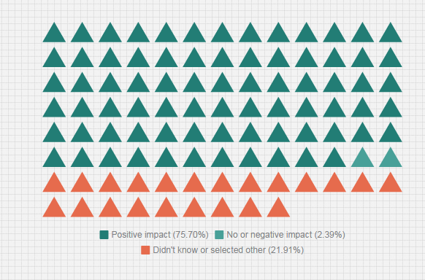
Impact on children and families in Coventry
Overall, respondents felt the changes would have a positive impact on children and families in Coventry (76% 127/167)
A small proportion stated it would have no or negative impact (2.4 % 4/167)
The remaining participants stated they didn’t know or selected other (22% 36/167)

Slide 7
How the changes would affect a number of different groups
80% of (129 out of 162) respondents felt that the changes would have a positive impact on young people.
80% (132 out of 165) also felt the changes would have a positive impact on pregnant or breastfeeding mothers.

Slide 8
Service user focus groups
Focus groups were held with the following:
Parents from BME backgrounds
Parents from newly arrived communities via a health visiting clinic
Parents across the city via parent leaders

Slide 9
Service user focus groups BME backgrounds Respondents were asked what key things are important for you when accessing the different services being redesigned? They were also asked what could be included that’s new? What could be replaced?
Service | What key aspects are important for you when accessing these services | Count
Health visiting | Having up to date information | 4
Mamta | Support antenatal/ postnatal | 3
 | Having available interpreters | 2
 | Having accessibility to services via phone and out of hours | 2
 | Accessible in the community with health visitors working alongside Mamta to engage with community groups | 2
School nursing | Importance of having accessible services | 2
 | Visibility of service /contact details | 2

Slide 10
Service user focus groups BME backgrounds:
Service | What key aspects are important for you when accessing these services | Count
Infant feeding team | More awareness of the service | 2
 | Supporting post discharge through home visits after birth | 3
 | Partnership working - between mamta, the infant feeding team, midwifery and health visiting | 3
 | Women only sessions | 3
 | Having mamta peer workers supporting infant feeding | 2

Slide 11
Service user focus groups BME backgrounds:
Service | Introducing new aspects to the service | Count
Stop smoking in pregnancy service | Drop in session in the community such as at Foleshill Womens Training Centre | 2
 | Raising awareness about the harmful effects of secondary smoking and smoking | 2
 | Include links to parents | 2
School nursing | Introduce a new health check between the 2.5 year check and before starting school | 2

Slide 12
Service user focus groups BME backgrounds:
Service | Introducing new aspects to the service | Count
One body one life | Consider those from other cultures with women only sessions and information available in different languages | 3
Infant feeding team | More awareness of the service | 2
 | Supporting post discharge through home visits after birth | 3
 | Partnership working - between mamta, the infant feeding team, midwifery and health visiting | 3
 | Women only sessions | 3
 | Having mamta peer workers supporting infant feeding | 2

Slide 13
Parents from newly arrived communities
Users emphasised their positive Health visiting experiences(8)
Respondents were asked how services could support the whole family , promote self help and support children and families at transition points
Parents could support themselves by using 111 helpline and other health contact details (4)
Importance of language support (3)
Reminders to register children to primary schools were needed (3)
“Help in applying my son at school because I can’t speak English”
Effective signposting and support. Professionals giving advice with any problems the user has (6)

Slide 14
Parental focus groups responses
Positive experiences of using the health visiting service (11) and importance of infant feeding
Vital role of social connection and families when considering self help (9)
Suggestions of using a people map - to show where the gaps might be in families lives. (4)
Significance of support in the antenatal period and educating parents particularly about breastfeeding (5)
Partnership working with parents particularly at transition points including involving parents in the nursery (2)

Slide 15
Professional workshop analysis
8 professional workshops were held with staff involved in the current services. Professionals were asked to focus and explore on what they would reuse, enhance, replace and introduce for their services.

Slide 16
REUSE
Build social connections as a way to facilitate self help and gaining local intelligence (15)
Measurement of height and weight and the advice given about obesity, visibility of School nurses(5)
Keep the current mandated development checks for health visiting (7)
Keep the use of apps such as best beginnings for health visiting (5)
Health visitors to keep the ante-natal service and contact to discuss mental health (6)
Keep chat health school nursing texting service (3)

Slide 17
ENHANCE
General comments were made about the need for modern technology and online services to improve access and speed (6)
Multiagency working (24) e.g school nurses should show teachers screening issues
The need for tailored services (10) e.g. utilising the skills of Nursery Nurses in offering baby massage to promote
Family as partners (12)

Slide 18
REPLACE
Replace duplication, some questioned the effectiveness of the school nursing parent line suggesting that it was not being used to its full potential (5)
Replace old technology for school l nursing (5) and parent line for health visiting (5)
Focus on removing other responsibilities for Health visitors and School Nurses allowing them to focus on clinical issues(6).
Replacing family nurse partnerships rigid criteria (1)
Delivery of the health visiting service (3) e.g. continuity of care, resource allocation on deprivation in the city, changing the dna policies of health visiting

Slide 19
INTRODUCE
Multiagency working (35)
Tailored services (22) e.g. having early intervention services
Working in and around school reach area and educate parents (16)
Introduce family as partners (35) e.g. once children in reception class - offer parent support sessions in school
Introduce technology and more agile working (5)
Peer to peer shadowing (3)
Combination of specialists supporting from start to finish (12)
A combination of specialists identified as early as possible to support families (12)
Health visitors to look to meet the whole family and to assess the family’s needs, general comments were made about modern technology (17) e.g. having a central data hub across the system

