Slide 1
Delivering a more sustainable city
Councillor O’Boyle, Cabinet Member for Jobs and Regeneration

Slide 2
UK Battery Industrialisation Centre (UKBIC)
Partnership between Coventry City Council, Coventry and Warwickshire Local Enterprise Partnership and WMG
£80m awarded through the Faraday Challenge – a £246 million commitment on battery development for the automotive electrification market opportunity.
Notes:
£80 million of funding awarded in 2017 to a consortium of Coventry City Council, Coventry and Warwickshire Local Enterprise Partnership, and WMG to establish a new national facility for battery manufacturing development.
Funding was through a competition led by the Advanced Propulsion Centre and supported by Innovate UK as part of the Government Faraday Challenge – a £246 million commitment on battery development for the automotive electrification market opportunity.

Slide 3
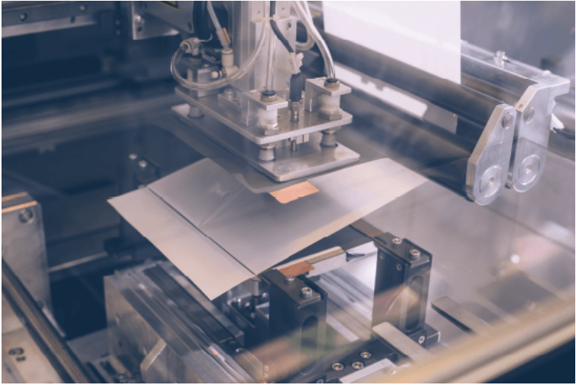
What does this mean for Coventry?
c.150 new jobs plus more throughout the supply chain 18,000m² building Industry focussed – supports OEMs and suppliers Creates scope for further investment.

Slide 4
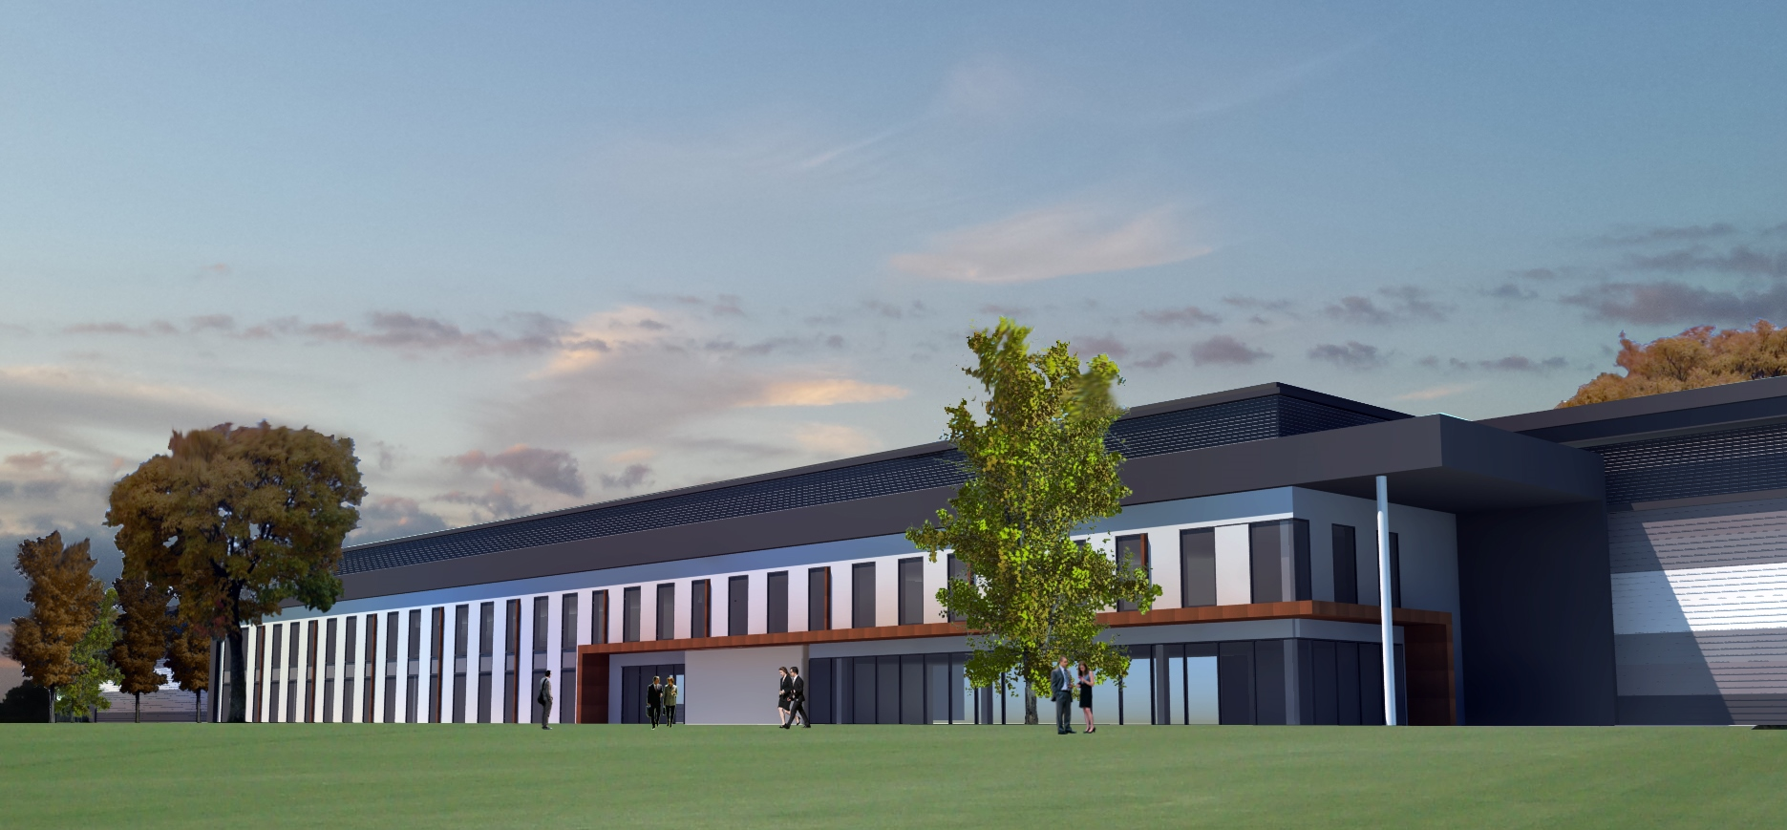
Artist’s Impression

Slide 5
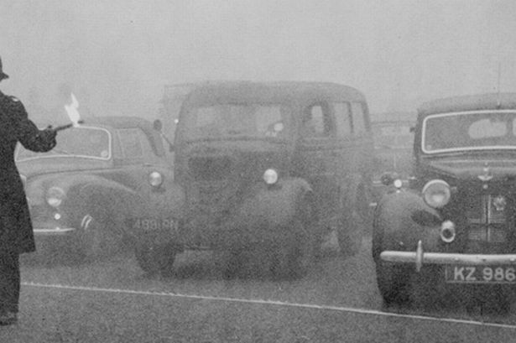
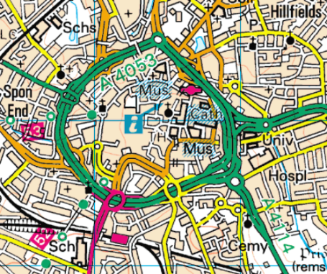
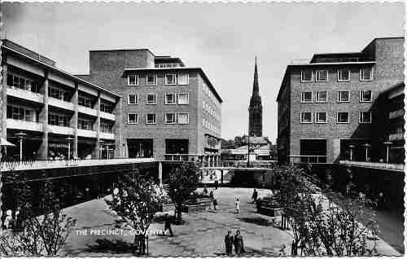
Coventry’s Firsts
The UK’s first smokeless zone (1948)
First pedestrianised shopping centre (1948)
First UK Ring Road (1973) – benefits for congestion and air quality
First climate change degree offered
Coventry was one of the first cities to produce a climate change strategy
One of first cities to recover power and heat from waste
First city to use electric vehicles in 1995
Notes:
5

Slide 6
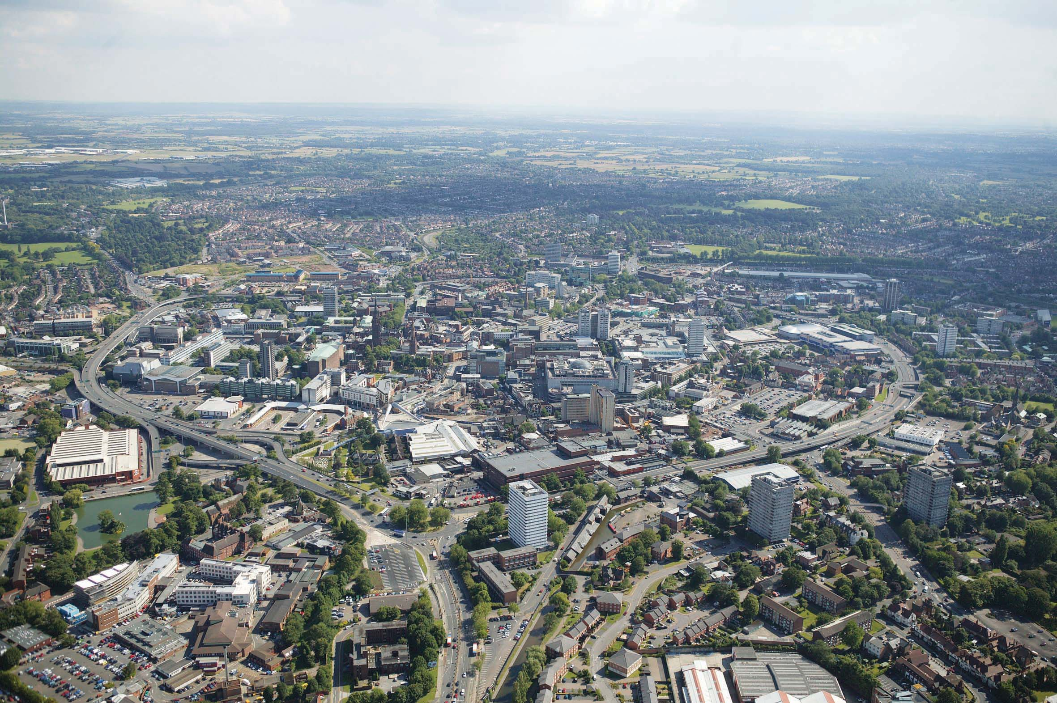
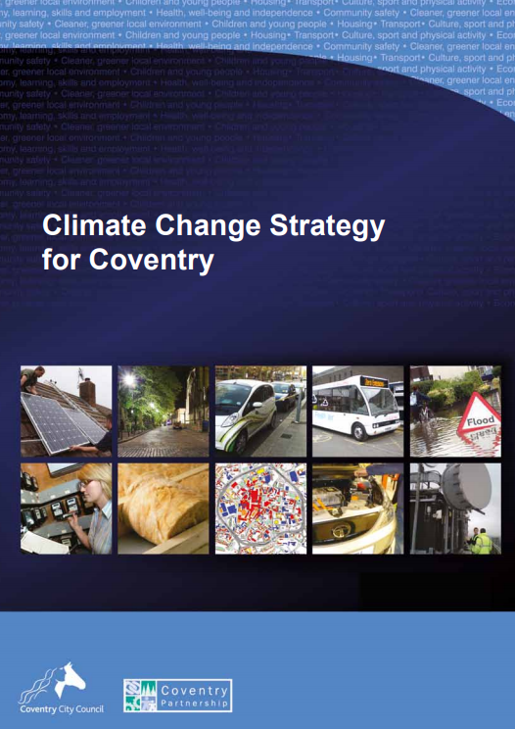
Coventry is committed to tackling climate change
The Climate Change strategy published in 2012 set a target to reduce carbon dioxide emissions by 27.5% by the year 2020
Coventry’s Carbon Footprint in 2016
1,335 tonnes
35.45% reduction (2016)
Hit our target in 2014, six years early!
In 2019 we are starting work on a new Climate Change Strategy for Coventry
Notes:
6

Slide 7
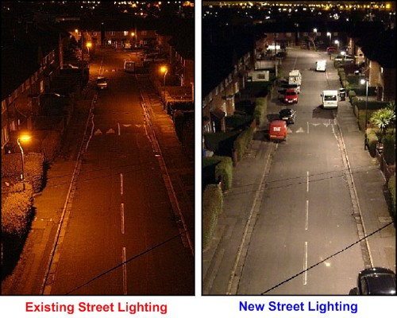
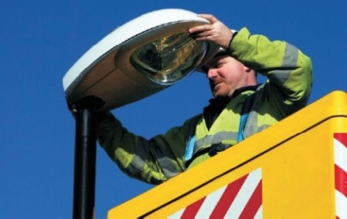
Street Lighting
Coventry is the UK's first city with centrally controlled dimming street lighting.
28,700 new lighting columns installed between 2010 and 2015.
Light targeted downwards to reduce light pollution.
38% energy reduction across the city
Saving 4,000 tonnes of carbon.

Slide 8
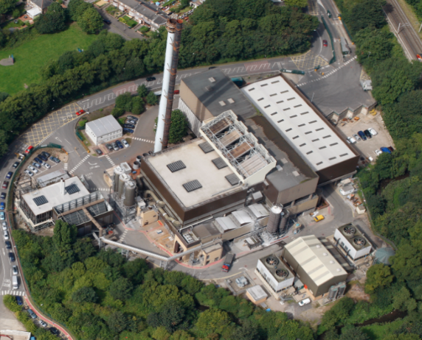
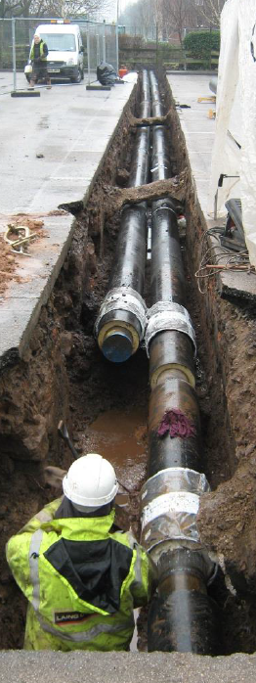
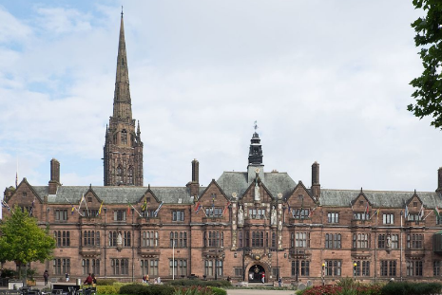
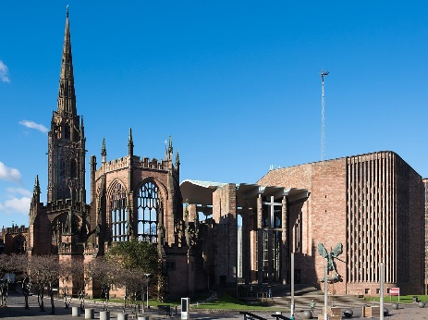
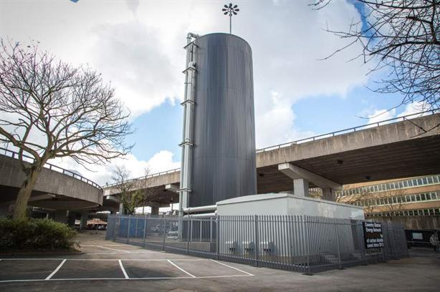
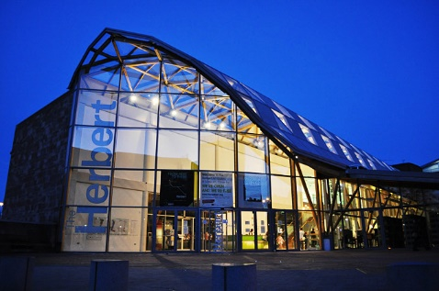
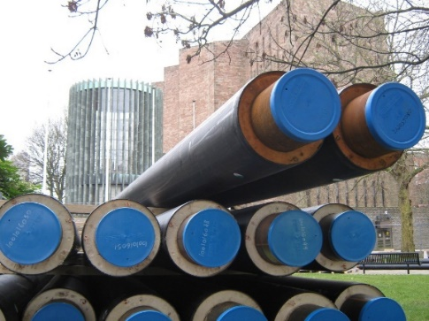
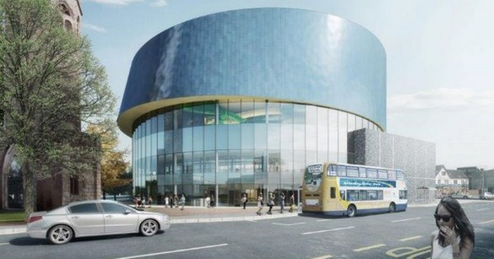
Heatline – Coventry District Heating Scheme

Slide 9
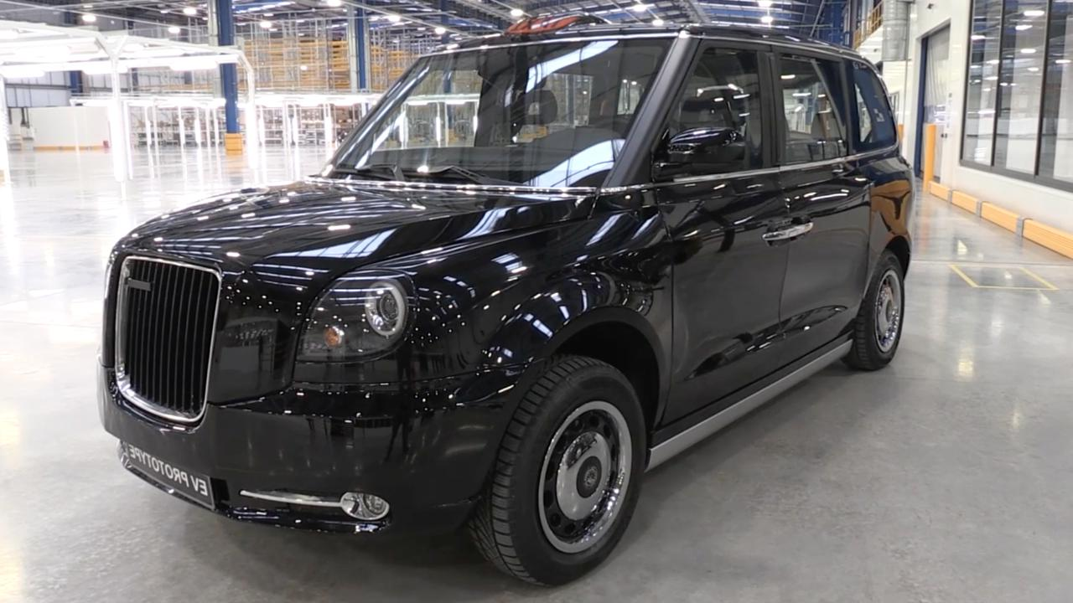
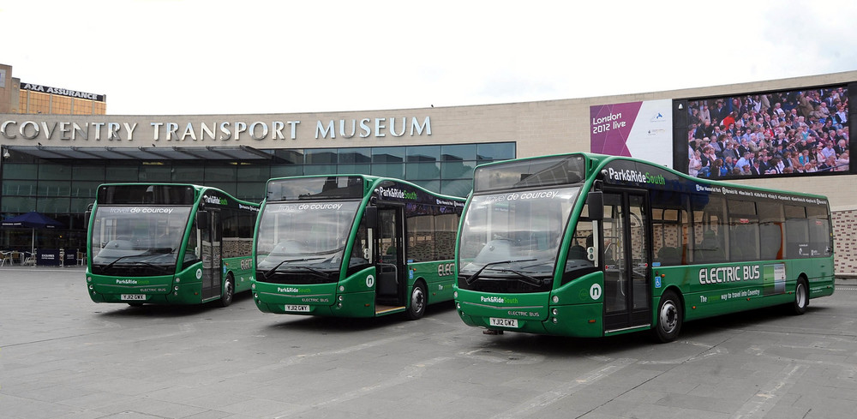
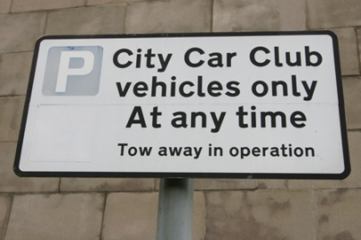
Electric vehicles and charging infrastructure

Slide 10
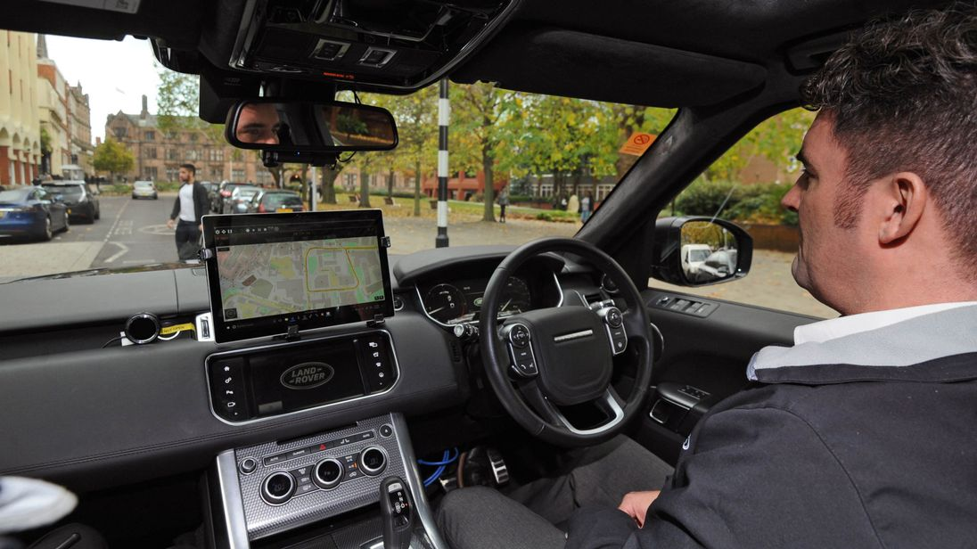
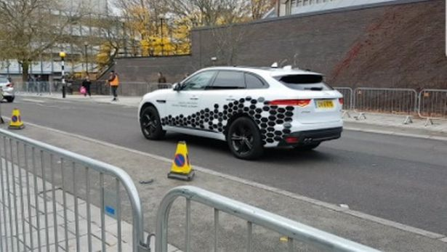
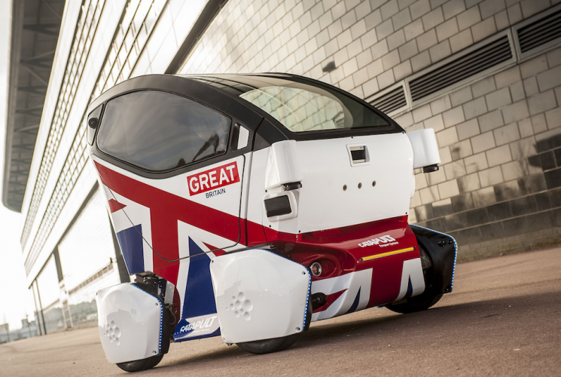
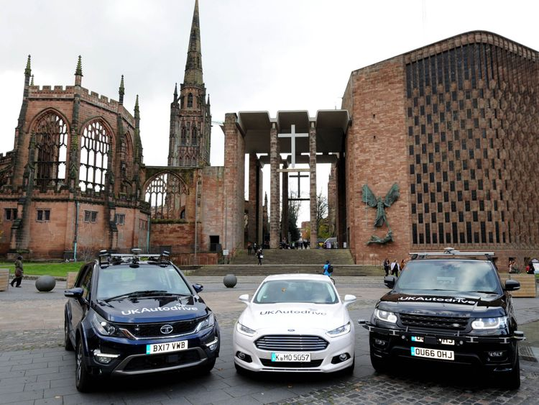
Driverless cars

Slide 11
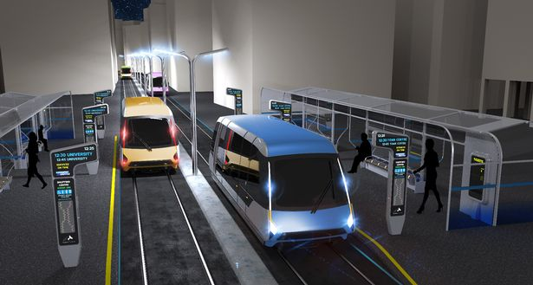
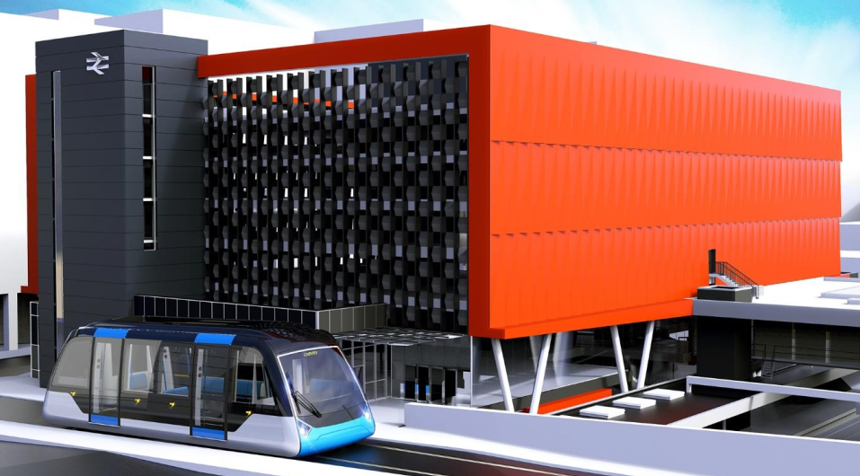
Very Light Rail

Slide 12
Any Questions?

