Slide 1
WELCOME
Tackling violence and keeping young people safe in our City
Presentation from Caroline Ryder - Programme Manager Youth Violence Prevention WM Police &
Sgt Nathan Witts - Youth Violence Reduction Team WM Police

Slide 3
Coventry Youth Violence Prevention Partnership Board Supported by Programme Management staff (1.1 FTE)
West Midlands Police
Coventry City Council
Coventry & Rugby Clinical Commissioning Group
The Bishop of Coventry’s Office
Coventry University
City of Culture Trust
The Probation Services
Schools, Secondary and Primary Rep
West Midlands Fire Service

Slide 4
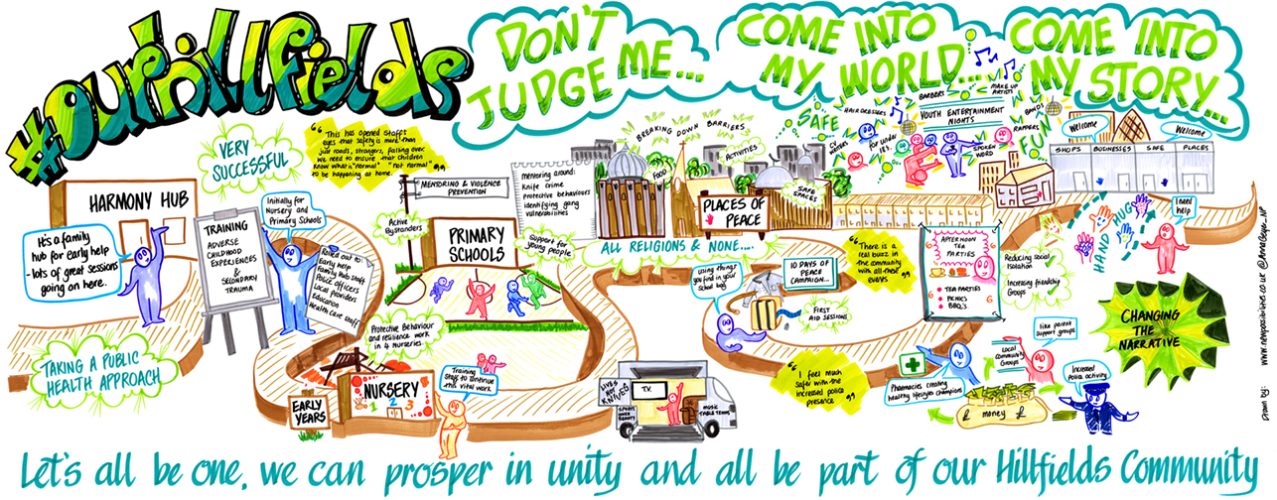

Slide 5
Current picture around young people and violence in Coventry
VWI numbers (U 25)
Knife crime figures
Robbery
Programmes of work
Funding opportunities
Family Hub staffing

Slide 6
Police approaches to managing young people in gangs
Coventry have a specialist Gangs Team who work closely with a wide range of partner agencies focussing on established gangs and members as well as focussing on an intervention and prevention approach.
The team work with third sector providers to explore alternative options
There is an inevitable enforcement element to the work
The work cross sections other departments and teams within Coventry

Slide 7
Police approach to managing young people at risk through schools panels
The Police and school panels are an information and intelligence sharing process for both Secondary schools, Primary schools and colleges.
Panels give school senior leadership the opportunity to raise concerns and issues that affect their school, their students and the local school community.
Police data is shared includes arrests, ASB incidents, stop and searches, caution, YOS information, missing and DV incidents. The information is shared with the school that the particular child or young person attends.
Each school in Coventry has an allocated school link officer which is either a PC or PCSO. They work directly with schools and their pupils to offer support and advice.
The SLO’s focus on intervention and prevention for those individual students who have been raised through the school panel data. They alter their approach according to the need of that YP, the incident and the other factors that are known by school.
Information sharing is a key part of the panel process and we actively encourage schools to share intelligence and concerns at every opportunity.
The school panels are used as a forum to discuss external funded provisions and new ways of working
The main ethos of the panel process in Coventry is to enable effective joint working between police and key partners to allow for consistent engagement that is proportionate to the needs of schools, young people and the police

Slide 8
Prevention V's Intervention - services currently on offer in the City
Prevention: Family Hubs, Parenting Programmes, Programmes in schools including Mentors in Violence Prevention, Places of Peace, Healthy lifestyles programme and many more
Intervention: St.Giles provide a number of services across the City (Teachable moments in UCHW, Gangs Resettlement). Guiding Young Minds provide a violence interrupter scheme. We have our own Horizon Team. We have the MASH. Children’s Social Care.
Whilst it’s important to have intervention we need to try and focus on prevention because this will make the biggest difference in the City over the longer term.

