Slide 1
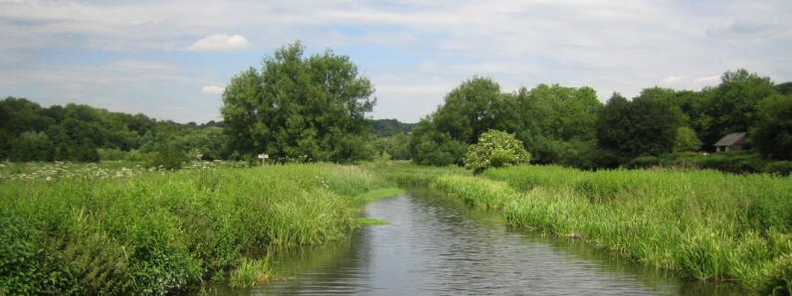
How does a river system operate?
Learning objectives:
Knowledge of how the water cycle relates to drainage basins
Understand that a drainage basin operates as an open system
Identify how rivers respond to changing precipitation

Slide 2
What is a system?
Systems are bounded and have inputs, stores, transfers and outputs.
Systems have sub-systems, e.g. a sub-system of the water cycle is the drainage basin.
Inputs and outputs are measured for the sub-system, e.g. the water balance for a drainage basin describes the flow of water in and out of a system.
The subsystems within a system need to be studied so that it is known what their function is and how they work.
The sub-systems of a system
Inputs
Subsystem
Subsystem
Outputs
Subsystem
Subsystem
What are the inputs to the water cycle?
What are the outputs of the water cycle?
Precipitation.
Evaporation, transpiration, river runoff.

Slide 3
Drainage basin as an open system
Discuss:
What human activities can reduce river runoff in a drainage basin?
e.g. Runoff in the catchment area is reduced by public water supply abstraction.
Precipitation (rain and snow)
Interception storage, surface water, soil water, channel storage
Stem flow, overland flow, infiltration, percolation, throughflow, groundwater flow, channel flow
River runoff, transpiration, evaporation
Inputs
Stores
Transfers
Outputs
Notes:
Acknowledgement: Data from the UK National River Flow Archive

Slide 4
Drainage basin glossary
Cut out the cards from your sheet and then match up the key word cards to their correct definition.
River runoff
When the water flows into the sea.
Soil water
This occurs when the water infiltrates downwards into the soil.
Stem flow
This is when water flows down vegetation, e.g. a tree trunk.
Surface water
If the ground is hard then the rain lies on the surface in puddles until it soaks into the ground.
Transpiration
A process where water is lost from a plant through the stomata in its leaves into the atmosphere.
Throughflow
This occurs where water flows sideways through the soil.
Channel storage
This occurs when the water enters the river and stays there until it reaches the sea.

Slide 5
Channel flow
This occurs when water from the adjacent land flows into a river.
Evaporation
A process where water is lost from the land and river into the atmosphere.
Groundwater flow
This occurs in the zone of saturated rock and is a lateral movement.
Infiltration
This is where water passes into the soil.
Interception storage
This occurs when the rain falls on the trees or grass and is stored until it evaporates or flows downwards.
Overland flow
Where water flows on the ground into the river.
Percolation
The constant movement down through the soil and rock.
Precipitation
The main input and it varies over time and space.
Colour the inputs blue, the stores green, the transfers yellow, and the outputs pink.

Slide 6
Answers
Inputs
Stores
Transfers
Outputs
Precipitation
Surface water
Infiltration
River runoff
Interception storage
Percolation
Evaporation
Throughflow
Transpiration
Soil water
Channel storage
Groundwater flow
Channel flow
Stem flow
Overland flow

Slide 7
Analyse the factors which influence river runoff in a catchment area.
Rainfall reaches river slowly
Few surface streams and low drainage density on permeable rocks
Large, elongated or gentle sided basin
Low risk of flooding
Factors’ affecting the way a river responds to precipitation
Basin size, shape and relief
Small or circular or steep sided basin
Drainage density
Many surface streams and higher drainage density on impermeable rocks
Slow infiltration on clay soils due to small pore spaces
Rapid infiltration on sandy soils due to large pore spaces
Rainfall reaches river quickly
Soil type
Higher risk of flash flooding
Higher risk of flooding
Low risk of flooding

Slide 8
Heavy rain falling on hard ground leading to increased runoff and flash floods
Ground becomes saturated increasing risk of flooding
Lower river levels if high rates of evapotranspiration due to high temperatures
Less infiltration if ground frozen or baked hard
More surface runoff and more streams
Temperature
Intense storms
Prolonged rainfall
Impermeable rocks, e.g. granite
Types of precipitation
Factors’ affecting the way a river responds to precipitation
Snowfall
Rock type (geology)
Higher risk of flooding
Meltwater in spring
Porous rocks, e.g. chalk and pervious rocks, e.g. carboniferous limestone
More interception if high levels of plant cover/ trees in full leaf
Land use
Lower levels of flooding in forested area
Less interception if low density of plant cover
Higher risk of flooding in deforested areas or in areas of moorland or grassland or urbanised areas
Little surface runoff and few streams

