Slide 1

STOP SMOKING IN PREGNANCY
VERY BRIEF ADVICE

Slide 2
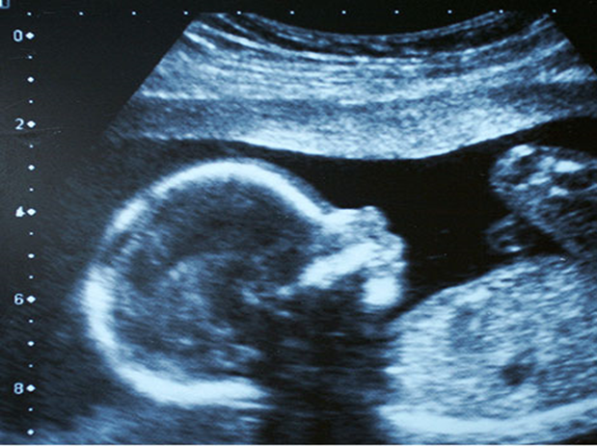
BACKGROUND
Smoking is the single largest modifiable risk factor for adverse outcomes in pregnancy and is therefore the most important behaviour change to tackle.
Given the magnitude of the risk, it is important to deliver Very Brief Advice (VBA) on smoking to pregnant women as a standard of care.
Smoking is the leading preventable cause of:
Miscarriage
Stillbirths, and
Neonatal deaths

Slide 3
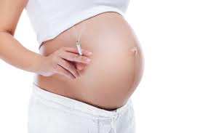
Smoking is clearly linked to an increased risk of the following avoidable conditions:
Intrauterine growth restriction (IUGR)
Premature birth
Low birth weight
The total annual cost to the NHS of smoking during pregnancy approximately £64 million, for treating the resulting problems for mothers and could be as high as £23.5 million for treating babies up to one year of age mainly attributable to the care of low birth weight / preterm babies .(2019)
It is estimated that spending between £13.60 and £37.00 per pregnant smoker would yield positive cost savings for the NHS.
Estimated that the increased cost to the NHS of smoking during pregnancy is £1500 per smoker.
Stop smoking interventions reduced the risk admission to Neo-Natal Intensive Care Unit immediately after birth by 22%

Slide 4
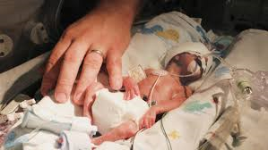
Babies born to smokers have a much higher incidence of:
Perinatal and neonatal morbidity and mortality
Sudden Infant Death Syndrome (SIDS, cot death)
Respiratory illnesses including asthma
Behavioural problems

Slide 5

Inequalities in smoking prevalence
In the UK, rates of smoking in pregnancy differ across groups.
Mothers aged 20 or under are six times more likely than those aged 35 and over to have smoked throughout pregnancy (35% and 6% respectively).
Pregnant women are also more likely to smoke if they are less educated, live in rented accommodation and are single or have a partner that smokes.

Slide 6

Women who have mental health or substance misuse problems are also more likely to smoke during pregnancy (with a prevalence of 43% in this group of women) and are less likely to quit.
They are also likely to be more tobacco dependant, thus decreasing their chances of quitting successfully and increasing their risks of a poor outcome in pregnancy.

Slide 7
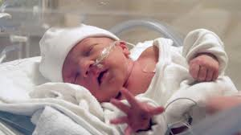
Research has shown that women who stop smoking before 15 weeks of pregnancy cut their risk of spontaneous premature birth and having a low birth weight babies to the same as a non-smoker.

Slide 8

Women’s Smoking Status at Time of Delivery:
Key Facts:
10.6 % of mothers were recorded as smokers at the time of delivery- England
This has reduced from 11.4% in 2014/15
This continues the steady year-on-year decline in the percentage of women smoking at the time of delivery from 15.1% in 2006/07.
This is the first time national annual figures have been below the 11% target.
However, there are some geographical differences amongst all NHS England Regions, smoking prevalence at delivery varied from 16.0 % in Cumbria and North East to 4.9 % in London.
New Target 6% by 2022

Slide 9

The NHS's ambition is to have six per cent of women or fewer smoking during pregnancy. At present only 33 out of 195 local NHS trusts have met this target. Several initiatives have been launched by the NHS to help achieve this target.

Slide 10

Data for England for 2019-20 showed that 10.4% of mothers were recorded as smokers at time of delivery. This was the same as in 2018-19 but there has been a steady decline in the percentage of women reported as smoking at the time of delivery since 2006-7 (16%).
Coventry
The data for Coventry is comparable to the national average with a Quit rate of 45-52%. The Smoking at time of delivery rate is 10% therefore we are developing a robust plan to meet the new 6% target!

Slide 11
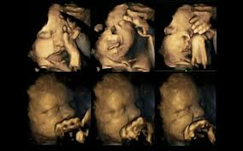
About 1 in 5 women smoke at some stage in pregnancy, and there are many identified opportunities for smoking to be addressed with these women.
For this to happen every health care professional and carer has to play their part, and a coordinated approach is needed with strong leadership, clear protocols, policies, and care pathways.

Slide 12
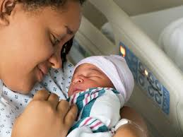
Promoting wellbeing, ensuring that advice is evidence-based and working in partnership with patients to help them access relevant health care is all part of the Nursing & Midwifery Council - - Professional standards of practice and behaviour for nurses, midwives and nursing associates (2018).

Slide 13

All staff coming into contact with pregnant women have a role to play, mainly through triggering quit attempts by delivering very brief advice on smoking.

Slide 14

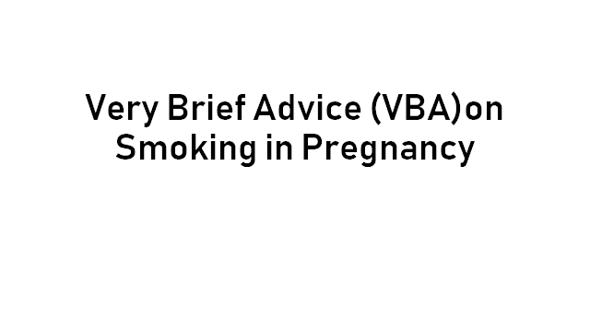

Slide 15
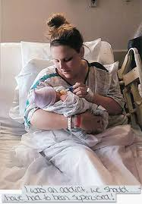
Very Brief Advice , what is it?
Designed to be a simple piece of advice that can be used in almost any consultation with a smoker

Slide 16
NICE Guidelines
Understand the impact that smoking and second hand smoke can have on a woman and her unborn child
Know how to ask questions in such a way that encourages them to be open about their smoking
Always recommend quitting rather than cutting down
Know what local evidence based stop smoking support is available and how to refer a woman
Refer all women who smoke, or have stopped smoking within the last 2 weeks, to stop smoking support.

Slide 17
68% higher success rate if NRT is offered
217% higher with the offer of support and NRT
Just mentioning stopping smoking does not increase quit attempts

Slide 18
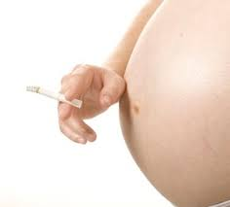
All pregnant women deserve high quality evidence based behavioural support, Nicotine Replacement (NRT)as required and this is what the Stop Smoking in Pregnancy Team (SSIP) is offering to all pregnant women in Coventry

Slide 19
Basic Psychology Behind the Approach
The recommendation is that the smoker is not advised to stop or asked if they want to stop smoking, by asking someone if they want to stop smoking they will automatically start generating reasons why they should not or can’t stop .

Slide 20
All smokers know that it is bad for their health and will want to quit.
Do ask ,Do you smoke at all?
Has your smoking changed since you discovered that you are pregnant?
Do you still smoke?
Questions will obviously vary depending on your relationship with the pregnant mother.

Slide 21

In-depth questions e.g. how many they smoke, what they smoke, how long they have smoked for, if they have tried to stop before can be saved until they receive the specialist stop smoking service that all pregnant women ideally need to stop.

Slide 22
It is best practice to always ask about smoking status, both current and past use (up to 70% of ex-smokers return to smoking in the couple of years post stopping.

Slide 23
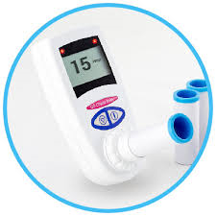
Carbon Monoxide Testing (CO )
Part of routine ante-natal checks , every contact with the stop smoking service, every pregnant woman is CO tested (not happening presently due to COVID 19 restrictions) it is a very useful way of raising the subject of smoking.
CO is a poisonous gas contained in cigarette smoke, it affects the body’s ability to transport oxygen around the body, CO crosses the placenta and enters the baby’s blood stream.

Slide 24

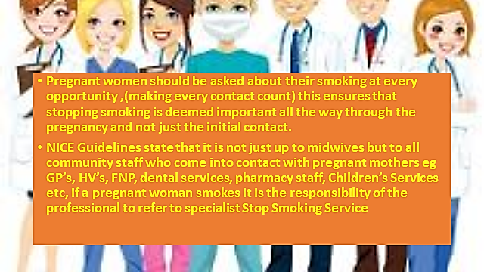

Slide 25
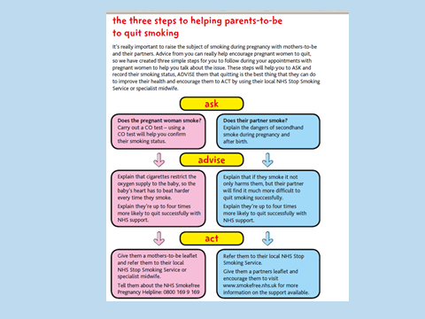

Slide 26

Important to assess the woman’s motivation to stop smoking
Pregnant women need to reassured that they are not being judged but that you are keen to ensure the best outcome for the pregnancy.
Smokers frequently deny or minimise the health risks of smoking to them and their baby.
Professional needs to communicate their understanding that quitting is not easy, provide encouragement and communicate the support that will be provided

Slide 27
Women who Express little or No Interest in Stopping Smoking
Example of how to explore a woman’s lack of interest in quitting , need to communicate an understanding that is not easy.
‘I can understand why you feel it might be difficult right now’
‘What worries you about giving up smoking?’
Always try to use open questions.
Ensure a motivational message is given

Slide 28
‘With support and NRT you are much more likely to be successful, you’ve got nothing to lose it’s so important to stop smoking whilst you are pregnant
Pregnant women have a right to decide to not stop smoking and therefore discussing smoking with those who say they do not want to stop needs to be done in a sensitive manner
Always respect a woman’s decision but be clear on the advice you are giving, re-iterate that the service is still on offer to her throughout her pregnancy.

Slide 29

Quitting v Cutting Down
A reduced number of cigarettes does not equate to significantly reducing health risks and stopping smoking completely is the only way of ensuring that the unborn baby is not at risk from smoking.
Research indicates that between 75-95% of quitters who have a single cigarette resume regular smoking .
Explaining the concept of compensatory smoking

Slide 30

‘Your brain and body are used to regular doses of nicotine. When you cut down the number of cigarettes that you smoke your brain and body still 'demand’ those regular doses’ so what happens without you realising it, is that you will get similar doses of nicotine from fewer cigarettes by smoking those cigarettes more efficiently (taking more puffs, inhaling deeper and longer, smoking more of the cigarette. Similar doses of nicotine equals similar doses of tar and CO which means little or no benefit from cutting down on your smoking’

Slide 31

Summary of Action to be taken to Support pregnant Women
To provide information to women on the effects of smoking on pregnancy outcomes and to re-inforce the importance of quitting smoking in early pregnancy
To use CO monitoring to assess tobacco use and to provide feedback
Offer local support
Complete a referral to the SSIP Team
Re-inforce the importance of quitting completely versus cutting down.
Discuss and support women to plan to remain smoke free post delivery

Slide 32
Case study
A.N. referred to SSIP
Contact made home visit carried out
A.N had a toddler
Next visit carried out in new accommodation – no facilities
A.N. feeling very isolated
Collaborative working
Good engagement throughout, quit.
Completed service successfully
Six month serious case review
Paperwork up to date and complete.

