Slide 1
Child Sexual Exploitation
a new police approach
DCI Ian Green
June 2016

Slide 2
CSE and Missing
This has been written to show the current overview within Coventry in relation to missing / absent and the approach to CSE.
The PowerPoint does not contain specific cases nor does it detail tactical processes as it is designed to give an overview around processes and governance.

Slide 4
Background
CSE came to the forefront from the beginning of 2015 to this region, on the back of high profile cases and SCR’s in other parts of the country.
The chief executives of the seven local authorities and other partners had agreed to work towards a regional approach and the regional framework was devised.
Prior to this it was difficult to explain or understand the risk to an area such as Coventry, due to the lack of screening and understanding.

Slide 5
2015 (April) onwards
CSE and missing cases linked to CSE were being discovered and between 70 – 90 had been risk assessed.
Cases were dealt with in an ad hoc way as the partners tried to understand the regional processes and the overall risk within the city.
CMOG was running but was saturated with cases and functioning in a similar ad hoc way.
Missing and absent was often overlooked due to workloads and lack of governance

Slide 6
The process required stripping back and a refocus.
LSCB group was reinvigorated and a new proposal was put forward to manage the increasing work and ensure a joined up plan.
Initially clarity was sought around the current governance areas across victims, locations and offenders.
Police Pursue team was implemented (May 2015)
Multi Agency Horizon team implemented (Sept 2015)

Slide 7
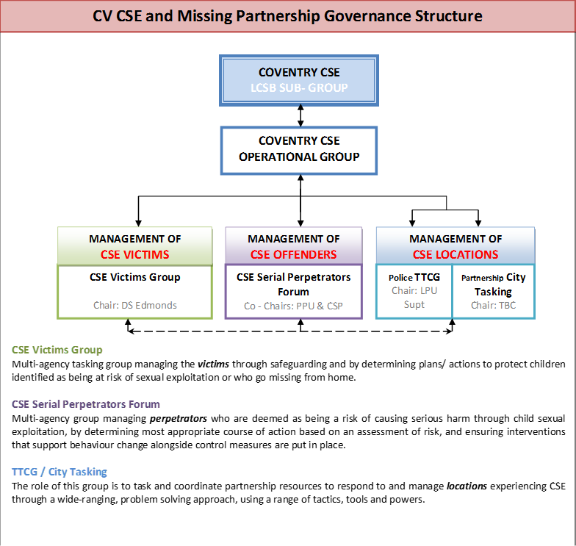

Slide 9
This refocus allowed us to start to understand the risk picture in more detail and provided clear governance around each area of business.
However we continued to see issues being missed at earlier opportunities around absent and missing children who were showing risk indicators around CSE…..
A new process was suggested to address the gaps.

Slide 11
The new process only commenced in January 2016 and is already seeing significant benefits around the early identification of risk factors – these aren’t all CSE and in fact a large number relate to other exploitation such as gangs and drugs etc.
Further scrutiny and governance is now also being placed around CSE investigations and offenders via two piloted structures.

Slide 12
Strategic Oversight
Strategic Management Group (SMG) process over complex abuse cases.
Allows for senior governance and resourcing / decision making.

Slide 13
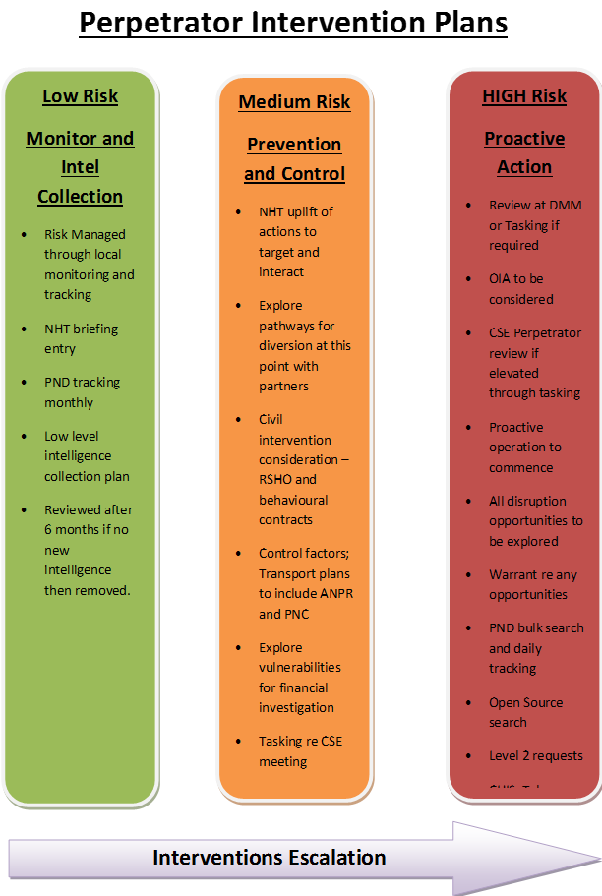
Offenders
New regional risk assessment is being piloted within CV and SH. (Pilot for the region)
Will see levels of risk for each offender mapped to allowed a tiered intervention plan to be put in place via the perpetrator forum.
Will allow clear tasking and intervention plans both criminal and civil to be explored.
Ensure a vital link back into the partners and intelligence system

Slide 14
Current Position and Issues
Over 200 victims and rising……
Intensive work and support needed to victims
Still gaps in our understanding of the picture of CSE
Potential mapping of around 50 - 70 suspects.
Complexity of the victims.
Smarter early help and intervention required. (CAN work)
Rising 18’s (Regional)
New Risk level required for no risk (Regional)
New processes are still bedding in.

Slide 15
Good News
Really strong position regionally
Strong partnerships
Utilising all civil tools and legislation available – PSPO x 1, Sexual Harm Prevention Orders and Sexual Risk Orders x 3, multiple CAWN etc.
Utilising criminal tools around human trafficking and CSE legislation.
Nine current CSE operations in progress
Future discussions around co-location.
Early identification through partners and MASH

Slide 16
Thank you
Questions?

