Slide 1

Right Help Right Time
Workshop
Notes:
Welcome and thank delegates for attending
Thank venue for hosting
Introduce key people facilitating the event & available to answer questions:
Case study facilitators
LSCB Staff
MASH Representative

Slide 2
Purpose of Workshop
Introduce the Right Help Right Time Guidance
Understand why it is needed
Explore key messages for practice
Practical application with case studies
Answer any questions

Slide 3
Learning outcomes
By the end of this workshop practitioners will be able to:
Understand the new Right Help Right Time Guidance
Address concerns about children at an early stage
Be more confident in managing risk
Know where to go for advice and support
Be more confident in seeking consent from families

Slide 4

Right Help Right Time Guidance
Published by LSCB on 23rd April
Available on our website and on in our online procedures manual

Slide 5
Why is it needed?
LSCB statutory duty to provide guidance
Board priority: to ensure that early help services are available to children and young people and are resulting in positive outcomes
Learning from audit work and serious case reviews showed that advice available was insufficient to ensure good decisions were being made for children and families
OFSTED recommendation that the LSCB supports partners to understand and consistently apply appropriate thresholds to levels of need at every stage of the child’s journey, including the early help pathway

Slide 6
Key Messages
Assessing and managing risk
Seeking consent
Early Help Assessments
Referrals to social care
Seeking advice and support

Slide 7
Assessing and Managing Risk
Guidance clearly defines the right level of support to meet the need of children and families.
It should be considered as a flexible continuum.
The child and the impact on their outcomes should be the focus of assessing risk.
Guidance clearly describes the appropriate action a practitioner should take if they assess a child/family as needing support at a particular level.
Using this guidance correctly means that practitioners do not need to report all concerns about a child to MASH, because they can be more effectively met by the direct delivery of early help

Slide 8
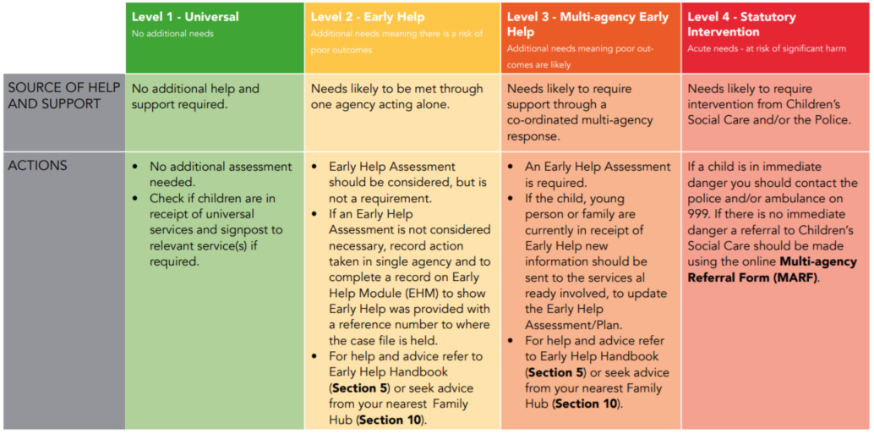
Using the Guidance to Assess & Manage Risk

Slide 9
Seeking Consent (Early Help)
Early Help is a voluntary assessment process and, as such, a child, young person and their parent/carer must give consent at the start of the process, for the assessment to take place.
If a family does not agree to an Early Help Assessment, or stops engaging with a current plan, the lead professional must determine if this results in a higher level of risk to the child that would require a referral to Children’s Social Care.
The purpose and benefits of the process should be explained clearly, emphasising that it is a process to determine the most appropriate type of support required for a child, young person or family.
For help & advice visit our procedures manual to read our new guidance: Working with families who refuse to consent or engage, or who demonstrate disguised compliance

Slide 10
Seeking Consent
(Social Care Referrals)
Consent from the child, young person and their parent/carer is required for a referral to Children’s Social Care, unless to do so would place the child at increased risk of significant harm.
In the event that the parent, carer or child does not consent to the referral, professionals should determine if the concerns justify making a referral without consent in any case.
Decisions not to seek consent, together with the rationale, must be recorded on the MARF.
For help & advice visit our procedures manual to read our new guidance: Working with families who refuse to consent or engage, or who demonstrate disguised compliance

Slide 11
Early Help Assessments
The early help assessment provides a framework for professionals and families to work together to improve outcomes for children.
The early help assessment currently used is the CAF. A new assessment is being developed in line with this guidance and Signs of Safety, but will not be available until later this year.
Until the new assessment is available practitioners should use the CAF whenever the need for an early help assessment is identified.
The launch of the new early help assessment later this year will be accompanied by new guidance and training, which will replace all existing CAF guidance and training.
Right Help Right Time describes when an early help assessment should be used.
When delivering early help, or completing an assessment, professionals should contact the Family Hub that covers the area where the child, young person or family live to ensure all relevant agencies contribute to the assessment and any ongoing action plans.

Slide 12
Referrals to Social Care
If a professional considers that the level of need of a child or young person is such that they are at risk of significant harm (Level 4) then a referral to Children’s Social Care must be made, without delay.
Referrals should be made the same day as the concern is identified.
All referrals must be made using the online Multi Agency Referral Form (MARF).
On receipt of the MARF the MASH will provide a reference number and a copy of the submission.
Referrers will receive written feedback when a decision has been made.
Any disputes should be dealt with using the LSCB Escalation and Resolution of Professional Disagreements policy.

Slide 13
Seeking Advice and Support
You can telephone Children’s Social Care for advice on existing cases, general advice from a social worker, or to make a referral.
Early help is co-ordinated through the family hubs. Contact details for each hub are included in the guidance.
Visit Coventry City Council website to find the local hub for the child or family you are working with.

Slide 14
Questions

Slide 15
Case Studies

Slide 16
Thank You
Notes:
Invite any final questions / comments before closing session

