Slide 1
A more environmentally friendly future for motoring?
0300 302 0626 | fleetevolution.com

Slide 2
Time for some blue sky thinking?
CO2
NOX
Particulates
Hydrocarbons
Fossil fuels future?

Slide 3
What concerns are coming?

Slide 5
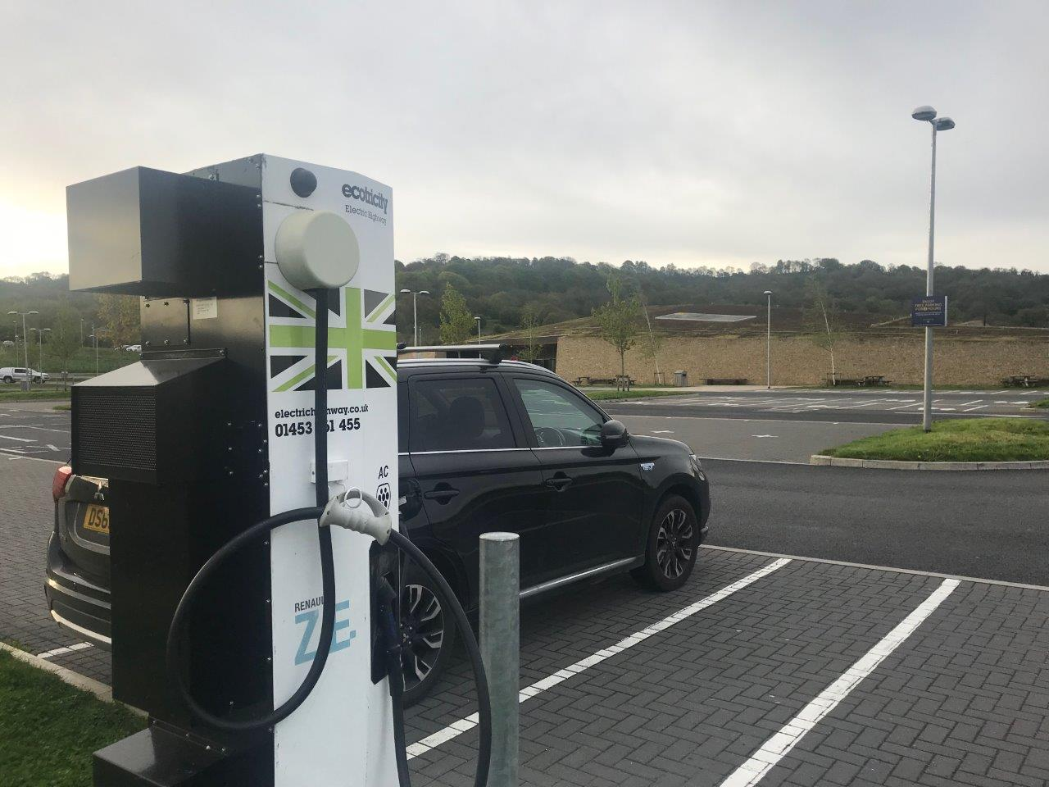
Plug in Hybrid
Pro’s
Up to 25 (ish) miles ev range
Easy charging from any socket
No range anxiety
Cons
High list price
Polluting on long journeys
Fossil fuel reliance
Company car tax

Slide 6
Pure Electric
Pro’s
Running costs
Performance
Charging
Cons
Capital cost
Range Anxiety
Infrastructure
Customer Data – 32,600 miles covered in a Nissan Leaf for £341

Slide 7
Hydrogen
Very expensive to buy and run
Demand limited by cost
Cost high due to demand

Slide 8
Cost based justification
Car (12,000 miles per annum) Van (20,000 miles per annum)
Ford Focus lease cost £400 Ford Transit Con Purchase £17,000
fuel cost £100 (and rising) fuel cost £220
Nissan leaf lease cost £400 Nissan NV200 Purchase £19,000
electric cost £30 (15ppkw) electric cost £65
salary sacrifice cost £300 100 miles range
180 miles range fast charge
Hyundai Kona lease cost £500
electric cost £30 (15ppkw)
salary sacrifice cost £400
280 miles range (60kw)
+ no congestion zone
Other grants
0300 302 0626 | fleetevolution.com

Slide 9
Grants, incentives and giveaways
Vehicle Grant - £4,500 ev, £2,500 hybrid
£8,000 van
Up to £500 off charging point
Free charging point from some schemes
Council aid for street charging
No congestion charge
Solar
Vehicle to Grid

Slide 10
Who Are Fleet Evolution?
Employee car scheme specialists
Salary Sacrifice
Ecos
Affinity
Fleet management
Green Fleet
Cost neutral employee car schemes with no leaver risk

Slide 11
We make new cars more affordable for employees, up to 40% cheaper than retail via a simple payroll deduction
The greener the car the bigger the saving

Slide 12
QUESTIONS?
andrew.leech@fleetevolution.com
07961079965
engagement@fleetevolution.com
Further guides – Guide to greener motoring
Guide to ULEV’s
0300 302 0626 | fleetevolution.com

