Slide 1






Denise Osborne
Marketing & Events Co-Ordinator
Green Business Programme

Slide 2
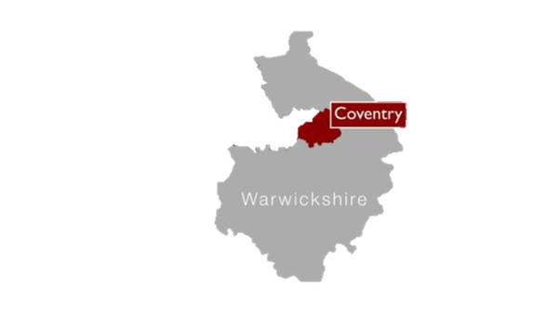

What is it?
A support funded programme for SMEs and organisations in Coventry and Warwickshire to help business become more energy/resource efficient and make the most low carbon opportunities.
Who?
All small to medium size businesses (SMEs) in Coventry and Warwickshire
  Employ less than 250 employees.
  Have an annual turnover of not exceeding €50 million and/or an annual balance sheet not exceeding €43million.

Slide 3
Highlights of Phase 1 Programme (2016-2018)
£1.5m in grants were awarded to 73 small to medium sized enterprises (SMEs)
There have been over 11,600 tonnes of CO2 savings
60 new jobs have been created
88 SMEs have received non financial support
300 local organisations joined the Green Business Network

Slide 4
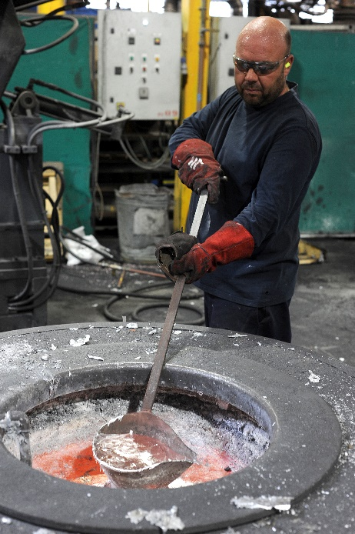
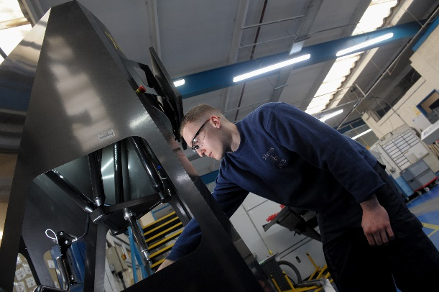
New Programme – launched in January (2019-2021)
Energy and resource efficiency grants - £1k-£50k (with 40% intervention)
Free energy and resource efficiency audits to help identify energy, water and waste savings
Continued free membership to the Green Business Network with new benefits
New scope of audits to include advice on waste, materials and water savings
Access to other specialist support to enable growth and innovation
Free events, workshops and 1:1 support

Slide 5


Energy/Resource Efficiency Audits
Identify potential energy/resource efficiency measures
Audit looks at: Building fabric, energy bills, heating, lighting, equipment, process, water, waste, behavioural
Includes estimated capital costs, energy savings & payback periods – used to provide a business case
Energy efficiency report

Slide 6
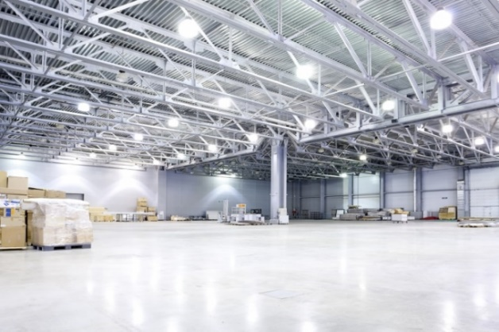

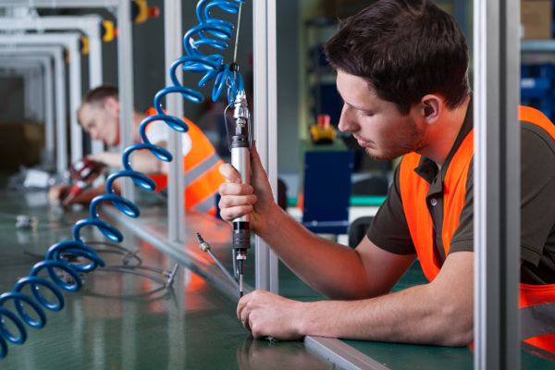
Energy/resource efficiency grants
  Capital grants to improve energy/resource efficiency (Min £1K up to £50k)
  Grants of 40%
  Must save Approx. 5 tonnes+ of CO₂ per year.
What can be supported?
  Measures that save carbon
  Typical measures include lighting - LED, heating, energy efficient equipment, transformers, power factor correction, renewable technologies, ventilation, refrigeration, recycling and waste - compactors, balers and crushers
Eligibility:
  >50% B2B
  Match funding can’t be via another public sector grant etc.

Slide 7
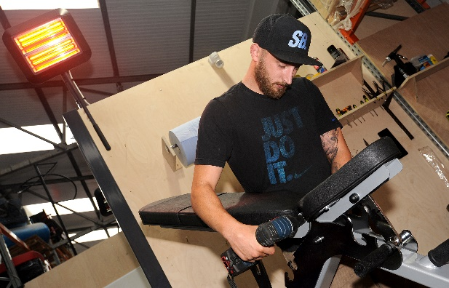
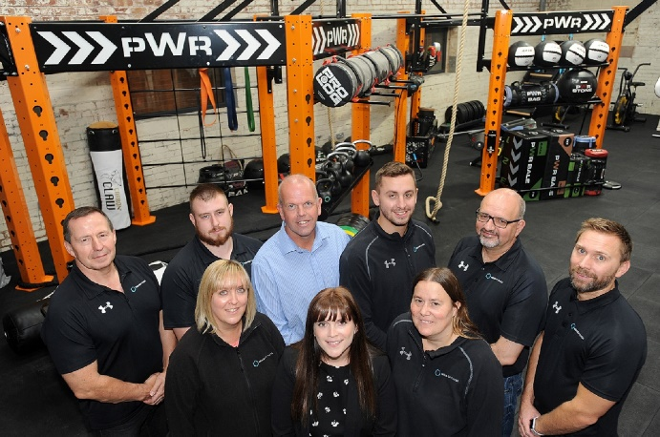
Indigo Fitness
UK’s largest Fitness equipment manufacturer
£62,070 energy efficiency grant
  New insulated roof. 30% energy saving
  Sensor controlled LED lighting throughout. 70% energy savings
  New heating system plus infrared heating with sensor controls
Lighting – save 22 tonnes of carbon per year
Roof insulation save 13 tonnes of carbon per year
£6,000 a year saving on energy costs

Slide 8
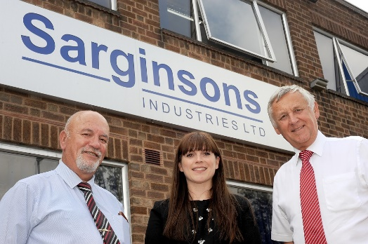
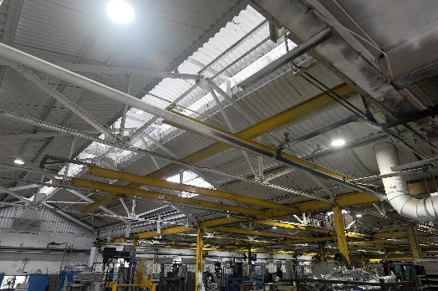
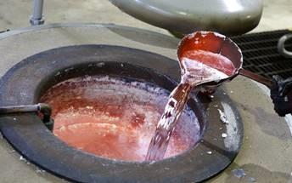
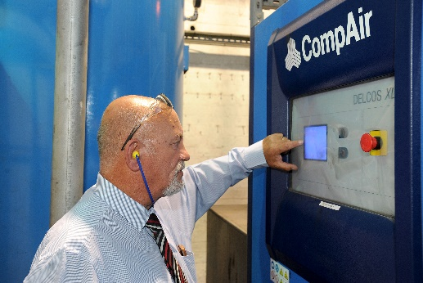
Sarginsons
Aluminium Diecasting
£370,000 spend per annum electricity and gas
£130,000 capital investment
£26,000 energy efficiency grant
  2 recuperation gas furnaces
  Variable speed air compressors and drying equipment
  LED lighting throughout
  Power Factor Correction
Payback – 1.5 year
335 Tonnes CO2 saving/ annum
£50k per annum in energy bills

Slide 9

Green Business Network
Membership is free and offers a range of benefits:
Events and workshops
Monthly newsletter – news, events new legislation, case studies
Membership certificate
Expert advice
Enhance green credentials to secure new business
Networking and supply chain opportunities (Inclusion
in Green Business Directory)
Currently have 460 other organisations you can network with
Signposting to other grants
  Business Support
  Innovation
  Skills 4 Growth

Slide 10

Upcoming Events
June
Electric Dreams
Waste Management Legislation
For more information visit http://bit.ly/cwgreenevents

Slide 11



Coventry University Enterprises – Delivery Partner
Research Innovation and Adoption of Low Carbon Technologies
Grants up to £10,000 (40% intervention) to support the development of low carbon
products and services, supporting activities including:
Intellectual Property Protection
Supporting new businesses to progress their innovations
Licensing
Prototype Developments
Product Testing
Accreditations and Certifications

Slide 12


Expert 1-to-1 advice and workshops on a range of sustainable building techniques and technologies
Free workshops include: 16 May 2019 – Workspace optimisation
  AutoCAD
  Passivhaus design and principals
  Sustainable Refurbishment and Energy Efficiency Strategies
  IP and Your Business
  Building Information Modelling (BIM) 1-to-1 Business Support available to provide bespoke solutions to energy efficiency and sustainability challenges

Slide 13

Green Business Programme
Contact us
Telephone: 024 7678 6901
Email: GreenBusiness@coventry.gov.uk
Website: www.coventry.gov.uk/greenbusiness
Twitter: @cwgreenbusiness
Join our LinkedIn group

Slide 14


Project Summaries
CW SME Growth Programme
Ian McFarlane-Toms
Business Growth Advisor
University of Warwick Science Park

Slide 15
CWLEP Growth Hub
Information, Diagnostic and Brokerage
Summary: The Growth Hub is a one-stop shop for all business needs, offering a range of free services including mentoring, financial advice, growth planning and networking opportunities. The team of advisors are on hand to help businesses grow and keep growing in the future.
Target group: SMEs in Coventry & Warwickshire
Contact: Laura Delahunty T: 0300 060 3747 E: support@cwgrowthhub.co.uk

Slide 16
University of Warwick Science Park
Business Ready
Summary: an innovative business support package primarily for tech-based SMEs with the characteristics and ambition for growth. It supports tech based businesses and businesses that are innovation led and/or knowledge based
Target group: Tech based, innovative or knowledge intensive businesses with growth potential. Will engage with start ups if they are high-potential and capable of achieving a £250k turnover within 3 years.
Contact: www.business-ready.co.uk E: businessready@uwsp.co.uk T: 024 7632 3121

Slide 17
CUE Business Solutions
Technology Business Start-up
Summary: Start up support to individuals and new businesses who wish to operate tech-based businesses. We will also assist students. Our focus is in the High Tech Sectors (e.g. creative, technological, digital, transport and low carbon sectors)
Target groups: Individuals and Students wishing to start their own Tech-Based business – or those who registered their business less than 12 months ago
Contact details: Lindsey Martin, Business Delivery Manager, Technology Business Start-up
E: LMartin@cad.coventry.ac.uk M: 079 7498 4070

Slide 18
C&W Chamber of Commerce
Business Support - Accelerated Growth & Start-Up
Summary: Accredited business advisers offering 1-1 assistance with Marketing strategies, cash flow reviews, business planning, funding & grant searches & assistance with CW Investment grants, website reviews, competitor analysis, in-depth SWOTS, and KPIs
Target group: Existing businesses with an appetite to grow ERDF eligible
Contact: E: supportforbusiness@cw-chamber.co.uk
Summary: Deliver Start Up advice across Warwickshire on behalf of Warwickshire County Council and Districts/ Boroughs (Rugby Borough, Stratford District, Nuneaton & Bedworth Borough, Warwick District, and North Warwickshire Borough)
Target group: Any client that has a business idea and considering self employment, and those clients that are in the first 24 months of trading.
Contact: Hardeep Sandhu (Team Leader)
T: 024 7665 4123 M: 07703 730132 E: hardeeps@cw-chamber.co.uk
All Startup enquiries to be sent to: startyourbusiness@cw-chamber.co.uk

Slide 19
Warwickshire County Council
Business & Investment Strand
Summary: A package of activities designed to attract businesses from the CWLEP’s priority sectors to the sub-region and to support existing businesses to expand and grow.
Target group: New investors to the area OR existing businesses in Coventry & Warwickshire looking to expand / relocate into the CW area and/ or needing access to finance advice
Contact: Louise Richardson T: 01926 418067 E: louiserichardson@warwickshire.gov.uk

Slide 20
Coventry City Council
Investment Fund
Summary: To support eligible SME’s across Coventry and Warwickshire to access finance through the award of grant funding towards the cost of capital expenditure with job creation as a result of the project.
Target group: SMEs across Coventry and Warwickshire from the following sectors: advanced manufacturing and engineering, aerospace, automotive, creative industries and ICT, intelligent mobility, and professional services
Contact details: Kierandeep Bal E: Kierandeep.bal@coventry.gov.uk

Slide 21
Coventry City Council
Employer Hub and Wellbeing Teams
Summary: Employer Hub provides recruitment support to businesses including- vacancy promotion to 19,000 Job Shop registered customers, support to run recruitment events, pre-screening of candidates, advice on apprenticeships and grants for eligible customers.
Wellbeing services focus on signing up businesses to West Midlands Thrive at Work award. Businesses can be supported through Bronze, Silver and Gold award with each stage involving increasing levels of Wellbeing activity. The team also provide general Wellbeing advice and support and deliver various Wellbeing workshops.
Target group: Focus primarily on LEP Priority Sector SME’s
Contact details: E: employerhub@coventry.gov.uk T: 02476 785609

Slide 22
C&W Cooperative Development Agency
Social Enterprise Support
Summary: From pre-start through to trading, sustainability and expansion, support for all aspects of business development, working with community businesses, co-operatives and other types of social enterprises.
Target group: Social Enterprises & community businesses
Contact details: Kate Launchbury E: k.launchbury@cwcda.co.uk T: 02476 633911

Slide 23
Prince’s Trust
ERDF CW Business Support Programme
Summary: A cohesive programme of support which seeks to create sustainable new businesses, support young start-up businesses (less than 12 months) and address barriers to growth.
Target group: Young people aged 18-30, who have a business idea living in the Coventry/Warwickshire area
Contact details:
Alison Millard - Operations/Delivery E: Alison.Millard@princes-trust.org.uk
Candy Lee – Contracts E: Candy.Lee@princes-trust-org.uk

Slide 24
Coventry & Warwickshire Reinvestment Trust Creative SpringBoard
Summary: Support Warwickshire’s creative sector to develop and grow. Entrepreneurs will learn how to develop new markets, enhance business skills and make more advanced use of digital technologies. Areas covered include personal development, imagining growth, branding and digital marketing, social media and finance
Target group: small and new businesses and freelancers (trading under 2 years) from Warwickshire’s creative sector
Contact Details: Jude Bowcott T: 02476 551777 M: 07494 442869

Slide 25
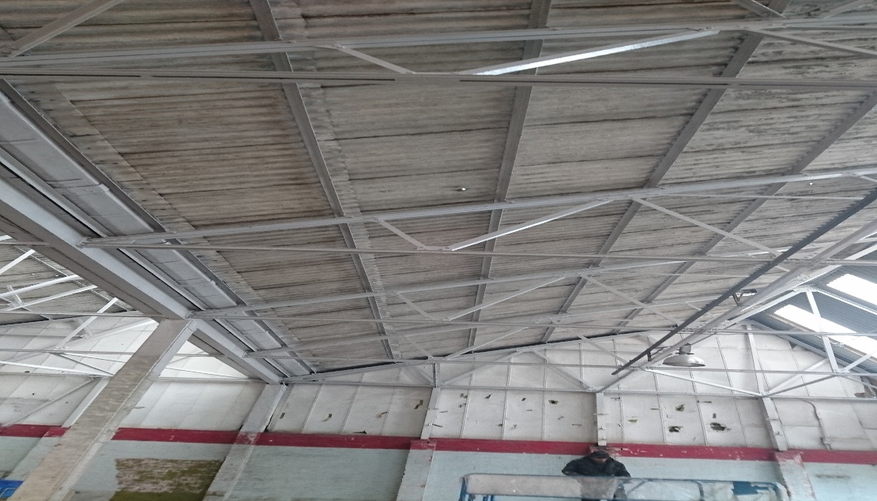
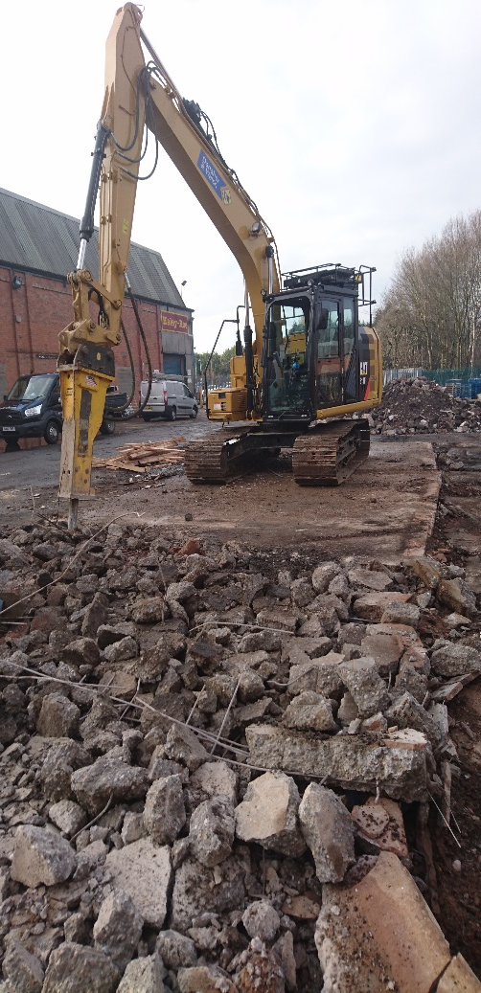
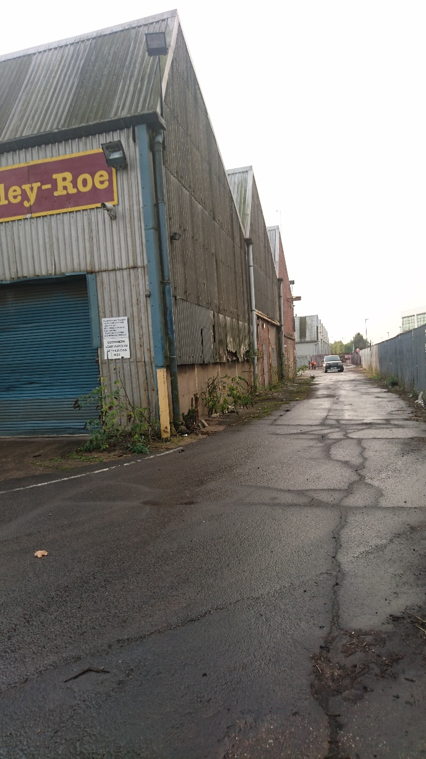
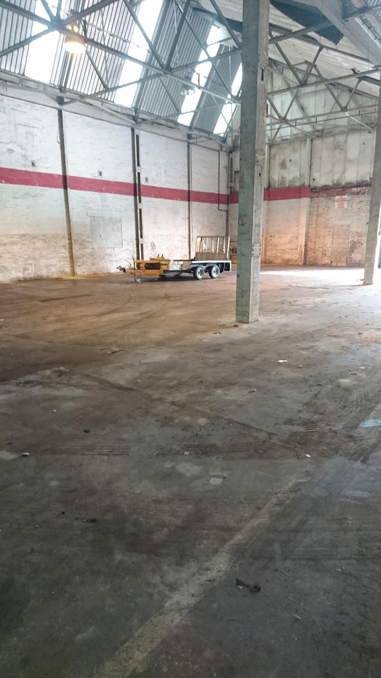
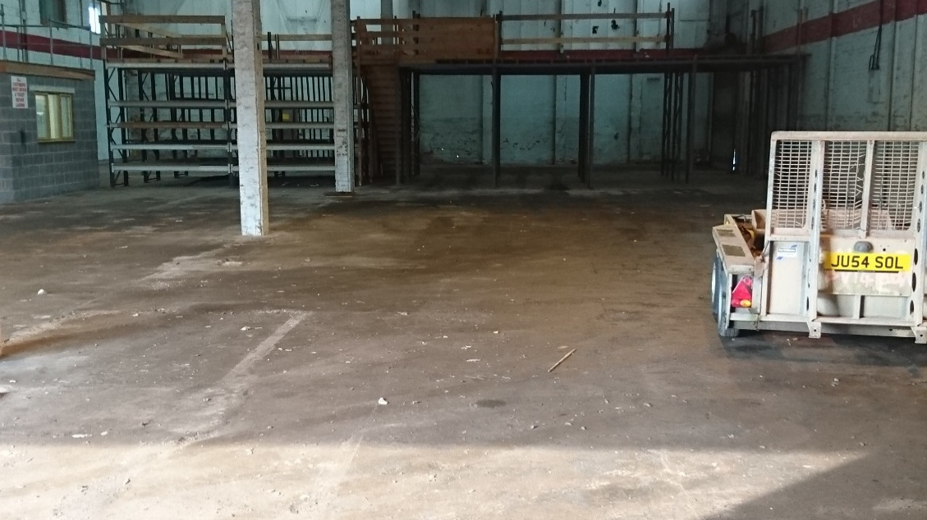
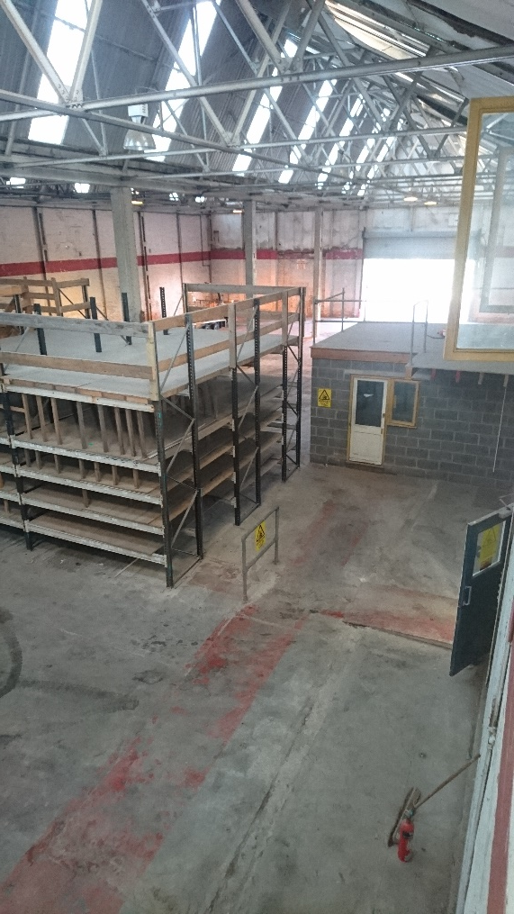
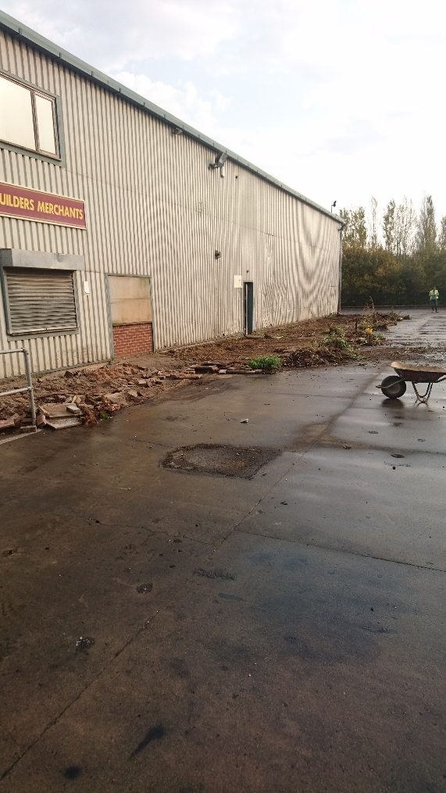
Peter Bates, Managing Director, Bates Timber Merchants Ltd BEFORE GRANT

Slide 26
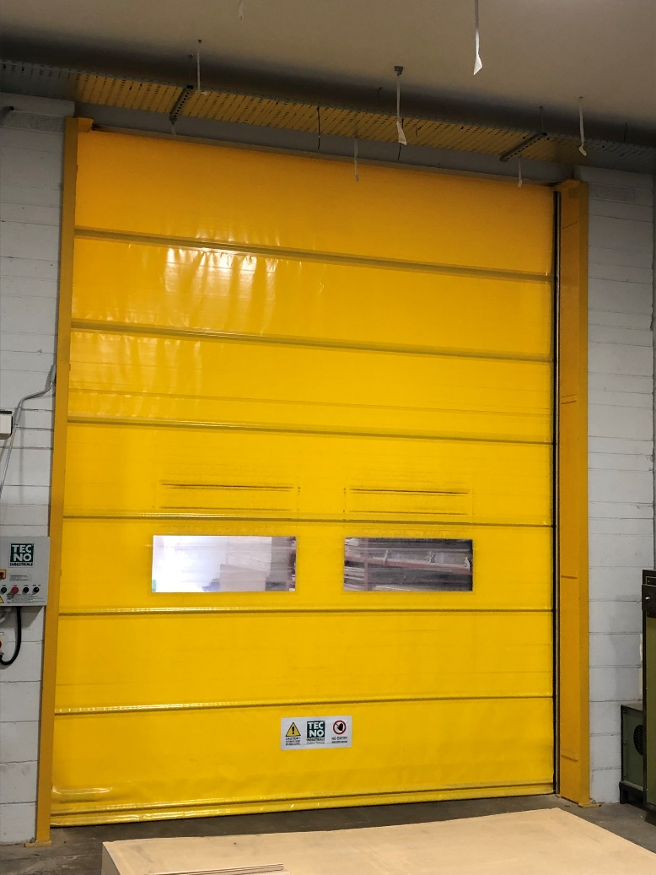
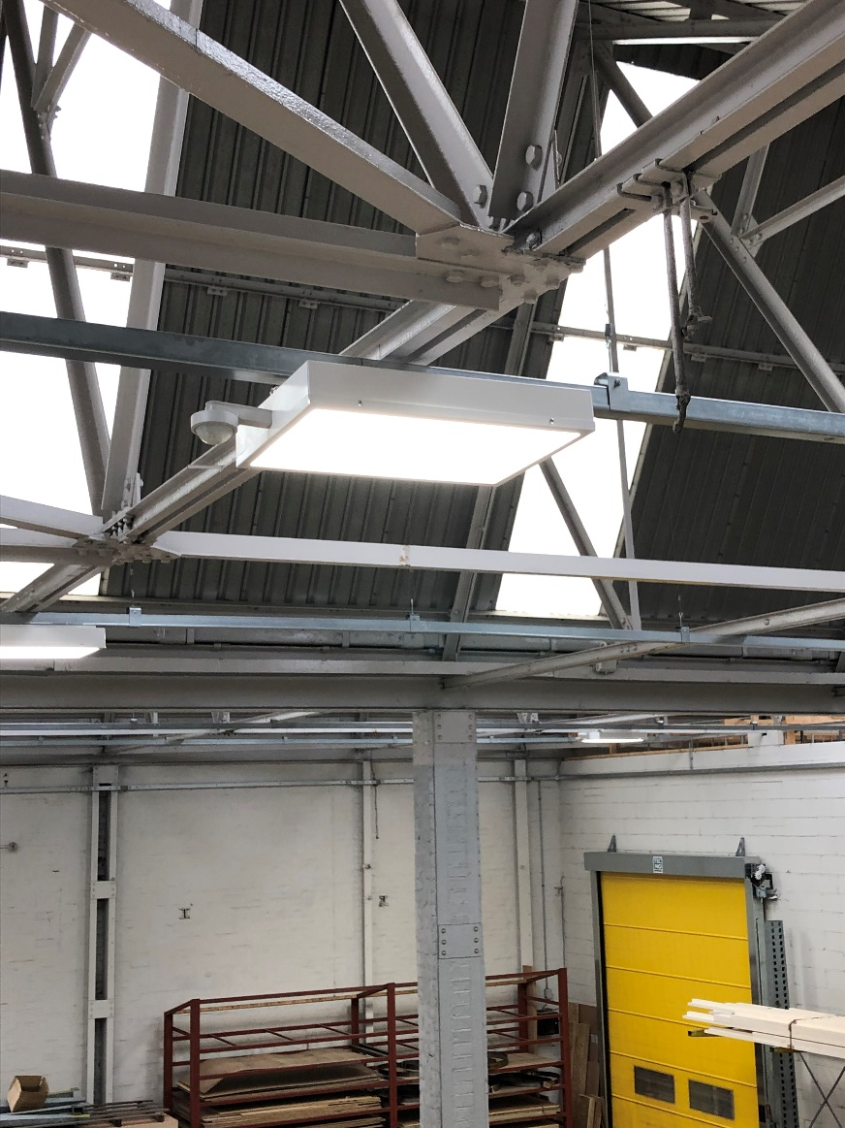
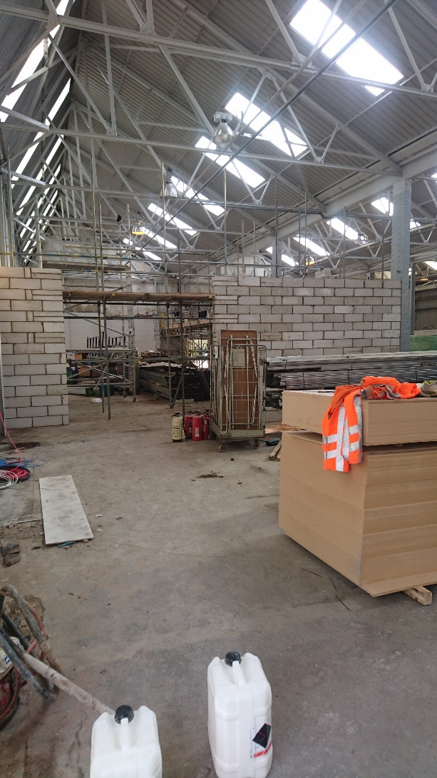
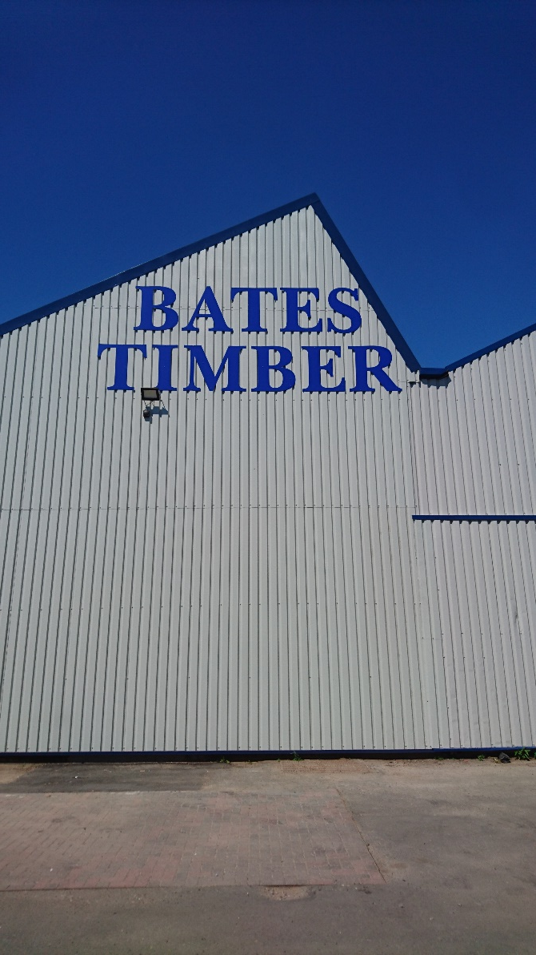
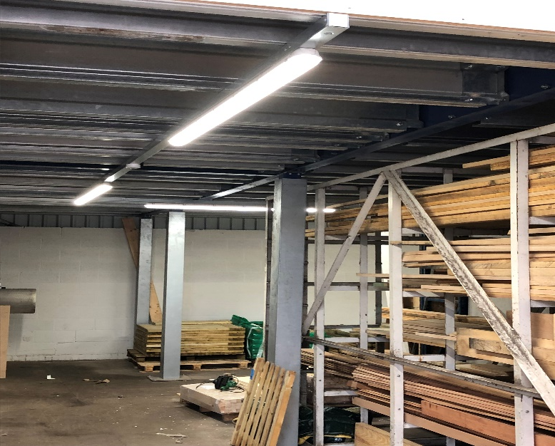
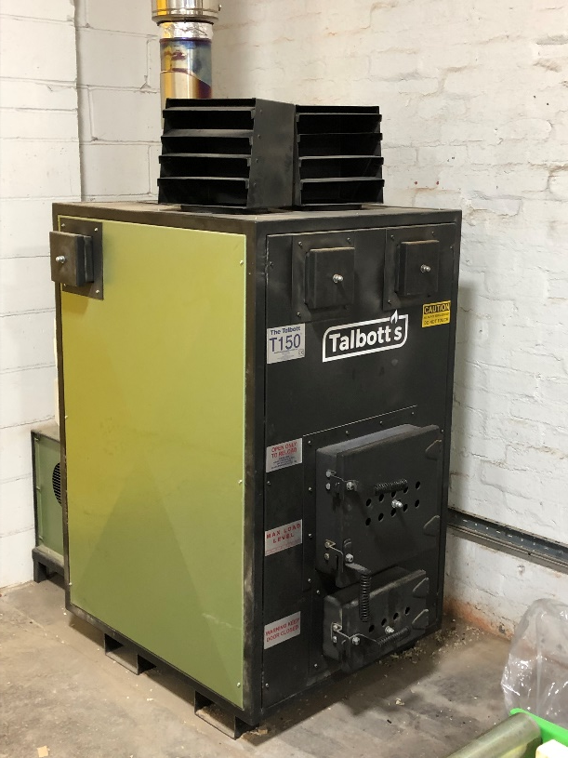
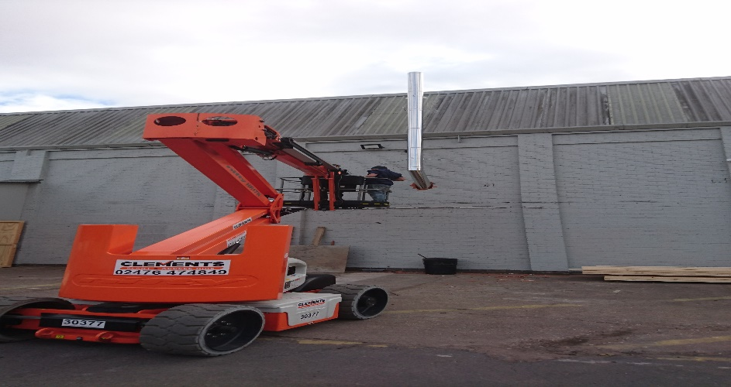
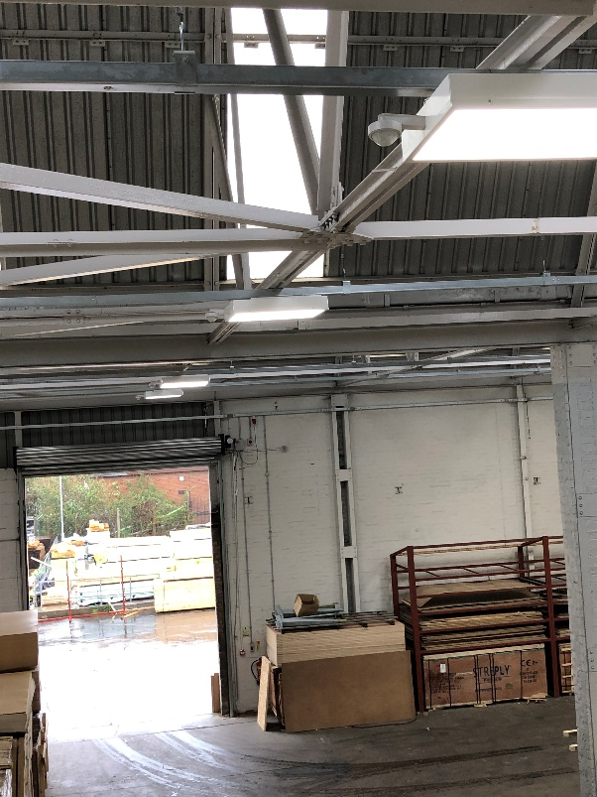

Slide 27
Embedding sustainability
Changing behaviours
Sarah Watson

Slide 28
  Using resources wisely. Not wasting energy and water. Eliminating waste. Reusing materials and recycling. Buying local. Caring for the environment.
Embedding sustainability
There is no ‘one size fits all’ model when it comes to embedding sustainability.
To really embed sustainability – to be an organisation which people are proud to work for and want buy from – there are a few things you need to think about and put in place. What are your key drivers for embedding sustainability? Who already gets it and who still needs to be convinced?
Changing behaviours

Slide 29
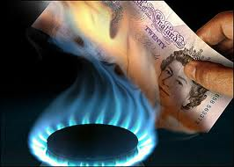




Why focus on sustainability and behaviour change ?
Rising cost of energy, water and waste
Carbon footprint
Wasting resources and money
PR
We only have one planet
Save 10% on energy costs
It’s free!
Makes business sense
The new normal
Notes:
The Carbon Trust has over a decade of experience in helping thousands of public and private sector organisations to cut carbon and become more sustainable. This experience suggests that with an investment of between 1-2% of energy spend in an effective employee engagement campaign, many organisations can save up to 10% on energy costs. Behaviour

Slide 30

Notes:
https://www.youtube.com/watch?NR=1&v=BMgv011VBh0&feature=endscreen

Slide 31
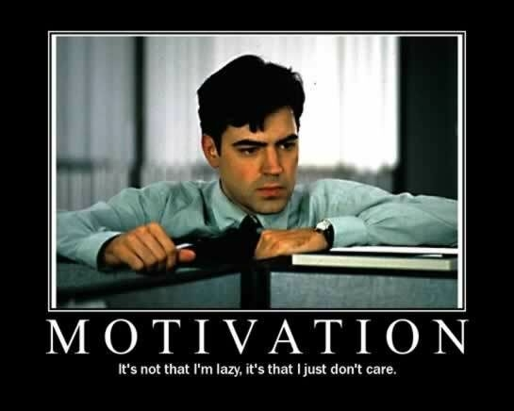
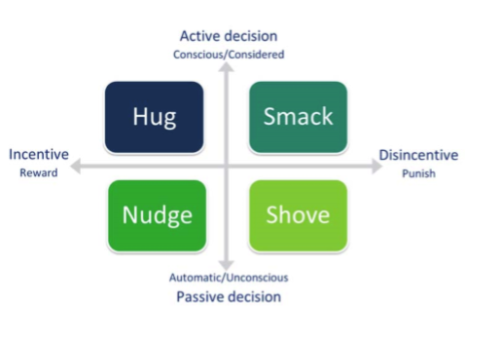

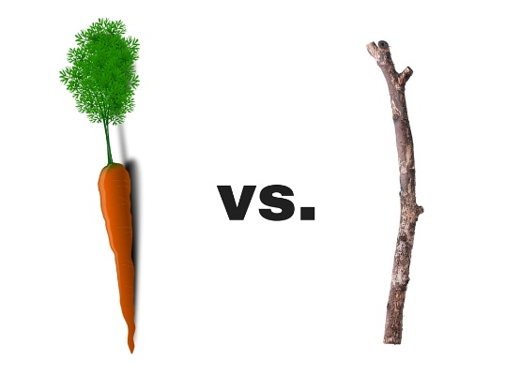
What behavioural change approach?
Need to understand why people do things the way they do – motivations.
Approach
Using a combination of factors that focus not only on the individual but also collective, the culture, environment and what motivates people.
Notes:
Problem - people are complex and everyone is different
Numerous studies, theories and models
Not everyone is interested in Climate Change
Communications and information alone are not enough

Slide 32
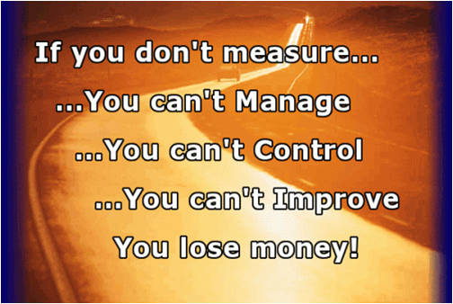


Top tips for building an effective campaign
You can’t manage what you can’t measure. Understand where energy is being consumed. Where is waste coming from? What and how much is being thrown away.
Prioritise the behaviours you want to change. Start with biggest impact first or what is easiest.
Decide what goals you are actually trying to achieve, so that you can actively monitor performance and feedback on results.
Motivation. Find out what is important to your staff and how they think, behave and interact with the building, technology and others around them. Make it easy and fun.
Senior leadership and support is key to unlock resources
Notes:
Top tips for building an effective campaign
You can’t manage what you can’t measure. Understand where energy is being consumed. Where is waste coming from? What and how much is being thrown away. Are there better ways of doing things?
Prioritise the behaviours you want to change. Start with biggest impact first or what is easiest.
Decide what goals you are actually trying to achieve, so that you can actively monitor performance and feedback on results.
Find out what motivates or what doesn’t motivate. Find out what is important to your staff and how they think, behave and interact with the building, technology and others around them. Make it easy and fun.
Senior leadership and support is key to unlock resources

Slide 33
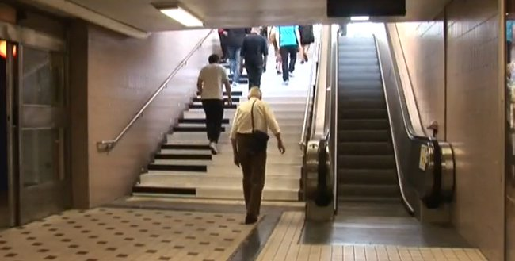
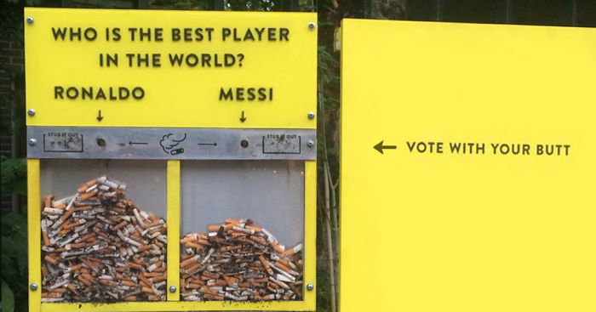
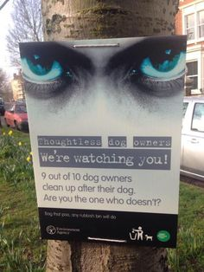
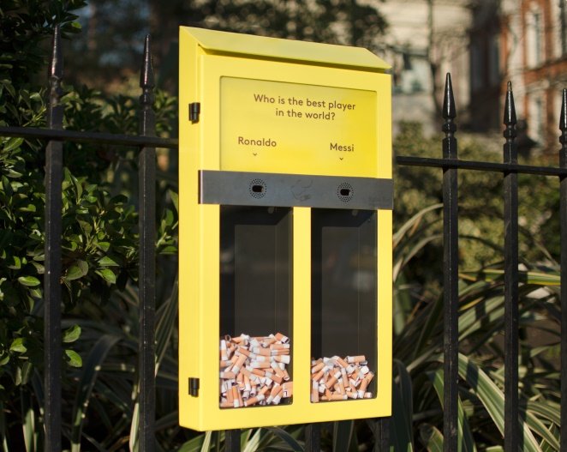
Examples that have changed behaviours

Slide 34



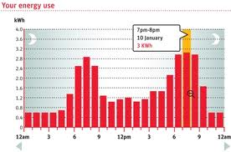



Embedding behavioural change CCC - framework
Lead from the top
  Simply cannot afford to be wasting money
  Taking no action is not an option
Integrated like H&S
Infrastructure – audits, premises meetings
Training
Job descriptions, competency framework
Lead by example – all senior managers
Support
People - Green Champions

Slide 35


Green Champions is a network of people throughout the Council who lead by example and encourage others to reduce our energy use, water and waste, in addition to promoting green travel options and using resources wisely.

Slide 36


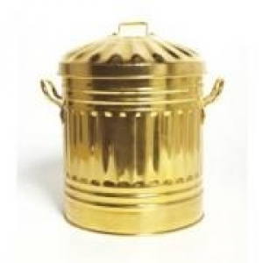

The power of competition – case study
Motivation and reward
Most people are naturally competitive
Competition between teams
Rewards Green Champion and the team
Ownership – set up local initiatives
Recognition and thanks
Tangible
Fun
Guess the trophy...
Notes:
FIFA World Cup Trophy (every 4 years)
The Wimbledon Championship Trophy – gentlemen's singles tennis champion (annually)
Webb Ellis Cup – Rugby World cup (every 4 years)
Golden Bin Trophy

Slide 38
Best team win the coveted Golden Bin
Green Champion - local ownership
  Paper cups
  Local café on board
  Composting
  Other recycling
  Tea towels
  Craft materials
  Making own bags
  Packaging returned
Results announced quarterly
High level thanks & recognition – Director level

Slide 39




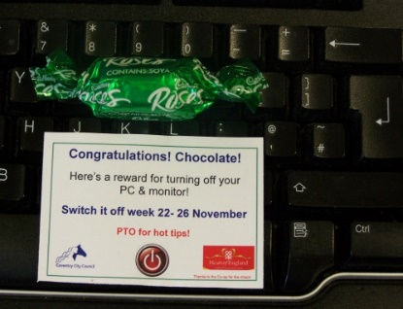


Slide 40
Key messages
Support from the top
Need to understand why people do things the way they do – motivations
You can’t manage what you can’t measure - report
Local led – Green Champions
Empowerment – ideas (ask)
Don’t always need a big budget
Use what you have already
Make it easy to change behaviours
The power of competition
Thanks, recognition and reward

Slide 41
Going Green: the benefits for your business
Pro Enviro Limited
  Steve Stones, Pro Enviro Ltd 9 April 2019

Slide 42
Outline
Business Case for Energy Efficiency
Measuring, Monitoring and Managing Energy Use
Practical Advice
Case Studies

Slide 43
The Business Case
Financial incentives
10 – 30% savings in your annual energy costs.
Improve your bottom line
20% cut in energy costs represents the same bottom line benefits as 5% increase in sales / turnover in many businesses.
Improve your image
External clients.
Employees.

Slide 44
The Business Case
Energy Prices continue to rise – 15% to 20% in last six months and currently forecast to rise further.
Energy taxes rising – Climate Change Levy rose by 50% in April 2019.
Focus on sustainable supply chains and reducing “Carbon Footprint” – Energy is often the largest element of an organisations Carbon Footprint.

Slide 45
Measuring, Monitoring and Managing Energy Use

Slide 46
Where do you start
You have to start with meaningful data.
This is not the cost of energy but the level of consumption – measure the kWh.
Data can come from a number of sources:
  Bills
  Main meters
  Sub meters

Slide 47
Where do you start
Compare the consumption against something relevant:
  Production volumes
  Running hours
  External temperatures

Slide 48
Energy Bills
Energy bills can give you a start point but there is limited detail on many bills:
  Days / nights
  Beware of estimates
  Variable time periods in months and different numbers of working days

Slide 49
Half Hourly Meter
Many companies are being moved on to half hourly meters. When you are – make the most of the data.
  Half hour intervals
  Data can be viewed in many different ways
  Provides a good overview of patterns of consumption

Slide 50
Electricity Consumption

Slide 51
Electricity Consumption

Slide 52
Electricity Consumption

Slide 53
Half Hourly Data
Can show unexpected anomalies in patterns.
Only shows the whole site so if there is a lot going on then it does not show the detail.
If you do not have the data you can sub meter the supply for a period to obtain a snap shot of consumption.
How do you improve on the data?
  Progress to sub metering at a lower level

Slide 54
Sub Metering

Slide 55
Press 33

Slide 56
Traditional Heating Pattern
Heating consumption traditionally taken from bills. What does this tell us?

Slide 57
Heating
How do we compare one year to another when winter periods or heating seasons can be so different each year?
We compare the heating consumption to local degree days.

Slide 58
Heating Pattern Compared Against External Temperatures

Slide 59
Summary
If you want to implement energy efficiency measures you need to understand what is currently happening and identify the waste.
  Lighting
  Space heating
  Process heating
  Compressed air
  Motors
  Refrigeration

Slide 60
Summary
The measurement can then be done again after the improvements have been made and the impact of the changes can be seen.

Slide 61
Improvement Activities
LED Lighting.
Motion and daylight sensors – potential 80% savings.
Temperature controls on heating systems – a 1 degree reduction can reduce heating costs by 8%.
Timers to restrict out of hours consumption e.g. water heaters.
Ensure that boilers are serviced and replaced when appropriate.

Slide 62
Improvement Activities
Temperature settings on process heating and chilling; establish optimum temperatures by controlled experiments.
Monitor heat up periods prior to start of production.

Slide 63
Equipment Heat Up Periods

Slide 64
Improvement Activities
Compressed Air leaks – a small leak can cost over £700 per year if not repaired. Recent survey identified 38 leaks with an estimated annual cost of over £5,000.
Variable speed v fixed speed compressors.
Variable speed motors / invertors – reducing the speed of motors can reduce energy consumption by 50%.
Match the load on the equipment to the requirements of the business.

Slide 65
Case Studies

Slide 66
Case Study – Gas Usage

Slide 67
Case Study – Gas Usage
Process gas usage should be no more than 180,000 kWh/yr.
Process and space heating gas consumptions separated for the first time.
Process gas usage was 240,000 kWh/yr – much higher than expected.
Energy Action Plan set target for reduction in process gas usage of 60,000 kWh/yr.
In this case, target achieved by insulation of a small furnace.
Savings of £2,000/yr.

Slide 68
Case Study – LED Lighting
Current System 222 Lights:
  Energy Cost: £24,240 pa
  Carbon Cost: 123.5 CO2e tonnes pa
  Power: 39 kW
Recommended System 232 Lights:
  Energy Cost: £8,030 pa
  Carbon Cost: 41 CO2e tonnes pa
  Power: 12.7 kW

Slide 69
Case Study – LED Lighting
Savings:
  Energy Savings: £16,210 pa
  Carbon Savings: 82.5 CO2e tonnes pa
  Power Reduction: 26.3 kW
  67% reduction in energy consumption and costs
  Reduced maintenance and replacement costs
  Significant improvement in quality of lighting

Slide 70
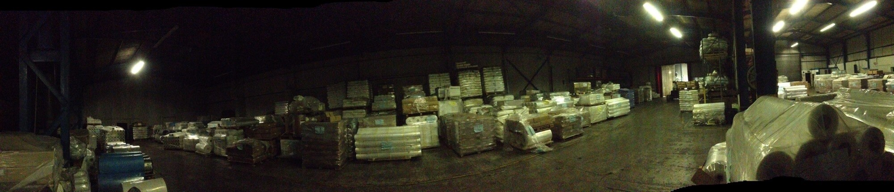
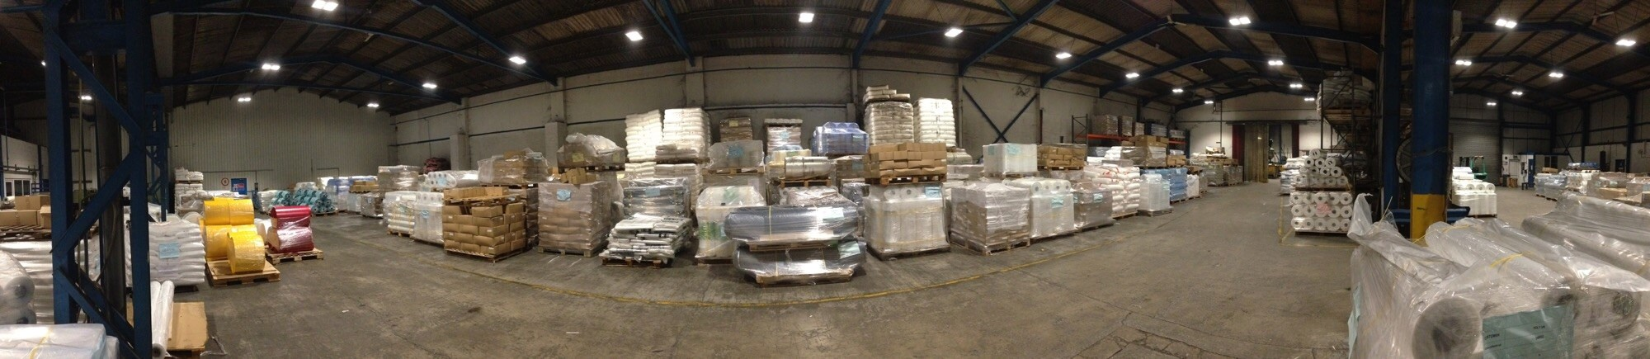
Case Study – LED Lighting

Slide 71
Questions / Discussion
  Steve Stones
  Pro Enviro Ltd
  www.proenviro.co.uk

