Slide 1



Before you start
Growing Careers for Positive Change
Home-learning KS4 lesson 2: Making a difference
To start, play this slideshow from beginning
Adapted for home learning with kind permission from the Environment Agency

Slide 2

Home learning KS4 lesson 2:
Making a difference

Slide 3



  We are learning:
  about how people can make a difference through their career choices.
  We will be able to:
  explain how and why people select organisations to work with that align with their values.
  explain how people’s career choices can help make a difference to the things that matter to them.

Slide 4
Need help? Click here for some examples
A few examples of what you might consider to be important could include:
A sense of community or a friendly workplace
Sharing similar values
Good pay
A job that people admire or respect
Opportunities to learn or develop skills
A role that helps to protect the environment
Opportunities to change people’s live for the better
What do you think are the three most important things to think about when choosing a career or job?
Write this down and keep it safe!
You will be returning to it at the end of the lesson.
Notes:
A few examples of what you might consider to be important could include:
A sense of community or a friendly workplace
Sharing similar values
Good pay
A job that people admire or respect
Opportunities to learn or develop skills
A role that helps to protect the environment
Opportunities to change people’s live for the better

Slide 5
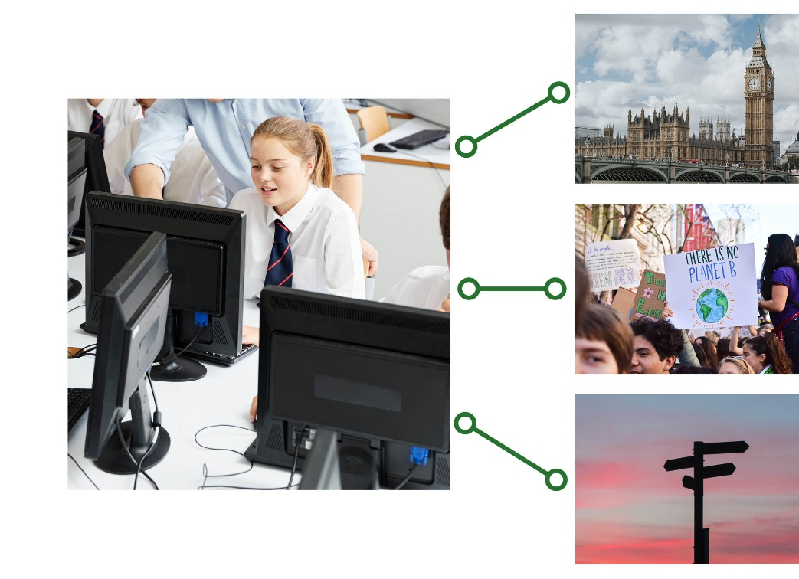
Motivation and wellbeing
Read the next slide and consider the following questions:
How might Erika’s feelings and actions differ between lessons she doesn’t want to take at GCSE and those she could do well in?
What advice do you have for Erika around the subjects she is less interested in?
What implications does this have for Erika when considering a career direction and applying for jobs?

Slide 6
Motivation and wellbeing
Erika has just started Year 9 and she wants people to know more about what is happening with the climate. She isn’t sure what to do as a career, and this means she is finding it hard to choose her options subjects for GCSE.
Erika feels like she does really well in English, so she spoke to her English teacher about her ambitions. She also spoke to her Science teacher about how she feels about the climate. Her teachers discussed careers with her for a short while and now Erika thinks that she might like to go into politics, so that she can help generate change.
Erika has decided to take Citizenship and Geography as GCSE subjects, but she knows she’s going to have to continue all of her current subjects for another year. This includes Music and Computer Science which Erika doesn’t like as much. She’s not sure how either of these subjects will help her become a politician!

Slide 7
Click on each question to reveal what Erika may need to consider about her lessons and career decisions
How might Erika’s feelings and actions differ between lessons she doesn’t want to take at GCSE and those she could do well in?
Erika may find that she produces work of a higher standard in subjects she prefers. She might feel that she has the skills to do well in these lessons.
Erika should consider that she may have several careers in her life, she may want to keep her options open as subjects that feel ‘less useful’ now may become more important in the future. Erika may also learn useful skills in one subject that can help in others.
If Erika enjoys a particular subject she might want to consider related careers. However, she may also want to consider topics that are not studied at GCSE, but that are available after she leaves high school. For example, she may choose to study politics in college.
What advice do you have for Erika around the subjects she is less interested in?
What implications does this have for Erika when considering a career direction and applying for jobs?
Notes:
How might Erika’s feelings and actions differ between lessons she doesn’t want to take at GCSE and those she could do well in?
Erika may find that she produces work of a higher standard in subjects she prefers. She might feel that she has the skills to do well in these lessons.
What advice do you have for Erika around the subjects she is less interested in?
Erika should consider that she may have several careers in her life, she may want to keep her options open as subjects that feel ‘less useful’ now may become more important in the future. Erika may also learn useful skills in one subject that can help in others.
What implications does this have for Erika when considering a career direction and applying for jobs?
If Erika enjoys a particular subject she might want to consider related careers. However, she may also want to consider topics that are not studied at GCSE, but that are available after she leaves high school. For example, she may choose to study politics in college.

Slide 8
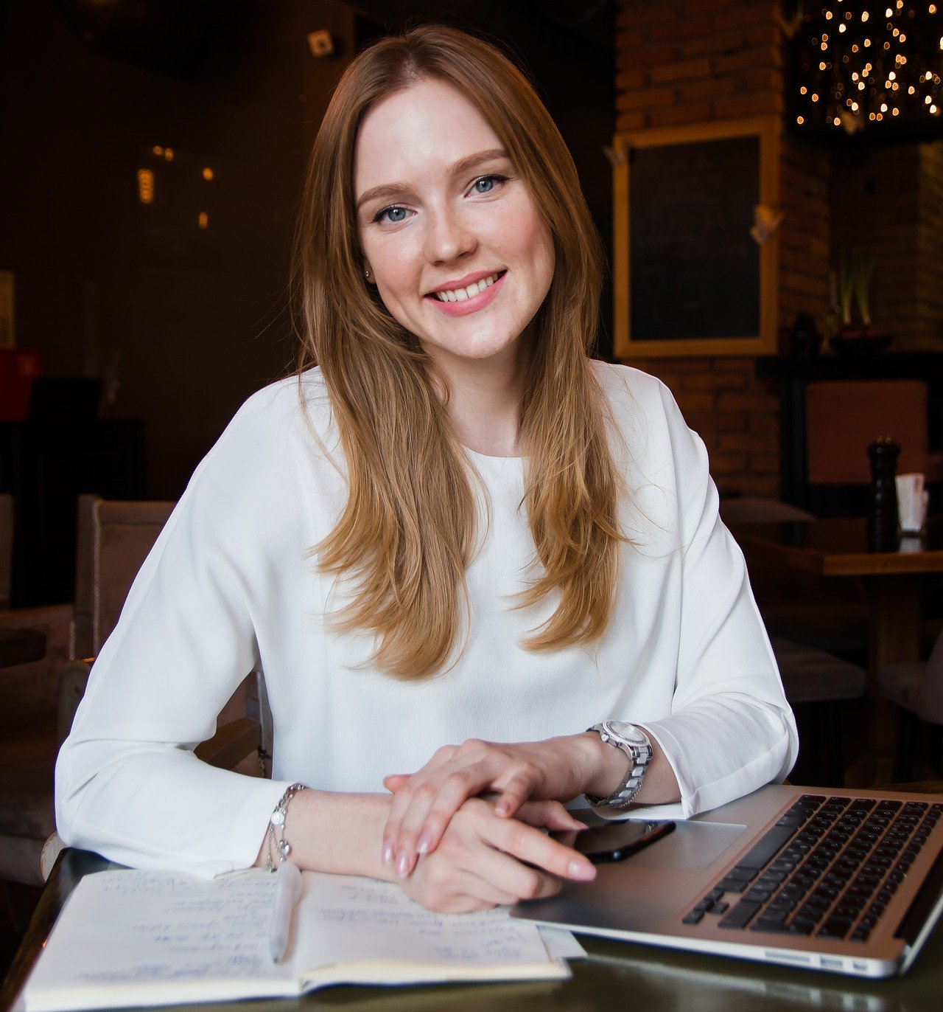
Organisations and values
We know that people hold a variety of values as individuals, but people in communities and organisations can hold shared values too. Sometimes when we share values, we feel more motivated and positive about our work.
Can you think of any values you share with an organisation or community?
For example, your school’s values, religious values or the values of a sports club you belong to?
Nina has just graduated from university and is looking to start her career. Read the mission statements on the next slide and decide which organisation you think would be a good fit for Nina.
Nina
Nina has recently finished a Business degree. She’s looking forward to making some new friendships in her a new workplace.
Nina enjoyed the sense of community she experienced while volunteering in her university’s student union. She regularly helped with volunteering opportunities, especially those that included helping to provide learning opportunities for young people.
Click the picture
Notes:
Nina
Nina has recently finished a Business degree. She’s looking forward to making some new friendships in her a new workplace.
Nina enjoyed the sense of community she experienced while volunteering in her university’s student union. She regularly helped with volunteering opportunities, especially those that included helping to provide learning opportunities for young people.

Slide 9




Click each organisation to learn about their values
Keen Ideas
Our mission is to create a global community that allows people to meet and share their experiences.
We believe that a more connected world is a kinder world. Big thinking works better together.
We embrace diversity and work to ensure that everyone who works with us has equal opportunity to excel in their career.
Fantastic Child
At fantastic child we believe that everyone should be given the chance to succeed.
That’s why we work to provide those children who are less fortunate with all of the support and essential items they need to thrive in their studies.
We do this by connecting communities in need with those who have more resources.
Sustainabelle
At Sustainabelle we produce eco-friendly fashionwear. We feel looking good shouldn’t cost the Earth, and that people should be at the centre of business – that’s why
everything we produce is Fair Trade and made from sustainable materials.
We provide the very best in quality and sustainability without compromising on style. Our products are the ultimate symbols of creativity, innovation and fashion.
Nutrious.ly
Nutrious.ly was set up to help people to eat nutrient-rich, delicious food every day. We work with local farmers across the UK to deliver boxes of organic produce to the
doorstep of our customers.
We think that food brings families together, and that dinner is a time to celebrate. We want to share our success, so for every food box ordered in the UK, we send one to a country in need.
Notes:
Keen Ideas
Our mission is to create a global community that allows people to meet and share their experiences.
We believe that a more connected world is a kinder world. Big thinking works better together.
We embrace diversity and work to ensure that everyone who works with us has equal opportunity to excel in their career.
Sustainabelle
At Sustainabelle we produce eco-friendly fashionwear. We feel looking good shouldn’t cost the Earth, and that people should be at the centre of business – that’s why
everything we produce is Fair Trade and made from sustainable materials.
We provide the very best in quality and sustainability without compromising on style. Our products are the ultimate symbols of creativity, innovation and fashion.
Fantastic Child
At fantastic child we believe that everyone should be given the chance to succeed.
That’s why we work to provide those children who are less fortunate with all of the support and essential items they need to thrive in their studies.
We do this by connecting communities in need with those who have more resources.
Nutrious.ly
Nutrious.ly was set up to help people to eat nutrient-rich, delicious food every day. We work with local farmers across the UK to deliver boxes of organic produce to the
doorstep of our customers.
We think that food brings families together, and that dinner is a time to celebrate. We want to share our success, so for every food box ordered in the UK, we send one to a country in need.

Slide 10
Organisations, values and motivation:
People might find that they feel more motivated working in an organisation that has values that they agree with, or find that they make lasting friendships with colleagues that share their values.
However, it’s not always possible to find a job at an organisation that aligns with a persons value’s exactly. Sometimes gaining experience in another organisation can be a good stepping stone.
Shared values are one of a number of considerations people have when looking for a job. For example, they will also need to consider:
  Whether they have the right skills for the job
  If the money they will be paid meets their needs

Slide 11
If you want an extra challenge, choose one of the characters you met last time and decide which organisation would be the best fit for them.
Billy
Since having children, Billy has been more aware of the need to keep the planet safe for future generations.
Billy currently has a job mapping the oceans, but he has been offered a higher pay by an oil company which he could use to buy a bigger house.
Nicola is a fitness vlogger and often makes vlogs with other people who have similar interests. She is a popular person and enjoys working with others.
Nicola’s friend has just won an award for their vlogs. Nicola feels happy for her friend, but wonders if she should have an award too.
Nicola
Eli
Sabina
Eli has worked hard to get a job designing luxury cars. His family are very proud of him and he likes being able to donate to environmental charities.
Eli’s doing really well in his job. He wonders if he should continue doing what he’s good at, or if he should look for something more challenging.
Sabina volunteers in after school clubs with lots of sports and activities to help children who have moved to the UK make new friends.
Sabina can’t decide on her next step, should she start a research degree about migration or become a teacher?
Notes:
Billy
Since having children, Billy has been more aware of the need to keep the planet safe for future generations.
Billy currently has a job mapping the oceans, but he has been offered a higher pay by an oil company which he could use to buy a bigger house.
Eli
Eli has worked hard to get a job designing luxury cars. His family are very proud of him and he likes being able to donate to environmental charities.
Eli’s doing really well in his job. He wonders if he should continue doing what he’s good at, or if he should look for something more challenging.
Nicola
Nicola is a fitness vlogger and often makes vlogs with other people who have similar interests. She is a popular person and enjoys working with others.
Nicola’s friend has just won an award for their vlogs. Nicola feels happy for her friend, but wonders if she should have an award too.
Sabina
Sabina volunteers in after school clubs with lots of sports and activities to help children who have moved to the UK make new friends.
Sabina can’t decide on her next step, should she start a research degree about migration or become a teacher?

Slide 12
Need help?
Click here for some examples
A few examples of values you might expect could include:
A sense of community within the organisation
Helping the wider community outside the organisation
Helping employees to learn and develop their skills
Helping to support employees health and wellbeing
Helping to protect the environment or reduce waste
Personal reflection
A few examples of values you might expect could include:
A sense of community within the organisation
Helping the wider community outside the organisation
Helping employees to learn and develop their skills
Helping to support employees health and wellbeing
Helping to protect the environment or reduce waste
We have explored how these values can be shared with an organisation.
What values would you expect, or look for, in an organisation you would want to work for?
Notes:
A few examples of values you might expect could include:
A sense of community within the organisation
Helping the wider community outside the organisation
Helping employees to learn and develop their skills
Helping to support employees health and wellbeing
Helping to protect the environment or reduce waste

Slide 13
Career case studies.
On the next slide, choose and read one of the three career case studies.
Try to answer the following questions about the case study you have chosen:
How have they gained skills or knowledge to help them feel confident?
How do they feel connected to their local community or the wider world?

Slide 14
Career case studies
Click to reveal some of the ways each person has gained skills or knowledge and how they feel connected to others.
Susanna has gained knowledge and skills from:
Her degree in Marine Biology
Her volunteering experience which is relevant to her chosen career path
Susanna feels connected to others in her job because:
She regularly works with new people
Susanna
In my job I help to manage coastal areas. Before joining the Environment Agency I completed a degree in Marine Biology and volunteered on a research project investigating the effects of tourist boats on the behaviour of dolphins.
I always encourage people to volunteer as much as possible to get experience.
I am constantly working with new people. I love working with them to figure out sustainable solutions to a wide variety of complex challenges.
Yianni has gained knowledge and skills from:
His degree in Civil Engineering
Asking questions to more experienced team members in new roles
Yianni feels connected to others in his job because:
He interacts with others when asking questions
He sees the impact of the organisations work on different communities
Yianni
I recently completed a degree in Civil Engineering (designing and constructing buildings, bridges etc.) I am now part of the Environment Agency graduate scheme so I am trying out different roles within the agency.
When I am in a new role I make sure to ask questions so I can improve my understanding of that area and feel more confident. The best part of the job has been seeing the effects of our work on different communities around the country.
Faye
I have been working for the Environment Agency for a couple of years now and I have been involved in a range of different projects. I’ve been taking on more responsibility over time, from working as part of a team when I first started to taking more lead roles in projects now.
I am currently working with a colleague to find out what kind of plants are growing in a local river. This helps to prevent these plants from overgrowing which causes flooding and can be really difficult for the local community.
Faye has gained knowledge and skills from:
The range of projects she has been involved in
Her experience in taking on a little more leadership responsibility in each project
Faye feels connected to others in her job because:
She regularly works closely with colleagues in teams or pairs
She knows how important her work is to helping the local community.
Notes:
Susanna
Susanna has gained knowledge and skills from:
Her degree in Marine Biology
Her volunteering experience which is relevant to her chosen career path
Susanna feels connected to others in her job because:
She regularly works with new people
Yianni
Yianni has gained knowledge and skills from:
His degree in Civil Engineering
Asking questions to more experienced team members in new roles
Yianni feels connected to others in his job because:
He interacts with others when asking questions
He sees the impact of the organisations work on different communities
Faye
Faye has gained knowledge and skills from:
The range of projects she has been involved in
Her experience in taking on a little more leadership responsibility in each project
Faye feels connected to others in her job because:
She regularly works closely with colleagues in teams or pairs
She knows how important her work is to helping the local community.

Slide 15
Looking back at your list of important factors when choosing a job, has anything changed?
Can you explain your choices in more detail?
Need help?
Click here for some examples
A few examples of what you might consider to be important could include:
A sense of community or a friendly workplace
Sharing similar values
Good pay
A job that people admire or respect
Opportunities to learn or develop skills
A role that helps to protect the environment
Opportunities to change people’s live for the better
What do you think are the three most important things to think about when choosing a career or job?
Notes:
A few examples of what you might consider to be important could include:
A sense of community or a friendly workplace
Sharing similar values
Good pay
A job that people admire or respect
Opportunities to learn or develop skills
A role that helps to protect the environment
Opportunities to change people’s live for the better

Slide 16


Support
If you have questions or concerns about topics explored here, you can always speak to your parent or carer, or contact a teacher in school for more advice and support.
There are lots of places to get advice about career pathways:
For information, advice and guidance about a wide range of careers and education pathways, visit the national careers service.
nationalcareers.service.gov.uk
For information, advice and guidance about career options should you choose to go to university, visit prospects.
www.prospects.ac.uk

