Slide 1
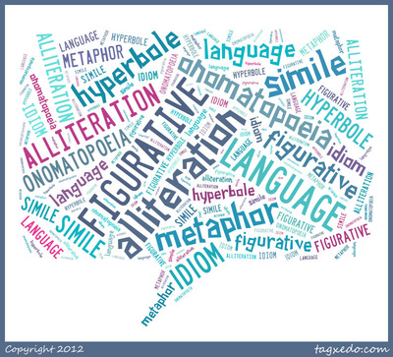
Work for English
It is essential for students to be able to identify and use a range of language devices when studying English. The following tasks will enable you to create some resources that will help support your learning next year.

Slide 2
Language devices
Devices |  | Devices
A | Alliteration, Anecdote | R | Repetition
F | Facts, Flattery | A | Alliteration
O | Opinion | S | Simile
R | Rhetorical Question, repetition | M | Metaphor
E | Emotive language, Exaggeration | O | Onomatopoeia
S | Statistics, Second Person Pronoun | P | Personification
T | Triples | S | Sibilance
But also: Imperatives, Nouns, Verbs, Adjectives, Pronouns
Notes:
Go over the importance of knowing devices ready for next term. Important for reading and writing task – Language and Literature.

Slide 3
AFOREST or RASMOPS!
The hungry horse hurried home.
Today is Wednesday.
The poppies danced in the fresh morning air.
The trees were as still as the grave
The man raced towards the exit.
Snap! Crackle! Pop!
Susie was tired, so tired.
Is it really fair to expect people to lockdown for 3 months?
English is boring
30% of people ignored the lockdown rules.
It is ridiculous to ignore the government warnings about social distancing.
The sly snake silently slithered towards its victim.

Slide 4
Firstly …..
1. Go to BBC Bitesize https://www.bbc.co.uk/bitesize/guides/zx7cmnb/revision/1
This will go through the important language devices for you.
Have a play on some of these games to test your knowledge:
https://wordwall.net/resource/2160359/english/aforest-language-devices-persuasion
https://wordwall.net/resource/50596/english/language-techniques
https://quizlet.com/51115761/literary-devices-flash-cards/

Slide 5
3. Create a mnemonic (memory cards) or a game, quiz, activity to test students’ understanding of language devices.
You will need to find the definition of each device and create your own examples.
Ensure you include all of the devices in the orange boxes. The devices in the blue and grey boxes are also important so include them if you can.
You could:
Create a poster for AFOREST and RASMOPS
Create memory cards for each device. When you bring them to school I will laminate them and you can use them for reference in lessons.
Create a quiz to test students – perhaps a true/false quiz – remember you need to include the answers.
Make a crossword – you will need to create your own clues and grid. Use this website: http://puzzlemaker.discoveryeducation.com/CrissCrossSetupForm.asp
Create a Wordsearch. http://puzzlemaker.discoveryeducation.com/WordSearchSetupForm.asp

Slide 6
Remember to group devices – AFOREST + imperatives, pronouns, verbs, nouns, adjectives, adverbs for non-fiction texts.
Alliteration | Second person pronoun | adverbs
Facts | Triples | adverbs
Opinions | Emotive language | verbs
Repetition | Exaggeration | adjectives
Rhetorical Question | Flattery
Statistics | Imperative

Slide 7
RASMOPS + – descriptive devices for creative writing and analysis.
Repetition | Personification | imagery | tone
Alliteration | Sibilance | symbolism | flashback
Similes | rhyme | foreshadowing | protagonist
Metaphors | Pathetic fallacy | Idiom
Onomatopoeia | irony | mood

Slide 8
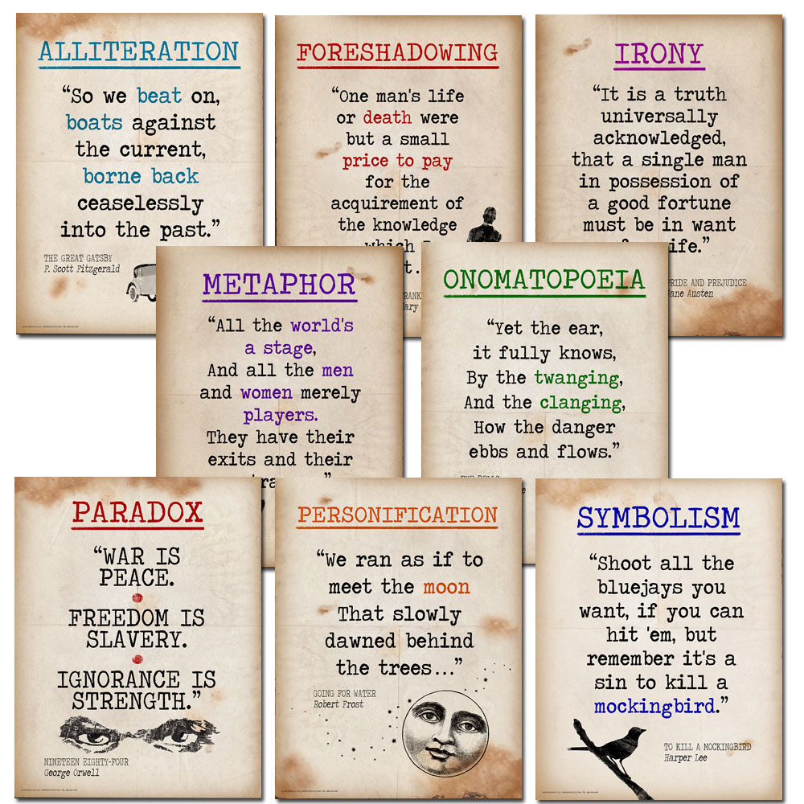
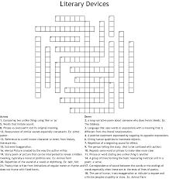
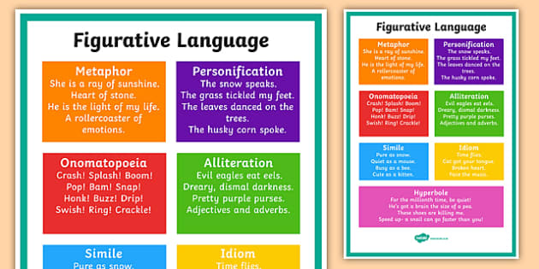

Slide 9
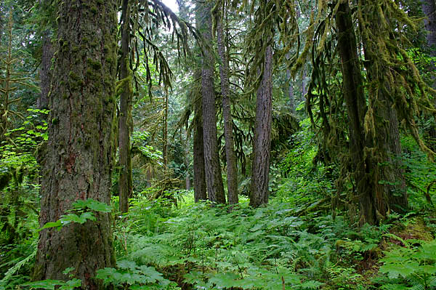
Stuck?
AFOREST
ALLITERATION/ ANECDOTE
FACTS
OPINION
REPETITION/
RHETORICAL QUESTION
EMOTIVE LANGUAGE/EXAGGERATION
STATISTICS/
SECOND PERSON PRONOUN
TRIPLES
But also: Imperatives, personal pronouns,

Slide 10
Stuck?
RASMOPS

