Slide 1
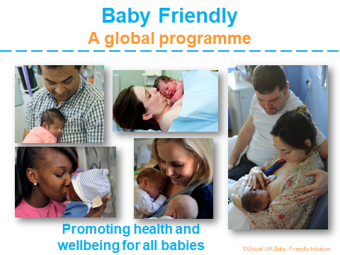
Breastfeeding

Slide 2
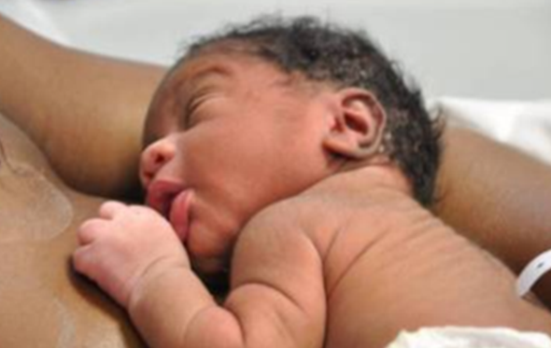
Breastmilk is so much more then FOOD!
Benefits
Closeness
Relationship building
Oxytocin
Brain development
Microbiomes

Slide 4
Breastmilk is not just anout FOOD it is so much more

Slide 5
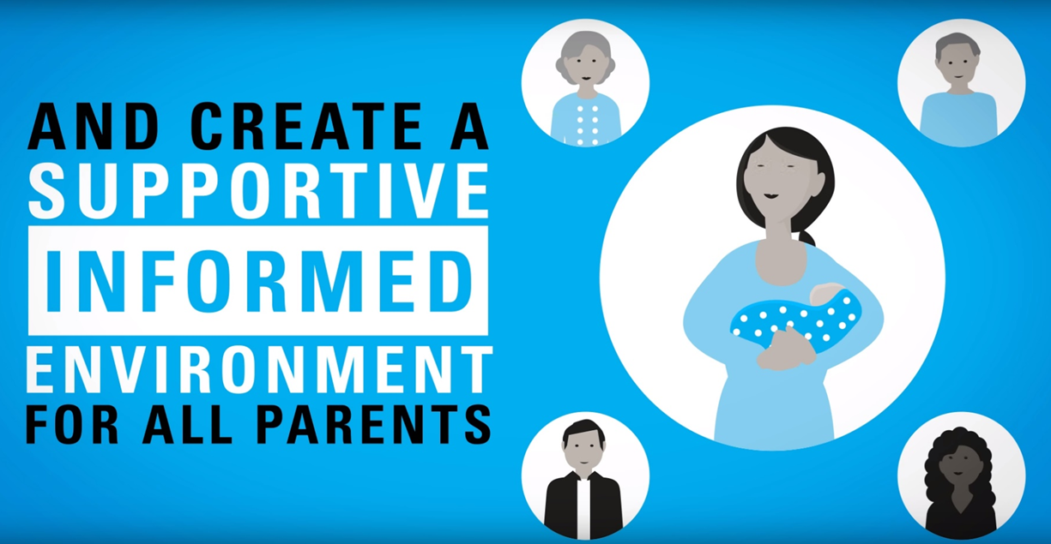

Slide 10
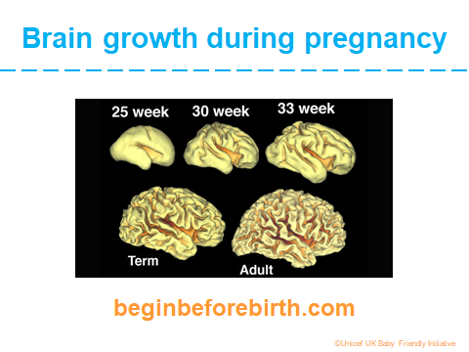

Slide 12
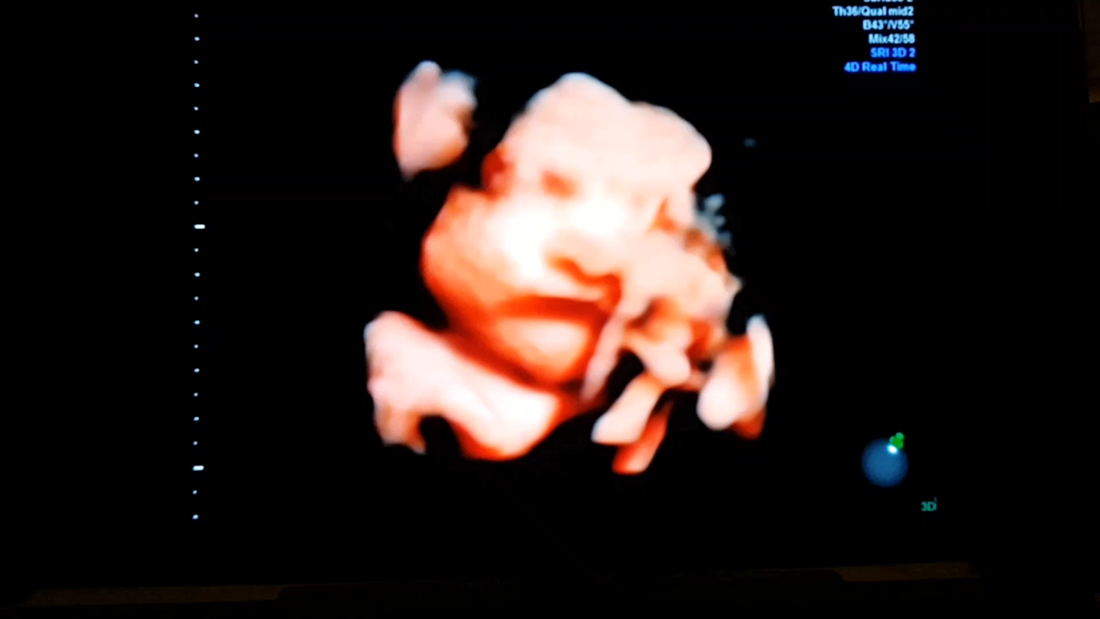
Experiences in utero

Slide 13
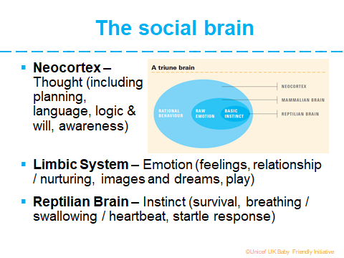

Slide 16
The Hormone of love and closeness

Slide 19
At least 2 amazing events happen during childbirth

