Slide 1
Online Safety

Slide 2
Expectations and Agenda
By the end of the workshop you should feel more equipped to:
Be aware of the prevalence of concerns around online safety and what risks are posed
Be aware of the pressures of social media
Image sharing and the law
Open a discussion with a young person around their online activity
Action a concern
To ensure that this is a comfortable learning experience for everyone; can we please…
Keep your microphones and videos turned off
Use the chat facility to ask questions throughout. A Q&A will be available at the end. All questions are valid- we don’t know what we don’t know!
Be sensitive to the topics being covered

Slide 3
Young people & being online
Research by the UK Safer Internet Centre (2019) captured current views of being active online and highlights how important being online is to young people.
65%of young people say they would feel disconnected from the world if they couldn’t be online.
67% of young people say it’s easier to learn, understand and navigate topics they’re nervous to ask about in the online space.
48%of young people say being online makes them feel like their voices and actions matter.
Almost half (48%) admit their peers don’t always think before they post.
36% of young people are sharing screenshots of other peoples’ photos, comments or messages at least weekly.
Half of young people (51%) think their friends should ask for permission before tagging them or sharing a photo or video of them.
Over half of young people (52%) said someone they know shared a photo or video of them without asking.
34% have said yes to something about them being shared online, even though they didn’t want it to be.
Whilst the majority of young people would always remove something they’d posted about a friend if asked to, 36%would not.
68% would report something that had been shared about them without permission and 63% would report if it happened to a friend.

Slide 4
Social Media Pressures

Slide 5
Image Sharing and The Law
Creating or sharing explicit images of a child is illegal, even if the person doing it is a child. A young person is breaking the law if they:
take an explicit photo or video of themselves or a friend
share an explicit image or video of a child, even if it’s shared between children of the same age
possess, download or store an explicit image or video of a child, even if the child gave their permission for it to be created
However, as of January 2016 in England and Wales, if a young person is found creating or sharing images, the police can choose to record that a crime has been committed but that taking formal action isn't in the public interest
Crimes recorded this way are unlikely to appear on future records or checks, unless the young person has been involved in other similar activities which may indicate that they're a risk.

Slide 6
Zipit
Zipit helps young people to respond to unwanted chat with the power of GIFs.
What you can do with Zipit:
save GIFs and images onto your device and share with friends
share GIFs and images on Facebook, Twitter or WhatsApp
share GIFs on apps like Instagram and Snapchat
get advice
call ChildLine, or save the number to your phone.

Slide 7
Test your knowledge!
Would you know what they’re saying?!...
LMIRL LH6
CU46 TDTM
DOC WYRN
NIFOC Q2C
GNOC RUMORF
GYPO RUH
IWSN S2R
53X RU/18
LMIRL Lets meet in real life LH6 Lets have sex
CU46 See you for sex TDTM Talk dirty to me
DOC Drug of choice WYRN What’s your real name
NIFOC Naked in front of camera Q2C Quick to cum
GNOC Get naked on cam RUMORF Male or female
GYPO Get your pants off RUH Are you horny
IWSN I want sex now S2R Send to receive
53X Sex RU/18 Under 18

Slide 8
Grooming and Exploitation
Grooming is when someone builds an emotional connection with a child to gain their trust for the purposes of sexual abuse, sexual exploitation or trafficking.
Children and young people can be groomed online or face-to-face, by a stranger or by someone they know - for example a family member, friend or professional.
Groomers may be male or female and could be any age.
Many children and young people don't recognise that they have been groomed or that what has happened is abuse.
Three quarters (650) of contacts to the NSPCC helpline about online issues in 2015/16 related to online sexual abuse
41% of these contacts were serious enough to result in a referral to an external agency
There’s been a 250% increase in ChildLine counselling sessions about online sexual abuse in the past 3 years.

Slide 9
Harassment - act of sending offensive, rude, and insulting messages and/or being abusive.
Denigration – sending information about another person that is fake, damaging or untrue. Sharing photos of someone for the purpose to ridicule, spreading fake rumours and gossip.
Flaming – purposely using extreme & offensive language and getting into online arguments and fights. This is done to cause reactions and enjoyment in the distressed caused.
Impersonation – This is when someone hacks (or makes a fake account) of someone’s email or social networking account to use the person's online identity to send or post vicious or embarrassing material to/about others.
Cyber bullying
Cyber bullying includes any form of bullying via technology.
Cyber bullying is rife and sadly the majority of young people will witness or experience this at some point in their life.
A recent survey found that 56% has been someone being bullied online and 42% have felt unsafe online.
It can happen 24 hours a day, 7 days per week and has the potential to go far & wide very very quickly.
It can come in many forms…

Slide 10
Outing and Trickery – sharing personal information about another or trick someone into revealing secrets and forward it to others. They may also do this with private images and videos too.
Cyber Stalking – This is the act of repeatedly sending messages that include threats of harm, harassment, intimidating messages, or engaging in other online activities that make a person afraid for his or her safety. The actions may be illegal too depending on what they are doing.
Exclusion – This is when others intentionally leave someone out of a group such as group messages, online apps, gaming sites and other online engagement. This is also a form of social bullying and sadly very common.
There’s no such thing as an innocent bystander – anyone can report something distressing

Slide 11
Reassure them you are genuinely interested in their life, both offline and online
Ask how they enjoy using apps or online, this will help you understand why & how they’re using them
Be positive however do express when you have concerns
Reassure them they can come to you with worries
Explore who they are talking to
Ask what they think is appropriate for their/different age ranged, this way they feel involved in the decision making
SCAREMONGERING DOESN’T WORK!!
Starting the discussion
How and when to talk to children & young people about their online activity can be difficult to pin point – we believe that making it part of regular discussions is best. Regular, non-pressured discussions means that children will feel relaxed about talking about being online and when they do have worries, they are more likely to discuss them.
Some things that may help include:
Notes:
During Covid-19 more than ever is the time to be discussing online activity.

Slide 12
What next?
Consider organisational guidelines including protocols on exploitation before taking action. Alongside these please think about:
Does action need to be taken?
Are there organisational guidelines or procedures to guide you?
Is there a safeguarding lead or other appropriate person in your organisation who can support you?
If there is no obvious need for action, can the children or young people involved benefit from extra education or support?
If you are not a professional working within an organisation with internal procedures or frameworks, you may want to consider contacting a specialist organisation that can advise you.
You may also want to consider;
Contacting the Police if you think that a crime has taken place.
Sharing information with somebody that can safeguard the young person such as a parent or family member.
Contacting Social Care for advise and guidance and to share concerns.

Slide 13
Resources
NSPCC
https://www.nspcc.org.uk/keeping-children-safe/online-safety/
NSPCC holds brilliant resources and guides for parents on discussing risks and online safety.
CEOP
https://www.ceop.police.uk/safety-centre/
Here you can report a concern about something/someone online and gain excellent resources for a range of ages.
ThinkUKnow
https://www.thinkuknow.co.uk/
ThinkUKnow are in partnership with NCA & CEOP and again are an amazing resource

Slide 14
Positive Choices
Amongst other support, Positive Choices are here to support young people with unhealthy partner relationships which also includes low level grooming &/or exploitation. Some of the ways we can support include:
Exploring & encouraging healthy relationships
How could sharing a nude affect my life?
CEOP; videos and resources
Warning signs of grooming & scenarios
Factors that might make a young person vulnerable to grooming
Explore the lack of information we know about online contacts who we don’t know in the real world
Keeping a safe social media profile
Develop social media safety plans
Explore how a young person judges who they can trust
Explore the young person’s perception of what a “groomer” might look like and challenge stereotypes
Discuss age differences in relationships– why would this be concerning?
Explore the roles of friends and bystanders when someone is being groomed or exploited
Identify the young person’s support network

Slide 15
How to make a referral
You are more than welcome to call our Duty Worker or refer via our website for a quick and secure way to place the referral
www.changegrowlive.org/positive-choices-coventry
Coventryyp.info@cgl.org.uk
Please consider:
Consent of the young person (including parental consent for under 13s)
Include as much relevant information as possible
Keep us involved in Early Help/Social Care meetings

Slide 16
How to contact us
Address:
23-25 City Arcade, Coventry
Phone:
02476 010245
Website: (referrals & online chat)
www.changegrowlive.org/coventryyp
Facebook:
PositiveChoicesCov
Instagram:
Positivechoices_Coventry
Twitter:
@PosChoices_Cov

Slide 17
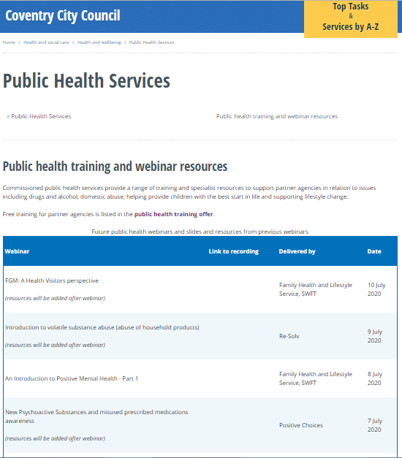
Thank you for listening
Please visit the City Council website:
Slides and recordings of past webinars
Timetable of future webinars
Details of more in-depth training available free from Public Health services
Google “coventry public health webinars” or visit
www.coventry.gov.uk/info/190/health_and_wellbeing/3283/public_health_services/2
Feedback and ideas for future webinars
Please give is your feedback and suggestions of future webinars via the Let’s Talk Coventry site at https://letstalk.coventry.gov.uk/publichealthtraining

