Slide 1
Treatment and support for non-dependent and dependent drinkers in Coventry
Calvin Holman – Coventry Health Lifestyles
Mo Choudhury – Change Grow Live

Slide 2
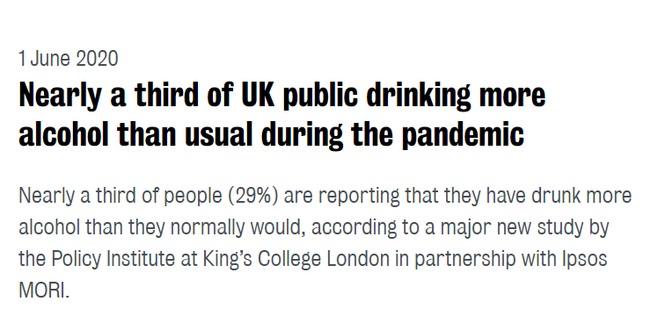
Alcohol use during Covid 19

Slide 3
Content -
Assessing the level of alcohol use
An overview of the spectrum of alcohol use
Prevention, information and self-help
Support available for non-dependent drinkers (those who may be ‘hazardous’ or ‘harmful’ drinkers)
Support available for alcohol-dependent drinkers
Harm reduction during COVID19

Slide 4
Identifying an alcohol problem
The current government recommendation for men and women should be not to drink more than 14 units of alcohol each week, This equals 6 pints of average strength beer or 6 medium size glasses of wine which would mean a low risk of illnesses such as liver disease or cancer. The previous guidelines were 21 units for men and 14 units for women per week.
Understanding alcohol units: what is one unit of alcohol:
Half a pint of ordinary strength beer or lager
One pub measure of spirits( some have increased by 40%)
125 ml glass of wine( 12%)
Home measures can be double or more.

Slide 5
Identifying Problematic Alcohol Use
Hazardous drinking is defined as a quantity or pattern of alcohol consumption that places people at risk for adverse health events
Harmful drinking is defined as alcohol consumption that results in adverse events (e.g., physical /psychological harm)
Dependant drinking is a development of behavioural, cognitive and physiological symptoms after repeated alcohol use. It is an increased alcohol tolerance and a physical withdrawal reaction when alcohol use is stopped. Dependency can be physical or psychological
Alcohol Audit is a way many people can have their levels of alcohol assessed for potential risks -

Slide 6
Spectrum of alcohol misuse / support
AUDIT Score
0
7
8
15
16
19
20
Level of alcohol use
No risk
Low risk
Increasing risk
Higher risk
(Binge drinking)
Alcohol dependency
Commissioned services and interventions
Lifestyle coaching
Self-help (incl ‘Best You’ portal
Structured treatment
Harm reduction advice
Brief advice
Talking therapies
Peer support
Detox

Slide 7
Healthy Lifestyles Service Coventry
Who’s it for?
18+ years
Universal (but targeting people with LTC, mental health, in greater deprivation and with multiple unhealthy lifestyle behaviours
(Self & agency referrals accepted)
What we do?
Integrated Lifestyle coaching, including support around stop smoking, weight management, physical activity, reduction in alcohol consumption (non-dependent use)
Stop smoking support via primary care
NHS Health Checks
Central base, open 5 days a week,
Operate from clinics, outreach, - dependent on client need
Universal self-help support – available via ‘Best You’ platform
Stop smoking via pharmacies & GPs
Varenicline PGD across all subcontracted pharmacists
Address: 2nd Floor, John Sinclair House, Canal Basin, Coventry CV1 4LY
Tel: 0800 122 3780
Email: info@hlscoventry.org
Web: www.hlscoventry.org

Slide 8
Results
In Year 1, 1072 people completed the service, achieving 1316 goal outcomes.
Whilst in year 2, 1453 people completed the service and achieved 2128 goal outcomes.
Helped over 150 people reduce their alcohol intake to within the Government Guidelines
The Challenge
1 in 6 Adults in Coventry current smoke
56.5% of adults in Coventry are classed as overweight or obese
1 in 6 adults are diagnosed with anxiety
Alcohol has an impact on all areas
comment
Integrated Alcohol
Over 150 people with a mental health condition have reduced their smoking volume by at least 50%. Out of this population, 11% also achieved an alcohol outcome (GG & 50% reduction)
How can you refer?
GP Gateway Referral form
Secure referral form built into our website to refer yourself or a patient (https://hlscoventry.org/referral-form/).
Free phone number (0800 122 3780)

Slide 9
Drug and alcohol addiction treatment
Who’s it for?
18+ years
Addiction to drugs and/or alcohol
Parents & carers
(Self & agency referrals accepted)
What does it do?
Needle exchange (20 pharmacies)
Opioid substitution prescribing, talking therapies
Support with housing, employment, etc
BBV testing and support
Aftercare / recovery groups
Access to residential rehab units (30 used across England)
Clinical care led by a Consultant Psychiatrist
Central base, open 5 days a week, 1 late evening
Also operate from UHCW, Pharmacies and Criminal Justice services
Advocacy via Coventry Recovery Community
Family Focus
Single Point of Contact 24 hours a day, 7 days a week
Address: 1a Lamb Street, Coventry CV1 4AE
Tel: 024 7601 0241
Email: Coventry.info@cgl.org.uk
Web: www.changegrowlive.org/content/CGL-coventry (incl electronic referral)

Slide 10
Alcohol Audit – what is it?
The alcohol use disorders identification test (AUDIT)
Can be used as a self assessment to measure the level of risk of any individuals alcohol use
Its a tool developed by WHO (World Health Organisation)
Currently the main tool used by many health delivering organisations across the world including the NHS, CGL and HLS
https://www.gmmh.nhs.uk/download.cfm?doc=docm93jijm4n639.pdf&ver=1017

Slide 11
Non dependant Alcohol Use
Audit score over 16
SADQ – under 20
This is classed as non dependant – but hazardous
This person would still need a structured support
Exploring Change group
6 sessions online – 1 ½ hours per week
Dealing craving and urges
5 ways to wellbeing
Dealing with difficult situations
Mutual aid
Breaking Free online
App available on any smart device
Personal plan available 24 /7
Easy to follow and totally confidential
Mutual aid – online groups
AA, SMART
Peer support
Family support

Slide 12
Dependant Alcohol users
Audits score over 20
SADQ score over 20
This person is now classified as dependant alcohol user
This person would need structured support with CGL’s Alcohol Team
Treatments options –
Safe and gradual reduction
Maximum of 10% daily –
Depends on individual and support
Psychosocial support – what does this mean ?
Peer support
Possible prescribing options
Depending on level of risk there are detox options
Under 30units daily – ambulatory detox -
Currently home detox only option – with appropriate support in place
Inpatient detox – Currently unavailable due to COVID 19
- When available – higher risk / no support / underlying medical issues, history of seizures

Slide 13
Dependant Alcohol users
Aftercare support;
Possible medications as over
Psychosocial support
Mutual aid / online support
Relapse prevention
Signpost to appropriate services / mental support
Prescribing options for alcohol
- Antabuse – what is this / when is it prescribed
Acamprosate - what is this / when is it prescribed
Naltrexone - what is this / when is it prescribed
Support and prepare service user with Rehab
Funding is via Coventry City council
Rehab sit monthly to review applicants
12 weeks usual rehab period

Slide 14
Harm Reduction advice - Alcohol
Never share glasses, bottles and drinking straws
Start a drink diary. Every time you have a drink, write down what you’re drinking, how much you have, how you are feeling at the time and what the situation is. This will help you see patterns and make changes.
Set yourself a weekly limit, and stick to it. Don’t stockpile alcohol, just buy the amount you need for the week.
Choose at least three alcohol-free days a week – stick to the same days each week.
Don’t drink on an empty stomach. Always have something to eat first.
Have a soft drink between each alcoholic one. This will help you pace yourself and make sure you’re not drinking more alcohol because you’re thirsty.
If you start having cravings, distract yourself for a few minutes. Meditation apps and videos are good distractions.
If you have children, always wait till they’ve gone to bed before you have a drink. It can be scary for children when a parent has been drinking. If there are two of you at home, make sure one of you always stays sober
If people are dependant on alcohol it’s important that they don’t just stop due to seizures (that could be fatal)?

Slide 15
Safeguarding dependent drinkers project
Project between Alcohol Change UK, Coventry and 17 other Local Authorities
Aims to improve the wellbeing and safety of adults who are chronic and change resistant dependent drinkers by:
Producing a practical guide and delivering training on using legal frameworks to protect and support this group of clients
First step is identify local challenges and best practice in safeguarding change resistant and dependent drinkers
Please help – 10 – 15 min survey at https://www.surveymonkey.co.uk/r/RPV9YRK
Further information – paul.hargrave@coventry.gov.uk
Thank you!
Notes:
Alcohol Change UK, in partnership with local authorities and services across the country is running a national project to:
improve the safeguarding of vulnerable adults who are chronic and change resistant dependent drinkers.
Coventry is a partner in this project.
In particular, it will develop:
a national briefing document on how to use the Mental Capacity Act (2005), the Mental Health Act (1983 revised 2007) and the Care Act (2014) to protect and support this group of clients.
Next year, a one day training programme will be developed and run that will deliver the key messages of the briefing to professionals who encounter these clients.
One of our first steps is an online survey to identify local challenges and best practice in safeguarding change resistant and dependent drinkers. We are looking for experience, practical examples and case studies of both effective and ineffective use of any of these legal frameworks with his client group.
We would be grateful if you could complete this short questionnaire (10 questions) to tell us about your experience. It should take no more than 15 minutes to complete.
You can access the survey at:
https://www.surveymonkey.co.uk/r/RPV9YRK

Slide 16
Thank you – Please feel free to email any questions ?
Calvin Holman – Coventry Health Lifestyles
Calvin.Holman@hlscoventry.org
0800 122 3780
Mo Choudhury – Change Grow Live
mohammed.choudhury@cgl.org.uk
02476 010241

Slide 17
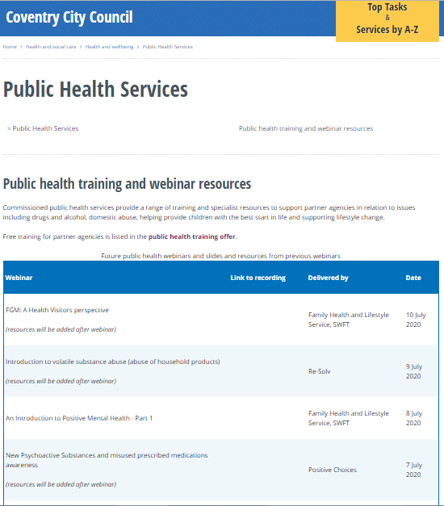
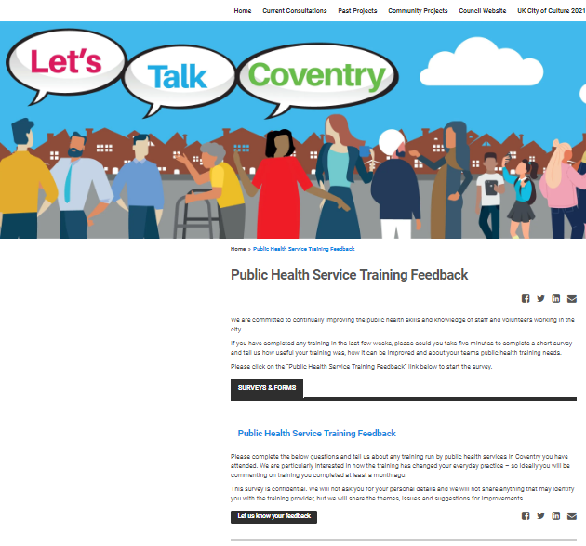
Thank you for listening
Please visit the City Council website:
Slides and recordings of past webinars
Timetable of future webinars
Details of more in-depth training available free from Public Health services
Google “coventry public health webinars” or visit
www.coventry.gov.uk/info/190/health_and_wellbeing/3283/public_health_services/2
Feedback and ideas for future webinars
Please give is your feedback and suggestions of future webinars via the Let’s Talk Coventry site at https://letstalk.coventry.gov.uk/publichealthtraining

