Slide 1
NPS and Prescription Medication Awareness

Slide 2
Expectations and Agenda
To ensure that this is a comfortable learning experience for everyone; can we please…
Keep your microphones and videos turned off
Use the chat facility to ask questions throughout. A Q&A will be available at the end. All questions are valid- we don’t know what we don’t know!
The session is being recorded so be mindful of this if you do not wish to be identified
By the end of the workshop you should feel more equipped to:
Know the basics around NPS and misused prescribed medications that may be commonly misused
Be aware of the effects and basic risks
Understand the law
Understand what support is available

Slide 3
What are NPS’s?!
NPS stands for New Psychoactive Substances.
NPS’s are a group of substances that are created to replicate and mimic the effects of illicit drugs. They come in a variety of forms such as powders, pills, smoking mixtures, liquids, capsules, or on perforated tabs.
Over the next couple of slides we will explore the most commonly used by young people within Coventry.
10% of 15-24 year olds have used a NPS

Slide 4
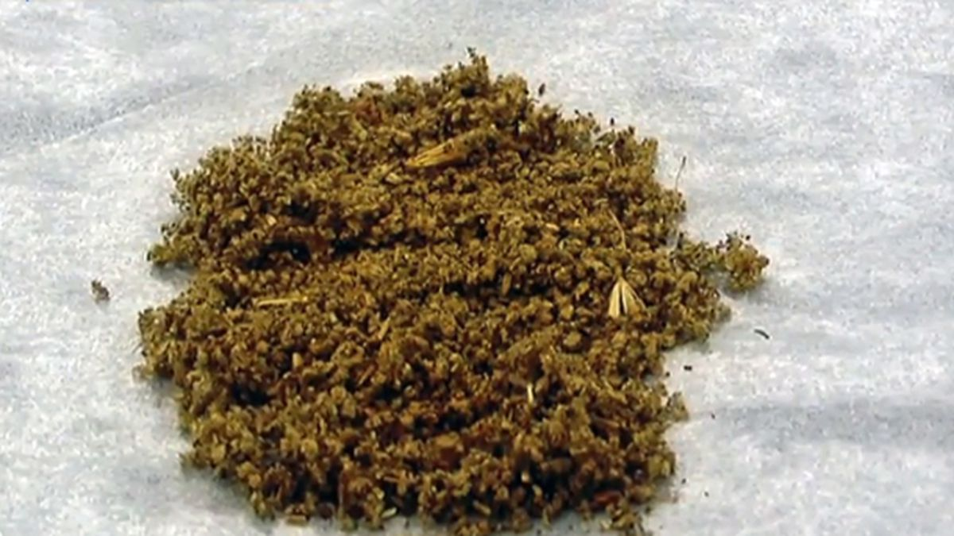
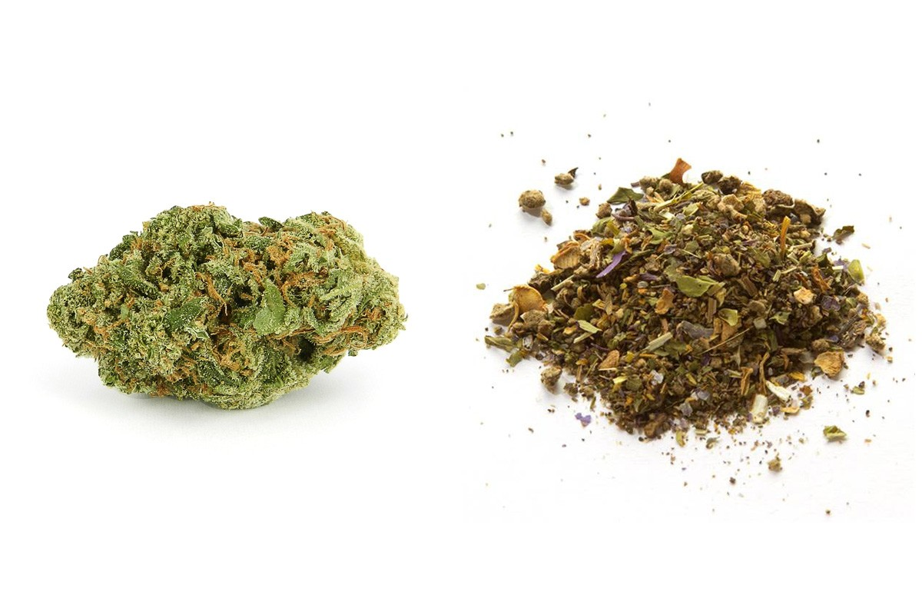
Spice
Spice is the common name for Synthetic Cannabinoids.
Spice may look similar to Cannabis however they couldn’t be further apart in their effects!! THEY ARE NOT THE SAME!!
Effects can include:
Feeling stimulated and energetic
Increased appetite
Producing a dream-like state

Slide 5
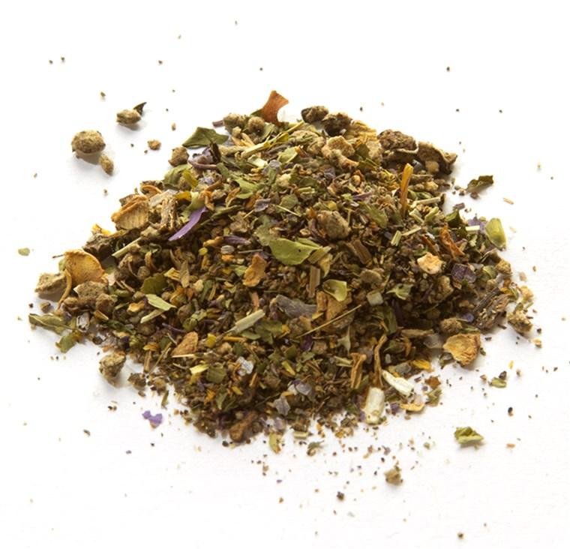

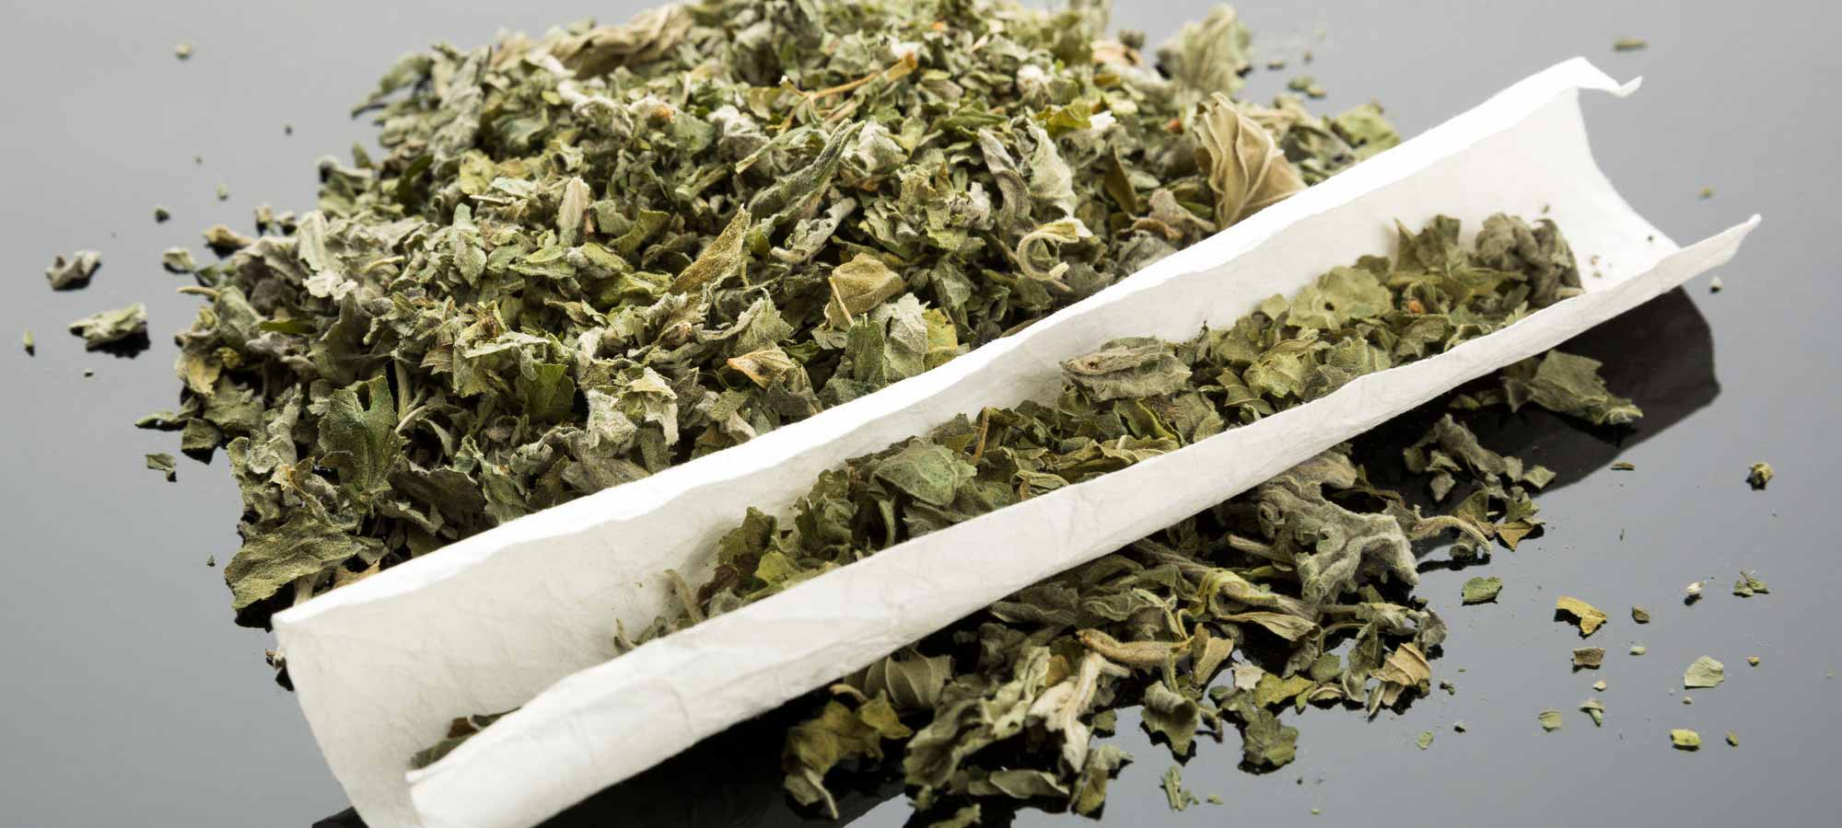
Spice
Other more negative effects include:
Overdose
temporary psychotic states
unpredictable behaviours
Sudden increase in body temperature and heart rate
Hallucinations
Confusion leading to aggression and violence
Seizures
Respiratory failure
Intense comedown that can cause users to feel suicidal.
The severe side effects are likely due to two key reasons:
Very high potency & strong binding to receptors in the brain;
An absence of naturally occurring cannabinoids found in herbal cannabis (CBD) which normally counteract the effects of THC.

Slide 6
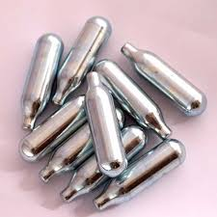

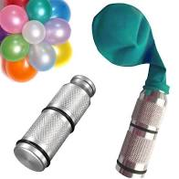
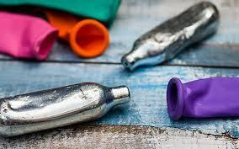
What is Nitrous Oxide?
Nitrous oxide is a colourless gas with a slightly sweet smell and taste.
It is normally bought in pressured canisters, varying in size and depending on what it will be used for.
There are three main legitimate uses of nitrous oxide:
To numb pain during medical procedures such as dental work.
In engines to increase their power output.
In catering, in whipped cream aerosol cans to prevent the cream going ‘bad’ and in food packaging to prevent the food from rotting.
When being misused, the gas is removed from the canisters into balloons which are then inhaled.
Nitrous Oxide is more commonly known as laughing gas and is very popular at present.
Canisters cost around 28p each with balloons already filled with gas cost around £1.50.

Slide 7
The effects
Nitrous oxide is depressant-type drug, which means it slows down your brain and your body’s responses (the Central Nervous System).
The effects of nitrous oxide vary depending on how much has been inhaled but they often include the following:
Feelings of euphoria, relaxation and calmness
Dizziness
Difficulty in thinking straight
Fits of giggles/laughter (hence the name laughing gas!)
Tingling sensations
Audio and visual distortions
In some people, a headache can be an unwanted immediate effect.
The effects are immediate however are short lived which means frequent re-dosing takes place which increases the risks.

Slide 8
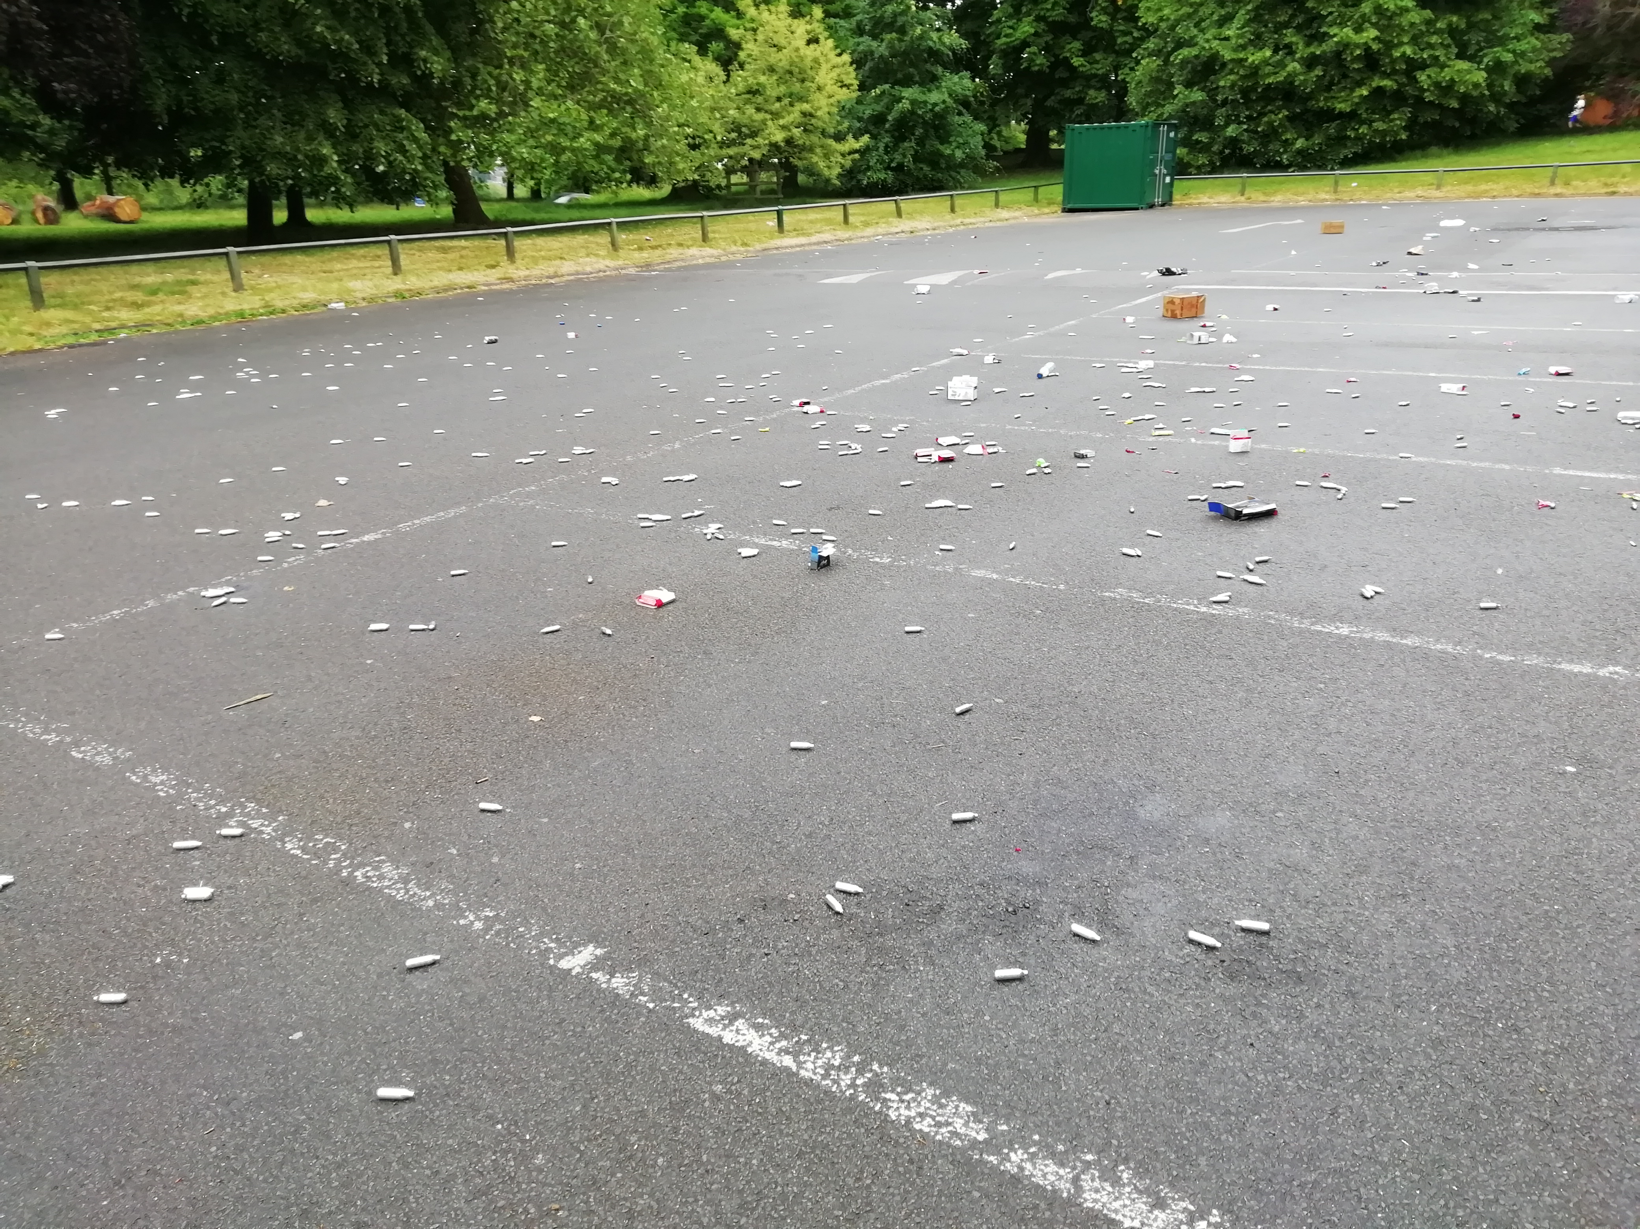
Short term risks
Long term risks
Heavy regular use of nitrous oxide can lead to a deficiency of vitamin B12 and to a form of anaemia. Severe B12 deficiency can lead to serious nerve damage, causing tingling and numbness in the fingers and toes initially. This can be very painful and make walking difficult.
It may be possible to become psychologically dependent on nitrous oxide, meaning that users develop an increased desire to keep using it despite any harms, but the evidence on this is limited. In anecdotal reports, some people have reported developing cravings or feelings that they want to continue using nitrous oxide.
As Nitrous Oxide is mainly inhaled from balloons; there is a risk of not getting enough oxygen which can result in unconsciousness or suffocation…people have died from this.
It can also be hard to judge how much is too much which can quickly lead to accidents, fainting etc.

Slide 9

The Law
The Psychoactive Substance Act came into effect in 2016 which made an substance with a psychoactive effect illegal to produce or supply. The exemption to this being substances already covered by the Misuse Of Drugs Act such as already controlled by the Misuse of Drugs Act, nicotine, alcohol, caffeine and medicinal products.
Quite what constitutes a psychoactive substance is one of the most contentious issues in the Act, which defines it as: “any substance which (a) is capable of producing a psychoactive effect in a person who consumes it, and (b) is not an exempted substance”.
Supply of a NPS can result in up to 7 years imprisonment.

Slide 10
Some clauses to the Law
There are some clauses to parts of the Psychoactive Substance Act
Poppers
Poppers (or alkyl nitrites) are not part of the PSA as it doesn’t fall under the definition of psychoactive
Nitrous Oxide
Although covered by PSA, this is only when it is supplied with the intention or likihood of using them to ‘get high’. Otherwise they have a legitimate purpose within the kitchen or the medical room!
Nutmeg
Nutmeg is psychoactive however similar to Nitrous Oxide it’s perfectly legal in the kitchen!

Slide 11

Why talk about Prescription Medication?
Increasingly we are seeing young people misusing prescribed medication; often with the misunderstanding that due to them being available from doctors that they are safe.
Many of the medicines being misused have properties which make the users at risk of dependency. The most common seen by Positive Choices and which include this risk are:
Xanax
Codeine

Slide 12
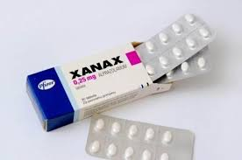
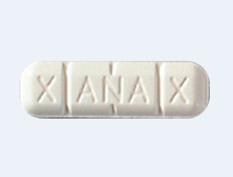
Xanax
Xanax is the used name for a drug called Alprazolam.
Xanax is a Benzodiazepam which is prescribed for anxiety and panic disorders however not commonly in the UK.
When prescribed they come in doses of 0.25mg (white), 0.5mg (pink)and 1mg (blue) which are colour coded.
In comparison, it’s 10 times stronger than Diazepam/Valium and is quicker acting.
Street bought Xanax is usually fake and therefore the dosage cannot assumed to be as printed.
They induce periods of calmness, relaxation and sleep and are often used alone or after stimulant use to ‘help a come down’.
Users are at risk of dependency and withdrawals include headache, nausea, anxiety and confusion.
Without a prescription, Benzos are a Class C drug.

Slide 13
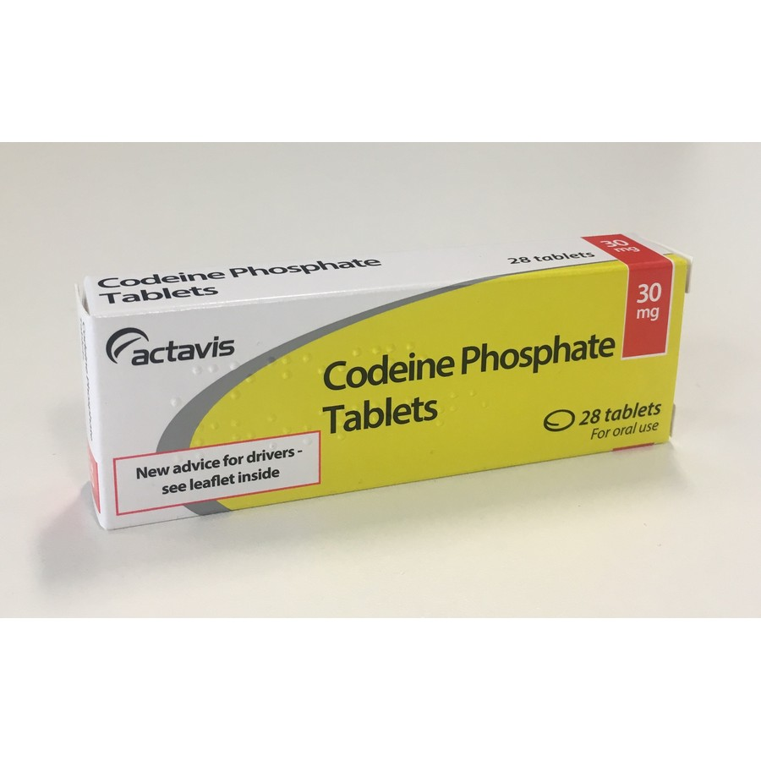
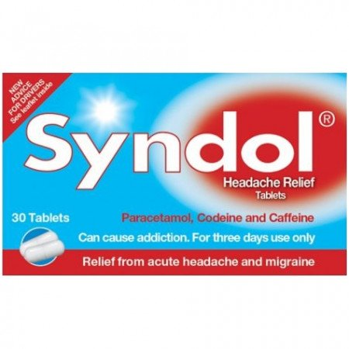
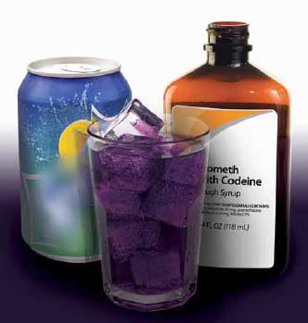
Codeine
Codeine is from the family of depressant drugs called Opiates…the same family as Heroin.
Codeine is prescribed for mild to moderate pain relief however as it also has sedative (drowsy and relaxed) effects people misuse this medication.
Codeine can be found in medications like Co-codamol and Nurofen Plus/Max .
It is highly addictive and shouldn’t be used for more than 3 consecutive days.
With young people there is a trend to mix codeine (usually from strong cough medicine) with a fizzy drink and sometimes sweets to sweeten the taste.
Naloxone is now being prescribed as overdoses are fatal as they are with Heroin.

Slide 14

Positive Choices
Amongst other support, Positive Choices are here to support young people with their substance use. Some of the ways we can support include:
Harm reduction techniques
Building on awareness; informed decisions are best!
Exploring the impact of their use
Making changes to use; reduction or abstinence plans
Alternative coping techniques
Diversionary activities

Slide 15
How to make a referral
You are more than welcome to call our Duty Worker or refer via our website for a quick and secure way to place the referral
www.changegrowlive.org/positive-choices-coventry
02476 010 245 coventryinfo.yp@cgl.org.uk
Please consider:
Consent of the young person (including parental consent for under 13s)
Include as much relevant information as possible
Keep us involved in Early Help/Social Care meetings

Slide 16
How to contact us
Address:
23-25 City Arcade, Coventry
Phone:
02476 010245
Website: (referrals & online chat)
www.changegrowlive.org/coventryyp
Facebook:
PositiveChoicesCov
Instagram:
Positivechoices_Coventry
Twitter:
@PosChoices_Cov

Slide 17
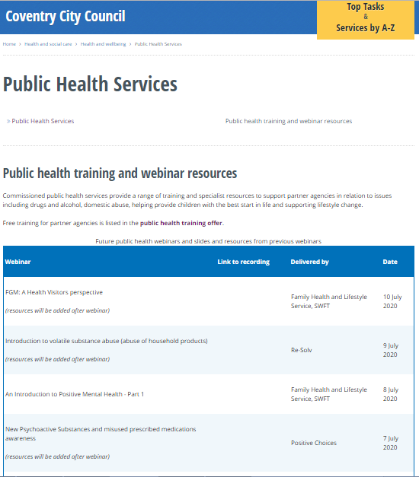

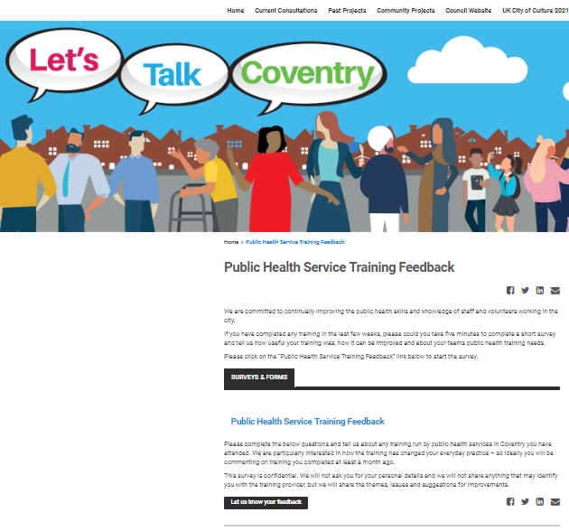
Thank you for listening
Please visit the City Council website:
Slides and recordings of past webinars
Timetable of future webinars
Details of more in-depth training available free from Public Health services
Google “coventry public health webinars” or visit
www.coventry.gov.uk/info/190/health_and_wellbeing/3283/public_health_services/2
Feedback and ideas for future webinars
Please give is your feedback and suggestions of future webinars via the Let’s Talk Coventry site at https://letstalk.coventry.gov.uk/publichealthtraining

