Slide 1
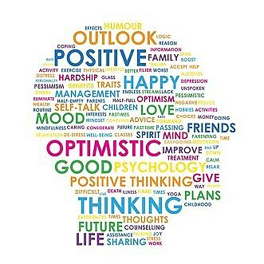
Positive Mental Health Part 1
Bally Dhugga

Slide 2
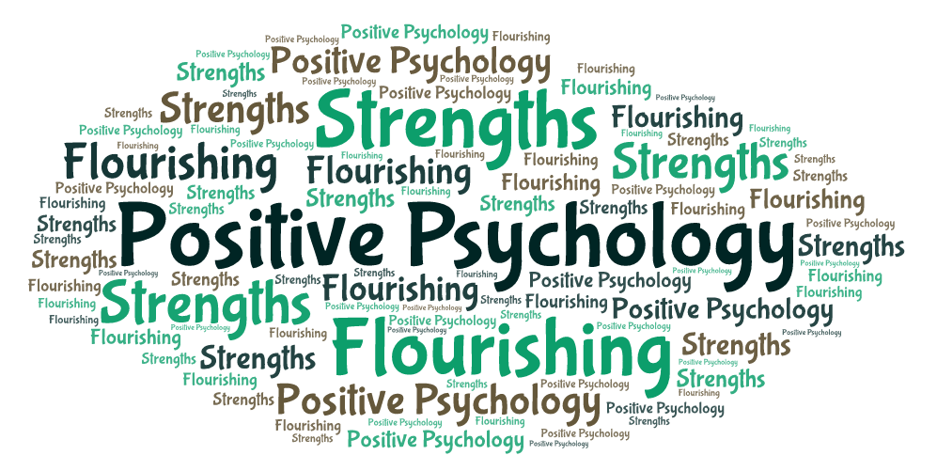
Aims
An introduction to Positive Psychology
What is Flourishing
Managing Negative Emotions
Benefits of Positive Emotions
10 forms of Positivity

Slide 3
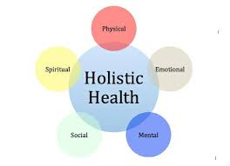
Background
Public Health Nutritionist (University of Surrey)
Qualified Health Kinesiologist
Accredited Strengths Based Practitioner (CAPP - Centre of Applied Positive Psychology)
Accredited Lead Trainer for Eating Disorders
Charity Tastelife

Slide 4
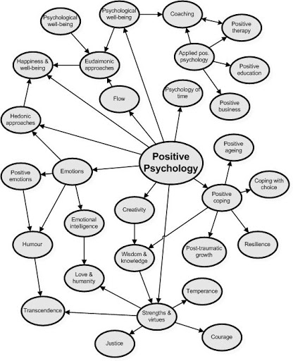

Slide 5
Positive Psychology
Martin Seligman developed the concept of Positive Psychology in 2000 to counter-balance the focus of psychology on pathology with what’s right with people and the conditions needed for people to flourish.

Slide 6
Happy
Interested in new things
Personal Space
Achieving
Food
Positive relationships
Confidence
CURIOSITY
Thinking
Clearly
Having Fun
Friends
LOVED
Self Worth
SAFE
RELAXED
Rest and Relaxation
Physically Fit
In Control
Community
Faith
Trusted
Being Involved
Positive future
Doing Well
Parks
Included
Feeling Good
Sunshine
Valued
BEING HEARD
Energy
CHILLED
Respected
Giving to
others
GOD
Healthy
Stress-free
Getting on with others
Learning new things
Warmth
Feeling good
about myself
Enough money
Positive use of time
Family
TREES
AND
GRASS
Challenged
Support
Having a purpose
Where i live
Coping with
problems

Slide 7
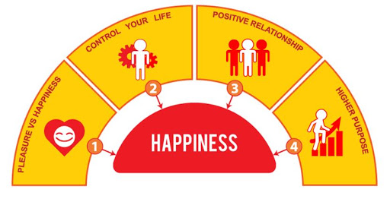
Flourishing
Feeling
Good
(HWB)
Functioning
Well
(FWB)
Hedonic Well-being Seeking Pleasure
‘External happenings’
Eudemonic Well-being
Functional Well-being
Meaning & Purpose
‘Inner fulfilment’

Slide 8
Flourishing
Flourishing is when people experience a high frequency of positive emotions and low frequency of negative emotions.
This dynamic “emotional fuel” allows you to be engage and to take part in meaningful activities.
People who experience flourishing are more creative, resilient, productive, fulfilled and can live up to nine years longer.
As we flourish individually and corporately we can empower
communities to do so as well – this is the heart of flourishing.

Slide 9
A Schematic Diagram of the Mental Health Spectrum
Only 18% of over 2000 adults in UK are flourishing (Seligman, 2011)
Low Levels
of HWB & FWB
High Levels of
HWB & FWB
Percentage of population
Mental disorder
Moderate Mental Health
Flourishing
Languishing
Psychological Resources

Slide 10
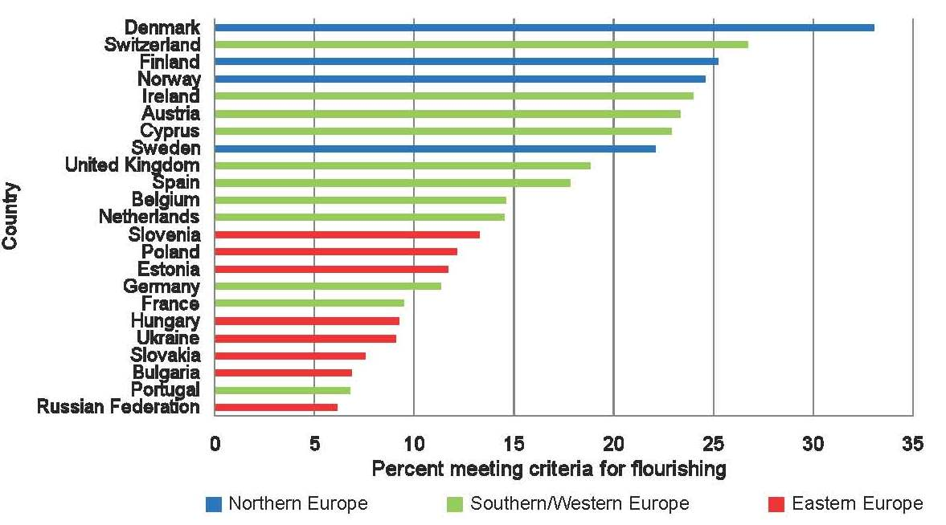

Slide 11
Factors that Influence Well-being
Socio-cultural Factors
Social environment
Early environment
Abuse
Neglect
Social support
Parent’s behaviour
Work marriage
Wellbeing
Personality
Defences
Relationships
Life events and situations
Cognition
Psychological mechanisms
Parent’s Genes
Emotion
Other mental disorders
Previous episodes
Medical
Brain mechanisms
Substance abuse
Subject’s genes

Slide 12
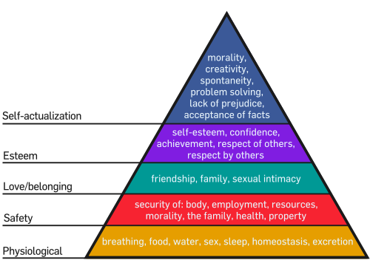
Ways to Enhance Your Functional WB
Keep learning new things that inspire you
What new things have you tried recently?
Have direction and purpose
What are your most important goals?
Be part of something bigger
What gives your life meaning?
Using your psychological strengths
What are your strengths?

Slide 13
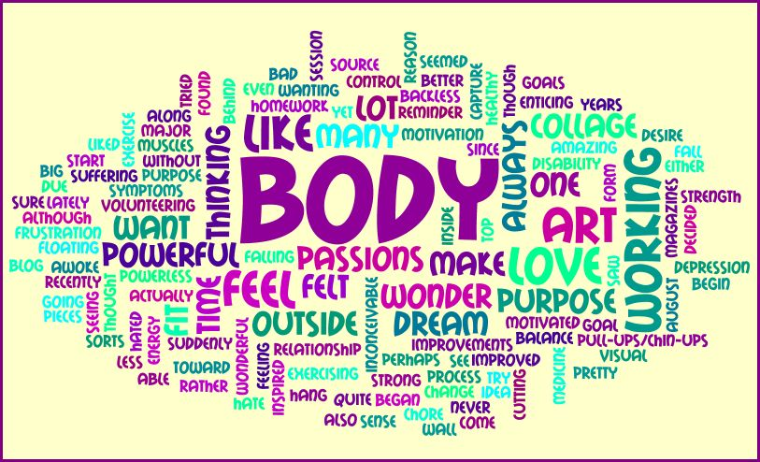
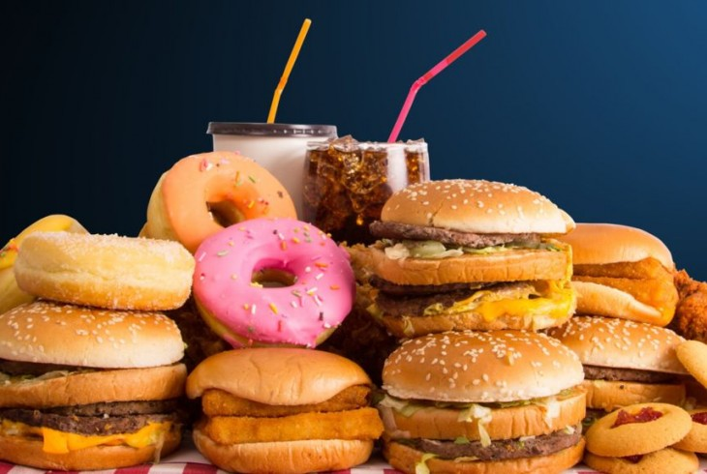
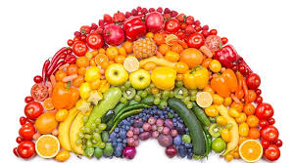
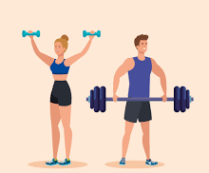
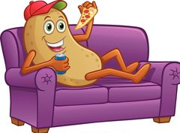

Slide 14
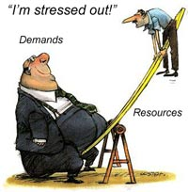
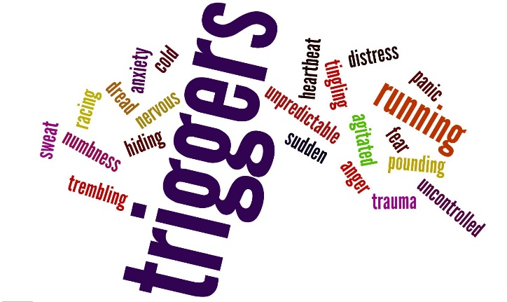
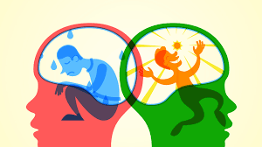
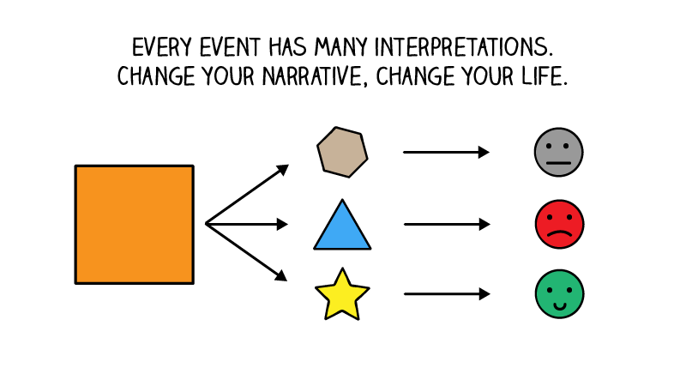
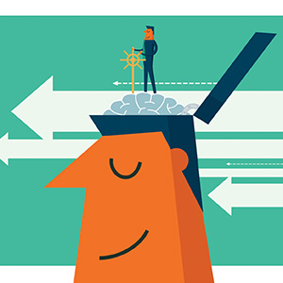

Slide 15
Negative emotions narrow mind-sets:-
‘Fight, Flight or Freeze’

Slide 16
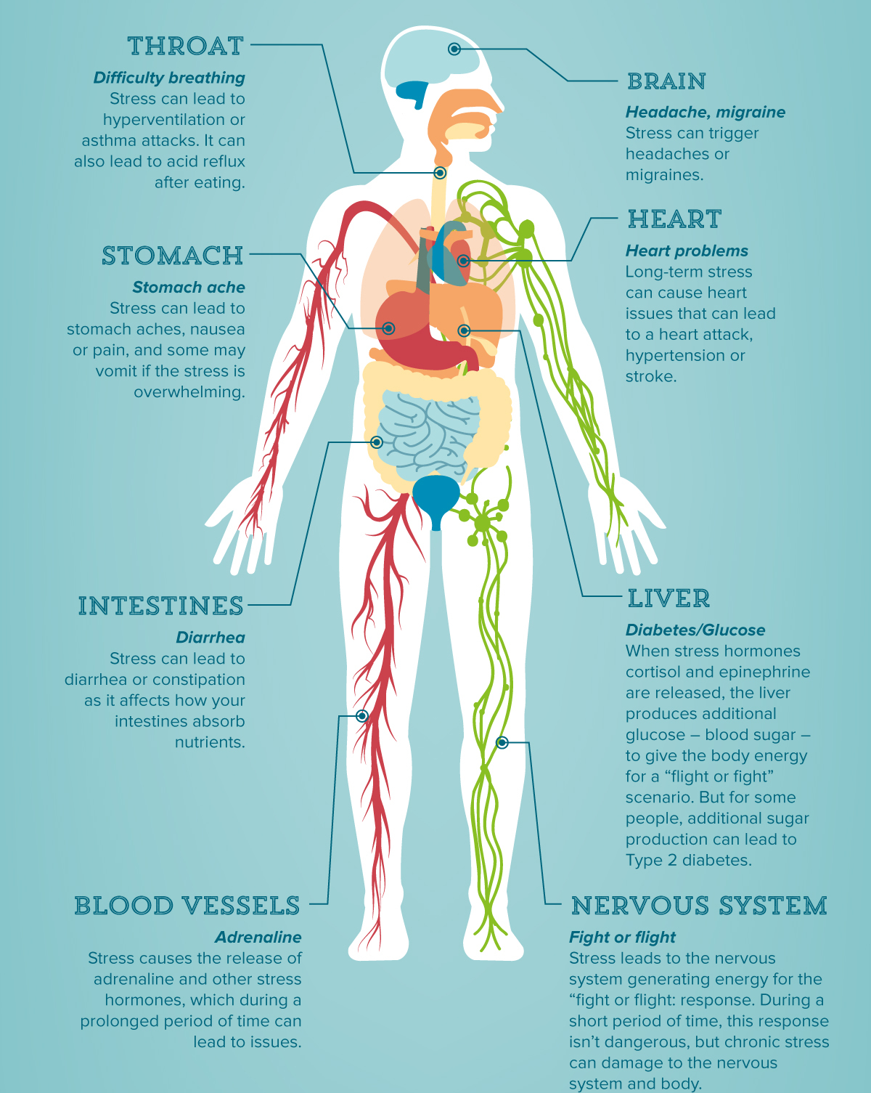

Slide 17
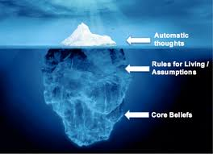
of change
of failure
of future
of rejection
of illness
of dying
of lack
of being out of control
of losing everything

Slide 18
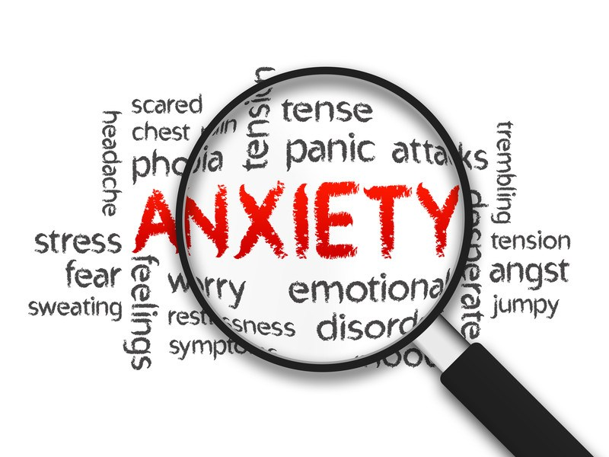
Stress
Worry
Overwhelm
Panic Attacks
Loneliness
Isolation
Impatience
Nervousness
Dread
Uncertainty
Doubt
Frustration
Irritation
Anger

Slide 19
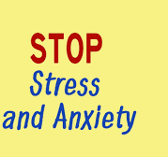
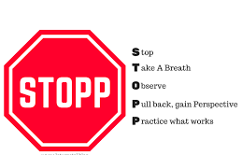
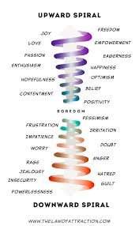
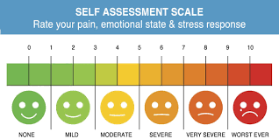

Slide 20
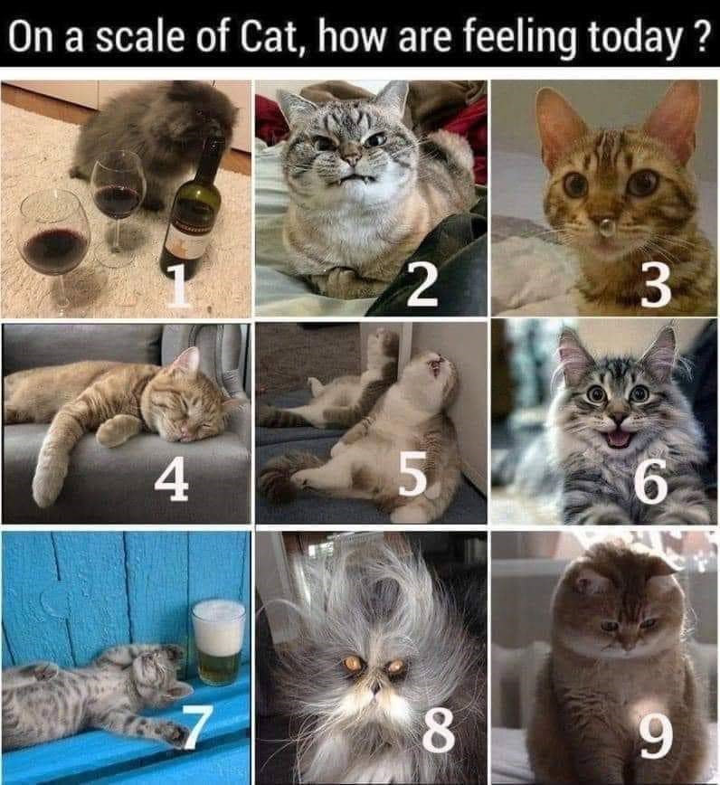
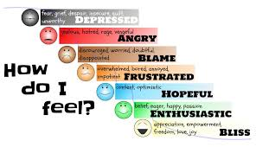

Slide 21
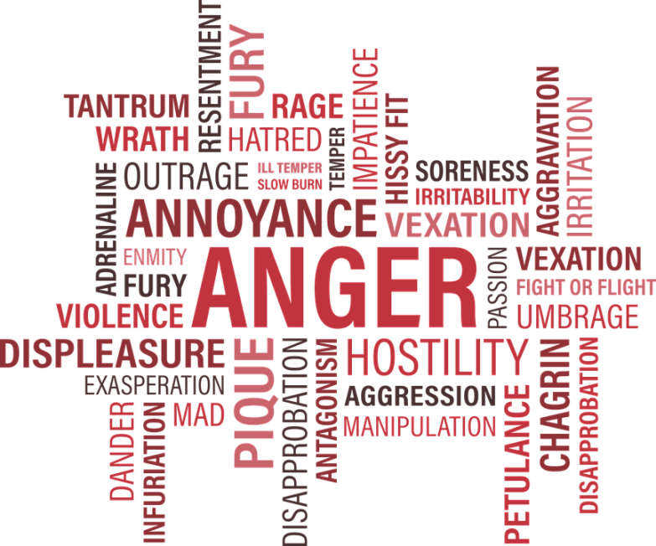

Slide 22
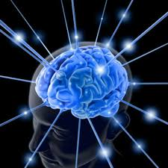
Positive Emotions Builds Durable Personal Resources
Physical Resources
Intellectual Resources
Boosts immunity
Cardiovascular health
Enhances brain function
Problem solving skills
Learns new information
Broadens perceptions
Positive
Emotions
Psychological Resources
Social Resources
Strengthens bonds
Makes new bonds
Builds trusting relationships
Develops resilience & optimism
Develops sense of identity &
goal focus

Slide 23
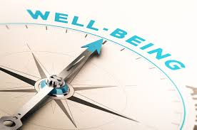
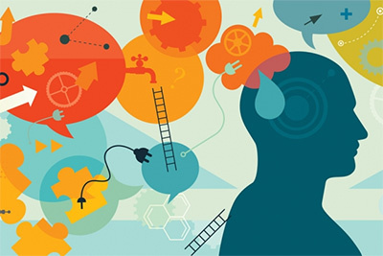
Can you think of 10 positive emotions in a minute?
1.
2.
3.
4.
5.
6.
7.
8.
9.
10.

Slide 24
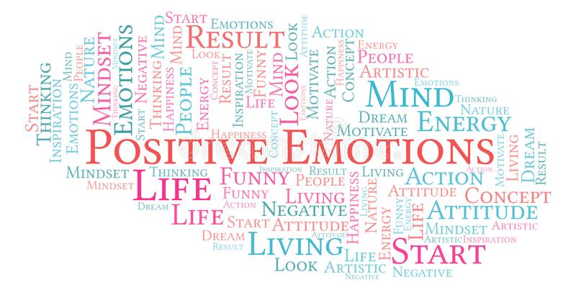
Positive Emotions
'Negative emotions closes down minds and hearts,
whereas positive emotions open the heart and
changes mind-sets’
*Joy *Pride
*Gratitude *Amusement
*Serenity *Inspiration
*Interest *Awe
*Hope *Love
Barbara Fredrickson 2005

Slide 25
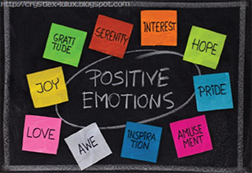
Food for Thought! Recent studies have shown that a human being generates around 1500 new neurons per day. So what we think about will fill those neurons.
‘’Our day-to-day positive emotions function as nutrients for our overall wellbeing. Today’s positive emotions do not simply exemplify today’s wellbeing, they also help to create next month’s increases in well-being.”
(Dr Barbara Fredrickson)

Slide 26
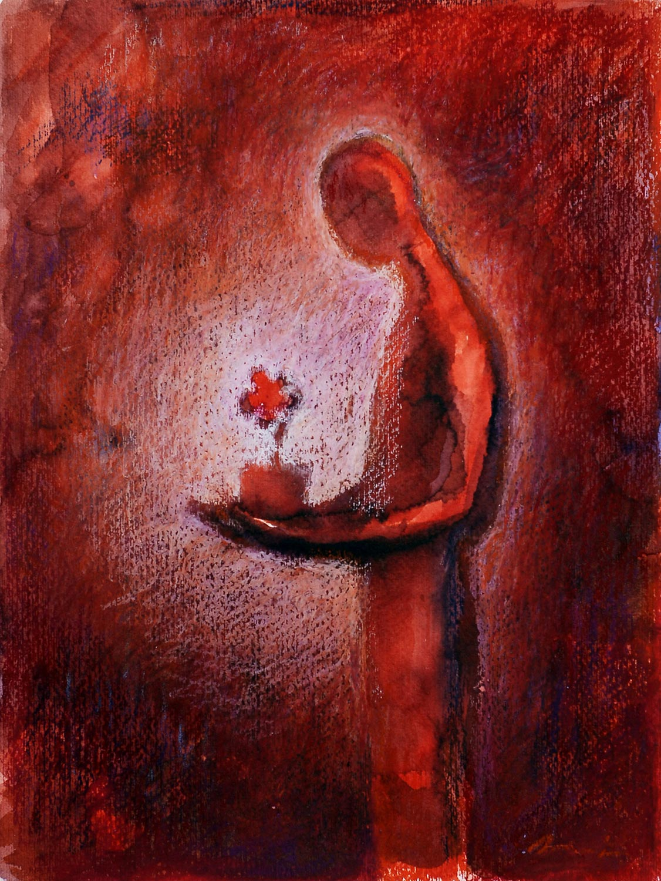
Gratitude
Is a feeling of being thankful and appreciative
Gratitude opens your heart and carries the urge to give back
If you feel you have to pay someone back, then you are not feeling grateful as heartfelt gratitude gives back freely and creatively
When was the last time you felt grateful – not polite or indebted, but truly and openly grateful?

Slide 27
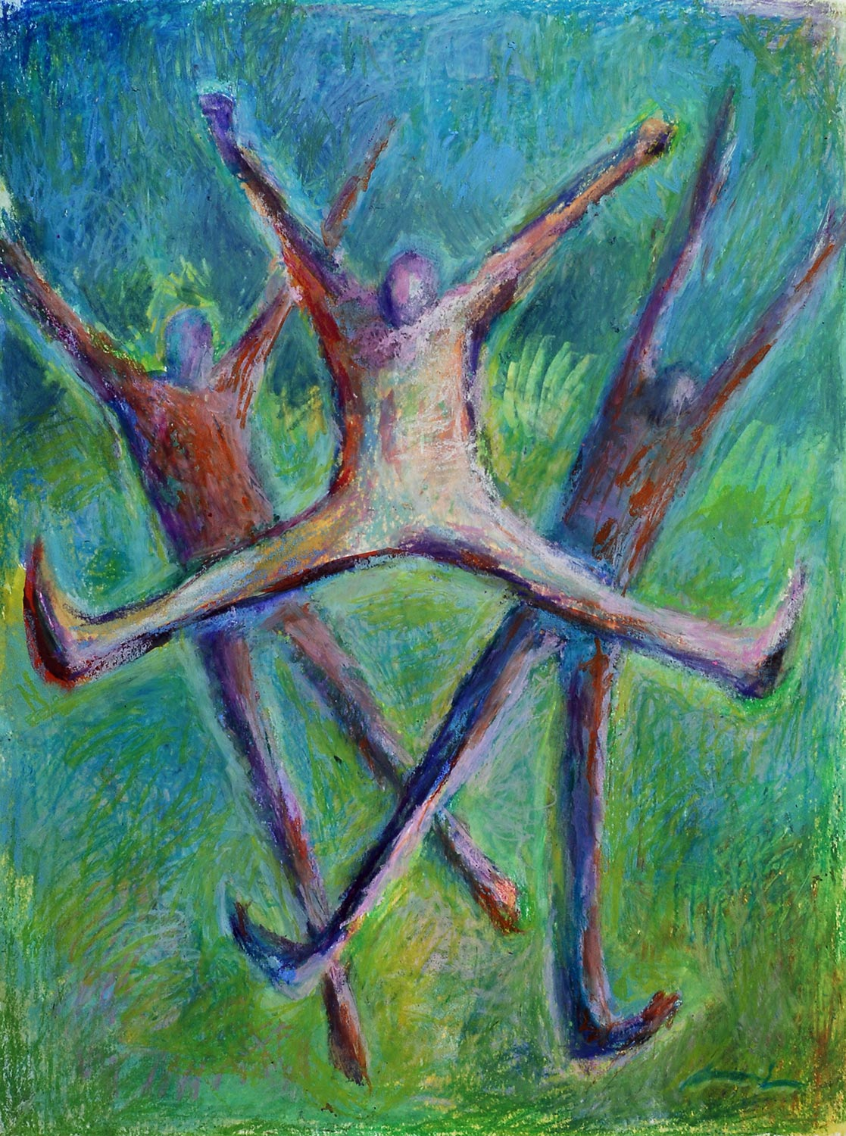
Joy
Gratitude opens the door to joy
Joy feels bright and light. Colours seem more vivid.
There is a spring in your step and your face lights up with a smile and an inner glow.
You feel like taking it all in. You feel playful and you want to jump in and get involved.
There are many sources of joy
What brings you joy?

Slide 28
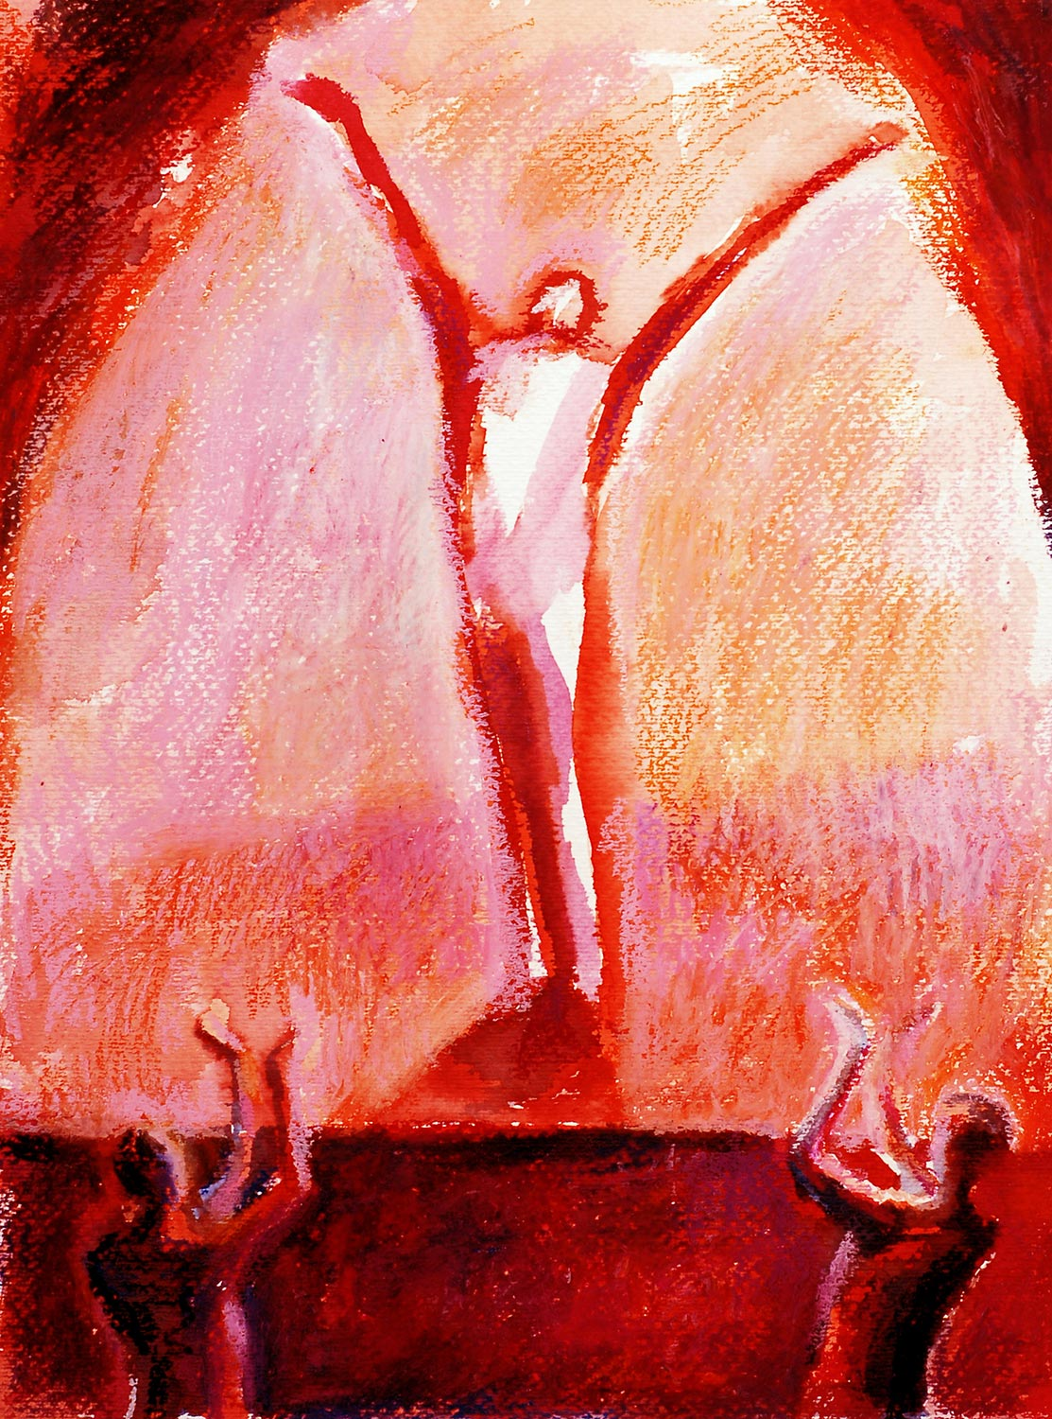
Pride
Any emotion can go too far and perhaps this is especially true for pride. When tempered with appropriate humility, pride is clearly a positive emotion.
Pride blooms in the wake of an achievement you can take credit for. You invested your time, effort ,skills and succeeded. Or when you recognise that you made a positive difference to someone else
The mindscape of pride is expansive - It kindles dreams of further achievements. If I can do this, maybe I can go for a promotion.In this way, pride fuels the motivation to persist on difficult tasks & go out of your comfort zone.
What has pride inspired you to do?

Slide 29
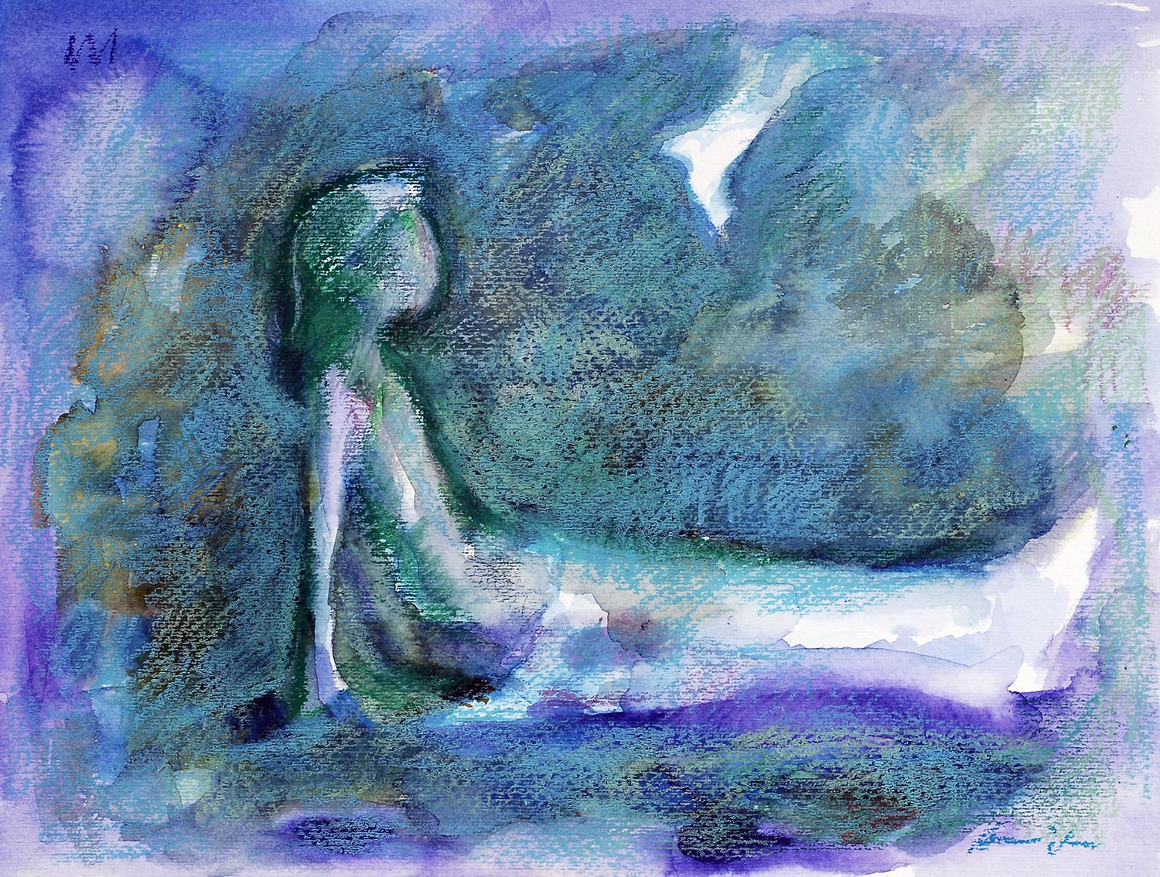
Serenity
Like joy, serenity enters when your surroundings are safe.
Serenity makes you want to sit back and soak it in.
It is a mindful state carries the urge to savour your current circumstances and find ways to integrate them into your life more fully and more often.
When you tell yourself, “I need to do this more often!” that is serenity.
When was the last time you savoured a serene moment?

Slide 30
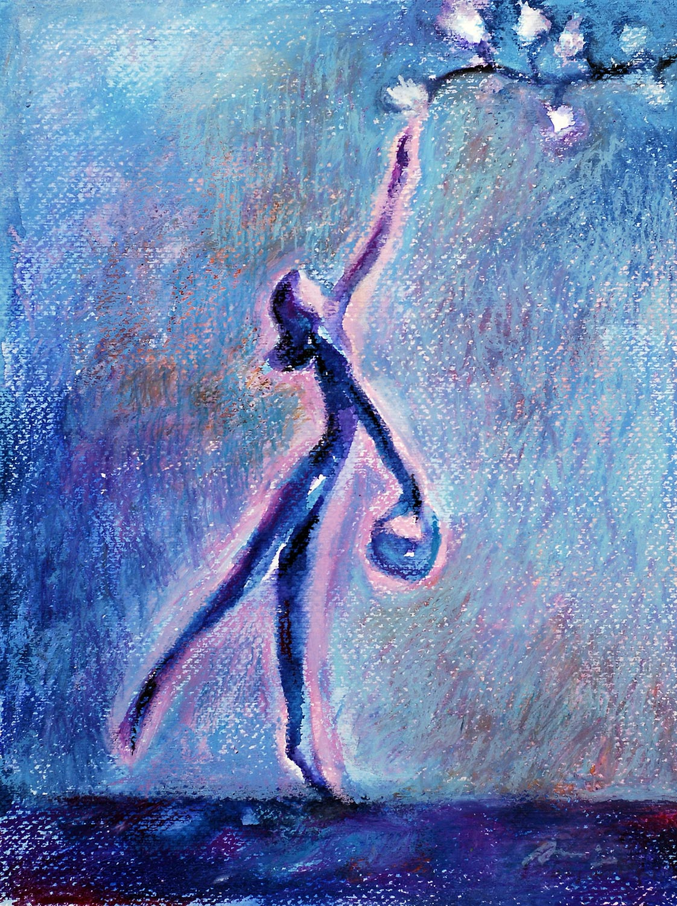
Inspiration
Witnessing human nature at its very best can inspire and uplift you.
Feeling inspired draws your attention, warms your heart and draws you in.
Inspiration does not simply feel good, it makes you want to express what is good and do well yourself.
It creates the urge to do your best so that you can reach your own higher ground.
It is a form of positivity that pulls us out of our shell of self-absorption.
Can you think of a time recently when you made the choice to be inspired?

Slide 31
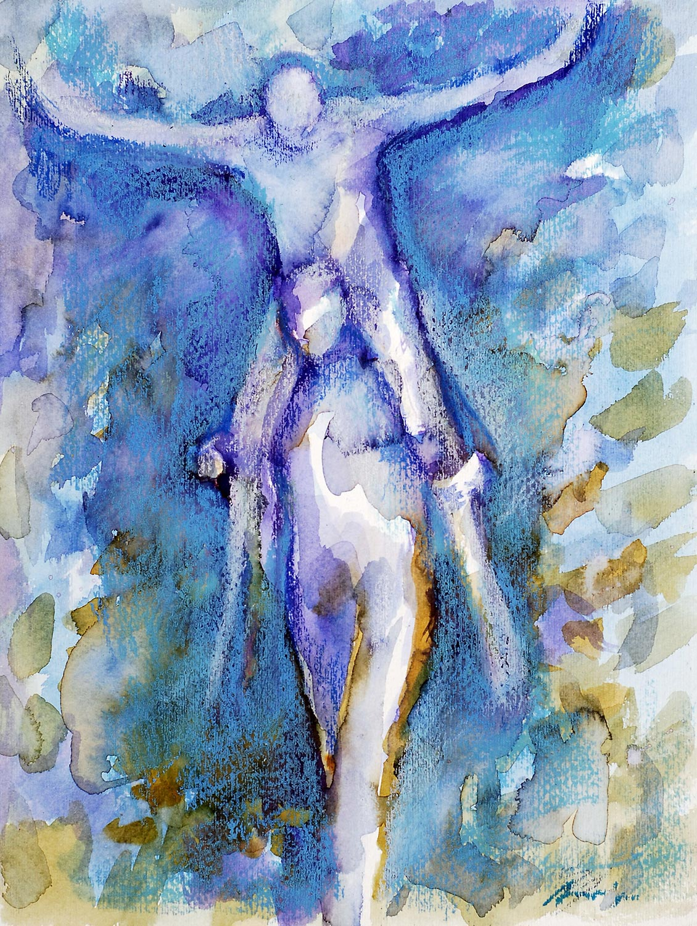
Amusement
Sometimes something unexpected happens that simply makes you laugh.
Heartfelt amusements bring the urge to laugh & share your humour with others.
Shared laughter signals that you find your current situation to be safe & light-hearted and that you would like to use this time to build connections with others.
When was the last time you truly laughed?

Slide 32
Awe
Closely related to inspiration, awe happens when you come across goodness or you can literally feel overwhelmed by greatness.
Awe make you stop in your tracks. You are momentarily transfixed. Boundaries melt away and you feel part of something larger than life.
Sometimes we are awed by nature, the miracle birth of a baby, observing acts of bravery and how much progress has been made in the world.
When was the last time you was compelled to see yourselves as part of something much larger?

Slide 33
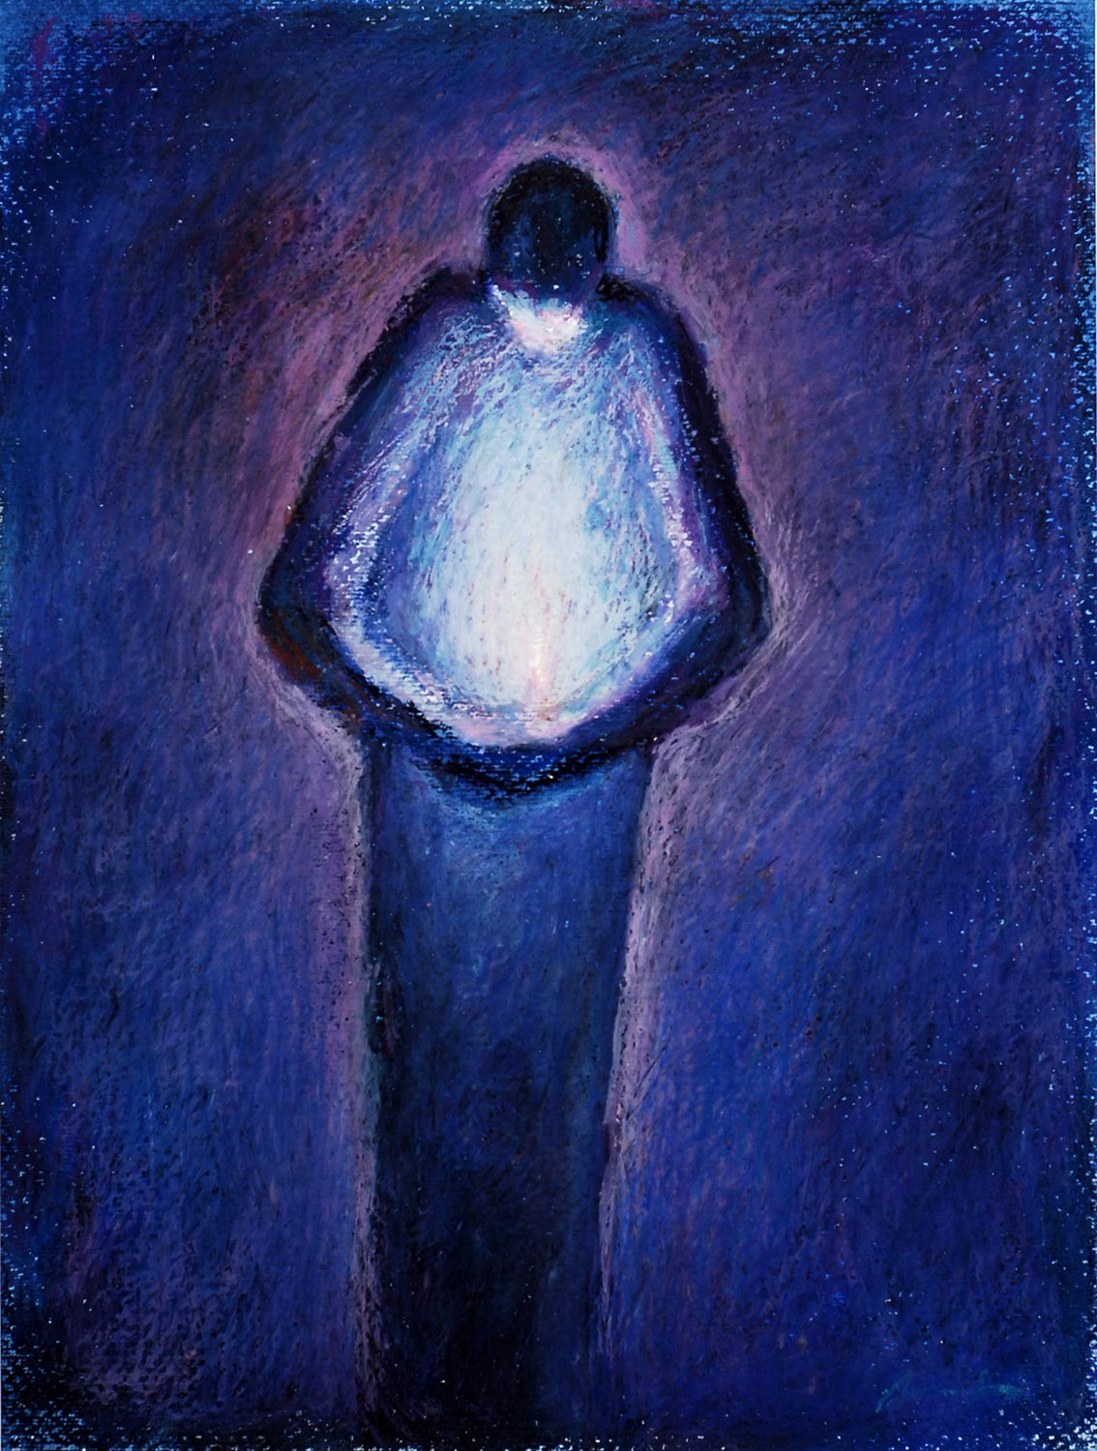
Hope
Hope comes into play when things are not going well for you, or there is considerable uncertainty about how things will turn out. Hope arises precisely within those moments when despair seems just as likely.
Perhaps you have just failed an important test, lost your job. Hope, in desperate situations like these, is “fearing the worst but yearning for better”.
Deep within the core of hope is the belief that things can change.
Possibilities exist. Hope sustains you. It inspires you to plan for the better future.
With hope, we become energised to do as much as we can make a good life for ourselves and for others.
When was the last time you felt like this?

Slide 34
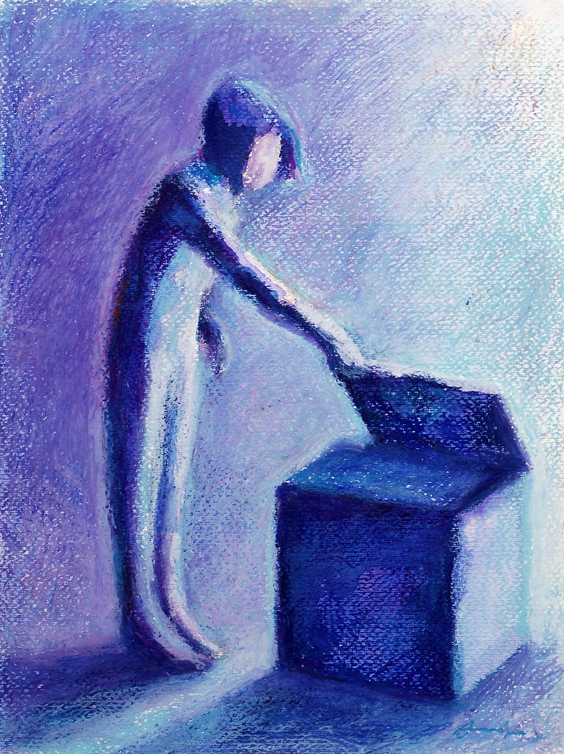
Interest
Unlike joy and serenity, emotion of interest call for effort and increased attention on your part.
You are pulled to explore in what you are just now discovering.
It is when you uncover a new set of challenges that allow you to build your skills and awakens you to new ideas.
When you are interested, you feel open and alive.
The intense pull of interest beckons you to explore, to take in new ideas and to learn more.
When did interest last draw you in?

Slide 35
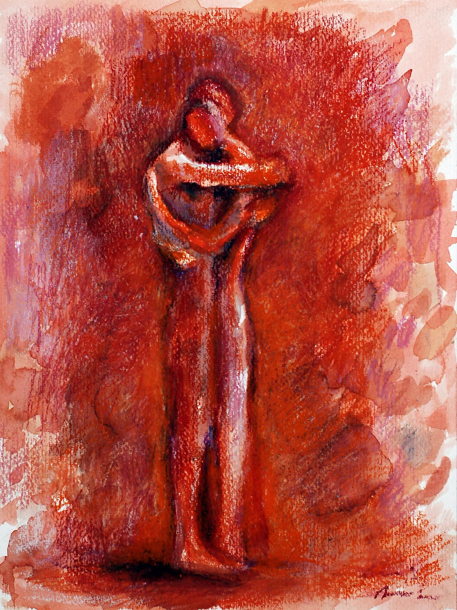
Love
Love is not a single kind of positivity its all of them including joy, gratitude, serenity, interest and so much more.
Love is a choice - both an intention and an action.
Its selfless service, where you choose intentionally to be patient, kind forgiving and believing the best.
When these good feelings stir our hearts within a safe, often close relationship, we call it love.
When was the last time you felt safe and secure with someone?

Slide 36
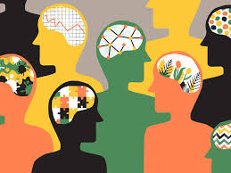
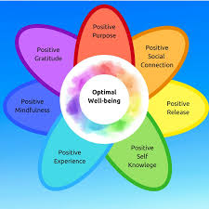
When we feel more positive emotions than negative ones, difficult situations are easier to handle.
Positive emotions build our resilience, the emotional resources needed for coping.
They broaden our awareness, letting us see more options for problem solving.
Your moments of heartfelt positivity can transform your life for the better.
Each positive emotion holds the ability to broaden and build your life helping you to flourish.

Slide 37
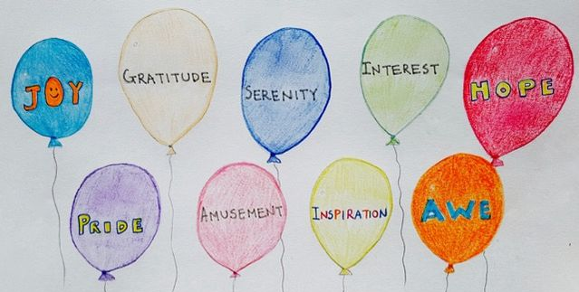
Positivity Portfolio
10 Reflective Questions
Living document
Photos, words, pictures, poems, letters, objects, songs, video clips, goals
Positivity comes in many shapes and sizes. You’ll come to see that it encompasses far more than mere physical pleasure or a vague sense of happiness’
(Fredrickson, 2009)
When have you felt…
joyful about what was happening in the moment?
grateful and thankful of someone or something?
contented and at peace?
hopeful and encouraged by the possibility of a good outcome?
alert, curious, deeply interested in something or someone?
most proud of yourself?
silly, amused and fun-loving?
truly inspired or uplifted by goodness?
intense wonder or amazement?
close, safe and secure with someone?
https://www.psytoolkit.org/survey-library/mhc-sf.html#_run_the_demo

Slide 38
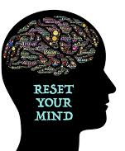
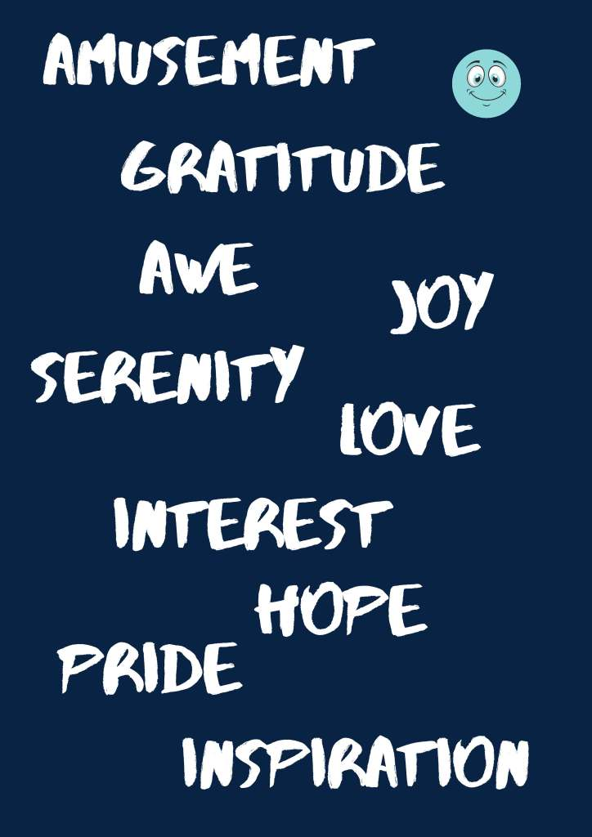
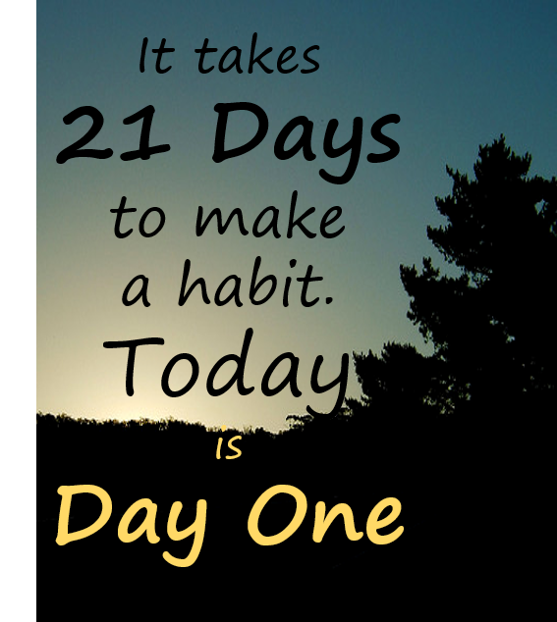
1 | 2 | 3 | 4 | 5 | 6 | 7 | REWARD
 |  |  |  |  |  |  | REWARD
 |  |  |  |  |  |  | REWARD
SELF REFLECTION

Slide 40
Thank You For Listening

Slide 41
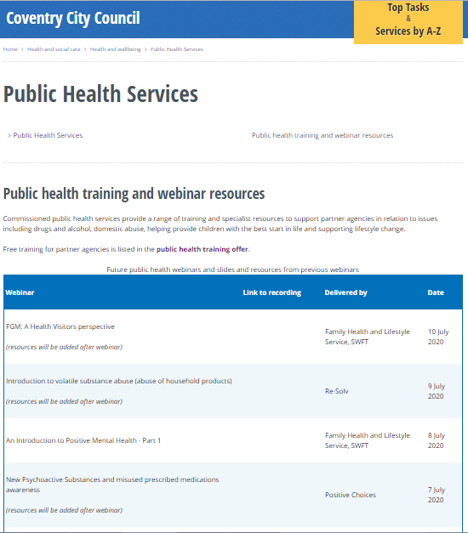
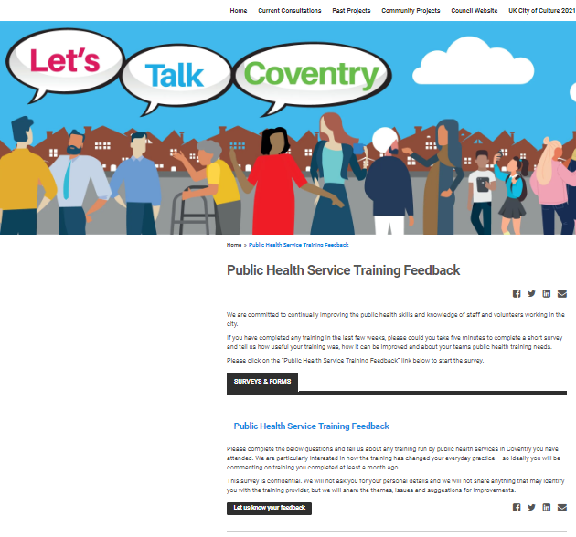
Please visit the City Council website:
Slides and recordings of past webinars
Timetable of future webinars
Details of more in-depth training available free from Public Health services
Google “coventry public health webinars” or visit
www.coventry.gov.uk/info/190/health_and_wellbeing/3283/public_health_services/2
Feedback and ideas for future webinars
Please give is your feedback and suggestions of future webinars via the Let’s Talk Coventry site at https://letstalk.coventry.gov.uk/publichealthtraining
Part 2 Positive Mental Health – 17th September

