Slide 1
Optical illusion art
Watch the different clips showing how to draw optical illusion art. Follow the creative ideas to gain an understanding of how they are created. Once you are confident create your own optical illusion pieces.
https://www.youtube.com/watch?v=gkdMY4Bf-9w
https://www.youtube.com/watch?v=KnZQYXPJnXU
https://www.youtube.com/watch?v=ZW0evffIxEM
https://www.youtube.com/watch?v=NZfj81PEn9o
https://www.youtube.com/watch?v=Fiv5HQ4hvd8&list=TLPQMDYwNzIwMjDpWTtDcjlT4A&index=2

Slide 2
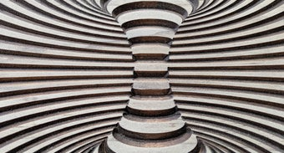
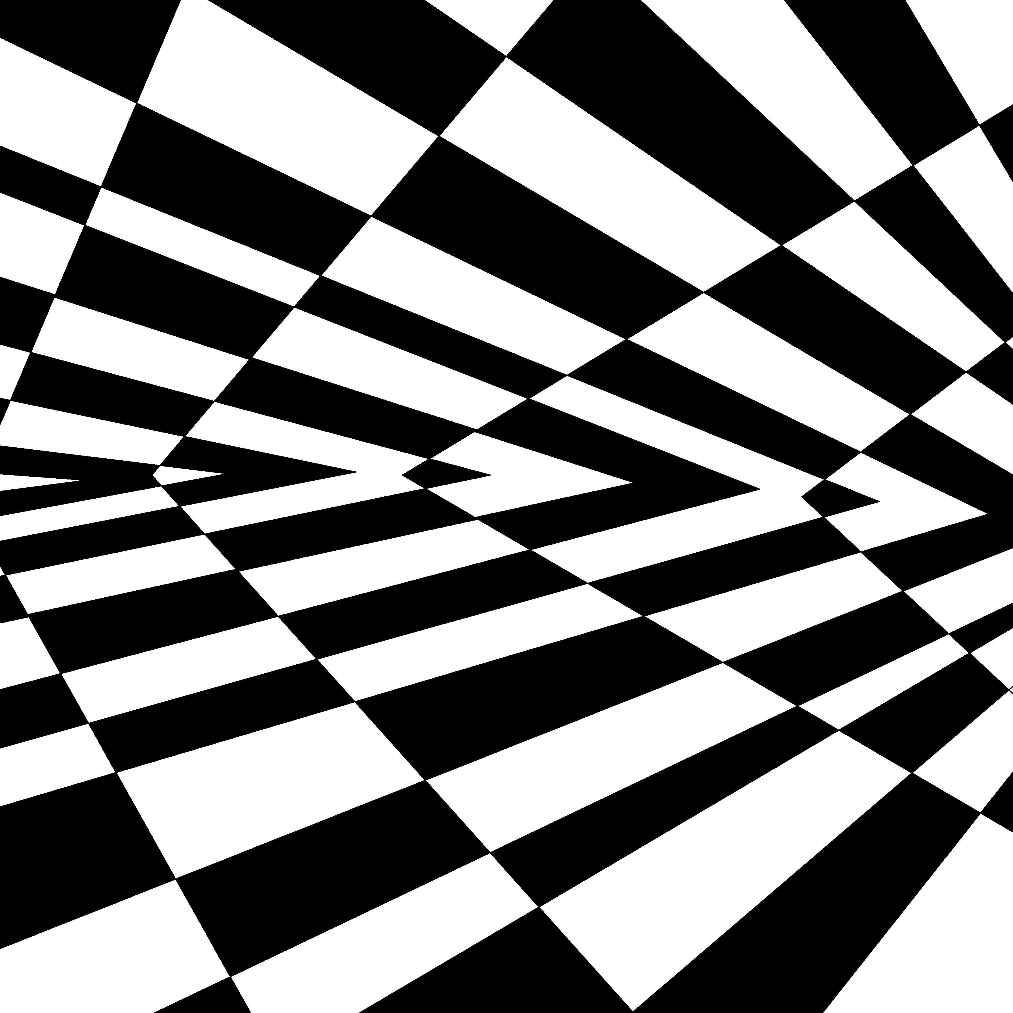
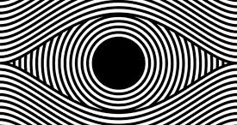

Slide 3
