Slide 1
KS3 Adapted resouces for distance learning July 2020
L.O. To use investigative techniques to find out who committed the murder at Muchley Manor

Slide 2
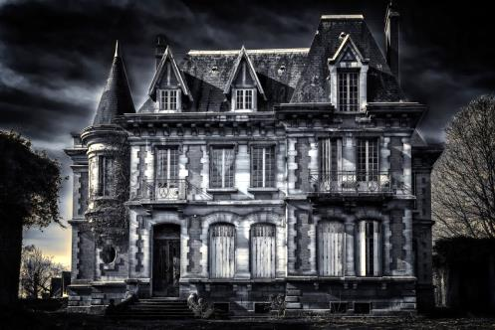
You and your team have been called to the town of Chumley, in the English countryside to investigate …
… the murder at Muchley Manor

Slide 3
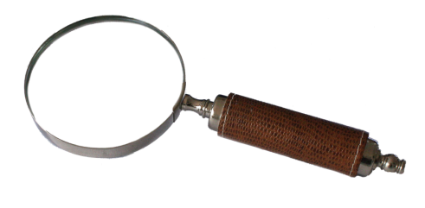
A young man, the nephew of Colonel and Lady Muchley, David, has been brutally murdered …
Your team is going to explore the manor, searching for clues as you go. Keep a note of every clue and every word, as they could all prove crucial at the end!

Slide 4
Before we go in, we need to get our brains warmed up and ready to solve the crime!
How many words of three letters or more can you make from the letters in the word …
You can use each letter only once unless it appears more than once. You have three minutes!
FORENSIC INVESTIGATION

Slide 5
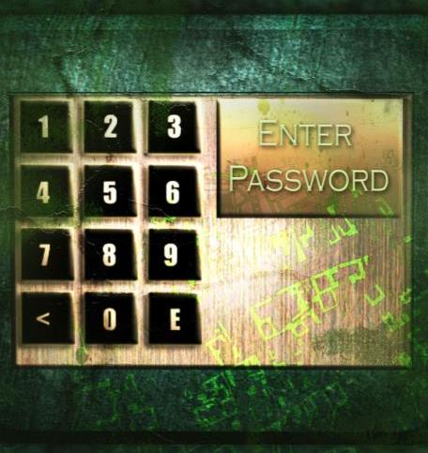
You knock and ring the bell, but nobody answers.
It is then that you notice the plaque and keypad next to the door.
Write down the correct forms of there/they’re/their and the door code.

Slide 6
there = 1, they’re = 2, their = 3
There
_______ is a group of friends who like to spend time together.
_______ out for a walk when the weather closes in.
They lose _______ way in the woods.
_______ getting wet in the storm.
‘There’s a house over _______!’ Tom shouts.
_______ is no one in the house when they knock on the door.
_______ starting to get cold.
David lights _______ way with a match.
The door slams behind them. _______ is silence.
_______ screams echo off the walls.
They’re
their
They’re
there
There
They’re
their
There
Their
Enter passcode: ______________
Keep a note of this passcode – you’ll need it later!
1232112313

Slide 7
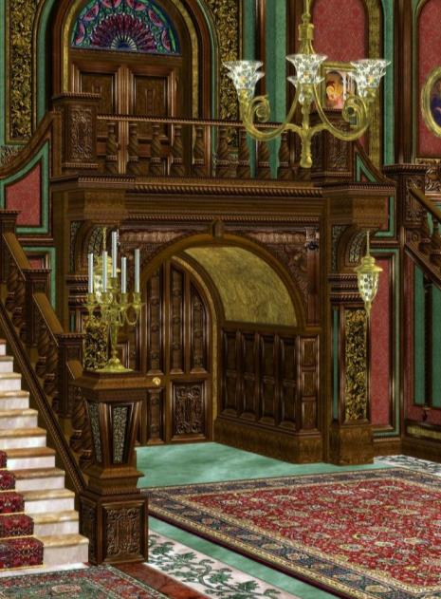
You’re in. As you look around, you realise that this is a very large house, and this mystery will take a bit of unpicking. But first, it’s time to meet the family and their guests. Remember – everyone’s a suspect!

Slide 8
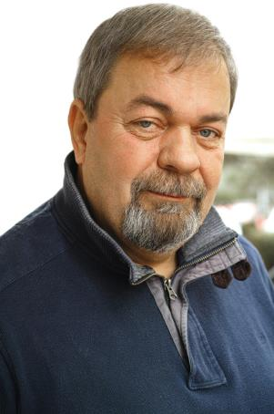
Colonel Colin Muchley
Long since retired from the British army, Colonel Muchley comes from a long line of Muchleys, in a very wealthy family. He is wealthy in his own right due to writing hugely successful war themed books after his retirement from active service. He has been in very poor health recently.
Make brief notes on the characters to refer to later.

Slide 9
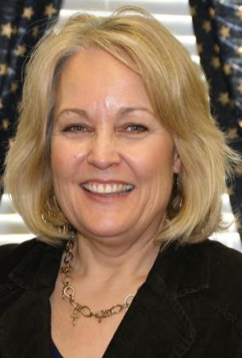
Lady Ethel Muchley
Although charming, Lady Muchley’s smile never reaches her eyes. She is absolutely devoted to her family, particularly her daughter, and only child, Sadie. She is a member of the parish council.

Slide 10
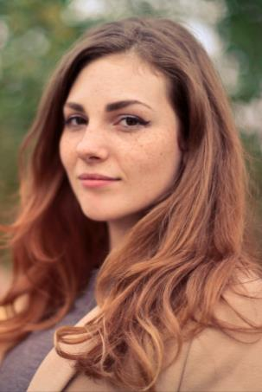
Sadie Muchley
Sadie Muchley has studied fashion and design at university. Desperate to keep in touch with her old college friends, she often throws wild parties and has a reputation for being a little wild and reckless. She is a very emotional person and can become upset easily.

Slide 11
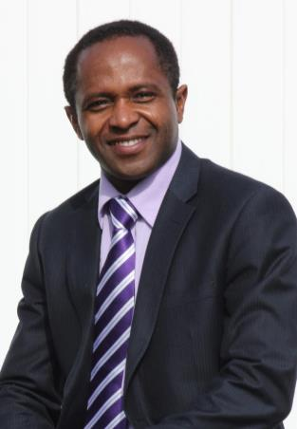
Sir William Hawksley
Hawksley is a tremendously wealthy man. He is an old Army friend of the Colonel, and made his fortune through land development and property. He is at the party to discuss the possible purchase of land around the manor for development. He gives generously to charity.

Slide 12
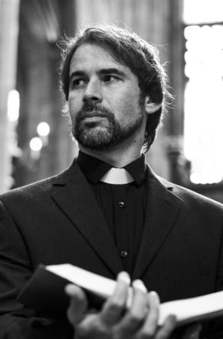
Reverend Jeremy Laxton
Although he is a man of God, Reverend Laxton has a reputation for being a bit of a straight talker, and often easily offends other people. He arrived here very suddenly two years ago under secretive circumstances. To this day, nobody knows why he moved from his old parish.

Slide 13
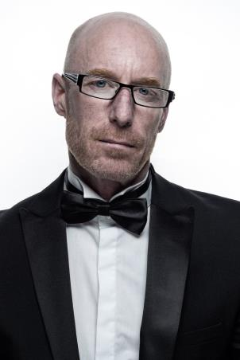
Peeves, the butler
Peeves lives up to his name. Although he is good at his job, he is often both miserable and spiteful. This is probably something to do with the fact that his family was once richer than the family he now serves, but his father lost it all betting on the stock market.

Slide 14
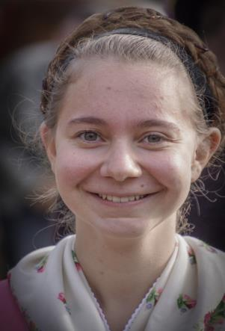
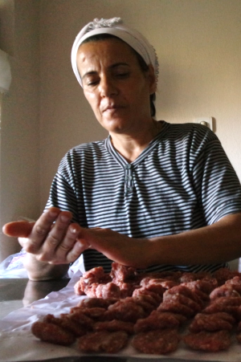
Magdalena, the cook
No one knows a great deal about Magdalena, as she keeps herself to herself. Local rumour has it that she knows all about herbs and poisons, and comes from a long line of witches, though this has never been proven.

Slide 15
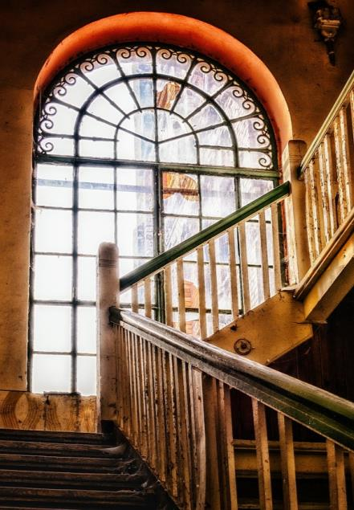
You decide to begin the search in some of the upstairs rooms.
Remember – make a note of any clues as they might prove useful!

Slide 16
Let’s make a start in the master bedroom.
There’s a book of poetry on the bedside table. You open it out of curiosity and a piece of paper used as a bookmark falls out.

Slide 17
Select the poem’s words wisely!
Use the door code to write down a word from each line.

Slide 18
The doors of my love-struck heart,
A victim of love’s true dart,
Are opened. Lady, please walk in.
Here, beneath the heavens, my mind spins,
The days all blend into one
The nights are a mess of confusion
Lost in the turmoil of emotions.
I am committed to one, only one,
Of who I am in admiration,
And the house of my love bids her welcome.

Slide 19
You move on into the bathroom. You use the toilet and, as you’re washing your hands afterwards, the steam from the taps reveals some writing on the mirror.
Notes:
© darkday, 2014, flic.kr/p/pQZ4Cz

Slide 20
Correct the errors and write down the letters you have corrected. You should have two more clues.
Sometimes, I feel so alone.
mornings are the worst. until a year ago, I never knew what sadness was, but now I do. rarely does a day pass without the fear gripping me. dawn and dusk are as dark as each other. every day is a struggle just to survive. right now, I can’t see a way forward.
when will it end? When can i be free? tomorrow never seems to come, and always seems out of reach. heartbreak is all I have in store.

Slide 21
You have finished upstairs. It’s time to go back downstairs, moving into the study.

Slide 22
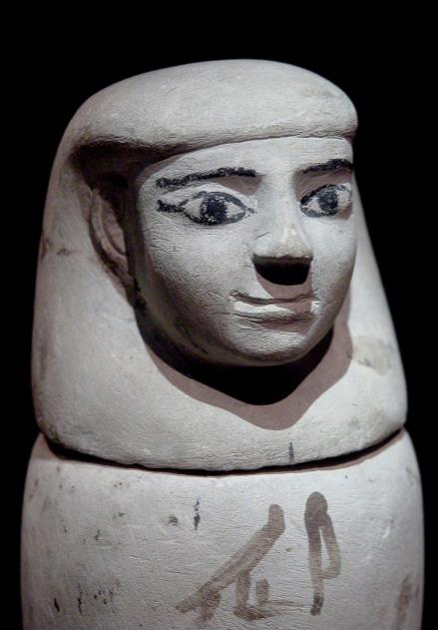
There is lots to see here, but particularly interesting is a small area of Egyptian artefacts – the family clearly love Egyptology!
You pick up a small statue and notice a written code on the bottom.

Slide 23
Use the key on the left to decipher the message.
Notes:
© By Alphabets alphabetical - Own work, commons.wikimedia.org/w/index.php?curid=39702181

Slide 24
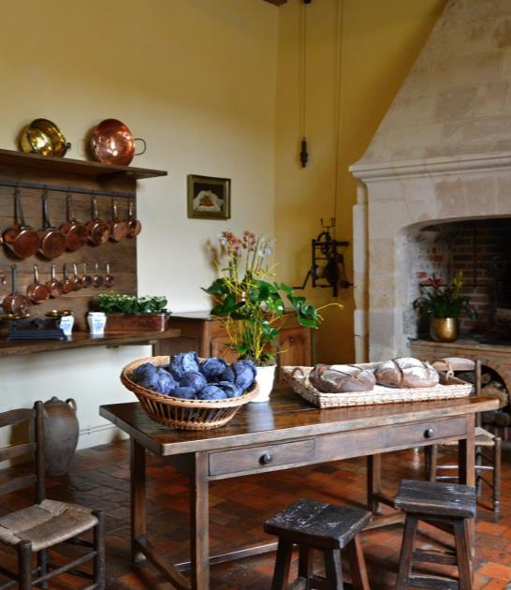
On down the corridor now, and it’s time to visit the kitchen.
You begin to look around and notice a piece of paper on the worktop. It seems like a recipe ...

Slide 25
Identify the first letters of the adjectives:
The simple, perfect way to roast an awesome chicken is to take your time.
A nice, neat work surface also helps to make the preparation and cooking
an easy and relaxing process.

Slide 26
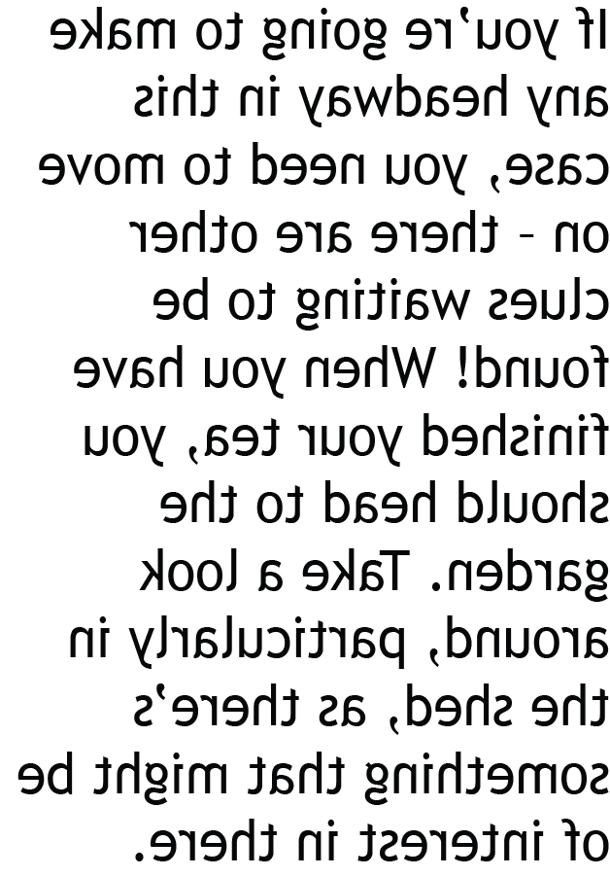
Time for tea!
You take a quick break and have a cup of tea while you decide where to go next. On the back of the recipe is the following note, but it’s backwards. Decipher the message to discover where you need to go next.

Slide 27
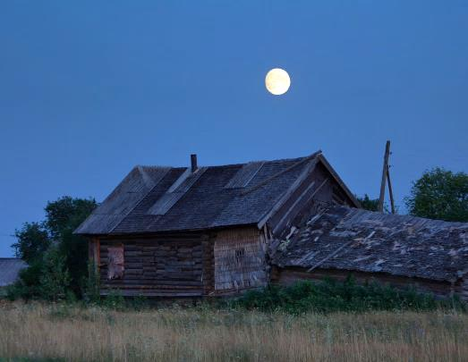
You pay attention to the note and step out into the garden for a bit of fresh air. As it suggested, there’s an interesting looking shed with its door swinging in the breeze.
There’s just enough moonlight coming through the window for you to be able to investigate a little ...
Notes:
© By Stanislav Drozdov, commons.wikimedia.org/w/index.php?curid=53132593

Slide 28
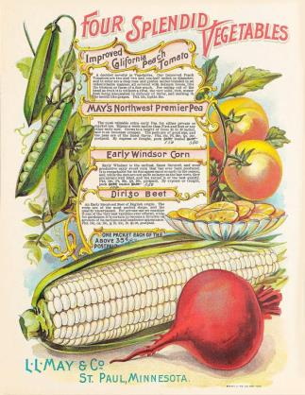
You begin to poke around on a work bench, and are moving packets of seeds around when you notice some writing on the back of one of these packets.
My first is in ‘old’ and in ‘not’ too,
My second is in ‘love’, but not in ‘vote’,
My third begins ‘door’ and is there at the end,
My fourth is in ‘rote’ but not in ‘root’,
I’m doubled in the river flowing on through.

Slide 29
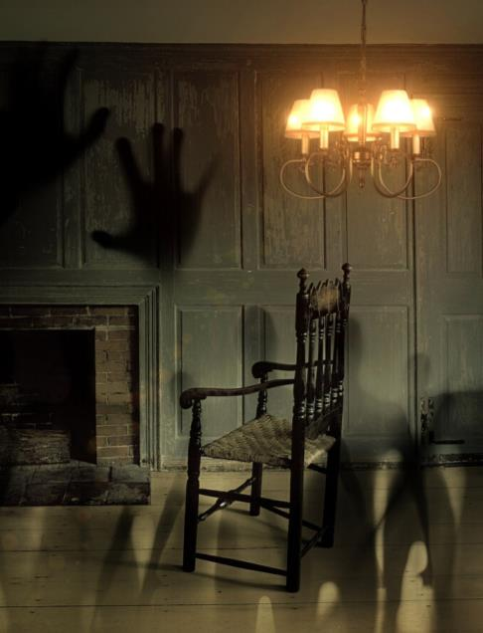
That’s enough time pottering about in the shed. Back into the house and down that corridor to the sitting room …
Everything seems to be in order here. But what’s that standing in the corner?

Slide 30
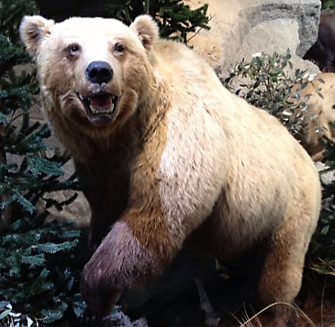
In the corner of the sitting room there is a huge, stuffed bear, obviously the result of a hunt at some time in the past.
There is a rolled up piece of parchment between the bear’s feet. It seems to outline the process for hunting a bear, but it doesn’t make sense. There’s also some kind of strange number/letter key on the sheet.

Slide 31
Put the instructions in the right order, and then use the code on the left to identify four clues.
Bear hunting
Instruction | Word
When you finally locate the bear, keep low and minimise noise.
First, begin to track a bear by finding its trail – paw prints are a good place to start.
Aim so that you will be hitting the heart.
Wait until the bear is still, then take careful aim.
Breathe deeply, then squeeze the trigger gently.
Follow the trail, staying downwind at all times.
1 : 5
3 : 5
5 : 7
6 : 5

Slide 32
Bear hunting
Instruction | Word
1 : 5
3 : 5
5 : 7
6 : 5
First, begin to track a bear by finding its trail – paw prints are a good place to start.
Follow the trail, staying downwind at all times.
When you finally locate the bear, keep low and minimise noise.
Wait until the bear is still, then take careful aim.
Aim so that you will be hitting the heart.
Breathe deeply, then squeeze the trigger gently.

Slide 33
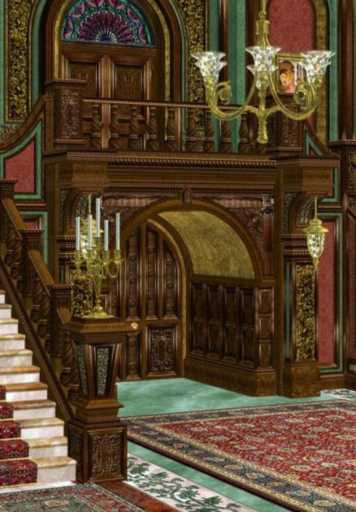
You’re almost there – the clues are starting to mount up, but there’s one final piece of the puzzle that needs to be found. You look down at the wall and there’s a display – a set of grammatical rules. But what’s this? Some of them don’t seem right ...

Slide 34
You begin to work out which ones are true and false and, as you do so, you realise that there’s a pattern emerging in the first letters of the rules which are true. They spell out a word!
F
F
T
T
F
T
T
T
F
F
T
‘To’ and ‘too’ mean the same thing.
‘Instant’ is a verb, a doing word.
Good dialogue (spoken words) should always have speech marks around it.
Always use a question mark to end a question, even a rhetorical one.
‘Lazy’ is a noun, a naming word.
‘Rapidly’ is an adverb, a word that describes how a verb is carried out.
Don’t use apostrophes for plurals i.e. ‘book’s’.
Even short sentences need to begin with capital letters.
‘Maid’ is an adjective, a describing word.
You do not need to write ‘I’ on its own with a capital letter.
Not all nouns need to begin with capital letters.

Slide 35
Coming to a deduction
That’s it – the clues have been collected, and all the family and their guests are gathered in the sitting room to find out who the murderer is.
You just have one more thing to do. Unscramble all the word clues you have collected into one sentence so that you can make the formal accusation and the arrest! You should be able to state who committed the crime, how and with what, where and when.

Slide 36
And the murderer is …
Lady Ethel Muchley
‘The older lady of the house committed murder, hitting the victim with a spanner, in the garden, beneath the moon.’
Can you think why?
Lady Ethel Muchley, concerned about the fact that her nephew, the only male relative and heir, will inherit Muchley Manor upon her husband’s death and kick both her and her daughter out! With David’s death, the house must then pass on to the sole remaining child – Sadie, to whom she is devoted.

