Slide 1
Creative writing
https://wordwall.net/resource/41147/english/examples-descriptive-devices

Slide 2
DO NOW – match the similes
As quick as
a racing car
ice
As smooth as
a baby’s skin
A knife
As ugly as
a wart
A baby’s skin
As sharp as
a knife
The sun
As sly as
A racing car
a fox
the sun
As hot as
A fox
As cold as
ice
A grave
As quiet as
a grave
A wart
Notes:
A quick warm up. Do NOW!

Slide 3
DO NOW! Which technique has been used in the following sentences?
The sun saluted the passers by...
The children were cotton wool being blown in the breeze.
The nasty chink of the old swing sang merrily.
Creak! The children played on the see saw.
The pool lit up like a light bulb under the blazing sun.
The smell of succulent sausages floated in the air.
The toddlers played peacefully in the park.
There are at least 12 examples of RASMOPS – can you find them all?
Did I miss any?
RASMOPS - Repetition, Alliteration, Simile, Metaphor, Onomatopoeia, Sibilance
Notes:
This task could be completed as a class or printed off and given to students individually. There may be more than one example of a device, encourage students to identify all.

Slide 4
A golden ring | A letter | A new neighbour
An old wardrobe | A piece of good luck | An old class mate
An empty room | A new discovery | A farmer
A wise fox | A hidden secret | Young girl
An expensive watch | A love of chocolate | A crazy scientist
A locked door | A mistaken identity | A grumpy granny
An old watch | A fear of spiders | A long lost friend
A pair of binoculars | A search for happiness | A mysterious woman
A black hat | A long journey | An angry chef
A party invitation | A hidden secret | A football star
A letter | A drowning | A glamorous woman
Select at least 4 of the prompts and use them to create your own story.
See my example on the next slide.

Slide 5
A glamorous woman appeared out of the darkness, her diamonds sparkled under the deep red spot light of the red carpet. Her golden taffeta gown billowed in the delicate breeze, as she bowed and nodded to the eager crowd. She stared straight ahead, her ice cold eyes lacked any emotion. The red painted smile stretched awkwardly across her thin, pale face.
What they didn’t know, what no one knew, was that hidden in the expensive folds of fabric was something she treasured, something she never left behind….
A letter, handwritten, weathered with the stains of time lay stitched into the underskirt of her garment. The words etched not only on the paper but deep into her soul. They reminded her of the past, of a time when life was very different. A time before the argument.
He never wanted her to pursue her dream of being an actress. He had begged her not to leave for the glittery lights of fame but to stay behind – with him. They ‘could have a fabulous life together,’ he wrote.
But she wouldn’t listen. She wanted the bright lights, the fame, the adulation – marriage and Tim could wait.
If only she’d known that their time was short. ‘A drowning,’ they said; ‘couldn’t help him,’ they said. A passer-by spoke of how she saw a man, head slumped low, slowly wade into the murky water of the stagnant river. He swam into the depths of the darkness ahead. Not looking back or pausing for breath…. until he vanished from sight.
This is how I would do it!
Challenge: Read through and identify any descriptive devices –
Repetition Alliteration Similes Metaphors Onomatopoeia Personification Sibilance
Notes:
Example of responding to task.

Slide 6
More story tasks to get you started
Write about a time when you felt scared.
Write a story that begins with the line: They had almost made it.
Write a story with the following title: The Phone Call
Write a story about something strange or odd happening in your school.
Write a story beginning with the following: I had never seen anything so disgusting in my life.

Slide 7
Story Openers …….
I didn’t ask for a dragon as a pet
Losing the keys to the kingdom was not going to look good, especially as this was my first day…..
I admit that I was jealous, but what happened at the competition wasn’t entirely my fault…..
Agreeing to meet at the old museum was my first mistake. The second was agreeing to go over the barrier that clearly said ‘Do Not Cross!’ in bold print.
The room that I was trapped in was bare and cold. The door was bolted and my throat was hoarse from shouting for help. No one was coming to rescue me. If I was going to get out of this, I would have to do it myself.
It started four nights ago. Seeing the shape again now made me shudder.

Slide 8
Write a description suggested by this picture. Or Write a story with the opening sentence Today was the day. Tomorrow would be different. Life will never be the same again.

Slide 9
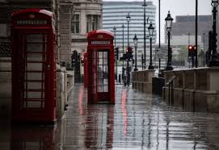
Creative Writing Write a description as suggested by this picture. OR Write a story about a time when time stopped.

Slide 10
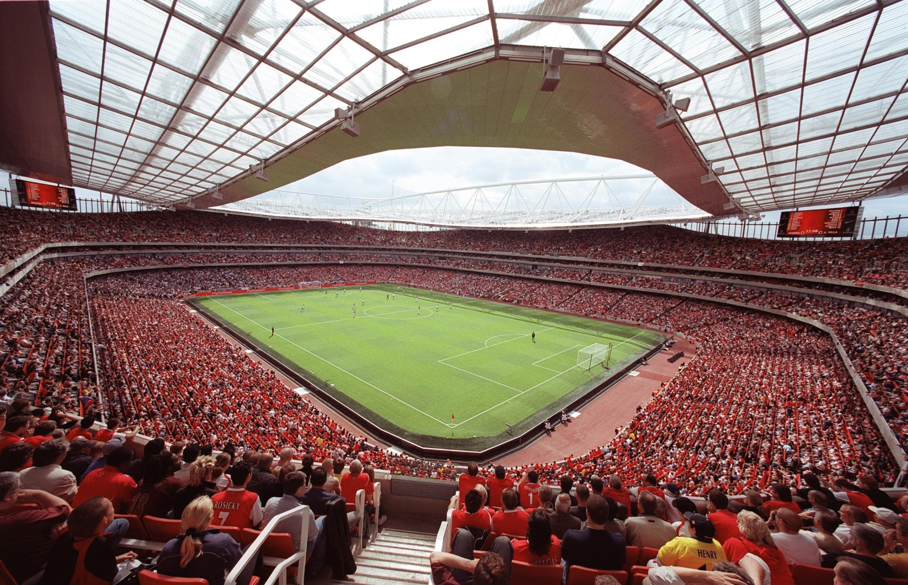
Write a description suggested by this picture.
OR
Write about a time you attended an exciting event.

Slide 11
Stop and Check…………Have you…..
Used paragraphs
Included lots of descriptive detail – ‘show’ don’t ‘tell’ (RASMOPS)
Chosen the correct homophone – there/they’re/their etc
Used the correct spelling.
Included short sentences for effect?
Used a new line for a new speaker when using speech?
Used punctuation consistently.
Used capital letters at the start of sentences and for proper nouns.
Used a range of punctuation – exclamation marks, question marks, semi-colons, speech etc?

