Slide 1
The Blue Sky Centre Supporting Victims/Survivors of Sexual Assault in Coventry and Warwickshire

Slide 2
Your Questions are (probably)
What is a SARC?
Where is it?
When is it open?
What does it offer me?
Contact details?
How do I refer?

Slide 3
What is a SARC?
“A SARC is a one-stop location where victims of rape, sexual abuse and serious sexual assault, regardless of gender or age, can receive medical care and counselling and have the opportunity to assist a police investigation, including undergoing a forensic examination, if they so choose.”
(A Resource for Developing Sexual Assault Referral Centres – Home Office, Department of Health, Association of Chief Police Officers – October 2009)

Slide 4
What does a SARC do?
Mainly secure forensic evidence for police cases
Also self-referral, including storage and anonymous submission (stranger or offence uncertain)
Submit anon intelligence
Assess risk of pregnancy and infection
Onward referral to GU, MH and support services
Blue Sky Centre for 18 and over

Slide 5
Forensic timeframes
Vaginal rape – 7 days
Anal rape – 72 hours
Oral rape – 48 hours
Digital penetration – 48 hours
Toxicology – 72 hours (blood) 120 hours (urine)
Underwear, bedding potentially unlimited

Slide 6
Where is it
George Eliot Hospital, Nuneaton
Available 24/7 365 days a year
Free dedicated parking outside
No specific referral process, phone call will do
Unpredictable caseload

Slide 7
Video links
https://www.youtube.com/watch?v=_nqS9kp4jGo&feature=player_detailpage
www.blueskycentre.org.uk

Slide 8
Rape S1 Sexual Offences Act 2003
Penetration (to any degree) of vagina, anus or mouth by penis
Without consent
Offender does not reasonably believe there is consent
Cannot consent when heavily intoxicated, incapacitated or asleep
Only committed by males
Any gender can be victim

Slide 9
Assault by penetration S2 Sexual Offences Act 2003
Penetration by object other than penis, ie finger, bottle, sex-toy
Penetration of vagina or anus (not the mouth)
Perpetrated by any gender
Victim any gender

Slide 10
Sexual Assault
An assault is the touching of one person by another, not necessarily forceful or causing injury
Sexual assault where the touching is sexual
This may be obvious due to the part of the body touched or could be any part of the body if the circumstances make it sexual, ie the words used by by the offender

Slide 11
Historic vicious circle – Rape Myths
Disbelief and other barriers
Under-reporting
Lack of convictions
Offender behaviour
Offending

Slide 12
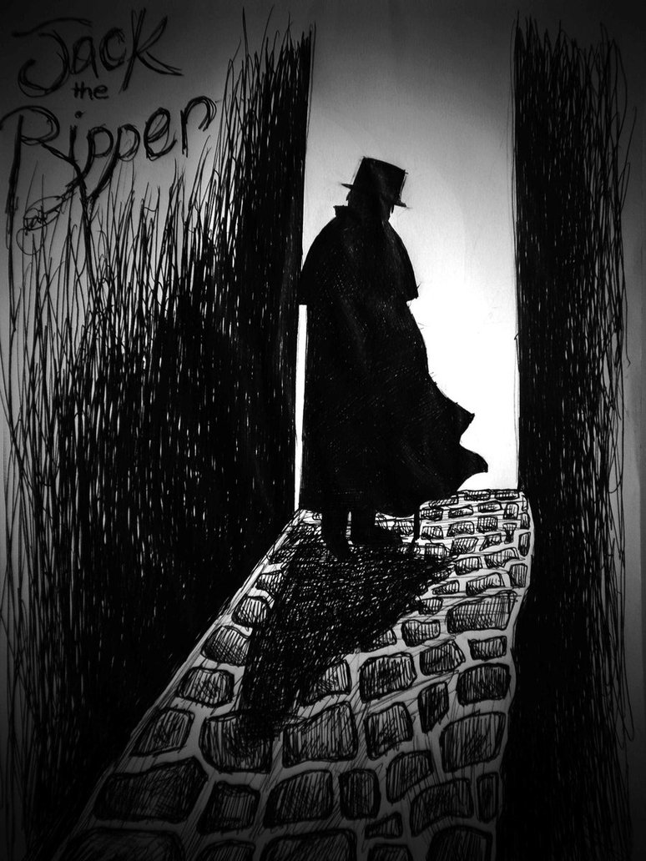
Offence
Rare, near death,
violent, alleyways,
bushes, knife

Slide 13
Offender – Stranger, Half-man Half-beast, Sex-crazed

Slide 14
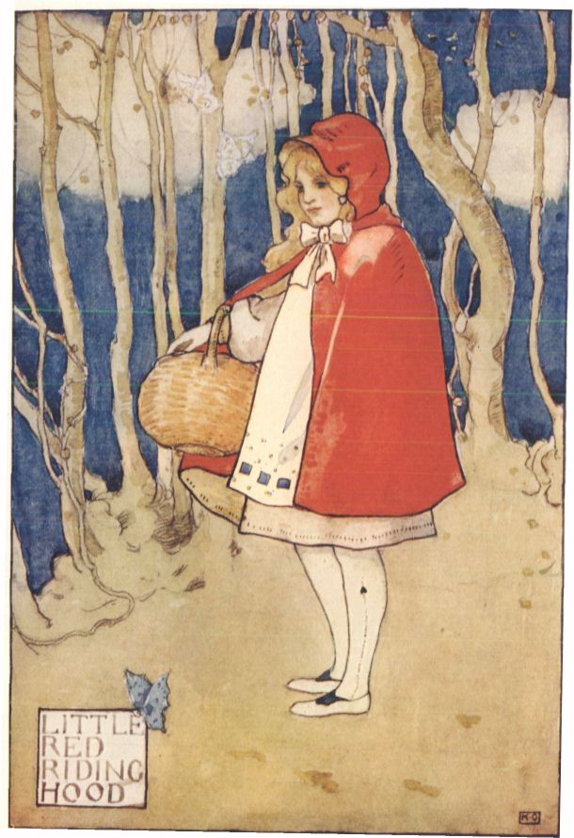
Victim/Survivor – Pure and innocent

Slide 15
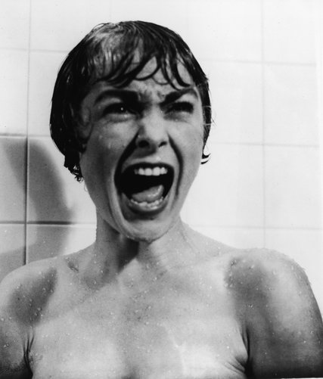
Victims will scream

Slide 17
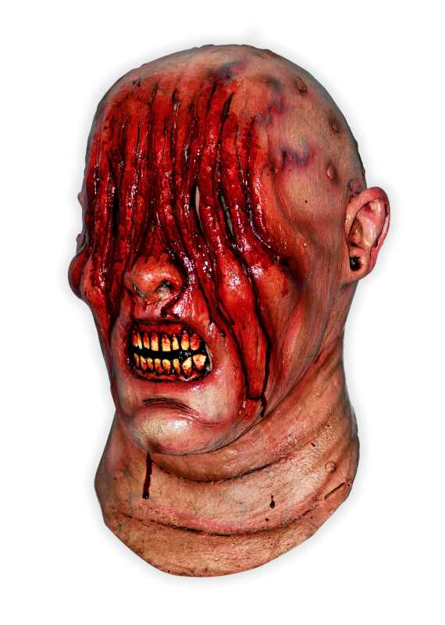
Victims will scratch…

Slide 18
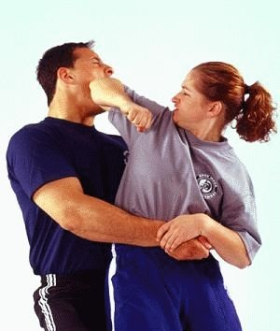
Victims will fight…

Slide 19
Blaming the victim

Slide 20
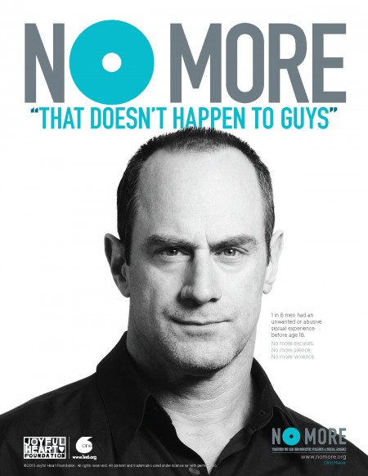
Real men don’t get raped…

Slide 21
Rape/abuse reality
Higher prevalence than popularly thought
Most offenders known
Violence rare
‘Normal’ appearance
About power and control rather than lust
Victims are ‘normal’ too
Amygdala determines response – often illogical

Slide 22
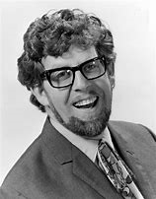
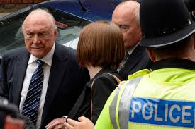
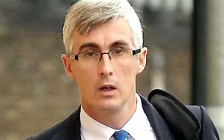
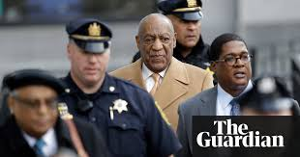
Real offenders

Slide 23
Real victims
Thanks to the bravery of Terry Crews, the actor and former football player best known as the buff sergeant Terry Jeffords in Brooklyn Nine-Nine, we have a vivid real-life example…Last month, Crews alleged that a male Hollywood executive groped his genitals at an event in 2016. Even though Crews is six-foot-three, 245 pounds, and known for his muscular physique, he did not feel he could fight back: “I didn’t want [to be] ostracized – par [for] the course when the predator has power and influence.”
Laura Hudson The Verge November 13, 2017

Slide 24
Who subscribes to the myths?
The public, who make up juries
The public, who are victim’s parents, friends and colleagues
The Police/Social Services
CPS/Solicitors/Barristers/Judges
Journalists
Victims

Slide 25
How many of you are scared of tomatoes?

Slide 26
Spiders?

Slide 27
First glance

Slide 28
Other barriers
Embarassment
Shame
Cultural
Ignorance
Practical – language, disability
Desire to protect offender (CSE in particular)
Desire to protect parents
Lack of awareness of victimhood (children)

Slide 29
Historic reporting rate
10% - 15%
British Crime Survey 2011
Report of Childrens Commissioner 2015
96% report stolen cars
6% conviction of reported rape, 6% of 10% = 0.6%, so 99.4% of rapists escaped justice.

Slide 30
Offender behaviour
Extreme selfishness
Arrogance
Power and control
Link to Domestic Abuse
Why would they stop?
One victim repeatedly or a series of victims
Unless caught?

Slide 31
Contact
Antony Mumford 01926 562160
antony.mumford@uk.g4s.com antony.mumford@uk.g4s.com.cjsm.net (secure)
www.blueskycentre.org.uk
G4S Health Call Centre 0800 970 0370
West Midlands Children & Young Person Service
www.westmidscyps.co.uk
0808 196 2340

