Slide 1
Sexual Health; Infections and Diseases
Webinar

Slide 2
The plan for this afternoon…
Keep your microphones and videos turned off
Use the chat facility to ask questions throughout. A Q&A will be available at the end. All questions are valid- we don’t know what we don’t know!
This is being recorded so please be mindful if you don’t want to be identified
With any level of sexual contact there is a risk of an infection or disease being transmitted between partners.
This webinar will build on your knowledge around these infections and diseases and explore ways in which these risks can be reduced.
Sexually Transmitted Infections and Diseases – picture alert!
Barrier contraception
Local information and services

Slide 3
What are Sexually Transmitted Infections and Diseases?
Sexually Transmitted Infections/Diseases are often referred to a ‘STIs and STDs’.
They are caused by bacteria or viruses and are passed between partners when one is infected.
Ways they can be passed include:
Vaginal, anal or oral sex
Mutual touching
Sharing of sex toys
Hand to eye contact
And potentially from a Mum to baby during birth

Slide 4
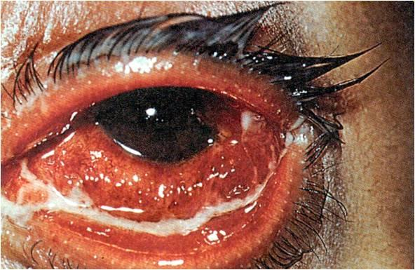
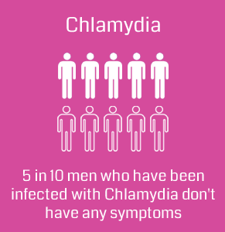
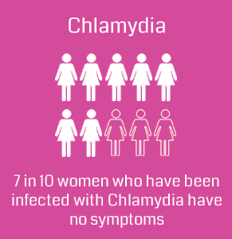
Chlamydia
The most common STI
Chlamydia can infect the eyes or throat if you have unprotected oral sex.
Symptoms:
  Burning and/or itching in the genital area
  Pain when passing urine
  White/cloudy or watery discharge from the penis, Painful swelling of the testicles
  Unusual vaginal discharge, Bleeding between periods, Pain/Bleeding during/after sex, Heavier periods, Lower abdominal (pelvic) pain
Treatment:
Antibiotics

Slide 5

Gonorrhoea
Bacterial infection
Can be known as "the clap"
Second most common STI
Symptoms:
Around 1 in 10 infected men and 5 in 10 infected women don't experience any symptoms.
a thick green or yellow discharge from the vagina or penis
pain when urinating
bleeding between periods in women.
Treatment:
In most cases, treatment will involve having a single antibiotic injection followed by one antibiotic tablet.
There are cases that are untreatable due to Gonorrhoea becoming resistant to anti-biotics.
Untreated, it can cause infertility and Pelvic Inflammatory Disease (PID).

Slide 6
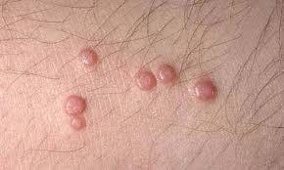
Genital Warts
Small fleshy growths, bumps, skin changes that appear on or around the genital or anal area
Caused by a virus
Usually painless
Can take up to one year to develop
Treatment:
Visual examination – several treatments – creams, freezing warts but can come back. They do not pose a serious risk to health so treatment is cosmetic.

Slide 7
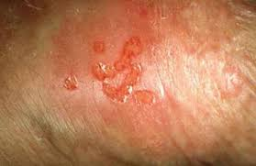
Genital Herpes
Causes painful blisters on genitals and surrounding areas.
A cold sore can pass on herpes through oral sex.
Virus – can not be cured but be managed – can come and go.
It remains in your body and can become active again.
Treatment:
Anti-viral Medication and a cream for pain

Slide 8
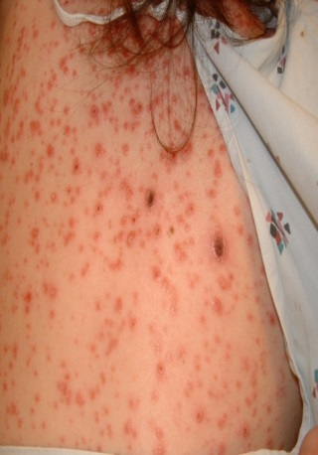
Syphilis
Bacterial infection
Stage 1 (Primary Syphilis) – Painless but highly infectious sore’(s) on the genitals. The sore lasts two to six weeks before disappearing.
Stage 2 (Secondary Syphilis) – Skin rash and sore throat, these symptoms may disappear within a few weeks, after which you experience no symptoms which can last for years.
Stage 3 (Tertiary Syphilis) – at this stage, it can cause serious damage to the body, it may affect the brain, nerves, eyes, heart, bones, skin or blood vessels, potentially causing; Stroke, Dementia, paralysis, blindness, heart disease.
Treatment: Blood test, can be treated by antibiotics.

Slide 9

HIV
HIV is a virus which attacks the immune system, and weakens your ability to fight infections and diseases.
Most people who are infected with HIV experience a short, flu-like illness that occurs two to six weeks after being infected. After this, HIV often causes no symptoms for several years.
AIDS is the final stage of HIV infection, when your body can no longer fight life-threatening infections. With early diagnosis and effective treatment, most people with HIV will not go on to develop AIDS.
Coventry has one of the highest rates in the West Midlands
PEP and PREP
PrEP: Short for “pre-exposure prophylaxis,” PrEP is an HIV prevention strategy in which people take an oral pill once a day before coming into contact with HIV to reduce their risk of HIV infection. ... PEP must be started within 72 hours after HIV exposure, stop the virus taking over healthy cells.
Treatment:
There is no ‘cure’ for HIV, but ART (antiretroviral therapy) will stop the virus from reproducing in the body. It
can reduce the amount of virus in the blood to undetectable levels, meaning that the virus cannot be pass on.

Slide 10

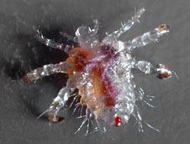
Pubic Lice
Severe itching around the genitals.
Small nits (& eggs) on pubic hair and underwear.
Treatment:
Lotion

Slide 11
How can the risk of getting an infection be reduced?
As (the majority) STI’s are transmitted via the exchange of bodily fluids…
‘Barrier’ contraception methods should be used

Slide 12
Explore your knowledge…
According to research by YouGov and Public Health England (PHE), how many 16 to 24-year-olds surveyed admitted to having sex with a new partner without using a condom?
Almost ¼
Almost ½
Almost ¾
√
The same survey found that how many sexually active 16 to 24-year-olds had never used a condom?
One in 5
One in 10
One in 15
√

Slide 13
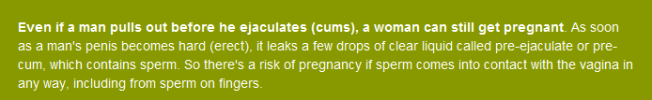
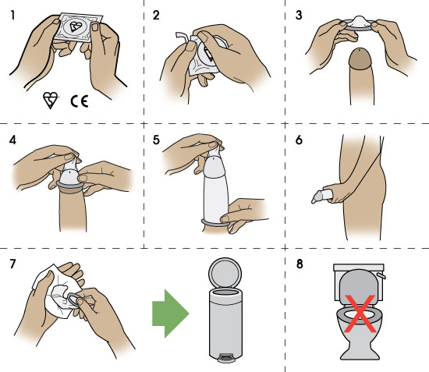
Condoms
Condoms are the most commonly used barrier method of contraception. If used correctly, condoms are 98% effective at protecting against most STIs like chlamydia and gonorrhea. However, condoms don't protect you from all STIs such as herpes, genital warts and syphilis which can be spread from skin-to-skin contact.
Condoms should be used every time you have vaginal, anal and/or oral sex.
Condoms must display the BSI Kite mark and/or CE mark on the wrapper – this means they have been machine-tested to a really high standard.

Slide 14
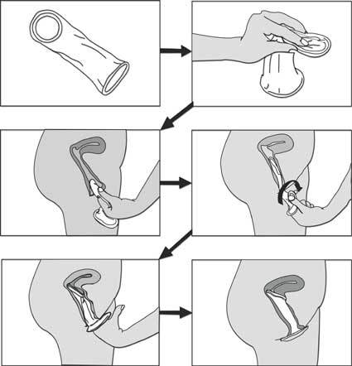
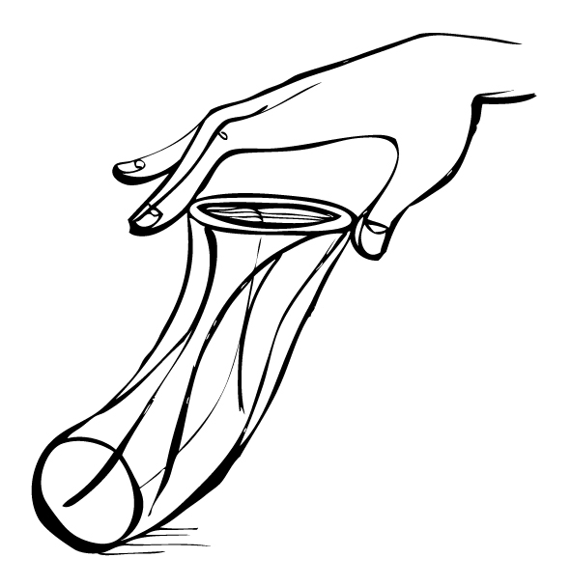
Femidoms
Femidoms are like male condoms except they fit inside the vagina. They are 95% effective IF used correctly every time you have sex.

Slide 15
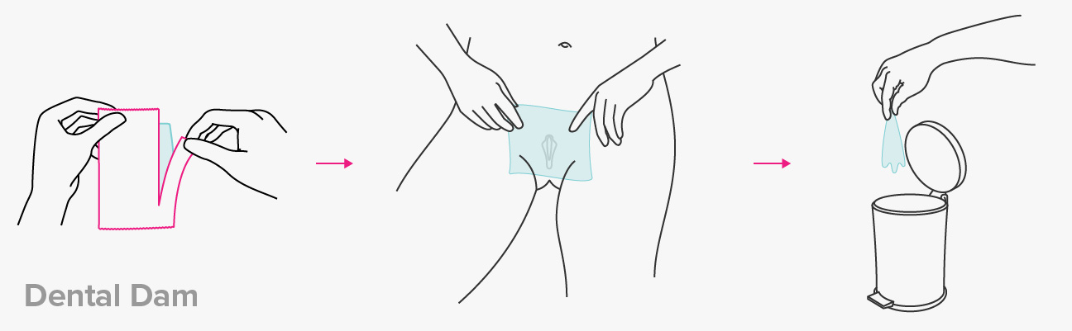

Dental Dams
A Dental dam is made of the same material as a condom. However they are flat and rectangular which are then used for protection during oral sex.

Slide 16
What is Coventry like for Sexual Health?
Living in Coventry means we should be aware of our local trends and concerns.
Remember; knowledge is power!!

Slide 17
What’s the picture for Coventry…
In 2017, over half (53%) of all new STIs were diagnosed in individuals aged under 25 years.
Chlamydia infections are responsible for half of all new STIs in the West Midlands and are particularly common in those aged under 25.
The overall diagnosis rate for Gonorrhea has increased gradually over the last ten years. The highest rates in 2017 were reported in Birmingham, Coventry and Walsall.
Syphilis is also on the increase
Herpes has shown a dramatic decrease (14%) which is likely due to the HPV Vaccine.
Early diagnosis of STIs and HIV leads to fewer complications and reduced transmission to other partners. Regular testing is always recommended, even if you are not noticing signs or symptoms. It is recommended you complete a screening with a change of partner.
PHE; Spotlight on Sexually Transmitted Infections in West Midlands

Slide 18




What support do we have available in Coventry?
We are lucky in Coventry to have access to multiple services to support people with their Sexual Health.

Slide 19
Positive Choices
Positive Choices are the commissioned service in Coventry to support young people around their Sexual Health. Some of the ways we can support include:
Are you ready? - Message exploring feeling ready for intimacy
Registration for C-Card Scheme
Building knowledge on STIs
Exploring the pros and cons of different forms of contraception
Stages of intimacy
Condom negotiation and demonstration
Arranging & supporting medical appointments
Building knowledge and confidence around consent
Parental aspirations

Slide 20
C-Card
Provides 13-25 year olds who live in Coventry with the opportunity to access free condoms, Chlamydia screenings and information on sexual health services within Coventry.
It’s confidential and is easy to access with a range of venues able to provide them including Pharmacies…just look for the C-Card sign in the window!!
To find the closest venue please use the following link:
https://www.ishs.org.uk/health-services

Slide 21
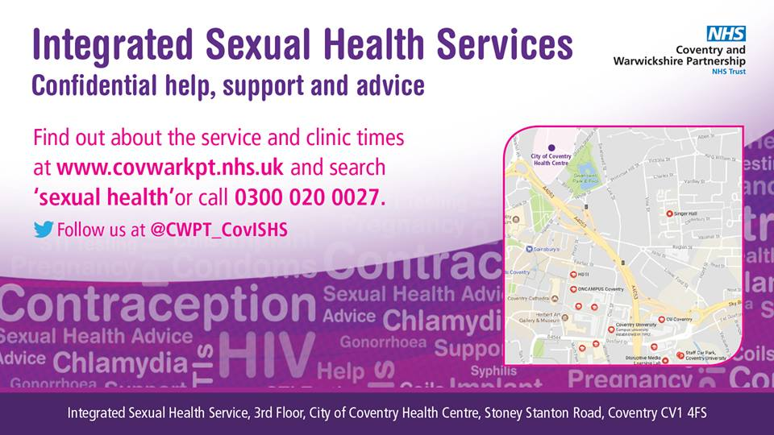
Integrated Sexual Health Service
This is where you can discuss and access support for anything sexual health related!
On offer is:
Sexual health screening
Contraception
Emergency contraception
Pregnancy testing

Slide 22
Get in touch!
If some of the module has left you with further questions or would like to refer someone; then please get in touch!
Address:
23-25 City Arcade, Coventry
Phone:
02476 010245 coventryyp.info@cgl.org.uk
Website:
www.changegrowlive.org/coventryyp Referrals and online chat
Facebook:
https://www.facebook.com/PositiveChoicesCov
Instagram:
Positivechoices_Coventry
Twitter:
@PosChoices_Cov

Slide 23
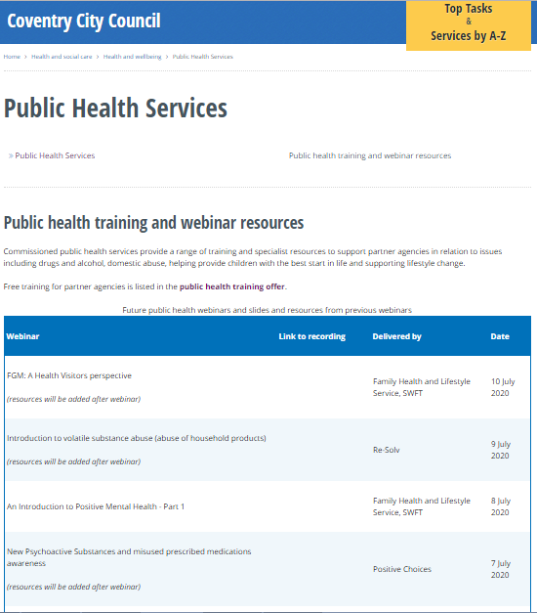
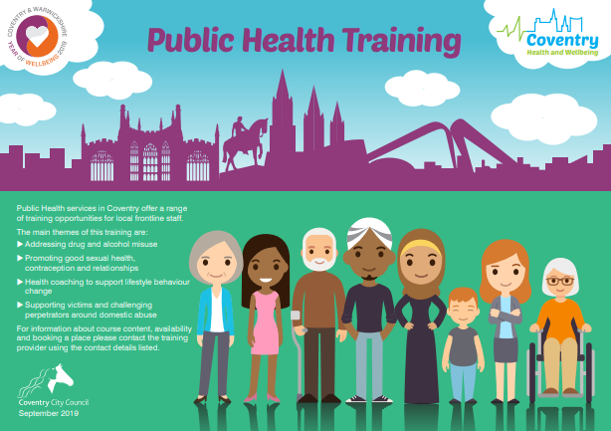
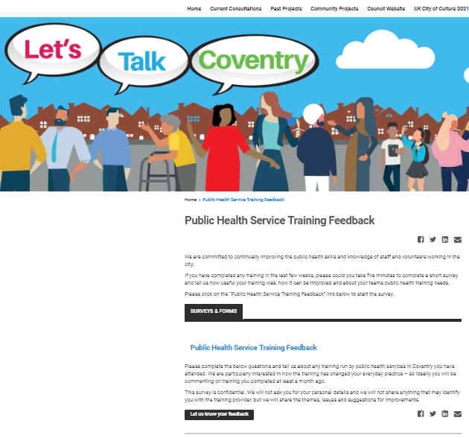
Thank you for listening
Please visit the City Council website:
Slides and recordings of past webinars
Timetable of future webinars
Details of more in-depth training available
free from Public Health services
Google “coventry public health webinars” or visit
www.coventry.gov.uk/info/190/health_and_wellbeing/3283/public_health_services/2
Feedback and ideas for future webinars
Please give is your feedback and suggestions of future webinars via the
Let’s Talk Coventry site at https://letstalk.coventry.gov.uk/publichealthtraining

