Slide 1
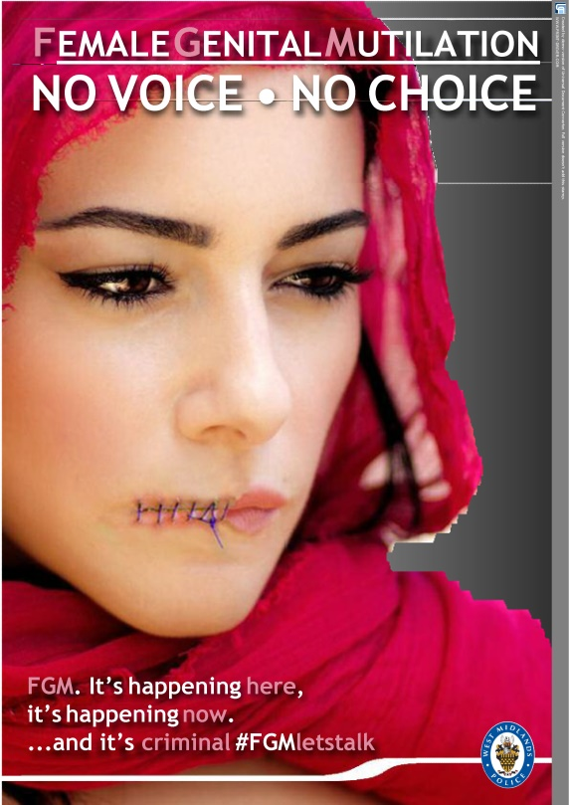
Female Genital Mutilation “Care, Protect, Prevent”
Specialist Health Visitor
Veera Samra

Slide 2
What is FGM
“all procedures involving partial or total removal of the external female genitalia or other injury to the female genital organs for non-medical reasons.”
World Health Organisation (WHO)
It has existed for more than 2,000 years and is performed on girls from birth, up to just before marriage, and sometimes beyond.
FGM is also known as "female circumcision" or "cutting", and by other terms locally.

Slide 3
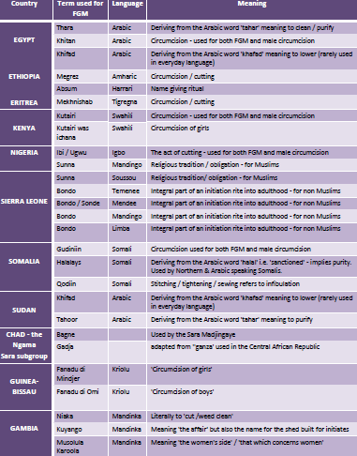
Term used for FGM in various languages

Slide 4
Based on WHO definitions there are four types of FGM:
Clitoridectomy
Type I: Partial or total removal of the (external) clitoris and/or the
prepuce
Excision
Type II: Partial or total removal of the (external) clitoris and the
labia minora, with or without excision of the labia majora
Infibulation
Type III: Narrowing of the vaginal orifice with creation of a covering
seal by cutting the labia minora and/or the labia
majora, with or without excision of the clitoris
Other harmful procedures
Type IV: All other harmful procedures to the female genitalia for non
-medical purposes, for example: pricking, piercing, incising, scraping

Slide 6
GLOBALLY, OVER 200 MILLION WOMEN AND GIRLS ARE AFFECTED BY FGM.
It is estimated that more than 200 million girls and women alive today have undergone female genital mutilation in the countries where the practice is concentrated. Furthermore, there are an estimated 3 million girls at risk of undergoing female genital mutilation every year. The majority of girls are cut before they turn 15 years old.
In the UK, it is estimated that: around 137,000 women have undergone FGM some 60,000 girls under 15 years old are at risk
FGM has been documented in at least 30 countries, mainly in Africa, as well as in the Middle East and Asia. It is also prevalent in diaspora communities around the world (Jewish people living outside Israel)

Slide 8
Reasons for practising FGM

It brings status and respect to the girl.,
It preserves a girl’s virginity/chastity,
It is part of being a woman,
It is a rite of passage, 
It gives a girl social acceptance,
Especially for marriage,
It upholds the family honour,
It cleanses and purifies the girl,
It gives the girl and her family a sense of belonging to the community,
It fulfils a religious requirement believed to exist,
It perpetuates a custom/tradition,
It helps girls and women to be clean and hygienic,
It is cosmetically desirable,
It is mistakenly believed to make childbirth safer for the infant.

Slide 9
What are the health consequences of FGM?
Death
Severe pain and shock
Broken limbs from being held down
Injury to adjacent tissues
Urine retention
Increased risk of HIV and AIDS
Uterus, vaginal and pelvic infections
Cysts and neuromas
Increased risk of fistula
Complications in childbirth and pregnancy
Depression and post-natal depression
Psychosexual problems
Sexual dysfunction
Difficulties in menstruation
Trauma and flashbacks

Slide 10
Coventry
In 2013 Coventry became the first authority in the UK to support a full council motion to condemn the practice of FGM. Protecting girls and women from short and long term harm caused by such practices.
The Coventry Picture
In Coventry during 2016-2017, health agencies newly recorded 60 instances of FGM. In 2017 West Midlands Police recorded 153 referrals in the region with 32 of those in Coventry.
These are only the cases we know about, the actual numbers are likely to be much higher. Remember this is a hidden highly secretive crime…
Work with your partner agencies to protect the most vulnerable who have no voice.

Slide 11
Legal framework
FGM is an illegal practice in the UK and has been since 1985 under the Prohibition of Female Circumcision Act.
This law was extended in the Female Genital Mutilation Act 2003 to address the practice of taking girls abroad to undergo FGM procedures and increased the maximum penalty from 5 to 14 years’ imprisonment.
Female Genital Mutilation Protection Orders (FGMPOs) offer a legal means to protect and safeguard victims of FGM.
FGM is a serious criminal offence with a maximum penalty of 14 years in prison for anyone found guilty.
Expectation that health and social care professionals and teachers in England and Wales report known cases of FGM in under 18-year-olds to the police.
Serious Crime Act 2015 amends the 2003 Act to include:
FGM Protection Orders
Mandatory Reporting Duty
Parental Liability
Lifelong victim / survivor anonymity

Slide 12
What to do if you have concerns about a child at risk of FGM
Inform your designated Safeguarding Lead and refer into MASH
Contact Social Care/Police Child Abuse Investigation Unit
Consider siblings / girls within the practicing community
Risk Assessment Tool/documentation/reporting

Slide 15
FGM conviction Jan 2019
Mother of three-year-old is first person convicted of FGM in UK
Ugandan woman from east London was accused of mutilating daughter in 2017
The mother of a three-year-old girl has become the first person to be found guilty of female genital mutilation (FGM) in the UK in a landmark case.
The Ugandan woman, 37, and her Ghanaian partner, 43, both from Walthamstow, east London, were accused of cutting their daughter over the 2017 summer bank holiday.
While the parents were on bail, police searched the mother’s home and found evidence of witchcraft, including spells aimed at silencing professionals involved in the case. Police found spells written inside 40 frozen limes and two ox tongues with screws embedded in them with the apparent aim of keeping police, social workers and lawyers quiet.

Slide 17
Asking the Question?
Health visitors and community nurses are in a good position to reinforce information about the health consequences and the law relating to FGM and make referrals to other services. They have a duty to take appropriate action to prevent the prospect of any child they care for coming to harm.
•Who? – Best Practice…. BE FEMALE HEALTH PROFESSIONAL WITH FEMALE INTERPRETER.
•How? – sensitively and neutrally.
•Frame it: “We know that in the country you come from, women have a procedure whereby they have cutting done on their private parts, it can be important for us to know about this for you health care…..”
“I notice you come from a country where female cutting is practised?”
During this consultation, the health professional is in a good position to inform the woman of the law and health consequences of FGM, the human rights of children, and the supportive services available.
Health professionals should ensure that this information on FGM in the mother is shared with all agencies to safeguard against FGM occurring to girls within the family. Document in red book as people move around country!

Slide 18
Points to remember!
Maintain a healthy scepticism! HV’s revisit the FGM conversation throughout that child’s journey within Health visiting services and hand over and liaise with appropriate key professionals in their lives such as GP, Practice nurse, School nurses
People’s circumstances change all the time so don’t think if you’ve ask once that’s it!
FGM is a violation of the rights of the child and woman. It is child abuse and illegal in the UK. Remember to complete Data reporting and/or Mandatory reporting.

Slide 19
Support for Victims of FGM in Coventry
Coventry Haven offers various services:-
Specialist practical and emotional support for women, children and girls whom are victims, or at risk of FGM and abuse
Safe refuge accommodation
Training to professionals in statutory and voluntary services
Awareness raising of FGM within practicing communities with community engagement
Recruitment of Community Champions to extend and to reach all communities-Work with communities to change attitudes and engage credible voices.
Coventry Rape and Sexual Abuse Centre (CRASAC) -
Telephone - 02476 277777
website: http://www.crasac.org.uk
Coventry Haven
Telephone - 02476 444077 (Monday - Friday 9am-4.30pm)
Website - https://www.coventryhaven.co.uk

Slide 20
Outreach support group
Friendship Group, held at the Central Library, Smithford Way, Coventry CV1 1FY, please contact Nene on 02476444077 or by email on nojoawo@coventryhaven.co.uk.
Specialist Vulnerable baby clinic held every Wednesday 09.30am-11.30am at Hope centre, Sparkbrook street, Coventry, CV1 5LB
Contact your local Safeguarding team for additional support

Slide 21
Further Resources
FGM Multi agency guidelines
www.gov.uk/government/publications/female-genital-mutilation-guidelines
FGM resource pack
www.gov.uk/government/publications/female-genital-mutilation-resource-pack
Recognising or Preventing FGM training
www.fgmelearning.co.uk
Procedural information for mandatory reporting
www.gov.uk/government/publications/mandatory-reporting-of-female-genital-mutilation-procedural-information
NSPCC FGM Helpline
0800028 3550 fgmhelp@nspcc.org.uk
FGM Unit
fgmenquiries@homeoffice.gsi.gov.uk
Petals Web App
http://petals.coventry.ac.uk/ Young people’s Web App
http://petals.coventry.ac.uk/professionals/ Professionals Web App
Coventry Rape and Sexual Abuse Centre (CRASAC) -
Telephone - 02476 277777
website: http://www.crasac.org.uk
Coventry Haven
Telephone - 02476 444077 (Monday - Friday 9am-4.30pm)
Website - https://www.coventryhaven.co.uk

Slide 22
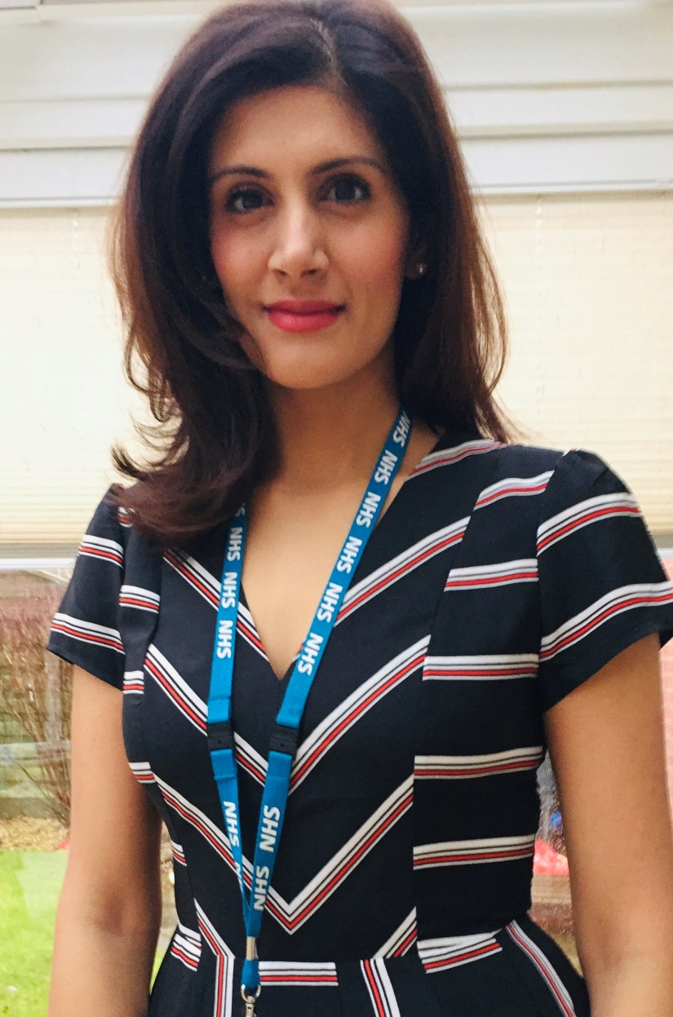
Thank you
Veera Samra
Specialist Health Visitor
Independent Nurse Prescriber
Registered General Nurse
Veera.samra@swft.nhs.uk
Contact 07826510358

Slide 23
