Slide 1
Domestic Abuse and Sexual Violence - who can access services
10th August 2020

Slide 3
Valley House Supported Accommodation
Valley House are the commissioned service for Domestic Abuse Supported Accommodation – Lot 2
We are commissioned to provide accommodation units that are safe and appropriate for female and male victims of abuse with or without children.

Slide 4
Harder to Reach Groups
Due to our accommodation being ‘supported accommodation’ rather than Refuge accommodation we are able to better reach the harder to reach communities including specialist provision for Black Asian Minority Ethnic and Refugee victims, lesbian, gay, bisexual and transgender communities, older people and people with care and support needs.
Disability Units that can accommodate Live in Career if needed

Slide 5
Valley House have 54 Units of Accommodation in the Coventry area
The majority of these are Self Contained (not having to share with others)
The Accommodation consists of 3 Bedrooms Houses, 2 Bedroomed Houses, 1 and 2 bedroomed flats and a small amount of shared accommodation
All properties are fully furnished
Due to the accommodation being self-contained, we accept families with boys over the age of 14years
If a victim has a family pet which is a barrier to them leaving, we can accept the pet (only in self-contained accommodation)

Slide 6
Victims living at Valley House have access to support 24/7
Referrals can be made 24/7 into the service, direct to Valley House on 02476266290 or 0800 328 9084 or via email referrals@valleyhouse.org.uk
We have accommodation for male, LGBT,Older People, Disability, parents with older boys as most of our accommodation is single and victims don’t have to share. Valley House have accommodation for victims who have disabilities, which can accommodate a live-in career if required
Valley House can be flexible with accommodation for victims who are high risk and still have non-dependent children living with them (dependent on circumstances to keep families together)

Slide 7
The Valley House Offer
Support includes:
Risk assessment and safety planning
Culturally specific support
Practical and emotional support
1 to1 case work and structured group work
Court support for service users involved in criminal justice and civil proceedings
Family support work
Signposting and advocacy
Valley House also offers:
Peer support groups
Coffee mornings
Counselling Service
Service user involvement and volunteering opportunities
Learning and development opportunities
Social activities

Slide 8
Case management for victims living in our supported accommodation. This includes IDVA provision for victims involved in criminal justice and civil proceedings
Resettlement support for victims who have moved on from our supported accommodation. This includes advice, guidance, peer support, counselling, groupwork

Slide 9
Making a referral to Valley House
All referrals for supported accommodation come directly to Valley House – 24/7
Referrals can be taken from professionals and self-referrals, by phone at any time or by attending our office during office hours
To make a referral or find out more information contact - Referral Line 0800 328 9084 (24/7)
Email - referrrals@valleyhouse.org.uk

Slide 10
Key contacts at Valley House
LJ Winterburn – CEO
Caroline Pike – Director of Operations
Andrea Ruddock – Domestic Abuse Service Manager
Jez Kumari - Domestic Abuse Service Manager
To contact any of the above – 02476 266280 (main Valley House reception)
Linda Blayney – Senior servive Manager Domestic Abuse Service

Slide 11
Presented by Amar Kaur, Services Co-ordinator

Slide 12
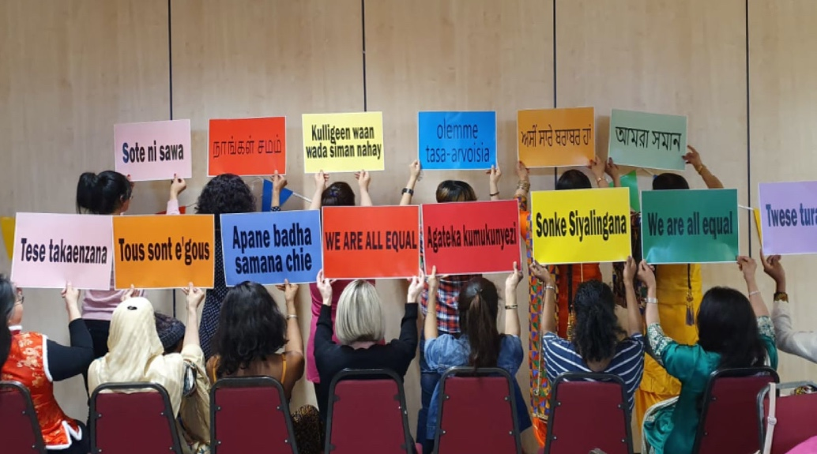
Who is Panaghar?
A dedicated
by-and-for BAMER organisation.
Providing specialist support services for BAMER Women and Children experiencing domestic and sexual violence and abuse as well as specialist services for male victims.
Delivering services in Coventry for over 40 years and across Leicester for over 20 years.
Notes:
Panahghar is urdu word meaning ‘safe house’

Slide 13
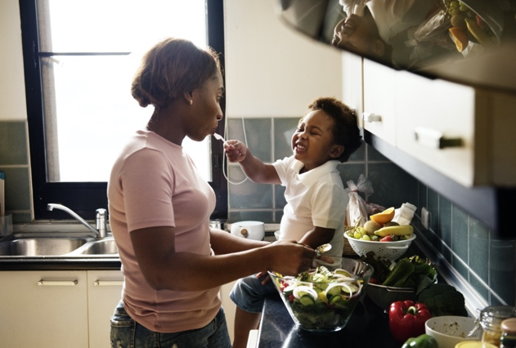
Who do we support?
Black, Asian, Minority Ethnic and Refugee victims and their children who are fleeing from domestic abuse, sexual abuse or other gendered abuse such as forced marriage, FGM or ‘honour-based’ abuse and violence.
Our support is mainly for women and children but we also provide some separate male support services.

Slide 14
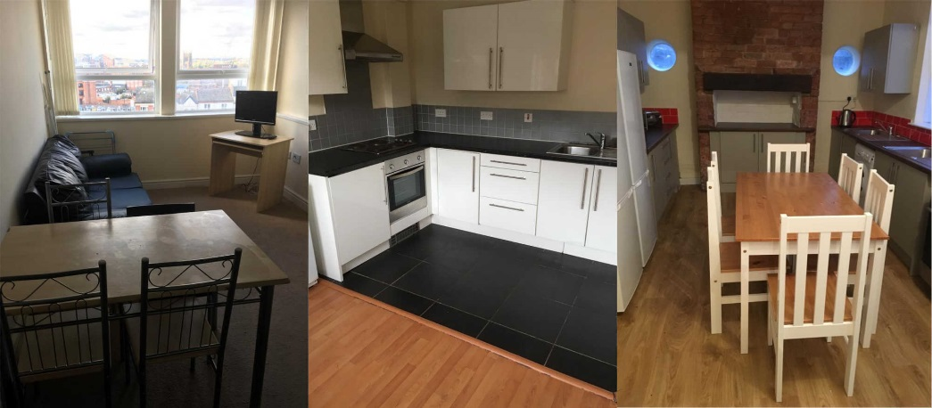
Support available in Coventry
v
1. Haven Panahghar Relate (HPR):
“Safe To Talk” Helpline 0800 111 4998
Independent Domestic Violence Advisor Service: for women and male victims of domestic abuse
Community based outreach: for women and male victims of domestic abuse
2. Panahghar Refuge Accommodation:
18 bed spaces across Coventry: mixture of shared and self-contained units
3. In-House Counselling
provision available for all service users
4. West Midlands Forced Marriage and Honour Based Abuse 24 Hour Helpline and Outreach Support 0800 953 9777

Slide 15
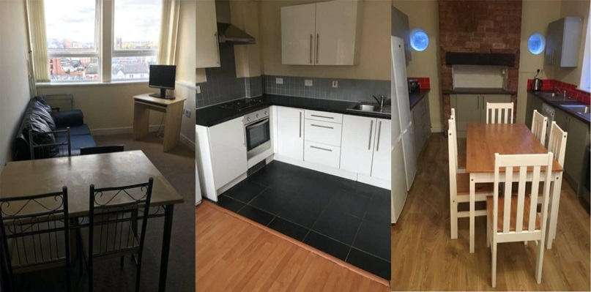
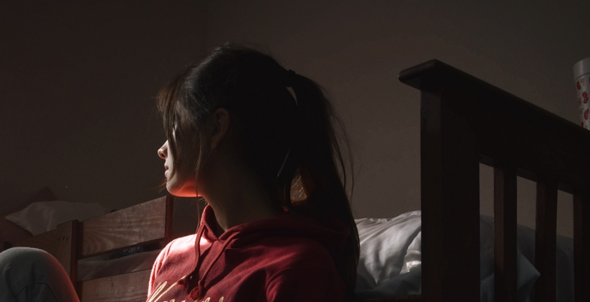
Support available in Leicester
1. Complex Needs Refuge provision: 12 units comprised of both shared and self contained accommodation
2. Complex Needs Outreach
Wrap-Around Service: specialist support for those presenting with Mental Health, Substance Misuse, and BAMER specific issues: FM, HBA, Immigration abuse, & FGM.
3. Step Forward Project: specialist BAMER shared refuge service for women and children

Slide 16
Panahghar’s support goes beyond helplines and refuge
EMOTIONAL SUPPORT
Crisis Intervention, Safety planning & Risk Assessments
Multi Lingual and confidential support
Counselling & emotional support
IMMIGRATION & CULTURAL SUPPORT
Immigration support
Interpreting services
HBV, FM & FGM support & professional guidance
Expertise in BAMER cultural challenges, offer guidance for professionals
COURT & LEGAL SUPPORT
Court support with explaining the court process and pre-court visits
Advocating in court on behalf of service users
Attending court hearings
Applying for orders and explaining different types of orders

Slide 17
EDUCATIONAL SUPPORT
Information, advice and advocacy on DA and UK laws and Social Care
Access to other services, training, education & employment
Support for training, education and employment applications
OUTREACH SUPPORT
Outreach, resettlement and wraparound work
Support groups and self-help groups
Parenting support, Triple P Parenting & safeguarding
Life administrative tasks support
REFERRALS
Attend/ Refer to Multi Agency Risk Assessment Conference
(MARAC)
Explaining referral process and support to survivors
Refer to other agencies for parallel support/ joint working
Make essential referrals for funding/ subsistence for NRPF Service Users

Slide 18
No Recourse for Public Funds
One of the biggest challenges we face as a charity and a community is the No Recourse for Public Funds issues which means survivors who have insecure immigration status in the UK cannot access the services provided for domestic abuse survivors in the UK which comes with a multitude of issues and safety risks.
At Panahghar, we have in-depth knowledge and expertise around NRPF issues and are always available to offer advice and assistance for both professionals and victims on the options available and best route of action to access mainstream support.

Slide 19
Male Victim Services
Men can also experience abuse in a relationship or by family members.
At Panahghar, we have specialist knowledge and support available in different languages to help everyone who is suffering from domestic abuse including Black, Asian and Minority Ethnic men with specialist IDVA and outreach services.
We understand the multiple cultural barriers and stigma this client group experience and work towards breaking down these barriers. Our male victim services are separate from the services we offer for women and staff are fully trained in using the RESPECT risk assessments.

Slide 20
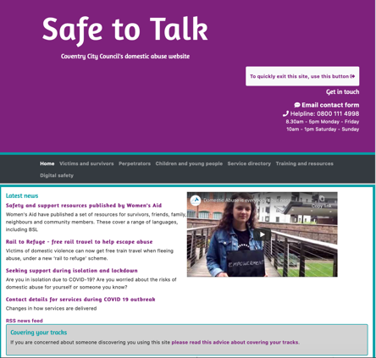
How can you refer?
If you are concerned for someone else and suspect they may be experiencing domestic abuse, sexual abuse or gendered abuse, we can help:
“Safe To Talk” Helpline:
0800 111 4998
(Mon –Fri: 08:30–17:30,
Sat-Sun: 10:00-13:00)
“Safe To Talk”
Website:
www.safetotalk.org.uk
“Safe To Talk” Email: referrals@coventryhaven.cjsm.net
(Mon –Fri: 08:30–17:30,
Sat-Sun: 10:00-13:00)

Slide 21
Contacting Panahghar directly
Panahghar Direct: 0800 055 6519
Open 24 hours a day, 7 days a week
www.safehouse.org.uk
Amar Kaur Services
Co-ordinator
amar.k@safehouse.org.uk
Follow us
@panahghar
@panahghar

Slide 22
Thank you

Slide 23
SAFE TO TALK Freephone helpline 0800 111 4998 Secure Referral Email: referrals@coventryhaven.cjsm.net Non-secure email (password protect documents): referrals@coventryhaven.co.uk:
The SafeToTalk Helpline is delivered in partnership by CHWA and Panahghar
Free 0800 number:
8.30am-5.30pm: Monday to Friday
10.00am–1.00pm Saturday and Sunday
Available to all victims (female and male), perpetrators (male and female), families, professionals, employers, and the public
Provide advice, information, emotional and practical support on all issues of abuse
Undertake initial risk and needs assessment and refer immediately into MASH, MARAC and Police, accommodation service or perpetrator service if needed and signpost to other agencies as required
Will have access to trained multi-lingual helpline workers, run by paid staff and volunteers
Will provide clear information on National DA Helpline, emergency numbers for support and accommodation outside of hours of operation
www.coventryhaven.co.uk

Slide 24
COMMUNITY SERVICES
We provide a range of community based active management support, all tailored to the victim’s needs as follows:
All services are available at least 9am-5pm weekdays, evenings and weekends with extended service hours where needed
Referral route: self-referrals and from professionals and agencies
One worker allocated to each victim to ensure continuity of support
A diverse staff team, with dedicated BAMER staff too, speaking a range of languages (South Asian, European, Eastern European, Arabic, African languages currently available – there are 40 languages in-house)
Delivery of structured programmes of support, offering options based on needs such as, the ‘Power to Change’ programme; one-to-one support and Group support, specifically tailored for support in the community
www.coventryhaven.co.uk

Slide 25
IDVA (HIGH RISK VICTIMS)
Designated team of IDVAs – MARAC, BAMER and generic
IDVAs provide In-depth 1-1 case work to high risk victims, female and male, for 12 weeks initially, including court support, and then reviewed
After the 12-week review, victims who need it will be referred to other case work support to ensure capacity in the MARAC team to take on new referrals
Exciting pilots being discussed with PPU
Email: idvateam@coventryhaven.cjsm.net
www.coventryhaven.co.uk

Slide 26
CASE BASED SUPPORT (FOR STANDARD and MEDIUM RISK)
For victims who require longer term support, our Community Based team provide:
Up to 6 months’ in-depth case work support. A review after 6 months will ensure capacity for others; if further support is needed after 6 months, service users will be referred into After Care services
Coventry Haven Women's Aid provide services to females and Panahghar and Relate to male victims
We work with and will reach out to, under-represented groups such as LGBTQ, BAMER, older and younger people, and those with a range of disabilities
A range of structured programmes of support are offered and can be delivered in other languages as required, including group and 1-1 support
A range of geographical venues are offered to allow accessibility to all
A named Community Worker is linked to each Family Hub
www.coventryhaven.co.uk

Slide 27
AFTERCARE
Peer groups (specialist)
Drop Ins – no appointment necessary
Coffee mornings, social meets eg: ‘walk and talks’, ‘knit and natter’
Just4Me© – activity based sessions
OneStepForward© Survivor/Thriver forums and closed group
“Your Voice” – for victims to have their voice heard
Champions and Volunteer Programmes
TRAINING AND AWARENESS
We have a comprehensive set of training programmes, half/whole day offers
for professionals, community groups, schools, employers etc
DVA
Coercive Control
FGM
FM/HBA
Perpetrators
Impact on children
Clare’s Law/the Law
…to name a few
www.coventryhaven.co.uk

Slide 28
SANCTUARY SCHEME
Security installations are provided through ‘Safe Partnership’, a not-for-profit group that already works with local authorities and is certified to British Standards. They:
Operate 8am-8pm, with emergency callouts and installations completed within 4 hours
Safe Partnerships locally based installer will work with private and other landlords, Police, Fire Service as needed. They are skilled in supporting victims and can assess risk, and safety plan
Referrers acknowledged and victims contacted the same day; appointments made within 48 hours and installations completed in 5 days
Property and surroundings are comprehensively assessed. All installations are demonstrated and clients assisted with ongoing safety planning if required
All applications are managed via Coventry Haven Women’s Aid
www.coventryhaven.co.uk

Slide 29
COVENTRY HAVEN WOMEN’S AID - FULL SERVICE OFFER
Safe and confidential refuge accommodation including aftercare
Access to safe accommodation nationally
SafeToTalk Helpline support 0800 111 4998 (7 days a week)
Live Chat function via our website
General enquiries 02476 444 077
Independent Domestic Violence Advocate (IDVA) support with criminal and civil processes
Sanctuary Scheme
Practical and emotional support / 1-2-1 casework
Legal clinic
Professional counselling
Extensive multi-language bank (in-house)
A range of Community Outreach services for victims and their children:
Specialist FGM support service
Specialist FM/HBA projects workers
IRIS - GP Surgery Project
Group work/Peer groups – Just4Me©
Drop-In at various venues
Volunteer and Community Champion/Ask Me programmes
Training and Awareness Raising including our OneStepForward© DA programme for survivors, plus various training offers to professionals including all agencies, employers, magistrates, clergy and community groups etc
Coventry Women’s Partnership
Home of Her Own Project
www.coventryhaven.co.uk

Slide 30
COVENTRY Rape and sexual abuse centre (CRASAC) SUPPORT FOR ALL
Kellie Ziemba– Strategic Lead | www.crasac.org.uk | 10.08.2020

Slide 31
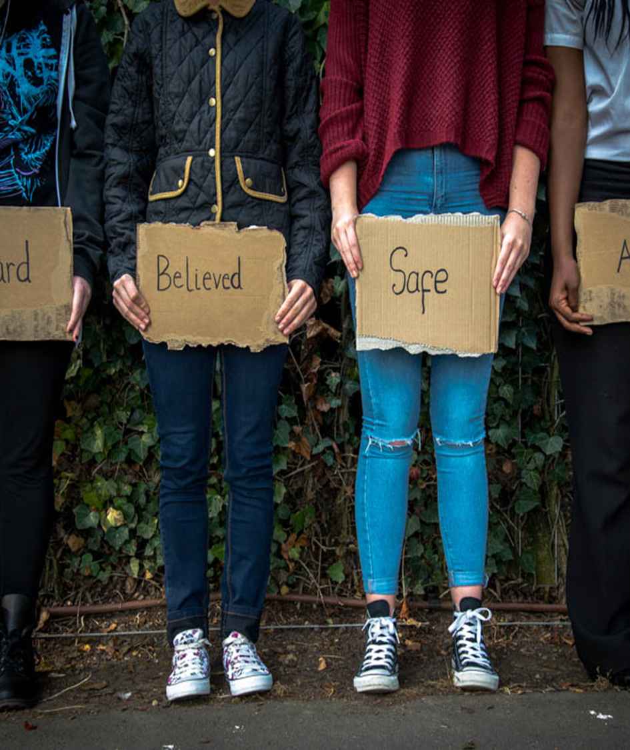
Overview
About CRASAC
Services available
Service adaptation (Covid-19)
Support for all
Making a referral
Contacts and links

Slide 32
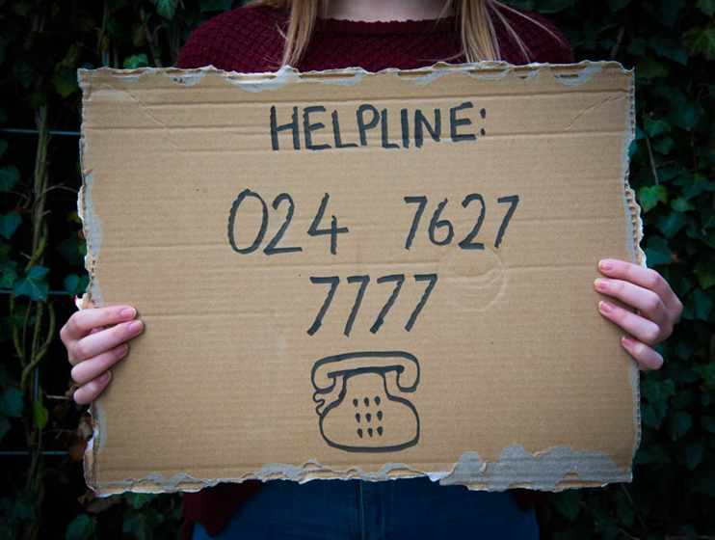
About crasac
CRASAC exists to address the trauma and injustice of sexual violence and abuse through the provision of specialist services and to promote the needs and voices of victims and survivors through training and awareness raising
We turn 40 in 2021!
Support for ANY survivor of sexual violence and/or their supporters
We know that there is no typical survivor, which is why we treat everyone who comes to us ​for support as an individual
We work from an empowerment approach
The incident(s) may have happened at any time
Confidential
No pressure to report to the Police
Free to all
Notes:
SV includes a range of acts from unwanted touching to rape, online sexual harm, sexual harassment, sexual exploitation and more. The impacts can be significant and lifelong

Slide 33
Services available
Helpline- support and advice to survivors, supporters, and professionals
ISVA (Independent Sexual Violence Advisor) Service- advocacy and support
Crisis Counselling (referred from SARC)
Counselling (up to 26 sessions)
Emotional Support (Waitlist)
Parent Support Project
Young People’s Advisory Group (YPAG)
Community Outreach

Slide 34
Covid-19 adaptation
We are still here!
Helpline- call backs
ISVA- mostly phone support, some online, support at trials, police interviews etc.
Counselling- phone, online
Emotional support calls
Parent Support- phone support
Young People’s Advisory Group (YPAG)- online group
Community Outreach- virtual outreach
Currently planning partial transition to building and some face to face services
https://youtu.be/_0d2lx8rLU8

Slide 35
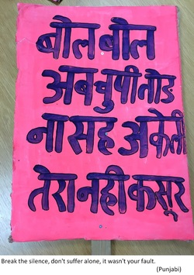
Support for all
Non judgmental, non-discriminatory, anti racist
Women, men and anyone who identifies as any gender (or none)
Parents/Carers of very young children
Children and young people from 5
We have survivors in their 70s and 80s in service (it is never too late)
Supporters of survivors
Free services (no recourse to public funds not a barrier)
Disabled access to building
Interpreters can be arranged
Notes:
Sexual violence is both a cause of, and a symptom of, gender inequality. The majority of perpetrators of sexual violence are male, and the majority of victims are female. This does not mean that all perpetrators are male or that men are not victims too. It does mean, however, that sexual violence is a crime that disproportionately affects women and girls within our society.
Any man or boy can be raped or sexually assaulted regardless of their age, size or strength. Within society men often have the belief that they are expected to be strong, to be able to defend themselves and for this reason many men often blame themselves for the abuse and turn the anger on themselves for not preventing what happened.
Because of our society's taboo about male rape and sexual assault, it is rare that men go to the police or seek immediate help. Being abused does not relate in any way to your sexuality. Sexual abuse is about power and control and most sexual abuse is perpetrated by heterosexual men. Sexual violence is not connected with your sexuality but men in gay relationships or who are men having sex with men may also experience rape and abuse.
LGBT people who have experienced violence and abuse may have specific fears in relation to:
• Reporting to the police
• Encountering homophobic or transphobic services
• What will happen to them or their loved ones if they get help
Our workers will never judge or scrutinise someone’s sexuality
Our counsellors and crisis support workers will always use a person’s preferred pronoun, will never out someone’s trans* status or unduly focus on their gender identity.
CRASAC understands the complexities of sexual abuse in BAMER communities and the barriers faced by those within them when accessing support. CRASAC is here to hear, believe and provide free and confidential support by staff who understand the values of different cultures. We can support through Counselling and in our Crisis and Advocacy service. CRASAC provide training and resources for staff to ensure that they are aware of the cultural needs. CRASAC also offers effective and appropriate interpretation for clients with language barriers.
In addition, CRASAC reaches out to people who cannot reach in by providing outreach support and information to black, Asian, minority ethnic and refugee women and girls who have experienced sexual violence or who feel that nobody is listening to them.

Slide 36
Referrals & Useful contacts
CRASAC: Helpline: 02476 277777 or email: helpline@crasac.org.uk
www.crasac.org.uk
Sky Blue Centre (SARC): 0800 970 0370
National Rape Crisis hotline: 0808 8029999 or www.rapecrisis.org.uk
Also has a ‘live chat’ facility
Rugby Rosa (Warwickshire): 01788 551 151
Safeline (Warwickshire): 0808 800 5005

