Slide 1
Challenging Attitudes around sexual health
Presented by: Ashleigh Roach; Positive Choices

Slide 2
Expectations and Agenda
By the end of the workshop you should feel more equipped to:
Challenge a young person’s understanding and behaviour around sex and relationships
Recognise how your own personal values and beliefs may affect your responses
Have difficult conversations with young people around their sexual health.
Know what to do if you are worried about a young person and where to get further support.
To ensure that this is a comfortable learning experience for everyone; can we please…
Keep your microphones and videos turned off
Use the chat facility to ask questions throughout. A Q&A will be available at the end. All questions are valid- we don’t know what we don’t know!
Be sensitive to the topics being covered

Slide 3

Guess the age!
Daniel Radcliffe said that he celebrated his 16th birthday by having sex with a much older girlfriend

Slide 4
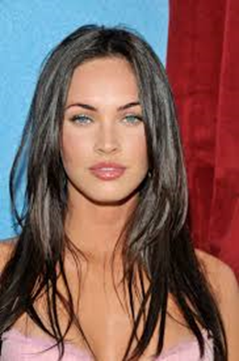
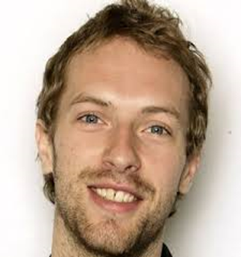
Guess the age!
Megan Fox said that she lost her virginity to her first boyfriend who she fell in love with at the age of 17
Chris Martin said that he waited until he was 22 due to religious and confidence reasons

Slide 5
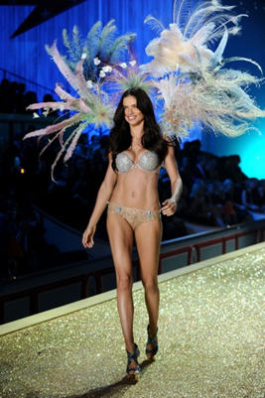
Guess the age!
Although considered a sex symbol, Adriana Lima(Victoria’s Secret Model) didn’t have sex until she was married at the age of 27

Slide 6
What do we learn from this?!
Between one quarter and one third of people are thought to have had sex before the age of 16; so…
Not all young people are having sex!

Slide 7
Personal values and beliefs
Can your personal values and beliefs affect how you respond to a young person’s behaviour?
Each of us have our own set of values, beliefs & morals which guide us.
Professionals these can at times be put to the test so how can we ensure we are comfortable but still provide the support & give the advice we need to?
Provide non-biased, factual information
Acknowledge & allow for other people‘s opinions
Educate & upskill ourselves
Seek support from your Line Manager
Ensure we look after our own well being
Acknowledge if we are unable to do the above and discuss re-allocation
Notes:
Group discussion

Slide 8
Challenging risky behaviours
These are real questions / statements posed by our young people – how would you respond?
“Is it ok to have anal sex and then vaginal sex straight after?” (15 year old female)
“I don’t want a baby until I’m 25 so I wear three condoms when I’m doing it” (14 year old male)
“What’s that?” Whilst looking at an image of a vagina (14 year old male)
‘If I could have any STI it would be Syphilis because it looks like chicken pox and that’s no big deal” (14 year old male)
“Wouldn’t a girl enjoy being raped then?” ( 15 year old male)
“If your boyfriend likes anal sex you kind of just have to do it, don’t you?” (14 year old female)
“If I have sex with my girlfriend could I be arrested?” (15 year old male)
“I’m pretty sure we had sex, but we didn’t take our clothes off?” (14 year old female with severe learning needs)
“Why would you have sex when you can get all these diseases?” (16 year old male)
“I don’t need to wear condoms because I pull out” (15 year old male)
“Oh sh*t… I’ve had a rash that looks just like that for months now” whilst being shown a photo of a symptom of Syphilis (16 year old male with learning needs)
“People will think I’m a sl*g if I get the implant (14 year old female)
“You know how all girls like it rough?” (14 year old male)

Slide 9
Having difficult conversations – Condom negotiation
I can’t feel anything/It doesn’t feel as good
You can relax and enjoy sex more with condoms because you don’t have worry as much about STI’s or pregnancy.
2. I’m on the pill/My partner is on the pill
The pill doesn’t protect you from STI’s.
3. I’m allergic to latex
You can be issued with latex-free condoms.
4. I always pull-out
It’s not a reliable method of birth control and doesn’t protect against STIs.
5. I don’t have anything (STIs)
You can’t tell by looking at somebody if they have an STI – a lot of people do not experience any symptoms.
6. The condom won’t fit
Condoms are made in all different sizes to fit everybody.

Slide 10

What could I do about a behaviour I have concern for?
The Sexual Behaviours Traffic Light Tool supports professionals working with children and young people by helping them to identify and respond appropriately to sexualised behaviours.
It categorises sexualised behaviors of children & young people using a traffic light system. It supports professionals with:
Making decisions about safeguarding children and young people
Assessing and responding appropriately to sexual behavior in children and young people
Understanding healthy sexual development and distinguish it from harmful behavior
This resource has been designed to help professionals think through their decisions and does not replace organisational procedures or assessment frameworks

Slide 11
What next?
Consider organisational guidelines including protocols before taking action. Alongside these please think about:
Does action need to be taken?
Use the organisational guidelines or procedures to guide you?
Is there a safeguarding lead or other appropriate person in your organisation who can support you?
If there is no obvious need for action, can the children or young people involved benefit from extra education or support?
Making contact with Family Hub or Social Care to gain further advice or to make a referral
Contact NSPCC (Turn the page Programme) / Positive Choices / ISHS / CRASAC for support

Slide 12

Positive Choices
Amongst other support, Positive Choices are here to support young people with sexual health. Some of the ways we can support include:
Are you ready? - Message exploring feeling ready for intimacy
Registration for C-Card Scheme
Building knowledge on STIs
Exploring the pros and cons of different forms of contraception
Stages of intimacy
Condom negotiation and demonstration
Arranging & supporting medical appointments
Building knowledge and confidence around consent
Parental aspirations

Slide 13
How to make a referral
You are more than welcome to call our Duty Worker or refer via our website for a quick and secure way to place the referral
www.changegrowlive.org/positive-choices-coventry
Coventryyp.info@cgl.org.uk
Please consider:
Consent of the young person (including parental consent for under 13s)
Include as much relevant information as possible
Keep us involved in Early Help/Social Care meetings

Slide 14
How to contact us
Address:
23-25 City Arcade, Coventry
Phone:
02476 010245
Website: (referrals & online chat)
www.changegrowlive.org/coventryyp
Facebook:
PositiveChoicesCov
Instagram:
Positivechoices_Coventry
Twitter:
@PosChoices_Cov

