Slide 1
Harmony hill fields
Using a whole life course approach to tackling violence

Slide 2
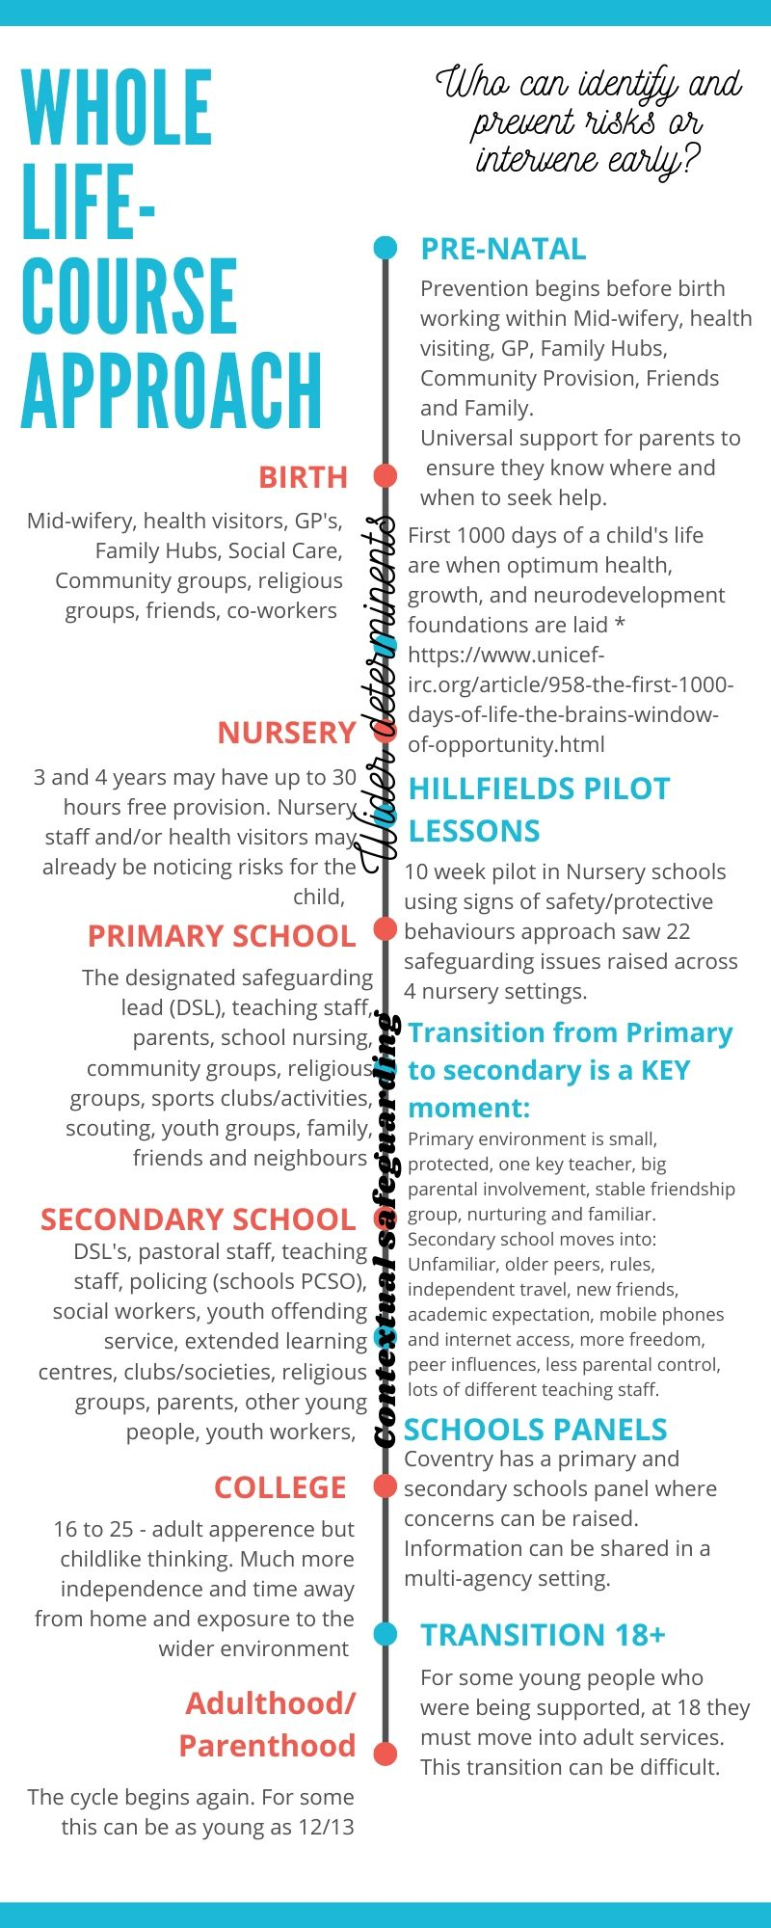
Violence is preventable not inevitable
Whole life course approach

Slide 3
Develop a trauma informed network that embeds the approach locally
Establish ACE awareness in local early years services, increasing earlier intervention with families impacted by risk factors as described above
Provide a robust transition program from Y6 to Y7 for local school children
Increase the provision of open access safe spaces locally, providing places of safety at key times i.e. after school, and weekend evenings
Provide a detached youth provision operating during weekends to engage the most hard to reach young people
Work with local young people in Hillfields to develop a credible counter-narrative and communicate this to the community
Collaborate with the community, voluntary and statutory sector, and businesses to reclaim public space and engage with the most hard to reach community members
Incorporate MVP, IRIS and existing local diversionary activity ensuring coordinated pathways and effective links to primary care, schools and youth services
Provide campaigns that focus on health and develop partnerships between the pilot and pharmacies, increasing accessibility to the project and primary prevention activity

Slide 4
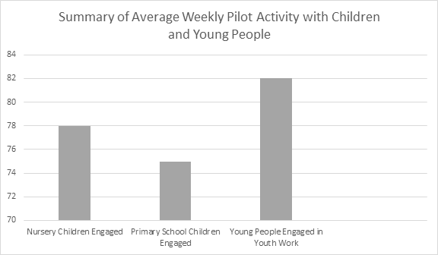
Successes
Early years, building the network, setting foundations

Slide 5
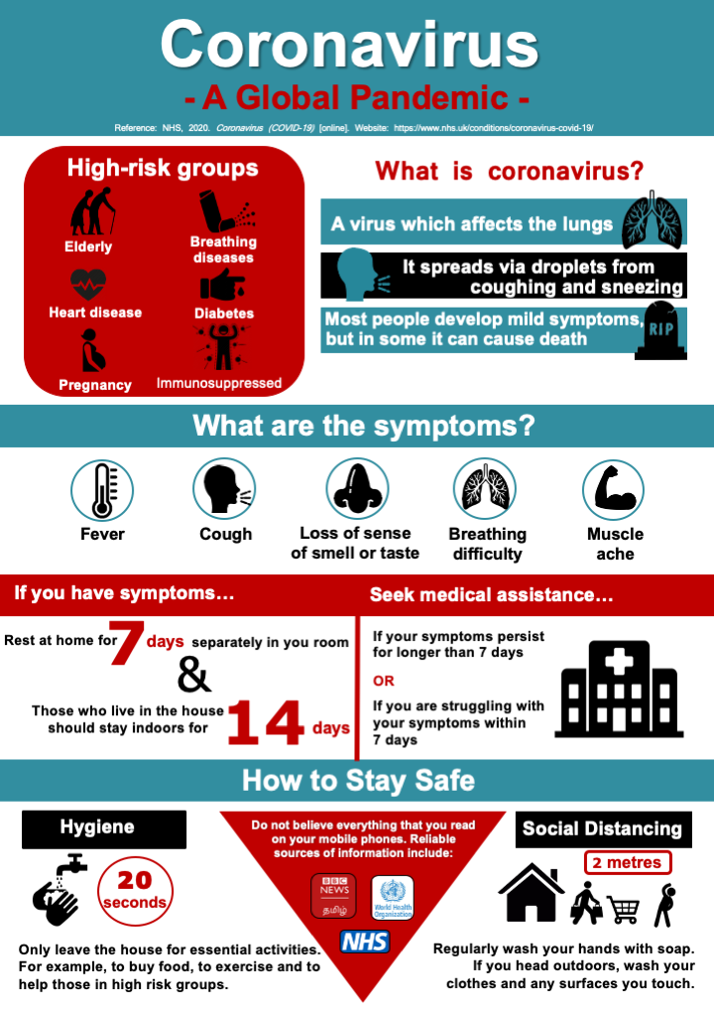

Slide 6
Phase 2 - Sept ‘20
Growing the network
Focus on early years and prevention
Community Navigator
Lift and shift within Coventry

Slide 7
caroline.ryder@coventry.gov.uk - Programme Manager - Youth Violence, Coventry City Council
N.pennistion@west-midlands.pnn.police.uk - Regional Manager- Localities, West Midlands Violence Reduction Unit

