Slide 1
Healthier You
National Diabetes Prevention Programme
ww.covwarks@nhs.net
vpower@ww.com
www.ww.com/uk/healthieryou
Vicki Power
Senior Health Solutions Manager
September 2020

Slide 2
Our Purpose
We inspire healthy habits for real life.*
* For people, families, communities, the world—for everyone.

Slide 3
Healthier You: NHS Diabetes Prevention Programme (NHS DPP) is a joint commitment from NHS England, Public Health England and Diabetes UK, to deliver at scale, evidence based behavioural interventions for individuals identified as being at high risk of developing Type 2 diabetes
The programme offers the opportunity to attend group based lifestyle intervention for a nine-month period of regular support and, IT IS COMPLETELY FREE to people with non-diabetic hyperglycaemia at risk of developing Type 2 diabetes.

Slide 4
Why refer patients to Healthier You?
Many cases of Type 2 diabetes are preventable and there is strong international evidence that behavioural interventions can significantly reduce the risk of developing the condition by getting support to lose weight (where appropriate), getting more physically active and eating healthy food
Public Health states that 12.5% of our population are at risk of developing Type 2 diabetes due to non-diabetic hyperglycaemia (HbA1c between 42-47mmol or 6.0-6.4% or a Fasting Plasma Glucose FPG of 5.5-6.9mmol )
Diabetes treatment currently accounts for around 10 per cent of the annual NHS budget
Improved lifestyle can reduce the incidence of complications associated with diabetes – eg heart, stroke, kidney, eye and foot problems and therefore reduce health inequalities

Slide 5
PHE report ‘Beyond the data: Understanding the impact of COVID-19 on BAME groups’
Rapid review of published literature was undertaken
External stakeholder engagement information included
Some evidence to support hypothesis that BAME groups more likely to test +ve
Evidence suggests excess mortality due to COVID-19 in BAME populations, with individuals of Black African or Black Caribbean and Asian ethnic groups may have the highest increased risk
Once infected, many of the pre-existing health conditions that increase the risk of having severe infection (such as having underlying conditions like diabetes and obesity) are more common in BAME groups and many of these conditions are socioeconomically patterned

Slide 6
PHE report ‘Beyond the data: Understanding the impact of COVID-19 on BAME groups
Stakeholders pointed to racism and discrimination experienced by communities and more specifically by BAME key workers as a root cause affecting health, and exposure risk and disease progression risk
Historic negative experiences of healthcare or at work may mean that individuals in BAME groups are less likely to seek care when needed or as NHS staff less likely to speak up when they have concerns about PPE or testing
Stakeholders expressed deep dismay, anger, loss and fear in their communities about the emerging data and realities of BAME groups being harder hit by the COVID-19 pandemic than others, exacerbating existing inequalities
It is clear from discussions with stakeholders that COVID-19 in their view did not create health inequalities, but rather the pandemic exposed and exacerbated longstanding inequalities affecting BAME groups in the UK

Slide 7
PHE report ‘Beyond the data: Understanding the impact of COVID-19 on BAME groups
Mandate comprehensive and quality ethnicity data collection and recording
Support community participatory research
Improve access, experiences and outcomes of NHS, local government and Integrated Care Systems commissioned services by BAME communities
Accelerate the development of culturally competent occupational risk assessment tools
Fund, develop and implement culturally competent COVID-19 education and prevention campaigns
Accelerate efforts to target culturally competent health promotion and disease prevention programmes for non-communicable diseases
Ensure that COVID-19 recovery strategies actively reduce inequalities caused by the wider determinants of health

Slide 8
Ethnicity and Outcomes from COVID-19: The ISARIC CCP-UK Prospective Observational Cohort Study of Hospitalised Patients’
Cohort Studied:
Hospitalised patients with COVID-19
Main study aims:
To investigate:
Ethnic inequalities in critical care admission patterns
The need for invasive mechanical ventilation (IMV)
In-patient mortality
This was a prospective cohort study with data from 260 hospitals across England, Scotland and Wales
Data collected between 6th Feb to 8th May 2020

Slide 9
STUDY FINDINGS
Recorded Ethnicity | % Enrolled | Age | LTC | Symptom Onset to Time to Admission | Illness Severity at Admission | Critical Care Admissions Adjusted for age, sex, location, deprivation, comorbidities | Adjusted Mortality
South Asian | 5% | younger | Singular disease, Diabetes Type 1 and 2 | No difference | No difference | More common | Higher- mediated by pre-existing diabetes
East Asian | 1%
Black | 4% |  |  |  |  | More common | Higher
Other Ethnic Minority | 8% |  |  |  |  | More common | Higher
White | 83% | older | Multiple co-morbidities: CHD, Dementia, Diabetes

Slide 10
BAME DATA
ADMISSIONS TO ITU SAHF DATA | 2011 | 2020 | DIFFERENCE
WHITE | 86% | 67% | decrease
ASIAN | 7.5% | 15% | 2 x risk
BLACK | 3.3% | 9.7% | 3 x risk
RCN DATA | WHITE | BAME
ACCESS TO RECOMMENDED PPE | 66% | 43%
HAVING TO RE-USE PPE | 37% | 49%
ACCESS TO TRAINING | GOOD | POOR
ABILITY TO SPEAK OUT | ABLE | LESS ABLE

Slide 11
DIABETES COMMUNITY CHAMPION
New role developed through NHSE transformation funding
Full time Champion Lead
Community Champion Volunteers
Community links
Diabetes newsletter
Diabetes website
Pocket Medic video
Punjabi TV

Slide 12
PROVIDER AND CHAMPION LEAD CO-WORKING
NHS DPP
WW Provider
Comms plan
Self-referrals
Community links
Volunteer cascading information
DUK
Volunteer training
Patient information
Innovative working
DESMOND
Educator training
DESMOND BAME
Food models
Cultural adaptation
Bite-size
Volunteers cascading information
PRIMARY CARE
GP information platforms
Patient packs
Website design and content

Slide 14
The Healthier You DPP, provided by WW currently delivers a remote and digital service that enables participants to engage in 13 core curriculum themes, personalised to them, with each and every touchpoint being tailored to NDH and the benefits of risk reduction of T2DM

Slide 15
Update on Programme - COVID-19
Referrals are being received as normal with participants still being sent a letter/email within 48 hours of referral received from healthcare professional or when contacted directly from participant.
New referral participants will be given 3 options:
Join the Healthier You programme remotely - more details on next slide
Join our digital only programme
Pause their programme until physical face to face workshops resume.
Contact Centre open 6 days a week 8am-8pm Monday -Friday 9-5pm Saturday to discuss any questions/concerns/triage.
Remote workshops will be held by a NDPP trained coach where relevant topics are discussed which are key to participants who are at risk of Type 2 diabetes but also key to people who are in isolation who still need to look after themselves.
Remote workshops are held 6 days a week from 9am through to 7pm and participants can choose which one to opt for.
WW happy to provide updated letters if surgeries are wanting to send letters out to patients on the ‘at risk’ register.

Slide 16
Eligibility and Referring
TT = Triage Team
>18 years of age
Blood Test (within 24 months) to confirm they are pre-diabetic
(HbA1c of 42 - 47 mmol/mol (6.0 – 6.4%) or an FPG of 5.5 - 6.9 mmol/l)
Process:
GP upload completed Referral form/send bulk letter out to patients
Participant emailed/sent introduction letter
Participant calls TT for initial assessment (IA1)
TT to discuss what option is best for the participant.
Participant booked into first workshop.
Relevant team notified
Participant attends 1st Workshop (IA2)

Slide 17
Remote Workshops
Sessions will be booked for a 12 week period. Booking will continue until face to face can resume. Once face to face sessions resume participants will be invited to complete their 9 month intervention attending weekly. Initially up to 36 sessions.
Participants will be asked to complete a 3 question survey (via Qualtrics) where they provide weight, WW reference number and their postcode. Any participants on the telephone will be asked individually, in private, by the support coach for their information.
Session includes:
Individual welcome from coach.
Support regarding how remote sessions work.
DPP risk reduction discussion.
Supported to identify core sessions to ensure attendance across all curriculum topics.
Current face to face 1:1s (completes IA)will be replaced by the coach offering a 1:1 for those that would like that option. Participants will be privately messaged by the coaches during the workshop using the chat feature. Participants will provide their name, contact telephone number and preferred time for the call. The coaches will then call the participant at the requested time.
https://www.weightwatchers.com/uk/nhsdpp-workbook

Slide 18
What a Healthier You participant gets above and beyond a self-paying WW member
Augmented Curriculum
Personalised to participants – workshop materials and Coach delivery linked to T2DM and risk reduction
Linking healthy behaviours to risk reduction
Workbook with T2DM risk reduction through healthy behaviours programme content and link to session content – supporting the individual to build a tailored programme covering all behaviour change components using lenses linked to their specific goals and challenges
Bespoke Materials
Signposting to local services/activities, workbook, emails, video content, moderated online discussions

Slide 19
My Healthier You DPP Journey (Face-to-Face)
ME
Healthier You DPP Bespoke Content and Programme:
Motivate
Initial assessment
Welcome and personal plan
Foundation
Getting active to prevent T2DM
Eating well to prevent T2DM
Positive mindset to prevent T2DM
Key strategies (behaviour change)
Health macro-nutrients
Healthy eating on-the-go
Staying active to prevent T2DM
Coping with setbacks
Healthy eating balance to prevent T2DM
Get more active to prevent T2DM
Staying motivated
Maintenance
Referral
Milestone 1
Embedding - Milestone 2
Sustaining – Milestone 3
Consolidating - Milestone 4
Post
Bespoke workshop content: Coach 1:1 (goals, motivation, progress), bespoke curriculum content and talking points
Workbook with DPP curriculum content, supported by (e)mail curriculum
Healthier You DPP video content with Coach moderated social community and risk reduction discussion forum
Supported by evidence based WW behavioural change programme (myWW):
Following the programme day to day using SmartPoints and FitPoints to guide my choices
Integrated digital platform including social communities, 1000s recipes, digital tools
Supported by DPP programme specific additional resources:
GP training in motivational referral and new feedback reporting
Enhanced training for call handlers in DPP
Training/
Delivery for brief intervention for smoking
Monitoring and reporting on key
DPP demographics
Specialist training for Coaches in diabetes prevention and risk reduction
New dedicated and moderated social environment with bespoke curriculum content
Enhanced and bespoke participant engagement programme
Ongoing refresh of curriculum content
Enhanced corporate and delivery workforce
2 year post programme maintenance programme and bespoke resources
Notes:
The 13 curriculum are the top boxes, excluding the first three.

Slide 20
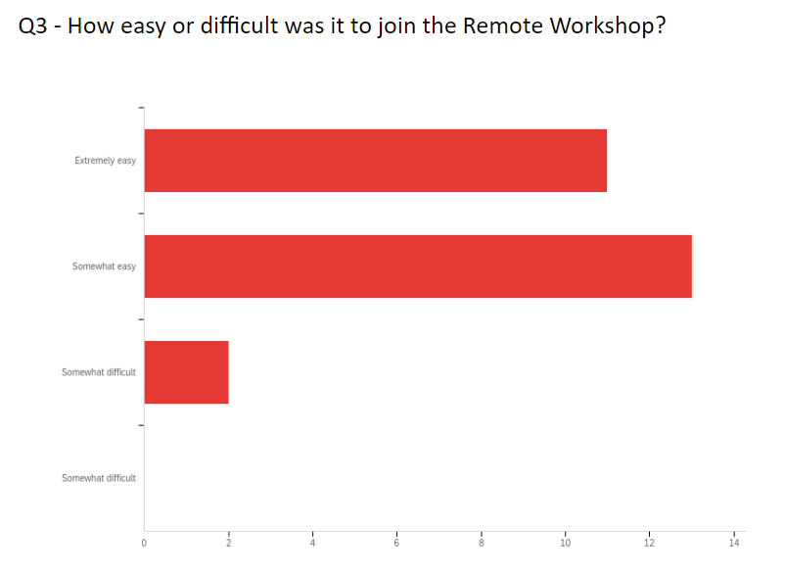
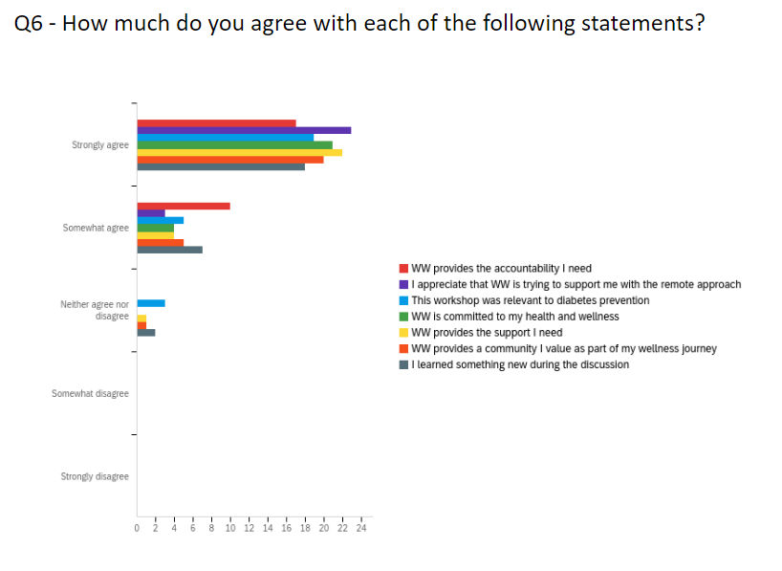
Feedback so far
Thank you - I value this support and help with motivation weekly
Very pleasant and motivating
Excellent work ladies felt very comfortable once I'd learned how to work it. I was very pleased with the private messaging i was able to do while still being involved with the workshop. Look forward to the next one x
Very pleasant , clear in direction .
Thank you for your support finding & using ways to carry on the Workshops
Polite, friendly put you at ease.
Very interesting experience and very encouraging that contact, discussion and support can continue virtually. I found it very useful. Thank you.
Thank you for your encouragement and initiating this resource on-line in the current difficult situation for us all.
It was a new experience for us all. Anna Power did very well. Trying to explain where the controls are... when we are using different equipment is not easy but this has been a great help.

Slide 21
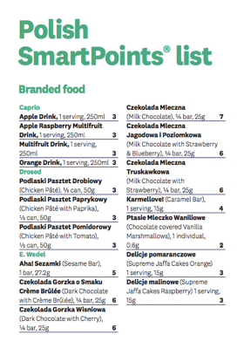
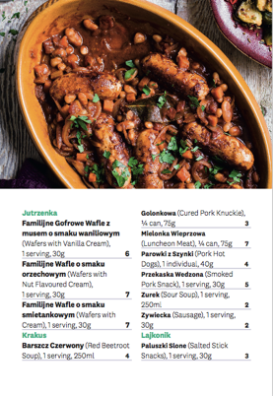
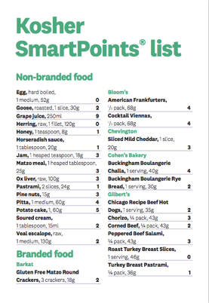
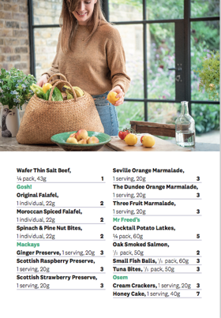
Tailoring for different cohorts
Cultural food lists and recipes
Translated materials for ≥five requested languages
Friends, relatives and assigned translators welcome at any of our workshops
Use of browser-enabled translation
Tailoring physical activity goals and content to suit their own lifestyle, culture and activity preferences

Slide 22
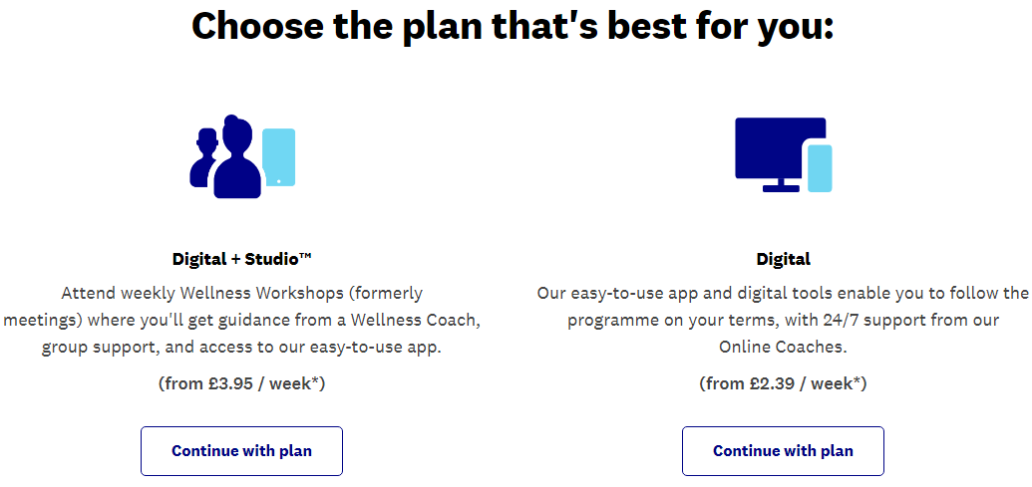
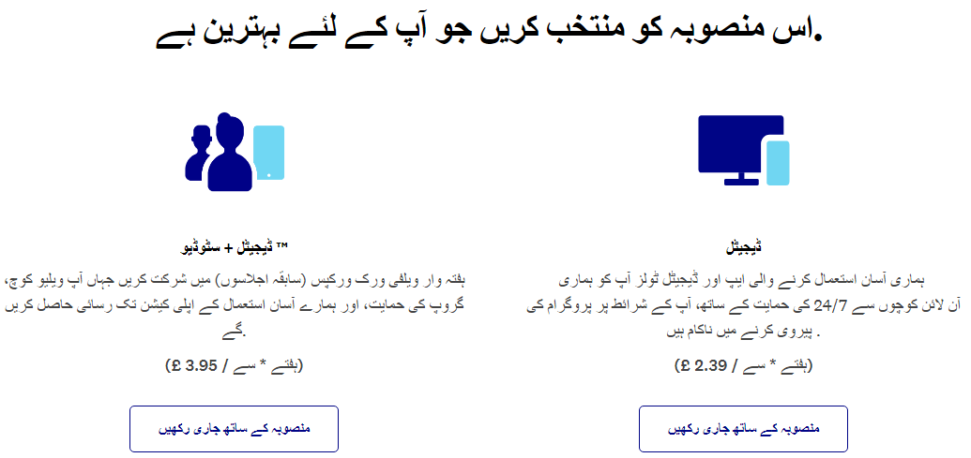
Using Google Translate to broaden access
Example - English to Urdu

Slide 23
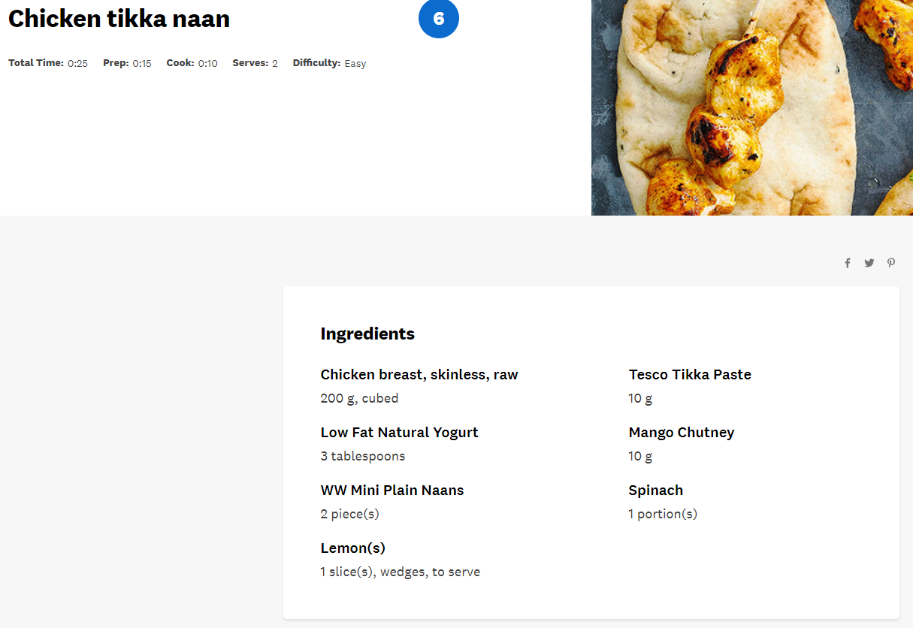
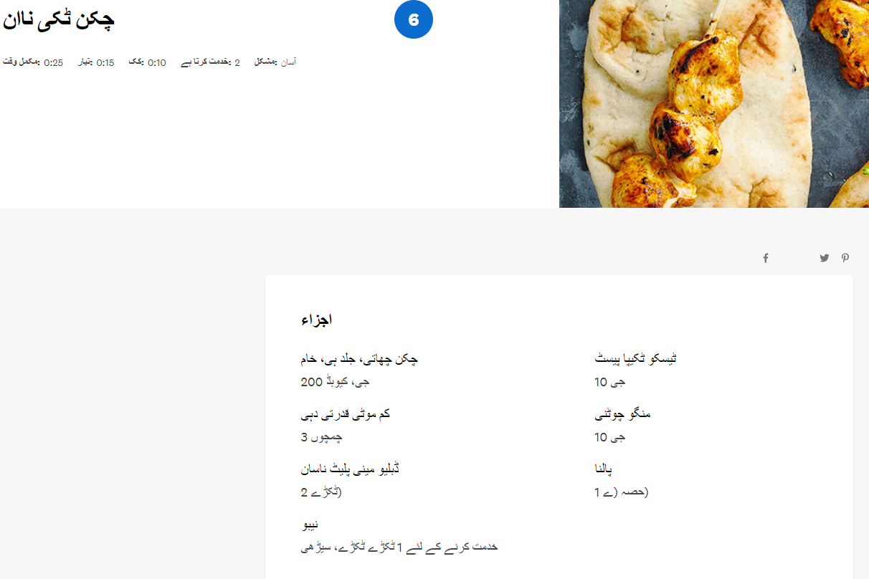
Using Google Translate to broaden access
Example - English to Urdu

Slide 24
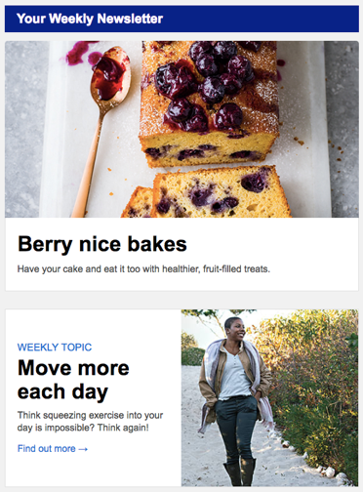
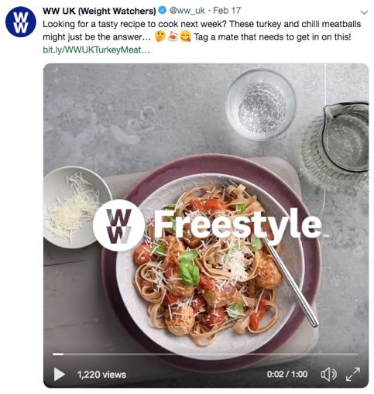
Continued engagement outside of remote workshops
eCRM content
App content
Connect group
Social post
24

Slide 25
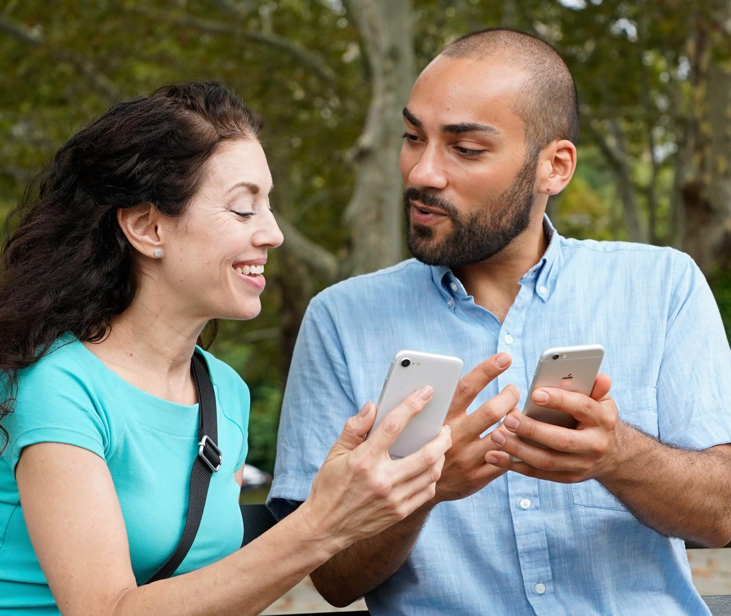
Digital Programme

Slide 26
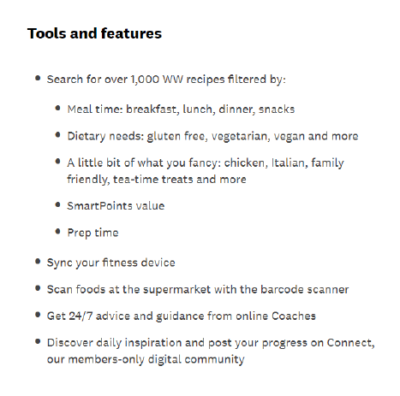
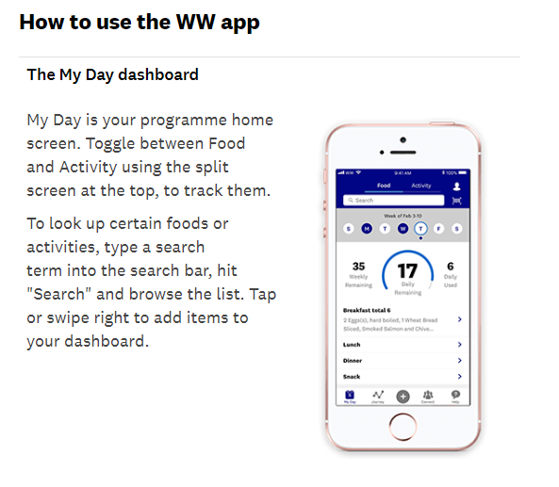

Slide 27
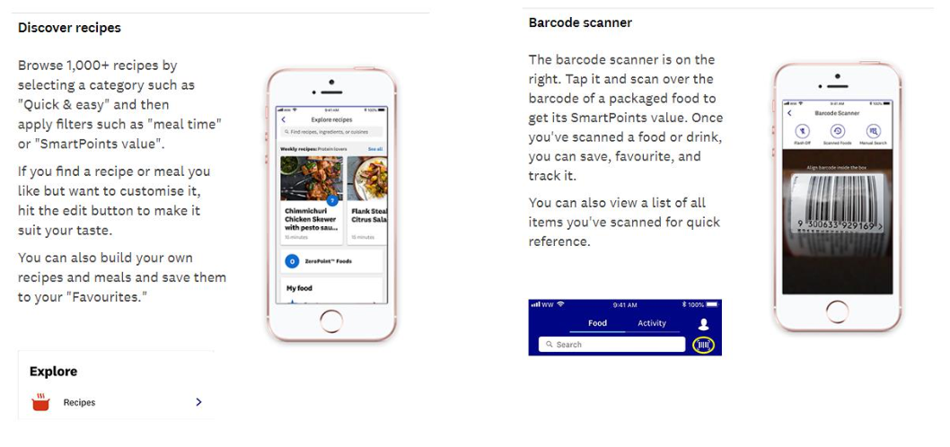

Slide 28
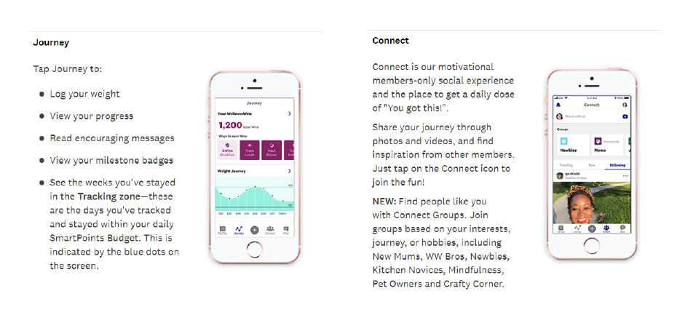

Slide 29
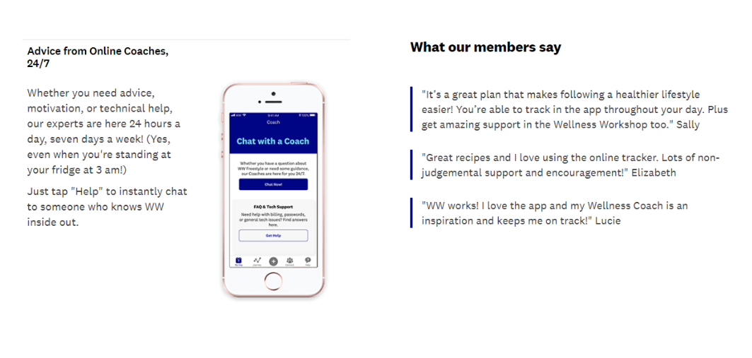

Slide 30
Extra tools for success
In addition, all participants will have access to the following innovative tools for sustainable success:
WellnessWins: A behaviour-based rewards programme, offering free healthy living products/experiences to incentivise healthier behaviours (this can be tailored for the DPP through local partnerships)
‘3 Good Things’: A reflection tool which promotes a behavioural technique proven to increase gratitude
‘Keep Your Why Close By’: Techniques to remind participants why they are on the programme, celebrating success.

Slide 31
ww.northeast@nhs.net
www.ww.com/uk/ndpp

