Slide 1
Improving on Good Referrals to MASH - using Signs of Safety Practice
Getting the Right Help at the Right Time… and the “Right Outcome” for children and families
Making the best decisions for children and families
Sarb Bhambra ( MASH Team Manager) & Dinesh Ranchhod ( SofS Lead )
Updated 10 Sept 2020 @ 17:00pm.

Slide 2
Making for a good Webinar -
Please turn off mics and videos to improve quality of call
Please ask questions during the session via chat only. We will then do our best to run through the chat & answer questions at the end – and after that open it out to people to verbally ask questions.
Sorry if this means it’s a one-way conversation – but our webinars are short and snappy and we don’t want to break the flow / have lots of interruptions.
We will be recording the session - if you don’t want to say something during the recording , please contact Sarb or Dinesh via email or on Teams after the webinar to answer any questions.
Thank you

Slide 3
Webinar Outline – will cover briefly today
Work of MASH – overview of the Legislation, and Duty & Responsibilities around Working Together to Safeguard Children ( (Sarb)
The advice line. The Triage process and MASH –Why MASH need to make timely decisions for children ( Sarb)
Overview of Signs of Safety Principles to support Practice -A shared language between professionals (Dinesh)
Understanding the Signs of Safety Assessment - Seven Analysis categories (Dinesh)
How Signs of Safety framework supports completing the MARF to make good referrals, best decision making within MASH and the right response for children ( Dinesh)
Examples of referrals made to MASH and subsequent decision-making; how a practice methodology like Signs of Safety helps thinking about children (Sarb)

Slide 4
THE CONTEXT
Part of the improvement journey following an inadequate inspection judgement by Ofsted of Coventry children's services
Coventry’s Multi Agency Safeguarding Hub (MASH) launched in September 2014, bringing partners together to make best informed decisions for children and families.
Staff from across health, Children’s Services, the police, education, probation are based in the MASH at any one time at its base in Broadgate House in the city centre.
The aim is to facilitate early, better quality information sharing, analysis and decision-making, in order to safeguard vulnerable children and young people more effectively.
As a result, better decisions are made informing the next steps, focusing on the most urgent cases primarily, and ensuring best support for all others
MASH provide feedback to professionals reporting concerns in respect of the outcome

Slide 5
Advice Line
We take calls if you want advice around what you should do next
Speak to a Social Worker- 02476 788555
Triage
Part of MASH serviced currently by 7 Social Workers and 3 children and families workers
3.5 Team Managers
Receive communications and make decision on next steps
MASH
Probation, Health, Police and Education representatives
AIM: To ensure all safeguarding activity and intervention is timely, proportionate and necessary for keeping vulnerable children safe.
This ensures each partner agency is in the best position to make effective decisions and the most relevant agency works with the family

Slide 6
A shared aim for all professionals?
Working Together to Safeguard Children (2018)
Practitioners should be proactive in sharing information as early as possible to help identify, assess and respond to risks or concerns about the safety and welfare of children, whether this is when problems are first emerging
Fears about sharing information must not be allowed to stand in the way of the need to promote the welfare, and protect the safety, of children
All practitioners should aim to gain consent to share information, but should be mindful of situations where to do so would place a child at increased risk of harm.
Information may be shared without consent if a practitioner has reason to believe that there is good reason to do so and in the best interests of safeguarding a child
Within one working day of a referral being received the Local Authority must make a decision about next steps and the type of response required

Slide 7
Local Authority Response
No further action
Provide information/advice
To professionals around supporting the family
To parents
Information sharing
Diversion to Early Help
Hubs to start early help work with family
Other professional to start an early help
MASH episode to gather more multi agency information (systems) for 24 hours-AMBER rated
Immediate response? Confirm referral into statutory children's services-RED rated (safeguarding) or GREEN rated (eg. Homeless)

Slide 8
Right Help at the Right Time
The Safeguarding Partnership has developed a threshold document
https://www.coventry.gov.uk/downloads/download/5066/right_help_right_time

Slide 9
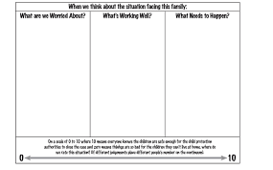
Lets Look at how Sofs Approach & Framework can help with better referrals to MASH (or Early Help )

Slide 10
Principles of Signs of Safety
Sofs has 3 Key principles to developing work with families.

Slide 12
Thinking critically and maintaining a stance of critical inquiry.
Risk assessment and regular conversations with families is a core task and requires constant balancing of strengths and dangers to avoid the common errors of drifting into an overly negative or positive view of the situation for children.
Developing a culture of shared reflective practice amongst professional and a willingness to admit you may be wrong are vital to ensuring Assessments & Plans are always reviewed and focused on providing the Right Help , in the Right Way, at the Right Time, and with the Right Outcome for children & their families.
Principles of Signs of Safety
The approach has three principles:

Slide 14
Signs of Safety Assessment and Planning Framework – basic understanding
The assessment and planning framework is used for “mapping” the worries, strengths, and required safety, all in plain language.
The 4 areas of enquiry and exploration questions for the mapping process are - what are we worried about, what is working well, what needs to happen and the scaling question

Slide 15
Signs of Safety Assessment and Planning Framework: More Deeper Analysis
We need to move forward from our basic use of the 4 Areas of Enquiry Questions to more
in-depth use of the 7 Analysis categories in the Assessment & Planning framework.
Why – to help us slow down our thinking, focus on specific details around the vulnerable children and do this in a way that uses both the worries & good things to make a clear & balanced assessment to inform planning & interventions
Mapping is still intended to be used with families

Slide 16
Signs of Safety Assessment and Planning Framework:
What are the Seven Analysis categories within SofS
Assessment & Planning Framework ?
What are we worried about?
What’s working well?
What needs to happen?
On a scale of 0–10 where 10 means the child/teen is safe enough and we can close the case and zero means things are so bad for the young person we must remove them into care immediately, where do you rate this situation today?
Put different judgment numbers on scale for different people, e.g. different professionals, child, parents etc.

Slide 17
Signs of Safety Assessment and Planning Framework: Seven Analysis categories
What are we worried about?
What’s working well?
What needs to happen?
1. HARM
2. DANGER STATEMENTS
3. COMPLICATING FACTORS
4. EXISTING STRENGTHS
5. EXISTING SAFETY
6. SAFETY GOALS
NEXT STEPS – Action Planning with family from Best Analysis Thinking
7. On a scale of 0–10 where 10 means the child/teen is safe enough and we can close the case and zero means things are so bad for the young person we must remove them into care immediately, where do you rate this situation today?
Put different judgment numbers on scale for different people, e.g. different professionals, child, parents etc.

Slide 18
Signs of Safety Assessment and Planning Framework: Seven Analysis categories – professional language
What are we worried about?
What’s working well?
What needs to happen?
HARM: Past & CURRENT hurt, injury or abuse to the child (likely) caused by adults.
Also includes risk-taking behaviour by children/teens that indicates harm and/or is harmful to them.
DANGER: The harm or hurt that is believed likely to happen to the child(ren) if nothing in the family’s situation changes.
COMPLICATING FACTORS: Actions and events in and around the family and child (and by professionals) that make it more difficult to deal with the problems.
EXISTING STRENGTHS: People, plans and actions that contribute to a child’s wellbeing, and plans about how a child will be made safe when danger is present.
EXISTING SAFETY: Actual Actions taken by parents, caring adults and children to make sure the child is safe when the concerning danger / worry is present. ( this includes evidence of any safety plans working to keep children safe & well)
SAFETY GOALS: The behaviours and actions the child protection agency needs to see to be satisfied the child will be safe enough to close the case.
NEXT STEPS:The next actions that will be taken to build future safety – including What, Who, When by & How - & How it links to achieving the safety goals
(ie this should link to reducing dangers /worries & increasing safety, care & well-being of the children)
On a scale of 0–10 where 10 means the child/teen is safe enough and we can close the case and zero means things are so bad for the young person we must remove them from home & into care immediately, where do you rate this situation today?
Put different judgment numbers on scale for different people, e.g. different professionals, child, parents etc.

Slide 19
Signs of Safety Assessment and Planning Framework: Seven Analysis categories – explanation for families
What are we worried about?
What’s working well?
What needs to happen?
HARM: Things in your child’s environment that might hurt them or make them feel scared like when mum/dad/other adults or other children give them bruises, cuts or broken bones or do things that scare them like fighting or uncomfortable touching
DANGER: This is what we are scared might happen if we don’t make any changes to the way things are now
COMPLICATING FACTORS: Things in your child’s life that make everything seem a little more difficult but don’t necessarily cause harm or injury to your child
EXISTING STRENGTHS: Those things that mum/dad/others in your child’s life are really good at and that make your child feel safer at home
EXISTING SAFETY: Things mum/dad/others do that make your child more safe at home even when things get difficult
SAFETY GOALS: All the things the child protection workers need to see happening to be sure your child is safe, and it is okay for us to close the case
NEXT STEPS: The things we all need to do to make sure we are making the right changes needed to keep your child safe and to be able to close the file

Slide 20
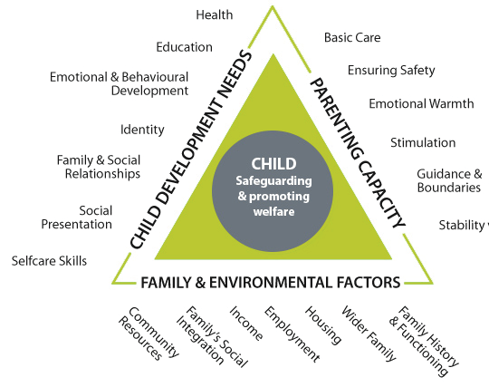

Slide 21
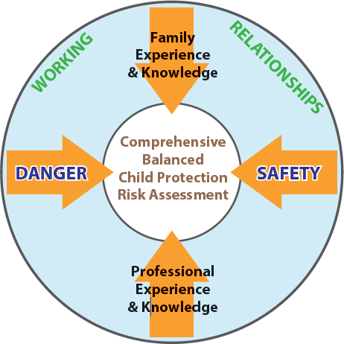

Slide 22
SECTION NINE: IDENTIFYING NEED TABLE
 | Level 1 - Universal No additional needs | Level 2 - Early Help Additional needs meaning there is a risk of poor outcomes | Level 3 - Multi-agency Early Help Additional needs meaning poor outcomes are likely | Level 4 - Statutory Intervention Acute needs - at risk of significant harm
CHILD’S DEVELOPMENTAL NEED | Achieving milestones. Any developmental delay is responded to appropriately. Age appropriate, positive and healthy relationships with parent/carer. Ability to cope with everyday emotional and relationship difficulties. All identified is met by the provision of appropriate services. | Slow in reaching developmental milestones, needs not consistently attended to. Unsafe use of the internet, including contact with unknown persons. Missed health checks/immunisations. Signs of disruptive or challenging behaviour, signs of offending or anti-social behaviour. Poor attachment. Unexplained but infrequent absences from school. Low level mental health issues, self-harm without suicidal thought or intent. Minor concerns regarding self-care. Underage sexual activity. | Developmental milestones not being met due to persistent parental failure/inability. Forming relationships with unknown adults. Difficulty coping with anger, frustration or upset. Displays challenging disruptive, offending behaviour. Risky sexual behaviour/activity Persistent non-attendance at school. Concerns regarding presentation, hygiene, basic care. Social exclusion. Regular missed appointments affecting developmental progress. Self-harm with suicidal ideation. | Non-mobile child with injury. Non-organic failure to thrive. Profound permanent multiple disabilities. Persistent or multiple relationships with unknown adults offending behaviour resulting in risk of significant harm. Frequently missing from home. High level emotional health issues. Drug/alcohol misuse affecting development. Teenage pregnancy under 13 years. Complex mental health issues affecting development. Hygiene and presentation concerns resulting in isolation. Challenging behaviour resulting in serious risk of harm.
PARENTAL CAPACITY | Accesses services appropriately e.g. health and education. Appropriate feeding, diet and nutrition resulting in age appropriate growth. Parent ensures child is protected from danger. Good attachments. Parent able to implement appropriate boundaries. Parents respond appropriately to advice given. | Poor supervision of the child. Missed health appointments with unscheduled attendances at GP and walk in clinics. Anti-social behaviour. Some positive stimulation, new experiences. Inconsistent care arrangements. Poor response to emerging need. Concerns about attachment/interaction. Inconsistent parenting. Risk of relationship breakdown. Reported domestic abuse where impact on child is not immediately known, e.g. the child is not present. | Parental learning or physical disabilities impacting on child’s development or needs. Parental Substance misuse or mental health issues impacting on child’s development or needs Poor supervision from the parent resulting in unmet need. Poor response to the child’s need from the parent. Signs of neglect. Domestic abuse impacting on child’s development. | Failure to access services likely to result in significant avoidable impairment to the child. Suspected neglect, for example persistent reports of child presenting as hungry/scavenging for food, or at risk due to being overweight/underweight. Child experience of domestic abuse resulting in risk of significant harm. Child sustains an injury due to lack of supervision. Suspected non-accidental injury. Child abandoned/rejected/persecuted. Private fostering arrangements. Non-compliance/disguised non-compliance. No positive stimulation. Extreme poverty impacting on parental ability to care for the child. Significant substance/alcohol misuse.
FAMILY AND FACTORS | Supportive and positive relationships and networks. Good family relationships. Accommodation has all basic required amenities. Secure tenancy. Family are able to manage financially using resources to meet needs. Access to positive activities. | Family affected by low income or unemployment. Parental advice needed to prevent escalation. Young carers. Poor housing/ home environment impacting on the child’s health. Poor access to core services. Early signs of neglect. | Transient families: frequent moves impacting on the child’s education. Housing concerns: tenancy at risk, home in poor state of repair. Relationship breakdown. Community harassment/ discrimination. | At risk of female genital mutilation. At risk of honour based violence. At risk of forced marriage. Unaccompanied asylum seeking children. Edge of care, for example at risk of homelessness. Suspicion of physical, emotional or sexual abuse or neglect.
ENVIRONMENTAL

Slide 23
July 2019
2066 contacts received
only 19.7 % required Statutory Children’s Services Response
June 2020
2089 contacts received;
COVID- a reduction in volume currently but a steady increase in risk and complexities
80 Strategy discussions where there have been risks of significant harm to children
Average of 70% of work into MASH is NFA-this month 30.2% hit the threshold for statutory services due to the level of risk with a further 12.4% requiring an Early Help service.
The challenge-reaching decisions within one working day in line with Working Together to Safeguard Children 2018

Slide 24
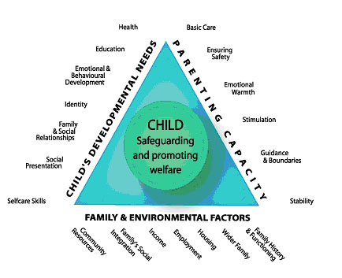
A few points.........
Using Signs of Safety-the practice framework adopted in Coventry
Basic details such as dob, names of children, parents, family composition are critical for MASH partners to check their systems
The child & their expereinces-Their world
“mum took an overdose”-is there a context behind this?
Any relevant information-how could a parents abilities be affected?
History
The better quality of information shared, the better informed the MASH decision, and the more likely that children get the outcome they need

Slide 25
Triage and information gathering
Referrer:
Area team covering postcode: (please enter postcode & area
Summary of Concerns (Referral details entered here)
Family Composition:
Child: and siblings
Parents:
Any other adults or children living within the property:
School:
GP:
Ethnicity:
Language:
Disability:
Religion:
Address:
Contact number for parent:
Has this matter been discussed with the parents:
Are parents aware that a contact has been made to Children’s Services:
Have parents consented to the referral:
Have parents consented to their information being shared with agencies:
Have parents consented for agencies to share their information with Children’s Services:
Is there any Youth Offending involvement?
Reason for Contact: (Referral details)
Records of all telephone calls and Signs of Safety:
Analysis to include professional curiosity

Slide 26
Example-safeguarding?
Referrer: GP surgery. It was marked as urgent.
Concern:
“Pregnant 19 year old lady, approximately 6 months pregnant, no input from Midwife, also has 9 month old son. Attended surgery as a new patient on 26th and complained of reduced foetal movements. Advised to attend UHCW to be checked - did not attend. Seen today, 27th, still has not been to be checked. What needs to happen next? Ensure mother gets support in accessing the right maternity services to safeguard her and her unborn child.”
What could have been done differently:
This was a health-related issue. The concerns could have been dealt with in a timely manner by the surgery liaising directly with the midwife to encourage mother to attend an appointment.
Gaining more context to the family situation. Information gathered from the mother during the appointment regarding why she hadn’t gone to UHCW would have been beneficial and could have focussed support. E.g. Childcare preventing her from going, transport issues, financial difficulties to pay for transport.

Slide 27
Example-timely decisions?
Referrer: West Midlands Ambulence Service
Concern:
“patient drank approx 700ml whiskey this evening - pt severely intoxicated - has scratches to her arm ?self harm short, slim build, blonde hair scratches to her arm"
What could have been done differently:
It is not clear who this information refers to
It transpired this related to a young teenager, but could have led to mis-interpretations that this was a parent
The impact
Being clear reduces the need for the UHCW safeguarding team to be contacted and records needing to be reviewed-this adds to delay for children and the right response

Slide 28
Ingredients of a good referral
All family members details including names and date of births.
Contact details for the parent.
The context of the concerns; How did they come about? What are you worried about? What has happened up till now?
Evidence that you have had a discussion with the parent. It is good practice to speak to the parents about your concerns and discuss with them and gain consent for making a referral, unless this puts the child at further risk. Does the parent want support?
Work openly and honestly with families, unless this puts the child at further risk.
What support has your service been providing or what support will you be supporting in the future?
Consideration of other avenues of support through referrals to other services and early help.
Is a referral to Childrens Services the right help at the right time?

Slide 29
What is the right help at this time?
Being clear on the worries and the strengths, using the signs of safety methodology, consider what level of support the family need.
Use the Right Help, Right Time Threshold document to decide which service would be best placed to support the family and make the necessary referrals directly as this prevents delay for children
https://www.coventry.gov.uk/downloads/download/5066/right_help_right_time
If the family's needs meet the threshold for early help, a referral can be directly to the Family Hub. This is quicker than referring into MASH and then a diversion to the hub for consideration at their next family matters meeting
If you are unsure please seek advice from the MASH advice line.

Slide 30
COVID-19 (Coronavirus)
Early Help is a range of services working together to help children, young people (0 – 19) and their families. We can provide this support through the Family Hubs and within the local community.
We aim to reach children, young people and families when the need first emerges; and to help and support when we can have the greatest impact.
Early Help: telephone 0800 8870545 or email earlyhelp@coventry.gov.uk
Emergency Duty Team: telephone 024 7683 2222 between 5pm – 8.30am and during weekends
Multi-Agency Safeguarding Hub (MASH): telephone 024 7678 8555

Slide 31
Conclusions and Questions
The Family Hubs
Aspire Family Hub
Humber Avenue, Coventry, CV1 2SF
024 7697 8100
Families for All Hub
454 Foleshill Road, Coventry, CV6 5LB
024 7697 7991
Harmony Hub
Clifton Street, Coventry, CV1 5GR.
024 7697 8030
The Moat Family Hub
Deedmore Road, Coventry, CV2 1EQ.
024 7697 8036
Mosaic Family Hub
Jardine Crescent, Coventry, CV4 9PL
024 7697 8160
Park Edge Family Hub
Roseberry Avenue, Coventry, CV2 1NE
024 7697 7880
Pathways Family Hub
Lawrence Saunders Road, Coventry, CV6 1HD
024 7697 8130
Wood Side Family Hub
Upper Ride, Coventry, CV3 3GL
024 7697 8090

Slide 32
Signs of Safety 2-day Training Courses
Autumn 2020 and Spring 2021
Dates:
Wednesday 25th & Thursday 26th November 2020
Wednesday 9th & Thursday 10th December 2020
Tuesday 18th & Wednesday 19th January 2021
Tuesday 9th & Wednesday 10th February 2021
Thursday 25th & Friday 26th March 2021
Times: 9.30am – 4.30pm
Venue: If courses are delivered face to face they will take place in the Council House. However, due to the Covid19 situation, this cannot be confirmed at the current time and courses may be delivered virtually.
Please make sure that the two day course is appropriate for your job role. If you are unsure please check with the Signs of Safety Practice Lead in your organisation.
To book a place on these courses please go to the link www.coventry.gov.uk/safeguardingbookingform
For general enquiries about the training please email: cscp.training@coventry.gov.uk

