Slide 1
Cannabis Awareness
Presented by: Ashleigh Roach

Slide 2
Expectations and Agenda
To ensure that this is a comfortable learning experience for everyone; can we please…
Keep your microphones and videos turned off
Use the chat facility to ask questions throughout. A Q&A will be available at the end. All questions are valid- we don’t know what we don’t know!
This is being recorded so please be mindful if you don’t want to be identified
By the end of the workshop you should feel more equipped to:
Know the basics about Cannabis
Understand the effects
Understand the law
Know how to refer a young person for support

Slide 3
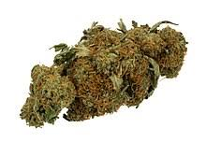
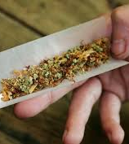
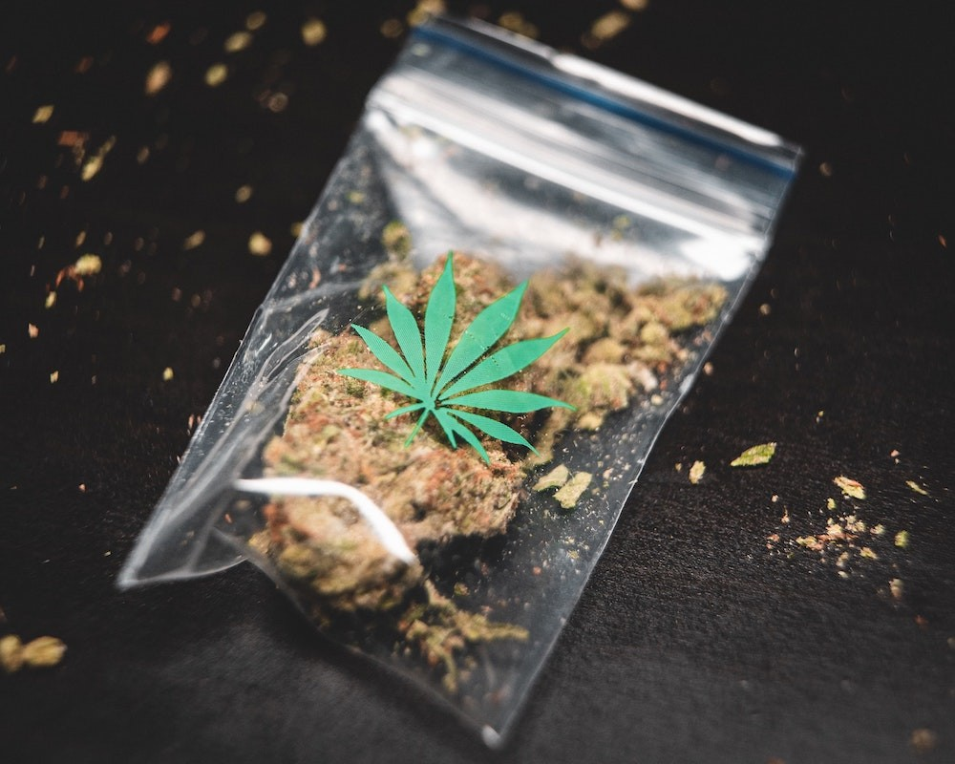
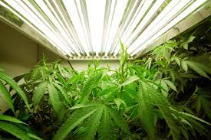
A ‘J’
A Zoot
Bud
Green
A ‘Bat’
Cali
Weed

Slide 4
There are many myths about Cannabis…

Slide 5
There are many myths about Cannabis…
Cannabis helps me sleep…
Cannabis may help you fall asleep however studies have shown that Cannabis changes your sleep cycle. THC impacts the amount of REM sleep someone gets, this is the part of sleep that helps us function well the following day having resorted our brain’s chemicals back to a normal balance.

Slide 6
There are many myths about Cannabis…
Cannabis cures Cancer…
Cannabis does have some medicinal qualities however it cannot cure cancer.
Research has shown that Cannabinoids (the chemicals within cannabis) can (not will!):
cause a cell to die
stop cells from dividing
stop cells from developing new blood vessels.
But they have also found that cannabinoids can:
damage important blood vessels
in some situations, encourage cancer cells to grow.
Some people receiving Chemotherapy may chose to use CBD products to ease pain and the sickness felt.

Slide 7
There are many myths about Cannabis…
Cannabis is a natural plant so it can’t be bad can it…
Cannabis does grow naturally in some countries however not in the UK. In the UK, Cannabis is grown deliberately which can be sprayed with things such as fertiliser and pesticides.
Aside from this, there are physical and mental health implications as well as impacts on your life such as financial, legal and relationships to name but a few!
So yes, it can be bad for you!

Slide 8
There are many myths about Cannabis…
If it’s a first time in possession, I’ll just get a street caution…
There are street cautions are utilised by the Police in attempt to not criminalise those caught in possession however this often leads to confusion around the legalities of Cannabis…CANNABIS IS A CLASS B DRUG!
Street caution/warning is available if:
you're in possession of a small amount of cannabis only
for your personal use
it’s the first time you’ve been caught with an illicit drug
you have no previous record of offence
you are compliant, non-aggressive and admit that the cannabis is for your own use only
You’re over 18
Second offence, the police can issue with a fixed-term fee notice, which is an on-the-spot fine for £80.
As long as you pay that within 21 days, there's no criminal record.
If there’s a third occasion, you will be arrested and taken to the police station.

Slide 9
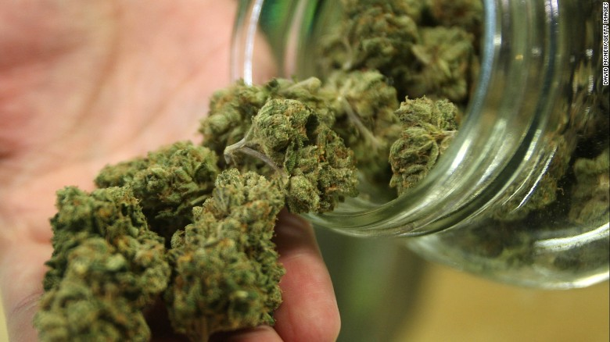
So what is Cannabis?!
Cannabis is a group of psychoactive plants from which people consume the ‘bud/flower’ of the plant.
It contains many Cannabinoid compounds however the two main ones are:
THC (tetrahydrocannabinol) – the active compound which is responsible for the ‘high’ a user can have. This is the compound which makes Cannabis illegal.
CBD (Cannabidiol) – this is not psychoactive and holds medicinal qualities which researchers are still exploring. It is known to help reduce inflammation and ease pain. It also helps with nausea, migraines, seizures, and anxiety.
Cannabis comes in different strains with different levels of each compound, this will determine the effect of that particular strain.
Indica – more relaxing (ie more CBD)
Sativa – more energising ‘high’ effects (ie more THC)
Hybrids – a combo of the two!

Slide 10
What are the effects?
The effects of cannabis can vary massively. Some people say feeling 'stoned' makes them feel chilled out and happy in their own thoughts, while others say it makes them giggly and chatty. But it can also make people feel lethargic, unmotivated and some people become paranoid, confused and anxious. Some of the main experiences may be:
Short term
Relaxation
Impaired memory
Lack of coordination
Talkative
Ease aches and pains
Increased appetite
Feel giggly
Help you nod off to sleep
Potential for paranoia
Long term (health only!)
Decrease in Dopamine being released
Irregular heart beat
Lung conditions such as damage or increased risk of lung cancer
Dependence (withdrawal including irritability, low appetite, and mood swings)
Increased risk of mental health disorders such as Psychosis with the risk being 5 times greater than someone who doesn’t use Cannabis
Duration: it normally takes a minute or two to feel stoned. If you eat cannabis, it can up to an hour. The effects if smoked will last between ½ hour and a couple of hours and if eaten 2-4 hours.

Slide 11
Cannabis and young people
Cannabis remains the most common substance for young people to enter treatment services with 88% having it as their primary substance.
Of the general population of 11-15 year olds; 8% have used Cannabis during the past year.
Those that had used a substance:
57% shared they got their substances from a friend
12% obtained the substance in school
13% of pupils agreed it was okay for someone their own age to take cannabis to see what it was like; compared to 3% for taking cocaine.
30% of 15 year olds thought it was okay to try cannabis, and 17% thought it was okay to use it once a week.

Slide 12
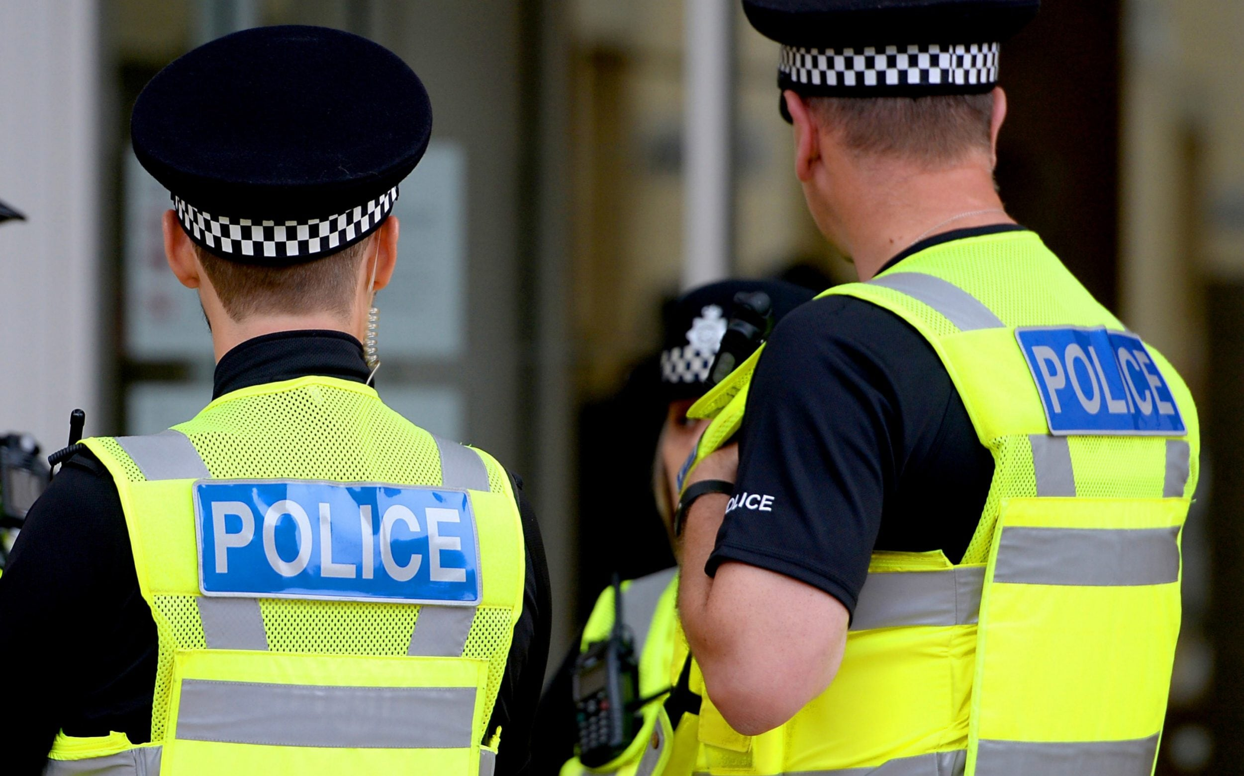
The Law
Cannabis is a Class B drug which means that ultimately someone could receive up to 5 years imprisonment for possession and up to 14 years for supply.
As mentioned previously, the Police have discretional powers to stop people being criminalised for using Cannabis.
Medicinal cannabis is legal when prescribed by a registered doctor, this was made legal in November 2018
There is a zero tolerance approach to driving whilst under the influence of Cannabis. 1/5 RTCs which involved under 30’s tested positive for Cannabis.

Slide 13

Positive Choices
Amongst other support, Positive Choices are here to support young people with their substance use. Some of the ways we can support include:
Harm reduction techniques
Building on awareness; informed decisions are best!
Exploring the impact of their use
Making changes to use; reduction or abstinence plans
Alternative coping techniques
Diversionary activities

Slide 14
How to make a referral
You are more than welcome to call our Duty Worker or refer via our website for a quick and secure way to place the referral
www.changegrowlive.org/positive-choices-coventry
02476 010 245 coventryinfo.yp@cgl.org.uk
Please consider:
Consent of the young person (including parental consent for under 13s)
Include as much relevant information as possible
Keep us involved in Early Help/Social Care meetings

Slide 15
How to contact us
Address:
23-25 City Arcade, Coventry
Phone:
02476 010245
Website: (referrals & online chat)
www.changegrowlive.org/coventryyp
Facebook:
PositiveChoicesCov
Instagram:
Positivechoices_Coventry
Twitter:
@PosChoices_Cov

Slide 16
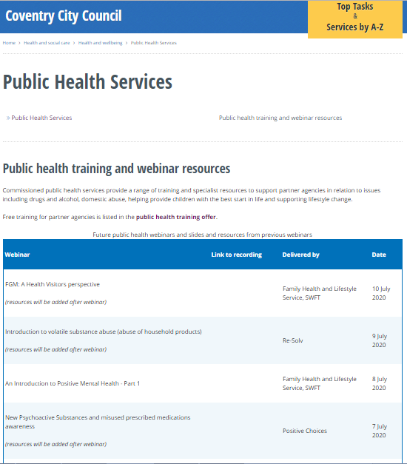

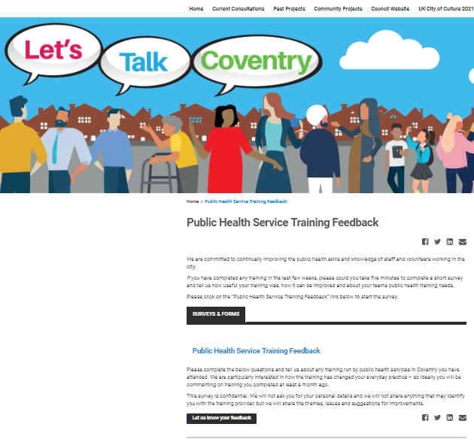
Thank you for listening
Please visit the City Council website:
Slides and recordings of past webinars
Timetable of future webinars
Details of more in-depth training available free from Public Health services
Google “coventry public health webinars” or visit
www.coventry.gov.uk/info/190/health_and_wellbeing/3283/public_health_services/2
Feedback and ideas for future webinars
Please give is your feedback and suggestions of future webinars via the Let’s Talk Coventry site at https://letstalk.coventry.gov.uk/publichealthtraining

