Slide 1
FEMALE GENITAL MUTILATION Awareness

Slide 2
PRESENTED BY
Name: Nene Ojoawo
Role: FGM Project Coordinator for Coventry Haven Women’ Aids
Project funded by West Midlands PCC
Expectation of today

Slide 3
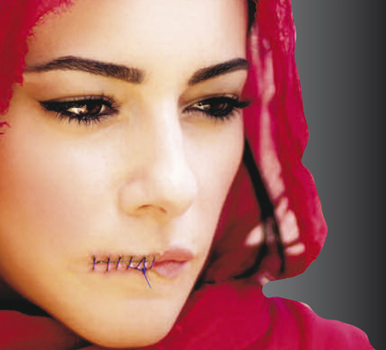
Brief overview of the history of FGM Classification of FGM Physical & mental health implications of FGM Motivations of FGM Facts & figures around FGM LEGAL Updates on FGM COVID 19 and FGM
LEARNING OUTCOMES

Slide 4
Female Genital Mutilation Definition
Female Genital Mutilation (FGM) also known as cutting, or circumcision comprises all procedures involving partial or
total removal of the external female genitalia
or other injury to the female genital organs
for non-medical reasons (Word Health Organisation, 2012)
Notes:
FGM is a dangerous practice that have ling-lasting health repercussion on women's and girls life. The societies where FGM prevails, there is elements of culture that include a particular beliefs, behavioral norms, customs, rituals, social hierarchies and religious, political and economic systems.

Slide 5
What are the types of FGM?
Type 1:
Partial or total removal
of the clitoris and or clitoris hood
(Clitoridectomy)
Type 2:
Partial or total removal of the clitoris
and the labia minora
with/without excision of the labia majora
(Excision)
Type 3:
Narrowing of the female genital
opening through the creation of a
covering seal formed by cutting and
repositioning the inner, or outer, labia
with or without the removal of
the clitoris
(Infibulation)
Type 4:
Includes all other harmful
procedures caused to the female
genitalia for non-medical reasons, e.g.
pricking, piercing, incising,
stretching, and cauterising of
the genital area

Slide 6
History of FGM
FGM is dated back at least 2000 years and the exact origin of the practice is unknown.
It is believed that it was practiced in ancient Egypt as a form of controlling women’s sexuality.
It was believed that FGM would ensure women’s virginity and reduction in the female desire.
Although FGM is commonly perceived in Western societies as a ‘foreign phenomenon’, the surgical removal of the clitoris (clitordectomy) was a recognised practice in 19th Century Britain in the management of mental health and epilepsy (Kandel, 1999).(Isaac Baker Brown)

Slide 7
History of FGM continue
The Romans performed a technique involving slipping of rings through the labia majora of female slaves to prevent them from becoming pregnant.
Similarly the Scoptsi sect in Russia performed FGM to ensure virginity.
In some communities it is valued as a rite of passage to womanhood. (for example in Kenya and Sierra Leone).

Slide 8
Socio-cultural context of FGM
Religion
FGM is viewed as a religious obligation by some Muslims/Coptic Christians/Ethiopian Jews.
Culture & Tradition
This is part of our heritage and deep rooted into our cultural belives ‘’everyone has FGM done’’.
Relationships
Ensuring chastity and faithfulness within marriage – reducing promiscuous behaviour and ensuring virginity.
Purity & Hygiene
Women who have had FGM are considered to be pure and clean, uncircumcised women are viewed unattractive and ostracised from the community.
Gender Identity
Part of being a good woman, increase in credibility, status and family name. FGM is significant in order to get married – rite of passage.

Slide 9
Impact victims' lives
Flashbacks
Anxiety
Low self-esteem
Feeling inadequate
Implications of intimacy in relationships
Struggles to disclose
Unable to undergo gynecological examinations and catheterisation
Lives alone with the problem
May not link problem to FGM
Women often don’t know what type of FGM they have had – sometimes women don’t know they even have FGM

Slide 10
Mental Health & FGM
FGM is associated with various degrees of mental health.
Loss of trust
Post-traumatic stress disorder
Shock and depression
Sexual dysfunction
However, the psychological effect of FGM in countries where it is culturally acceptable and prevalent it is thought to be minimal.
Limited data on the rates of individual disorders as a direct result of undergoing FGM

Slide 11
Potential health implications
Fractures of the limbs from forcibly being restrained.
Severe pain and shock
Injury to adjacent tissues
HIV/AIDS.
Painful intercourse
Delay in healing
Pelvic infection
Difficulty with menstruation
Infertility
Keloid Scaring
Internal/external cysts
Recurrent Urinary tract infections (UTI )
Fistula

Slide 12
Global & UK Prevalence Rates
The exact number of girls and women who have undergone FGM is unknown
UNICEF estimates that over 200 million girls and women worldwide have undergone FGM (UNICEF 2016)
170,000 women and girls living in the UK are living with the consequences of FGM (House of Commons Home Affairs Committee)
65,000 girls underage of 13 may be at risk of undergoing FGM (House of Commons Home Affairs Committee (2014)
In Coventry and Rugby CCG in 2018/2019, a total of 60 women and girls(including new cases) were identified by health care professionals as having undergone FGM (Coventry evening telegraph 29th July 2019.)

Slide 14
The law and FGM
Within Europe, most EU member states have criminal legislation which defines the practice of FGM as an offence, either as a specific criminal act or as an act of bodily harm or injury
At an international level, eighteen African countries have enacted laws criminalising FGM
There have been reports of prosecutions or arrests in cases involving FGM in several African countries, including Burkina Faso, Egypt, Ghana, Senegal, and Sierra Leone.
There has currently been 1 conviction in the UK for FGM
France - has had 100 successful convictions to date - under Child Protection Legislation
Has a penalty of up to 14 years imprisonment and/or a fine

Slide 15
Serious Crime Act 2015
Offence of failure to protect a girl from risk of FGM
If an offence of FGM is committed against a girl under the age of 18, each person who is responsible for the girl at the time the FGM occurred will be liable
The offence carries 7 years imprisonment

Slide 16
Mandatory reporting duty
The Serious Crime Act 2015 is a legal duty requiring specified regulated professionals to make a report to the Police in England & Wales of any known cases of FGM of a girl under 18
If any child (under 18) discloses to a regulated professional that they have had FGM, or if a professional observes that she has had FGM, they must report to the police, using the 101 non-emergency number
Regulated professionals are health workers, teachers, social workers (regulated by the Professional Standards Authority)
Complying with the duty does not breach any confidentiality requirement or other restriction on disclosure
For teachers and social workers, there are no circumstances in which you should be examining a girl. the teacher must make a report under the duty, but should not conduct any further examination of the child.
It is recommended that you make a report orally by calling 101, the single non-emergency number

Slide 17
FGM Protection Orders
An FGM Protection Order offers the means of protecting victims or potential victims from FGM under the civil law. Applications for an FGM Protection Order can be made by the girl/woman or relevant third party
FGMPO can contain restrictions or other requirements to protect the victim such as surrendering her passport and travel documents
Breach of FGMPO would be a criminal offence with maximum 5-year imprisonment or civil breach carrying a 2 years imprisonment
Applications for FGM Protection Orders are dealt with by the family court
The person completing the application should read the guidance first. see FGM700 (guidance on https://formfinder.hmctsformfinder.justice.gov.uk/fgm700-eng.pdf). This guidance is available in Amharic, Arabic, English, Farsi, French, Somali, Swahili, Tigrinya, Turkish, Urdu and Welsh.
Where an application is being made by the person to be protected (with or without legal representation) or a local authority, form FGM001
If an application is being made on behalf of someone else, the court’s permission to apply will be needed and so form FGM006 should be used

Slide 18
RISK AND IMPACT OF COVID 19
FGM support services are not considered as a medical emergency and a lot of facilities are closed and will remain so for at least several more weeks. Medical staff have rightly been re-allocated to overcome the COVID-19 outbreak or encouraged to avoid any non-urgent medical care for now. As a result, many FGM survivors and women in general are left without any access to needed medical care
Being locked down at home is exposing girls to a greater risk of undergoing FGM as the procedures are usually carried out during school holidays and the lockdown is being an opportune time for the procedure to be carried out in the home with ample time for healing
According to the United Nations Population Fund (UNFPA), the COVID-19 pandemic will result in an additional 2 million cases of FGM over the next decade, which would have been avoided had there been no outbreak
Due to disruptions caused by COVID-19, UNFPA anticipates a third reduction in the progress towards ending FGM by 2030
Reduced protection for girls from affected communities
Limited access to psychological support; leading to a possible increase in survivors with mental health needs
Reduced access to specialist services for survivors
Increased risk of girls potentially being cut in the UK

Slide 19
WHAT can be DONE to support?
Women currently have virtual access to counselling and advocacy support via the NHS FGM support clinics; however, non-urgent physical health needs are not being met during COVID-19 due to government guidance
FGMPO's can still be obtained during the pandemic
If schools have had any concerns for girls prior to closures, contact children social care for advice; and keep these students on the radar for when the school re-opens
Supporting community-based women and youth groups in identifying girls at risk of female genital mutilation
Raising awareness about their increased vulnerability and marginalisation as a result of the pandemic is one way to adapt community-based surveillance systems
Prioritise strengthening the response capacity of national hotlines to increase remote access to mental health and psychosocial, legal support, and safety planning opportunities with trained service providers
Ensure female genital mutilation referral pathways and information are updated and disseminated regularly
Communities must come together in response to COVID-19. If you are concerned about a girl or vulnerable adult, contact your local children’s social care team or the police. In an emergency, always contact 999

Slide 20
Key messages
Increased awareness is essential amongst health and social science professionals
Continued training is needed for professionals
Sensitive and appropriate response to women is needed
Racial profiling is unacceptable
Safeguarding is paramount
Introduce FGM into your policies & procedures & develop a specific FGM policy
Follow safeguarding procedures unless disclosure is made by a under 18 then report to the police
FGM is a life dynamic practice – it’s ever changing
As many people are being asked to stay at home, some are being trapped with their abusers and unless support is put in place, the fall out of the COVID-19 pandemic could be detrimental for women and girls around the globe for decades
There needs to be hotlines, support groups and accessible information so people aren’t in the situation where they’re suffering and think there’s no support available to them

Slide 21
Don’t be afraid to ask questions
Care
Protect
PREVENT
END

Slide 22
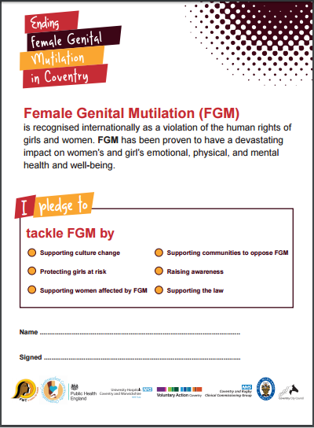
Individual pledge to tackle Female Genital Mutilation (FGM).

Slide 23
Let us save the life of our girls and women by saying no more FGM contact Coventry Haven on 02476444077/ 08001114998 Nene Ojoawo on 07539757412 Email: nojoawo@coventryhaven.co.uk

