Slide 1
Coventry NSPCC
Still here for children…
Our Service Offer –
providing specialist therapeutic-informed services
Gurpreet Dosanjh (Team Manager)
gurpreet.dosanjh@NSPCC.org.uk
Notes:
Good afternoon everyone and welcome to our NSPCC Webinar.
Reminder to mute mics and turn off videos for a smoother experience
Chat function manned by colleague Michelle, one of our practitioners – she will answer any straightforward questions, anything overly complex please do email our service centre email address and we will try and answer your enquiry later today.

Slide 2
Coventry NSPCC – the team
Who are we?
Our team is made up of six practitioners (social workers)
Two team managers (Gurpreet and Julia) and one service manager (Jan Fossick)
Admin support
Based in Coventry City Centre – near Coventry University
How have we adapted during this pandemic?
Creation of a virtual offer for most of our services and increase in telephone support.
More recently, we have re-opened our Service Centre and have safety measures in place

Slide 3
Impact of Covid-19 for young people
Both Childline and the NSPCC Helpline have seen an increase in the number of people worried about domestic abuse since the government’s stay at home guidance was issued.
“We should be allowed back to school now so my step-dad stops hitting mummy”
Boy, aged 10, Childline
NSPCC How Safe Report (2020) - NSPCC Helpline received an average of 1,066 contacts a month from April to July from adults with concerns that a child or young person was being physically abused – an increase of 53 per cent on the pre-lockdown average.

Slide 4
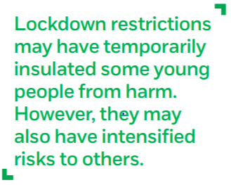
Impact of Covid-19 for young people
Placed heightened pressure on families – adults turning to alcohol and drugs to cope – associated with increased risk of child abuse.
8-24 year olds reported:
41% more lonely
38% more worried
37% more sad
34% more stressed
NSPCC ‘How Safe’ Report (2020)

Slide 5
Our services – three key themes
Preventing sexual abuse
Preventing online sexual abuse
Neglect in early years
Overall our strategy is moving towards more preventative based services
Common themes in the work we receive – unresolved parental trauma, domestic abuse experiences of both parent and child, more complexities, children finding it difficult to regulate, children are more anxious.

Slide 6
Preventing sexual abuse – Harmful Sexual Behaviour Services
“Sexual behaviours expressed by children and young people under the age of 18 years old that are developmentally inappropriate, may be harmful towards self or others, or be abusive towards another child, young person or adult.” (derived from Hackett, 2014).
AIM3 – aged 12-18
Assessment framework for young people who have committed or where there are serious concerns that they have committed Harmful Sexual Behaviour.
5 Domains - Sexual, Non-Sexual, Developmental, Family/Environmental and Self-Regulation.
Usually takes between 6-8 sessions.
Assessment report – pathways to the HSB, outlines the immediate risk management, medium and long-term intervention needs for both the young person and their parent/carer.
AIM under 12s - Information is gathered within four domains: sexual behaviours, development, parenting capacity and wider family and environmental factors. The assessment seeks to identify both concerns and strengths.
Technology Assisted HSB
HSB Consultation for professionals
Notes:
Children and young people are developmentally different to adults and should be responded to as such. • Children and young people’s sexual behaviours exist on a wide continuum, from normal and developmentally expected to highly abnormal and abusive. • Any child’s sexual behaviour must be viewed within a developmental context to recognise the key differences between the motivations and meanings of such behaviours at varying stages.
Children and young people displaying HSB are a complex group with diverse needs which cannot be addressed by a ‘one size fits all’ model of service provision.

Slide 7
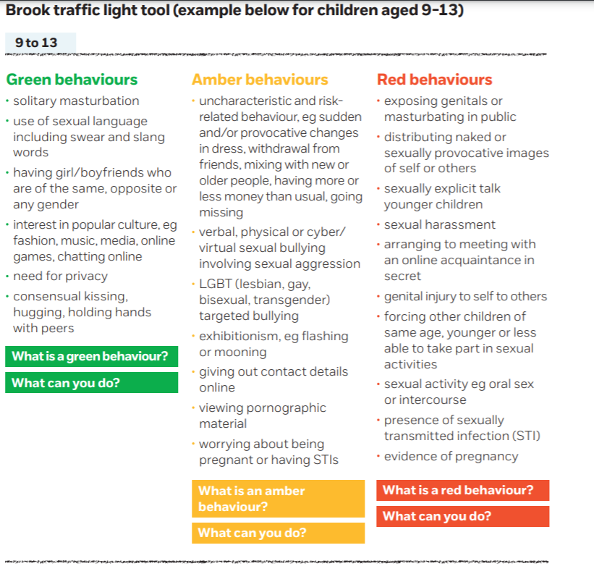

Slide 8
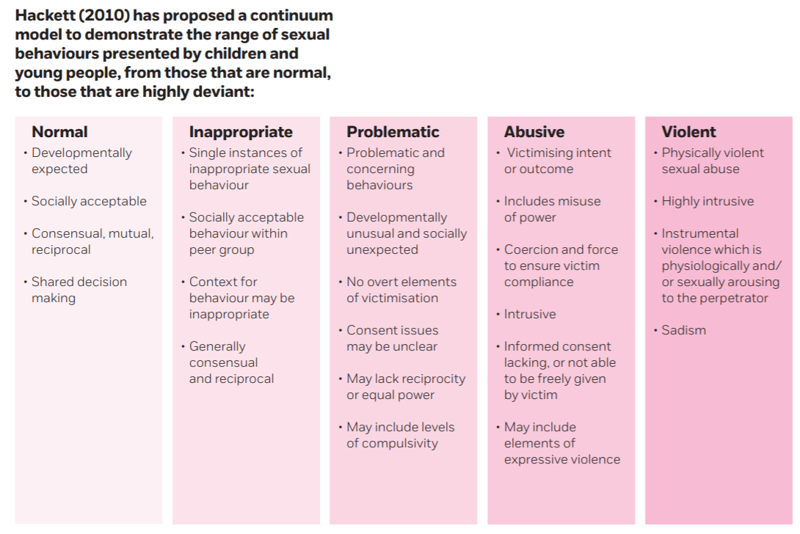

Slide 9
HSB - Interventions
Change for Good (up to 30 sessions)
- Manualised treatment programme for young people (without learning difficulties) aged 12 to 18 years old, who are displaying harmful sexual behaviour.
Good Way Model (tailored to YP)
- Young people who have mild to moderate intellectual or
learning difficulties, who also display harmful sexual behaviour.
Safe Home (Parent/carer work - up to 15 sessions)
psycho-educative and therapeutic programme for parents/foster carers who have/care for children who have displayed harmful sexual behaviour.
Delivered as part of YP accessing parallel intervention – or standalone intervention.
Notes:
The Change for Good model is a strengths based programmed designed to help young people to change their behaviours by identifying and managing their thoughts, emotions and actions. It was originally developed by Eamon McCrory with input from NSPCC practitioners (McCrory, 2011).
It is aimed at young males aged 12–18.
It aims to increase their socially acceptable behaviour (sexual and non-sexual) and refrain from sexually harmful behaviour and also improve their psychological functioning, optimism about the future and their sense of well-being. Work around consent and sexual knowledge would be undertaken as part of this work.
The programme is underpinned by a cognitive behavioural approach and draws on attachment theory, mentalisation theory, and psychodynamic and systems theories.
The intervention is strengths based and addresses the young person’s HSB in the broader context of the social and emotional challenges they are facing.
NSPCC deliver ‘Good Way’, which is a strengths based therapeutic approach for adolescents with learning difficulties. The intervention would introduce young people to the concepts of ‘good way’ and ‘bad way’ and would aim to assist him making safe and healthy choices whilst also exploring consequences of choices and behaviour. The ‘Good Way’ model integrates cognitive-behavioural and strength based approaches, with techniques drawn from narrative therapy, located within a trauma-attachment framework.
Safe Home includes:
Exploring and reflecting on the area of harmful sexual behaviour
Working with the parent to develop their knowledge and understanding of harmful sexual behaviour
Discussing the warning signs and consequences of harmful sexual behaviour, making sense of why young people might display harmful sexual behaviour
Developing a personalised safety plan that includes practical steps to prevent or minimise the impact of future abuse within the home.

Slide 10
Preventing neglect - Family Focus & Building Blocks
Family Focus – trauma-informed assessment approach addressing signs of possible neglect or where parent/carer has been identified as needing extra support to help them gain the skills and knowledge they need to care for their child.
Must be at least one child aged 7 or under in the household
Help understand the family history and their readiness to make changes – considers Scale, Type, Impact and Reason for abuse/neglect
Tailored plan for the family that ensures they receive the right intervention/support in the right order
Building Blocks - teaching parents/ carers practical skills to help them care for their children satisfactorily.
Mirroring and modelling / Whole Family Approaches used
Physical, safety, developmental and emotional are the key areas
Notes:
Underlying principles:
Good attachment is a protective factor
Productive relationships with practitioners support change
Early appropriate intervention is best for everyone
Parental trauma can have a detrimental effect on adults parenting ability
Child’s community, cultural, emotional and physical context and their experiences can define their behaviour as they grow
A proportionate holistic approach to assessment
of abuse and neglect with and associated toolkit
Where it:
Supports staff to understand the Scale, Type, Impact and Reason for the abuse/neglect
Uses therapeutic theories to support relationships and change
Uses a trauma focussed biographical conversation to identify the underlying parental issues
Describes a way of matching the assessment to the correct intervention
Supports staff to make capacity to change judgements

Slide 11
Building Blocks (intervention)
Currently delivered virtually or at the Service Centre
Can offer up to 20 sessions
Primarily an early intervention service, but the programme can also be delivered to families where children have more complex needs.
The focus will be on the child identified in the assessment as most in need, but the programme will still take into account all children in the family.
Examples of targeted areas –
Meet the child’s basic needs, including meal preparation and nutrition.
Manage challenging behaviour and rewarding good behaviour.
Emotional attunement/strengthening relationships

Slide 12
Preventing online sexual abuse – In Ctrl
In Ctrl is a creative intervention programme designed to equip young people with the skills and knowledge to explore their online world safely and know what to do when something goes/feels wrong.
Ages 9-13 (some scope for 14/15 if there are identified learning needs)
1:1 virtual offer / if there is a specific need we can offer Face to Face sessions
Identified as vulnerable due to previous adverse experiences, incl. Covid-19
May be some concerns about their online experiences/usage***
No ongoing child protection concerns/in crisis – not suitable for this service
Aim is to work closely with the parent/s to ensure safety/provide support
***Concerns should not include abusive behaviours/problematic sexualised behaviours/CSE
Wellbeing + Safety = Digital Confidence and Resilience =
Less risk of abuse online
Notes:
In Ctrl is an NSPCC preventative child sexual abuse service. Our In Ctrl practitioners have been working with children and families to prevent child sexual abuse online by working directly with them to help them gain an understanding of the potential risks, as well as the benefits that exist when being online.
During the COVID 19 lockdown our colleagues in the police are already seeing early evidence of an increased demand within the online CSA and exploitation domain, with children spending more time unsupervised online. This will inevitably lead to greater vulnerability to exploitation from perpetrators. It is likely that more youth produced sexual imagery (sexting) may also take place as the young communicate amongst their peers solely online.
It is recognised that keeping children safe online can prove challenging for many parents and carers. Since the COVID-19 lockdown, service centres and the NSPCC as a whole has received an increasing number of requests for support and advice about keeping children safe online.
The original In Ctrl programme adopts a holistic approach that includes supporting children’s offline relationships and emotional wellbeing. It also involves helping parents gain understanding of the potential risks that exist for children online to help them provide the guidance, support and protection needed. The aim of the work is to help build children’s digital resilience while increasing parental knowledge and confidence to support and protect their children.
The original service was developed and feasibility tested as a group-work programme, but due to the circumstances around COVID-19, the programme has been reviewed and adapted to work on a 1:1 basis and tailored to the needs of the individual child and parent. The following is a summary of the adapted virtual offer and NSPCC resources that are available to support it.
The adapted In Ctrl offer will provide children and where appropriate, their parents, with tailored 1-1 support to help keep children safe online. The support will be ‘relationship-based’ meaning practitioners build rapport and trust with the family to meaningfully engage them, understand their specific support needs and respond to these using a range of approaches and creative activities.

Slide 13
In Ctrl – online safety service…with a difference
Advice and guidance to parents/carers on online safety as well as supporting children emotionally.
1 x assessment session with young person.
1 x assessment session with parent/carer.
1 x joint safety planning session with young person and parent/carer.
At least 3 x sessions tailored to the young person’s needs
Session themes:
Friendships, relationships, and family life;
Cyberbullying/digital footprint
Social media, online spaces and enjoying life online and offline.
Learning about some of the risks online and who and what can help with these;
Building on the strengths
What to do if something feels uncomfortable

Slide 14
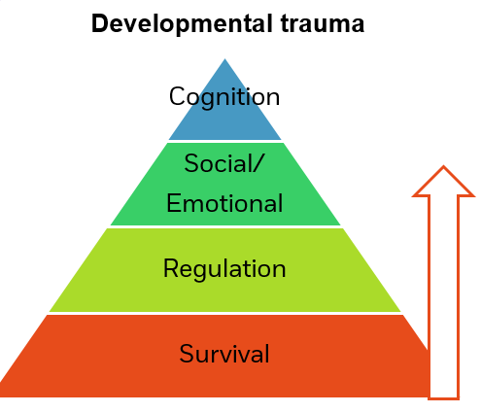
How we work and what approaches we use…
Trauma-informed and therapeutic based
Relationship-based working
Safeguarding at the forefront
Voice of the child

Slide 15
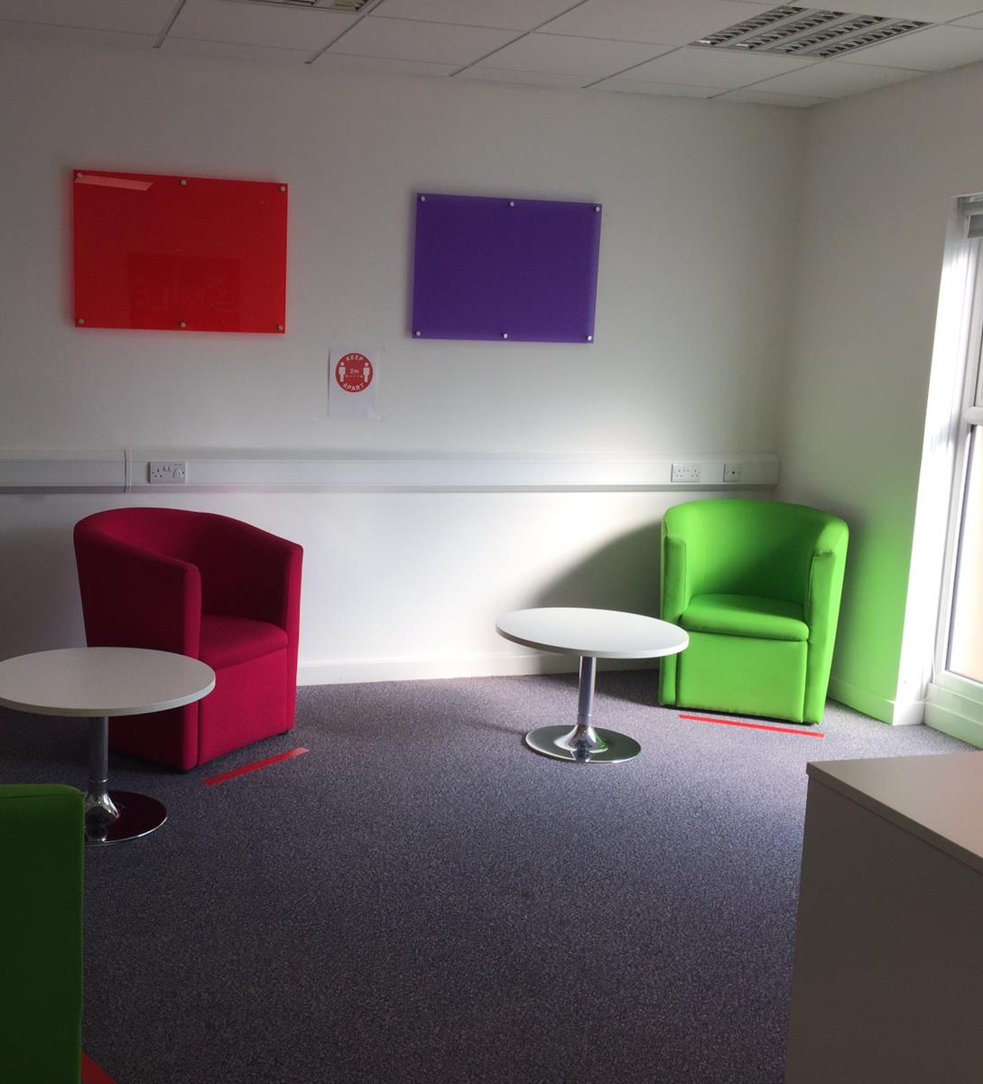
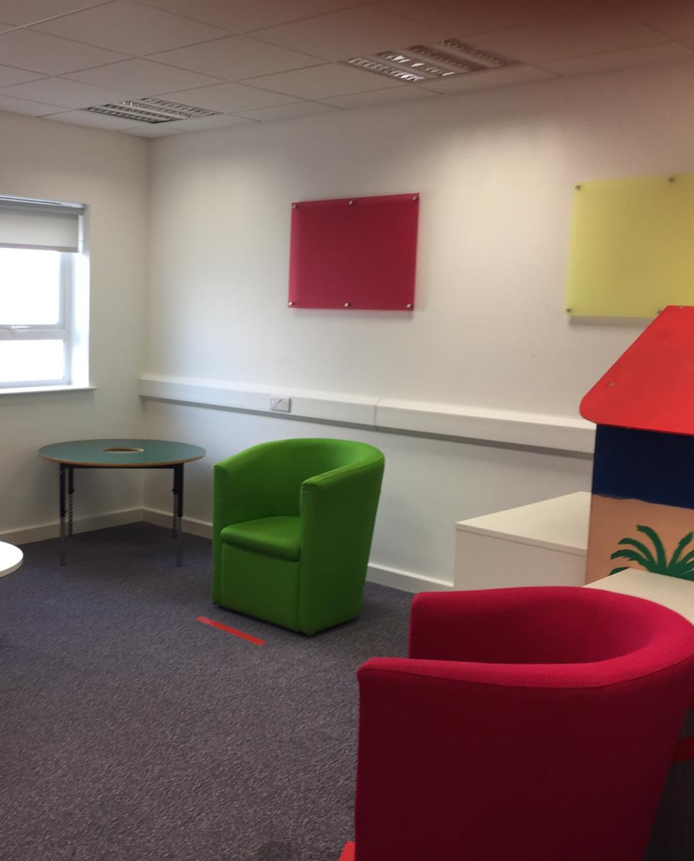
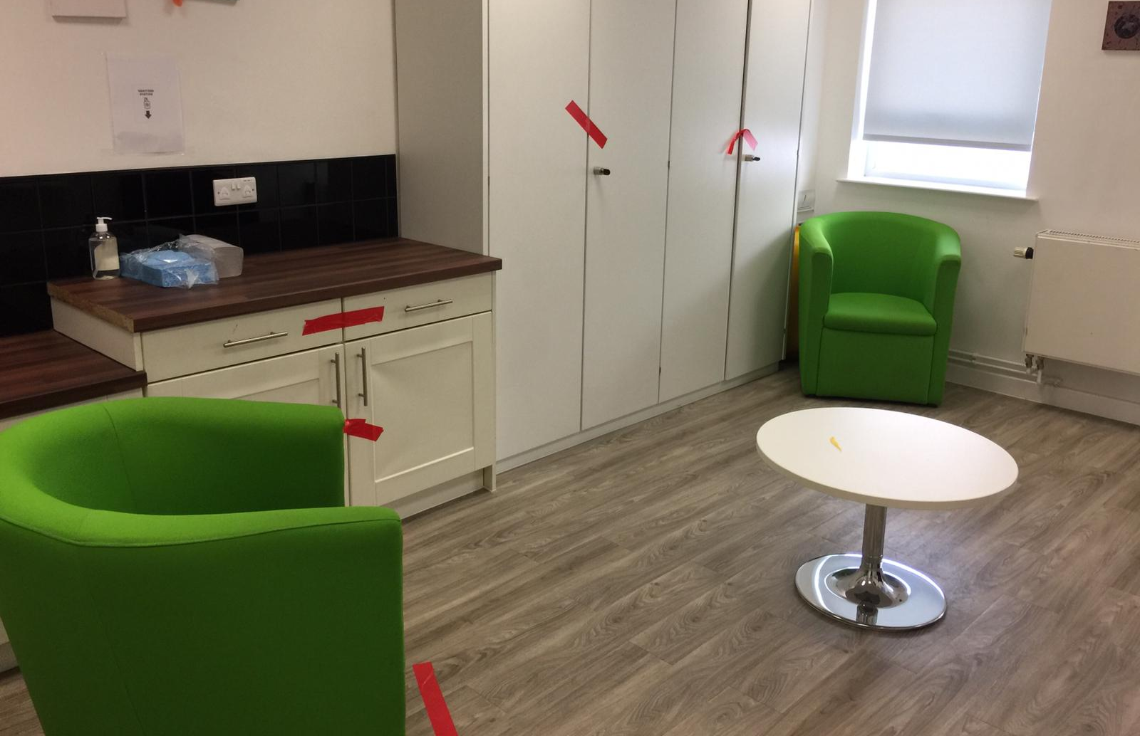
How we have adapted the Service Centre

Slide 16
How do you make a referral/enquiry?
Speak to one of our duty workers to discuss your family and confirm we have the right service at the right time for them.
Mon, Tues, Thurs and Fri - 9am-1pm.
All referrals should be discussed with the parent and child before sending to NSPCC.
Once the family have given their consent and you have spoken to us, complete the NSPCC referral form and send it to us via post or via email.
Once received, a duty worker will be in touch to discuss the referral – a decision is made within 7 days.

Slide 17
What makes a good NSPCC referral?
Consent from the family - we are a voluntary agency
Chronology of significant events/concerns
Copies of plans/assessments
Safety plans
We use Signs of Safety framework – shared language?

Slide 18
National Services:
NSPCC Website
NSPCC Learning – training for professionals
Helpline: 0808 800 5000
Childline: 0800 1111

Slide 19
Thank you for listening!
Any questions or enquiries:
02476 222 456
Coventry.ServiceCentre@NSPCC.
org.uk
Boole House
76 Whitefriars St
Coventry
CV1 2DS

