Slide 1
Supporting Young People
Across Coventry

Slide 2
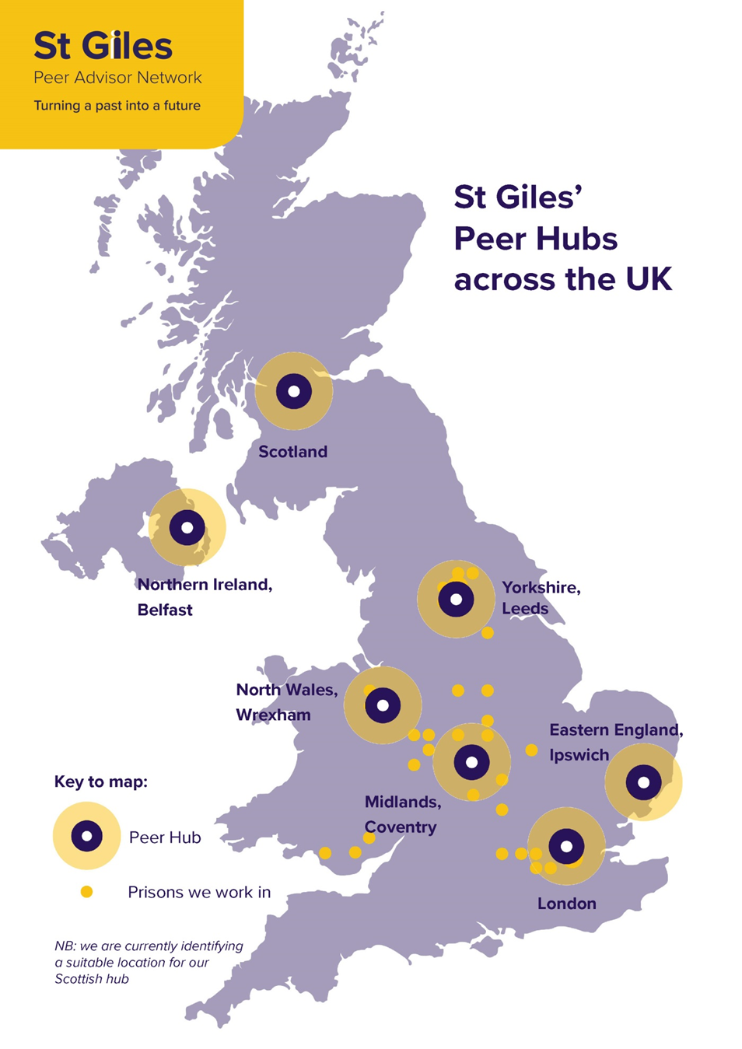
About St Giles
St Giles Trust is a charity putting experience to work on society’s most complex problems. We use our award-winning peer-led approach of training people who have successfully overcome disadvantages to support their clients forms the heart of our work.
We do that by:
Believing that people in the most desperate circumstances are still
capable of making positive changes to their lives.
Offering services which have real understanding of the situations
our clients face through using people who have been there themselves
Investing In people – not programmes. We offer a flexible, client-centred
approach which works to the needs of the individual

Slide 3
What We do..
We have over 70 different projects supporting over 25,000 people through locations in London, South East, Midlands, Wales and Yorkshire.
A few of these are:
A&E Early intervention
SOS Gang support
Police Custody Suite’s
County Lines services & R&R
SOS+ Preventative sessions
Family Gangs Units
SOC multiagency work
Prisons
And many more…..
Peer-led services – or those using people with lived experience of the issues facing those they are helping - are at the heart of St Giles’ work.

Slide 4
St Giles in Coventry
Across COVENTRY we offer:
Teachable Moments A&E Service supporting young people impacted by youth violence.
Police Custody Suite work supporting young people involved in violence, gangs, County lines etc.
Young Adults Gangs Resettlement Service supporting adult male prisoners on release from prison.
Peer Advisor Hub- Training people with lived experience to gain their L3 IAG and support into volunteering.
County Lines Victim Rescue Service supporting young people exploited into county lines
SOS+ School Early Intervention & Mentoring – part of phase two pilot in Hillfields

Slide 5
Our Approach……..
The offer
Connections with YP
Client focused
Reachable Moment
Contextual safeguarding
Multi-agency focused
1:1 Community mentoring
Debunk myths
Not time bound
The right staff
Lived experience
Cultural competence
Credible
Engaging
Understand Young People
Trust & respect
Positive role model
Passion
The results
Reductions at A&E, offending, gang activity/serious youth violence/ ASB, county lines activity
Improved knowledge of consequences, health & lifestyle, confidence – self-esteem and ability to say ‘no’, Improved family relationships, more positive opportunities
Positive Outcomes

Slide 6
Does it work?
“Being there, in the moment when incidents happen is so important. We can’t do that and it’s invaluable.” Social Worker, Early Help
“St Giles fills the void in this type of specialist service superbly. We are now experiencing the levels of knife crime that used to be just for London. We really needed this type of service and it’s perfect to be able to refer young people to them. We have a range of services on offer. St Giles is outstanding.” West Midlands Police Officer
“St Giles is one of three services that we can refer to. They are outstanding, not only in the service that they provide to young people who are vulnerable and involved in violence, but also in their delivery to professionals as well.” Youth Violence Prevention Team
“St Giles are doing a really good job with XXX – I can see that. I feel supported by them too. It’s very helpful to have them on board as they understand what’s going on and their knowledge and experience means that they can help.” Foster carer:

Slide 7
Teachable Moments A&E Service
The aim of the intervention service is to offer timely and tailored support to young people under the age of 25 who have been victims of a violent attack (youth, gang and domestic violence) and have been admitted to Coventry A&E supporting them to establish lifestyles that move them away from gang activity, violence, crime and victimisation.
This service is based on the understanding that young victims of violence are also likely to become perpetrators of violence, if they haven’t already. By engaging with young people when they are victims we can reduce the likelihood of repeat victimisation and of them becoming perpetrators. In 2013 SGT commissioned a report by JH Consulting, to identify key design features of a support service for young people presenting with these injuries to help them move away from gang activity, youth violence and harmful relationships.
Direct referrals not possible for this project. For more information on the service please email Peter.Walker@stgilestrust.org.uk

Slide 8
Police Custody Suite
The aim of the intervention service is to offer timely and tailored support to YP under 25 years old (YP) that come into police custody who are affected by criminal activities, gangs, and related issues such as carrying weapons and violence during the “reachable moment”. Our Youth Workers will work in partnership with West Midlands Police (WMP) and will operate within the existing infrastructure offering practical, emotional and 1-2-1 mentoring to YP and their families in custody and on release back into the community.
We will help each YP to identify and realise alternative aspirations and goals to support them to establish lifestyles that move them away from criminal activities, gang involvement, violence and negative life choices.
Currently we have less than 8% reoffending rate of young people supported through this project.
Direct referrals not possible for this project. For more information on the service please email Lisa.Hunter@stgilestrust.org.uk

Slide 9
Young Adults Gangs Resettlement
The aim of the intervention service is to support young adults up to 30 years of age that are either approaching release from a custodial sentence or have recently been released and living within Coventry. St Giles will offer a timely and tailored resettlement support service to those young adults who are associated with serious violence, gang involvement and weapon offences. All clients will receive the same offer of support encompassing the 7 pathways of resettlement, our service will cross over boundaries and will manage the client as a person to ensure practical, emotional and 1-2-1 mentoring is also included.
Our aim is to help each client to identify and realise alternative aspirations and goals to support them to establish lifestyles that move them away from criminal activities, gang involvement, violence and negative life choices which will support the VRU aims of reducing violence across the West Midlands.
Direct referrals not possible for this project. For more information on the service please email Hannah.Whiteley@stgilestrust.org.uk

Slide 10
SOS+ Mentoring - Hillfields
The SOS+ Project delivers early intervention work in educational settings, through preventative sessions on violence, vulnerability and exploitation. Our award-winning approach uses trained professionals with lived-experience of the criminal justice system to de-glamorise gang involvement and expose the harsh realities of crime and violence.
Our service offers:
• Prevention and awareness-raising whole year group assemblies
• Targeted sessions (with a group of up to 10 young people)
• Parent/carer information sessions
• Professionals/teacher training
• Intensive mentoring for those most at-risk
Direct referrals not possible for this project. For more information on the service please email Steve.Clarke@stgilestrust.org.uk

Slide 11
County Lines Victim Rescue Service
A new Home Office-funded service to support vulnerable children and young people under 25 criminally exploited through county lines in the West Midlands. We established the first ever specialist county lines support services helping young people and their families, this new service will help 30 young people exit or reduce their county line activity over the next 7 months in Coventry. Working closely with local partners in these areas, caseworkers will offer intensive one-to-one support for each young person and the wider family if needed. Our offer can lead us to collect a YP arrested out of area after an arrest.
The work addresses continued concerns around the grooming and exploitation of young people into county lines and will help young people and their families take back control of their lives.
Our service is now open for direct referrals of young people that you believe are victims of exploitation and still involved in county lines.
To make a referral for this project please email CountyLinesVSS@StGilesTrust.org.uk

Slide 12
County Lines referral criteria
Referrals will be accepted for young people under 25 years old
Must be a Coventry young person
Arrested out of area trapping
Consent based -Voluntary not enforcement
Involved in county lines as a victim or at risk of exploitation into county lines
Unexplained missing episodes
Open to both male and females
To make a referral email CountyLinesVSS@stgilestrust.org.uk A dedicated phone line is being activated.

Slide 13
County Lines Professionals Webinar
SOS+ professionals’ session aims: All participants will leave the session able to:
Define the term county lines
Outline the operational procedures involved in setting up a county line
Explain the methods used to groom, recruit and exploit young people
Have an awareness of the push and pull factors that contribute to a young person becoming vulnerable and susceptible to county lines involvement
Recognise key signs and indicators that young people are being exploited or at risk of county lines involvement
Describe the relationship between county lines and other forms of criminal activity and exploitation (i.e. serious violence, human trafficking, debt bondage, modern slavery and child sexual exploitation
Explain the risks and consequences of county lines involvement
Understand the perspective of either a survivor or perpetrator after hearing from an expert witness, including a brief overview of how girls are used
Develop initial long-term and solution based approaches to prevent and reduce the risks associated with each stage of the county lines process, inc. realistic exit strategies.

Slide 14
For more information
Steve Clarke Steve.clarke@stgilestrust.org.uk 0777 001 2447
stgilestrust.org.uk

