Slide 1
Developing Reading skills in Key stage 3
www.coventry.gov.uk
Friday 6th November 2020:
9:30am to 11:30am
Coventry Virtual School
Maria Collins: Advisory Teacher LAC: Key Stage 3 Lead
Email: maria.collins3@coventry.gov.uk

Slide 2
Introductions and Welcome
Maria Collins: Advisory Teacher LAC – Key Stage 3 Lead
Coundon Court
Laura Maton: Head of English
Lyng Hall
Liz Gaynon: SENCO

Slide 3
Agenda
Introductions
Information – Virtual School Team
Coundon Court:
Transition from KS2 to KS3 - What are the Reading demands on a young person at KS3?
Reading within the Key Stage 3 English Curriculum
Interventions to support Reading in KS3
Preparing for GCSE English
What can parents/carers do to support Reading at home?
Lyng Hall:
Supporting Reading at KS3
Virtual School:
Letterbox Club
BookTrust – Information and Practical Tips for reading with your child
Questions

Slide 4
Virtual School
The Virtual School is a small team set up to help improve the attainment of looked after children.
The team is made up of Advisory Teachers, a Next Steps Mentor - Post 16 PEPs, an Engagement & Enhancement Officer and a Lead Mentor
The team works with schools, social workers, carers and anyone involved in the education of looked after children, including post 16 providers.
virtualschool@coventry.gov.uk 024 7697 5535

Slide 5
Developing Reading Skills in KS3

Slide 6
Transition from KS2 to KS3 - What are the reading demands on a young person at KS2?

Slide 7
SATs
At the end of KS2 pupils take national curriculum tests in mathematics, English reading and English grammar, punctuation and spelling.
Pupils scoring at least 100 (scaled score) will have met the expected standard on the test. However, given that the difficulty of the tests may vary each year, the number of raw score marks needed to achieve a scaled score of 100 may also change. For example, if the overall difficulty of a test decreases compared to previous years, the raw score required to meet the expected standard will increase. Similarly, if the test is more difficult, the raw score required to meet the expected standard will decrease.
The lowest scaled score that can be awarded on a KS2 test is 80. The highest scaled score is 120.
Pupils scoring at least a scaled score of 100 will have met the expected standard in the test.
A pupil awarded a scaled score of 99 or less has not met the expected standard in the test

Slide 8
KS2 Headlines
National tests for 11-year-olds in England this year have shown a slight improvement in the proportion reaching the government’s expected standards in Maths and Literacy by the time they finish primary school.
Results for the standard attainment tests, known as Sats, taken at the end of key stage 2 found 65% met the government’s targets, compared with 64% last year and 61% in 2017, although attainment in Maths and reading scores moved in opposite directions.
In Maths the national figures showed a stronger improvement, with the percentage reaching the expected standard rising from 76% in 2018 to 79% this year. But tests of reading fell from 75% to 73%, although teacher-assessed scores for writing were unchanged at 78%.
Now the weakest area when it used to be grammar, punctuation and spelling. We have found that more time is spent on writing in primary schools than reading.

Slide 9
KS2 National Curriculum (Reading)

Slide 10
KS2 National Curriculum (Reading)

Slide 11
Reading within the Key Stage 3 English Curriculum and interventions to support with reading

Slide 12
KS3 National Curriculum

Slide 13
Improving Literacy in Key Stage Two Guidance Report Education Endowment Foundation
Repeated exposure to new vocabulary is necessary across spoken language, reading and writing
Pre-teaching and discussing new words can support reading comprehension
Pupils should learn both new words and how to use familiar words in contexts

Slide 14
Improving Literacy in Key Stage Two Guidance Report Education Endowment Foundation

Slide 15
DfE Literacy and numeracy catch-up strategies November 2017
Writing interventions appear to show consistently good results
Computer-based interventions appear effective
Some one-to-one methods have substantial positive results on pupils’ literacy progress
Phonics is a consistently effective approach for younger readers (aged 4-7)

Slide 16
Vocabulary expansion

Slide 17
Other Strategies that can be used:
Toe by Toe delivered through SEND
Handwriting and Fresh Start (rooted in phonics)
Guided reading
Year 7 students can be tested using NGRT (a reading test completed on the computer)

Slide 18
KS3 Recommended Books

Slide 19
Year 9 and 10 Recommended Books

Slide 20
Preparing for GCSE English and what can parents/carers do to support reading at home?

Slide 21
Reading at KS4
The average reading age of GCSE exam papers is 15 years and 7 months.
Children who are weak readers will struggle as much in maths and science at GCSE as they do in English and in arts subjects, according to one of the biggest ever studies of student reading.
The findings show that while there is a significant connection between reading ability and success in all GCSE subjects, the link between good reading and good grades is actually higher in maths than in some arts subjects like English literature and history; it also discovered that doing well in creative subjects such as art, drama, music, media and PE has very strong correlations to a student’s reading ability, underscoring how ‘text heavy’ and challenging these subjects are too.
The analysis, which is based on students who took the New Group Reading Test assessment, establishes a correlation coefficient (between 0 and 1) for how important literacy is to success in each subject. Correlations above 0.7 are considered strong, while correlations around 0.5 and 0.6 are moderate and statistically significant.
English language and geography topped the pile with a correlation of 0.65, followed by mathematics in third with 0.63. Then came history (0.61), combined sciences (0.61), English literature (0.6), drama (0.57), and citizenship (0.56).
The study also found that a quarter of all 15-year-olds have a reading age of 12 or below, and that the reading ability gap between boys and girls widens significantly after primary school.
According to the ‘Read All About It’ report, 20% of all 15-year-olds have a reading age of 11 and below, and 10% a reading age of 9 and below. The report authors conclude that “given the importance of literacy to the whole school curriculum, it follows that those students who struggle with reading are at a significant disadvantage in every one of the GCSE examinations they take”.
In Maths GCSE word problems can be especially challenging as a student often needs to read and comprehend a passage of text, identify the question that is being asked, and then solve a numerical challenge.

Slide 22
Strategies for Reading
Fiction and non-fiction texts
It doesn’t have to be a book: newspapers, magazines, online articles, blogs etc.
Talk about the texts that are being read
Vocabulary expansion

Slide 23
Close Reading defined
Close Reading is the methodical breaking down of the language and structure of a complex passage to establish and analyse its meaning. Teaching students to do it requires layered reading and asking sequenced, text dependent questions; and it should end wherever possible with mastery expressed through writing.

Slide 24
Why is Close Reading so important?
Helps defend against ‘gist’ readings – interpretations based on the text but not grounded in comprehension
Allows students to read a text that is over their heads
Develops ‘language sense’

Slide 25
A Close Reading session has four parts (occur roughly in this order but will overlap).
Using layered readings to read the text multiple times
Establish meaning via text dependent questions
Analyse meaning also via text dependent questions
Process insights in writing

Slide 26
Part 1: Layered Reading
1. The Contiguous Read: Get the broad context – read the whole text from beginning to end
Unmediated read, little discussion except define vocabulary
2. The line-by-line read: Pauses for discussion and analysis are frequent: you and the class read a section, then stop to make sense of it, unpicking meaning
3. The leap frog read: Follows an image, phrase or idea through a passage. This means leaping over others to glimpse related images or phrase

Slide 27
Part 2: Using Text-Dependent Questions to Establish Meaning
Referent Questions – ask what a word, often a pronoun, refers to.
Denotation Questions – asks about a meaning of a specific word or phrase.
Explanation Questions – ask what a word or phrase means in this setting. It emphasises understanding where several possible usages of a word is relevant.

Slide 28
Part 2: Sentence and Line-Level Questions to Establish Meaning
It is important for students to practice reading challenging sentences attentively and technically to understand how they create meaning.
A key line question asks about the denotation or connotation of a key line or sentence. Sometimes it asks what role it plays in a paragraph.
A reference question asks who or what a sentence refers to, especially whom characters are talking about, who spoke a certain line, or what event they are referring to.
A sentence structure question asks how the syntax of a sentence affects meaning.

Slide 29
Part 2: Paragraph and Stanza-Level Questions to Establish Meaning
It is important for students to see how ideas come together in a text.
1. A summary question asks students to distill a block of text and reduce it in scope to it most important ideas.
2. A delineation question is similar to a targeted summary question in that it asks students to trace the elements of an author’s argument or the sequence of events in a narrative
3. A finite evidence question asks students to track evidence comprehensively through a section of text. It requires students to find multiple pieces of evidence (or all the evidence or fixed pieces of evidence)

Slide 30
Part 3: Word and Phrase-Level Questions to Analyse Meaning
1) A word pattern question asks a question about a pattern that is set up (or sometimes broken) by repeated words and how this pattern contributes to meaning.
2) A connotation question asks a question about the implied meanings of words.
3) A figurative/literal meaning question asks students to clarify figurative meanings.
4) A sensitivity analysis question asks students to consider how a text could be read differently if the author had chosen a different word.

Slide 31
Part 3: Line and Sentence-Level Questions to Analyse Meanings
A key line question asks about the role a sentence plays in a passage.
2) An allusion question asks students to analyse an indirect reference to another text or to an important scene in the text they are reading.
3) A figurative language question at the sentence level asks about the meaning of imagery.
4) A pattern question at sentence level asks about a pattern in structure, syntax or sound.

Slide 32
Part 4: Process Insights into Writing
A Close Reading session should be completed with an activity of written processing
Writing requires every student to independently complete the analysis that synthesises the lesson
Writing makes thinking permanent

Slide 34
Questions to Support Reading
Based on what you’ve read/ seen so far, what do you think is going to happen? Why?
What questions have you got about the text so far? Is there anything that you are unsure of? (Students to write down questions and try to answer them as they read through the text)
Identify any words or phrases that the child is unsure of and seek information and clarify meaning
How could you summarise what you have read so far? What are the key ideas/ points/ events?
What do you already know about this topic?
What happens to the character during this section?
What does that word mean?
What does the word suggest?
How does the word link to what is happening in that section of the text?
Who or what does that sentence refer to?

Slide 35
Reading support at Lyng Hall School

Slide 37
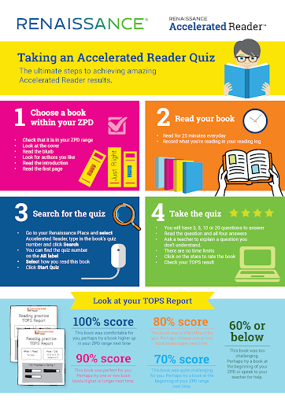
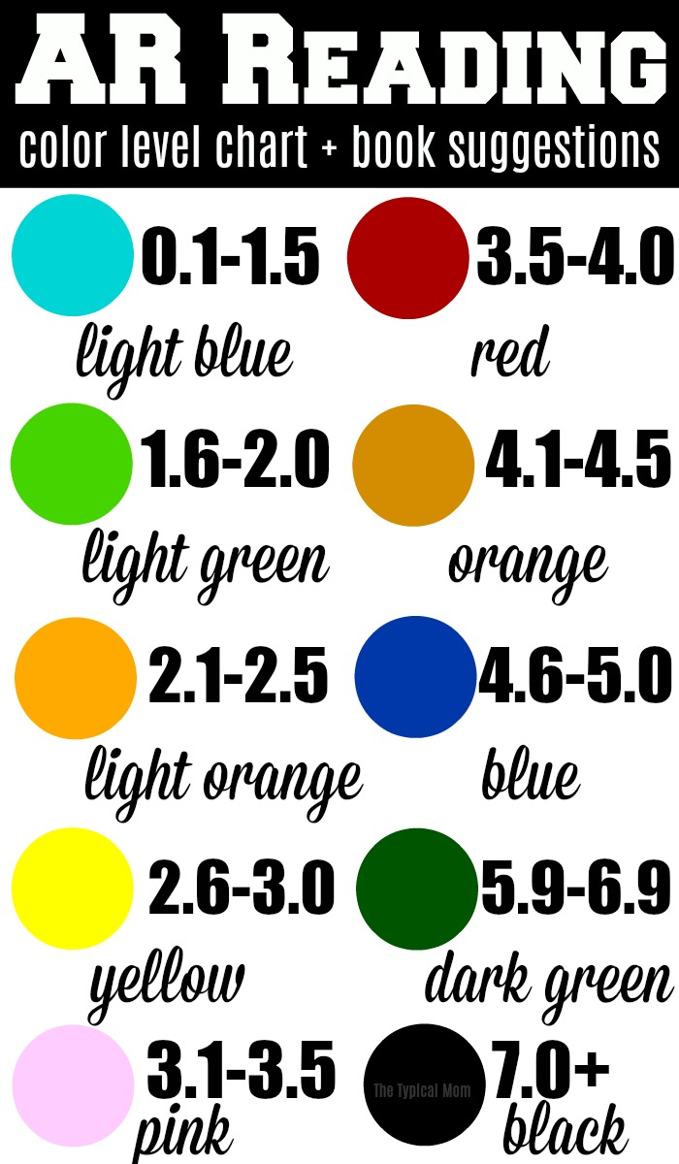

Slide 39
Students complete a reading test
This test covers lots of key areas of reading, letter sounds, blending, comprehension

Slide 40
The test sets out a path for the student
Students work their way through their path. The interventions are done online independently

Slide 41
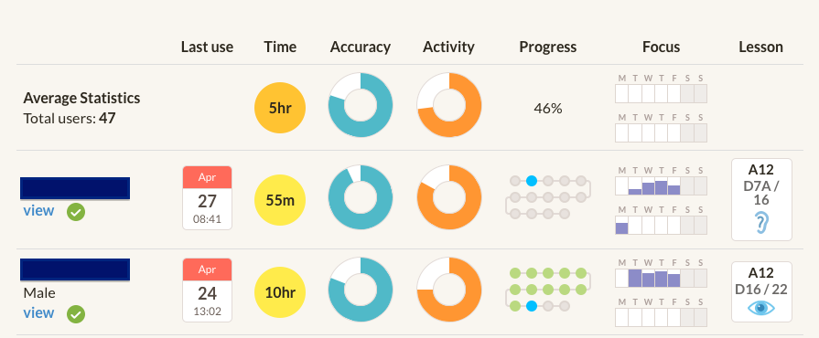
Teacher, student, parent/carer can track progress

Slide 43
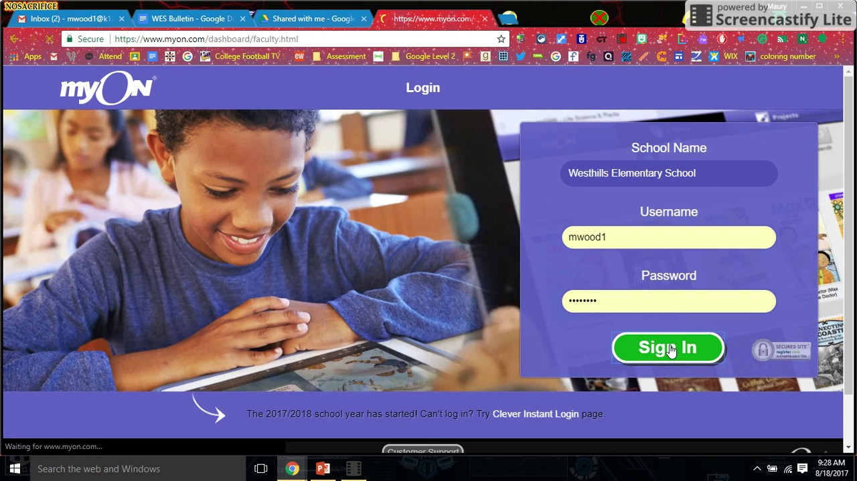
Students receive a log in. It can be accessed from any device, laptop, tablet, phone

Slide 44
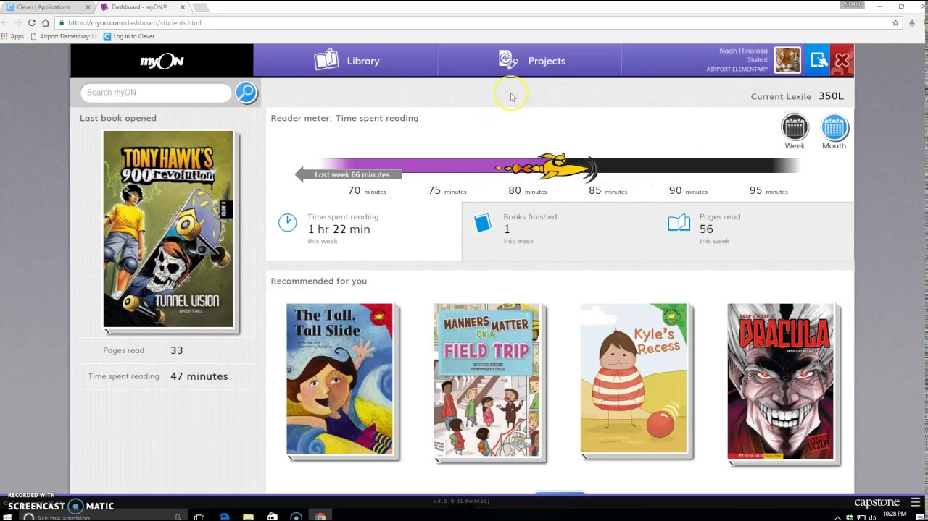
Students can search for books based on author, genre, topic

Slide 45
Students can read books on line. They can choose to read or be read to.
Student can make notes or highlight words they don’t understand and find out what they mean.

Slide 46
What can I do to support my child with their reading?

Slide 47
Precision teaching
You can complete a test with your child which would take around 30mins
Students read words, letter sounds, combination sounds

Slide 48
Reading the results sheet
High frequency words 20-25 21
Letter Sounds 20-25 16
Blending 20-25 20
Combination sounds 20-25 12
CVC words 20-25 8
CVCC words 20-25 10
We can then work on these specific areas to make them solid.
From this we can see where the gaps in their reading are.

Slide 49
How do I work on these specific areas?

Slide 50
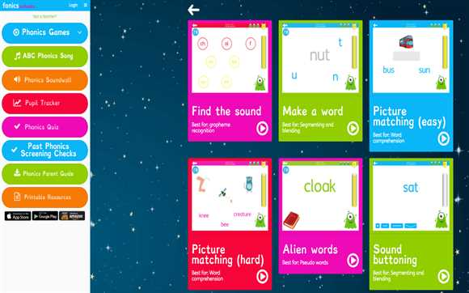
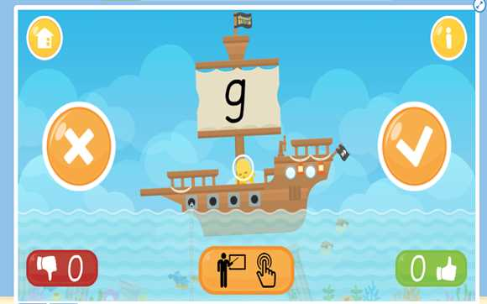
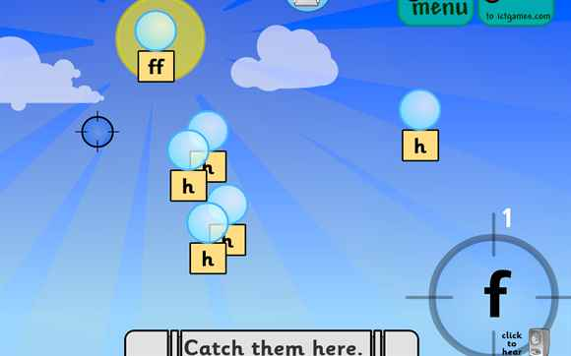
https://www.phonicsbloom.com
Free – Targeted at KS2 and low end of KS3
https://www.readwithphonics.com
Read with phonics £7.99. There is a free demo
Aimed at KS1 – KS2
Websites
https://www.ictgames.com/phonicsPop/index.html
Free – Targeted at KS2
Free aimed at KS2 and low end KS3

Slide 51
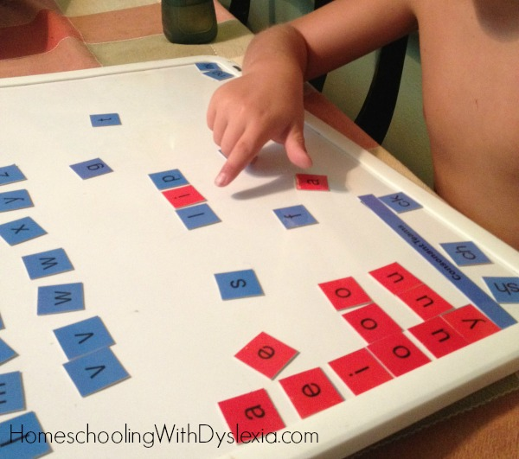
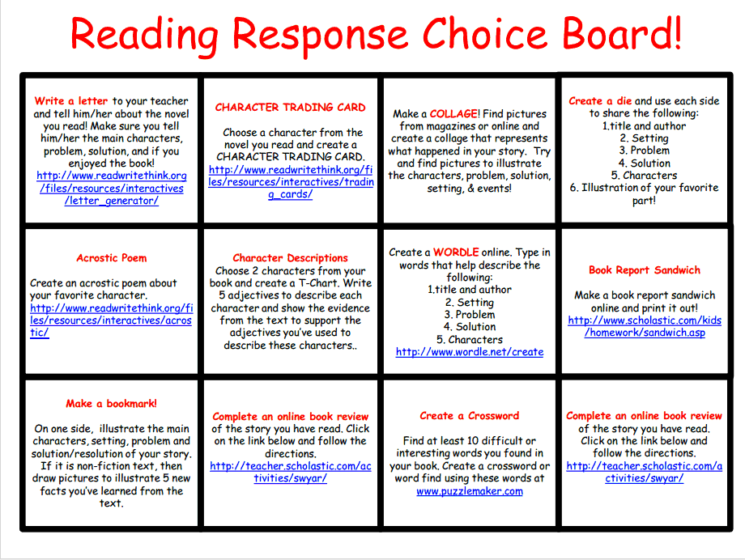
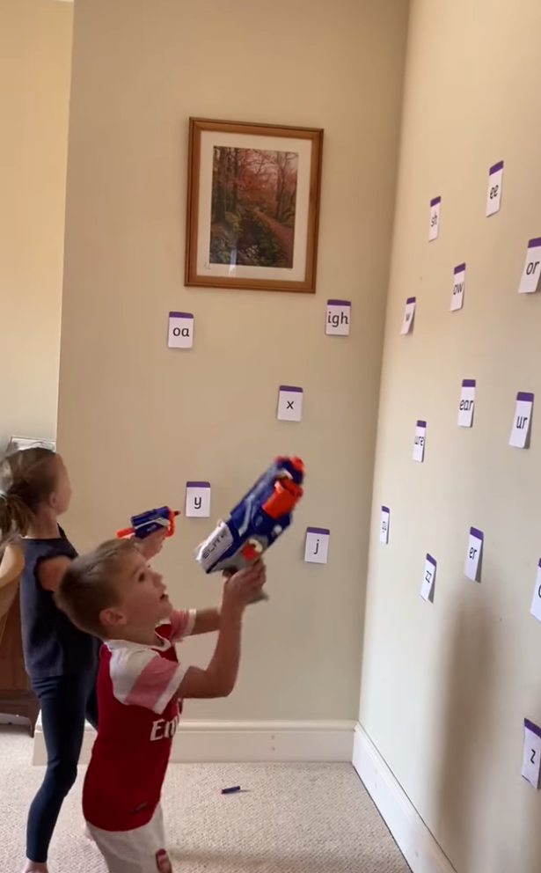
http://theorganizedchaosofinstruction.blogspot.com/2012/09/reading-response-choice-board-all-in-one.html
https://flippedtechcoaching.com/2017/03/06/reading-response-choice-board/
https://www.dailyrecord.co.uk/lifestyle/family-kids/coronavirus-mum-invents-fun-nerf-21752585
https://www.themeasuredmom.com/free-letters-and-sounds-game/

Slide 52
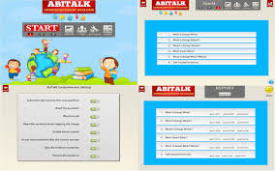
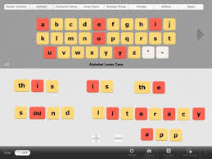
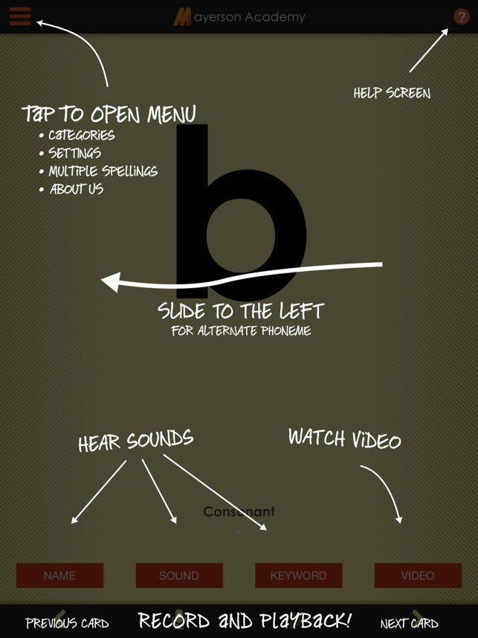
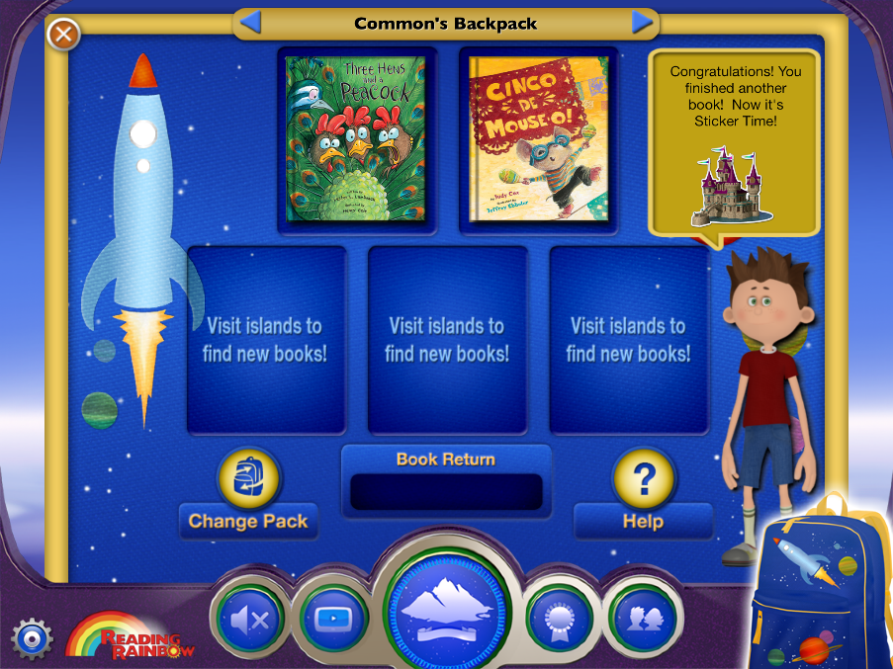
Sound Literacy
£9.99 KS3
Comprehension Builder Age 9-11 £7.99
Apps
OG card deck
Skybrary
Age 2 – 13 £4.99 month or £39.99 a year
One month free then £6.99 a month
Age 5 - 13
99p Age 8-11
Free – Age 8-14

Slide 53
Letter Box Club
The Letterbox Club has been running for six years
It is a programme which aims to inspire a love of reading and engagement with numeracy in children who are looked-after aged 3-13. It’s run by a reading charity called BookTrust, in partnership with the University of Leicester.
Children in year groups 2, 4, 6, and 8 will receive a brightly coloured parcel, once each month for six months from September 2020 to March 2021. The parcels are theirs to own and keep.

Slide 54
Letter Box Parcels include:
A range of carefully selected books from different genres.
Fun number games that can be played individually or as a group – you might want to join in the fun!
Stationery items, for writing and drawing, and other supportive materials.
Some of the parcels also include letters from famous children’s authors!

Slide 55
Letter Box Website and other resources
https://www.booktrust.org.uk/what-we-do/programmes-and-campaigns/letterbox-club/
Book Finder – search for books on a particular topic / age
Articles / News
Tips and Advice
https://www.booktrust.org.uk/tips-for-carers-and-foster-families
(You’ll find information and practical tips about reading with your child by visiting)
Including interactive books to read online ….

Slide 56
Foster Carers Library Card > No fines > Loan 25 books as a family See Virtual School web

Slide 57
Weblinks to books for teenagers with a low Reading Age: https://www.badgerlearning.co.uk/struggling-and-reluctant-reader-books.html https://www.pearsonschoolsandfecolleges.co.uk/secondary/EnglishAndMedia/LearningSupport/RapidPlus/RapidPlus.aspx

Slide 58
Any Questions

Slide 59
Virtual School contact details
024 7697 5535
virtualschool@coventry.gov.uk
.

Slide 60
And finally ….
Many thanks for attending today
Please complete the evaluations that will be emailed to you after the training

