Slide 1
Getting ready to engage!
Delivered by: Ashleigh Roach; Positive Choices

Slide 2
Expectations and Agenda
By the end of the workshop you should feel more equipped to:
Hold discussions around behaviour change
Be aware of the cycle of change
Hold motivational conversations
Be aware screening tools (substance use)
Complete some brief interventions to encourage change
To ensure that this is a comfortable learning experience for everyone; can we please…
Keep your microphones and videos turned off
Use the chat facility to ask questions throughout. A Q&A will be available at the end. All questions are valid- we don’t know what we don’t know!
Be aware the webinar is being recorded

Slide 3
Initiating a conversation
People are more likely to want to talk if they know there’s a reason your asking!

Slide 4
Initiating a conversation
Raising an uncomfortable or difficult issue may provoke a negative response, however following the 5 R’s will help us deal with potential conflict;
REFLECT:
What is your motivation for raising the issue i.e. what do you want?
REPORT:
What is the issue/concern?
RELATE:
How does this affect you / the other person / family / work / treatment etc.
REQUEST:
State what you would like the person to do differently.
RESULTS:
Say what the positive consequences of the change being requested will be.

Slide 5
Minimising Language
Think about the language young people may use when they are talking about their own behaviour.
How confident do we feel as frontline practitioners in challenging people on their behaviour?
Young People
I am only sending nude photo’s to my partner…
It hasn’t caused me any issues not using condoms…
I don’t use [drugs] that much…
I am only talking online, it could be worse I could be meeting them
Everyone is doing it…
My family have always used [drugs] and its not affected them…
Its not as bad as…
Professionals
I have seen worse…
I have tried talking to them about it but they don’t want support
There are already a lot of agencies in place, we are unsure this is a priority at the time.
Substance use is an issue but there are other risks causing concern
Parents are professionals, they can support no need for a referral
the young person does not see their parents use.
The home conditions are fine and basic needs are met
They can make their own decisions

Slide 6
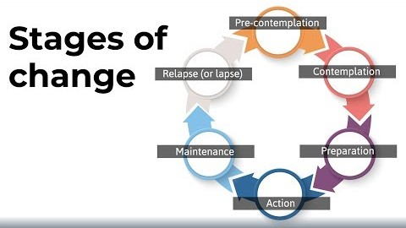
Cycle of Change
The Cycle of Change or Trans-theoretical Model has been a useful tool used within substance misuse to help substance users to identify where they are in terms of motivation. This tool can also be used to help people change other behaviours.

Slide 7





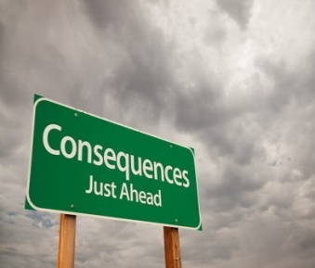
The Cycle of Change
Happy User | In two Minds | Getting Ready | Go | Keeping it up | Lapse/Relapse
There’s no problem so no need to change | There may be a bit of a problem but I still enjoy ….. | I need to make some changes … | I will make some changes… | This is good, I think I will carry on… | I may or may not want to do this again….

Slide 8
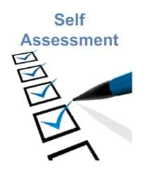
Screening Tools
The purpose of screening tools is to help you to raise the question and for individuals to focus briefly on self assessment.
Alcohol Audit
CAGE for Alcohol dependency
CPQ for Cannabis
Cocaine self assessment
Notes:
Copy to be shown & provided

Slide 9
5. How often during the past year have you failed to do what was normally expected of you because of your drinking? Never (0) Less than monthly (1) Monthly (2) Weekly (3) Daily or almost daily (4)
6. How often during the past year have you had a drink in the morning to get yourself going after a heavy drinking session?
Never (0) Less than monthly (1) Monthly (2) Weekly (3) Daily or almost daily (4)
7. How often during the past year have you felt guilty or remorseful after drinking? Never (0) Less than monthly (1) Monthly (2) Weekly (3) Daily or almost daily (4)
8. How often during the past year have you been unable to remember what happened the night before because of your drinking? Never (0) Less than monthly (1) Monthly (2) Weekly (3) Daily or almost daily (4)
9. Have you or anyone else been injured as a result of your drinking? No (0) Yes, but not in the past year (2) Yes, during the past year (4)
10. Has a relative, friend, doctor, or health care worker been concerned about your drinking, or suggested that you cut down? No (0) Yes, but not in the past year (2) Yes, during the past year (4)
Alcohol Audit
1. How often do you have a drink containing alcohol? Never (score 0) Monthly or Less (score 1) 2-4 times a month (score 2) 2-3 times a week (score 3) 4 or more times a week (score 4)
2. How many alcoholic drinks do you have on a typical day when you are drinking? 1 or 2 (0) 3 or 4 (1) 5 or 6 (2) 7-9 (3) 10 or more (4)
3. How often do you have 6 or more drinks on one occasion? Never (0) Less than monthly (1) Monthly (2) Weekly (3) Daily or almost daily (4)
4. How often during the past year have you found that you drank more or for a longer time than you intended? Never (0) Less than monthly (1) Monthly (2) Weekly (3) Daily or almost daily (4)
A score of 8-10+ indicates a concern for dependency

Slide 10




Is there a cost attached to your substance use/risk taking behaviour
Health cost | Relationship cost | Work/study cost | Legal cost

Slide 11
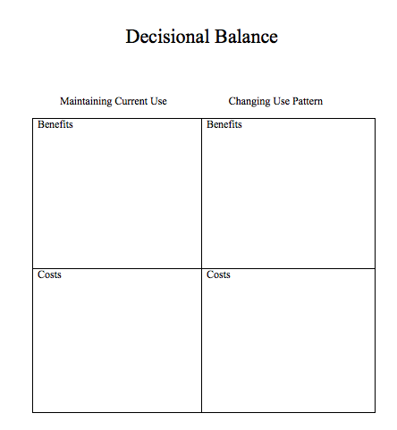

Decisional balance
One way to work with ambivalence is to encourage the young person to consider the pros and cons of their behaviour.
Change is unlikely to occur until the benefits to change outweigh the benefits of the use staying the same.

Slide 12
How to make a referral
You are more than welcome to call our Duty Worker, visit our live chat on CGL website or refer via our website for a quick and secure process.
www.changegrowlive.org/positive-choices-coventry
Coventryyp.info@cgl.org.uk
Please consider:
Consent of the young person (including parental consent for under 13s) – we are voluntary (& confidential!)
Include as much relevant information as possible
Keep us involved in Early Help/Social Care meetings

Slide 13
How to contact us
Address:
23-25 City Arcade, Coventry
Phone:
02476 010245
Website: (referrals & online chat)
www.changegrowlive.org/coventryyp
Facebook:
PositiveChoicesCov
Instagram:
Positivechoices_Coventry
Twitter:
@PosChoices_Cov

Slide 14
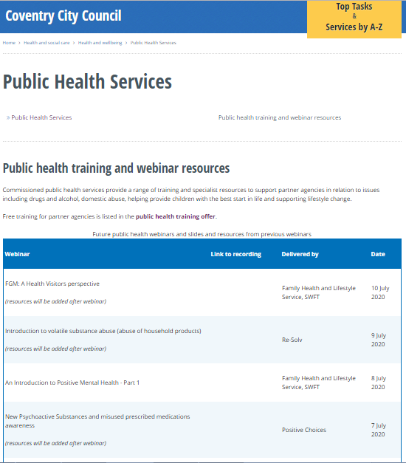

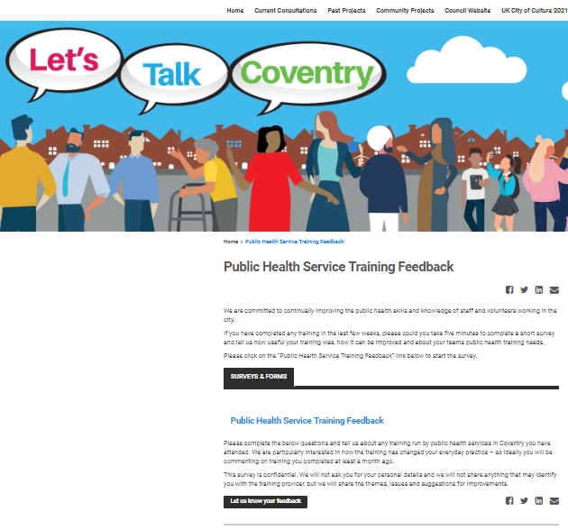
Thank you for listening
Please visit the City Council website:
Slides and recordings of past webinars
Timetable of future webinars
Details of more in-depth training available free from Public Health services
Google “coventry public health webinars” or visit
www.coventry.gov.uk/info/190/health_and_wellbeing/3283/public_health_services/2
Feedback and ideas for future webinars
Please give is your feedback and suggestions of future webinars via the Let’s Talk Coventry site at https://letstalk.coventry.gov.uk/publichealthtraining

