Slide 1
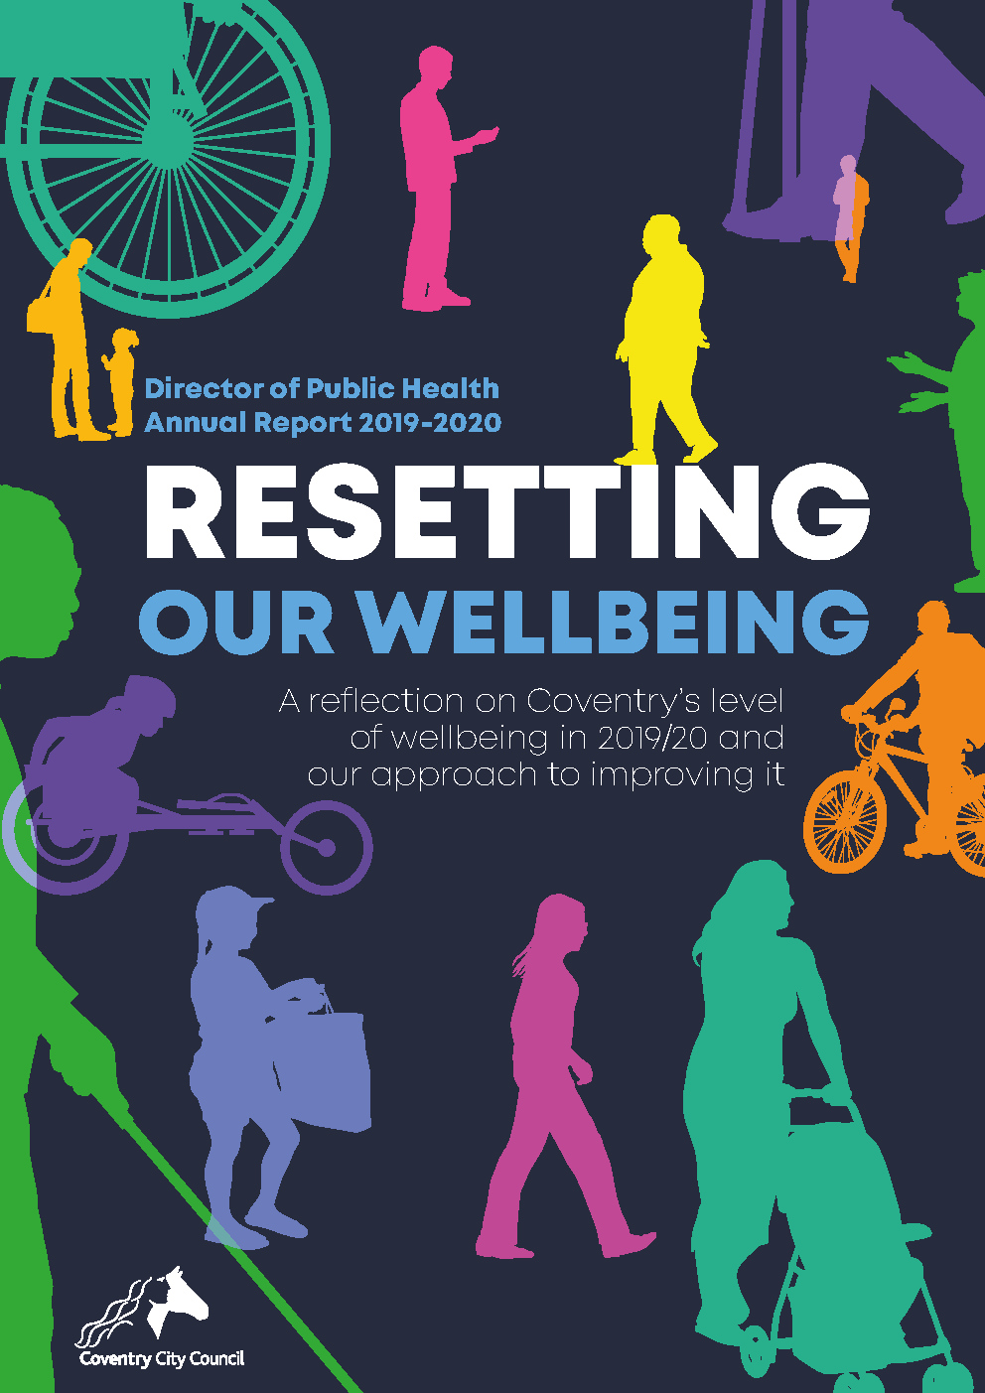
Download the Director of Public Health’s
Annual Report 2019-2020:
https://www.coventry.gov.uk/publichealthreports/

Slide 2
Aim of presentation
Wellbeing and surrounding concepts
Useful links for data
How we, as individuals and as organisations, can help to improve wellbeing

Slide 3
Wellbeing and surrounding concepts
Terminology | Meaning
Wellbeing | Feeling good and functioning well
Wider determinants of health | Factors affecting health and wellbeing
Health inequalities | ☹
Compensatory action | Extra support
Address / tackling / reducing health inequalities
Population health framework | Organisations and communities System
Health and wellbeing system | Outcome of Population health framework

Slide 4
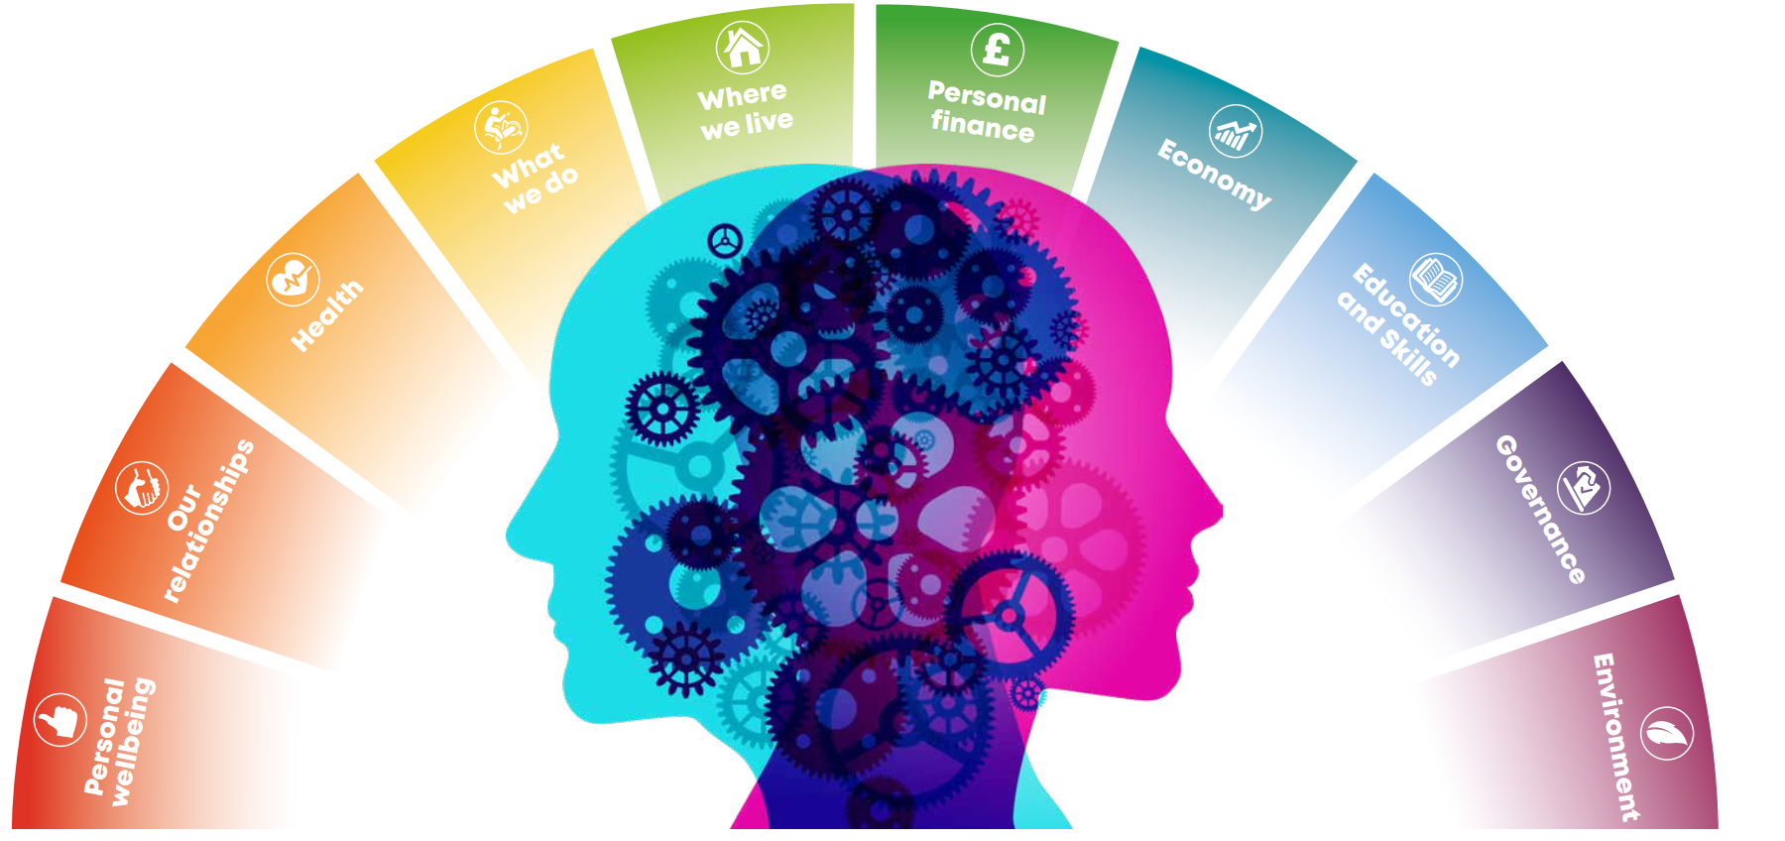
ONS 10 domains
https://www.ons.gov.uk/peoplepopulationandcommunity/wellbeing/articles/measuresofnationalwellbeingdashboard/2018-04-25

Slide 5
Two case studies
Batman [Gotham City] |  | ONS domain | Winnie the Pooh [Hundred Acre Wood]
Anxious | ☹ | Personal wellbeing | ☺ | Satisfied
Peak | ☺ | Health | ☹ | Overweight
Self-employed | ☺ | What we do | ☹ | Inactive
Vigilantism | ☹ |  | ☺ | Socialise
Not safe | ☹ | Where we live | ☺ | Safe
£££ | ☺ | Personal finance | ☹ | £0
Corruption | ☹ | Governance | ☺ | Local decisions
Pollution | ☹ | Environment | ☺ | Clean air

Slide 6
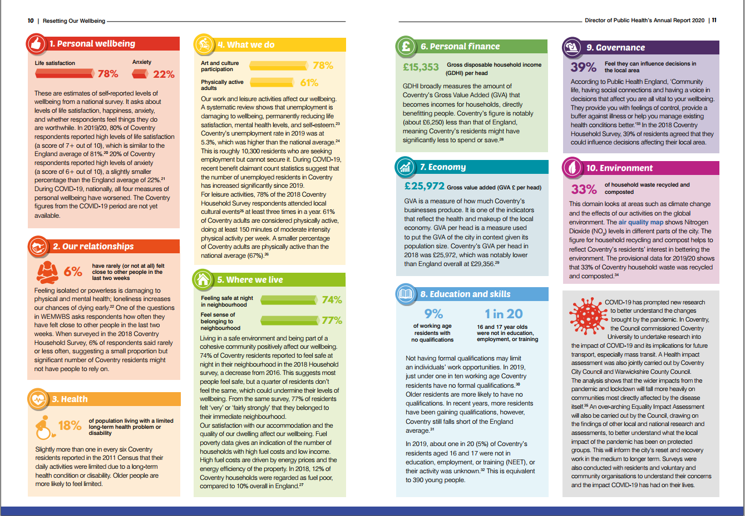
Accompanying Power BI Report

Slide 7
Useful links for data
Website | What you’ll find
Fingertips | Health data at LA level
Local Health | Health data at neighbourhood level
SHAPE tool | NHS, PH, primary care, and demographic data + map of healthcare assets and travel times
Local Authority Interactive Tool | Children and young people data at LA level
JSNA intelligence hub | Melting pot of publicly available data
JSNA data sources | List of indicators used in place-based JSNAs

Slide 8
What can we, as individuals, do to improve our wellbeing?
Notes:
Vaccinations
Flu vaccination
Healthy lifestyle – Eat healthily, active travel, do physical activities
Five ways to wellbeing – Keep learning, be active, connect, take notice, and give

Slide 9
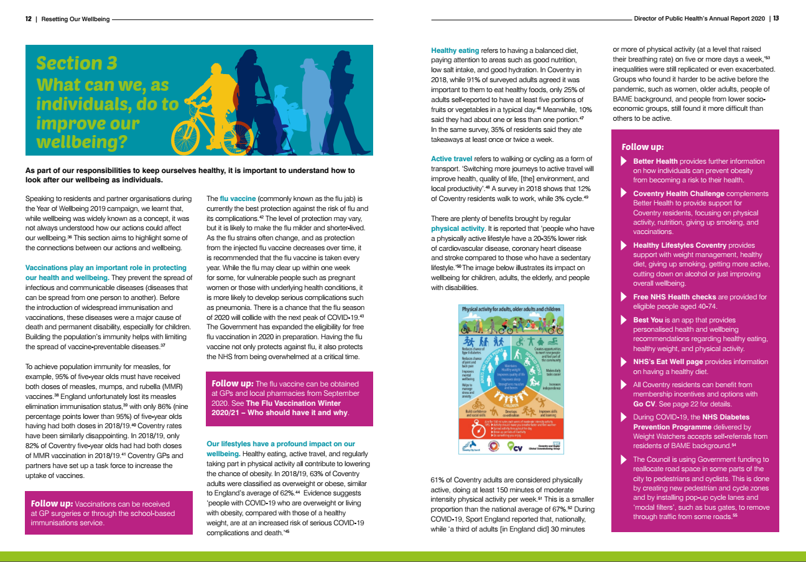

Slide 10
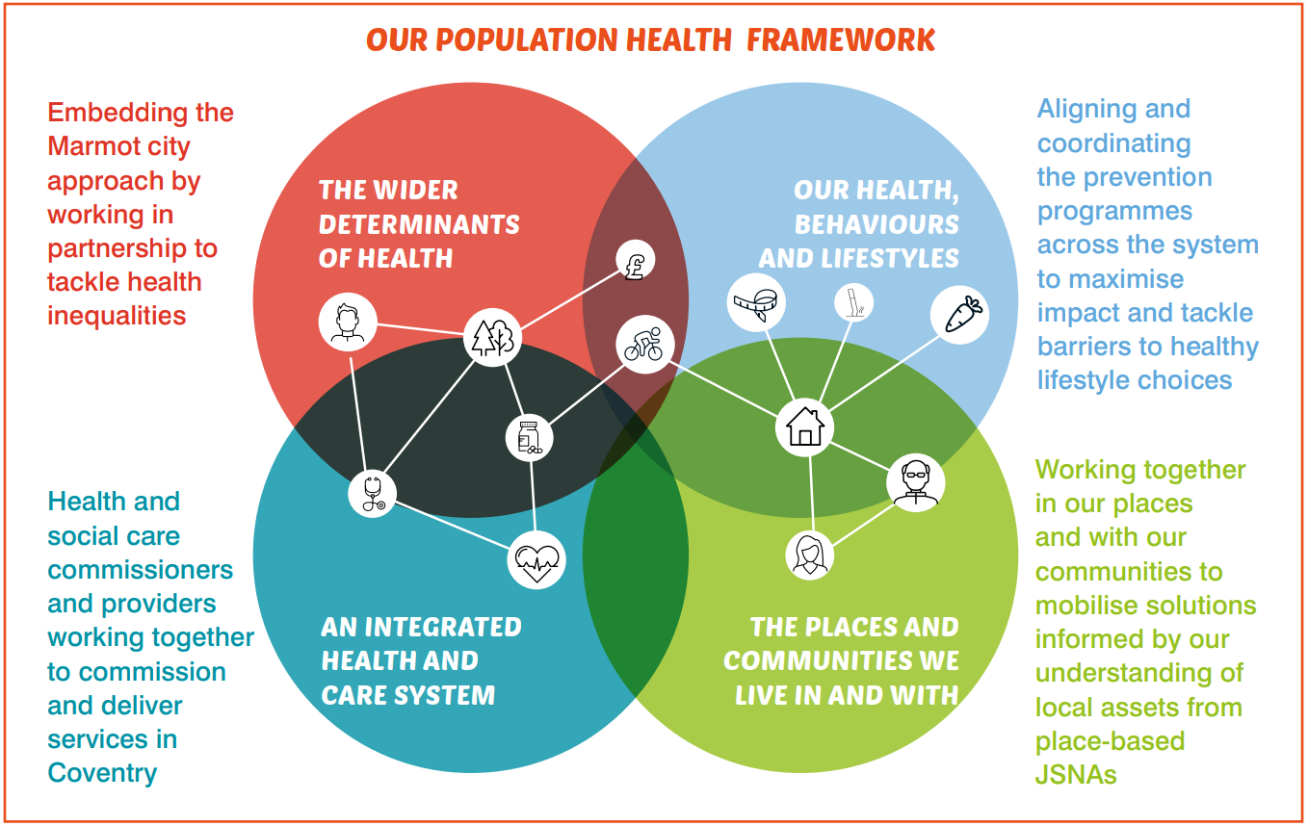
What did we, as organisations and a system, learn about Coventry’s approach to improving wellbeing?
Informed by:
Interviews with 20+ colleagues across teams and organisations
Performance reports and evaluations from the Council and partners

Slide 11
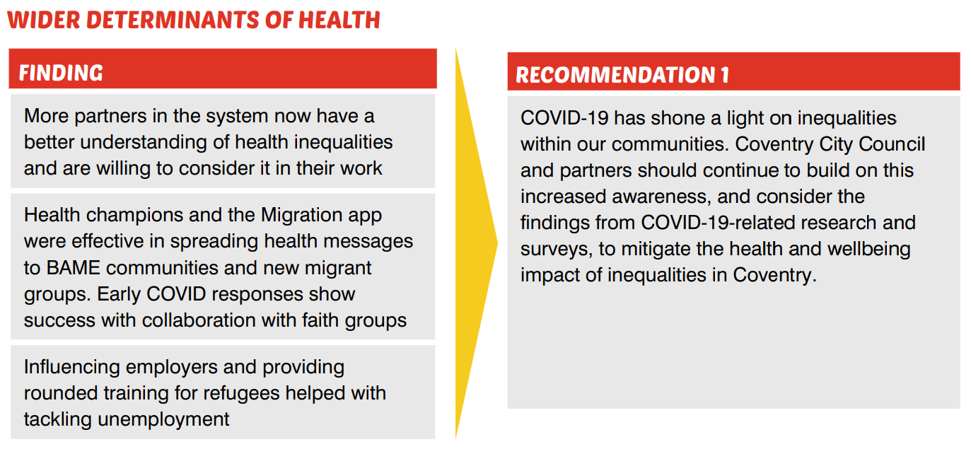
What can we, as organisations and a system, do to improve our residents’ wellbeing during COVID-19?
Employment inequality was addressed through specialist support for residents and influencing employers to improve recruitment practice

Slide 12
What can we, as organisations and a system, do to improve our residents’ wellbeing during COVID-19?

Slide 13
What can we, as organisations and a system, do to improve our residents’ wellbeing during COVID-19?

Slide 14
What can we, as organisations and a system, do to improve our residents’ wellbeing during COVID-19?
During COVID-19, place-based groups shared resources and intelligence to provide food relief and spread of public health messages
Coventry City Council and partners should set up spaces and channels to meet with residents, with the aim of inspiring them to imagine the change they wish to see in their communities, and enabling residents to lead the change.
New methods of consultation and engagement enabled residents to make informed decisions about their communities and start movements to address issues that mattered to them
Before and during COVID-19, activities from local organisations and the Council helped to alleviate loneliness and build community cohesion. Operation Shield has further identified socially isolated individuals

Slide 15
Report outline
Why does wellbeing matter?
How do we measure wellbeing?
What can we, as individuals, do to improve our wellbeing?
What did we, as organisations and as a system, learn about Coventry’s approach to improving wellbeing?
What can we, as organisations and as a system, do to improve our residents’ wellbeing during COVID-19?
Progress on 2019 recommendations
Record of
Coventry’s level of wellbeing in 2019/20
Explore the data in Power BI
Reflection on Coventry’s approach to improving wellbeing last year and in our early COVID-19 response

