Slide 1


National Campaigns - do they change behaviour?
Presented by
Kirsty Wootton – Behavioural Marketer
kirsty.wootton@icecreates.com
Lucy Webb – Health Coach & Nutritionist Lucy.Webb@hlscoventry.org
16th November 2020
Prepared for you by team

Slide 2

make
better
happen
www.icecreates.com
Notes:
Our mission is to co-create a well, confident and resilient society
For anybody who hasn’t heard of HLS Coventry, we are an integrated service – the first of its kind in Coventry. This means we support people to lose weight, quit smoking, get more active, reduce alcohol consumption and receive free nhs health checks. It’s all FREE
in its first two years we supported over 2.5K achieve and most importantly sustain multiple improvements in their health and wellbeing.
Our team of behavioural coaches typically work with their clients on a one-to-one and group basis, with appointments every 1-3 weeks across a 12-week programme.
prior to COVID coaches were meeting with clients face-to-face, and virtually whereas the service is now fully virtual and and we’ve seen great success with this

Slide 3
Agenda
An overview of the National Health & Wellbeing campaigns
New Year Health & Wellbeing Campaigns
What drives our behaviour
Behavioural Theories to influencer decision making and behaviour change
Can New Year Campaigns promote long-term behaviour change?
Notes:
This will be our agenda for today

Slide 4
National Campaigns

Slide 5
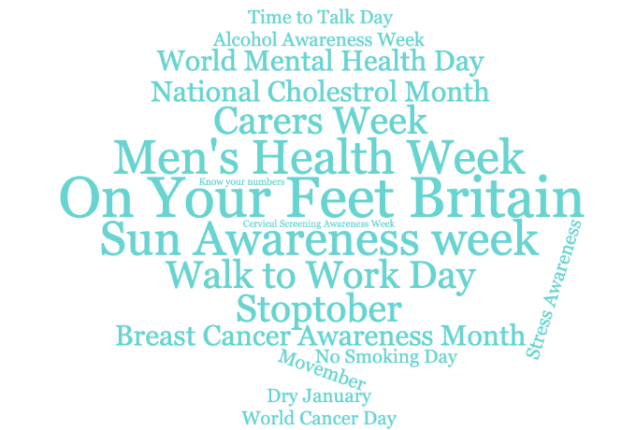
National Campaigns
Notes:
This gives you a snippet of the 50+ national campaigns that take place each year according to NHS Employers website
National campaigns generally focus on raising awareness and educating people about health and wellbeing
And there are a lot
have become quite trendy and a good marketing tactic for lots of companies in and outside of health, many work in our favour and support us in achieving our mission

Slide 6
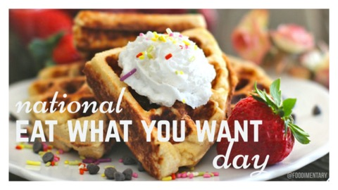
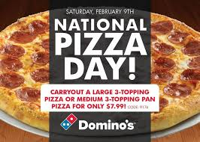

Notes:
Others not so much…
But we can create healthy messages around days like the ones shown here such as create your own pizza, adding a sprinkle of chocolate to your fruit and yogurt

Slide 7
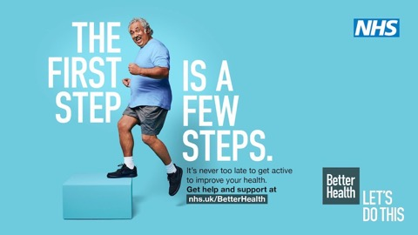
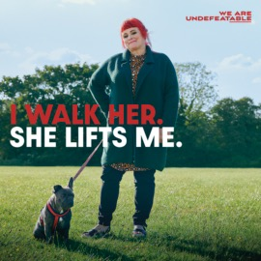
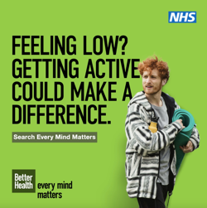
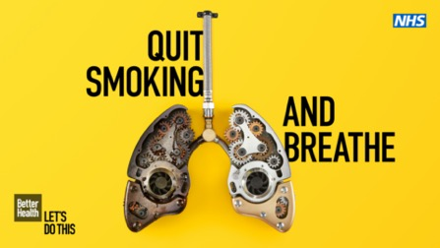
PHE National Campaigns
Notes:
Public Health England run a number of campaigns throughout the year, some images from Better Health,
Every Mind Matters and we are undefeatable, Stoptober are shown here
As a local service it is great to have large national campaigns like this to piggyback on to but localise our message and signpost to our free service.

Slide 8
National Campaigns – Local Message, Local Service
74% as of referrals were smoking in Q1
135% increase in weight management in Q2
238% increase in physical activity in Q2
Notes:
& we’ve seen great results this year
Q1 2020: 74% of all referrals were smokers influenced by fear of covid,
There was a big fear around COVID if you were a smoker, as a free service offering smoking support we used paid targeted ads to reach citizens and it worked.
Then we saw a drop off in Q2 BYT we saw an uplift in WM – we focused our messages around WM & PA to tie in with PHE and it worked – GPs got behind us, sending texts to their patients and it paid off
Shows the power of national above the line with localised targeting

Slide 9
New Year Campaigns
Dry January
Veganuary
General – New year, New start

Slide 10
HLS Coventry – January
3x as many people start an alcohol journey in January compared to any other month in the year.
40% more people start a weight journey in January compared to any other month in the year.
25% more people start a smoking journey in January than any other month in the year (including October!).
HLS Coventry Service data, Jan 2020 starters in service & Jan v rest of the year
Notes:
We know from evidence in our own services - we see an uplift in self and HCP referrals in
3x as many people start an alcohol journey in January compared to any other month in the year.
40% more people start a weight journey in January compared to any other month in the year.
25% more people start a smoking journey in January than any other month in the year (including October!).
Q4 – jan – march as patients and citizens buy into the new year new me message. They want to work off the excess weight and feel their best after over indulging over Xmas and New Year, so each year we push this

Slide 11
Dry January
It’s estimated that 4 million people take part in dry January
Reasons for taking part in Dry January:
To have a break from alcohol
To improve health, &
To prove something to themselves.
Data taken from Evaluation by Richard de Visser PhD of Dry January 2019

Slide 12
Dry January
During Dry January:
58% of participants reported a loss in weight
71% said that they had better sleep
86% of participants save money during Dry Jan
Benefits of reducing alcohol consumption
Improved energy levels
Skin will start to look better
Mental health will improve
Strong immune system
64% of participants drank less alcohol even 6 months after it had finished
Data taken from Evaluation by Richard de Visser PhD of Dry January 2019

Slide 13
Veganuary – 2019 results
Over quarter of a million people tried Veganuary
Almost half (47%) will stay vegan!
98% will recommend Veganuary to others
77% of those not planning to stay vegan said they are very likely to try vegan again in the future.
Highest age group was 18-44
Almost 30% were aged 25-34
Reasons for taking part: 46% health, 34% animals, 12% environment, 8% other
https://veganuary.com/veganuary-2019-the-results-are-in/

Slide 14
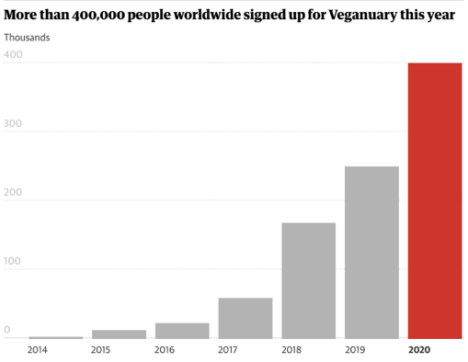
Vegan Growth
400,000 sign ups to Veganuary already for 2020 ->
600,000 Vegans in Great Britain
Over £740m Estimated sales of meat-free foods in 2018
Sainsburys reported double-digit growth of its plant-based and meat-free range
Rise in ‘flexitarians’
BBC, Guardian

Slide 15
Veganuary
The World Health Organisation say that we should eat a nutritious diet based on a variety of foods, originating mainly from plants
Can be full of essential vitamins and minerals
Higher in fibre and lower in cholesterol
Lower risk of heart disease compared to meat eaters
But it is not always necessarily healthier as vegan junk food is available
https://veganuary.com/veganuary-2019-the-results-are-in/

Slide 16
What drives our behaviour?

Slide 17
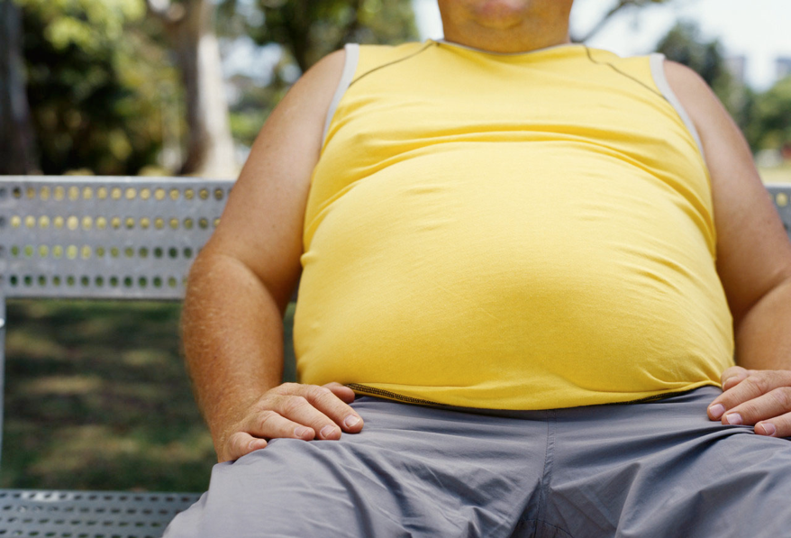
“It would be easy to give the public information and hope they change behaviour, but we know that doesn’t work very satisfactorily...
Otherwise none of us would be obese, none of us would smoke and none of us would drive like lunatics”.
Iain Potter
Director New Zealand Health Sponsorship Council, New Zealand Herald
Notes:
Just going to give you a minute to read this quote here
So yes, as humans even though we know things are bad for us we often don’t stick to them.
Lots of temptation around us to not be our healthiest

Slide 18
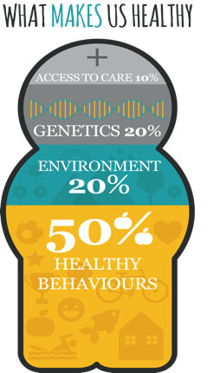
Notes:
Interesting a lot of people think that genetics and access to care effects what makes us healthy or our ability to be healthier but our own behaviors make up 50% of what makes us healthy.

Slide 19
Stages of
change
PRE-CONTEMPLATION
No intention on changing
behaviour
RELAPSE
fall back into
old patterns
of behaviour
CONTEMPLATION
Aware a problem exists but with no commitment
to action
UPWARD
SPIRAL
Learn from each relapse
PREPARATION
intent on taking action to address the problem
MAINTENANCE
sustained change; new behavior replaces old
ACTION
active
modification
of behaviour
Notes:
You’ll see here the stages of change
We have all done this.
I signed up to a 10k a couple of weeks ago, I wanted to keep the pounds off in the lead up to Christmas so I booked it.
I found training program I took the action I was running a couple of times a week and even got to running 11.5K and loved it!
but recently life has got in the way and I haven’t ran for over 2 weeks now.. I told Lucy I was going to go for a run this weekend but I didn’t! It was cold and dark, I had no intention of going outside to run
I’m blaming the dark nights.... I’m needing some support and motivation… especially now that I haven’t been for a while, it’s going to be tough.
Hopefully you’re all smiling now and remembering a time where you have been through the same pattern
It’s really important that we put that motivation and support in place for people to keep them on track.

Slide 20
How to influence decision making and change behaviour
Notes:
It all starts with influencing their decision making

Slide 21
Behavioural Theories (just a few…)
Social Norm Theory
Loss Aversion
COM-B Model
Notes:
There are lots of behavioural theories but as we don’t have tons of time today I’m going to talk through 3 very powerful ones in influencing behaviour.

Slide 22

Social Norms Theory
Social Norms Theory suggests that people’s behaviour can be strongly influenced by their perceptions of how their peer groups or other people of a similar age, or social status behave.
More than 400,000 people have signed up to Veganuary already for 2020
Notes:
The theory suggests that although many people think of themselves as individuals, people have a strong tendency to conform to group patterns and expectations – herd behaviour
Its why we use people based case studies and videos – people buy into people like me
We think if they can do it I can do it…

Slide 23
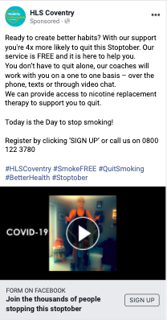
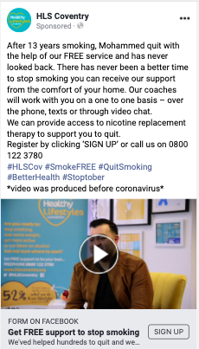
Social Norm HLS Examples
Case Studies – ‘people like me’, relatable challenges
‘Join thousands of people this Stoptober...’
‘We’ve helped thousands of people in Coventry and we can help you too’

Slide 24
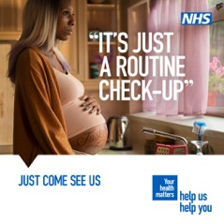

People like me - PHE National Campaigns

Slide 25
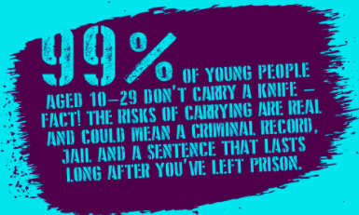


Social Norm Examples
Notes:
I need to protect myself and feel safe
Normal behaviour

Slide 26
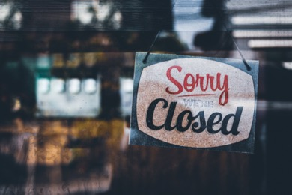
Loss Aversion
People tend to focus on potential loss more than potential gain. A loss is more painful to people than an equivalent gain is rewarding to them. If you lost £10, you would need to find £20 to close the gap, the ratio is about 2:1.
“You will lose £200 if you don’t do this” works better than “You will save £200 if you do this”.
Lockdown: The loss of restaurants closing feels worse than the gain of them opening.
Notes:
Use loss I the more influenctial way

Slide 27
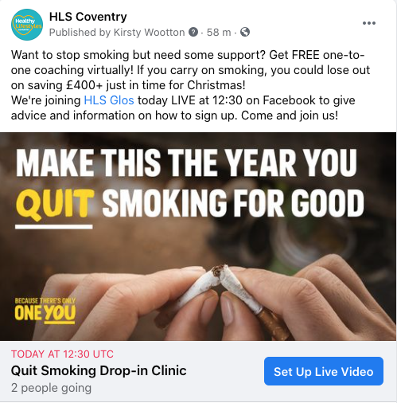
Loss Aversion – switching the loss & gain
Notes:
Because people value the loss much more than the gain we use this in our messaging to make the loss more attractive
If you carry on smoking you could lose out on saving £400+

Slide 28

Loss Aversion – switching the loss & gain
Example types of message for Dry Jan
Tired of wasting the day feeling hungover?
“My weekends feel so much longer now that I don’t spend half of it hungover”
“I would’ve spent hundreds this month if I was drinking. It’s not just buying drinks from the shop or at a bar, it’s the take away on the way home and the takeaway the next day….”
FOMO (Fear of missing out) – During lockdown, everybody is in the same boat, they can’t go out. If this is still during January FOMO won’t be factor to pull people away from being sober.

Slide 29
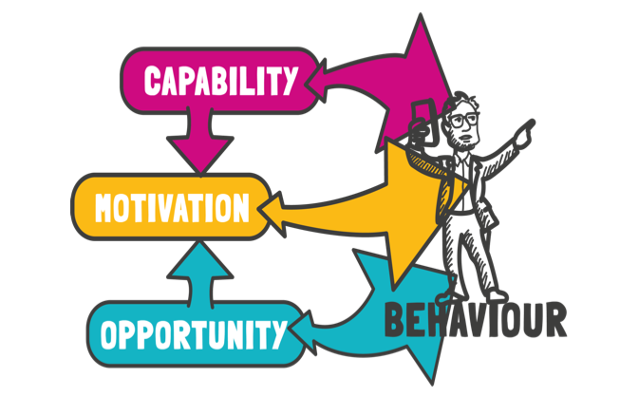
COM-B Model
Capability
Motivation
Opportunity
Notes:
The COM-B model of behaviour is widely used to identify what needs to change in order for a behaviour change intervention to be effective. It identifies three factors that need to be present for any behaviour to occur: capability, opportunity and motivation. These factors interact over time so that behaviour can be seen as part of a dynamic system with positive and negative feedback loops.
The COM-B model represents the observation that at any given moment, a particular behaviour will occur only when the person concerned has the capability and opportunity to engage in the behaviour and is more motivated to enact that behaviour than any other behaviours

Slide 30
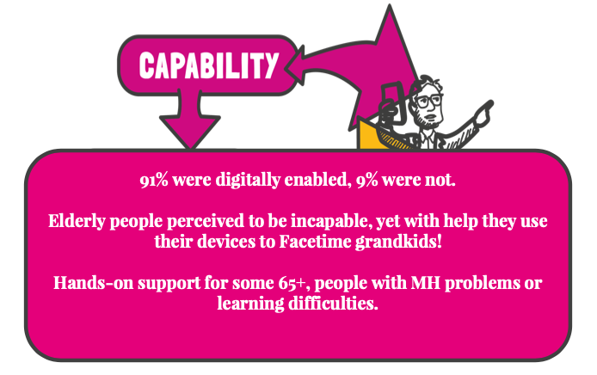
COM-B Model
Capability
Motivation
Virtual support via phone, online or video call
Provided with tools and techniques
Eligible for the service i.e. live in Coventry
Opportunity
Notes:
CAPABILITY: the physical strength, knowledge, skills etc. needed to perform the behaviour; the ability to overcome barriers to performance.

Slide 31
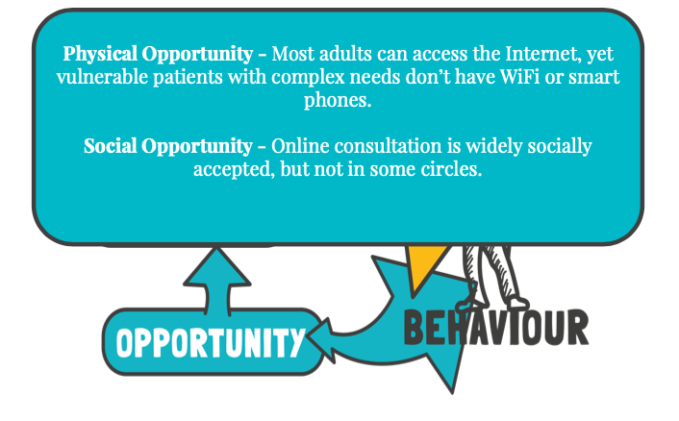
COM-B Model
Can access via phone, email, social media
The service is free!
Time that suits you
Fits into your schedule
Receive reminders and information to keep you on track
Capability
Motivation
Opportunity
Notes:
OPPORTUNITY: there must be the opportunity for the behaviour to occur, e.g. is it accessible? Affordable? Sufficient time to do it? Prompts to do it?

Slide 32
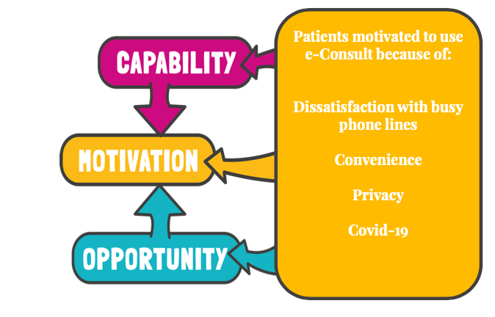
COM-B Model
Motivated by:
Social norms – people like me have done it / are doing it
The immediate benefits are appealing
The ‘loss’ is switched to a positive making it influential
Can easily access and stay on track thanks to support
Capability
Motivation
Opportunity
Notes:
MOTIVATION: the person must be more highly motivated to do the behaviour at the relevant time than not to do the behaviour, or to engage in some competing behaviour. Do I want to do it? Is it important to me to do it?

Slide 33
Do campaigns change behaviour in the long-term?

Slide 34
Do campaigns change behaviour in the long-term?
Veganuary
23% stayed vegan after Veganuary
77% of those not planning to stay vegan said they are very likely to try vegan again in the future.
Dry January
Among people who were completely dry during Dry January:
59% reported reduced alcohol intake
49% reported increased control over their drinking
43% reported better mental well-being, and
32% reported better physical health at 6-month follow-up.
HLS Coventry Service data, Jan 2020 starters in service & Jan v rest of the year
Notes:
Campaigns are great influence in providing a kick-start and sense of motivation
It’s clear that they do influence healthier behaviours BUT

Slide 35
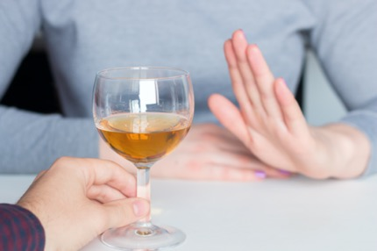
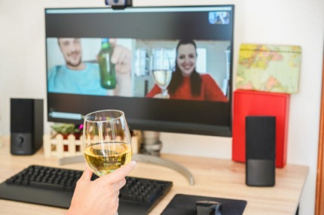
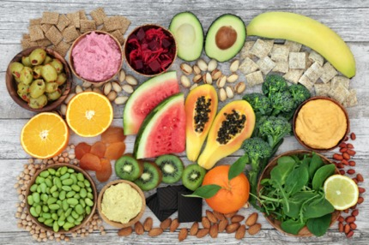
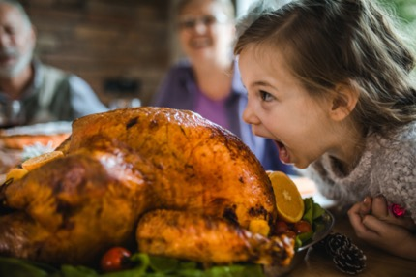
January 1st February

Slide 36
Stages of
change
PRE-CONTEMPLATION
No intention on changing
behaviour
RELAPSE
fall back into
old patterns
of behaviour
CONTEMPLATION
Aware a problem exists but with no commitment
to action
UPWARD
SPIRAL
Learn from each relapse
PREPARATION
intent on taking action to address the problem
MAINTENANCE
sustained change; new behavior replaces old
ACTION
active
modification
of behaviour
Notes:
Relapse is quite a few places away from action. But with each relapse they learn

Slide 37

Hybrid Coach & Digital Support
Assisted Self-Care
Notes:
Our service is about creating a long-term sustainable behaviour change through an holistic approach to health
Kirsty to hand over to lucy after this slide, 30% more effective than digital alone

Slide 38
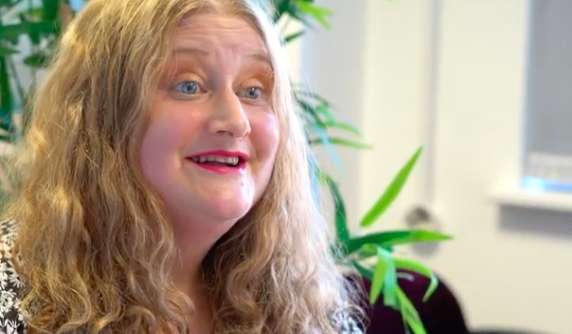
Holistic approach changes behaviour – HLS Service Results
Weight
Approx. 40% of people who start a weight journey in January go on to lose at least 3% of body weight.
  Of these 40%, 20% also reduced their alcohol to the gov guidelines
  75% of people who lost weight also increased their weekly activity by at least 30mins with just over 1/3 of people increasing their activity to the Gov guidelines.
HLS Coventry Service data, Jan 2020 starters in service & Jan v rest of the year

Slide 39
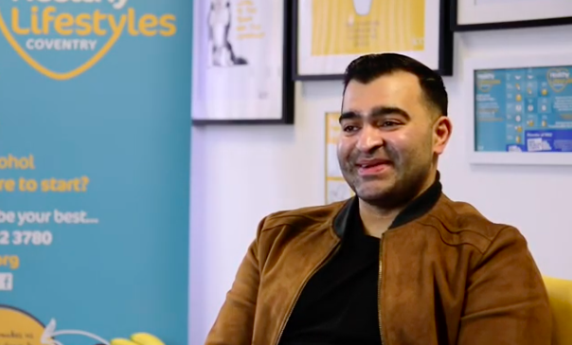
Holistic approach changes behaviour – HLS Service Results
Alcohol
50% of people who started an alcohol journey, reduced their alcohol intake by at least 50%
  Out of this 50%, half also lost at least 3% of their weight & ¾ increased their activity levels to the Government guidelines (150mins/week).
Smoking
Approx. 60% people who start a smoking journey, go onto to quit within 4 weeks.
HLS Coventry Service data, Jan 2020 starters in service & Jan v rest of the year

Slide 40
Summary
Behavioural theories influence decision making, providing clarity for capability, opportunities and motivation.
National Campaigns provide a kick-start and majority benefit
An integrated lifestyle service providing hybrid coach and digital support, provides an holistic approach to long-term behaviour change.
60% maintained their changes
Notes:
Kirsty to summarise

Slide 41

Thank you
Presented by
Kirsty Wootton – Behavioural Marketer
kirsty.wootton@icecreates.com
Lucy Webb – Healthy Lifestyles Coach
Lucy.Webb@hlscoventry.org
Notes:
Little book of insights

