Slide 1
Coventry Health Challenge
Prehabilitating vulnerable residents of coventry

Slide 2
Purpose
The Coventry Health Campaign focusses on the Coventry residents who are most at risk of serious illness if they catch Covid-19.
The campaign follows the Governments call to action on obesity in July #Betterhealth to reduce Covid health risks https://www.nhs.uk/better-health/
The goal is to support these residents in improving their health as much as possible to maximise their resilience.

Slide 3
Design
Local steering group – PH, Insights, CCG, ASC
Birmingham Prehab model reviewed
Coventry scoping – Covid response triangle, population health risks, community feedback, engagement routes, comms channels
Campaign draft – PHE BetterHealth toolkit, local adaptation, identity, engagement, comms
Evaluation and reach – social media, champion feedback, pledges, (referrals??)

Slide 4
Content
The Coventry Health Campaign Sept – March 2021 focusses on disseminating simple, clear, achievable health messages to the key target groups. The focus is on:
diet and nutrition
physical activity
smoking cessation
immunisations
We will create new toolkits each month with a different area of focus within these key themes. This will continue throughout the planned 6 months of the campaign.

Slide 5
Target groups
The key target groups for the campaign are:
Over 55s
People with pre-existing health conditions
Smokers
People who are overweight
BAME groups
These groups were selected as target groups for the campaign based on evidence that they are at greatest risk of serious illness / mortality from Covid-19.

Slide 6
Local Data
There were 28 obesity-related hospital admissions per 1000 residents in Coventry in 2018/19, compared to the national average of 16
The majority (66.6%) of Coventry's total population is White British, which includes English, Welsh, Scottish, and Northern Irish. Coventry has a notably higher percentage of black and minor ethnic population (BME) compared to the national average. The second largest ethnic group in Coventry is Asian/Asian British (16.3%),
Covid-19 deaths are not split by individual ethnicity due to the way NHS England presents data, but we know from the PHE rapid review and consultation June 2020 that the risk of health complications from Covid 19 in these communities are higher than in the white British population
46.3% of Coventry residents eat the recommended five portions of fruit and vegetables each day, compared to the national average of 52.3%.
61% of adults in Coventry are physically active – doing at least 150 minutes of moderate intensity physical activity per week - as compared the national average of 67%.
16.3% of Coventry’s population over the age of 16 smoke, compared with the national average of 15.5%.
24.5% under 75 mortality rate from respiratory disease considered preventable in 2016 – 18 in Coventry, as compared with the national average of 19.2%

Slide 7
Champions and messengers
One of our key approaches to disseminating the toolkit is via a range of ‘champions’ or ‘messengers’, i.e. individuals with broad networks, influence and cultural insight within our target groups in the community. We have approached a wide range of ‘champion’/ ‘messenger’ groups to achieve this and held various calls with them to discuss the Coventry Health Challenge and how they might be able to support it, as well as answering their questions and gathering their insights to inform toolkit development. They have all agreed to disseminate information from the toolkits through their networks.
These groups include:
Diabetes Champions
Adult Social Care
Social prescribers via Health Exchange
Community Messengers
Migrant Health Champions

Slide 8
Communications and resources
Residents will be set a challenge to work on improving their health in manageable stages, this will include advice and tips, checklists, case studies and signposting on social media. https://www.coventry.gov.uk/coventryhealthchallenge
These themes echoed in local media coverage, via the Coventry Telegraph and several BBC CWR programmes and seasonal Citivision magazines to reach those groups in our communities that are not online.
BBC Case study September: Mikayla weight client at HLS

Slide 9
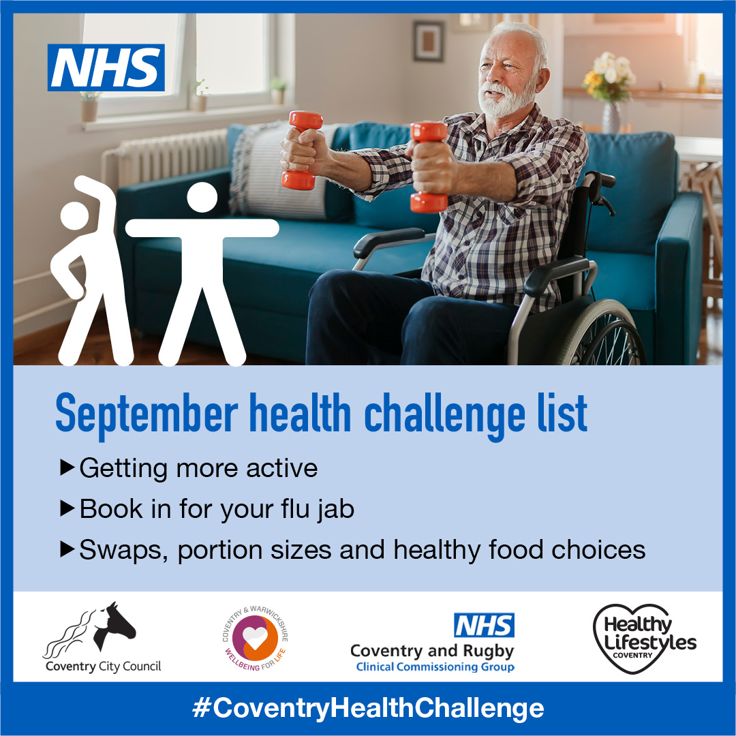

Slide 10
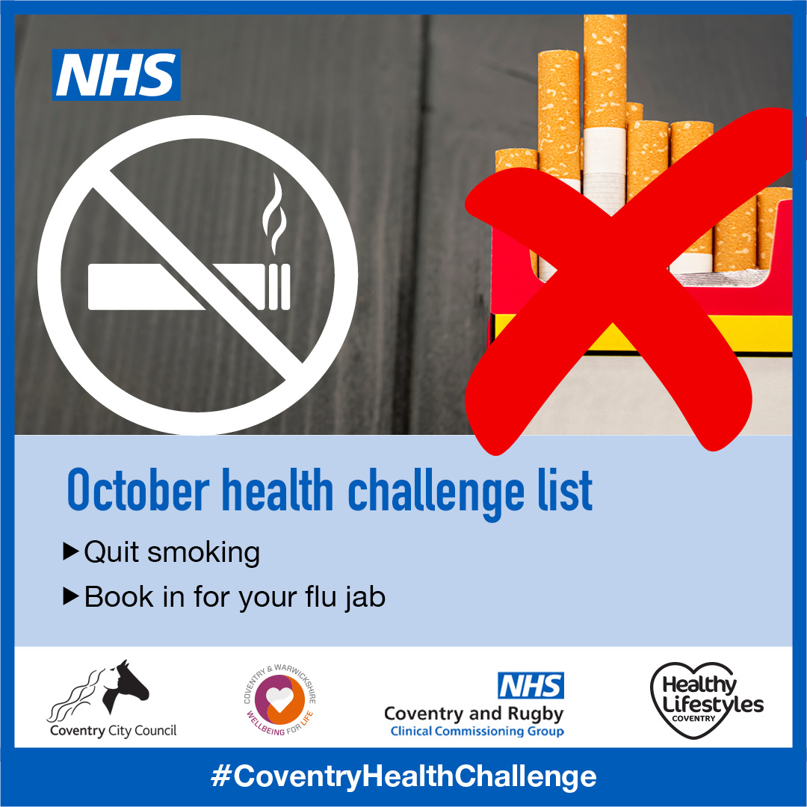
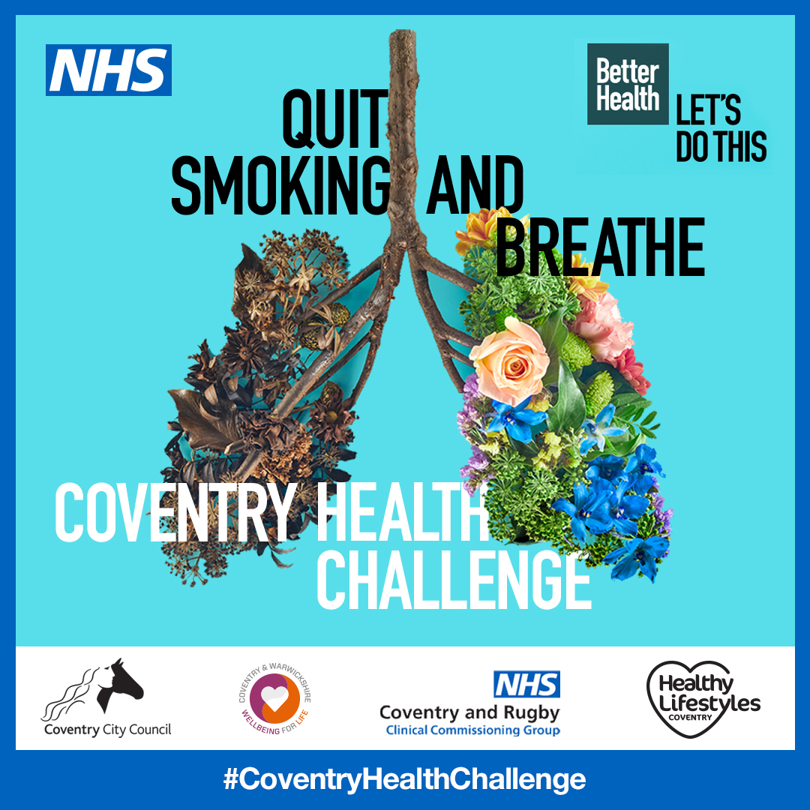
Communications and resources

Slide 11
Questions and Actions!
Ideas about reaching our target groups?
Can you be a champion or conduit to communicating the Coventry health challenge?
What works - evaluating community campaigns?

