Slide 1


A guide to self-care using

Slide 2
How can Digital Technology be used to manage health & wellbeing Is it effective? What is Best-You?

Slide 3
“Where you reach people is where
we need to be thinking hardest, it’s
about digital meets the behavioural
sciences.”
Duncan Selbie,
Chief Executive PHE

Slide 4

Digital technology is widely used across many sectors for patient care
Access medical Records
Prescribe Medication
Monitor inpatients
Communicate with patients
Monitor outpatients
81% hospital wards use tablets to record data
18% increase in patients monitoring a health condition at home from 2010 to 2018.

Slide 5
Increase people’s ability to self-care
Reduce illness and sickness
Reduce health and social care costs
via prevention
better managed conditions
Evidence outcomes –prove we have done a good job
What drives US?

Slide 6
Consumers have become more active in managing their own health as use of mobile/internet (from 37 to 48%), social media (20 to 28%) and wearable technology (22 to 31%) show the strongest growth between 2016 and 2018
Monitor fitness/activity/steps
Track other wellbeing parameters (sleep, stress)
Look up health information
Communicate with others on health-related topics
Use social media to see what others are doing
Accenture 2019 Digital Health Consumer Survey

Slide 7
What is Best-You?

Slide 8
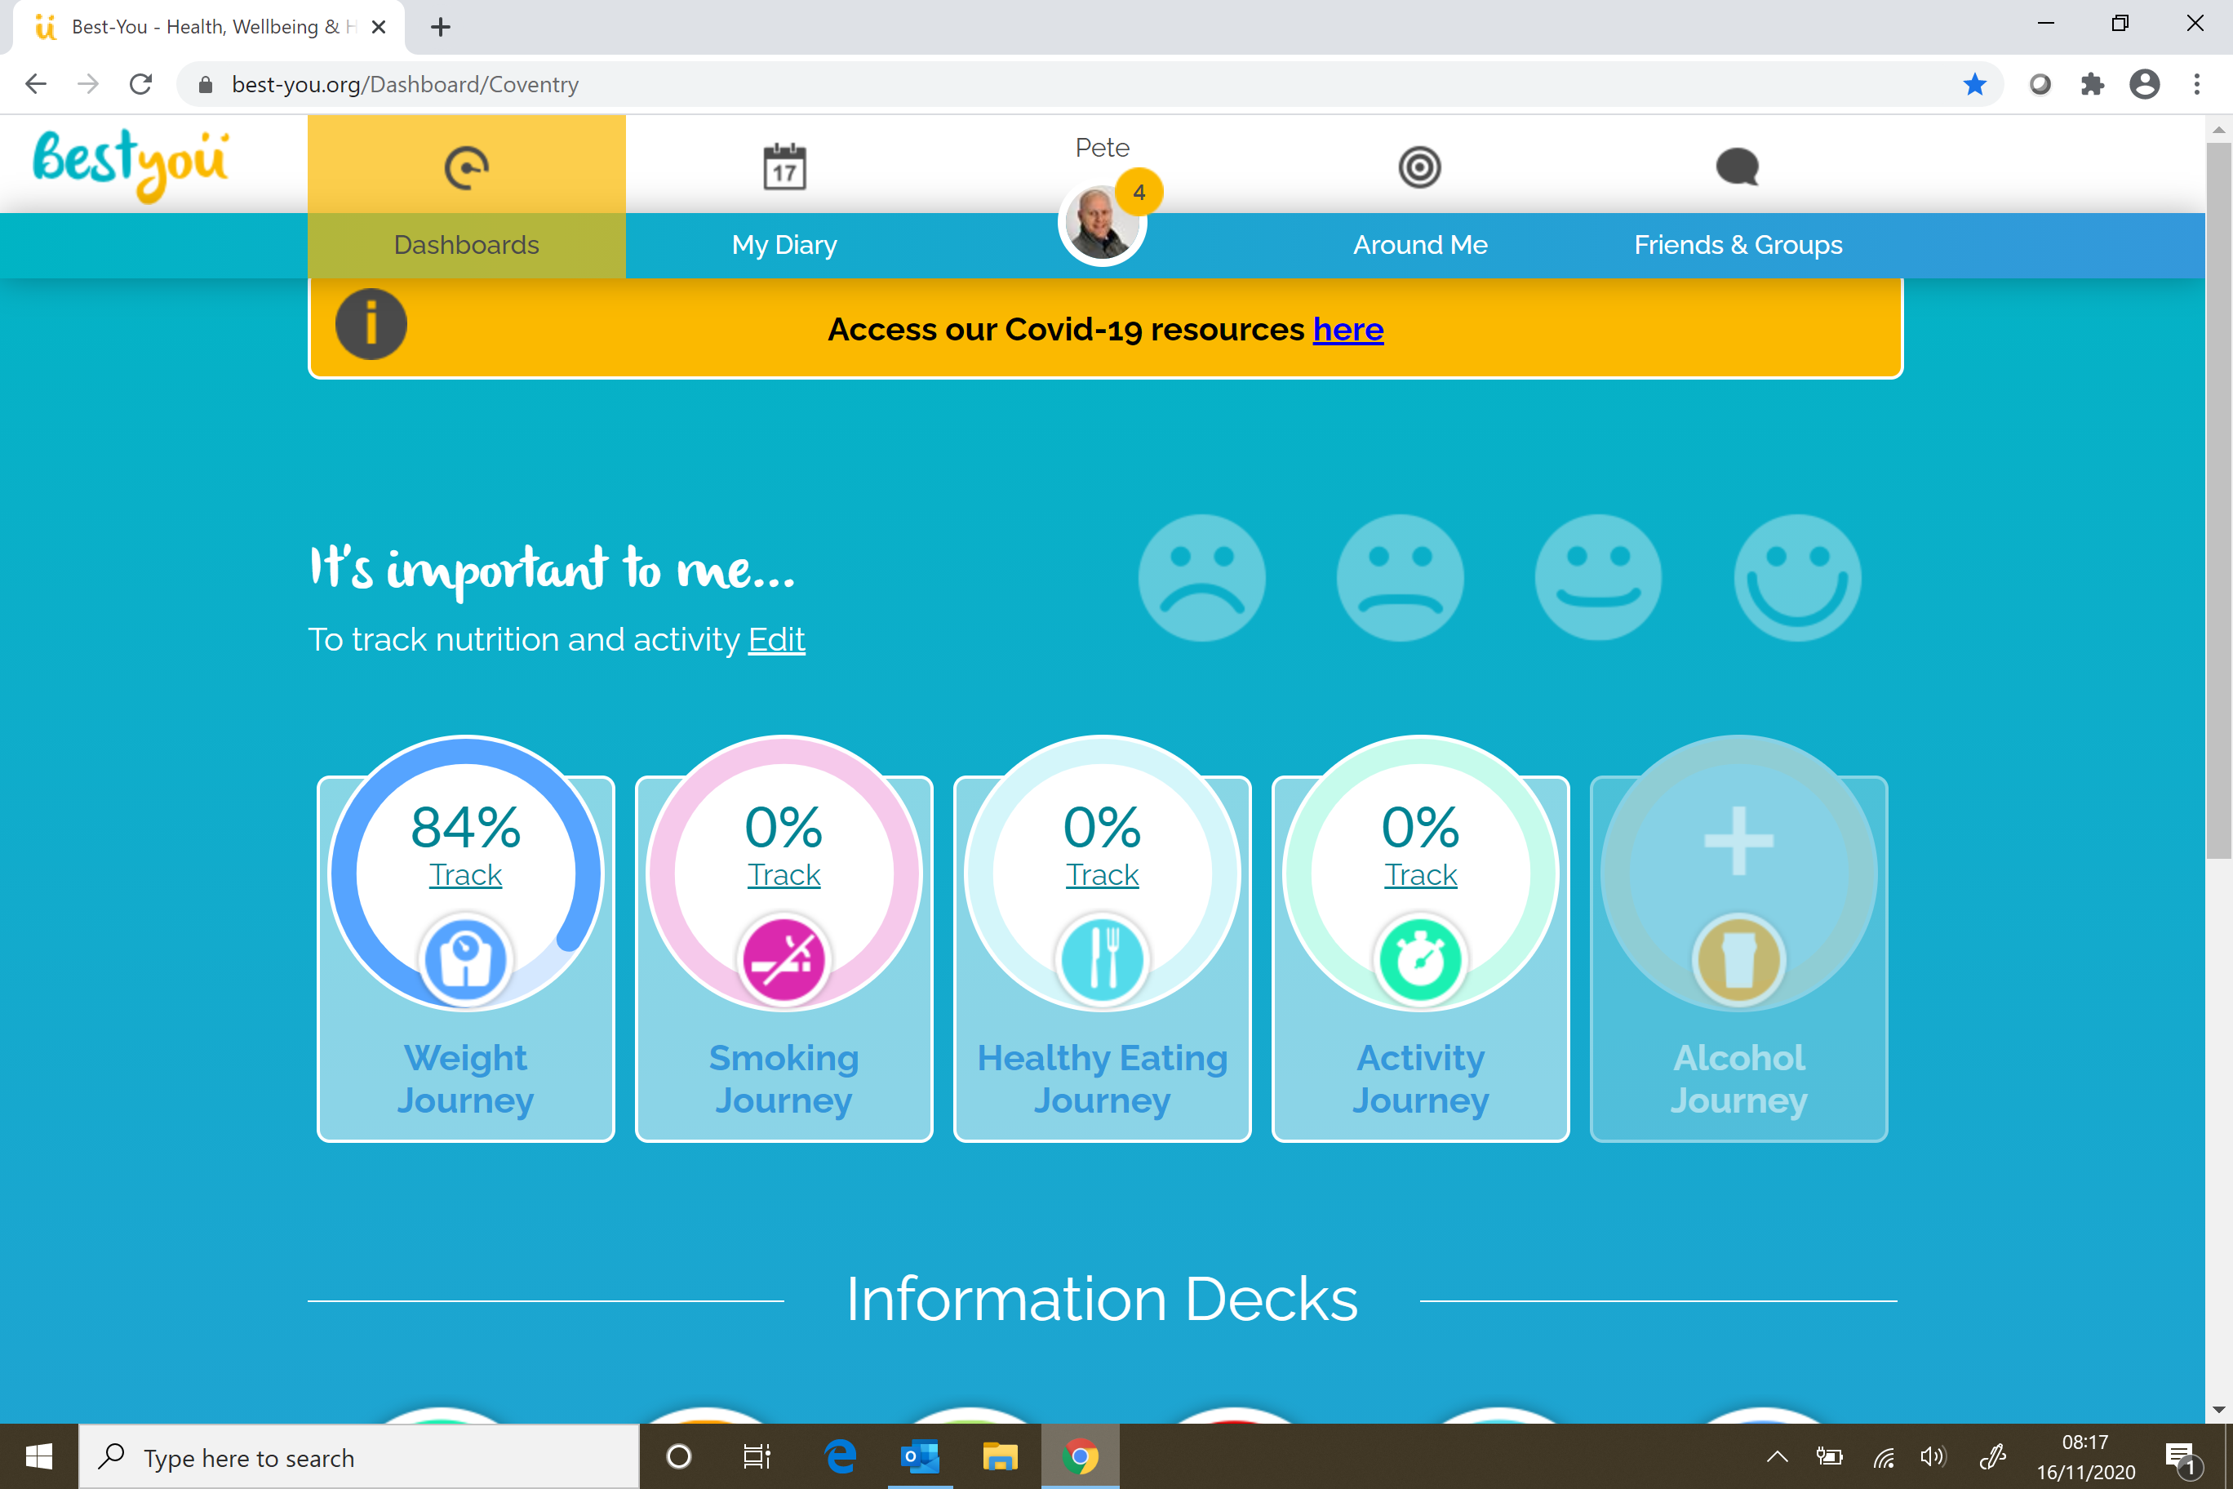
Notes:
Stu

Slide 9
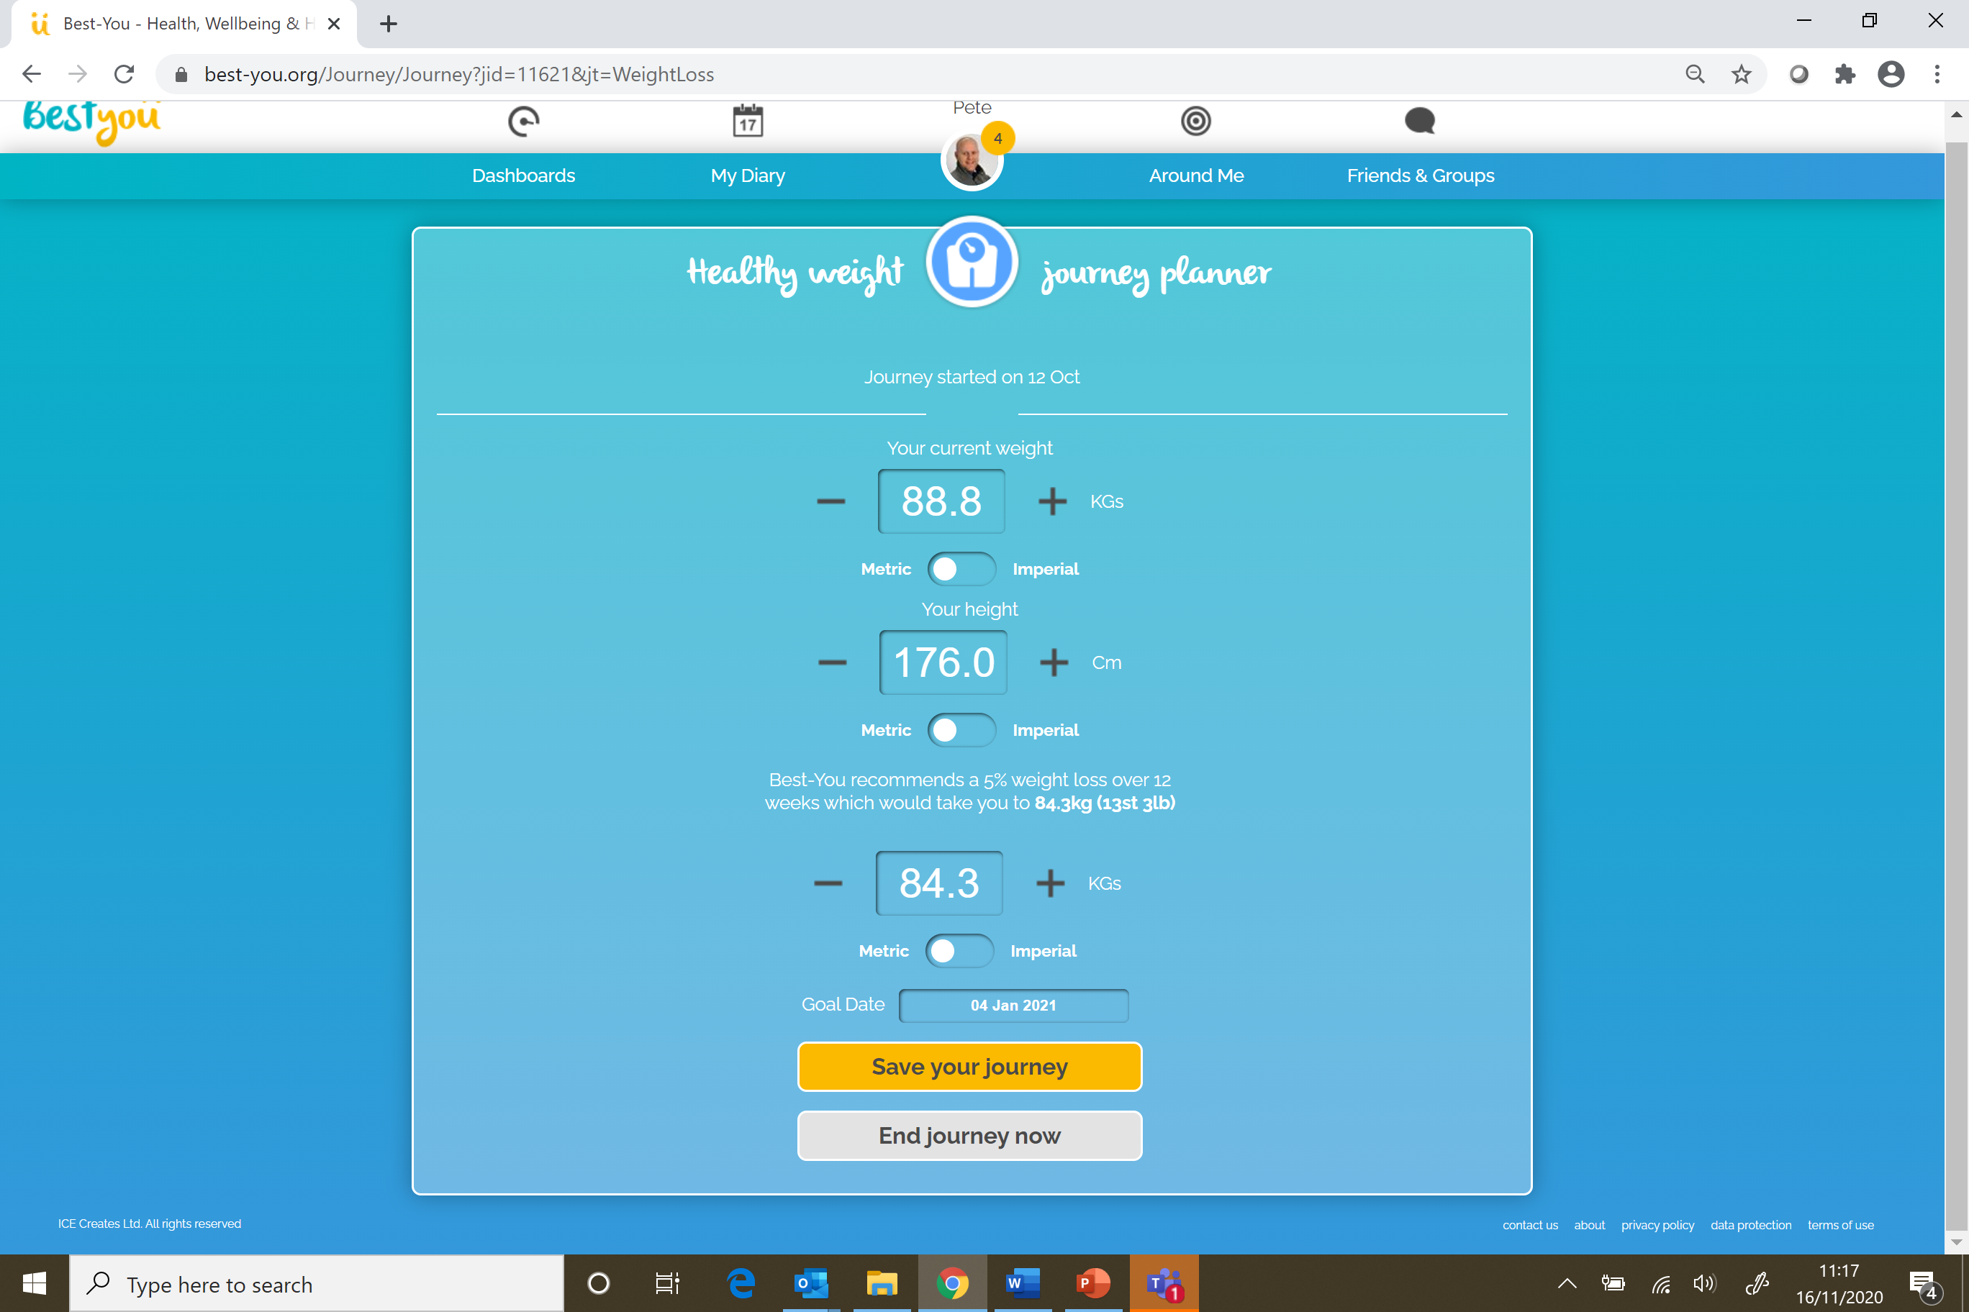

Slide 10
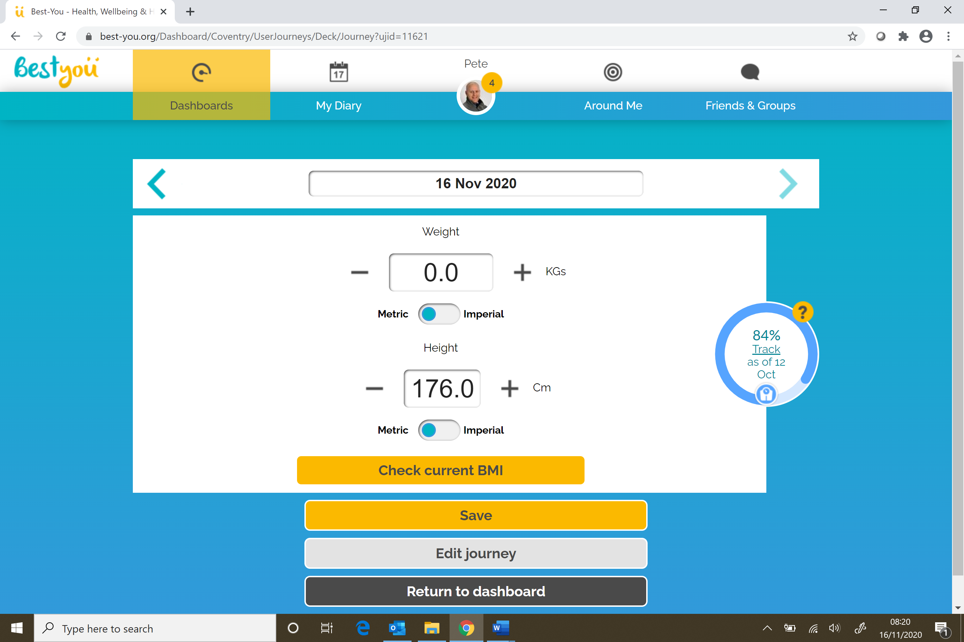

Slide 11
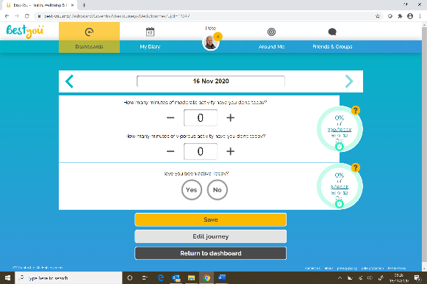
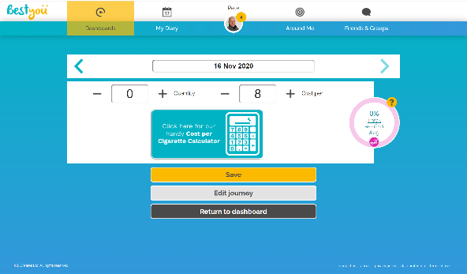
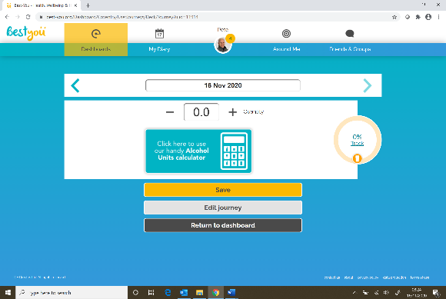
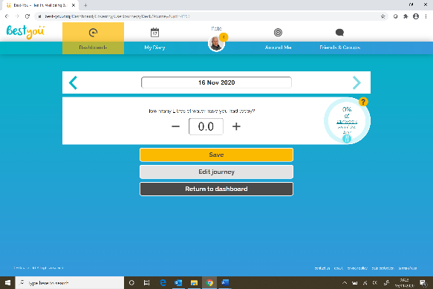

Slide 12
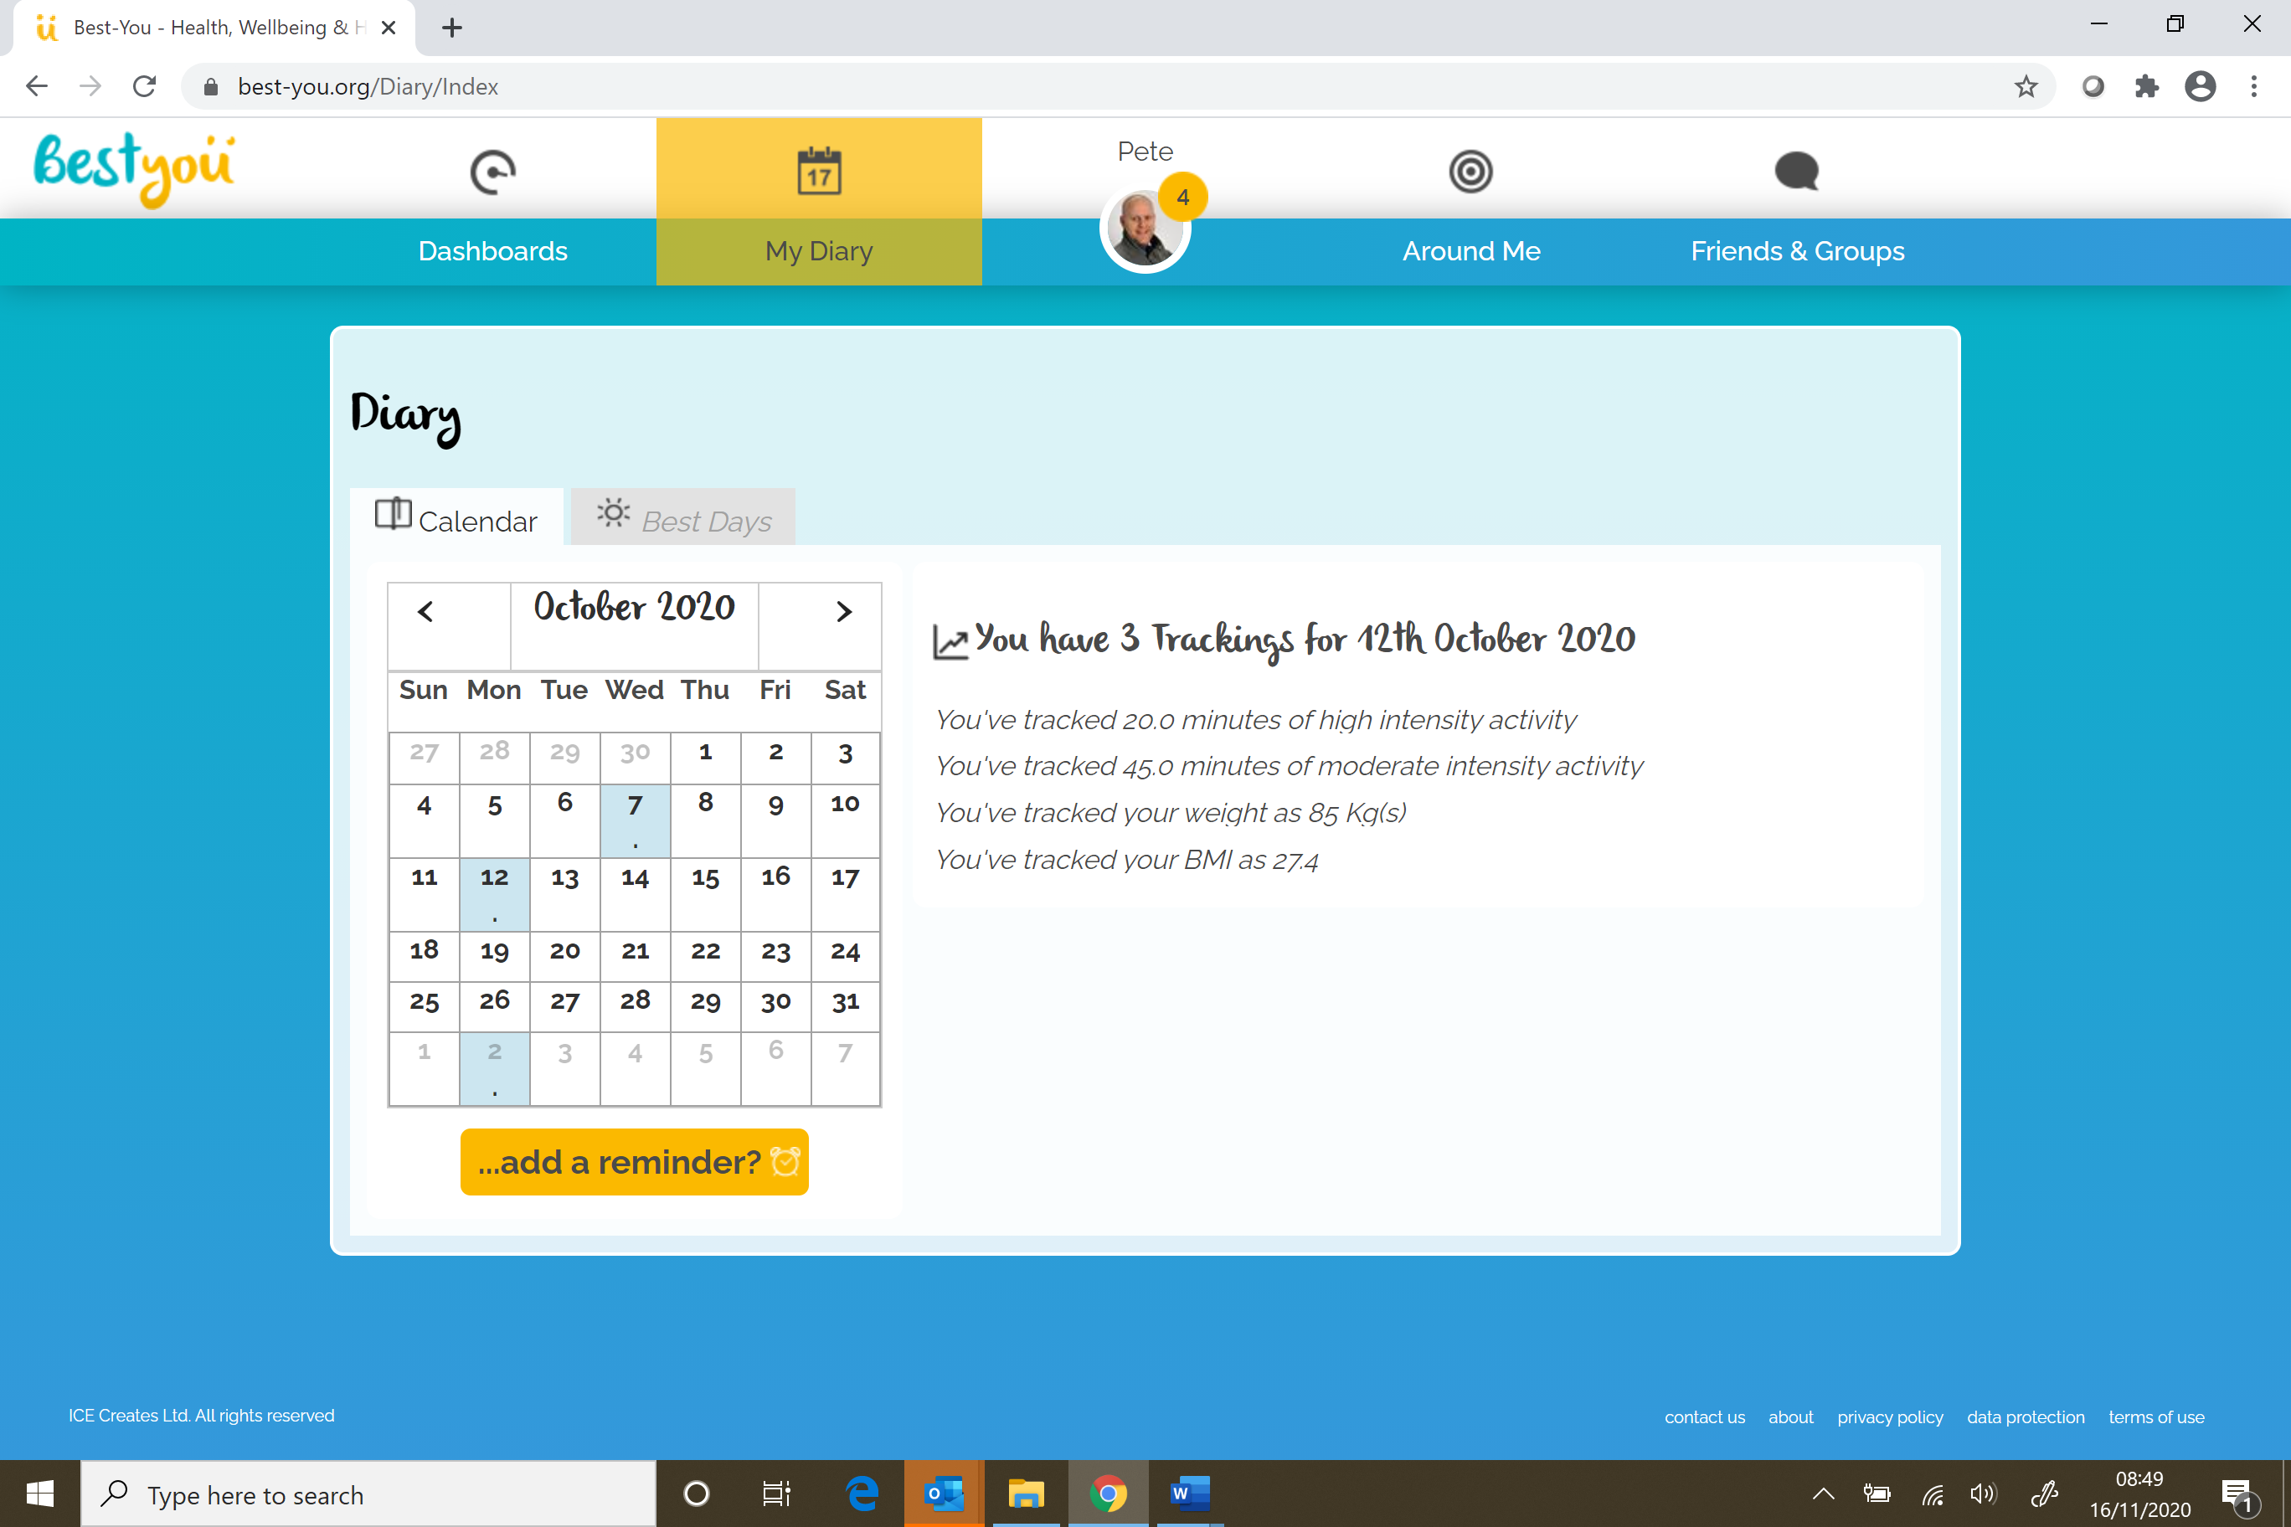

Slide 13
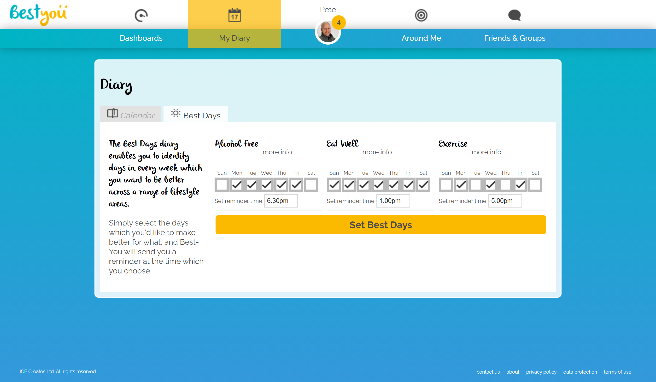

Slide 14
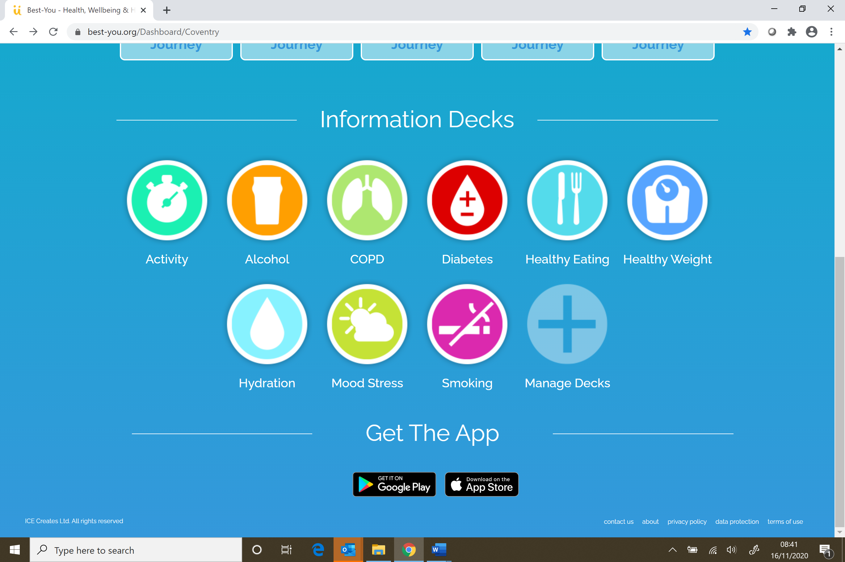
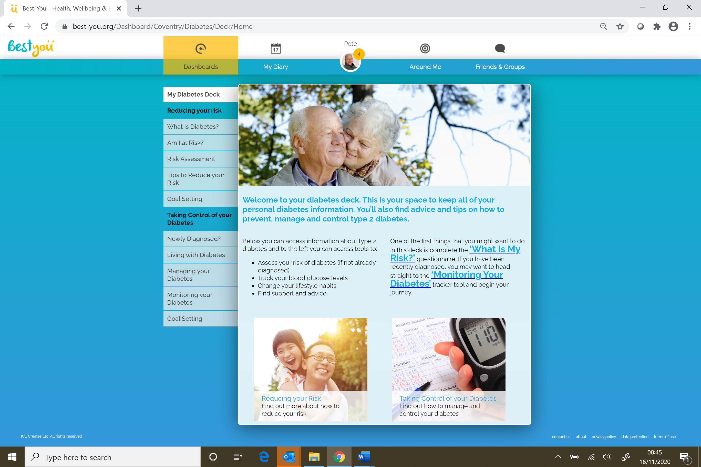
Specific IAG

Slide 15
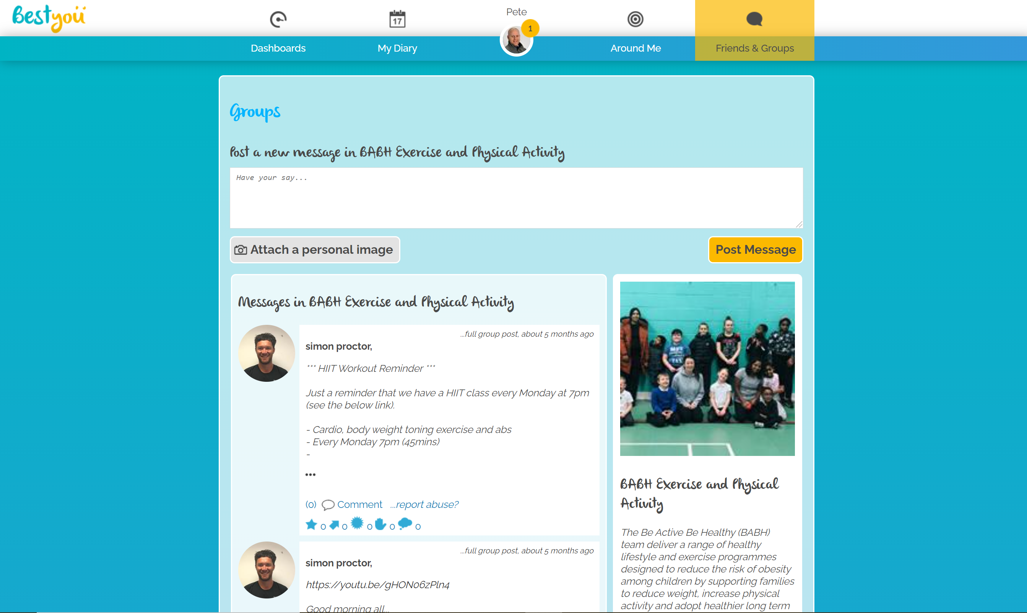

Slide 16


Do people change behaviour on ?

Slide 17



Data Insights
Sample size:
Gender:
Mean age:
20,000 +
38.4yrs
Male
44.2%
Female
48.8%

Slide 18

Smoking
The mean time between their first and last tracking data was 158 days.
The mean number of cigarettes smoked at T1 was 10.2, this has reduced to 2.8, resulting in a mean difference of 7.4

Slide 19
Alcohol
The mean time between their first and last tracking data was 127 days.
The mean number of units at T1 was 7.2, this has reduced to 2.9, resulting in a mean difference of 4.3

Slide 20
Healthy Weight
The mean time between their first and last tracking data was 168 days.
The mean weight (Kg) at T1 was 80.8, this has reduced to 77.7, resulting in a mean difference of 3.1KG or 6.82 lbs.

Slide 21
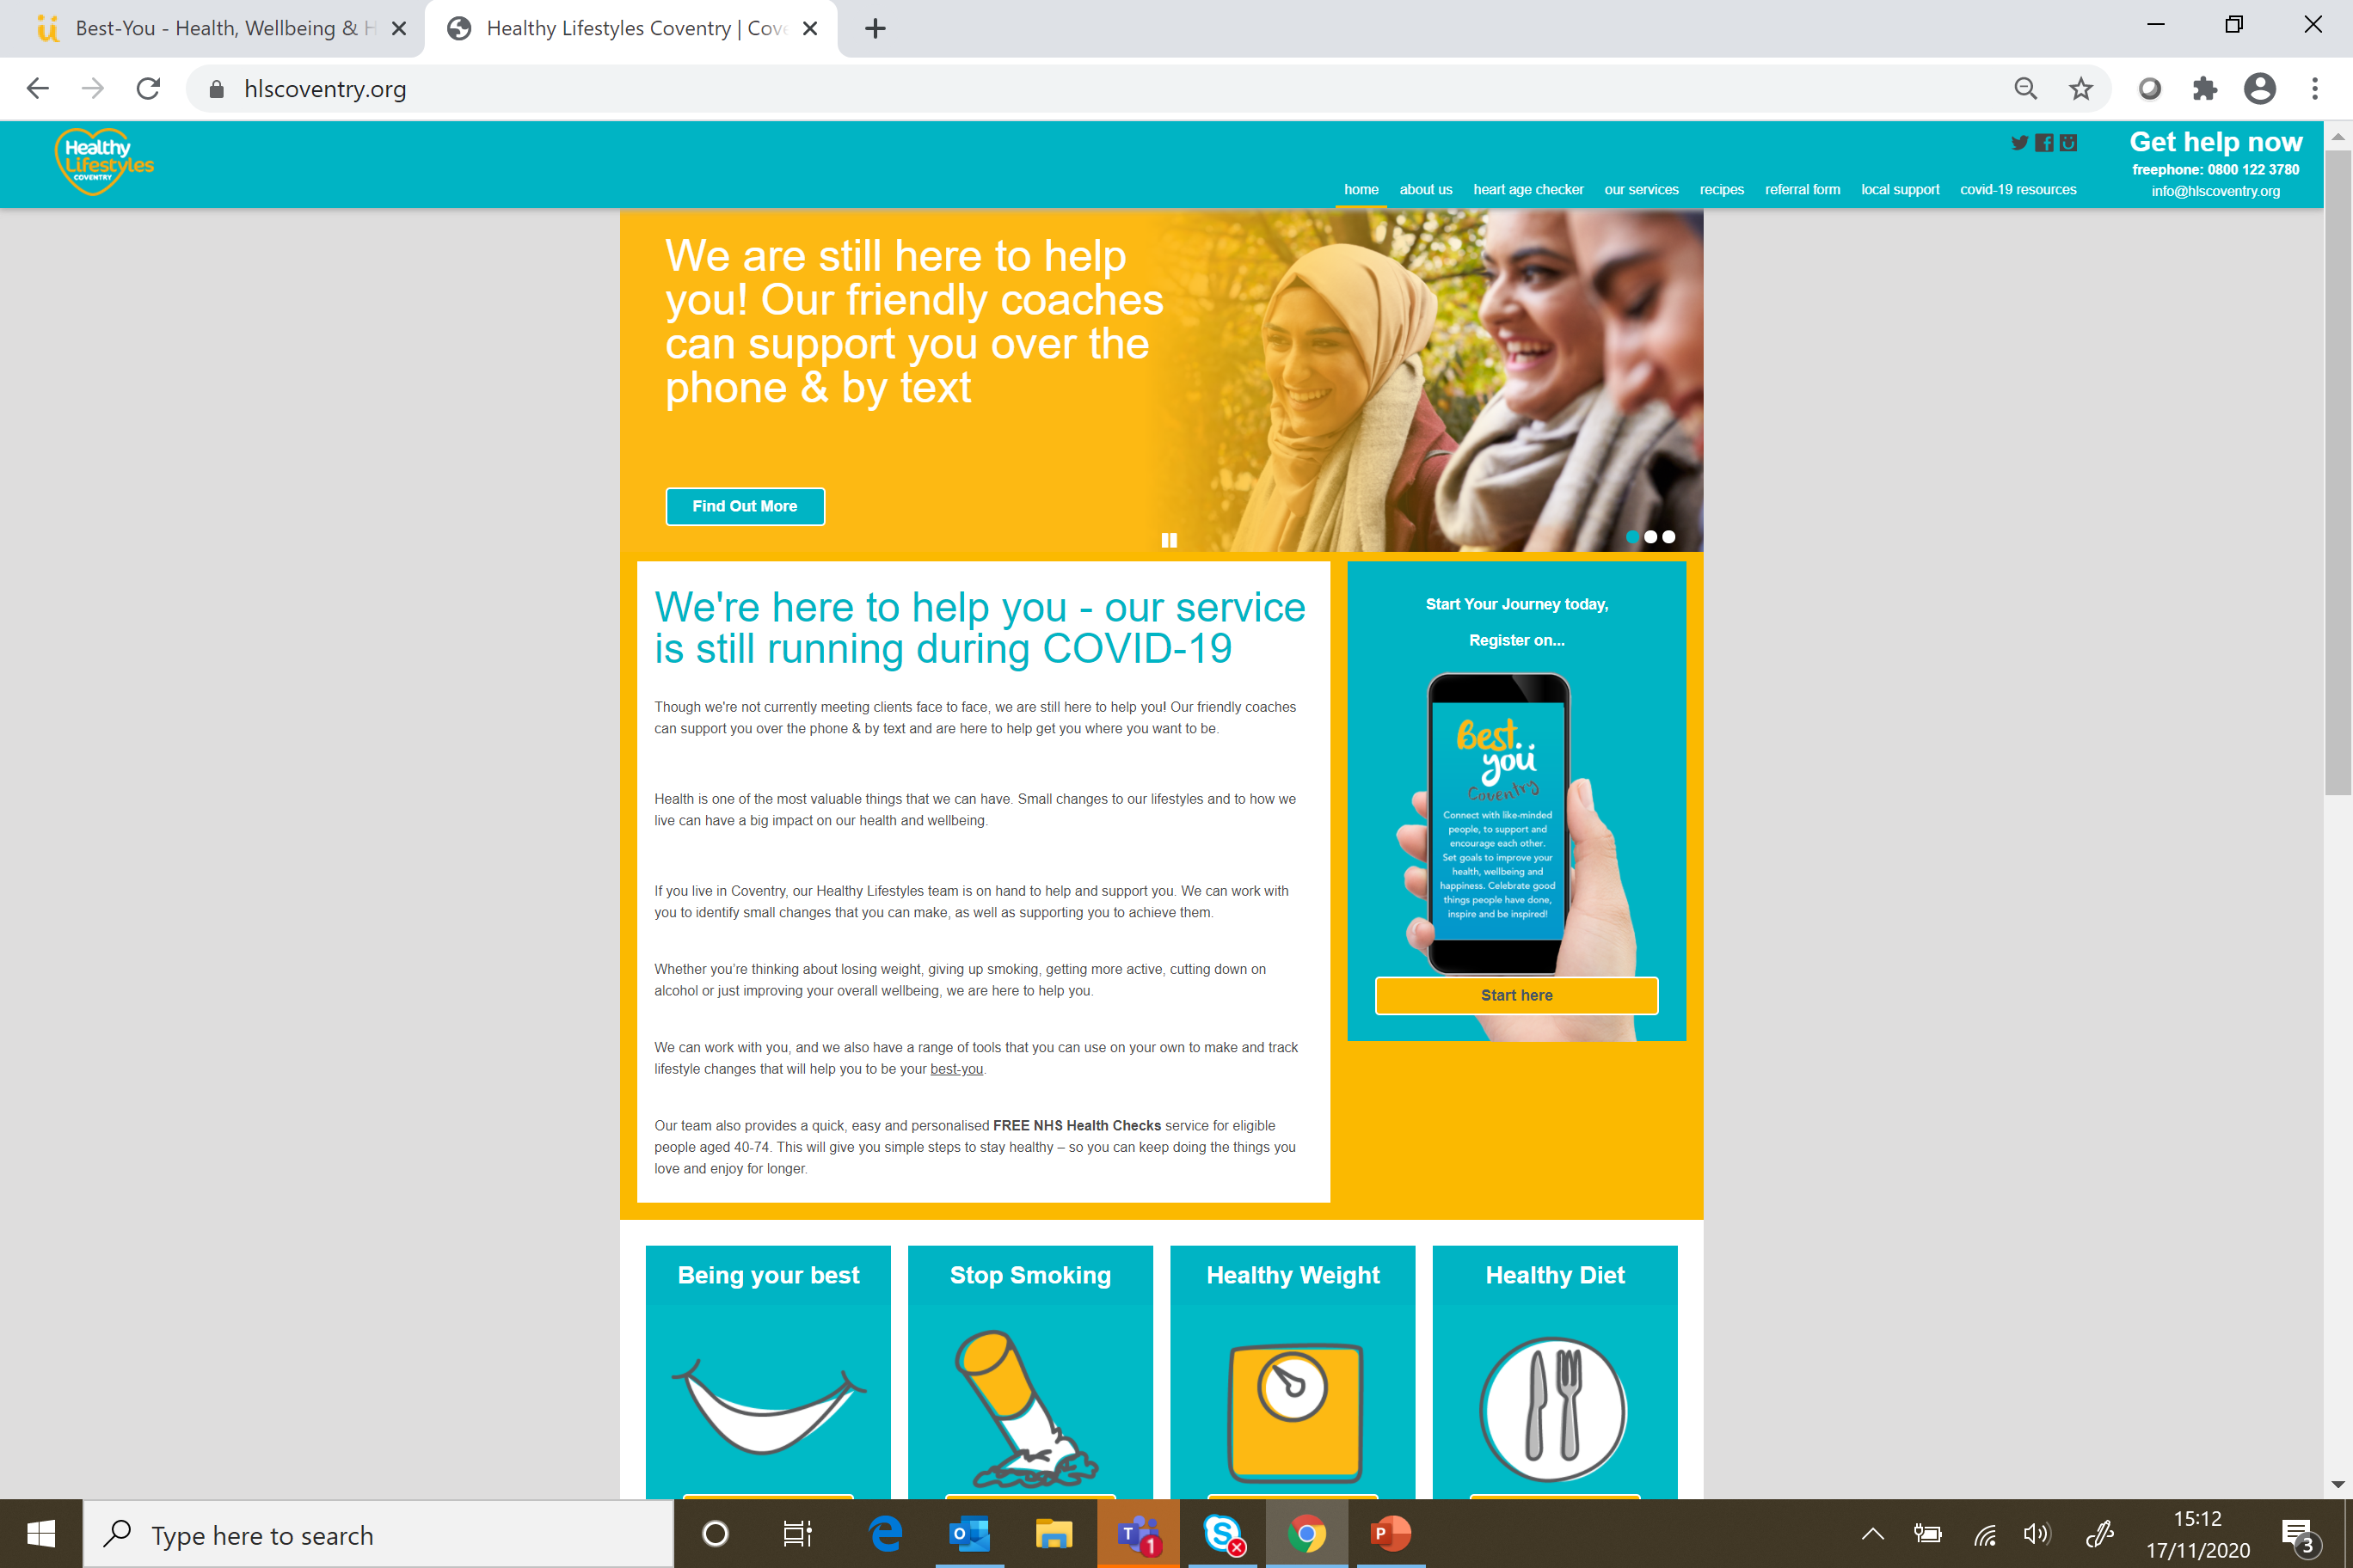
Start your journey…
www.best-you.org
www.hlscoventry.org
Download for free in the App store
For help setting up the app or for any further questions please contact the service via email info@hlscoventry.org or call 0800 122 3780

Slide 22
What are you waiting for?
#MakeBetterHappen

