Slide 1
Alcohol Awareness Webinar
Ashleigh Roach; Positive Choices

Slide 2
Expectations and Agenda
To ensure that this is a comfortable learning experience for everyone; can we please…
Keep your microphones and videos turned off
Use the chat facility to ask questions throughout. A Q&A will be available at the end. All questions are valid- we don’t know what we don’t know!
Be sensitive to the topics being covered
By the end of the workshop you should feel more equipped to:
Know the basics about Alcohol
Understand the effects
Understand the law and guidance
Know how to refer a young person for support

Slide 3
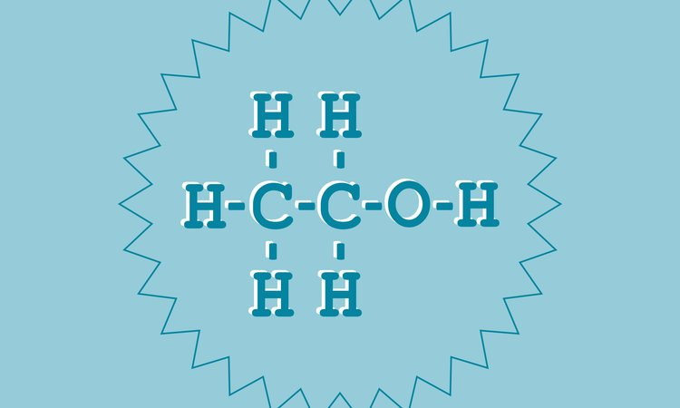
What is Alcohol?
Alcohol is a variety of drinks containing the chemical Ethanol
Alcohol comes in many forms, Beer, Wine and Spirits to name but a few; each coming with their own strengths which can be anything from 1% right up to 50% ethanol.

Slide 4
What is Alcohol?
Alcoholic drinks sometimes feel like a stimulant (or even hallucinogen in some cases), but alcohol is actually a depressant.
This means they slow down your central nervous system - not that they make you depressed – though it’s important to know that alcohol can affect your mood and mental health.
Alcohol has an effect on the neurotransmitters in the brain, which slows down our normal bodily responses.
Alcohol is broken down by the liver into other compounds at the rate of about 1 unit per hour. Only the liver breaks down alcohol in the body and nothing else (drinking black coffee doesn’t work!).

Slide 5
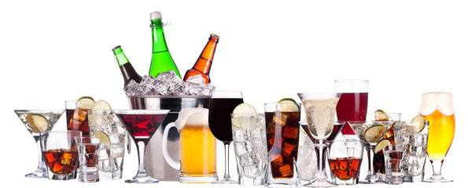
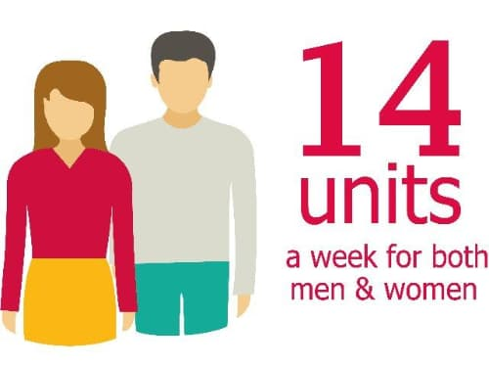
Alcohol
1 to 2 units
Your heart rate speeds up and your blood vessels expand, giving you the warm, sociable and talkative feeling associated with the first couple of drinks.
4 to 6 units
Your brain and nervous system starts to be affected. It begins to affect the part of your brain associated with judgement and decision making, causing you to be more reckless and uninhibited.
The alcohol also impairs the cells in your nervous system, making you feel lightheaded and adversely affecting your reaction time and co-ordination.
8 to 9 units
Your reaction times will be much slower, your speech will begin to slur and your vision will begin to lose focus.
Your liver, which filters alcohol out of your body, will be unable to remove all of the alcohol overnight.

Slide 6
Alcohol
10 to 12 units
Co-ordination will be highly impaired, placing you at serious risk of having an accident. The high level of alcohol has a depressant effect on both your mind and body, which makes you drowsy.
This amount of alcohol will begin to reach toxic (poisonous) levels. Your body attempts to quickly pass out the alcohol in your urine. This will leave you feeling badly dehydrated in the morning, which may cause a severe headache.
The excess amount of alcohol in your system can also upset your digestion, leading to symptoms of nausea, vomiting, diarrhoea and indigestion.
More than 12 units
If you drink more than 12 units of alcohol, you're at considerable risk of developing alcohol poisoning, particularly if you're drinking many units over a short period of time.
Alcohol poisoning can cause a person to fall into a coma and could potentially lead to their death.

Slide 7
What are the long term health effects?
Long-term risks come from regularly drinking alcohol over the low risk guideline over a long time.
High bloody pressure
Increased risk of strokes
Pancreatitis
Liver disease and cancer
Other related cancers
Alcohol related brain damage including Wernicke-Korsakoff syndrome (dementia)
Depression and other mental health concerns
Dependency

Slide 8
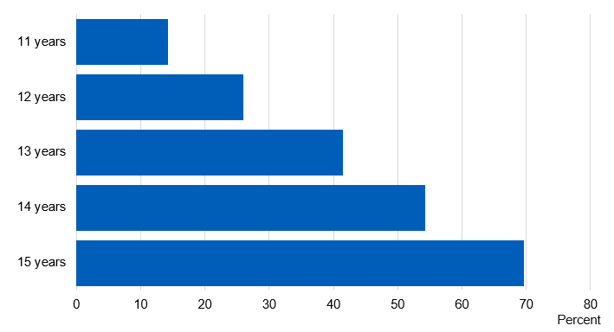
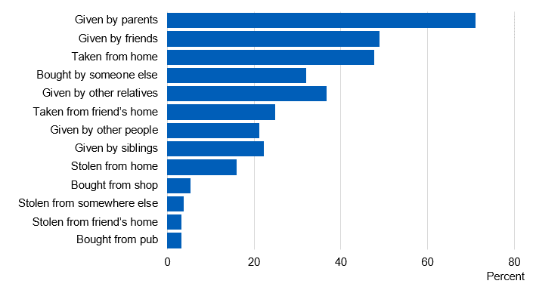
Alcohol and young people
14%
In 2018; 44% of 11-15 year olds had shared they have drank an alcoholic drink.
Saturday (67%)
Average of 10.3 units
10% had drank within the past week with 21% of that population having drank more than 15 units
47% of 15 year olds thought it was okay to drink at least once per week
SDD amongst young people, NHS 2018
71%

Slide 9
Young people’s guidelines
The UK Chief Medical Officers advise that an alcohol-free childhood is the healthiest and best option but if they are to drink, this should be over the age of 15.
If young people aged 15 to 17 years consume alcohol, it should always be with the guidance of a parent or carer or in a supervised environment.
Parents and young people should be aware that drinking, even at age 15 or older, can be hazardous to health and that not drinking is the healthiest option for young people.
If 15 to 17 year olds do consume alcohol, they should limit it to no more than one day a week. Young people aged 15 to 17 years should never exceed the adult guidelines.

Slide 10
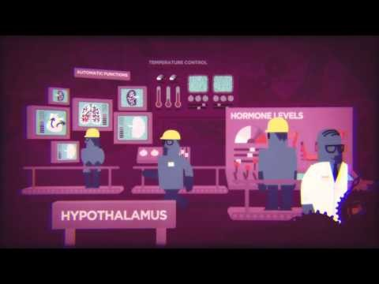
Alcohol and the teenage brain
There are significant concerns about the link between young people using Alcohol and the impact this has on their developing brain.

Slide 11
The Law
It is illegal for someone under the age of 18 to purchase alcohol
Over 16, you can drink a wine or beer with a meal in a licenced building, if with an adult
Within the home, the law states anyone over the age of 5 can drink alcohol!!
It is also illegal to drive whilst under the influence of Alcohol. There is no safe guidance on this other than to drink nothing as the way alcohol affects you depends on:
your weight, age, sex and metabolism (the rate your body uses energy)
Tolerance levels
the type and amount of alcohol you’re drinking
what you’ve eaten recently
On average there are 85,000 convictions each year (in England & Wales) with 3,551 getting seriously injured in an accident involving a drink driver.

Slide 12

Positive Choices
Amongst other support, Positive Choices are here to support young people (up to 24) with their substance use. Some of the ways we can support include:
Harm reduction techniques
Building on awareness; informed decisions are best!
Exploring the impact of their use
Making changes to use; reduction or abstinence plans
Alternative coping techniques
Diversionary activities

Slide 13
How to make a referral
You are more than welcome to speak with our Duty Worker or refer via our website for a quick and secure way to place the referral
www.changegrowlive.org/positive-choices-coventry
02476 010 245 coventryinfo.yp@cgl.org.uk
Please consider:
Consent of the young person (including parental consent for under 13s)
Voluntary
Confidential

Slide 14
How to contact us
Address:
23-25 City Arcade, Coventry
Phone:
02476 010245
Website: (referrals & online chat)
www.changegrowlive.org/coventryyp
Facebook:
PositiveChoicesCov
Instagram:
Positivechoices_Coventry
Twitter:
@PosChoices_Cov

Slide 15
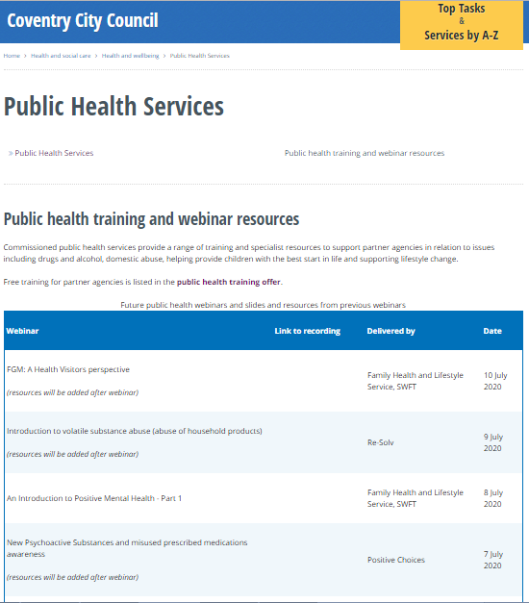

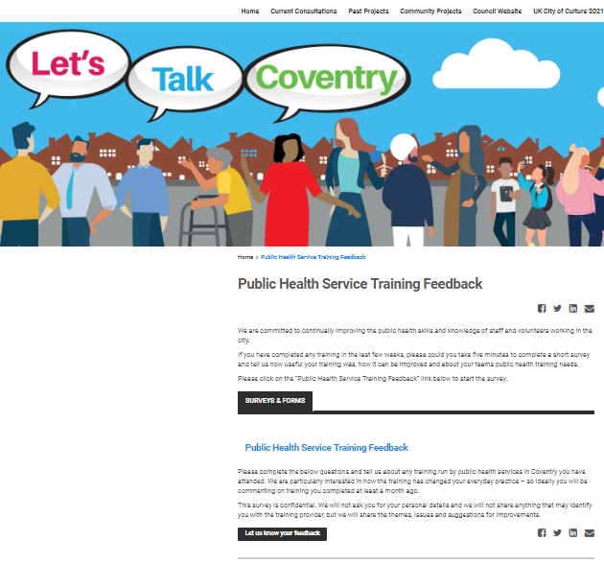
Thank you for listening
Please visit the City Council website:
Slides and recordings of past webinars
Timetable of future webinars
Details of more in-depth training available
free from Public Health services
Google “coventry public health webinars” or visit
www.coventry.gov.uk/info/190/health_and_wellbeing/3283/public_health_services/2
Feedback and ideas for future webinars
Please give is your feedback and suggestions of future webinars via the
Let’s Talk Coventry site at https://letstalk.coventry.gov.uk/publichealthtraining

