Slide 1

My Chat Book
Name
Created by CWPT ALD Speech and Language Therapy

Slide 2

Hello!
This pack includes information to help you work with your client. Please read all of the pages carefully.
It may feel intimidating and unfamiliar at first, but the more you use it and follow the instructions in this pack, the more comfortable you’ll get.
Thank you so much for your commitment to using this Chat Book! Our clients appreciate it.

Slide 3
“A person’s ability to communicate is not dependent on their being able to master certain skills, it is dependent on our ability to listen and communicate responsively.”
- Jo Grace
“We can never really know what a person is capable of until we provide them with the opportunity to learn
and show us.”
- Gail Porter
“Limited expectation is the most disabling barrier.”
- Denise Abrahams
“My needs aren't special. How my needs are met may be different but they are the same needs as anyone else’s.”
- DREAMdisability
“Not being able to speak is not the same as not having anything to say.”

Slide 4
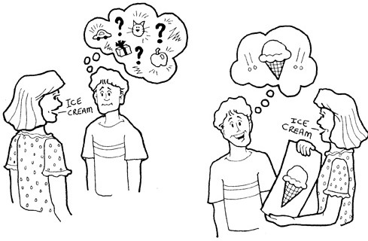
Chat Book
Why we use visuals - (Pictures, Photos, Symbols & Objects)
Speech disappears immediately after it is spoken. In fact, the spoken words can be completely gone before the person’s brain even registers that you have said something.
Visual tools remain present as long as necessary for the person to focus their attention and take in the information.
Hello! How are you?

Slide 5
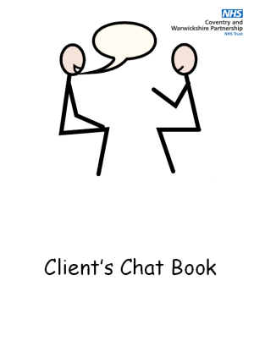
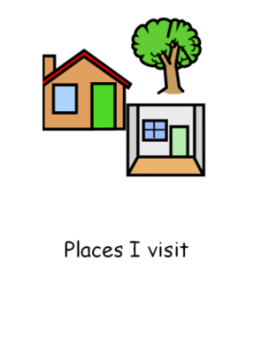

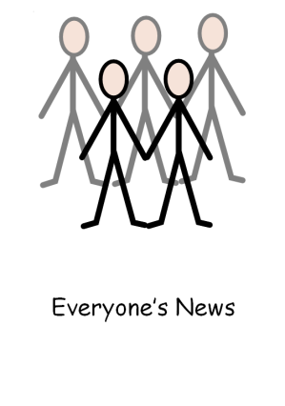
Chat Book
What is a Chat Book?
A Chat Book is a book of photos, paper reminders to record events, achievements, activities or things that are of interest to the client.
It can include family photographs, holiday souvenirs, drawings, tickets, programmes and objects (leaf from park or straw from McDonalds).
Example

Slide 6

Chat Book
The purpose of using a Chat Book
A Chat Book can be used as a prompt to increase opportunities for shared communication.
It helps focus the person’s communication and helps cue you in to that the person is talking about.
They can help encourage people to express themselves. A Chat Book can encourage a person, to talk about people, past and future events and activities that are pictured in the book.
They are a good way to start a conversation and get to know someone.
They can be great fun too!

Slide 7
Chat Book
How to use a Chat Book?
Involve the client as much as possible in creating the book. Try to use it everyday.
Whatever is entered into the book must be interesting to them.
You could use sentences/words that the client has said themselves to label the pictures. Include funny memories e.g. Jenny dropped her ice cream.
Provide the client with opportunities to use it as often as possible. It can be added to their timetabled activities.
Take photographs of activities the client has done or might be doing.
Collect things in relation to that topic e.g. bus ticket, train ticket, receipt, brochure or crisp packet and stick them into their book.
Use the chat book to start a conversation and help the client remember what they have done or might be doing.

Slide 8
Chat Book
Benefits
It increases opportunities for social communication.
It helps you talk about social activities e.g. holidays, trips etc.
It may help someone low in mood remember good times and increase their wellbeing.
It may help someone with memory difficulties recall past events, friends, family and carers.
It can give someone a positive way of gaining someone’s attention and spending time with them rather than through challenging behaviours.
Not using this resource may be detrimental to the client’s communication which may increase frustration and challenging behaviours.

Slide 9
References
Speechy Musings AAC Toolkit
http://speechymusings.com
Total Communication Resource Pack
https://www.eastsussex.gov.uk/media/3428/totalcommunicationresourcepackopt.pdf
Useful Links
https://usevisualstrategies.com/visuals-for-autism-who-needs-to-change/
https://www.youtube.com/watch?v=flFNMky22-U

Slide 10
Fit for Purpose
1. Does this resource make sense to you?
Yes No
If no, what doesn’t make sense?
______________________________________________________________
______________________________________________________________
______________________________________________________________
2. Is using this resource realistic / practical?
Yes No
If yes, what do you think the benefits will be? ______________________________________________________________
______________________________________________________________
______________________________________________________________
If no, why not and what would help support you to use the resource?
______________________________________________________________
______________________________________________________________
______________________________________________________________

