Slide 1
Coventry Early Years Team EYFS Reforms 2021

Slide 2
Time for Change
Time for change
The EYFS Statutory Framework 2021

Slide 3
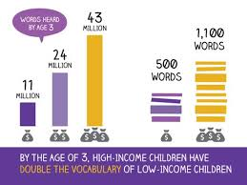
Why Change?
Time for change
Focus on strengthening language and vocabulary development to help close the ‘word gap’
Strengthen literacy and numeracy outcomes at the end of the Early Years Foundation Stage
Better prepare children for Key Stage 1 – by better aligning with Year 1
Are based on the latest evidence in childhood development – and the strongest predictors of future attainment
Are clearer for teachers to interpret – making the EYFSP assessment more straightforward
Streamlining assessment guidance and reviewing the moderation process to:
Reduce teacher workload and strongly encourage teachers to use their professional judgement and reduce reliance on recording unnecessary evidence

Slide 4
Revised Documentation
https://www.foundationyears.org.uk/wp-content/uploads/2021/02/DRAFT-EYFS-Framework-for-comment-February-2021.pdf
https://assets.publishing.service.gov.uk/government/uploads/system/uploads/attachment_data/file/944603/Development_Matters_-_non-statuatory_cirriculum_guidance_for_EYFS.pdf
https://www.birthto5matters.org.uk/wp-content/uploads/2021/04/Birthto5Matters-download.pdf

Slide 5
Changes at a glance
Early Years Foundation Stage Profile (EYFSP)
No longer a statutory duty for the LA to moderate the EYFSP
Joint school and PVI moderation encouraged
Schools will still be required to submit EYFSP data to the LA
The “exceeding” judgement criteria has been removed
Children will be assessed as On Track or Not On Track
EYFSP Handbook has been reviewed
Safeguarding and Welfare Requirements
Oral heath has been included to promote good health
Learning and Development Requirements
Educational programmes have been provided for the 7 areas of learning
Cognitive and language development are a key focus
Aspect of learning have changed
Early Learning Goals revised
Focus on pedagogy, child development and the role of the adult
Mandatory reception baseline assessment (RBA) introduced
When?
The reforms will be implemented nationally from September 2021

Slide 7
EYFS Statutory Framework: A ‘where to find’ overview
Summary | Section 1 The learning & development requirements | Section 2 Assessment | Section 3 The safeguarding and welfare requirements | Annex A& B:
Summary About this statutory framework Expiry or review date What legislation does this framework refer to? Who is this framework for? | The areas of learning and development Educational Programmes Early Learning Goals | Progress check at age two Assessment at the start of the reception year (RBA) Assessment at the end of the EYFS The Early Years Foundation Stage Profile (EYFSP) | Introduction Child protection Suitable people Staff qualifications, training, support and skills Key person Staff: child ratios: all providers (inc childminders) Health Managing behaviour Safety and suitability of premises, environment and equipment Special educational needs Information and records | A: Criteria for effective PFA training B:Statutory Framework for Reception Baseline Assessment (RBA)

Slide 8
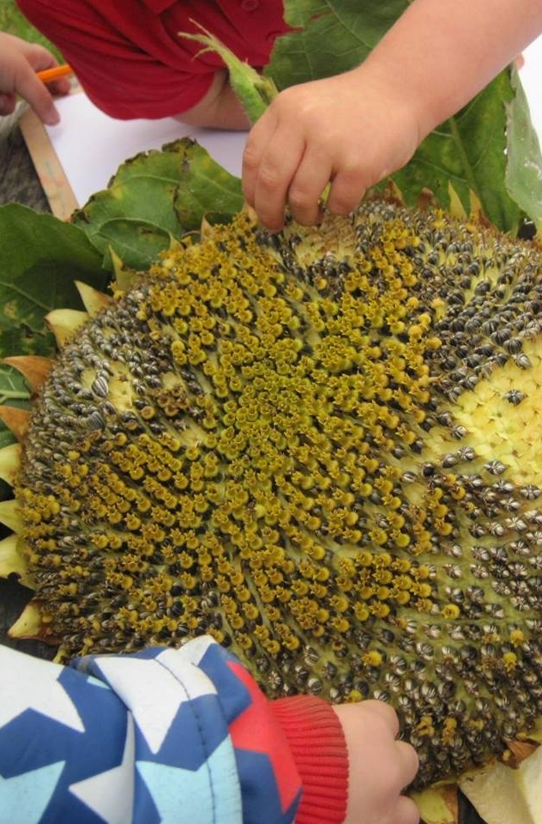
The Statutory Framework The Summary Section

Slide 9
The Summary Section
Time for change
What legislation does this framework refer to and who is it for?
The learning and development requirements are given legal force by an Order made under section 39(1)(a) of the Childcare Act 2006
The safeguarding and welfare requirements are given legal force by Regulations made under section 39(1)(b) of the Childcare Act 2006
Who is this framework for?
This framework is for all early years providers in England from 1 September 2021

Slide 10
The Summary Section
Time for change
The EYFS expects that children are:
Learning and developing well
Kept health and safe
School ready
The EYFS seeks to provide:
Quality and consistency
Every child makes good progress and no child gets left behind
Planning and assessing for the individual child
Partnership working between practitioners and with parents and/or carers
Equality of opportunity and anti-discriminatory practice

Slide 11
The Summary Section
Time for change
The 4 Principles Remain
Every Child is a Unique Child who is constantly learning and can be resilient, capable, confident and self-assured
Positive Relationships: children learn to be strong and independent through positive relationships
Enabling Environments: children learn and develop well in enabling environments with teaching and support from adults, who respond to their individual interests and needs and help them to build their learning over time. Children benefit from a strong partnership between practitioners and parents and/or carers. (See the characteristics of effective teaching and learning - paragraph 1.15)
Learning and Development: Children develop and learn at different rates. The framework covers the education and care of all children in early years provision, including children with special educational needs and disabilities (SEND) and those with EAL.

Slide 12
The Summary Section
Time for change
The Learning and Development Principles: What is required?
The 7 areas of learning and development which must shape activities and experiences (educational programmes) for children in all early years settings
The early learning goals that providers must help children work towards (the knowledge, skills and understanding children should have at the end of the academic year in which they turn five)
The assessment arrangements for measuring progress (and requirements for reporting to parents and/or carers)
The safeguarding and welfare requirements cover the steps that providers must take to keep children safe and promote their welfare

Slide 13
The Statutory Framework Section 1:
Learning and Development

Slide 14
Section 1:
Learning and Development considerations
Time for change
1.11 Practitioners must consider the individual needs, interests, and development of each child in their care, and must use this information to plan a challenging and enjoyable experience for each child in all areas of learning and development.
1.12 Throughout the early years, if a child’s progress in any prime area gives cause for concern, practitioners must discuss this with the child’s parents and/or carers and agree how to support the child.
1.13 For children whose home language is not English, providers must take reasonable steps to provide opportunities for children to develop and use their home language in play and learning, supporting their language development at home.
1.14 This framework does not prescribe a particular teaching approach. Play is essential for children’s development, building their confidence as they learn to explore, relate to others, set their own goals and solve problems. Children learn by leading their own play, and by taking part in play which is guided by adults.

Slide 15
Section 1:
Learning and Development considerations
Time for change
1.15 In planning and guiding what children learn, practitioners must reflect on the different rates at which children are developing and adjust their practice appropriately.
The three characteristics of effective teaching and learning are:
• playing and exploring - children investigate and experience things, and ‘have a go’
• active learning - children concentrate and keep on trying if they encounter difficulties, and enjoy achievements
• creating and thinking critically - children have and develop their own ideas, make links between ideas, and develop strategies for doing things
1.16 Each child must be assigned a key person (also a safeguarding and welfare requirement - see paragraph 3.27).
1.17 A quality learning experience for children requires a quality workforce.

Slide 16
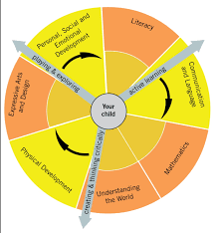
Section 1:
The 7 areas of Learning and Development
Time for change
All areas of learning and development are important and inter-connected
What is required ?
Three areas are particularly important for building a foundation for igniting children’s curiosity and enthusiasm for learning, forming relationships and thriving. These are the prime areas:
Communication and language
Physical development
Personal, social and emotional development
Providers must also support children in four specific areas, through which the three prime areas are strengthened and applied. The specific areas are:
Literacy
Mathematics
Understanding the world
Expressive arts and design

Slide 17
Section 1:
The Educational Programmes
Time for change
What has changed?
More depth has been added to all Educational Programmes
There is a focus on early language and extending vocabulary throughout
Detailed curriculum guidance on early years education from birth to end of Reception
Exemplification material is planned
Cognitive & Social development

Slide 18
Section 1:
The Educational Programmes
Time for change
Communication and Language
What is required ?
1.6. Educational programmes must involve activities and experiences for children, as set out under each of the areas of learning. This is a top line view of what must be taught.
The development of children’s spoken language underpins all seven areas of learning and development. Children’s back-and-forth interactions from an early age form the foundations for language and cognitive development. The number and quality of the conversations they have with adults and peers throughout the day in a language-rich environment is crucial. By commenting on what children are interested in or doing and echoing back what they say with new vocabulary added, practitioners will build children's language effectively. Reading frequently to children, and engaging them actively in stories, non-fiction, rhymes and poems, and then providing them with extensive opportunities to use and embed new words in a range of contexts, will give children the opportunity to thrive. Through conversation, story-telling and role play, where children share their ideas with support and modelling from their teacher, and sensitive questioning that invites them to elaborate, children become comfortable using a rich range of vocabulary and language structures

Slide 19
Section 1:
The Educational Programmes
Time for change
What does the curriculum need to offer for children to meet this educational programme?
Educational Programme What will children learn ? | Pedagogy needs to include | Notes
Development of spoken language with increasing sophistication | Adults who provide a language-rich environment Adults who engage in a number of high quality of the conversations with children throughout the day Adults who comment on what children are interested in or doing, and echo back what they say with new vocabulary added Adults who read frequently to children engaging them actively in stories, non-fiction, rhymes and poems conversation, story-telling and role play, Adults who provide extensive opportunities to use and embed new words / language in a range of contexts Adults who support and model language alongside sensitive questioning that invites children to elaborate Access to adults who spend time reading a wide range of stories, non-fiction, rhymes and poems Opportunities to engage in storytelling and role-play | Language and communication skills include the ability to understand others and express oneself using words, gestures, or facial expressions. Communication also requires the ability to listen. Children who develop strong language and communication skills are more likely to arrive at school ready to learn.
Ability to hold back-and-forth interactions to support the foundations of: language and cognitive development
Ability to use a rich range of vocabulary and language structures
Ability to use language and new vocabulary in a range of contexts
Ability to use language and new vocabulary in a range of contexts |  | Reflection Questions
Ability to use language and new vocabulary in a range of contexts |  | Does our curriculum reflect a step by step opportunity for children to progress in their Speech, Language and Communication skills
Ability to use language in role-play and story telling
Ability to share their ideas through conversations, storytelling and role-play |  | Do all of our team understand the sequence of development in early language and communication ?
Ability to use language and new vocabulary in a range of contexts |  | Resource: Communication Trust

Slide 20
Section 1:
The Educational Programmes
Time for change
The ethos and approach to learning & progress An example of our pedagogy
Educational Programme: Children need the ability to use a rich range of vocabulary and language structures
Note: What does this cohort need ? Recently, when reading ’Oliver’s Vegetables’ one of the children called every picture on the page, ‘peas’’ we noticed that many children didn’t have range of words for vegetables.
Approach (pedagogy): We will support this through planning a curriculum using a system of core books, rhymes and songs including lots of shared book reading and very rich first- hand experiences, so that children are not only hearing and using that vocabulary, but in a context that is very meaningful.
The adult role is crucial, in the way we read the story with the children, the way we do role play around the story, go to the shops and buy fruit, explore the fruit and so on
Julian Grenier: https://www.early-education.org.uk/news/interview-julian-grenier-early-years-foundation-stage-what-matters

Slide 21
Section 1:
The Educational Programmes
Time for change
The ethos and approach to progress
Progress: Progression in learning is a process of increasing sophistication, rather than covering a growing body of content. This is individual to each learner. It requires space for diversion, reinforcement and reflection as a learner’s thinking develops over time to new levels.
In thinking about progress, and designing a curriculum, we may consider:
What content do we need in a core book for September and then what content will we need in July?
Can we see the progress in terms of vocabulary, complexity, a song that is more technical, greater melody and rhythm in Sept to July?
We can use progress maps, or knowledge banks to help us to think much more deeply about what we provide as practitioners to help children steadily make step by step progress though the year. Rather than as a tool to assess them by.
Julian Grenier: https://www.early-education.org.uk/news/interview-julian-grenier-early-years-foundation-stage-what-matters

Slide 22
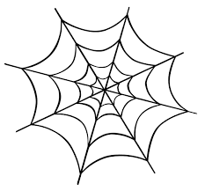
Section 1:
The Educational Programmes
Time for change
Focusing attention where it is needed
If we look at percentages of how children are doing, we can gauge how well they are doing. We must remember the percentage gap of those children not achieving, and to focus our efforts on these children is key.
Wider thinking around children needing support to catch up and keep up with the other children is essential. We must still focus on the individual children and think "What am I going to do to give a child intensive support to move them on?".
Julian also reflects on summer-born children - thinking developmentally, some children might be doing very well, but still might be behind an autumn-born child, because of their age. We must think “Is this child making the development and progress I want them to make at this stage?”
Julian Grenier: https://www.early-education.org.uk/news/interview-julian-grenier-early-years-foundation-stage-what-matters

Slide 23
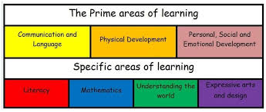
Section 1:
The Early Learning Goals
Time for change
Reflection Question:
Do all practitioners in the EYFS team have access sufficient training to develop and apply a deep knowledge of child development and learning from birth to five to curriculum design?
Can all practitioners to articulate their knowledge and professional judgement in the assessment of children?

Slide 24
Section 1:
The Early Learning Goals
Time for change
What has changed?
The early learning goals, which children must work towards achieving by the end of the academic year in which they turn five remain in place.
Communication and Language ELGs reduced to two. Listening, Attention and Understanding & Speaking
The ELGs under the Personal, Social and Emotional Development (PSED) area of learning have been reorganised under the headings: Self-Regulation, Managing Self and Building Relationships. These ELGs were formerly Managing Feelings and Behaviour, Self-confidence and Self-awareness and Making Relationships.
Under the Physical Development area of learning, the ELGs have become Gross Motor Skills and Fine Motor Skills. What was called the Health and Self-Care ELG has been absorbed within the PSED Managing Self ELG.
The Mathematics ELGs are now Number and Numerical Patterns. There is no longer a Shape, Space and Measure ELG.
There is no longer an ELG for Technology, with Understanding the World now focussing children’s understanding of Past and Present, People, Cultures and Communities and The Natural World.

Slide 25
The Statutory Framework Section 2:
Assessment

Slide 26
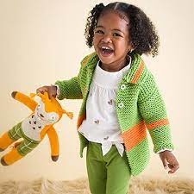
Section 2:
Assessment
Time for change
Progress check at age 2
This is the only statutory assessment that people working with pre-reception children will need to carry out.

Slide 27
Section 2:
Assessment
Time for change
Reception Baseline Assessment
A new assessment to be administered in all primary infant and first schools in England to children in Reception classes within their first 6 weeks of Reception class.

Slide 28
Section 2:
Assessment
Time for change
Early Years Foundation Stage Profile (EYFSP)
Key changes:
Specific guidance that practitioners assessing pupils’ progress should rely on their own professional judgement and should not be required to prove their judgements with physical evidence.
Focus on a ‘best fit’ judgement for each ELG.
Removal of the ‘exceeding’ criteria for the EYFSP
Removal of the LAs statutory duty to moderate the EYFSP in 25% of schools
Commenting on the Characteristics of Effective Teaching and Learning and passing this onto the Year 1 teacher is now optional.
Tracking and data collection should be limited to that which is relevant and informs planning

Slide 29
Section 2:
Assessment
Time for change
Partnership with Parents and Carers

Slide 30
The Statutory Framework Section 3:
The Safeguarding and Welfare requirements

Slide 31
Section 3:
The Safeguarding and Welfare Requirements
Time for change
Child protection
Suitable people
Staff qualifications, training, support and skills
Key person
Staff: child ratios: all providers (including childminders)
Health
Managing behaviour
Safety and suitability of premises, environment and equipment
Special educational needs
Information and records

Slide 32
Section 3:
The Safeguarding and Welfare Requirements
Time for change
New addition: Oral Health
The requirement within the EYFS framework to ‘promote the good health of children’ will explicitly include oral health
All other areas of safeguarding requirements remain unchanged
Supervised Toothbrushing is not expected

Slide 33
Section 3:
The Safeguarding and Welfare Requirements
Time for change
Ratios and Qualification levels
Refresh your understanding of these on page 29 of the new EYFS Statutory Framework 2021.
Qualifications: Staff must hold full and relevant qualifications: If in doubt – please use the DfE qualification checker https://www.gov.uk/guidance/early-years-qualifications-finder

Slide 34
Development Matters
2020

Slide 35
Development Matters
The Purpose
The main purpose is to help practitioners assess each child’s level of development.
Accurate assessment helps practitioners to make informed decisions about what a child needs to learn and be able to do next. The document is not a tick list for generating lots of data. You can use your professional knowledge to help children make progress without needing to record lots of next steps.
The guidance should be used to check that children are secure in all the earlier steps of learning before looking at their ‘age band’.
Depth in learning matters much more than moving from one band to the next or trying to cover everything. A child's learning is secure if they show it consistently and in a range of different contexts.

Slide 36
Development Matters 2020
Introduction | 7 Key features of effective practice | The characteristics of effective teaching and learning (CoETL) | Communication and language English as an additional language The Areas of Learning
The framework sets out: Three prime areas of learning that underpin everything in the early years: • communication and language • physical development • personal, social and emotional development Four specific areas help children to strengthen and apply the prime areas: • literacy • mathematics understanding the world • expressive arts and design All of those areas of learning are connected together. Development Matters sets out the pathways of children’s development in broad ages and stages | The best for every child High-quality care The curriculum: what we want children to learn Pedagogy: helping children to learn Assessment – checking what children have learnt Self-regulation and executive function Partnership with parents | The characteristics of effective teaching and learning weave through all seven areas of learning. These are: Playing and exploring Active learning Creating and thinking critically | Communication and language (including English as an additional language) Personal, Social and Emotional Development Physical Development Literacy Mathematics Understanding the world Expressive arts and design

Slide 37
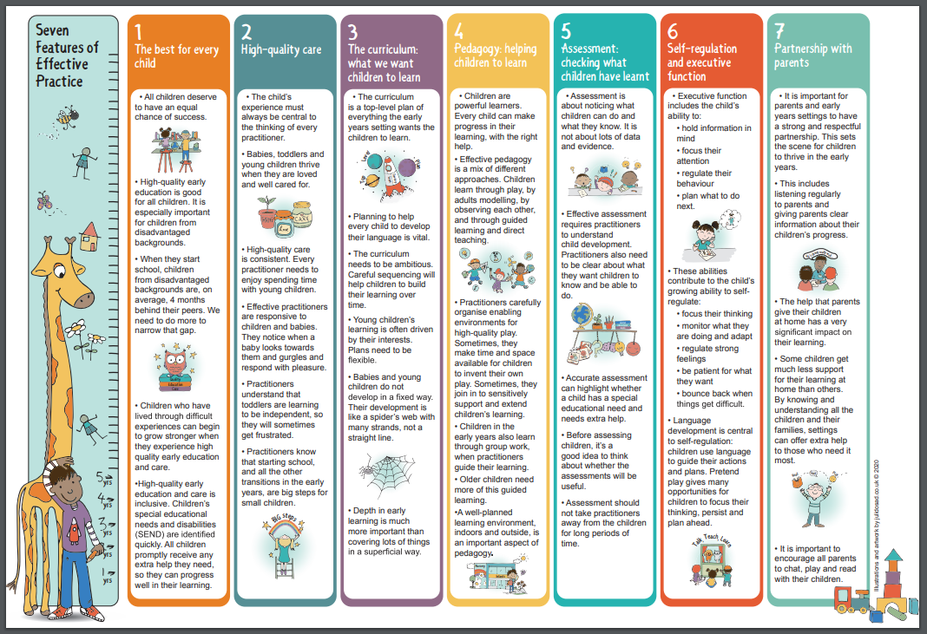
7 Features of Effective Practice
http://development-matters.org.uk/wp-content/uploads/2020/10/Working-with-the-revised-Early-Years-Foundation-Stage-Principles-into-Practice-.pdf page 12 and page 13​

Slide 38
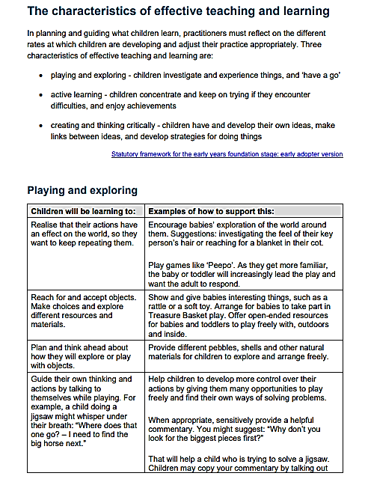
Development Matters
Characteristics of Effective Teaching and Learning
Three characteristics of effective teaching and learning
Playing and exploring - children investigate and experience things, and ‘have a go’
Active learning - children concentrate and keep on trying if they encounter difficulties, and enjoy achievements
Creating and thinking critically - children have and develop their own ideas, make links between ideas, and develop strategies for doing things

Slide 39
Development Matters
Communication and Language Focus

Slide 40
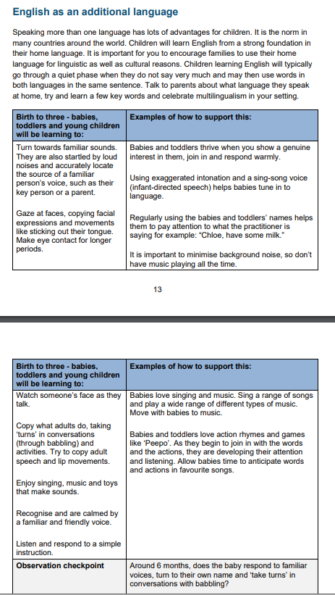
Development Matters
English as an Additional Language
Speaking more than one language has lots of advantages for children. It is the norm in many countries around the world.
Children will learn English from a strong foundation in their home language. It is important for you to encourage families to use their home language for linguistic as well as cultural reasons.
Children learning English will typically go through a quiet phase when they do not say very much and may then use words in both languages in the same sentence.
Talk to parents about what language they speak at home, try and learn a few key words and celebrate multilingualism in your setting.

Slide 41
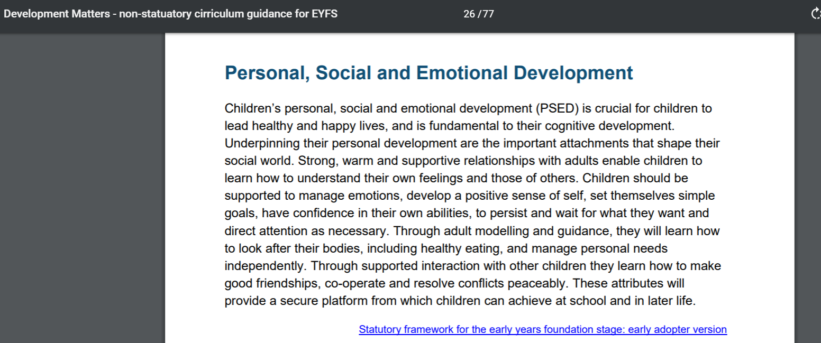
Educational Programmes
Located in Statutory Framework and Development Matters.
These outline the learning that should be covered within the curriculum
Educational programmes must involve activities and experiences for children, as set out under each of the areas of learning

Slide 42
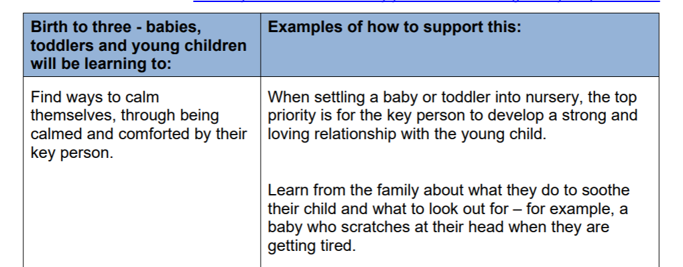
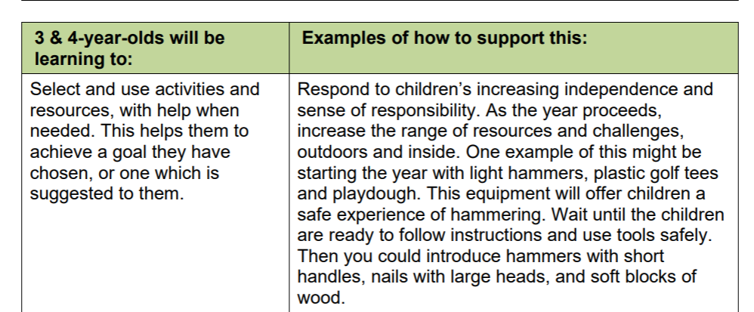
Development Matters 2020
Each of the 7 areas of learning are organised into 3 sections:
Birth to 3
3 and 4 year olds
Children in reception
Observation Checkpoints:
Identifies typical milestone indicators
Supports holistic picture of a child’s progress
Assessment:
Children are either ‘on track’ or ‘not on track’
Knowledge of what children know and can do
Secure understanding of child development supports the child to reach their full potential
Development Matters is not a curriculum or an assessment check list

Slide 43
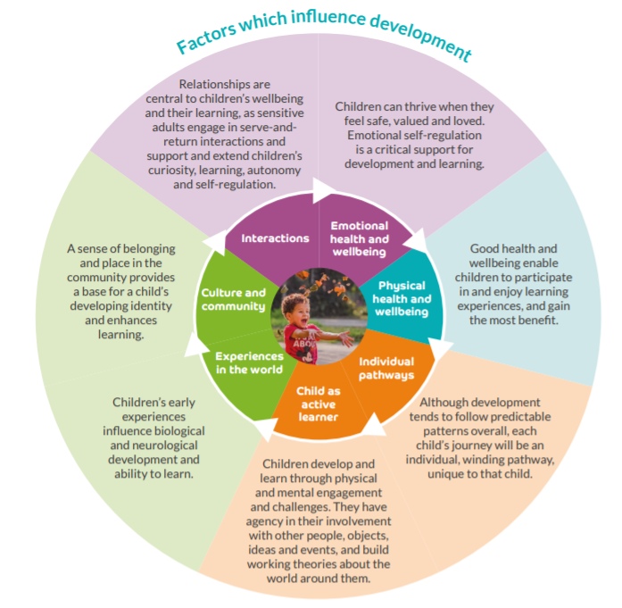
Birth to 5 Matters
Guidance to support children’s progress towards all of the Early Learning Goals.
Rooted in child development to support children’s progress
Set out in developmental ‘phases’ rather than age bands
Includes the 4 key principles of the EYFS.
Promotes inclusion, play, care and the importance of the role of the adult.
Can be used alongside Development Matters to support a holistic view of the child
Tool to support the development of curriculum and pedagogy

Slide 44
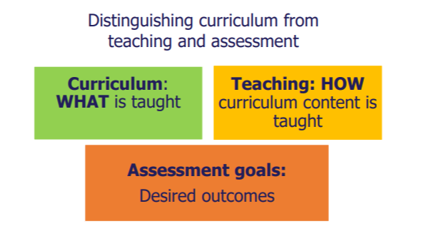
Ofsted
Ofsted evaluates the overall quality and standards of provision.
This is unchanged, but there is a greater emphasis on the curriculum
Leaders and teachers should be able to articulate:
What the curriculum is and what shaped its design
What the children are learning, not what they are doing
What the impact of the curriculum is on the children’s progress
What children know and can do
A robust knowledge of child development

Slide 45
In summary
Starting points: 4 principles and effective practice section
7 areas of learning and development in the EYFS with 7 Educational Programmes which outline what children must be taught
The early years foundation stage profile is an assessment at the end of reception against the 7 areas of learning and development. It is organised into smaller sub sections called 'aspects'
Reception Baseline Assessment: - the beginning of the reception year
Characteristics of Effective Learning: 'learning behaviours' which focus on how children learn at this age
Leaders and practitioners determine the content of the curriculum to meet the content of the educational programmes
Clear focus on the development of language and communication and practitioner interaction
Assessment should be proportionate and consider what type of assessments will inform teaching ?
Development Matters is a non-statutory guide to support curriculum design and aid assessment, not determine what is assessed

Slide 46
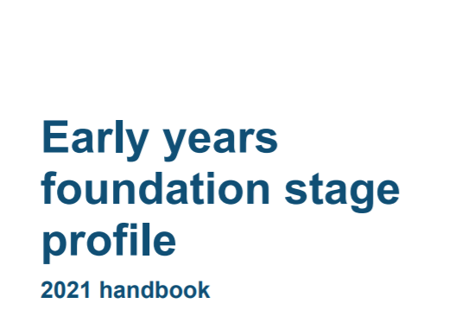
Recommended Reading
Recommended Reading

Slide 47
Any Questions?

Slide 48
Thank you for attending

