Slide 1



National and local energy policy: challenges and technologies for SMEs
18th November 2021
Dr Jonathan Radcliffe, University of Birmingham
Reader in Energy Systems and Innovation
IGI Resilient Cities theme lead
j.radcliffe@bham.ac.uk
@UKEnergyInnov8

Slide 2
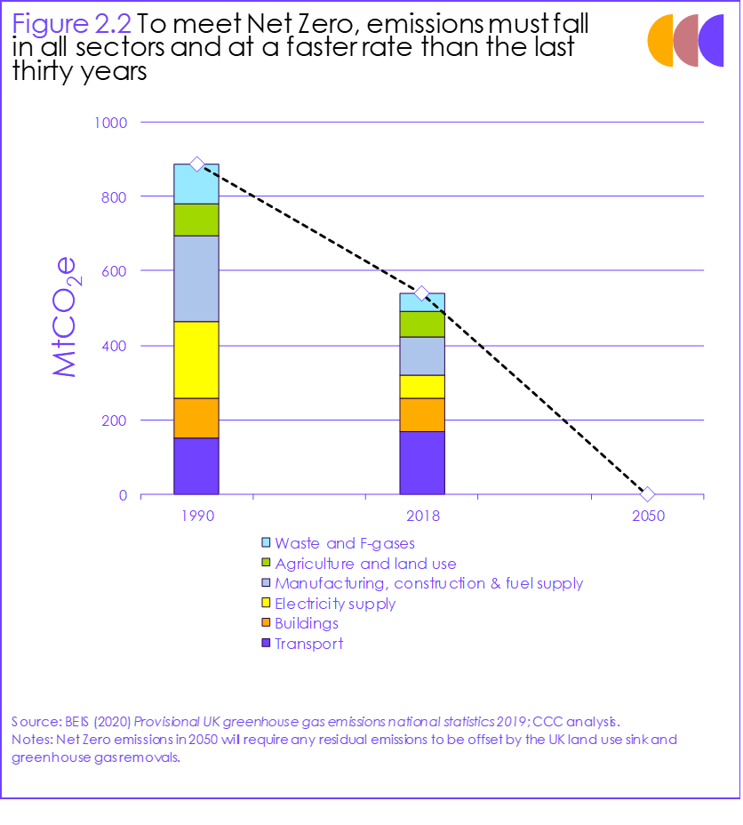
Outline
How the policy environment is having an impact on energy use by SMEs…
Energy system context: global and national scenarios for net zero
National policy: strategies and targets
Local solutions: industrial decarbonisation

Slide 3
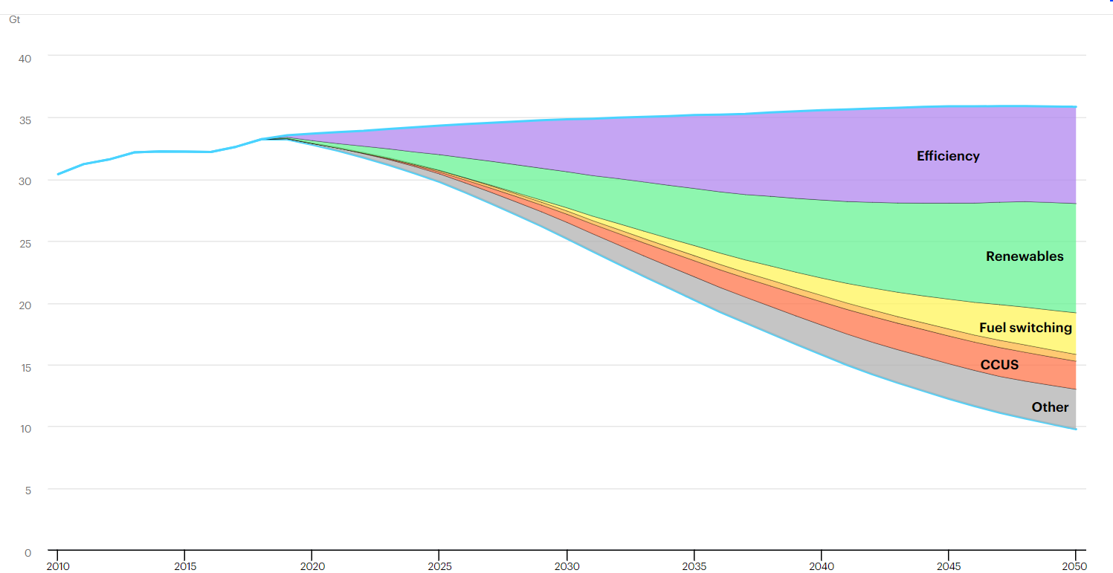
1. Energy system context
International Energy Agency, World Energy Outlook 2019:
“Additional energy efficiency improvements are the biggest factor that keeps final consumption in end-use sectors in the Sustainable Development Scenario below the levels seen in the Stated Policies Scenario, responsible for 60% of the savings.”
https://www.iea.org/reports/world-energy-outlook-2019/energy-efficiency#abstract

Slide 4
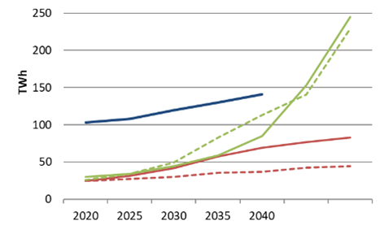
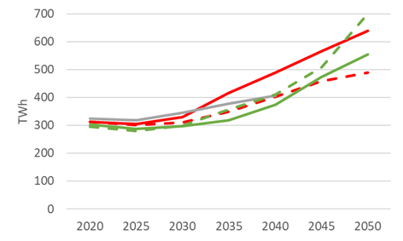
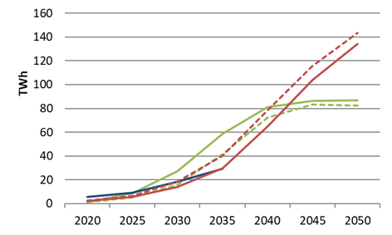
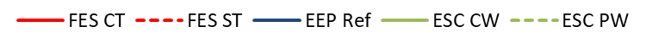
UK Net zero scenarios – demand side
Demand for electricity will increase, to provide power, transport and heat
Heating/cooling
Total electrical demand
Transport
Scenario data from National Grid ‘Future Energy Scenarios 2020’; ES Catapult, ‘Innovating to Net Zero’ (2020), BEIS, ‘Energy and emissions projections’ (2020)

Slide 5
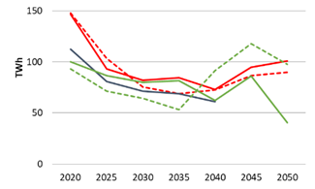
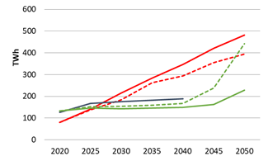
UK Net zero scenarios – supply side
Flexible generation
Wind + solar
Scenario data from National Grid ‘Future Energy Scenarios 2020’; ES Catapult, ‘Innovating to Net Zero’ (2020), BEIS, ‘Energy and emissions projections’ (2020)

Slide 6
Growing need for flexibility, reliability and resilience
Timescale | Challenge
Seconds | Renewable generation introduces harmonics and affects power supply quality. Reduced inertia from less rotating machinery.
Minutes | Rapid ramping to respond to changing supply (wind, PV) and demand (EVs, HPs).
Hours | Increasing daily peak in electricity demand for heat and EVs.
Hours - days | Variability of weather affecting wind and PV generation.
Months | Increased use of electricity for heat leads to strong seasonal demand profile. Seasonal variability affecting wind and PV generation.

Slide 7
2. National policy landscape for net zero
2019: Legislated net-zero by 2050
  https://commonslibrary.parliament.uk/research-briefings/cbp-8590/
2021: 6th Carbon Budget put into law, committing to 78% reduction on 1990 levels by 2035
  https://www.gov.uk/government/news/uk-enshrines-new-target-in-law-to-slash-emissions-by-78-by-2035
PM’s 10 Point Plan for a green industrial revolution, 2020, and subsequent strategies…
  https://www.gov.uk/government/publications/the-ten-point-plan-for-a-green-industrial-revolution/title
1: Advancing offshore wind | 6: Jet zero and green ships
2: Driving the growth of low carbon hydrogen | 7: Greener buildings
3: Delivering new and advanced nuclear power | 8: Investing in carbon capture, usage and storage
4: Accelerating the shift to zero emission vehicles | 9: Protecting our natural environment
5: Green public transport, cycling and walking | 10: Green finance and innovation

Slide 8
The policy landscape, 1/3
Energy White Paper: how transformation of energy system can drive economic growth and jobs, whilst reducing emissions
  December 2020: https://www.gov.uk/government/publications/energy-white-paper-powering-our-net-zero-future
Further strategies on:
National Infrastructure Strategy focus on decarbonising our infrastructure networks and levelling up the economy, as well as supporting private finance and accelerating infrastructure delivery through project Speed
  Nov 2020: https://www.gov.uk/government/publications/national-infrastructure-strategy
  Comment: https://www.rtpi.org.uk/policy/2020/december/rtpi-comments-on-the-national-infrastructure-strategy-and-updated-green-book/
England Tree Strategy: long-term vision for trees, woodlands and forestry in England
  Strategy expected spring 2021, how trees and woodlands can connect people to nature https://consult.defra.gov.uk/forestry/england-tree-strategy/
Transport Decarbonisation Plan: “a world-leading ‘greenprint’ to cut emissions from our seas and skies, roads and railways, setting out a credible pathway for the whole transport sector to reach net zero by 2050”, phasing-out all petrol and diesel by 2035/2040
  July 2021: https://www.gov.uk/government/publications/transport-decarbonisation-plan
  CCC response: https://www.theccc.org.uk/2021/07/14/ccc-responds-to-governments-transport-decarbonisation-plan/

Slide 9
The policy landscape, 2/3
Industrial Decarbonisation Strategy: how the low carbon transition can support industrial competitiveness and the green recovery
  Published March 2021: https://www.gov.uk/government/publications/industrial-decarbonisation-strategy
  Comment: https://www.pinsentmasons.com/out-law/news/world-first-industrial-decarbonisation-strategy-developed-uk; https://www.cbi.org.uk/articles/government-published-the-industrial-decarbonisation-strategy/
Net Zero Strategy: Build Back Greener: decarbonisation pathways to net zero by 2050, including illustrative scenarios policies and proposals to reduce emissions for each sector cross-cutting action to support the transition; submitted to the UNFCCC as the UK’s second Long-Term Low Greenhouse Gas Emission Development Strategy under the Paris Agreement.
  October 2021: https://www.gov.uk/government/publications/net-zero-strategy
  Comment: https://www.carbonbrief.org/in-depth-qa-the-uks-net-zero-strategy
Heat & Buildings Strategy: plan to significantly cut carbon emissions from the UK’s 30 million homes and workplaces in a simple, low-cost and green way whilst ensuring this remains affordable and fair for households across the country […] this will be a gradual transition which will start by incentivizing consumers and driving down costs.
  October 2021: https://www.gov.uk/government/publications/heat-and-buildings-strategy
  Draft in Scotland for consultation: https://www.gov.scot/publications/heat-buildings-strategy-achieving-net-zero-emissions-scotlands-buildings-consultation/

Slide 10
The policy landscape, 3/3
Hydrogen Strategy: sets out the approach to developing a thriving low carbon hydrogen sector in the UK to meet our ambition for 5GW of low carbon hydrogen production capacity by 2030
  August 2021: https://www.gov.uk/government/publications/uk-hydrogen-strategy
HMT Net Zero Review: how the transition to net zero will be funded and where the costs will fall, helping ensure an equitable balance of contributions between households, businesses and taxpayers.
  October 2021: https://www.gov.uk/government/publications/net-zero-review-final-report
  Comment: https://www.instituteforgovernment.org.uk/blog/treasury-net-zero-review
Bioenergy Strategy expected in 2022
Key point: lots of plans and strategies, sometimes lacking detail on implementation

Slide 11
How it’s going
Announced ambition for electric cars and vans, offshore wind, low-carbon hydrogen production, industrial decarbonisation to 2030 (but not to 2035) and tree planting to 2025 is broadly in line with the Committee’s scenarios
But notable overall shortfall with gaps in policy and strategy, particularly on the demand side
CCC, Progress report (2021)

Slide 12
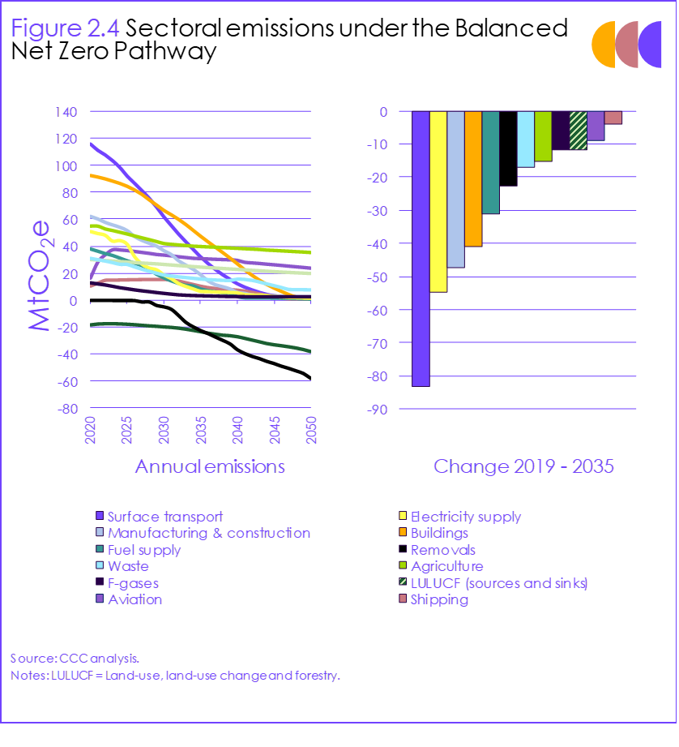
Where it needs to happen
Top 5 reductions by 2035 in
Surface transport: phase-out new fossil fuel cars and vans sales by 2032
Electricity supply: 70% variable renewables (wind + PV), up from 31% in 2020.
Manufacturing and construction
Buildings: phase-out new sales of gas boilers by 2033, oil by 2028
Fuel supply: phase-out coal
CCC, 6th Carbon Budget report (2020)

Slide 13
3. Local solutions
Smart Local Energy System (SLES)
Smaller scale, decentralised energy systems utilising smart technologies can be delivered at a local level to offer a route to Net Zero, while providing considerable market opportunities associated with the transition.
Funding through Industrial Strategy Challenge Fund: Prospering from the Energy Revolution (PFER)
Demonstrators in Oxford, Orkney, Oxfordshire
https://www.ukri.org/our-work/our-main-funds/industrial-strategy-challenge-fund/clean-growth/prospering-from-the-energy-revolution-challenge/
EnergyREV: international academic programme to identify evidence to inform change https://www.energyrev.org.uk/
Energy Revolution Integration Service (ERIS) promotes the social and economic benefits of smart local energy systems, sharing knowledge, opportunities and networking with key stakeholders https://es.catapult.org.uk/service-platforms/energy-revolution-integration-service/

Slide 14
Local policy making
>300 LAs have declared a Climate Emergency and others are taking strong action without declaring an emergency
e.g. Sandwell Council, has a target of “net zero carbon emissions for the Council in 2030 and for the whole of the Borough in 2041 (in line with the West Midlands Combined Authority target).”
Sandwell Metropolitan Borough Council (2020) ‘Climate Change Strategy 2020 – 2041’ https://www.sandwell.gov.uk/downloads/file/31151/climate_change_strategy
But limited levers…
CCC (2020) Local Authorities and the Sixth Carbon Budget
https://www.theccc.org.uk/publication/local-authorities-and-the-sixth-carbon-budget/

Slide 15
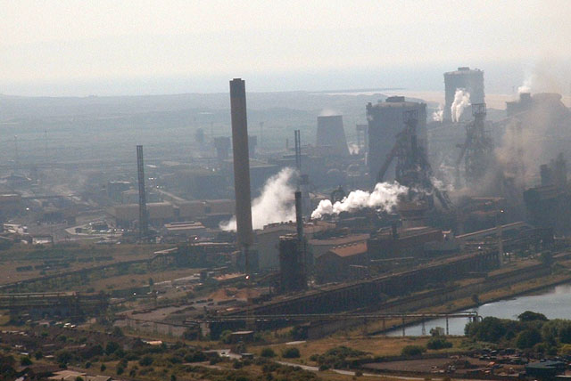
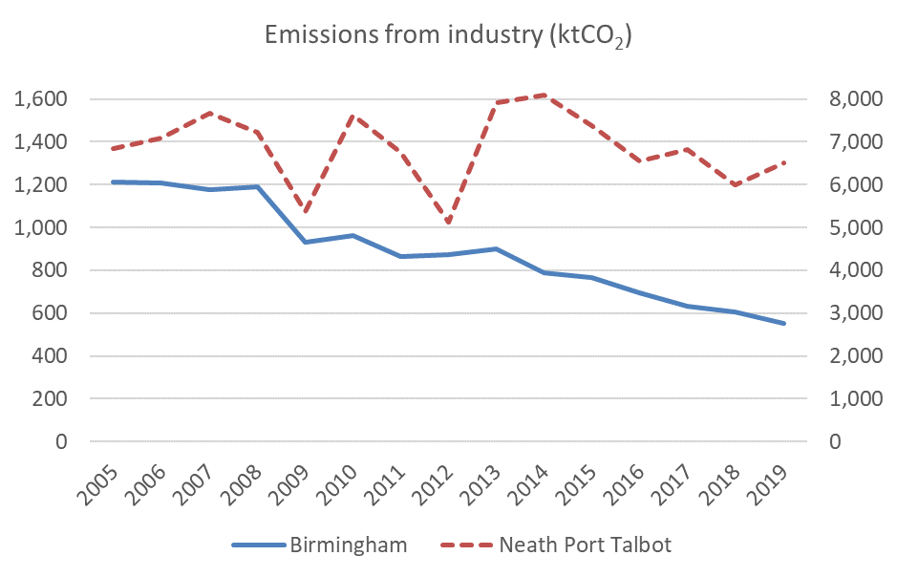
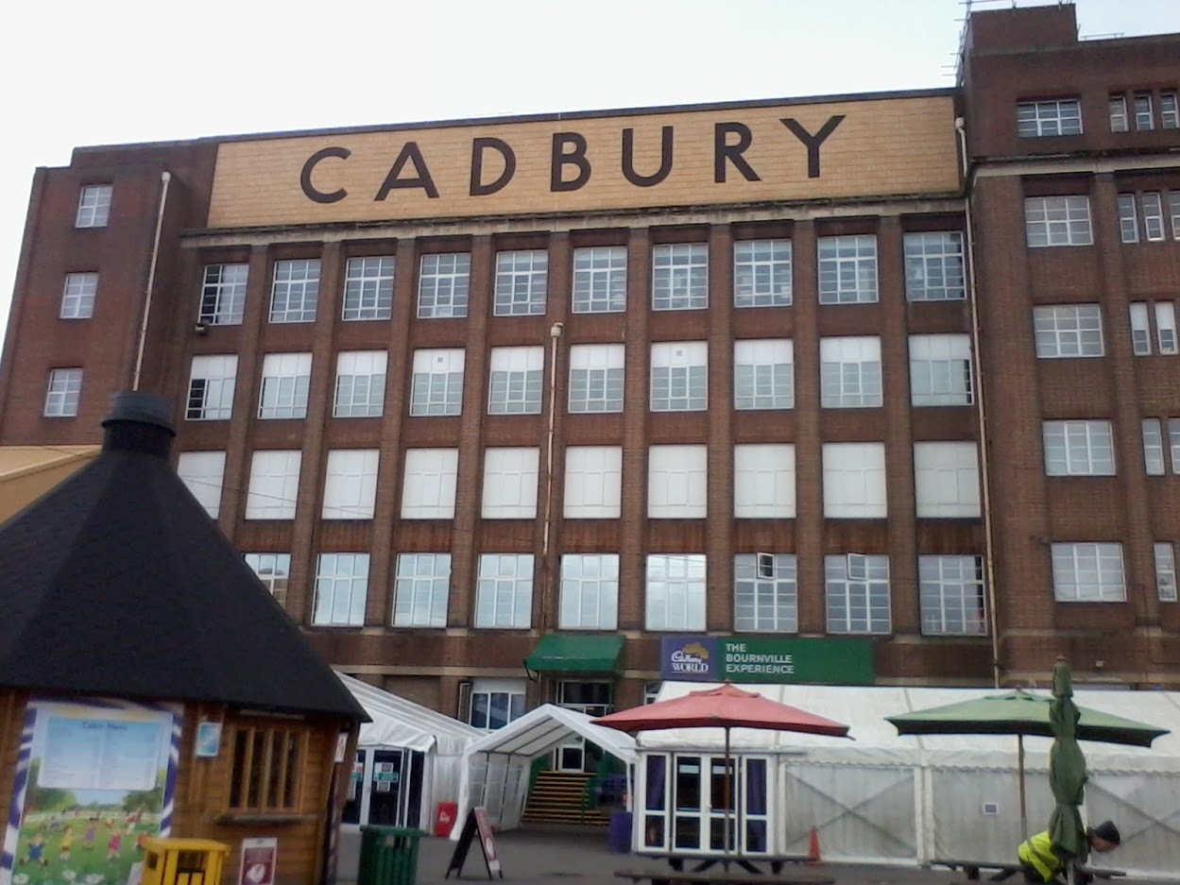
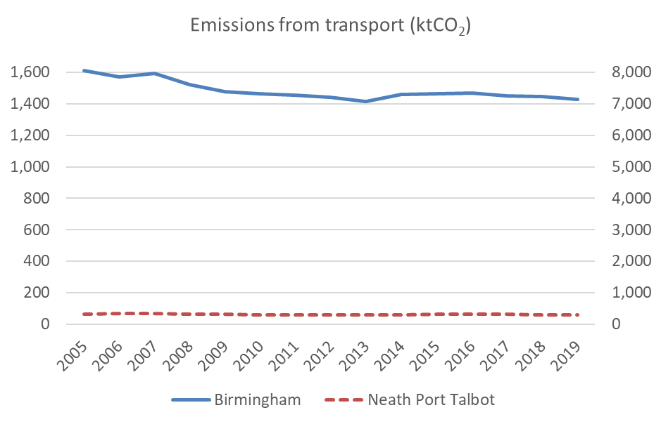
Local context is critical
Diversity in local emissions mostly driven by economic factors.
https://www.bbc.co.uk/news/uk-england-59170215
Innovate UK project, Repowering the Black Country, is developing ‘Zero Carbon Hubs’ to decarbonise local businesses and industry.
https://zerocarbonhubs.co.uk/
Chris Shaw / Port Talbot Steelworks

Slide 16
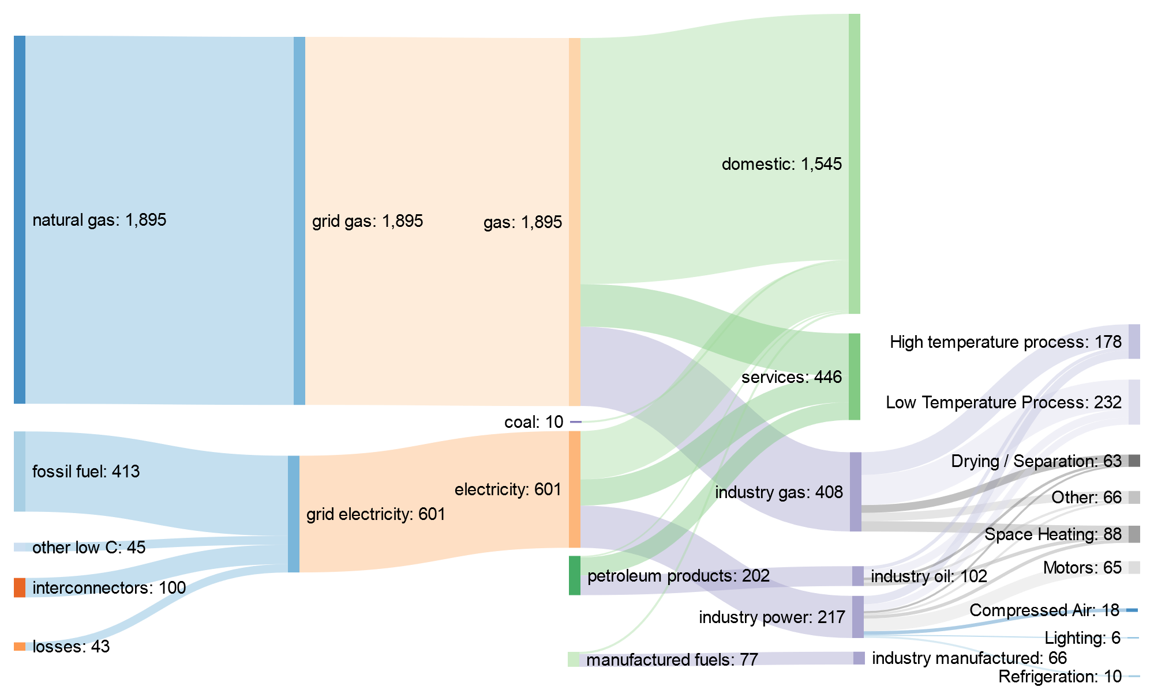
Local industrial decarbonisation
Linking national and local scales with Sankey diagrams: showing significant industrial end-use in the Black Country and sources of centralised production.
Flows of carbon (ktCO2) in the Black Country (2019)

Slide 17
Options for local industrial decarbonisation
The analysis above shows which processes using natural gas, which will be difficult to decarbonise otherwise, should be targeted by local interventions.
Some general options for decarbonising industry in the Black Country:
Local H2 production, using small-scale technologies (waste to gas, electrolysis), to decarbonise heating
More efficient processes, including use of storage to avoid wasted heat
Smart systems, with local hubs optimising energy supply and demand in an integrated approach, considering the whole system
The analysis framework could be applied in other areas to identify opportunities and scale-up solutions.
We will explore the wider impacts of interventions considering a local energy trilemma:
Carbon/environment: through emissions of GHGs (and other pollutants)
Security: improving the diversity and resilience of the local energy system
Economy: retaining value of industry in the local area

Slide 18

Thank you
to colleagues in Energy Systems and Policy Analysis group:
Dr Amruta Joshi
PhD student: Laurie Duncan
Antzela Fivga, Project Manager Supergen Energy Storage Network+
EPSRC
Supergen Storage Network Plus EP/S032622/1 https://supergenstorage.org/
j.radcliffe@bham.ac.uk
@UKEnergyInnov8
https://www.birmingham.ac.uk/ESPAG

