Slide 1


Forced Marriage and
Honour Based Abuse
Presented by:
Mandy Samra – Forced Marriage and Honour Based DA Practitioner
Ameera Jamil- Tackling Harassment & Hate Caseworker

Slide 2
Agenda
Difference between Forced and Arranged Marriage
Types of Abuse
Forced Marriage in different Countries and Cultures
Legislation on Force Marriage
What is Honour Based Abuse?
Different types of Honour Based Abuse
Key Facts and Figures & Stats
Motivation for Honour Based Abuse
Videos
Help and Support available
Notes:
Come back to slide at the end

Slide 3
What is the difference between a Forced Marriage and an Arranged Marriage?
A Forced Marriage is where one or both participants enter the marriage without giving their consent.
An Arranged Marriage is where both participants give their full consent and enter the marriage willingly.
Notes:
Grey area- when a marriage can begin as arranged and when consent from one/both parties is withdrawn, can end up being an FM.
Mental capacity.

Slide 4

Different types of Abuse
Coercive Control
Physical Violence
Sexual Violence
Emotional and Mental
Psychological
Spiritual
Online and Digital
Honour
Economical
Stalking and Harassment
Financial Abuse

Slide 5
Since 2011, the FMU has handled cases relating to countries across Asia, the Middle East, Africa, Europe and North America.
Women from Black Asian, minority ethnic and refugee backgrounds are at an increased risk of specific forms of domestic abuse such as honour-based violence and forced marriage.
In 2019, the FMU handled cases relating to 66 ‘focus countries’ , excluding the UK. The seven ‘focus countries’ with the highest number of cases in 2019 were:
Forced Marriage is not a problem specific to one country or culture
Pakistan - 559 cases (41%)
Bangladesh - 144 cases (11%)
India - 65 cases (5%)
Afghanistan - 54 cases (4%)
Somalia - 31 cases (2%)
Iraq - 23 cases (2%)
Romania - 22 cases (2%)
Source: Forced Marriage Unit Statistics 2019, Home Office, Foreign & Commonwealth Officer, June 2020. These statistics represent only the cases that have been reported to the FMU. Forced marriage is a hidden crime, and these figures will not reflect the full scale of the abuse.
Notes:
Gypsy – Roma – travelers- HBA prevalent

Slide 6
Legislation on Forced Marriage
The Anti-social behavior crime and policing Act 2014 made it a criminal offence to force someone to marry in the UK.
This includes taking someone abroad and marrying someone who lacks capacity.
Forcing someone to marry can result in a sentence of up to 7 years in prison.
Breaching the terms of a forced Marriage Protection Order, imposed under the family act 1996, can result in a sentence of up to 5 years in prison.
Notes:
Form can be filled in – family – Rights of Women – internal legal departments- gov.uk info- Coventry specific?

Slide 7
Identifying warning signs
Education
Employment
Health
Family History
Police Involvement

Slide 8
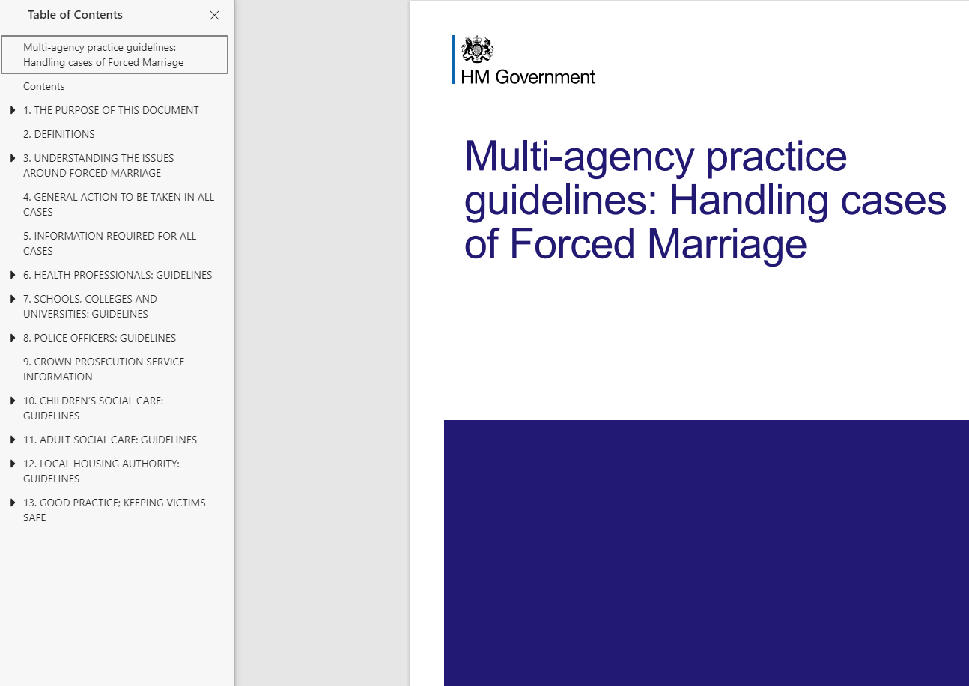

Slide 9
What is Honour-Based Abuse?
Any crime or incident which may have been committed to protect or defend the honour of the family or community.

Slide 10

Different types of Honour-Based Abuse
Physical
Psychological
Emotional
Denial
Threats to kill
Abandonment/Disownment
Social rejection
Isolation
Forced Marriage
Sexual violence
Honour Killings
Notes:
?

Slide 11
Key Facts and Figures
53% rise in honour-based abuse cases reported to the police since the criminalization of forced marriage
Research suggests that at least one ‘honour’-killing takes place in the UK every month & this is likely to be an underestimate
Source: IKWRO, 2017. Safe Lives, 2017, Spotlight Report #HiddenVictims Your Choice:‘honour’-based violence, forced marriage and domestic abuse

Slide 12
WM/Panahghar Stats
Supported 169 out of 230 FM & HBA cases
(April 2021 – 19 Nov 21)
Notes:
National stat from KM

Slide 13
The facts and motivation for Forced Marriage and Honour Based Abuse
Controlling unwanted behaviours
Stopping unsuitable relationship from forming
Listening and being pressured by peer groups, extended families, communities
Protecting family honour (izzat)
Attempting to strengthen family links, alliances and bonds; UK & Abroad
Financial gain
Ensuring land, property and wealth remains within the family
Protecting tradition, religion and culture, values and morals
Not expecting LGBTQi
Loss of virginity outside marriage
History of BME communities importance on marriage and preparation through life and childhood to obtain honour.
Religion and Culture are separate, but honour can be linked to both

Slide 14
Roles of Professionals/Organisations
Sound understanding when working with cases linked to Forced Marriage and Honour Based Abuse
More specialised information to be made visible and reachable – leaflets in different languages
The use of appropriate language and questioning techniques
Be confident to challenge despite cultural sensitivities
Provide an excellent and independent interpretation service- do not use family/community members
Build up trust – consistency, empathy, non-judgmental approach, be available, flexible, listen, support, referral to other agencies
Empower and take a victim-focused approach
Train and educate your peers/staff on how to handle cases in accordance with statutory guidelines
Equip potential victims with information on where to seek support by raising awareness
Signs/symptoms & warnings – CONSIDER, CONTACT, CONSULT
Safety Planning
Refer to specialist DA services or supporting agencies

Slide 15
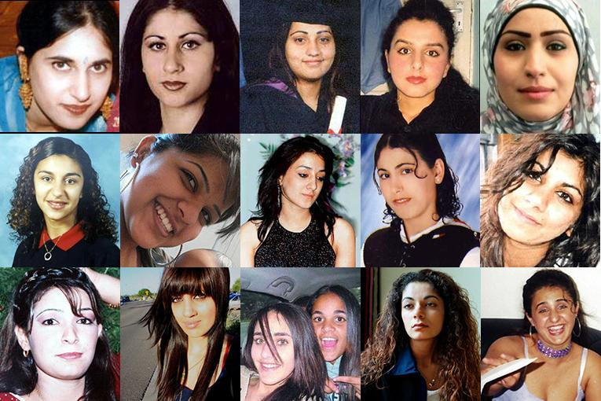
#WeRemember
Notes:
National DOM July 14th

Slide 16
Forced Marriage
Right to choose: Spotting the signs of forced marriage - Nayana – YouTube
Banaz Mahmod – YouTube – police interview (short clip)
Murdered By My Family | Banaz: An Honour Killing (Crime Documentary) | Real Stories – YouTube – full crime documentary
Land Gold Women Trailer – YouTube – film about HBA
Killer in My Village🙏Series 4 Episode 1 Jessica Patel Middlesbrough🙏Crime Documentaries – YouTube – recent case
A survivor’s plea to end child marriage | Payzee Mahmod | TEDxLondonWomen - YouTube

Slide 17
Support and Help
West Midlands FM and HBA Helpline
0800 953 9777
Forced Marriage Unit/British Embassy
No recourse victims/legal advice
Airport security- ‘spoon in underwear’ rule
Protection Orders
(FMPO)
Tell someone you trust
Safety Plan
Copies of passport and travel documents
Panaghar/other DA charities
Safe to Talk Helpline
The Police
Karma Nirvana helpline 0800 5999 247
Notes:
Police-trained officers- risk assessment specific to FM/HBA

Slide 18



Contacting Panahghar directly
Panahghar Direct: 0800 055 6519
Open 24 hours a day, 7 days a week
www.safehouse.org.uk
besafe@safehouse.org.uk
@panahghar
@panahghar

Slide 19
Contact information:
Mandy – mandip.s@safehouse.org.uk
Ameera- ad7648@coventry.ac.uk

