Slide 1





Using the GBP to become greener and reduce costs
Mark Dufty, Managing Director, GoodFlex Rubber

Slide 2
ABOUT THE
COMPANY
Goodflex Rubber Company is a global manufacturer and supplier of bespoke rubber hoses, mouldings & assemblies that perform for the entire product service life. The company commenced trading in 2002 and has recently re-located to a significantly larger manufacturing facility in Alcester.
The re-location has now provided Goodflex with the necessary resources to enable us to venture out and seek new opportunities whether this be through acquisitions or organic growth, while at the same time reducing our carbon footprint.

Slide 3

Working with the GBP will enable us to cut our CO₂ emissions by nearly 134 tonnes per year
Notes:
Please can you discuss during this slide how you found out about the GBP and why you had decided to apply?
We discovered the Green Business Programme through our engagement with the Coventry & Warwickshire Growth Hub and Jim Clark
We were considering a project to move our operations base to a larger facility and were keen to take the opportunity, if possible, to improve the building’s efficiency before moving in. This is both in terms of financial efficiency and minimising our impact on the environment.
The level of investment required at the time of moving was bringing into question the whole project, however the support afforded by the Green Business Programme enabled us to make these investments before we took occupation. Doing it this way ensured the installation cost of the improvements was as low as possible as there was no operational business in place to work around.

Slide 4
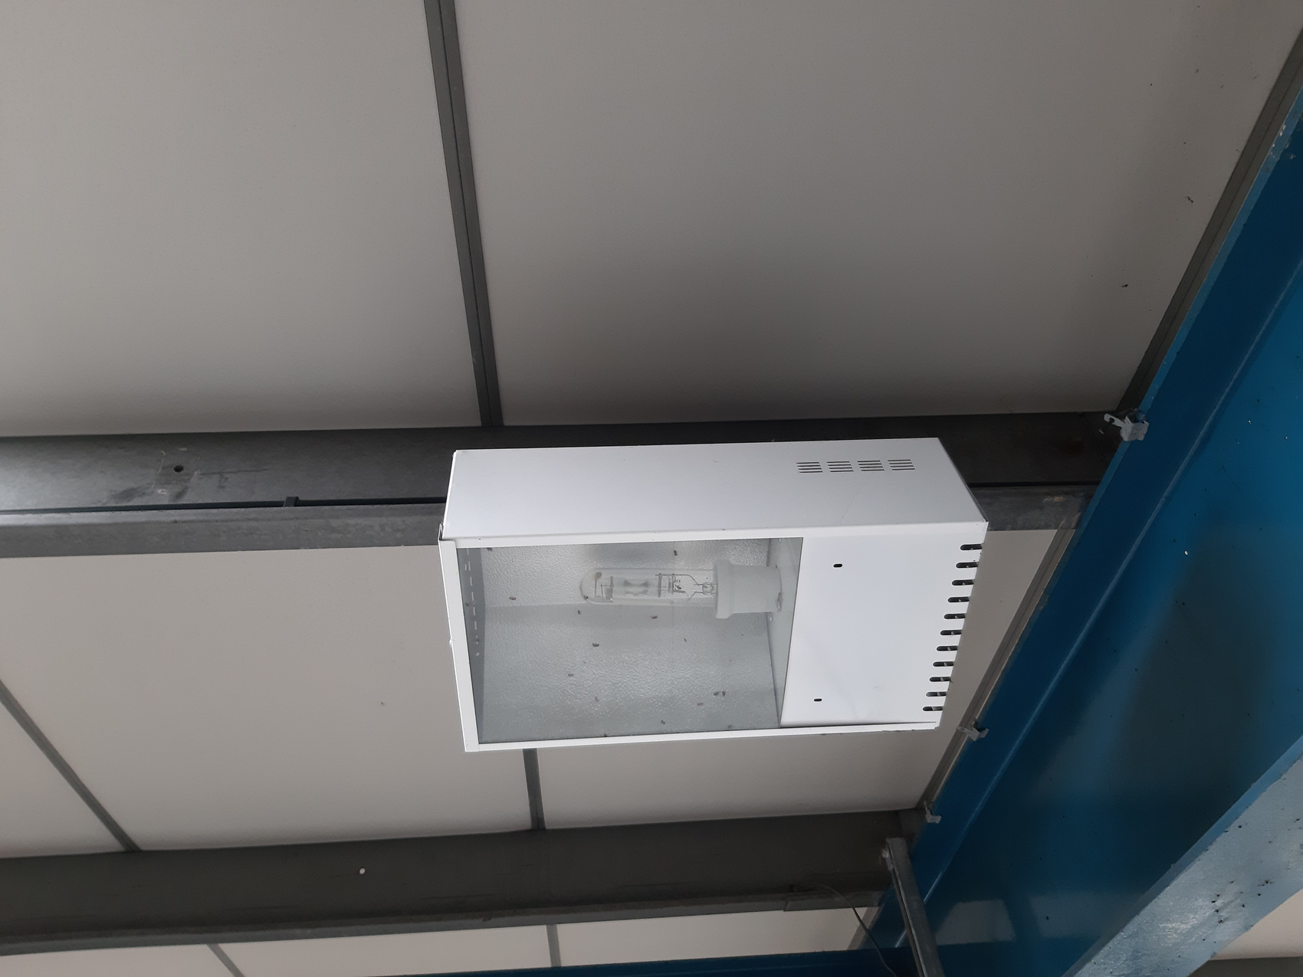
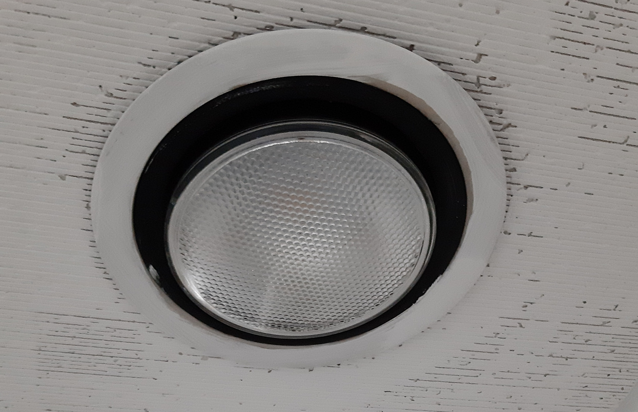
IMPROVEMENTS MADE
Replacement of 72 metal halide light fittings in the factory with new intelligent LED fittings.
Replacement of fluorescent lighting units in the office and reception areas with LED fittings.
Installation of destratification fans in the factory to help heat retention.

Slide 5
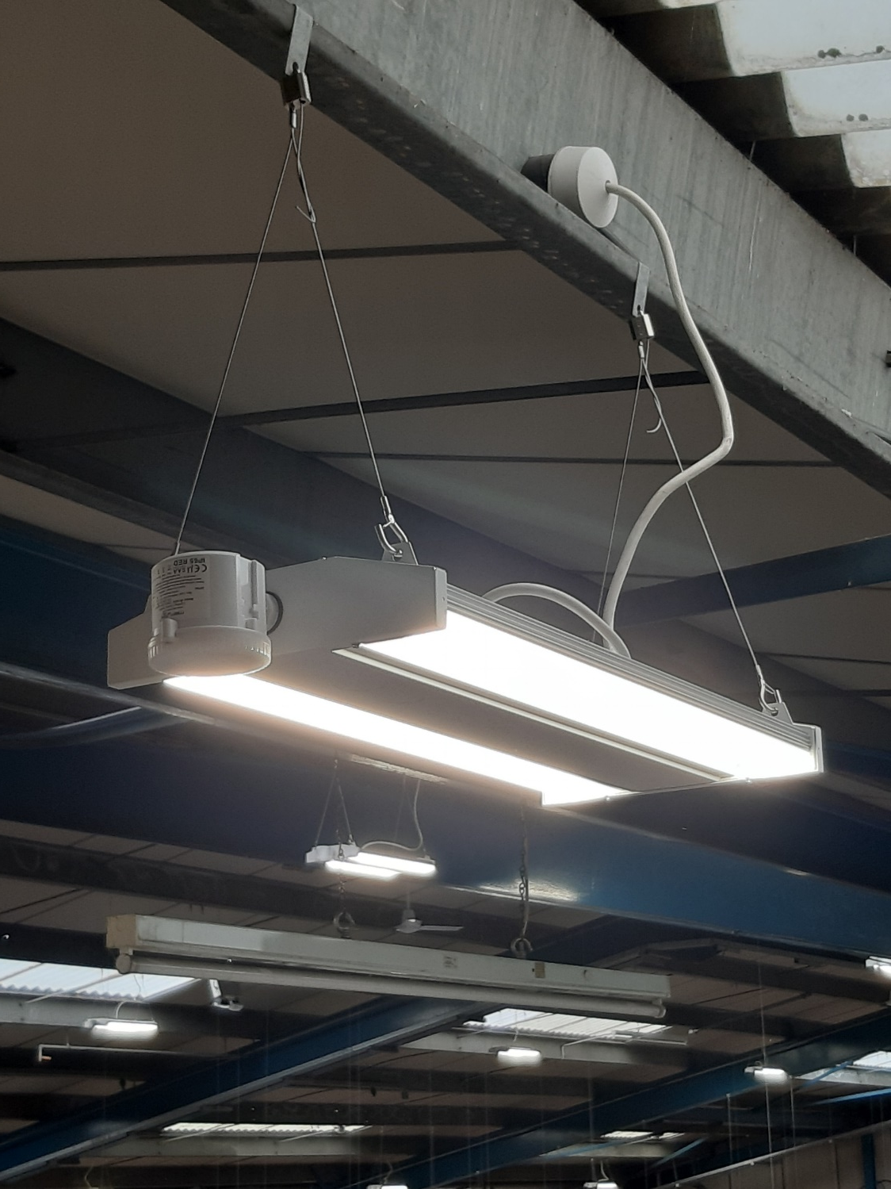
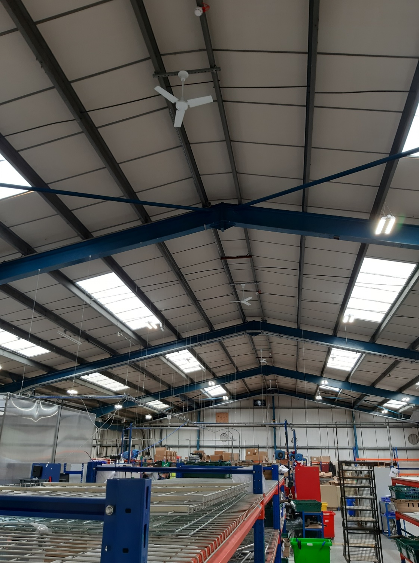
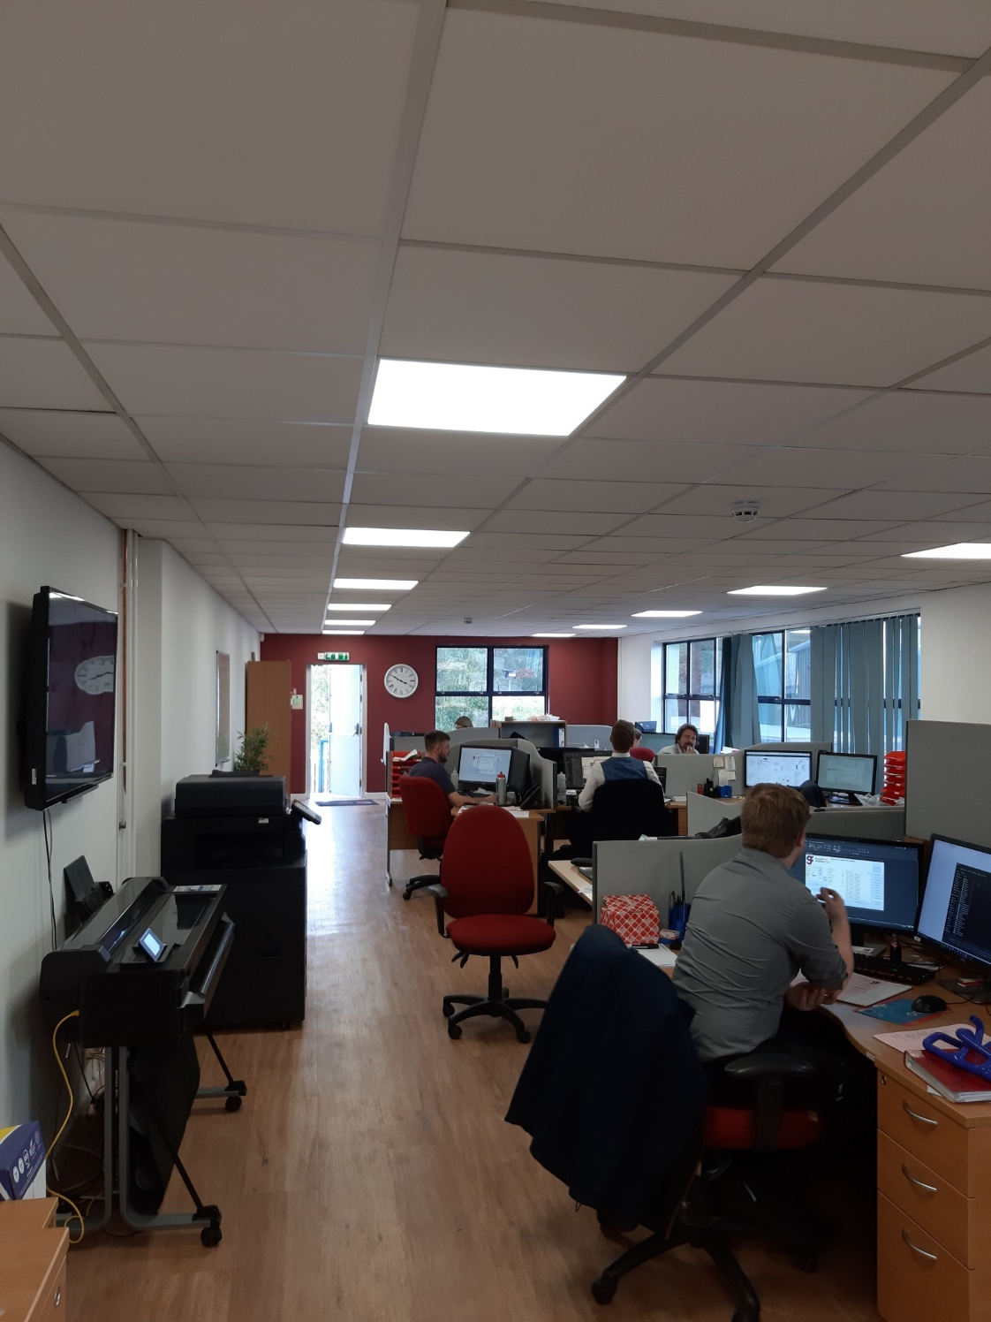

Slide 6


Annual cost saving = £11,577
Carbon saving = 35.41 tonnes / year
Notes:
Can you please talk about how this savings help your business and perhaps how you are planning to reinvest them
Energy prices are the talk of every business right now, with the increases being especially significant for energy-intensive users. Reducing our consumption through these improvements has allowed us to become even more competitive in the global marketplace, and will open up greater opportunities for future investment in additional plant and machinery which in turn will help to keep us at the forefront of innovation in our industry.

Slide 7
IMPROVEMENTS PLANNED
2022
  Complete installation of Heating Ventilation and Air Conditioning systems in the factory, office and reception areas, replacing large oil boilers and provide heating and cooling
  Replacement of an old inefficient air compressor
Annual saving = £14,386
Carbon saving = 98.36 tonnes / year
Notes:
Can you please discuss why these savings were important for your business and if you are happy to discuss how you are planning to reinvest this savings. Also it would be great if you could talk about if cutting down your carbon footprint was important for your business
Besides the financial benefits I have already discussed, the reduction in our environmental impact is both ethically and morally the right thing to do. It also has the benefit of enhancing Goodflex Rubber’s reputation as a contentious business that cares.

Slide 8
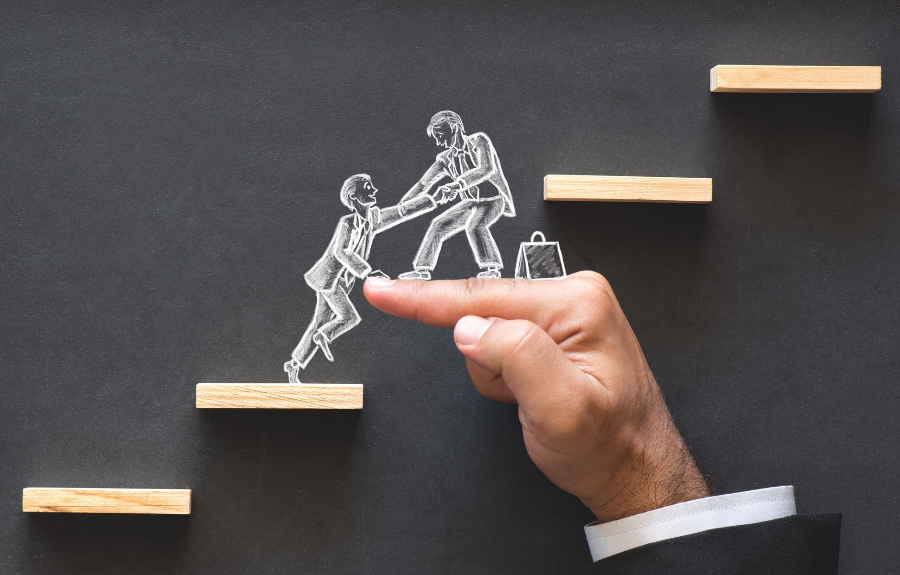
GRANT VALUE
£19,588
PROJECT COST
£48,970
Notes:
Can you please talk in here about the application process, how did you find it, was it easy, was the support offered by the team satisfactory, do you think it took a long time etc
The application process was relatively painless, and was made far easier by the support we received from the Green Business Programme. Our timescales for making the decision whether to move or not were accelerated by the emergence of an opportunity to move into an ideally-suited location, and the response from the team was very helpful. Whilst there is an unavoidable overhead in pulling the application together, the guidance and advice from the team made this as easy as it could be.
In terms of elapsed time, from our initial engagement with the team through to receipt of the grant offer letter took a little under 8 weeks.

Slide 9





WHY WE RECOMMEND OTHER SMES TO WORK WITH GBP
Free energy
audits
Reduce your CO2 footprint
Improve Energy
Efficiency
Support received throughout the process
Cutting down
costs

Slide 10
QUESTIONS WILL BE ANSWERED DURING THE Q&A SESSION
If you would like to contact me, my details are:
Tel. 01386 841480
Email: mark@goodflexrubber.com

