Slide 1
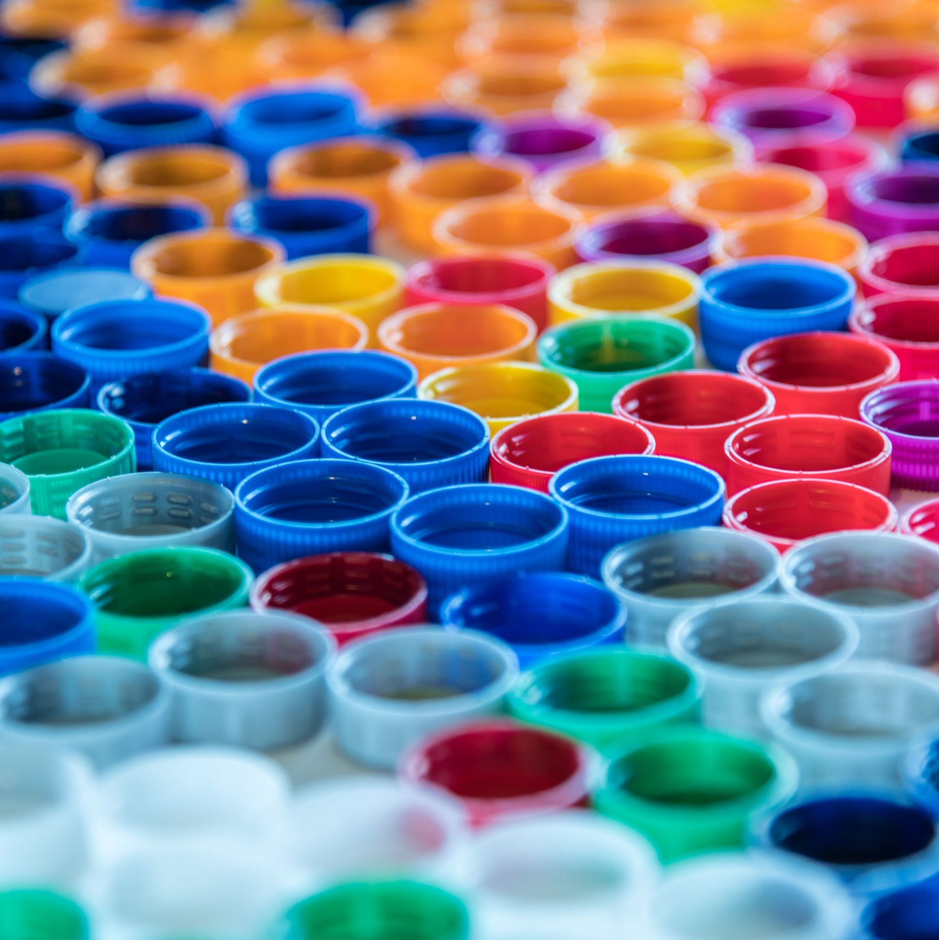
Plastic
Packaging Tax
Charlotte Briggs
Policy and Engagement Lead at Clarity Environmental

Slide 2
Plastic Packaging Tax
April 2022
£200 per tonne, with the de minimis set at 10 tonnes of plastic packaging placed onto the UK market
Particularly falling upon importers and manufacturers of plastic packaging
Intended to galvanise the market for recycled plastic, encouraging development and use of recycled content in packaging

Slide 3
Plastic Packaging definitions
The plastic packaging definition:
“Is a product that is designed to be suitable for use, whether alone or in combination with other products, in the containment, protection, handling, delivery or presentation of goods at any stage in the supply chain of the goods, from the producer of the goods to the consumer or user.”
Examples
Filled and unfilled packaging
Goods that can be used as packaging by consumers e.g. bin bags, plastic cups, sandwich bags
Multi-material packaging will be included where plastic is the majority material by weight

Slide 4
Plastic
Packaging Tax
Definition
Ensure your packaging meets the definition of a packaging component
Plastics included
Plastic includes bioplastics, including biodegradable, compostable and oxo-degradable plastics.
In scope of the tax
Looking at materials in scope can be difficult but key points can help to guide you where the tax point arises.
Multi-materials
The packaging, if made up of plastic predominantly by weight, will be liable and will be subject to the tax for the entire weight of multi-material.
Exemptions
Understand where exemptions lie and if any are applicable to your packaging and supporting evidence for this

Slide 5

Plastic Packaging exempt from the tax
Used in aircraft, ship and rail goods stores.
Immediate packaging of medicinal products
Designated for use other than packaging
Transport packaging on imported goods

Slide 6
Plastic Packaging
Registration
Meeting the de minimis
If you have manufactured or imported more than 10 tonnes of finished plastic packaging in the UK within the last 12 months or will do so in the next 30 days. This will be FROM April 1st 2022
Falling below the threshold
If you fall below the threshold you should maintain records to demonstrate this
Best practice
If you do not meet the de minimis from the previous 12 months but may go over, you should be checking how much finished plastic packaging you import or manufacture each month

Slide 7
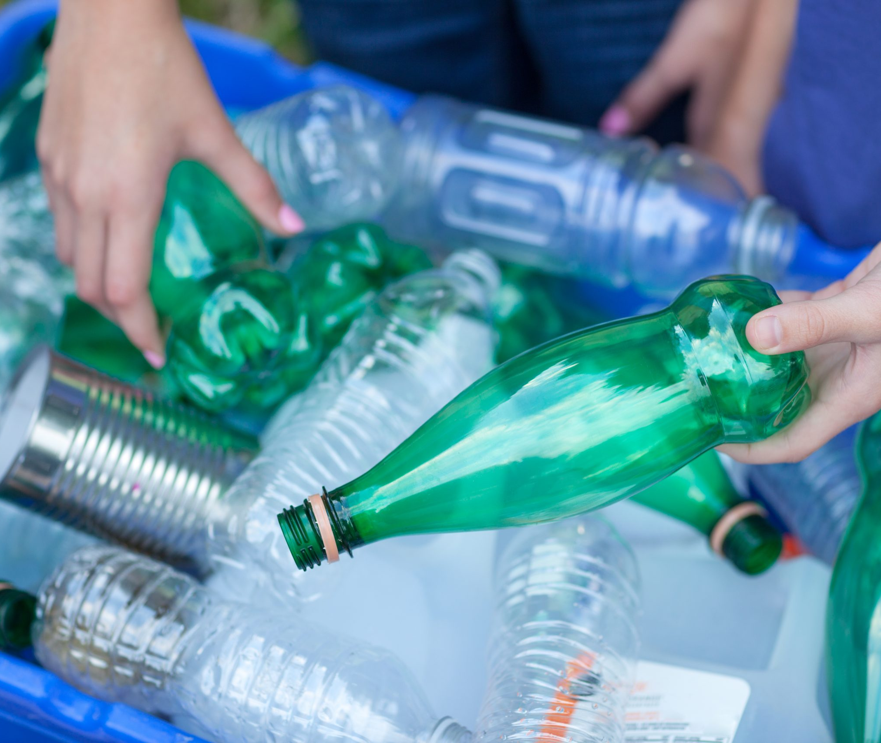
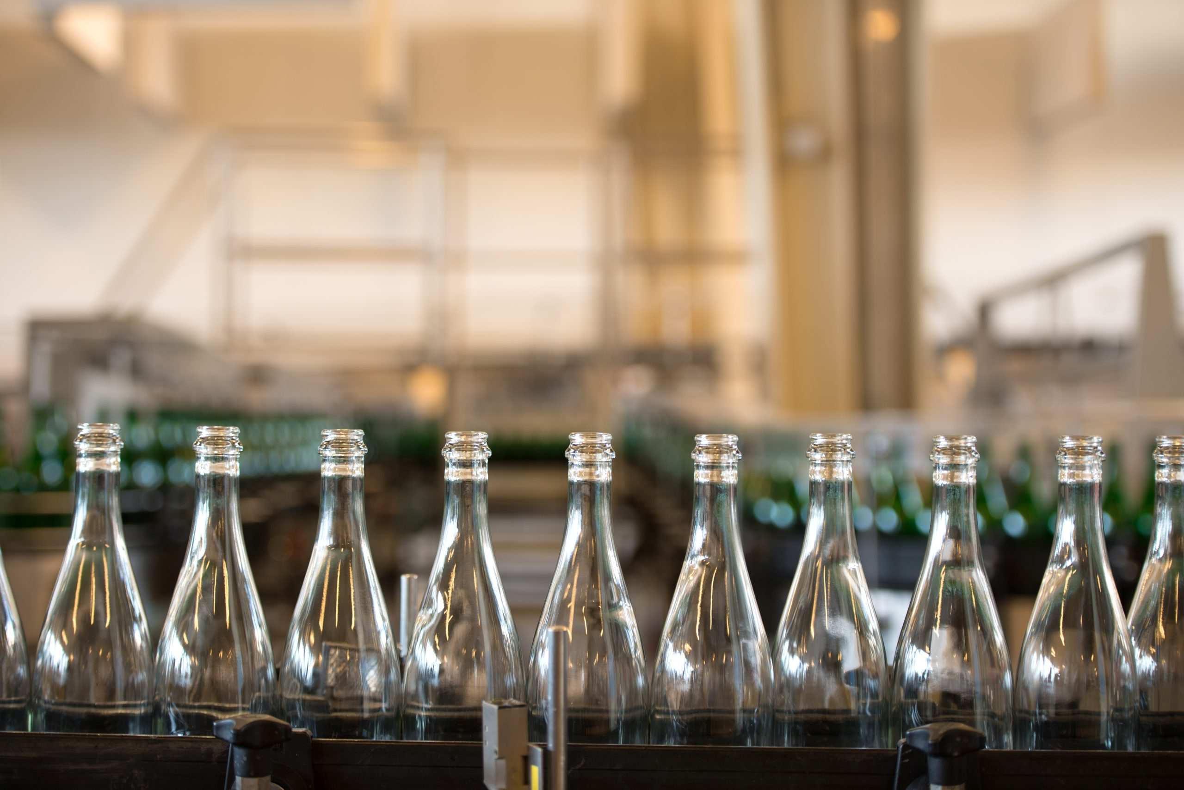
Important considerations
Supply chain intelligence
If you do not think you will be liable for PPT you may still see some of the costs of packaging rising
Data and reporting requirements
Trends of what will and will not be expected of brands and the legislation around environment and sustainability
Extended Producer Responsibility
Changes across packaging compliance means more SMEs will be expected to comply with packaging regulations

Slide 8
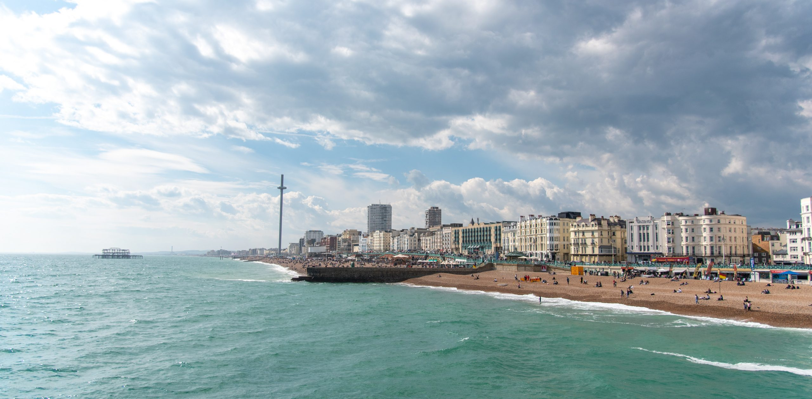

Questions
Make sure to check HMRC for a full overview of the technical aspects of PPT
We have a guide available for businesses to review on our website: www.clarity.eu.com

