Slide 1



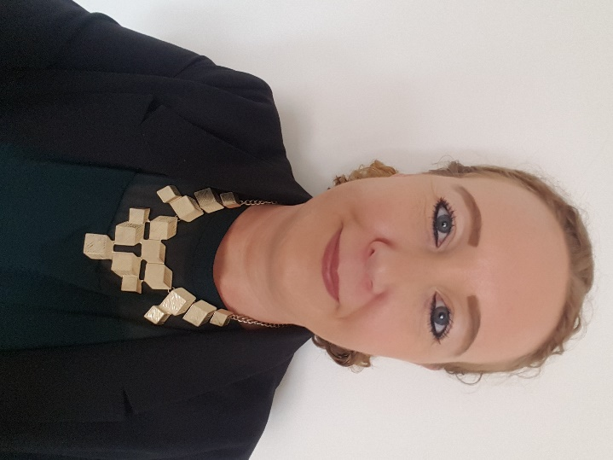

Green Business Programme overview
Bernie McCullagh
Business Energy Advisor
Coventry City Council

Slide 2
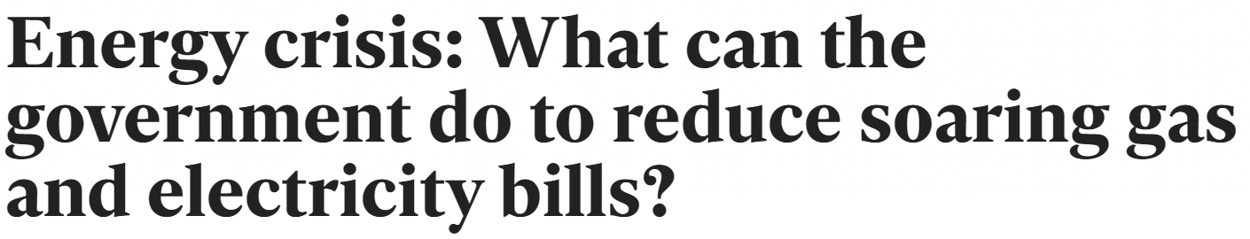
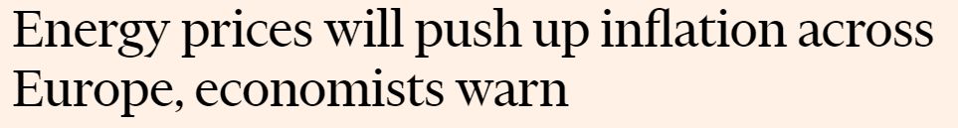
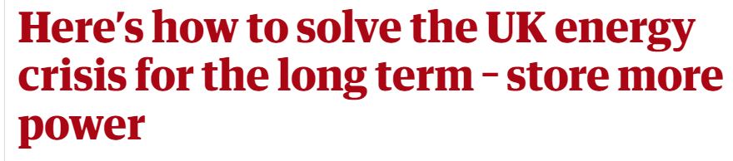
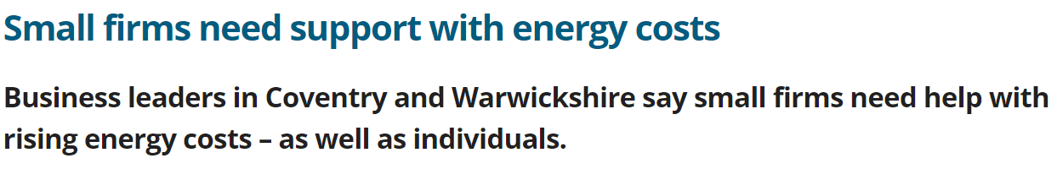
Current priorities:
Most SME's feel they are coming out of COVID challenges and are now looking to invest
Concern over rising energy costs and future-proofing their business premises

Slide 3
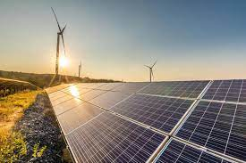




Future priorities:
So, while reducing operating costs is the main driver, awareness of the wider issues is growing
Interest in renewable technologies increasing
i.e. ASHP (air source heat pumps) and solar PV
Improved image and ability to win bids and tenders

Slide 4
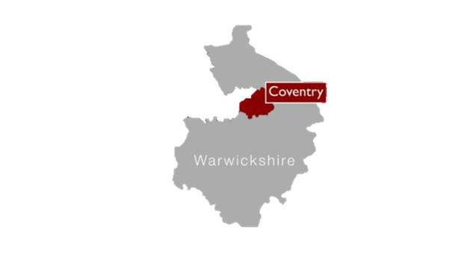
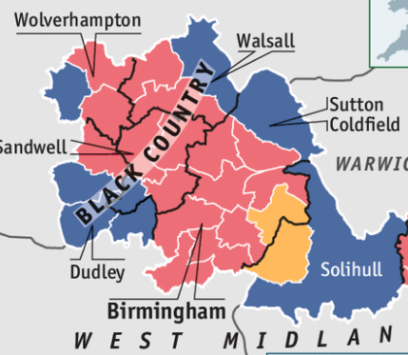
Green Business Programme
Coventry & Warwickshire region
(please note also other UK schemes i.e. Low Carbon SME:
Birmingham, Black Country & Solihull)
- Basic SME eligibility:
Less than 250 employees
Turnover of less than €50 million
Have received less than €200k in public aid over 3 years
Have at least 50% of sales through business to business

Slide 5
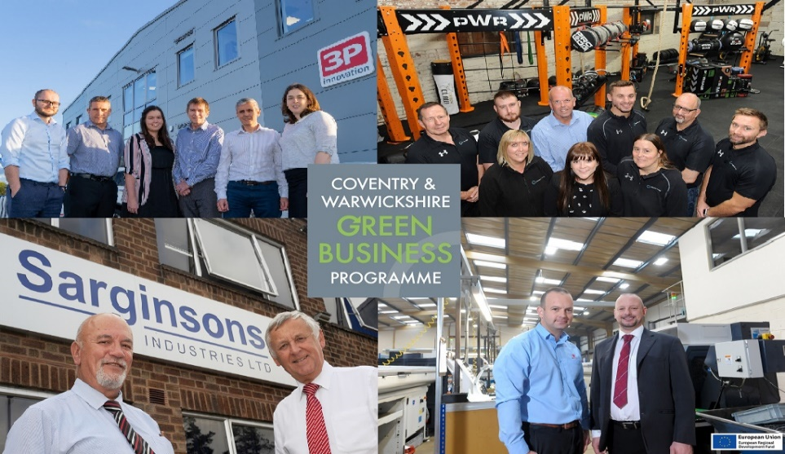

Aims of Scheme:
Help businesses reduce carbon
Access to grant funding to assist with investment
Provide energy efficiency advice and guidance

Slide 6
Ends Spring 2023
Grant funding; up to £50k max – 40% subsidy (minimum £1k). Must save at least 1 tonne CO2e per £1k of grant
2. Energy audit (worth £840) carried out FOC
  Carbon saving calculation
  Maximising potential energy savings
  Supports funding bids/compliance/ISO14001

Slide 7

How the programme works:
Businesses provide us with 12 months energy bills (if available).
We carry out an on-site energy audit of the premises; heating/lighting/processes/machinery/energy wastage.

Slide 8

Objectives:
To assess energy use, associated costs and carbon outputs, helping to identify areas of highest inefficiency.
Energy efficiency improvement measures are then recommended; but no obligation to follow all of these.
Finally, what grant funding is available to support the capital investment required to implement these measures.

Slide 9

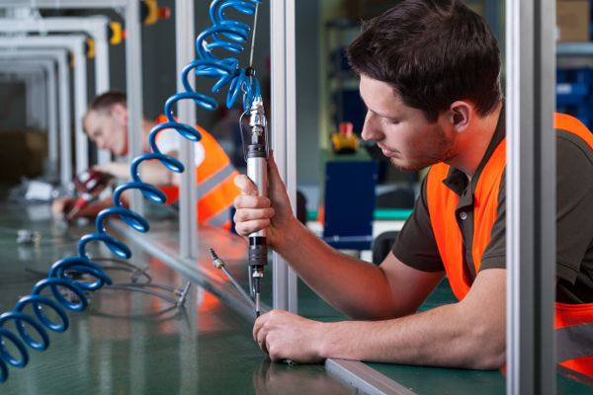
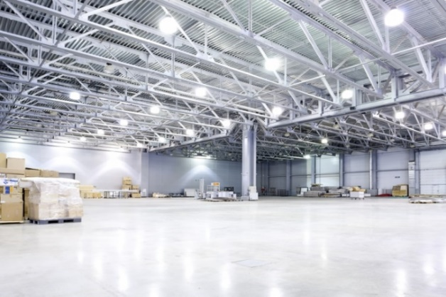
Example areas for recommendations:
Insulation
LED lighting
Heating
Glazing
Shutter doors
Solar PV
Heat Pumps
HVAC (Heating, Ventilation, Air Conditioning)

Slide 10
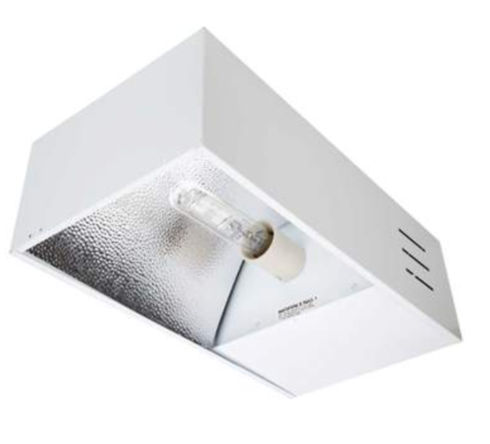
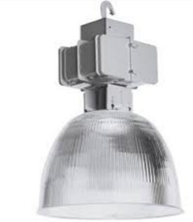
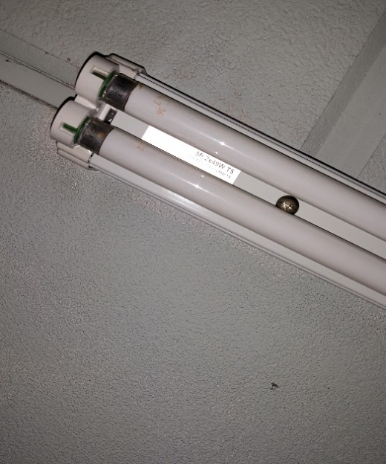
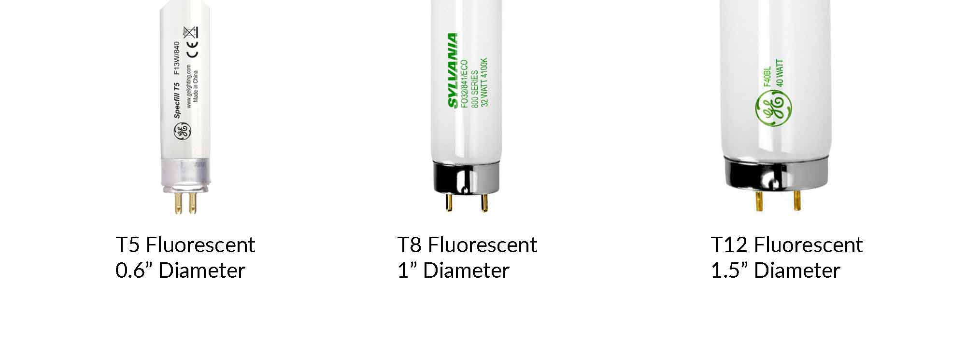
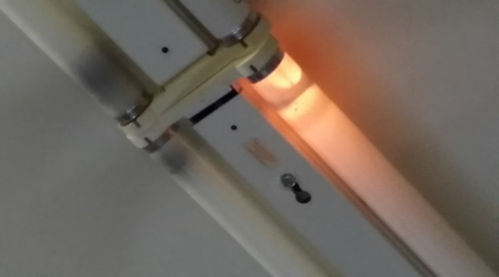

Lighting
Lighting: fluorescents, halogen, metal halide
Sensors, i.e. motion, daylight
Natural v artificial lighting

Slide 11
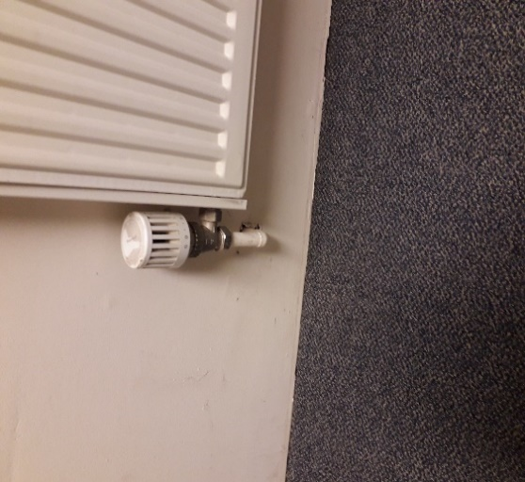
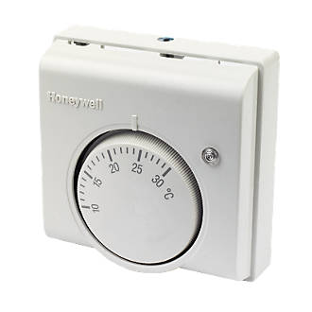
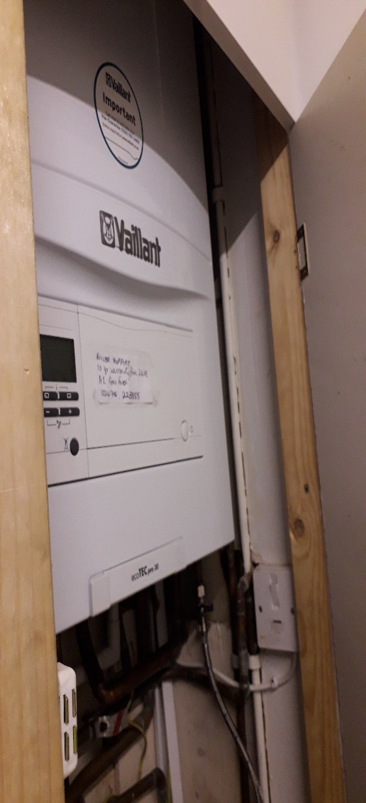
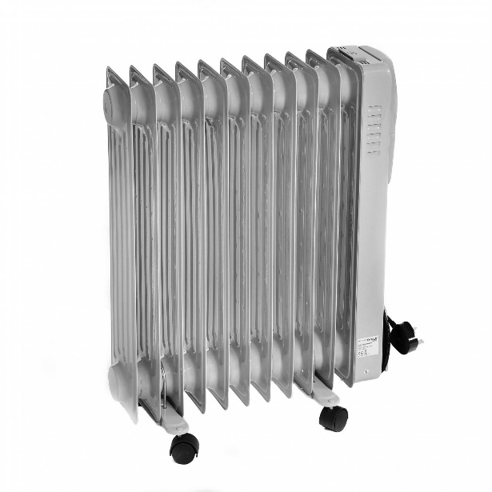
Heating, Cooling
& Insulation
Boilers/warm air units
Fans/air con
Timers/controls
Electric/oil portable heaters
Roof/ceiling/wall insulation
Infrared heaters

Slide 12
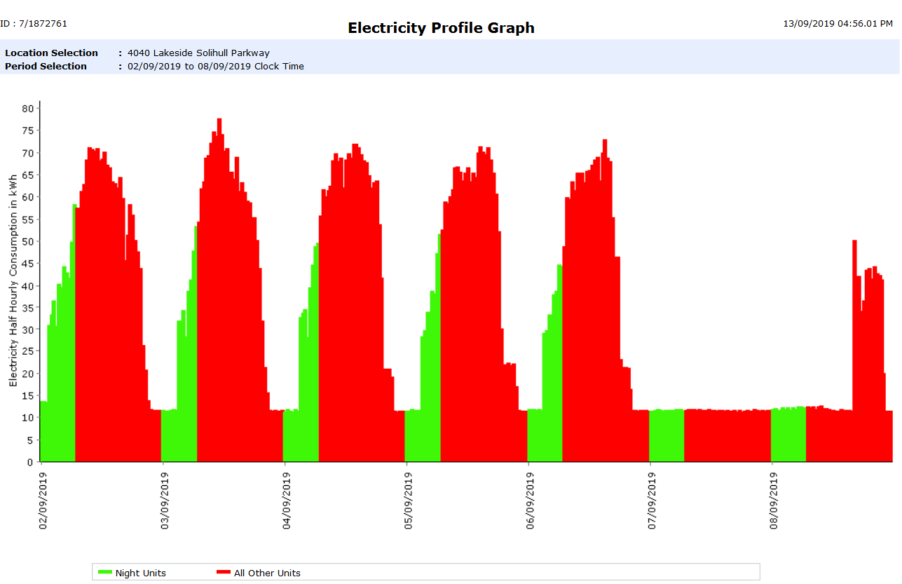
Energy management: 5 top tips!
Meters: take regular readings (or ask for smart meters)
Check your bills – look out for VAT/tariff rates/kVa charges
Already got a BMS or smart meters? Use the info!
Any energy wastage? - reduce/remove/replace as needed
Consider switching: via your energy broker or see -
Ofgem's Business Energy Guide or: CAB advice: business energy switching

Slide 13

Green Business Network
Membership is free and offers a range of benefits:
Events, workshops & webinars
Monthly e-newsletter – news, events, legislation, case studies
The opportunity to promote your news/projects
Expert advice with team of sustainability advisors
Enhance green credentials to secure new business
Networking and supply chain opportunities (join our Green Business Directory)
Currently 1,500 other organisations you can network with

Slide 14





Other funding resources:
Various additional funding, resources and business advice is available within the region: specialist grants and business support.
In the first instance, contact the Growth Hub who will then guide you to the most appropriate resource -
CW Growth Hub: www.cwgrowthhub.co.uk
Birmingham Growth Hub: www.gbslepgrowthhub.co.uk

Slide 15


For free energy advice, energy audits, funding support - get in touch:
Coventry & Warwickshire:
greenbusiness@coventry.gov.uk

