Slide 1
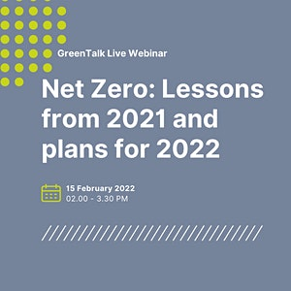
@SWMtweet
#SWMis20
Starting your Net Zero Journey
15 February 2022
Anna Bright
anna.bright@swm.org.uk
07751 923671

Slide 2
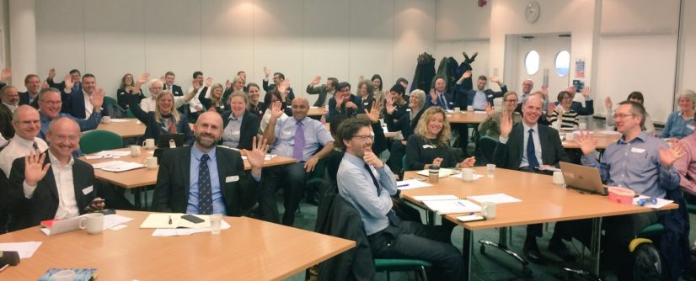
Who is SWM?
The sustainability adviser to cross-sector leaders of the West Midlands
Established 2002
Independent
Not-for-profit
Our 2030 Vision:
The West Midlands is leading in contributing to the national target of net zero greenhouse gas emissions by 2050 whilst addressing health inequality and driving inclusive growth
Our activities:
Membership
Support to organisations
Networks
Notes:
E’ve been workinin partnership with CIWEM to deliver a number of event in the region for our respective networks.
Some of you may have attended the joint event we delivered on AQ here at UoB back in June which served as a consultation opportunity in relation to the related aspects of our new Roadmap – more on that later!

Slide 3
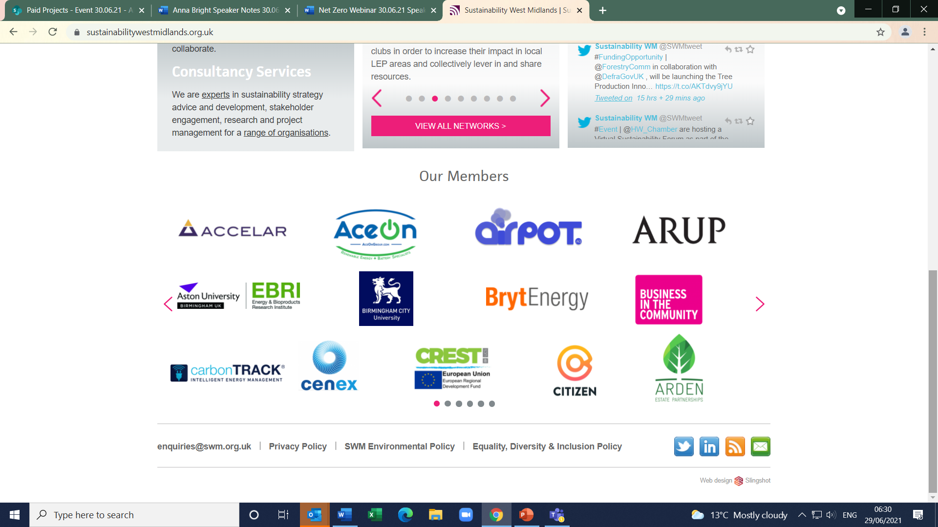
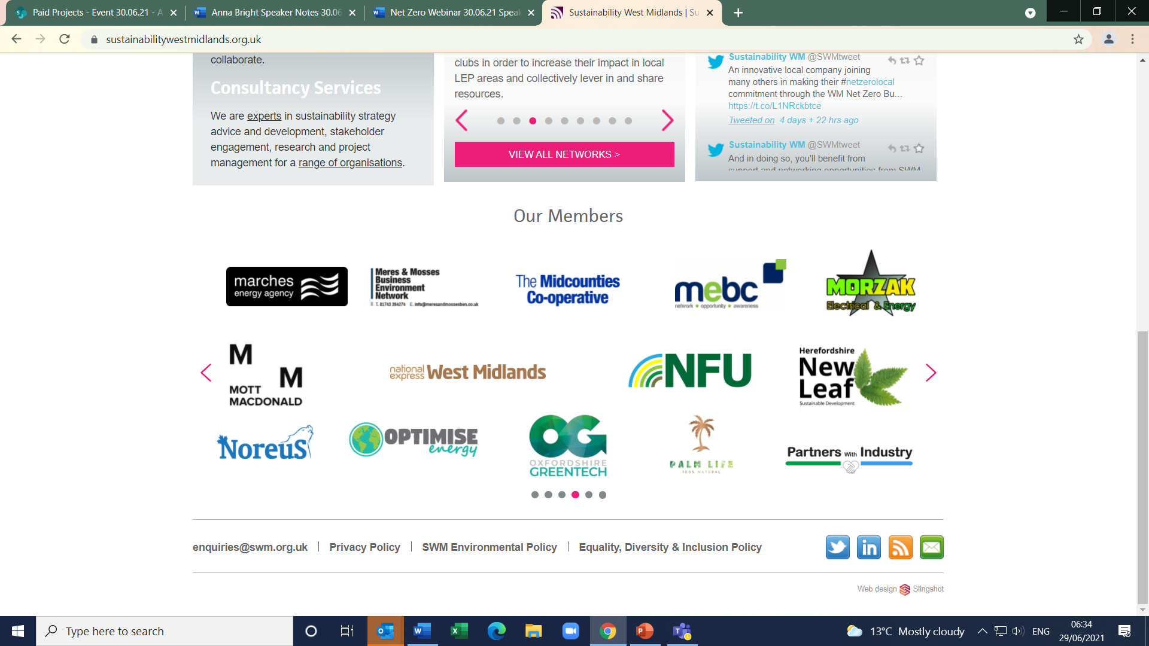
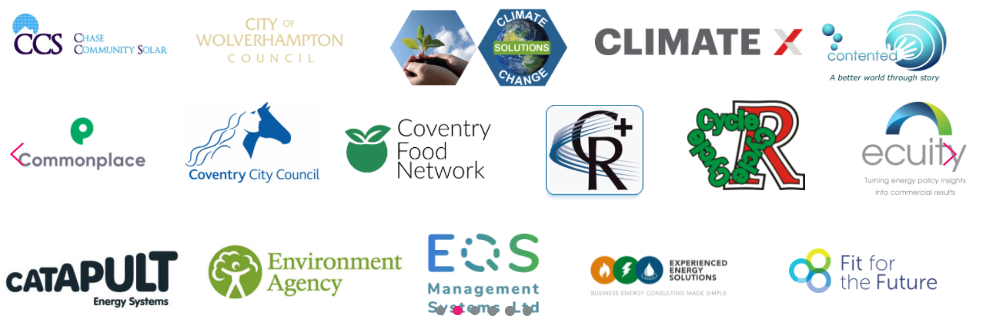
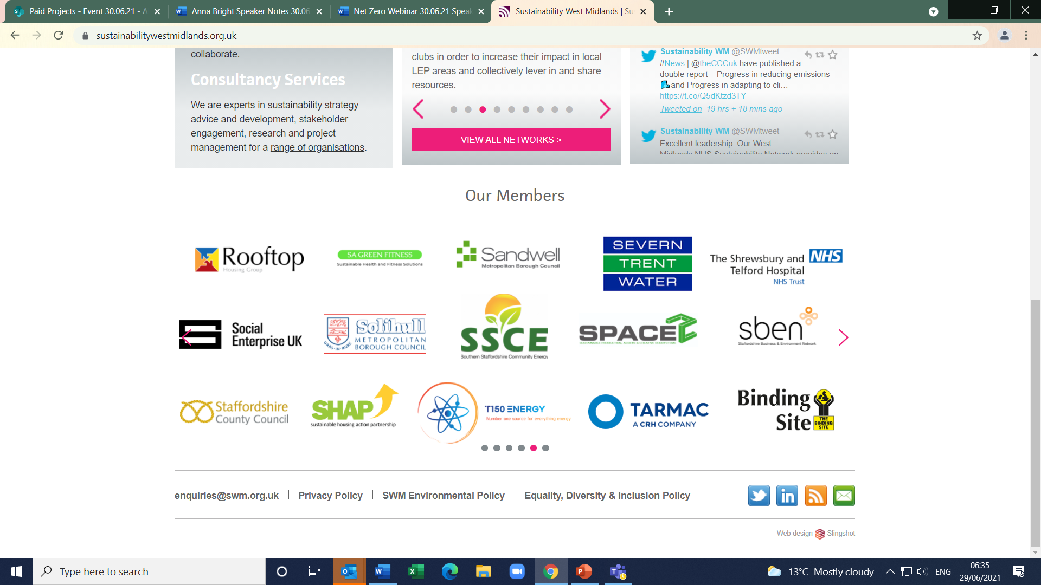
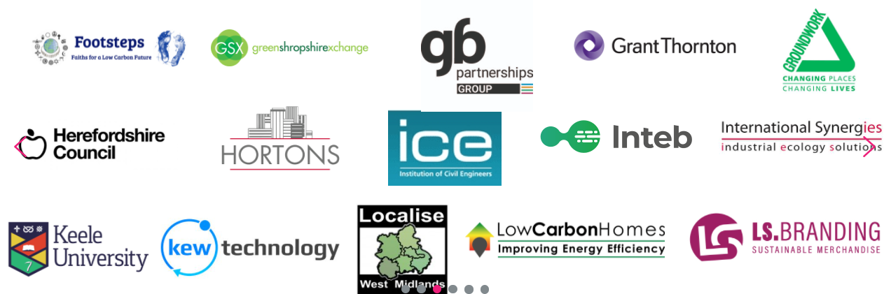
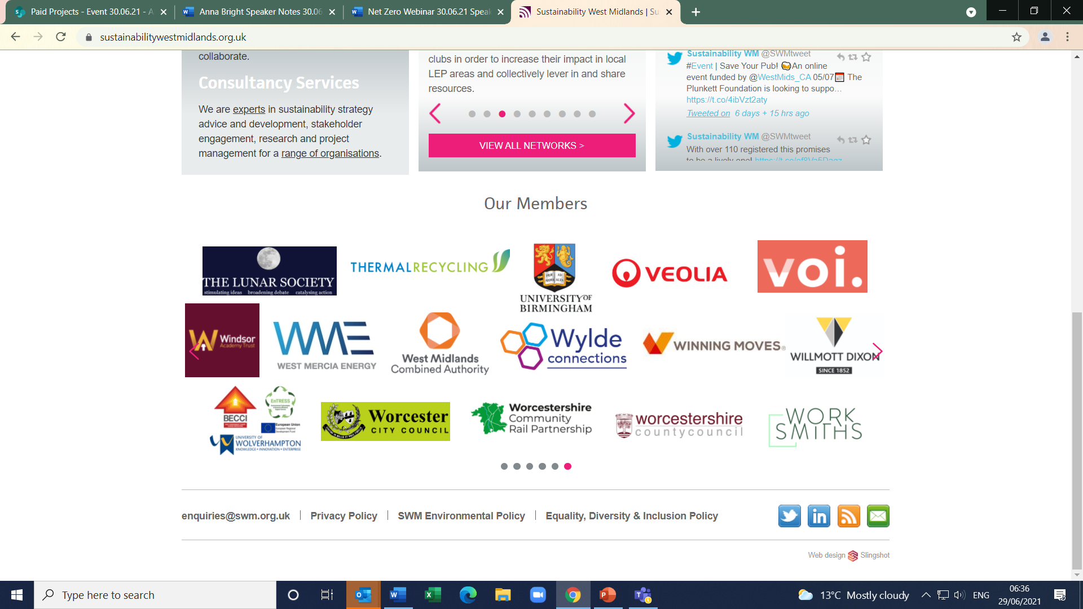
Our members

Slide 4
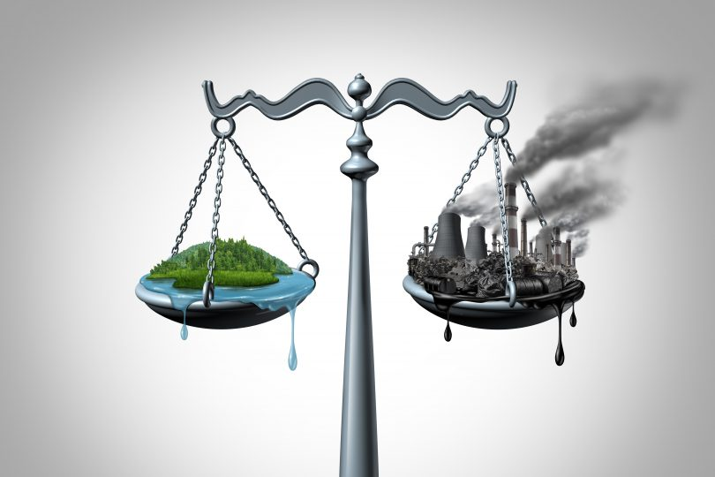
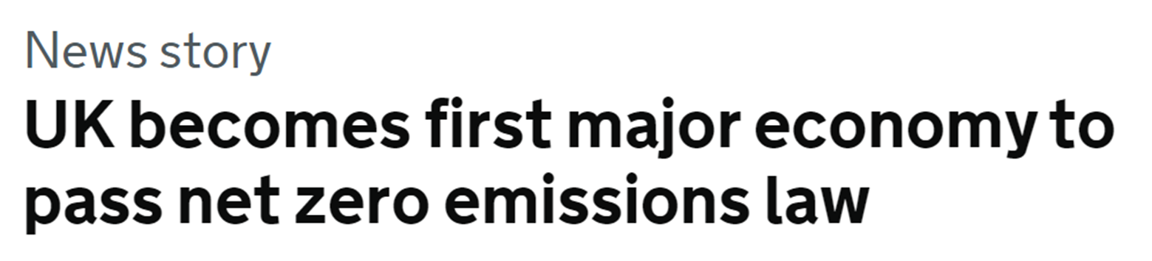
What is Net Zero?
When anthropogenic emissions of greenhouse gases to the atmosphere are balanced by removals over a specified period.
Net Zero is seen as the answer to slowing climate change.
Climate Change Act 2008 (2050 Target Amendment) 2019 committed the UK to reduce all greenhouse gas emissions to net zero by 2050.
Notes:
Net Zero is achieved when an actor reduces its emissions following science-based pathways, with any remaining GHG emissions attributable to that actor being fully neutralized by like for-like removals (e.g. permanent removals for fossil carbon emissions) exclusively claimed by that actor, either within the value chain or through purchase of valid offset credits.
Offsetting:
Reducing GHG emissions (including through avoided emissions), or increasing GHG removals through activities external to an actor, to compensate for GHG emissions, such that an actor's net contribution to global emissions is reduced. Offsetting is typically arranged through a marketplace for carbon credits or other exchange mechanism. Offsetting claims are only valid under a rigorous set of conditions, including that the reductions/removals involved are additional, not over-estimated, and exclusively claimed. Further, offsetting can only be used to claim net zero status to the extent it is “like for like” with any residual emissions. 1

Slide 5
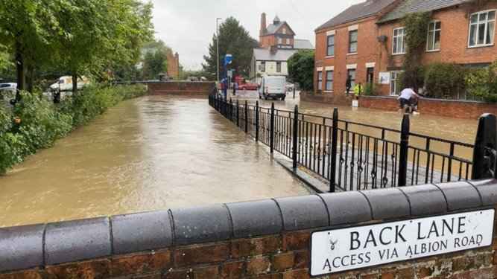
Why is Net Zero important?
Net Zero has been adopted as the best strategy to protect us and the natural world from rising global temperatures.
Net Zero differs from ‘carbon neutral’ because it means reducing emissions to their lowest amount through energy efficiency measures and then using offsetting to remove the remaining emissions.

Slide 6
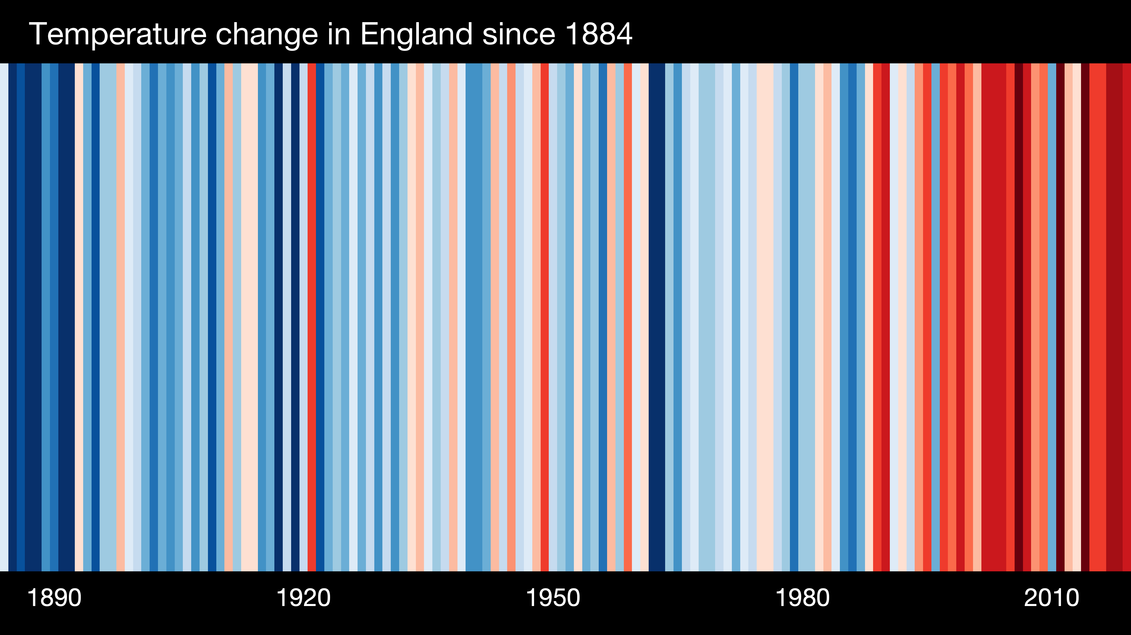

Slide 7

Carbon Footprint
Amount of carbon dioxide (CO₂) emissions associated with all the activities of a person or other entity
(e.g. building, business, country, etc.)
Can also include indirect emissions
(e.g. how much energy did it take to produce the things you own?)
https://footprint.wwf.org.uk/#/

Slide 8
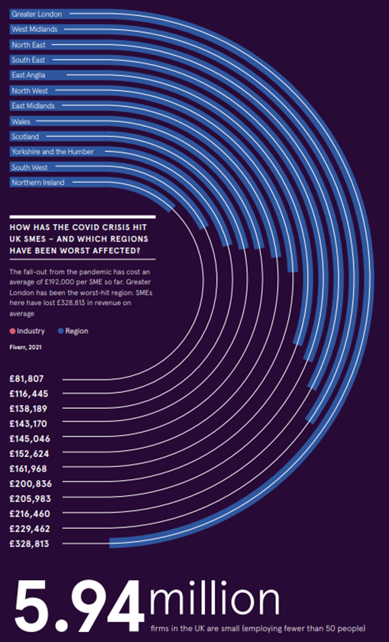
Why are SMEs important?
SMEs make up 99% of UK businesses.
Record numbers of small businesses established since the start of the pandemic.
SME leaders need support with approaches and and technology, enabling them to handle the ‘Net Zero’ tools that will help their businesses to survive and thrive in the digital post-covid age.
SMEs hit hard by the pandemic – West Midlands is second only to London for being worst affected
Notes:
With their job security at risk or redundancy, many people have set up companies for the first time

Slide 9
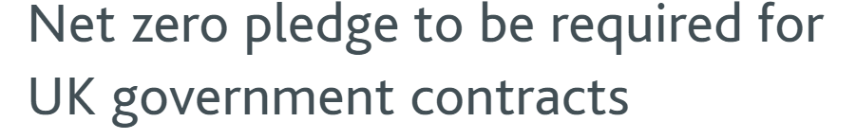
Benefits of Net Zero to SMEs
Profitability
Attract Investment and innovate
Improved public relations
Open your business to customers who have pledged to Net Zero and need net zero suppliers.
Notes:
Profitability: Operational cost savings, core process improvements, mitigation against future energy and carbon pricing and new revenue streams to support your diversification and recovery.
Attract Investment and innovate: Green investment is growing; funding options will reduce CapEx need/exposure and focus your organisation on innovation.
Improved public relations: Customers prefer environmentally responsible companies and are using their purchase power to prove this.
Contractors looking to pick up UK government contracts worth more than £5 million a year will also need to commit to achieving net zero carbon emissions by 2050 and detail their environmental management measures during the performance of the contract, according to new mandatory guidance issued by the government.
‘The NHS will be working with suppliers to ensure that all of them meet or exceed their commitment on net zero emissions before the end of the decade’
Businesses who have pledge to be Net Zero and will therefore need a Net Zero supply chain.
Co-op
Dell
Nestle
BBC
PepsiCo
WHSmith
Vodafone
Tesco
Sky
John Lewis
NHS

Slide 10
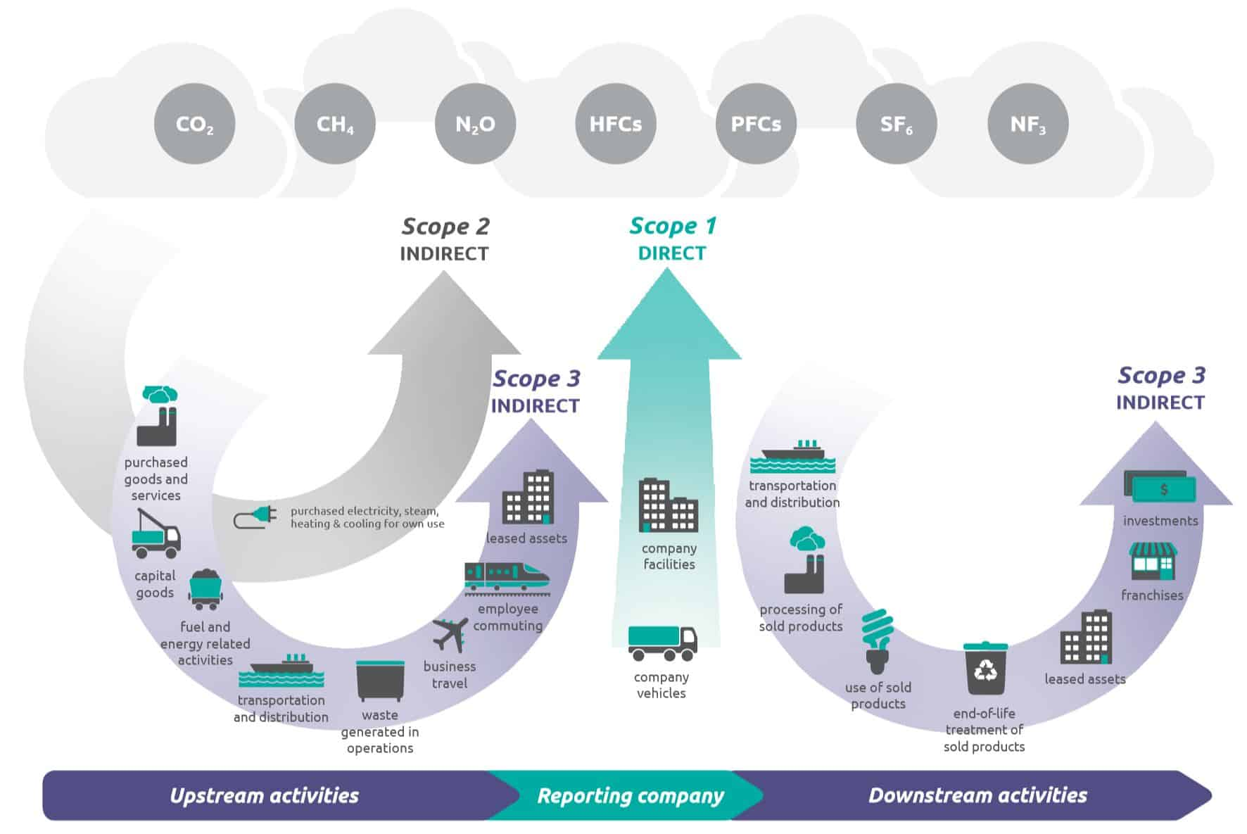
First steps
Stage 1: Awareness
Notes:
Scope 1- Direct emissions from own generation
Scope 2- Indirect from emissions of purchased energy
Scope 3- Indirect value chain emissions

Slide 11
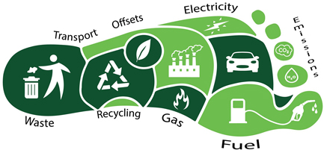
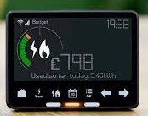
First steps
Stage 2: Measure & Knowledge
Measure your use of energy - install smart meters and understand what energy you use & how you use it
Measure and understand your carbon footprint
Notes:
Scope 1- Direct emissions from own generation
Scope 2- Indirect from emissions of purchased energy
Scope 3- Indirect value chain emissions

Slide 12
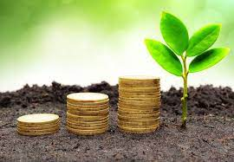
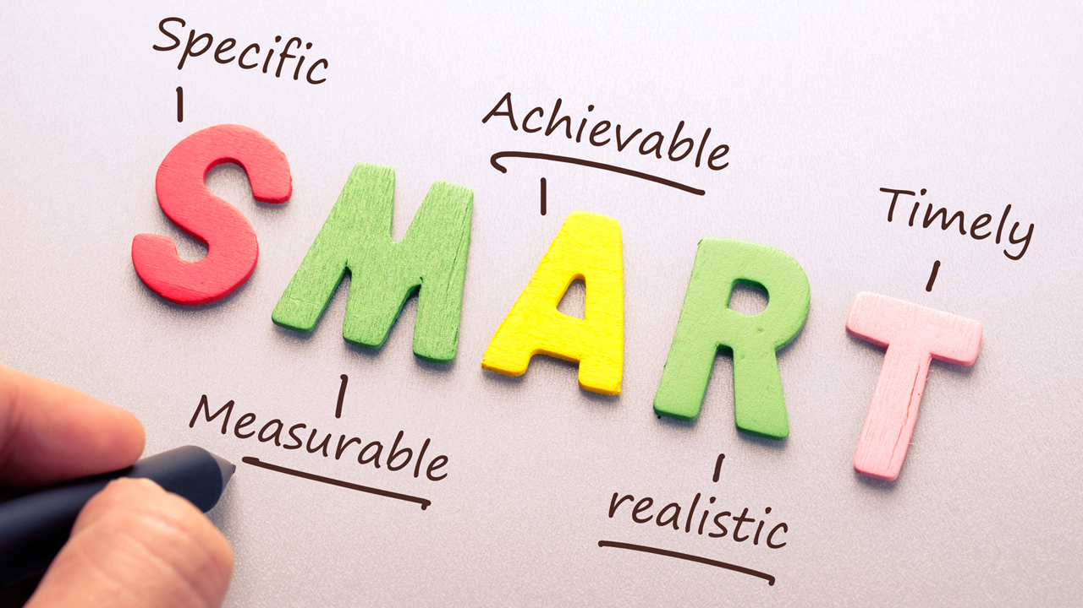
First steps
Stage 3: Planning & Actions
Develop your strategy, required capabilities, funding & staff engagement
What changes will you need to make?
Set realistic targets, supported by investments and ROI decisions

Slide 13
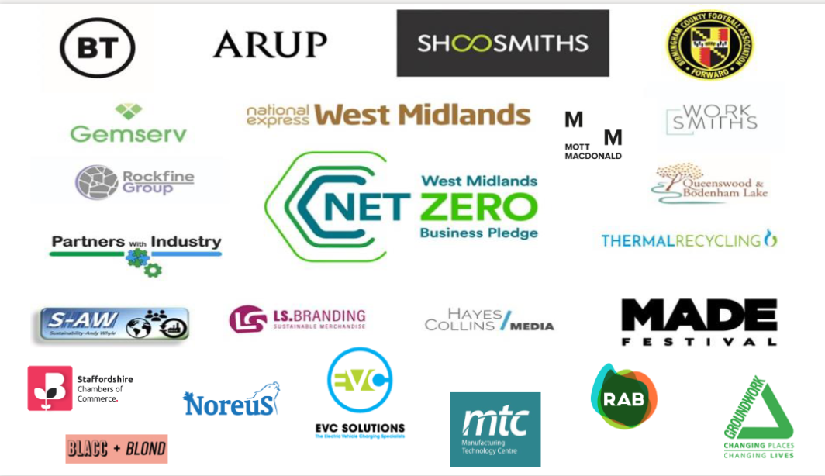
West Midlands Net Zero Business Pledge
Benefits for businesses:
  Help and guidance
  Funding and support
  Marketing and PR
  Annual review
  Reporting on progress

Slide 14
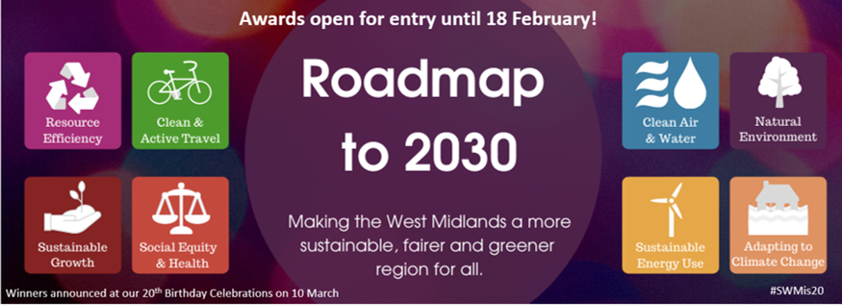
Other opportunities
Monthly Newsletter
Website
@SWMtweet
LinkedIn
SWM Sustainability Roadmap to 2030 Awards: Apply by 18 February!
SWM 20th Birthday Celebrations: 10 March at Millennium Point.
Sustainable Business Support Hub: C&W

Slide 15
@SWMtweet
#SWMis20
Starting your Net Zero Journey
15 February 2022
Anna Bright
anna.bright@swm.org.uk
07751 923671

