Slide 1


Sustainability vs profits
22 MARCH 2022
Clare ollerenshaw, ASSOCIATE DIRECTOR

Slide 2
Our Current linear economy
Take
Make
Dispose

Slide 3
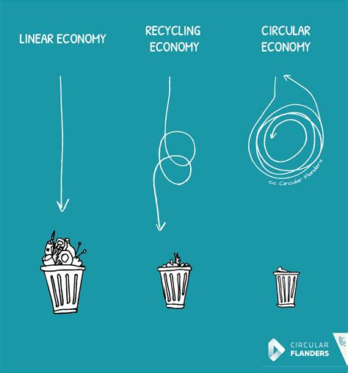
Circular economy principles
Design out waste and pollution
Keep products and materials in use
Regenerate natural systems

Slide 4


Slide 5
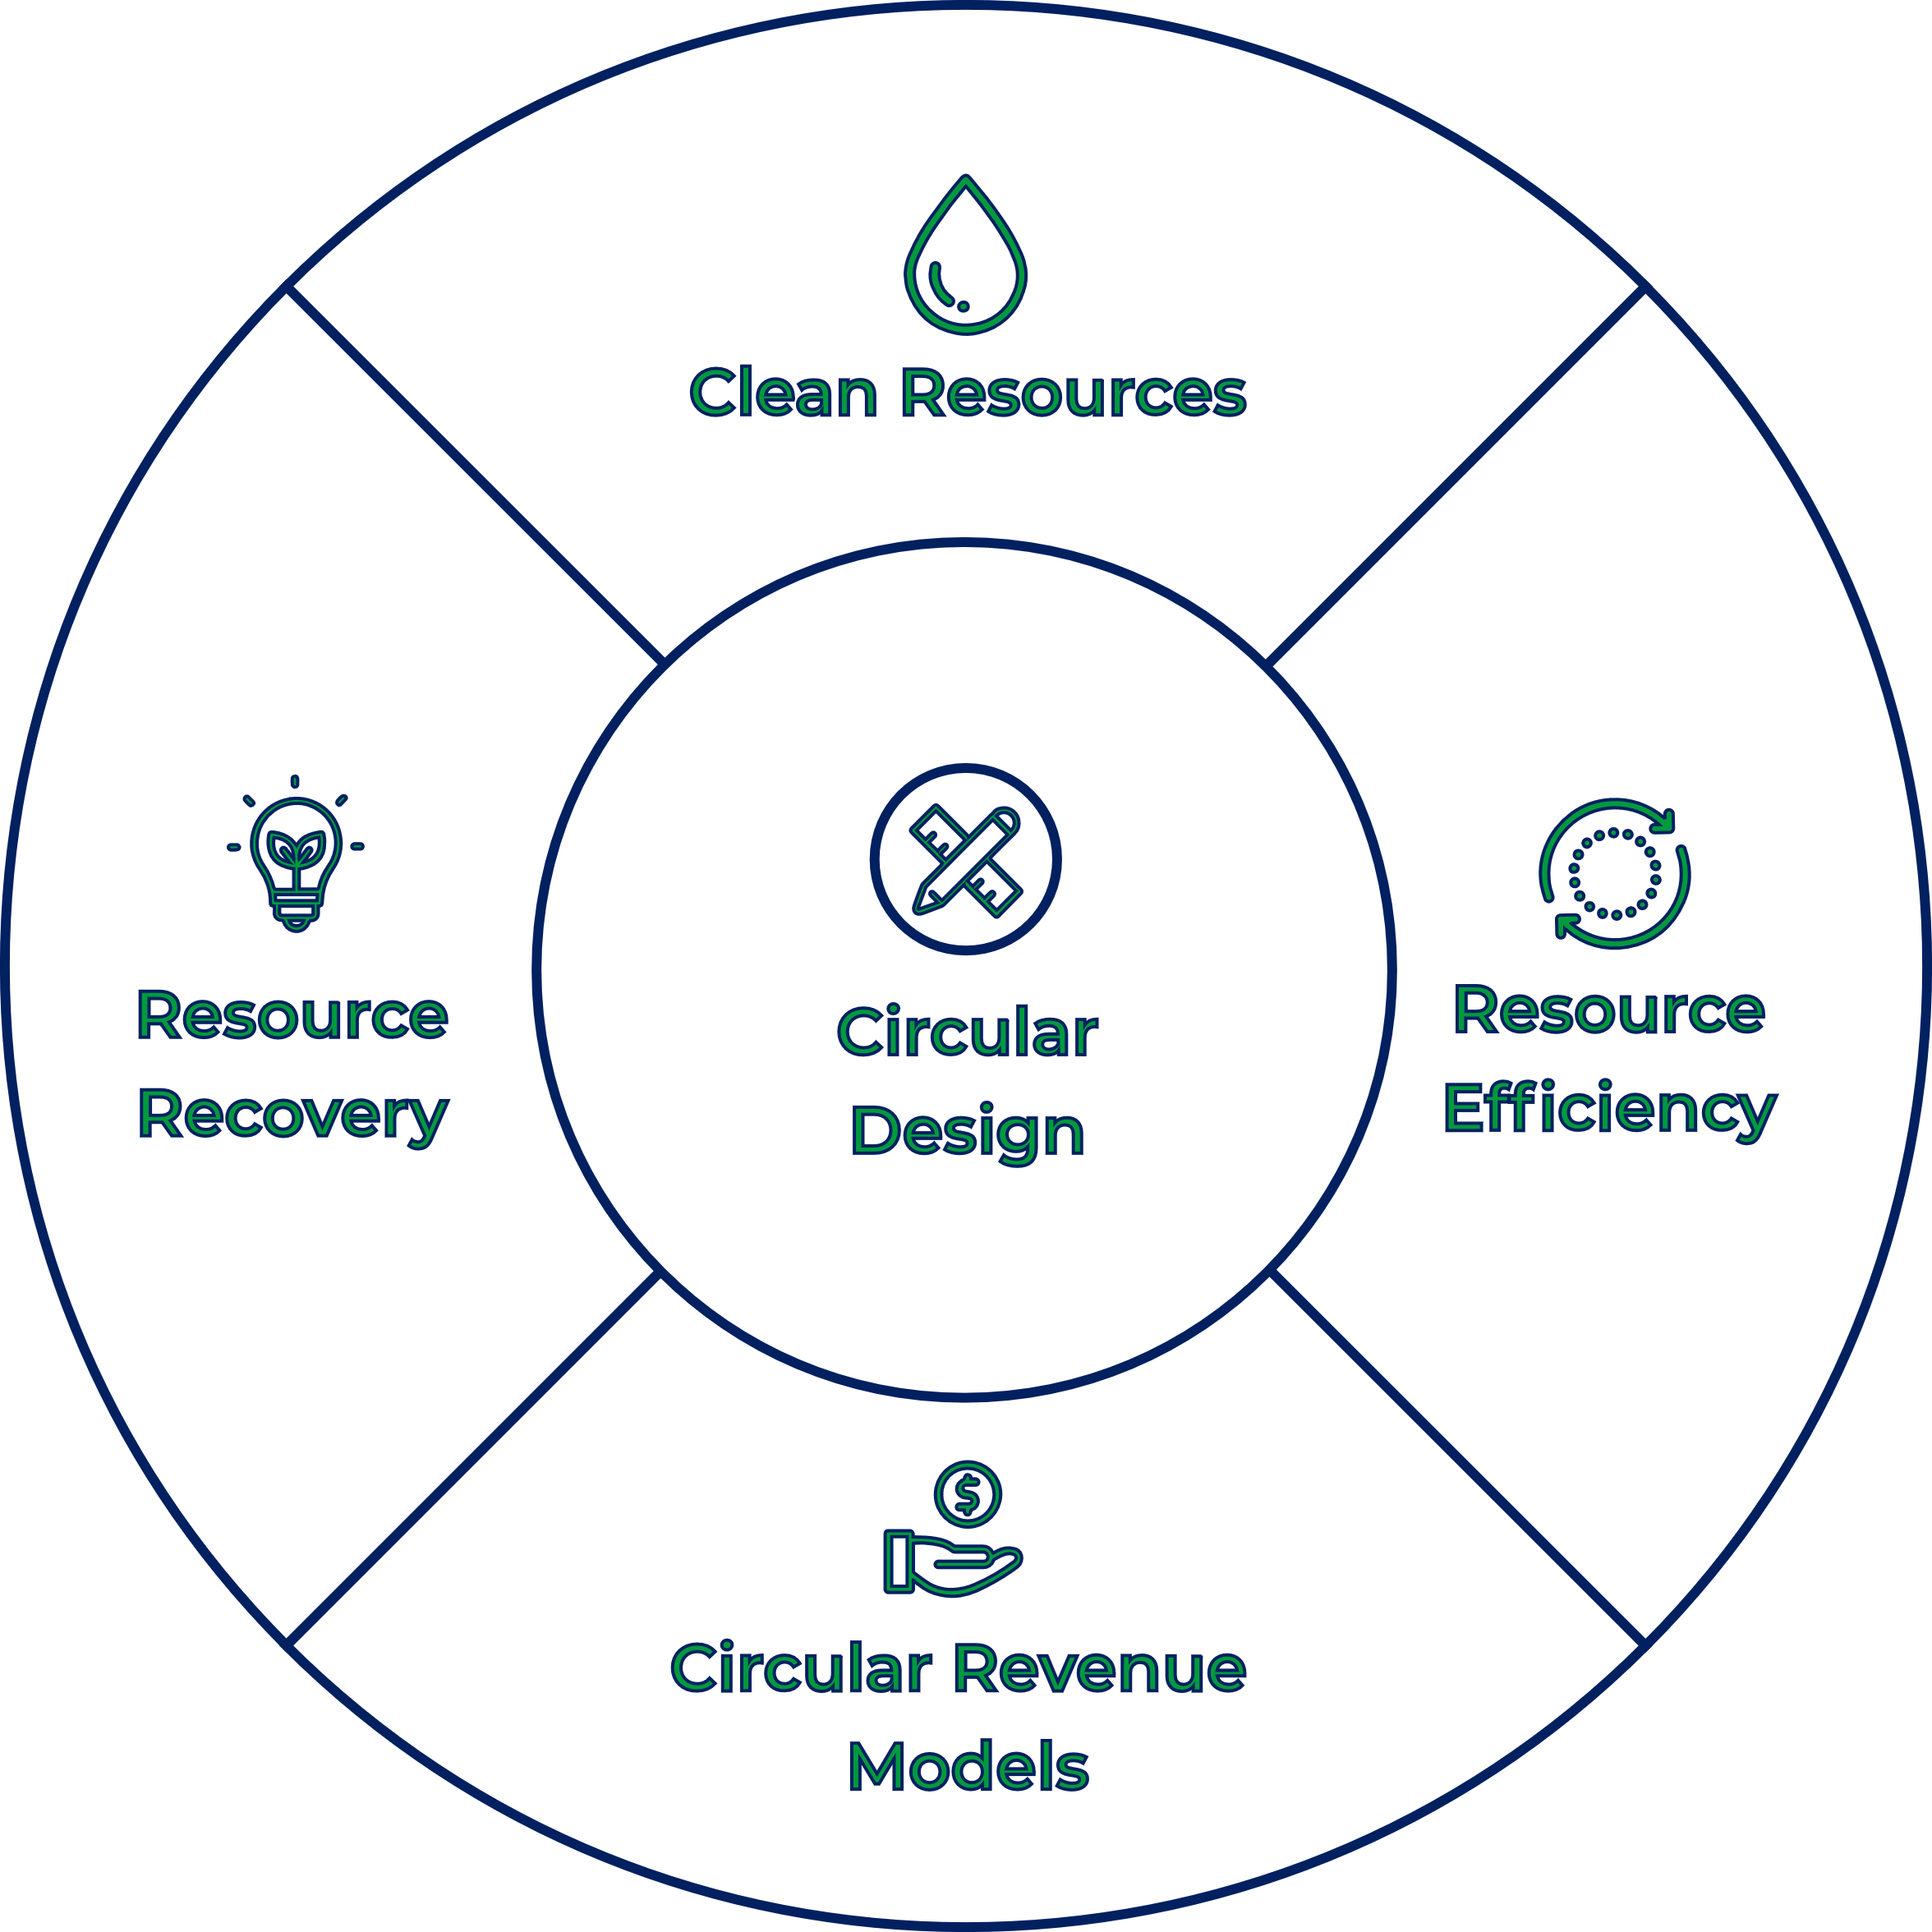
ReLondon business transformation’s circular framework, describing the different strategies for becoming more circular as a business
Supporting Circular Economy Business | ReLondon's Business Transformation | ReLondon

Slide 6

CLEAN RESOURCES
Notpla is revolutionary material made from seaweed and plants. It biodegrades in weeks, naturally. The company, based in London, has created unique machines and materials to package products in the most sustainable way.
For example Oohos replace plastic cups and bottles for running events, races and other sporting events, it was used to removed single use plastic from the Virgin Money London Marathon. https://www.notpla.com/
Photo by engin akyurt on Unsplash

Slide 7

CIRCULAR REVENUE MODELS
Circos is an online shop where you rent high-quality design clothes for children from newborn up to 2-3 years and maternity wear that fit your taste, need, and budget.
Order items you love from a selection of brands, enjoy them while they fit. You pay monthly for the kind and number of clothes that you’re using at that moment. When it is time for the next size or style, just return the items and select your next favourites - you swap whenever it suits you best.
https://circos.co/
Photo by Alexander Dummer on Unsplash

Slide 8

CIRCULAR REVENUE MODELS
Aceleron is a Birmingham based developer of sustainable and reusable batteries. They manufacture lithium ion batteries that are fully serviceable, upgradeable and recyclable.
Their circular economy battery technology aims to negate the challenge of waste from lithium-ion batteries. Such technologies are currently rarely reused or recycled and the electric vehicle (EV) industry is expected to create more than 11 million tonnes of battery waste a year in the next 20 years globally. Aceleron are advancing research into ‘end-of-life’ battery cell and module repurposing, whilst offering immediate reuse opportunities for waste battery packs to help reduce carbon emissions and underpin the clean energy revolution. https://www.aceleronenergy.com/
Photo by Mos Sukjaroenkraisri on Unsplash

Slide 9

RESOURCE REcovery
Paint 360 is based in Cradley Heath and was established to tackle the huge issue of waste paint disposal. The company re-engineers waste paint back into brand new paint which has been tried, tested and developed in conjunction with the trade. Each litre contains a minimum 65% recycled content, while competing on quality and price with premium brands. It is estimated by DEFRA that around 55 million litres of paint are thrown away each year in the UK alone.
Paint360 receives waste paint from Household Waste Recycling Centres, contractors and retailers which is re-engineered back into an award-winning range of emulsion paints with a minimum 60% recycled content. This paint is then sold direct to the market or through the UK’s largest builder’s merchant. https://www.paint360.co.uk/
Photo by David Pisnoy on Unsplash

Slide 10

RESOURCE recoverY
Toast Ale reduces demand for natural resources by replacing virgin barley with surplus fresh bread. One of the biggest environmental challenges is the increasing demand for agricultural land to grow more crops for food, drink and animal feed (despite one third of food going uneaten).
By using less barley, they have a smaller footprint on the land, reduce demand for water and prevent carbon emissions, whilst also preventing food waste.
https://www.toastale.com/about-us
Photo by Helena Yankovska on Unsplash

Slide 11
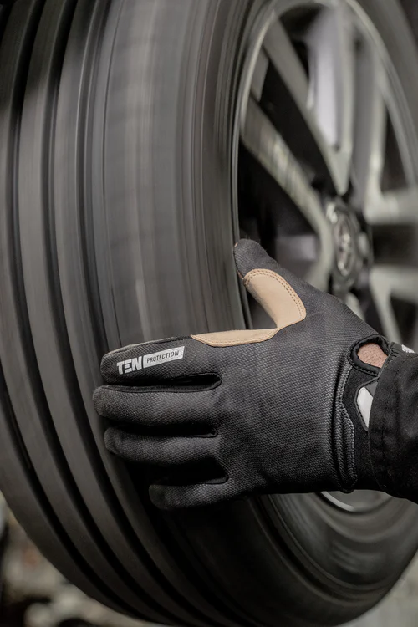
RESOURCE EFFICIENCY
Staysafe PPE offer a washing service for PPE and gloves. This is enabling employees to wear them more than a handful of times and reducing your requirement to replace them so often.
By washing industrial gloves and laundering and repairing your hi-vis outerwear Staysafe PPE guarantee savings in excess of 60%. They only charge for the items which are fit for purpose, and gloves are sorted into sizes and paired up ready for immediate re-issue.
Staysafe PPE operates a nil to landfill policy so by using their PPE and glove washing service, customers extend the life of their PPE, reduce landfill costs and carbon footprint.
Photo by Jimmy Nilsson Masth on Unsplash

Slide 12
Circular economy policy
West Midlands Combined Authority Circular Economy Routemap – has a focus on manufacturing, construction and food
wmca-circular-economy-routemap-final-full-document.pdf
Our waste, our resources: A strategy for England, DEFRA, 2018
Our waste, our resources: a strategy for England (publishing.service.gov.uk)
Waste Prevention Programme for England Towards a resource efficient economy Consultation version March 2021
Waste Prevention Programme for England consultation document.pdf (defra.gov.uk)

Slide 13
RESOURCES
Birmingham and West Midlands Circular Economy Club, part of a global circular economy network with +260 CEC local chapters in 110 countries. CEC’s activity is global, non-profit and free to join, with the mission to bring the circular economy to every corner of the world.
LinkedIn Group https://www.linkedin.com/groups/8721417/
CEC website Circular Economy Club (CEC) – Local action. Global impact.
Tools
https://www.strategyzer.com/canvas/business-model-canvas
https://circulab.com/toolbox-circular-economy/circular-canvas-regenerative-business-models/
https://intheloopgame.com/
Context
https://www.ellenmacarthurfoundation.org/

Slide 14
Contact details
Clare Ollerenshaw
Associate Director
collerenshaw@accelar.co.uk
www.accelar.co.uk

