Slide 1
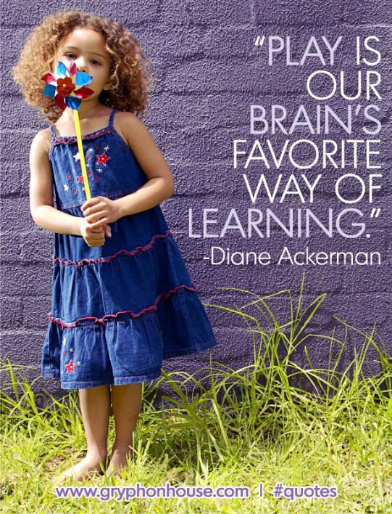
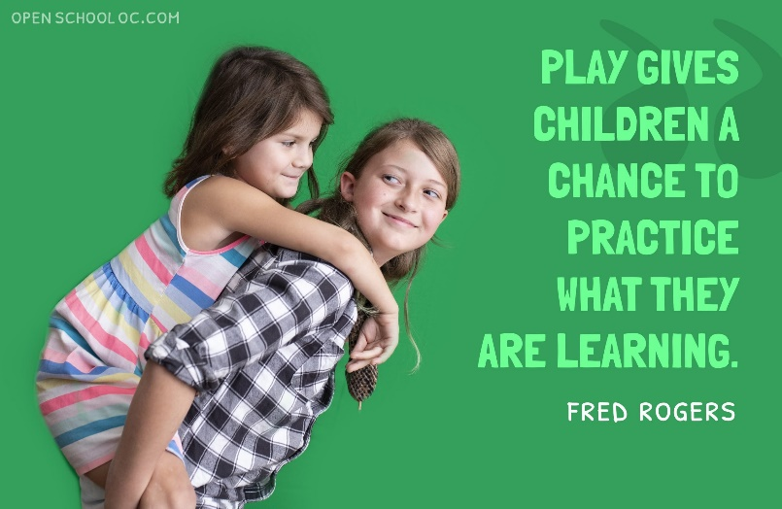
Learning through play

Slide 2
Rationale for play
This session will start by considering what it is that makes play so important and how does it support learning?
“The evidence keeps mounting that play is the best way for children to learn – and thrive . Our earliest days, play is how we relate to the world, and to each other. When children have plenty of opportunities to learn playfully, they do what they do best: pursue their natural curiosity. And, as they do, they build skills and aptitudes they’ll keep for life”. (Lego foundation)
“Play is one of the most important ways in which young children gain essential knowledge and skills” (UNICEF).
Within play it is useful to use PACE.
PACE (Playfulness, Acceptance, Curiosity, Empathy) is a model of caring and parenting developed by Dan Hughes. It helps support and form secure attachments with children and young people who may have experienced difficulties in early life.

Slide 3
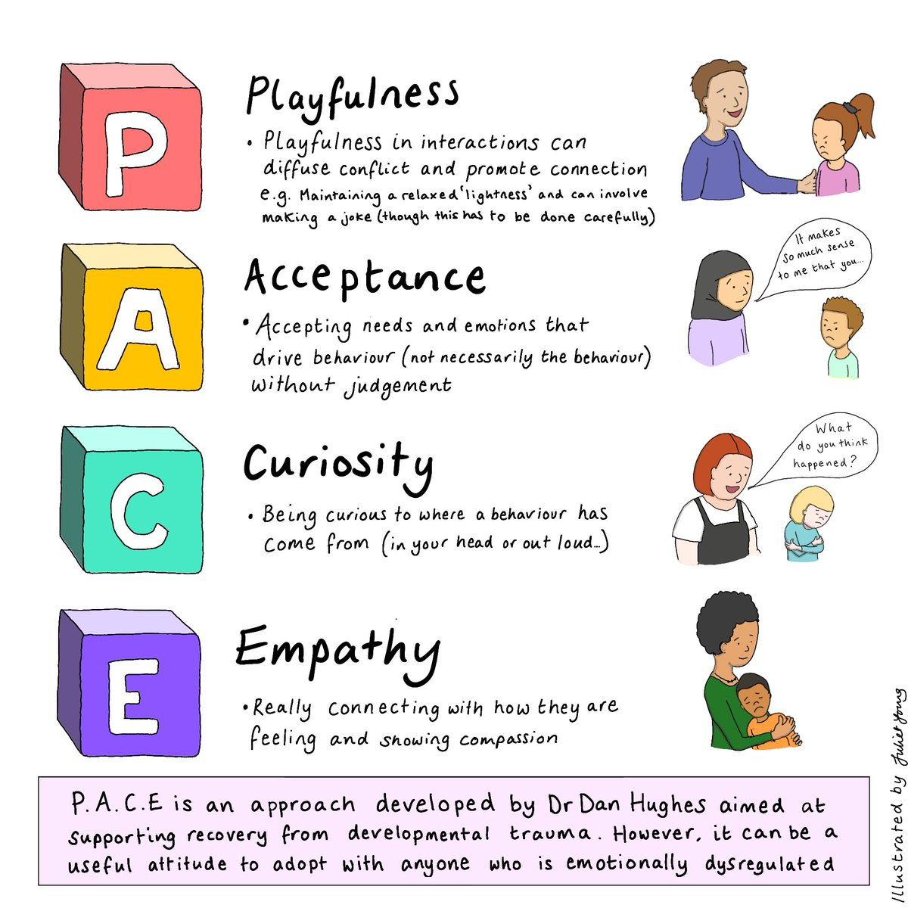

Slide 4
Why is PACE important?
PACE focuses on the whole child, not simply the behaviour. It helps children be more secure with adults and reflect upon themselves, their thoughts, feelings and behaviour, building the skills that are necessary for maintaining a successful and satisfying life.
For adults, using PACE most of the time, we can reduce the level of conflict, defensiveness and withdrawal that tends to be ever present in the lives of some children. Using PACE enables the adult to see the strengths and positive features that lie underneath more negative and challenging behaviour.
A child is not ‘naughty’ their behaviour is not acceptable.
You can like a child and not like their behaviour- it is important to separate the two.
http://www.fife.gov.uk/educationalpsychology
Notes:
A child is not ‘naughty’ their behaviour is not acceptable.
You can like a child and not like their behaviour- it is important to separate the two.

Slide 5
Why is PACE even more important now?
As a result of the current Coronavirus Pandemic, many children (and adults) will be experiencing a degree of trauma, stress and anxiety. Lockdown, school closures and the absence of normal life is putting unprecedented pressure on relationships of all kinds. Families who are used to spending hours apart each day are now suddenly expected to be with each other every minute of every day. At the same time, extended family, friends and colleagues are now more distanced than ever.
Children who may have experienced trauma or loss will benefit greatly from the use of PACE and the development of strong, trusting relationships.
Children are very sensitive to the reactions and moods of the adults around them. As well as experiencing their own anxieties, children will be picking up on the stresses of the adults around them too. Although our children’s anxieties can seem ‘small’ (e.g. missing their friends, changes to routine, not getting to play football), we must be careful not to minimise or dismiss these, but acknowledge them and give the child space to express their fears and sadness.
This does not mean that you have to completely hide your feelings- seeing you manage your emotions and self regulate is a good lesson for the child.
Notes:
This does not mean that you have to completely hide your feelings- seeing you manage your emotions and self regulate is a good lesson for the child.

Slide 6
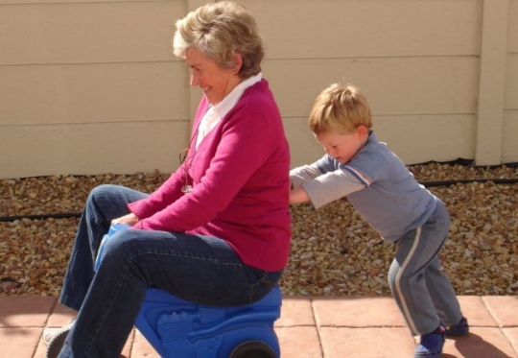

What is Playfulness?
Playfulness is all about the positive spectrum of emotions. It is used to elicit moments of shared joy and delight. It can be easy to forget playfulness when we are helping children to tolerate and regulate more difficult emotions, such as anger, terror and envy. But if we teach children how to cope with and seek out positive emotions, we are strengthening their ability to regulate all kinds of feelings.
Why is Playfulness important?
For a child with a background of neglect, abuse or loss, it may be difficult for them to realise that adults in school are safe, friendly and caring towards them. Playfulness is a great way of showing that you truly like the child and it reduces the authority of your role.
It should be noted that a playful approach is likely to be the last part of the PACE acronym that we apply when we are first building a relationship with the child who has experienced trauma. They are going to need our Acceptance, Curiosity and Empathy far more in the early days and these will be covered in subsequent blogs.
This can be hard if the child’s words or actions have stirred up powerful emotions in the adults who support them – but finding time for playful moments is essential in maintaining an open and engaged relationship.
Notes:
It should be noted that a playful approach is likely to be the last part of the PACE acronym that we apply when we are first building a relationship with the child who has experienced trauma. They are going to need our Acceptance, Curiosity and Empathy far more in the early days and these will be covered in subsequent blogs.
This can be hard if the child’s words or actions have stirred up powerful emotions in the adults who support them – but finding time for playful moments is essential in maintaining an open and engaged relationship.

Slide 7
Examples of playfulness
When we are attempting to foster relationships with children who have experienced relational trauma, our faces become a key ingredient in establishing attuned interactions; attunement is the sharing of emotional experiences. Facial ques = safety ques
Warm and Personalised Greetings- Some children may enjoy a high five or fist bump routine. Others who are more sensitive to touch may prefer a reciprocal wave or thumbs up. Some may need the reassurance of a hug.
Show you are interested- match the child’s excitement and keep regular eye contact to show that you’re really listening to what they’re saying. Facial ques = safety ques (smiling!)
The famous ‘still face experiment’ shows how distressed a child can become when an adult is not expressive and will desperately try and reconnect with the adult. You can see a demonstration of this experiment on YouTube at this link: https://www.youtube.com/watch?v=apzXGEbZht0
Find moments for silliness- be human! Make mistakes and laugh. When we find the humour in these moments, we are modelling how the child can handle similar situations. Tell stories in different voices, wearing a silly hat or using a puppet.
Defuse stressful demands – make getting ready a game, role play possibilities of new situations, give the child a specific job role to give predictability but make it fun with a badge or clipboard etc.
Notes:
When we are attempting to foster relationships with children who have experienced relational trauma, our faces become a key ingredient in establishing attuned interactions; attunement is the sharing of emotional experiences. Facial ques = safety ques

Slide 8
Acceptance
Accepting a child’s feelings and validating them can have a such a positive impact on the relationship between you and a child. It is about accepting that whatever the child (or you) are feeling right now is ok. You are accepting their thoughts, feelings and perceptions without judgement. It can help them accept themselves and see themselves in a positive way.
For example, a child may tell you “I know you hate me”. It is tempting to respond with “that’s not true” or “don’t say that” but this may leave the child feeling that you really don’t understand what it’s like for them. Instead, through using PACE we could respond with “I’m sorry you think I hate you, that must feel awful, no wonder you’re angry with me” or “I didn’t realise that you feel like that, I’m sorry it feels that way to you”.
Acceptance does not mean you have to accept the behaviour if this is harmful to themselves or to another person.
Notes:
During a ‘meltdown’ you may wish to use phrase such as ‘ I wonder if you are feeling angry or frustrated’. This is called attuning. Some children struggle to identify their feelings and helping them name them can help them understand and know how to cope with them. Co regulation – deep breaths together and calm time before talking to the child can be a great strategy as when children are dysregulated they are not ‘online’ and the logical part of their brain is not engaged ‘offline’.
Social stories and comic strip conversations are a great tool to use to look at how to respond differently to a situation.

Slide 9
Acceptance
During a ‘meltdown’ you may wish to use phrase such as ‘ I wonder if you are feeling angry or frustrated’. This is called attuning. Some children struggle to identify their feelings and helping them name them can help them understand and know how to cope with them. Co regulation – deep breaths together and calm time before talking to the child can be a great strategy as when children are dysregulated they are not ‘online’ and the logical part of their brain is not engaged ‘offline’.
Social stories and comic strip conversations are a great tool to use to look at how to respond differently to a situation.
Accepting how the child is feeling and attuning to this is important for developing a healthy relationship but also in helping the child deal with their emotions.
Example of attuning to child:
https://www.youtube.com/watch?v=QT6FdhKriB8

Slide 10
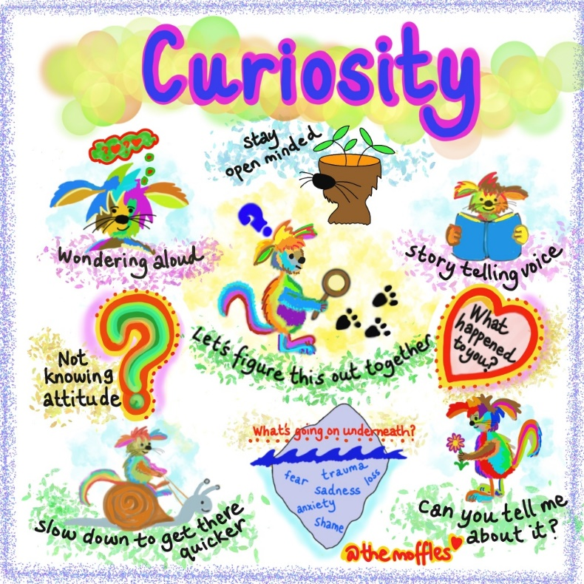
Curiosity
For caregivers and other adults working with a child, Curiosity is a process of discovery. It is also a powerful means of helping children to make sense of their inner experience, following adverse and traumatic events in their life. Curiosity is wondering about the meaning behind the behaviour for the child without judgement. Curiosity lets the child know that the adults understand.
Children often know that their behaviour was not appropriate. They often do not know why they did it or are reluctant to tell adults why.

Slide 11
Empathy
Feeling a child's sadness of distress with them, being emotionally available to them during times of difficulty shows the child that they are not alone and that the adult are strong enough to support them both through it.
https://www.youtube.com/watch?v=1Evwgu369Jw
What did you take away from the video?

Slide 12
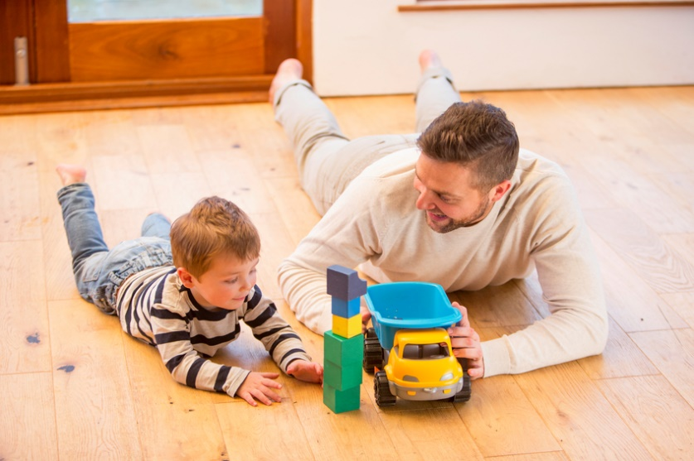
Facilitating play
Focus on the process (rather than the goal) of play. Ask exploratory questions that help extend the child’s play.
A child is making honking noises as he pushes a truck. Teacher: “Where is that truck going?” or “That is such a noisy truck. What is it honking at?”
A child holds a baby doll in the kitchen play area. Teacher: “What does the baby like to eat?”

Slide 13
Elaborate and build on children’s play or interests. Make comments, offer new and varied materials.
A child is busy racing and crashing trains. Teacher: “Those trains really must be in a hurry. I wonder what they are doing.”
Talk about what the children are doing or ask questions to support and extend their play. Teacher: “You are washing that baby. She must have been dirty,” “I wonder where that pig is going now. Is he hungry?”
Open ended questions will encourage the child to think more deeply and extend their understanding. E.g instead of asking “do you like the bubbles?” Ask “ what do you like about bubbles?”

Slide 14
Types of Learning Through Play
Free Play or Child-Led Play
Free play or child-led play is entirely initiated and directed by the child. The adult’s role is to observe and interact if the opportunity arises to extend learning, following the child’s interests. Children learn best when it's something a child is attracted to.
This could be a child's choice in playing in a certain environment or space, with a certain toy. They might want to include rubber spiders in their kitchen play area, or read in the sandpit. The possibilities are endless, and it's about them mixing things up however they like - within reason!
Adults will be responsive to the things that the child does or says, in order to keep their attention focused for an extended period of time. (Twinkl)

Slide 15
Adult-Lead or Active Learning
Adult-led play, sometimes called Active Learning, is initiated and directed by the adult. Specific learning intentions are planned for by the adult, and each child will participate in play-based activities related to these. This approach can be useful as it provides the fun and enjoyment of play whilst simultaneously focusing children’s learning in areas that they may not choose during free play.
Adult-led play gives adults the biggest role here, where the toys, areas, and games are chosen and led by the adult. They won't be actively involved in these activities themselves, but they'll be mentoring the children through it.

Slide 16
Be patient!
A lot of the children you may foster or care for will have had trauma or gaps in their development and will take longer to develop the neuro pathways in the brain that tell them how to feel and behave.
https://www.youtube.com/watch?v=_nWMP68DqHE
Learning through play and using PACE as the adult you are helping to build these pathways and eventually it will become second nature to the child.
During these play experiences you are modelling acceptable behaviour, self-regulation for example if you lose and you are okay with this. You can model how to react to different scenarios and teach the child the appropriate responses.

Slide 17
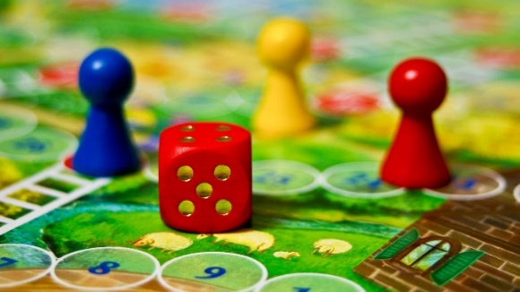
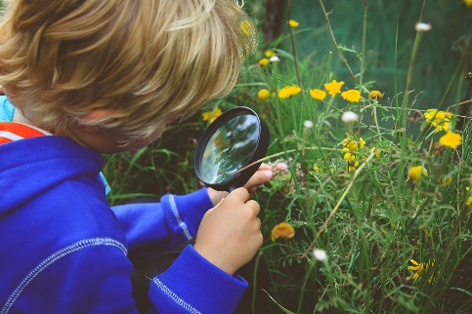
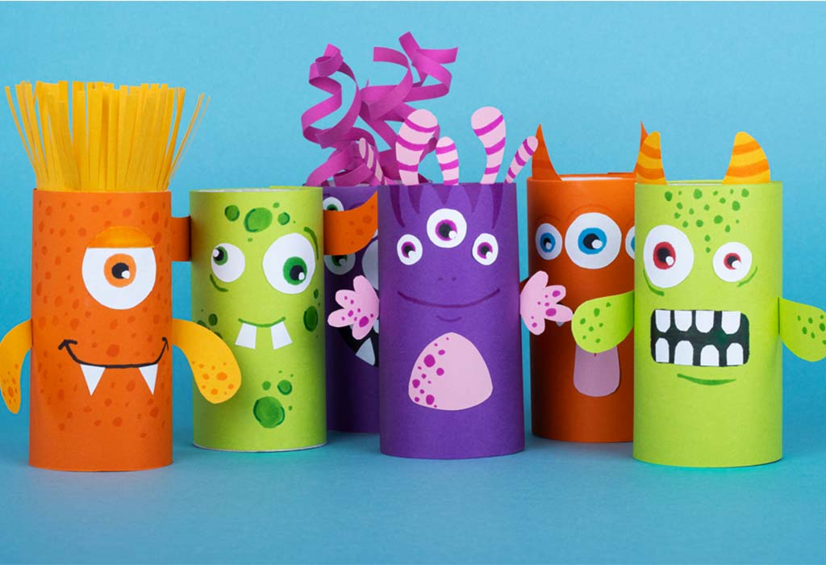
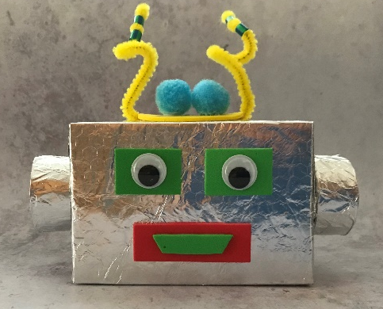
Ideas for play
Steiner considered that exposure to real-life experiences, such as cooking, cleaning, sewing and gardening led to a sense of wellbeing and security.
Role play a scenario that the child may find particularly difficult to model responses.
Nature walks – explore
Treasure hunts
Craft activities
Stories
Board games
Junk modelling
Any activity that the child engages with that means you are communicating and building a connection. The child can chose the play and you join in alongside them rather than always initiating. Avoid screen time when playing together. This could be a reward or for short periods of play. Remember open ended questions. Praise turn taking and use phrases like “I really enjoyed playing that game with you” to validate the time spent together and build self-esteem.
Fine motor skills activities, glitter trays, funky finger activities, dough disco
Gross motor – sport, climbing, craft and junk modelling
Phonics games
Social and emotional – build a worry monster
Maths- counting songs and games, tea parties for sharing amounts
Understanding the world- nature walks, It games
Notes:
Fine motor skills activities, glitter trays, funky finger activities, dough disco
Gross motor – sport, climbing, craft and junk modelling
Phonics games
Social and emotional – build a worry monster
Maths- counting songs and games, tea parties for sharing amounts
Understanding the world- nature walks, It games

Slide 18
Questions ???

Slide 19
References
Bomber, L.M. & Hughes, D.A. (2013). Settling to Learn. Settling Troubled Pupils to Learn: Why Relationships Matter in School. London: Worth Publishing Ltd.
Golding, K.S. & Hughes, D.A. (2012). Creating Loving Attachments: Parenting with PACE to Nurture Confidence and Security in the Troubled Child. London: Jessica Kingsley Publishers.
Hughes, D.A. & Baylin, J. (2012). Brain-Based Parenting: The Neuroscience of Caregiving for Healthy Attachment. New York: W.W. Norton & Company.
The Lego foundation . (2022). The scientific case for learning through play. Available: https://learningthroughplay.com/explore-the-research/the-scientific-case-for-learning-through-play/. Last accessed 10th May 2022.
Twinkl. (unkown). What is learning through play?. Available: https://www.twinkl.co.uk/teaching-wiki/learning-through-play. Last accessed 10th May 2022.

