Slide 1
Note to teachers
Thank you for downloading this presentation from the Young People’s Trust for the Environment. You are welcome to modify it by adding your own slides or deleting ones you don’t need.
Please do not remove the photo credits from any of the photos you use and we would be very grateful if you could leave YPTE’s logo and web address on the relevant pages.
We want to encourage more and more young people to learn about taking care of our world for the future. Our website is a great starting point for this, where you can find lots more supporting information - http://ypte.org.uk

Slide 2
SUSTAINABLE FOOD
FOOD MILES
Registered charity number 1153740

Slide 3
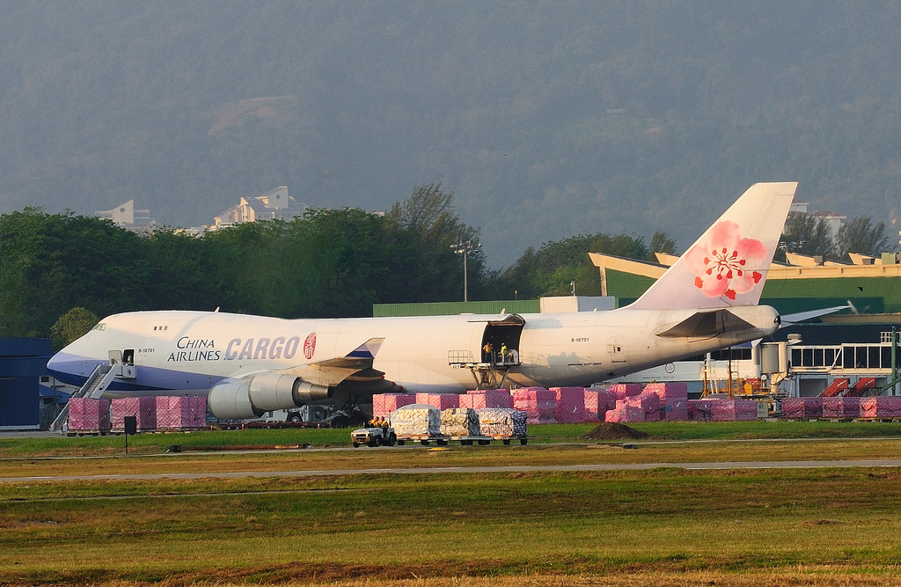
WHERE DOES OUR FOOD COME FROM?
Photo: Britney Lindsay

Slide 4
From Pasture To Plate
Farm
Where crops are grown or animals reared
Factory
Where food is used in recipes and/or put in packaging
Warehouse
Where food is sorted and put into lorries/ship/aeroplane
Supermarket/Shop
Where food is sold
Your plate!

Slide 5
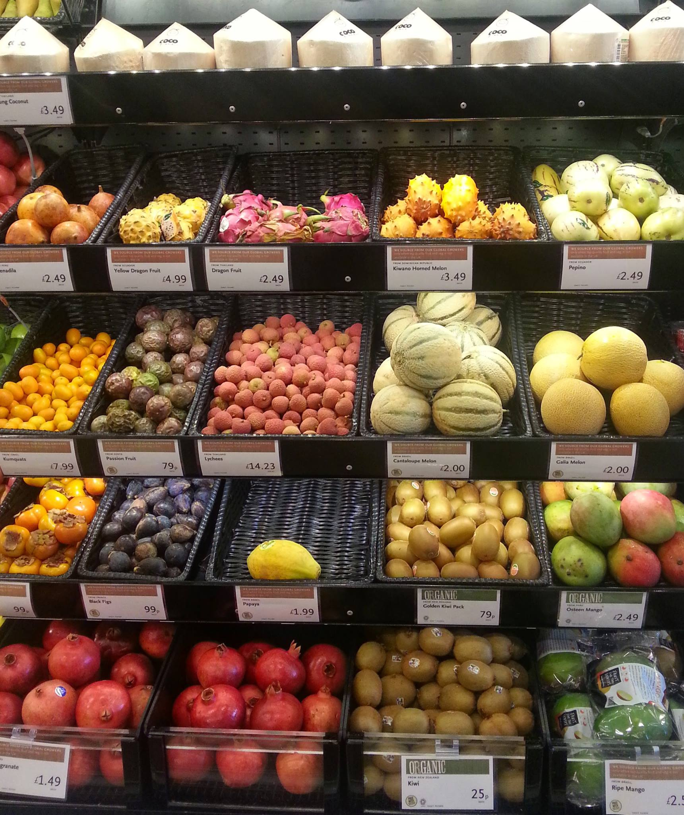
Global Food
A study has found that more than half of the UK’s food and feed now comes from overseas (The Guardian 2016)
Photo: eltpics

Slide 6
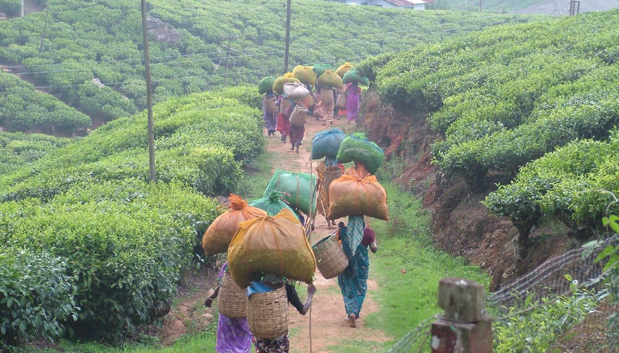
Why Does Our Food Need to Travel Miles?
Photo: Jon Brew
Tea pickers returning with sacks of tea, Munnar, India

Slide 7
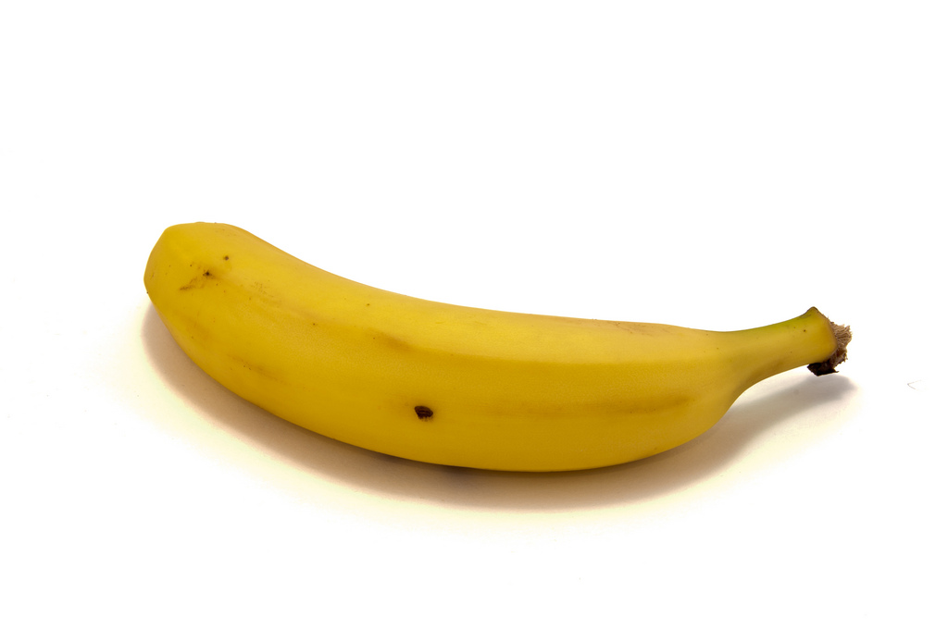
Going Bananas Over Food Miles
Photo: robin_24
Food miles are the distance food travels from where it is grown to where it is ultimately purchased or consumed

Slide 8
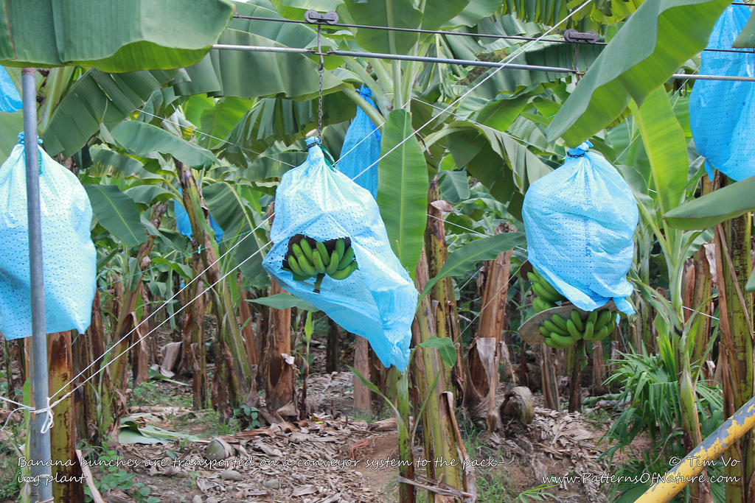
Bananas are grown in tropical regions, such as Central America, where the average temperature is 27 degrees celsius
Photo: Tim Vo
The coloured polyethylene bags protect the bananas from wind and from attacks of insects or birds

Slide 9
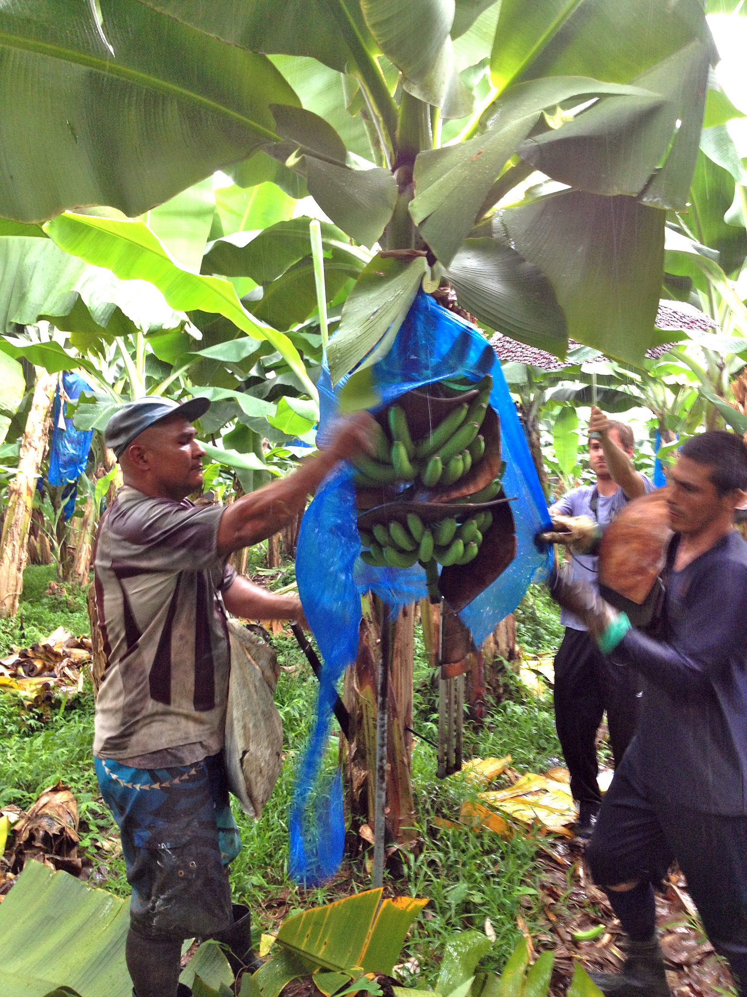
Photo: Heather
Each banana plant produces one huge bunch.
The time between planting a banana plant and the harvest of the banana bunch is from 9 to 12 months

Slide 10
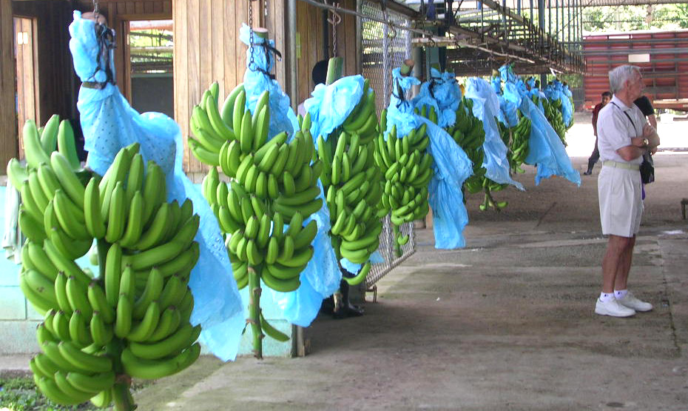
Bunches of bananas are brought to the processing station by a conveyor system or carried carefully by workers. Bunches can weigh over 100 pounds.
Photo: Roger W

Slide 11
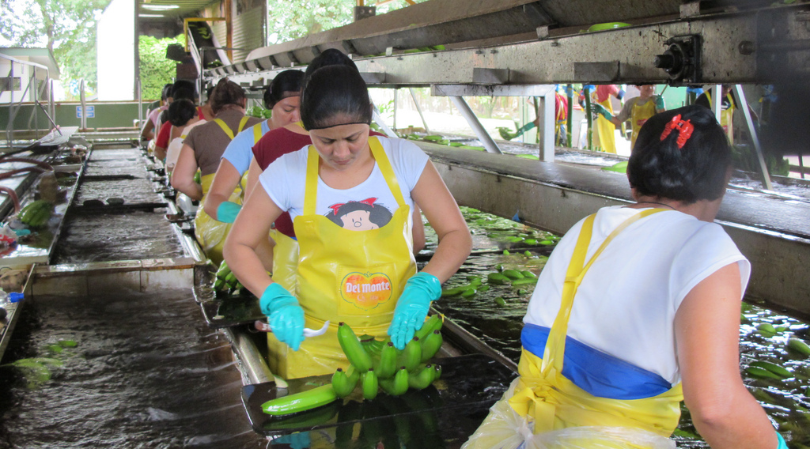
The bananas are washed, inspected and cut into ‘hands' of 6 bananas. Buyers of fruit in the UK want unbruised bananas so very high standards are set
Photo: Ali Eminov

Slide 12
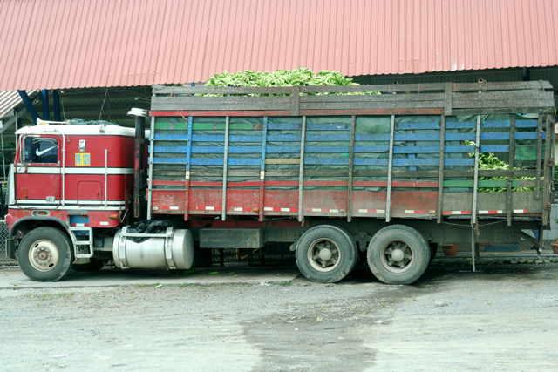
The bananas are taken to the local port by truck where they are inspected again
Photo: Steven Depolo

Slide 13
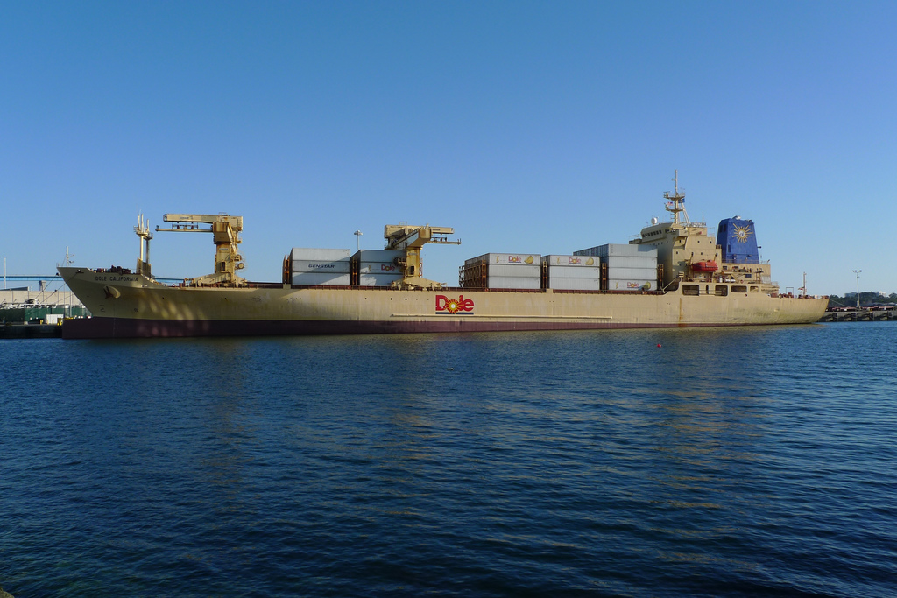
Bananas that pass the test are packed in refrigerated ships (to prevent ripening)
Photo: Joseph
It takes between 6 and 12 days to get from Central America to the UK

Slide 14
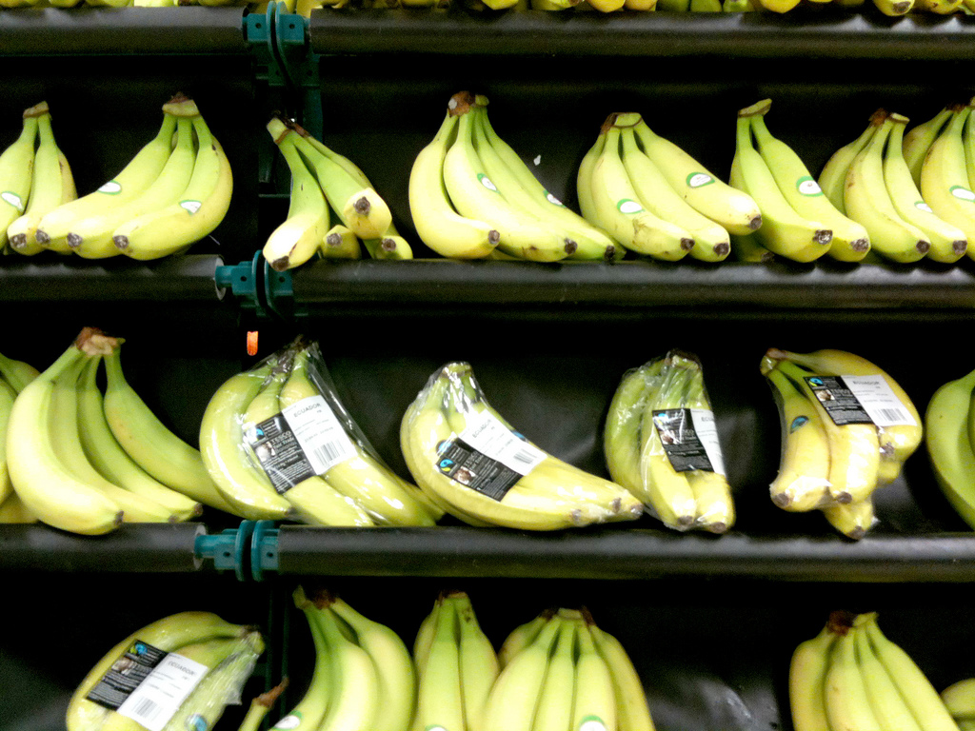
When the bananas arrive at their destination port they are first sent to ripening rooms and then to our shops
Photo: Nik Stanbridge

Slide 15
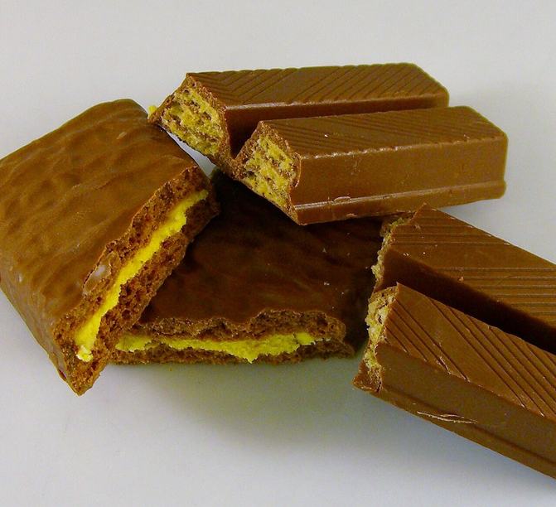
Produced Locally, Sourced Globally
Cocoa from South America
Salt from China
Calcium sulphate (a nutritional additive) from India
Sugar from the Caribbean
Milk and wheat from the EU
Palm oil from Southeast Asia
Photo: Dave Crosby
Whey from New Zealand

Slide 16
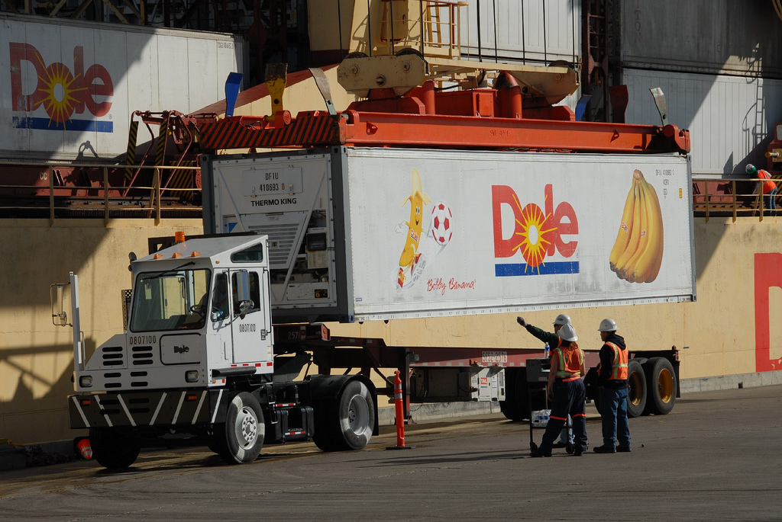
IMPACTS OF TRANSPORTING FOOD
Photo: Port of San Diego

Slide 17
Impacts of Transportation
Food Transport
Air pollution
Water pollution
Using up fossil fuels
Carbon dioxide emissions
Congestion
Accidents
Noise
Health problems e.g. asthma

Slide 18
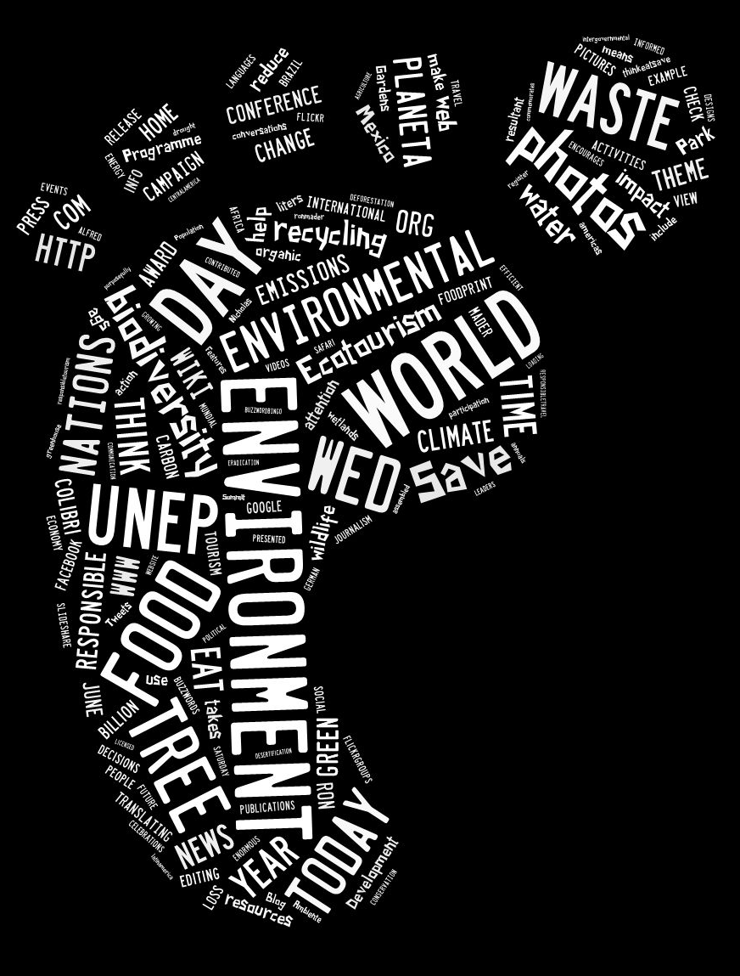
Food’s Carbon Footprint
The greenhouse gas emissions produced by growing, rearing, farming, processing, transporting, storing, cooking and disposing of the food we eat.
Photo: Ron Mader

Slide 19
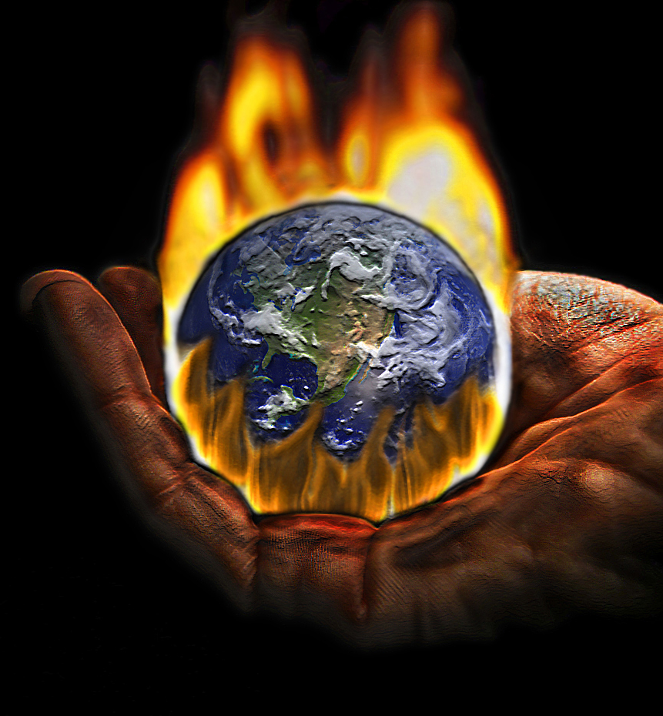
The greater the distance food has travelled, the greater the impact on the environment
Click here for greenhouse effect video
Photo: Roberto Rizzato

Slide 20
Only a small percentage of food is transported by air but it produces approx. 20% of the world’s food transport carbon emissions
Photo: Britney Lindsay

Slide 21
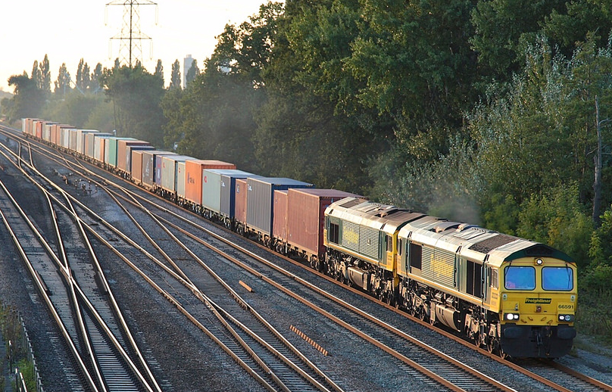
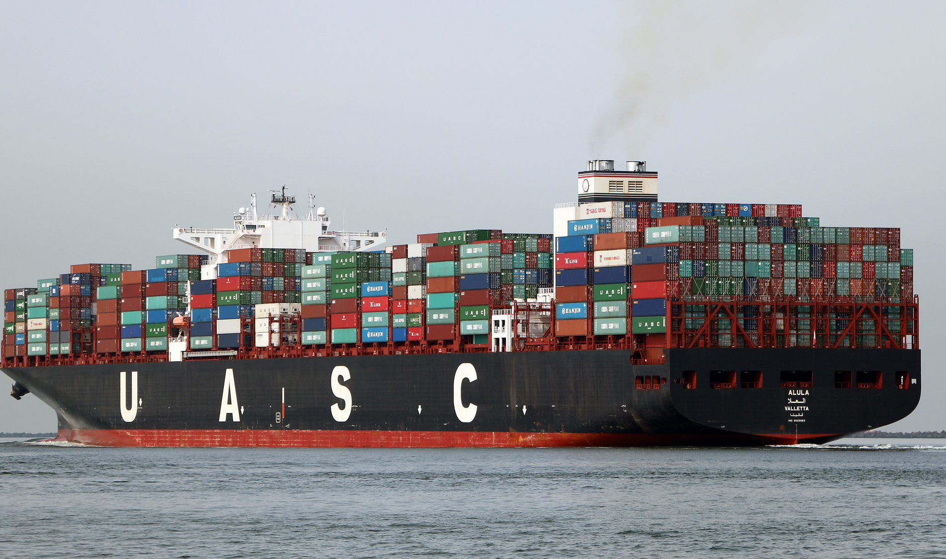
Photo: John Turner
Rail and sea transport produce approx. 10% each of the world’s food transport emissions
Photo: Roel Hemkes

Slide 22
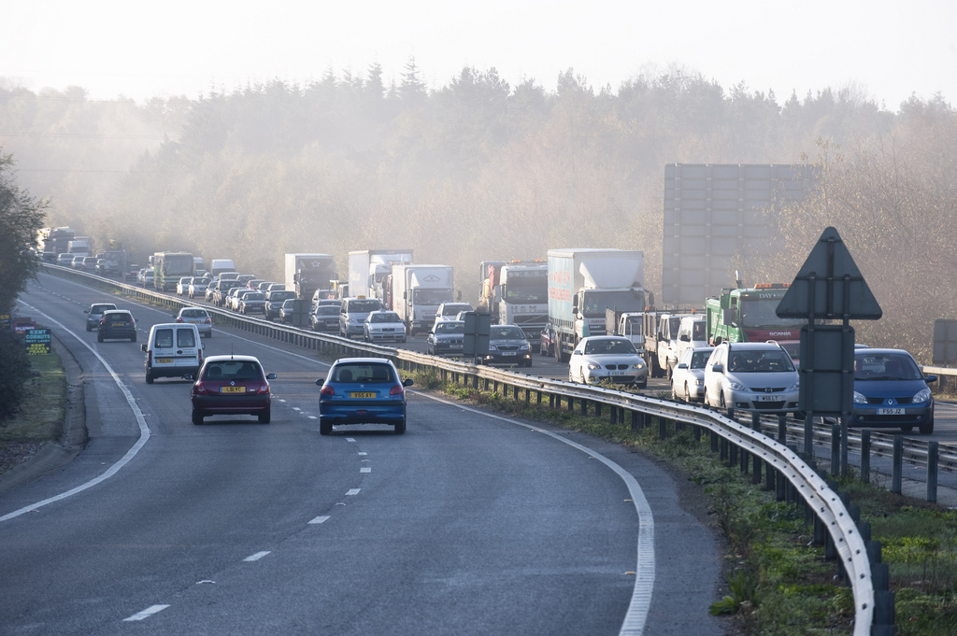
Road transport produces 60% of the world’s food transport carbon emissions
Photo: highwaysengland

Slide 23
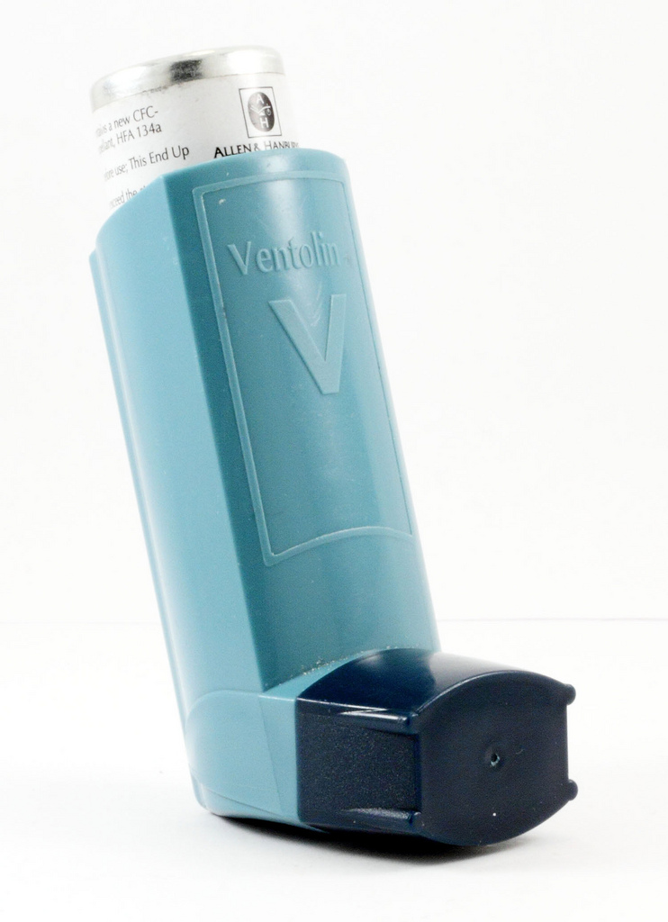
Health Implications
Pollutants, such as the chemicals in traffic fumes, can quickly trigger asthma symptoms
Stuart B

Slide 24
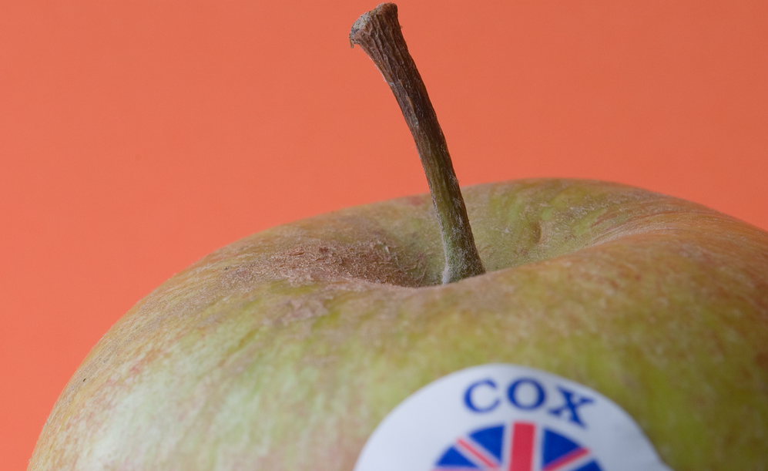
REDUCING FOOD MILES
Photo: Phil Mclver

Slide 25
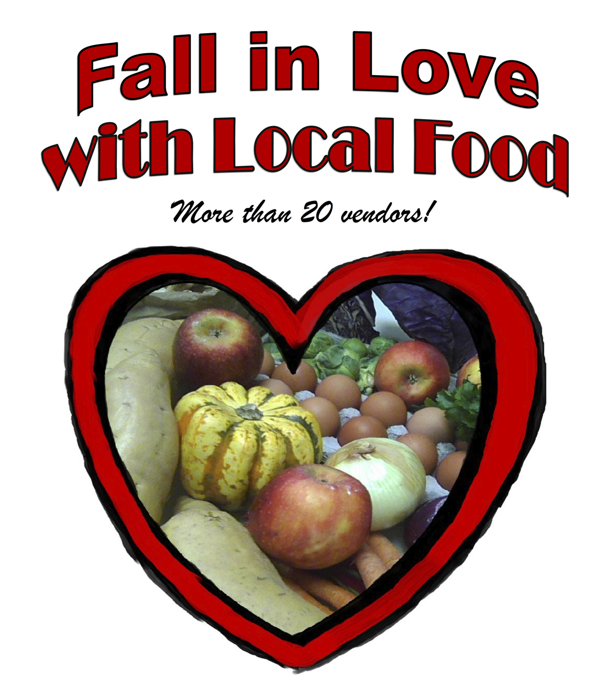
Buying local foods reduces food miles
Photo: Seacoast Eat Local

Slide 26
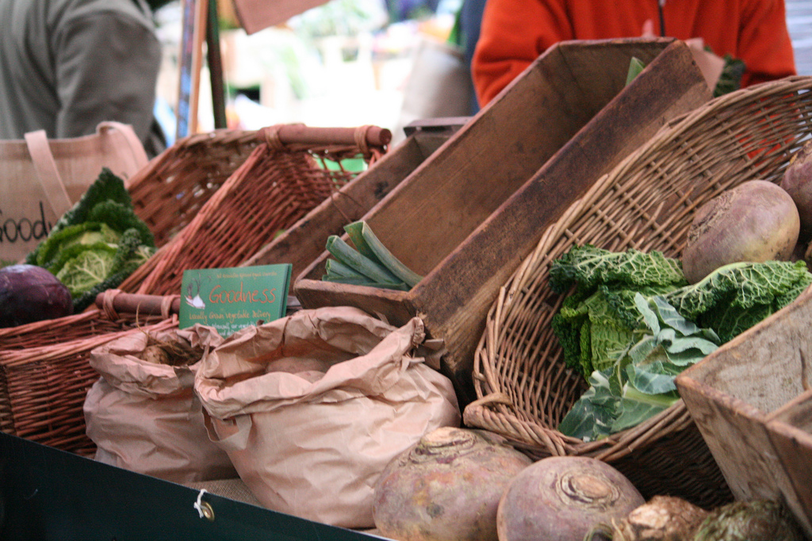
There are now lots of farm shops and farmer’s markets that sell locally grown food
Photo: Betuli

Slide 27
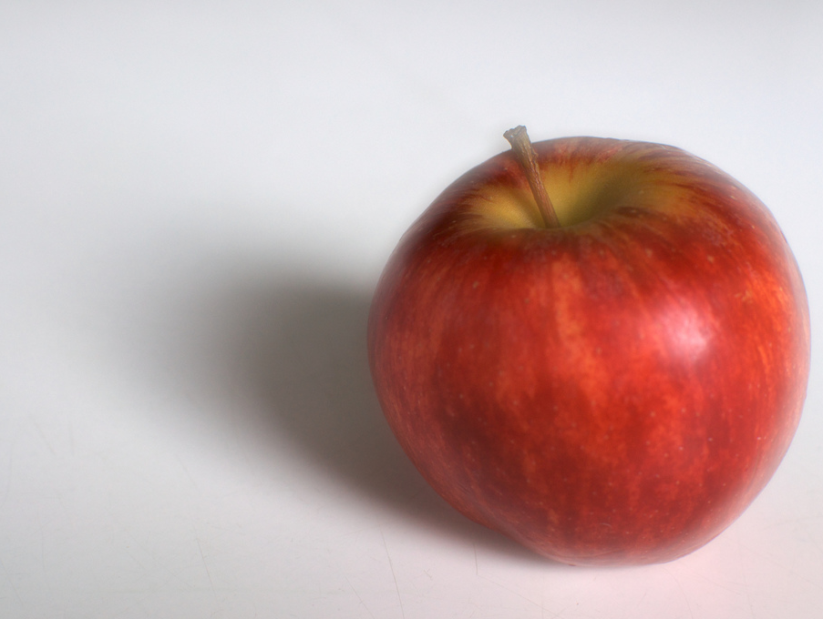
BUT buying local is not always best….
Buying British apples in June might not be any better than buying apples from New Zealand 12,000 miles away
Photo: Niklas Morberg

Slide 28
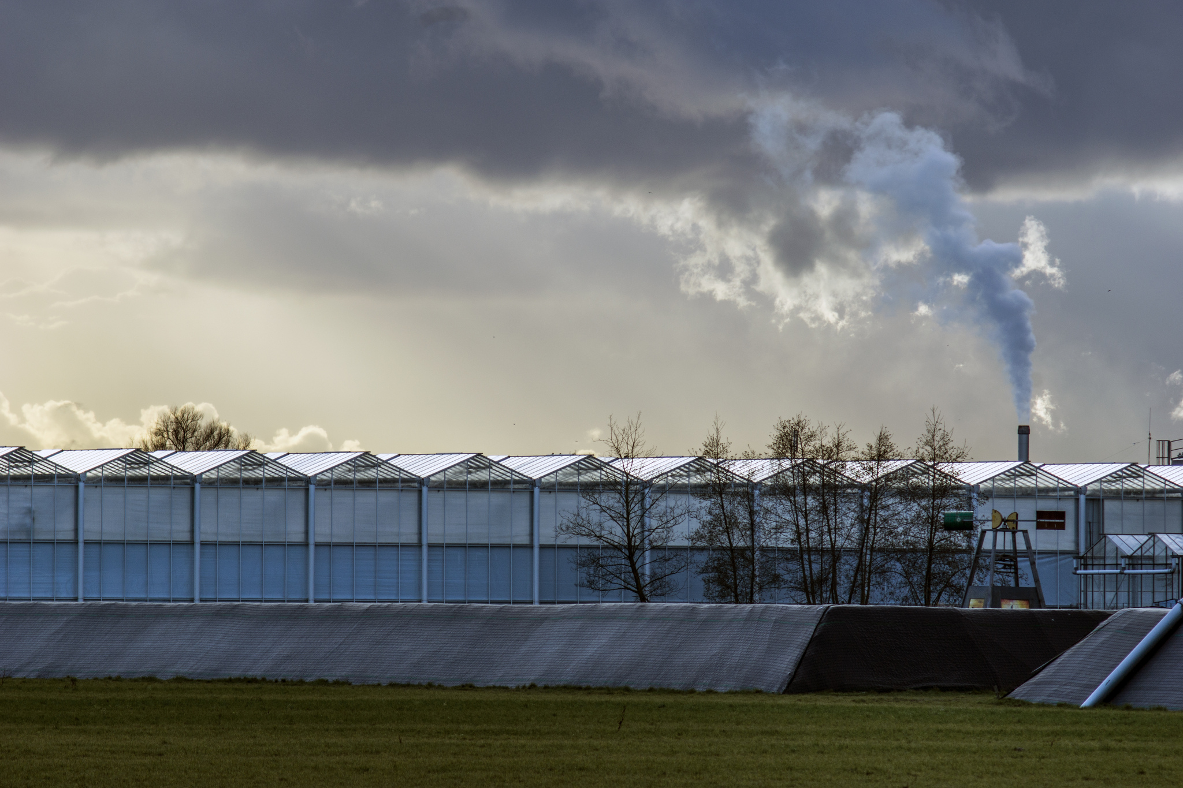
Imported tomatoes can have much lower carbon footprints than those grown locally out of season
Photo: Edo Dijkgraaf

Slide 29
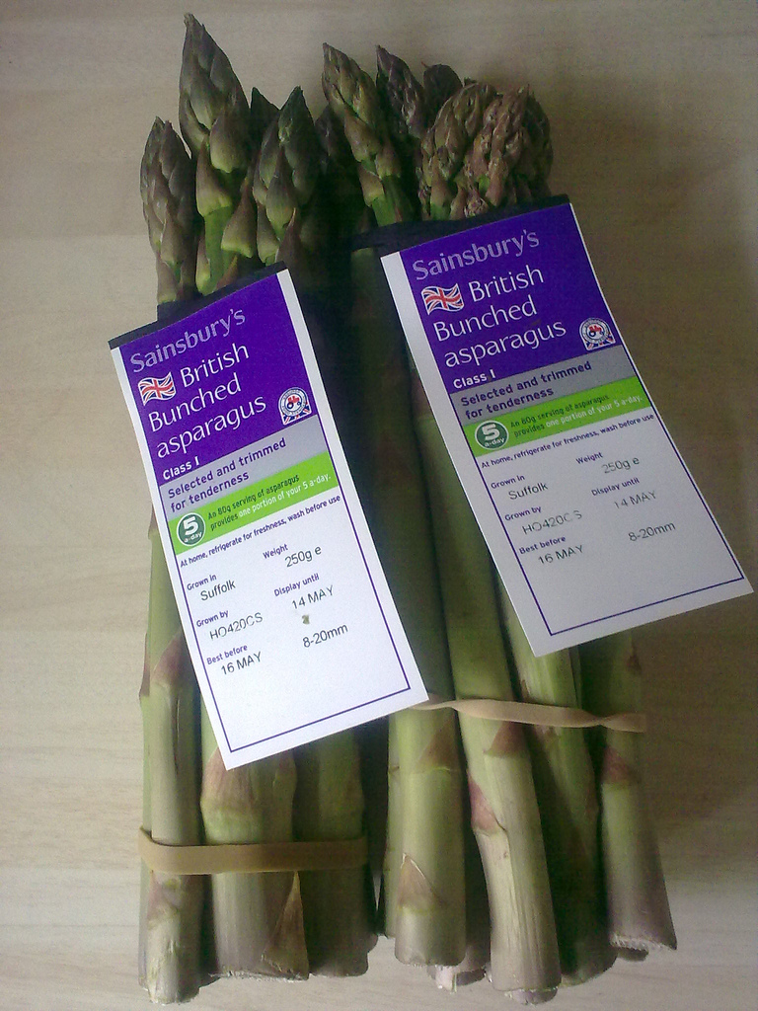
Buy British and seasonal foods to reduce food miles
Photo: Nick Saltmarsh

Slide 30
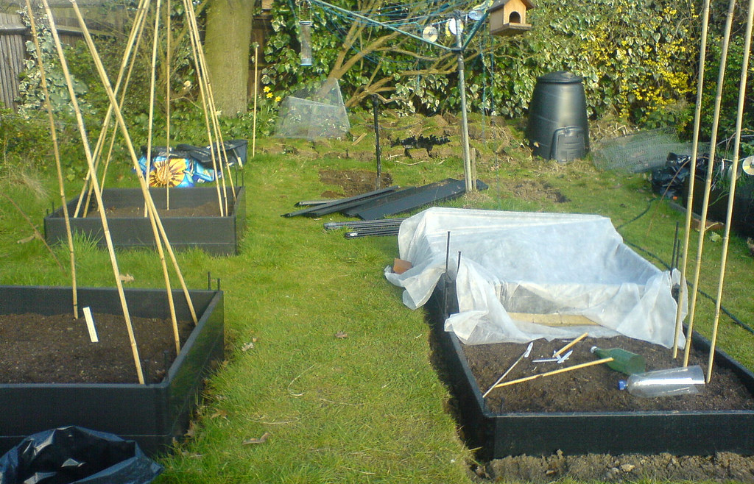
Grow Your Own
Photo: Adam Raoof

